Slide 1
Navigating the rocky seas of Perimenopause
Elizabeth Graf, PA-C
Certified Menopause Practitioner
University of Iowa OB/GYN
Division of Reproductive Endocrinology and Infertility

Slide 2
Disclosures
I use medications off label and doses off label
I use compounded medications

Slide 3
Objectives
Identify symptoms of perimenopause
Validate patient experience of perimenopause
Treat common symptoms of perimenopause
Refer patients for additional evaluation

Slide 4
Case #1
46 y/o G2P1102 female here to discuss concerns. She notes that her periods have become very heavy. She is changing a super tampon and pad every 2 hours for at least 5 days. She has extreme fatigue. Is sleeping poorly. She notes intermittent night sweats and has been getting more migraines than usual. She has been irritable to the point that her family has been concerned. She doesn’t feel like herself. Has gained 50 pounds in the past few years. She also has no libido. She would not care if she never had sex again. She had a tubal ligation 10 years ago because she hated how she felt on OCPs. PMH significant for obesity with BMI 44, HTN, and pre-diabetes.

Slide 5
What are some of her perimenopausal symptoms?
Menorrhagia (regular but HEAVY cycles)
Fatigue
Sleep disturbance
Night sweats
Migraines
Irritability
Weight gain
Low libido

Slide 6
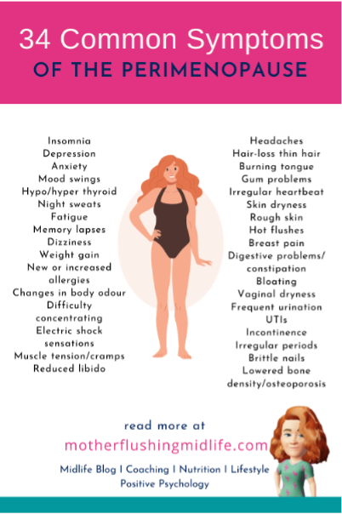
How do you know if it’s perimenopause?

Slide 7
What can we do to help her?
Validation!
We can address what is going on by giving a name to this phase of life: Perimenopause
We can tell our patients that this is a tough time because of changing hormones, and reassure them that there are many options to help with these symptoms
We can learn these treatments and implement them in our practice
Social media is filled with women who are frustrated with their providers
Do we really need a specialty clinic for a stage of life that every woman experiences? Where did we go wrong with our training?

Slide 8
A note about social media
Home - Mother Flushing Midlife

Slide 9
Now let me validate YOU
APPs are well suited and well trained to handle these concerns
Most of these concerns are treatable just like hypertension is treatable

Slide 10
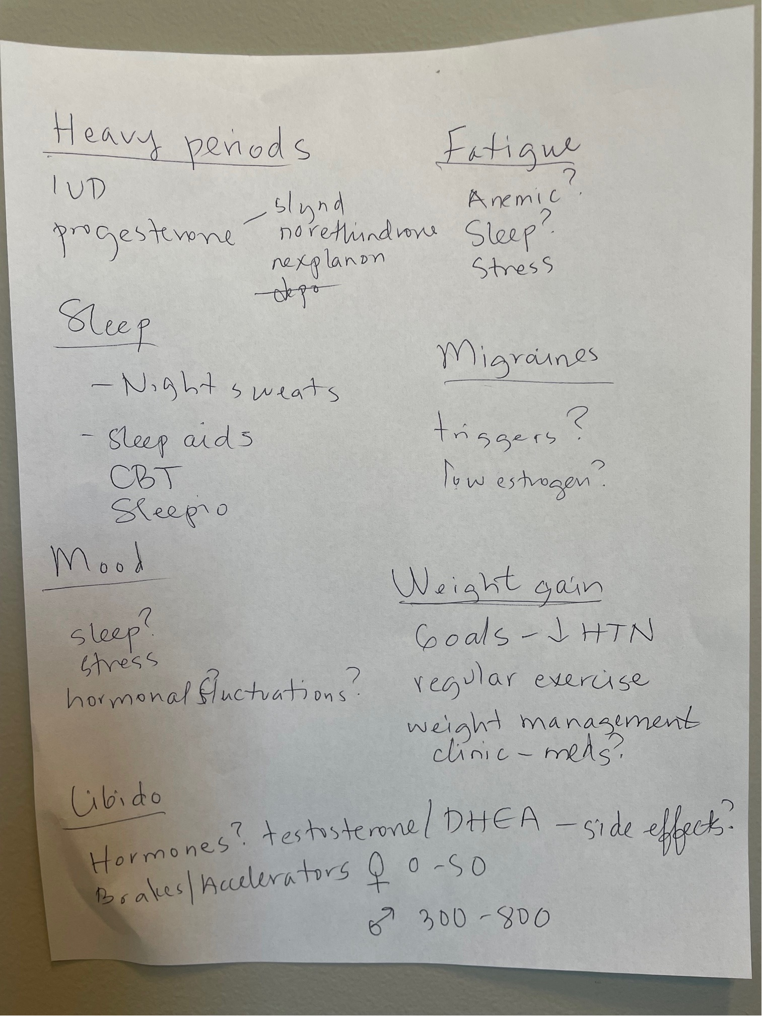
Use these tips to help navigate the visit
  Ask what their goals are for today’s visit
  Write them down and ask, “what else?”
  Validate that this is a lot of things to be experiencing
  Reassure they are in the right place
  Ask what they want to focus on today
  Reassure that we will schedule follow ups to monitor symptoms and treatment outcomes

Slide 11
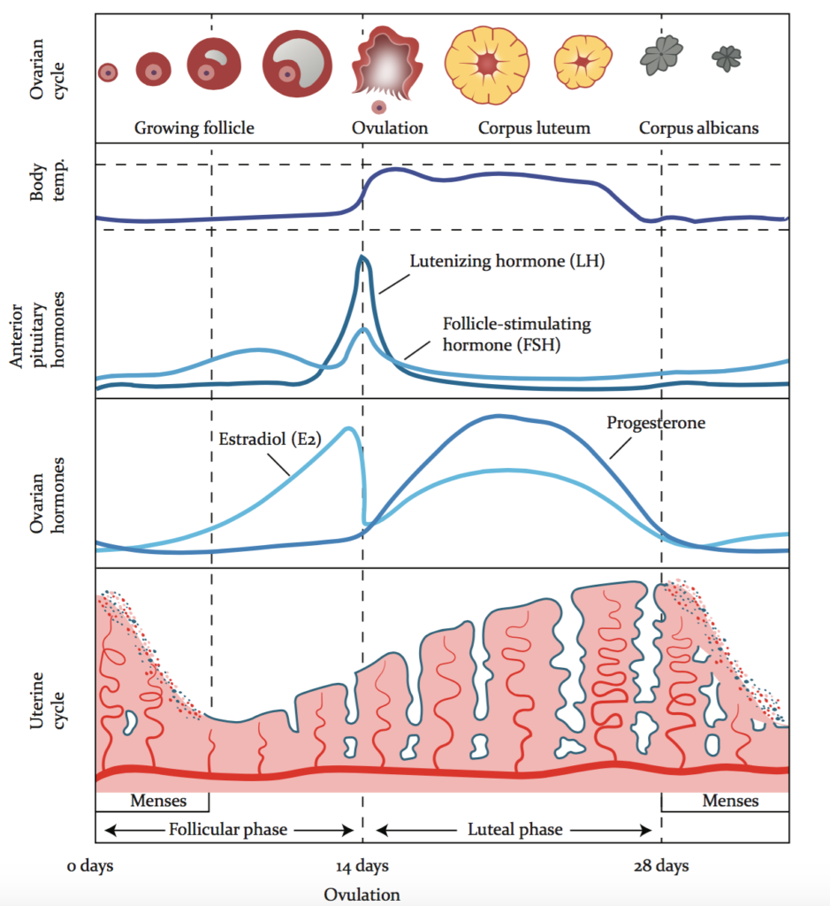
The beautiful menstrual cycle:
What can go wrong?
Menstrual problems
Migraines
Hot flashes
Irritability
Bloating
cravings

Slide 12
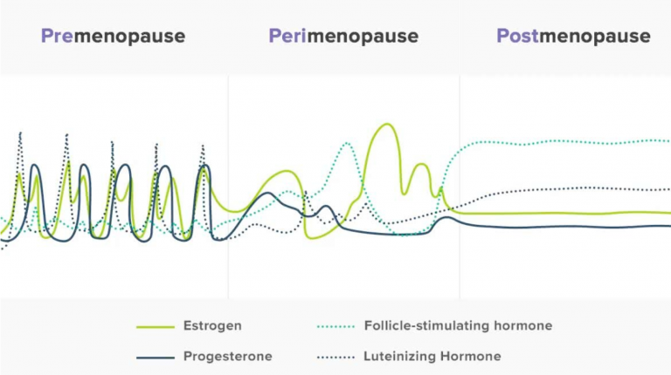
Perimenopause: the impish middle child

Slide 13
Should we draw hormone labs?
Day 3 FSH
  < 10 normal
  10-70 perimenopausal
  >70 menopausal
Day 3 estradiol
  < 80 normal
  > 80 indicative of LOOP cycles
AMH
  < 0.03 (undetectable) may go through menopause in ~ 1 year
AFC
  Test of “ovarian reserve” commonly used in fertility clinics
  < 10 concerning for diminished ovarian reserve
Ovarian volumes
  < 3 cc concerning for diminished ovarian reserve
  Atrophic appearance concerning for impending menopause

Slide 14
Back to our patient: Menorrhagia
Ultrasound – preferentially after her period ends
  Fibroids
  Polyps
  Endometrial thickening
Endometrial biopsy if AUB and endometrium > 12 mm
Anemia labs
TSH

Slide 15
Treatments for menorrhagia
OCP
LNG-IUD
Slynd (drosperinone)
Norethindrone Acetate 2.5 mg-15 mg (the 0.35 mg minipill does barely anything!)
Depo provera
Nexplanon
Ablation
MHT?
  Could consider a progesterone only method + a 0.05 mg estrogen patch (or 1 mg pill of estradiol)
Bonus if you can treat more than one symptom with one method!

Slide 16
Sleep
Almost everyone has poor sleep hygiene
Get out your sleep hygiene talk
Screen for OSA
Consider sleep aids (Trazodone, hydroxyzine, doxylamine)
CBT-I
  IOWA EAP has a free sleep program called Sleepio

Slide 17
Mood
Consider a PHQ-9 and a GAD-7 at each visit
Cyclic mood changes are often from hormones
  Try suppressing ovulation with hormonal intervention
  SSRI
    Daily
    Luteal phase
    On the worst days
Non-cyclic mood changes
  Questionable if hormones would be as beneficial if not cyclic
  Focus on improving sleep, lessening stress, increasing exercise, meditation
  Mood modulating medications
  Therapy, therapy, therapy

Slide 18
Weight gain
Validate, validate, validate
It is REALLY hard at this phase of life to exercise the recommended amount and eat right.
Does hormone therapy help to lose weight?
What I do:
  Evaluate readiness
  Consider body composition measurements
  Offer referrals to weight management clinics
    Dietary coaching
    Weight loss medications

Slide 19
Libido
Is it hormonal or a brain function or both?
Let’s try some interventions for her symptoms and see what remains
  Libido deserves a 30-minute problem-focused visit
Resources:
  Emily Nagoski
  The 5 love languages
  Fair Play
  Sex therapy
Invite me back next year and hear my sexual health lecture, including more on testosterone supplementation!

Slide 20
Case #2
47 y/o G4P4 female with irregular menstrual cycles and menstrual flooding at times. She just skipped three periods, and during this time she had constant hot flashes and night sweats resulting in poor sleep. She is struggling at her job, as she has terrible brain fog. She goes to bed easily but wakes up at 3 AM and sometimes cannot get back to sleep. She has had two normal menstrual cycles recently and has felt a bit better. She has been having shoulder pain for the past year and is in PT. Her hips have also been sore. She is noticing increased hair growth on her chin and hair loss at her temples and crown.

Slide 21
What are some of her perimenopausal symptoms?
Irregular periods
Intense hot flashes
Sleep disturbance
Brain fog
Joint pain
Hirsutism
Hair loss

Slide 22
Now is the time for MHT!
We still have all our options from before (BCP, IUD, Slynd)
MHT will work better now as the ovaries are running out of eggs and periods are spacing out
  Consider 0.05 mg estradiol patch + 200 mg of micronized progesterone at bedtime
    If irregular bleeding, please evaluate
      Consider cyclical administration
        patch all the time, prometrium on the 1-10th of the month
      Go back to higher dose daily synthetic progestins if AUB continues

Slide 23
Risks?
Minimize CVD risks:
  Familiarize yourself with the CDC guidelines on contraceptive management
  When able, use estrogen patches over pills
    A good starting dose is 0.05 mg for peri and newly menopausal women
    Consider lower doses like 0.025 mg and 0.0375 if CVD or migraines
Encourage regular mammograms and calculate a risk assessment
  Anyone who is high risk should be offered genetic counseling and a consult with the breast clinic
Be proactive about preventing and monitoring AUB
  Always pair estrogen with progesterone if your patient has a uterus
  Ultrasound
  Endometrial biopsy
  LNG-IUD

Slide 24
Hair loss
Also deserves a specific problem visit
Rule out anemia:
  H/H
  Iron panel
  Ferritin
Check androgens
  Free and total T
  DHEA
Check for insulin resistance
  A1c
  HOMA-IR score

Slide 25
Hair Loss Treatments
Treat anemia
  Reduce menstrual flow
  Oral iron
  Iron infusions
Lower androgens
  Spironolactone
  BCP
  Finasteride
Rogaine
Minoxidil
Viviscal
Treat insulin resistance
  Metformin
  Inositol

Slide 26
What about inflammation?
Encourage patients to consider following an anti-inflammatory lifestyle
handout_ai_diet_patient.pdf

Slide 27
A parting thought and a plea
Women deserve high quality care from their PCP throughout their lifespan, especially in perimenopause
Social media is villainizing us- let’s change the narrative
You can do this, in fact, you already know all of this
Use the tips from the IOWA provider communication course
Create patient tailored treatments and follow up regularly
Your patient will be so thankful and will walk out the door feeling exceptionally relieved, even with a smile! What could be better?
Help me get my waiting list down from over a year to a couple months!

Slide 28
Resources
Come As You Are by Emily Nagoski
Fair Play by Eve Rodsky
The Five Love Languages by Gary Chapman
Psychology today- search for sex therapy, couples counseling
The Menopause Brain by Lisa Mosconi
The New Menopause by Mary Clair Haver
Influencers: IG: The We Do Not Care Club by Melani Sanders
Clinical Gynecologic Endocrinology and Infertility by Speroff and Fritz, 8th edition.

