Slide 1
Anaphylaxis
Lauren Bracken
Notes:
I have worked in allergy/ immunology for 3 years at Iowa Health care now
I work in the adult clinic, so that’s where most of my focus will be for today

Slide 2
Disclosures
None

Slide 3
Objectives
Be able to identify anaphylaxis
Understand risk factors and common triggers
Understand how to treat anaphylaxis
Notes:
Most of these slides come from the AAAAI- our allergy national committee, but I’ve edited some of them to be specific to what I want, but uptodate from 2024
Ask crowd about ED/ urgent care, and PCP

Slide 4

IgE-dependent Release of Inflammatory Mediators
IgE
FcRI
Fce RI
binding site
Sneezing
Nasal congestion
Itchy, runny nose
Watery eyes
Over Hours
Cytokine production:
Specifically TNF-a, IL-4, IL-13
Immediate Release
Granule contents:
Histamine, TNF-α,
Proteases, Heparin
Over Minutes
Lipid mediators:
Prostaglandins
Leukotrienes
Cell recruitment
Wheezing
Bronchoconstriction
Williams C, Galli S. J Allergy Clin Immunol. The diverse potential effector and immunoregulatory roles of mast cells in allergic disease. 2000; 105:847-59​
Notes:
The inflammatory cascade is initiated when IgE bound to effector cells is cross-linked by allergen. Like mast cells/ basophils
Ige to mast cell/ basophils and degranulates
Mast cell degranulation is the key event that launches the symptoms of the early allergic response.
IL-4 and IL-13 may look family, they are part of Type 2 inflammation, and that is the target of Dupixent
I use Dupixent frequently, but I get some many ads for it, anyone else?

Slide 5
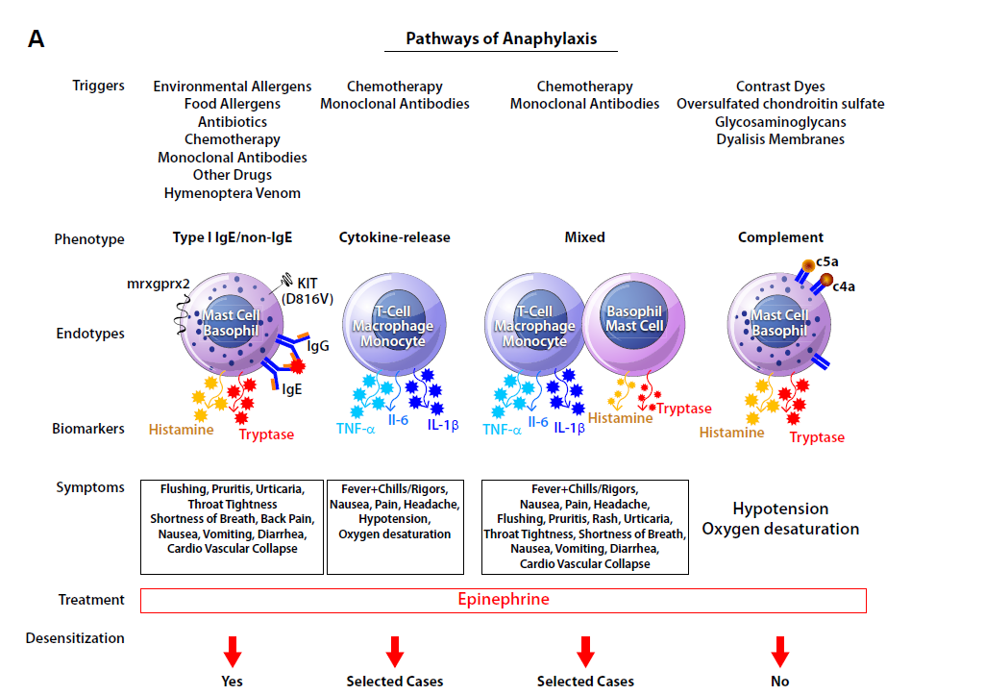
Castells M. J Allergy Clin Immunol2017;140:321-33
Notes:
Most common is IgE, that is typically what we see, that’s what youre most likely to see in practice
Most important on this slide, you don’t differentiate the types of anaphylaxis, but they are all treated with epip
There are other kinds of anaphylaxis that are less common, but they present very similarly, and in practice, you will treat the same- with epi

Slide 6
Anaphylaxis
A serious allergic reaction that is rapid in onset and may cause death
Typically, with multiorgan involvement
Clinical definition is based on expert consensus
Notes:
We practice evidence based medicine here
Allergy is an art- a lot of things seem made up, but again, evidence based

Slide 7
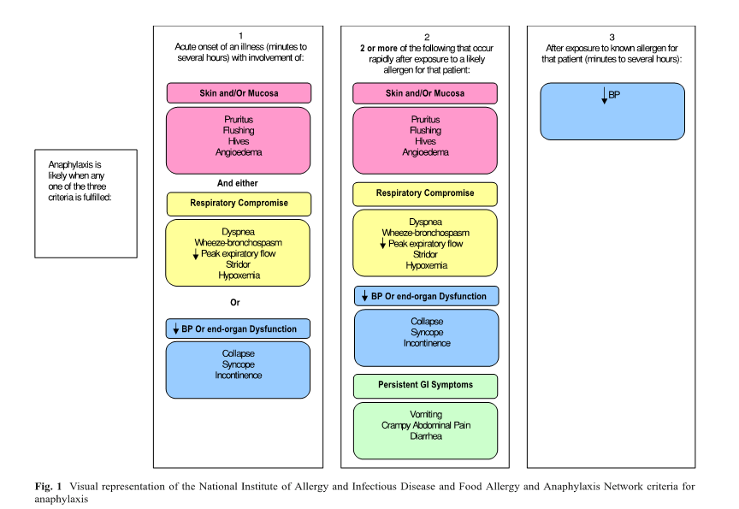
Anaphylaxis is a serious allergic reaction that is rapid in onset and may cause death*
Manivannan V, Dekker W, Stead LG, Li J, Campbell R. Visual representation of National Institute of Allergy and Infectious Disease and Food Allergy and Anaphylaxis Network criteria for anaphylaxis. Int J Emer Med. 2009;2(1):3-5
Notes:
Read each of the scenarios and review with the audience – some may have difficulty reading due to the small font in the diagram. Highlight the role of allergen exposure where relevant.

Slide 8
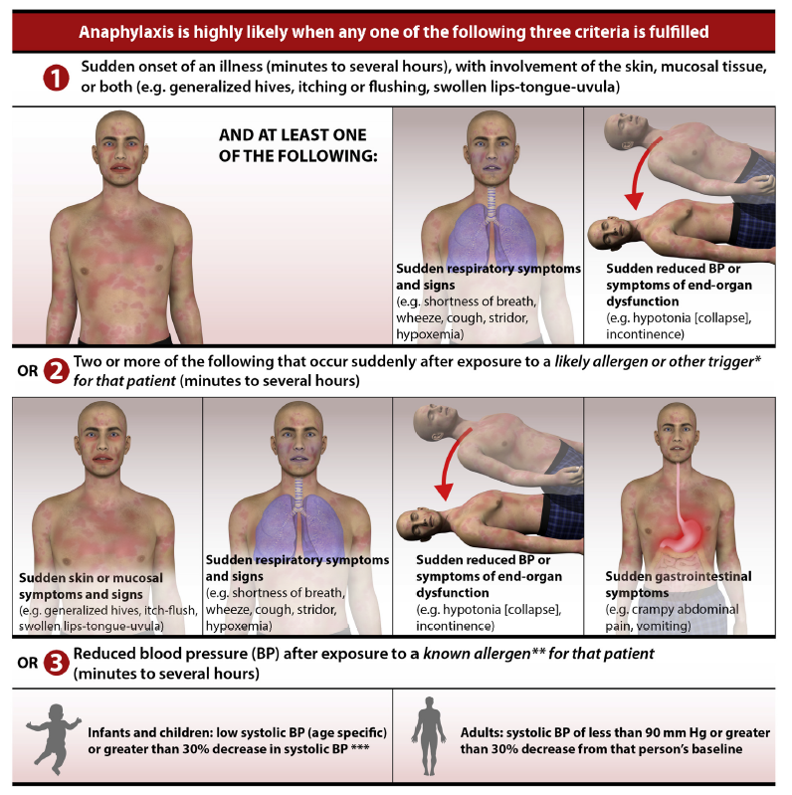
Golden DBK, et al. Ann Allergy Asthma Immunol. 2023 Shaker MS, et al. J Allergy Clin Immunol 2020;145:1082-123
Notes:
Clinical criteria for the diagnosis of anaphylaxis. Anaphylaxis is likely when 1 of 3 criteria are fulfilled: (1) acute onset of an illness (minutes to hours) with involvement of the skin, mucosal tissue, or both with either respiratory involvement or reduced blood pressure (BP)/associated symptom of end-organ dysfunction; or (2) >2 of the following that occur rapidly after exposure to a likely allergen for the patient, including (i) involvement of skin-mucosal tissue, (ii) respiratory involvement, (iii) reduced blood pressure or associated symptoms, or (iv) gastrointestinal symptoms; or (3) reduced blood pressure as a result of exposure to a known allergen trigger. Adapted from Simons et al.61

Slide 9
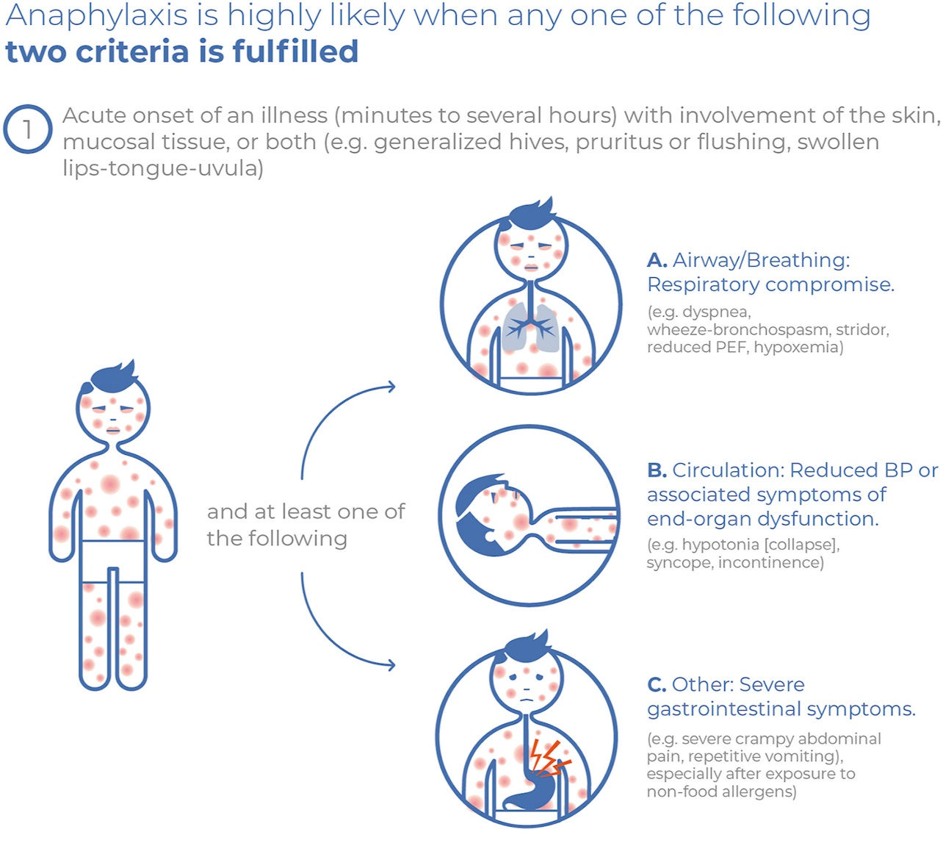
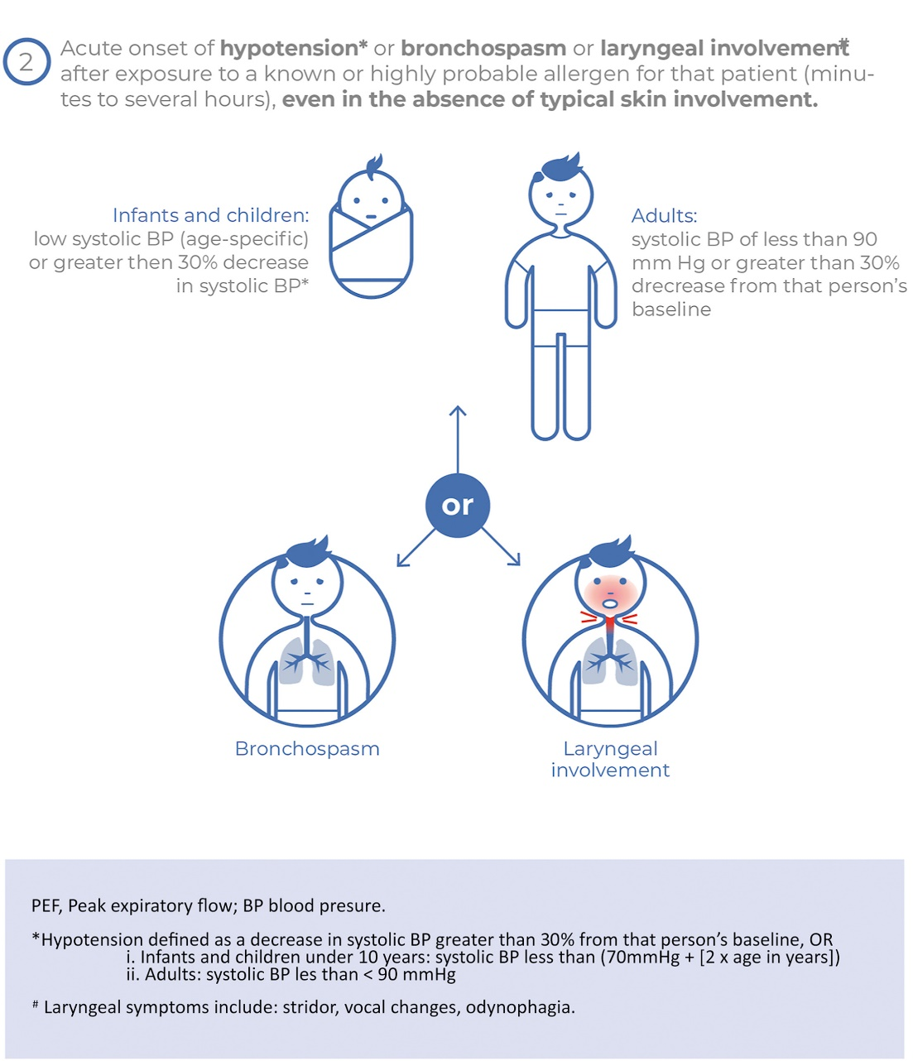
World Allergy Organization Anaphylaxis Guidance 2020
Cardona, Victoria et al.
World Allergy Organization Journal, Volume 13, Issue 10, 100472
Notes:
I like this picture better
Cleaner
But to simiplify- youre looking for 2 systems, not 2 symptoms, so swelling and hives is just one system
Anxiety can mimic that so use your best judgement

Slide 10
Epidemiology
Anaphylaxis has been estimated to occur in up to 5% of the overall population.
At least 1/3 of cases without an identifiable cause.
Wood RA, et al. J Allergy Clin Immunol. 2014;133:461-467. Golden DBK, et al. Ann Allergy Asthma Immunol. 2023.
Webb LM, Lieberman P. Anaphylaxis: a review of 601 cases. Ann Allergy Asthma Immunol. 2006;97:39-43.
Notes:
Like I said, allergy is an art
It can be really hard for patients to not have a cause, and I feel like a lot of the time they will attribute it to food when that’s not really it
So being able to tell patients that it could be unidentifiable is a hard conversation to have, but important

Slide 11
Risk Factors and Cofactors Potentially Associated with Severe or Fatal Anaphylaxis
Drug-induced anaphylaxis | Food-induced anaphylaxis | Venom bite or sting-induced anaphylaxis | Non-trigger−related cofactors/risk factors
Age>60y | Adolescence | Older age | Mast cell disorders
Cardiovascular diseases | Uncontrolled asthma | Male sex | Infections
Respiratory diseases | Alcohol consumption | Hereditary alpha-tryptasemia | Perimenstrual period
Antihypertensive drugs | Peanut or tree nut-induced reaction | Mast cell disorders | NSAIDS
 | Exercise | Cardiovascular disease | Alcohol consumption
 |  | NSAIDS | Psychological burden
 |  | Antihypertensive drugs | Exercise
 |  |  | Unknown cause
Adapted from Golden DBK, et al. Ann Allergy Asthma Immunol. 2023

Slide 12
Fatality
In the USA, case fatality rate between 0.25 and 0.33 % of hospitalizations/ED presentations for anaphylaxis
Fatal anaphylaxis from all causes except venom was associated with:
African-American race, older age
Fatal anaphylaxis from venom was associated with:
White race, older age, male sex
Highest risk of fatality from anaphylaxis in persons >60 years
Delayed use of intramuscular epinephrine has been associated
with increased risk for fatality
J Allergy Clin Immunol Pract 2017;5:171-5
Notes:
When in doubt, use the epi
If they’re not in anaphylaxis but you use it -anxiety, palpitations, tremor, headache, dizziness, pallor, and restlessness; these are typically short-lived and self-limited

Slide 13
Anaphylaxis is on the rise
Anaphylaxis-related ED visits (N=56,212) in the US (2005-2014)
Age at the time of ED visit:
43% patients aged 35 to 64 years
57.5% female
45% from South, 25% Midwest, 15% West, 15% Northeast
Triggers:
57% unidentified triggers
27% food
12% medication related
4% insect venom
J Allergy Clin Immunol Pract 2017;5:171-5;Canadian Institute for Health Information https://secure.cihi.ca/free_products/Anaphylaxis_Infosheet_en.pdf
Notes:
Retrospective study using administrative claims data for privately insured and Medicare Advantage enrollees in the United States
Database contains longitudinal health information > 100 million enrollees over the past 20 years
So while this info is somewhat dated, the trend continues to go up

Slide 14
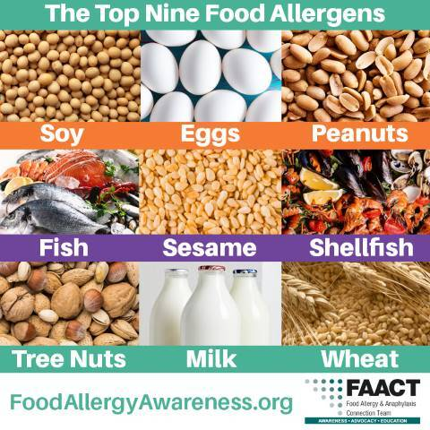
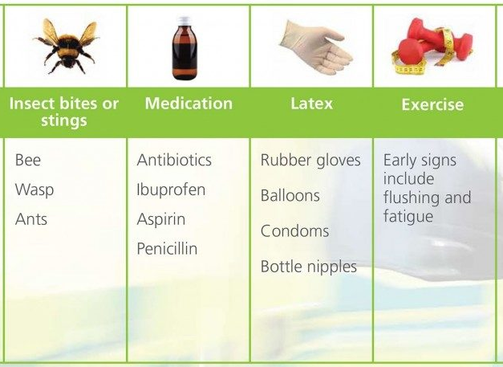
Anaphylaxis Triggers
Notes:
Sesame was added as 9th MC food allergen in 2021 – I have seen it once
I’ve never had a fish allergy- MC cod and salmon
Peanuts and tree nuts are not cross reactive- one allergy does not mean you have the other
Radiocontrast media (RCM) can have both IgE and non-IgE mediated reactions.
*Shellfish allergy does not increase risk of RCM anaphylaxis.
-Previous reaction, high dose, and advanced age are risk factors for RCM reaction

Slide 15



Triggers of Anaphylaxis: Food
Adults
Peanut
Tree nut
Fish
Shellfish
Children
Milk
Eggs
Peanuts
Tree nuts
Wheat
Soy
Simons FER, Ardusso LRF, Bilo MB et. al. World Allergy Organization Guidelines for the Assessment and Management of Anaphylaxis. WAO Journal 2011; 4:13-37 http://www.waojournal.org/content/4/2/13
Notes:
Changes to adult with less milk, egg, wheat, and soy, but add in shellfish
Shellfish is the most common food allergy to develop as an adult

Slide 16
Triggers of Anaphylaxis: Age-Related Differences
Most common etiology for anaphylaxis in adults is drugs:
Antibiotics
NSAIDs
Immunomodulators or biological agents
Anesthetics
Contrast agents and dyes
Chemotherapeutic agents
Outpatient fatal anaphylaxis more associated with food
Drug-induced anaphylaxis more common with hospitalized inpatients
J Allergy Clin Immunol Pract 2017;5:171-5
Notes:
But in children it is food

Slide 17
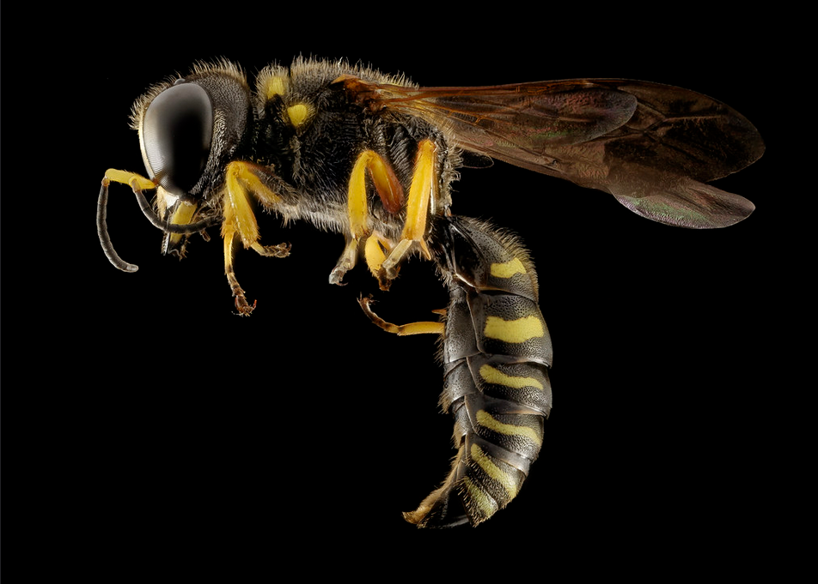
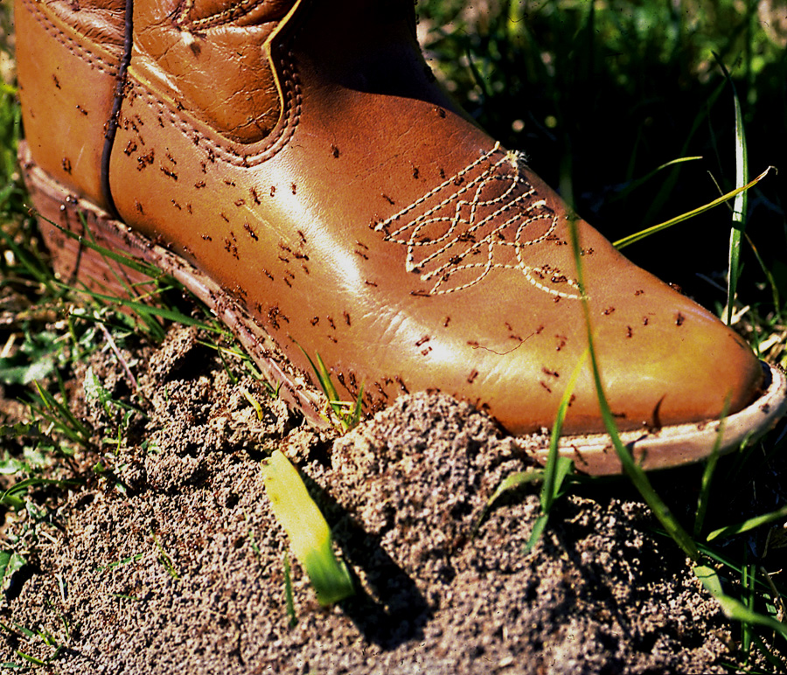
Triggers of Anaphylaxis: Insect Stings & Bites
Bees
Vespids
Yellow jackets, hornets, wasps
Fire ants and other ants
Scorpions
Bites a far less common cause than stings
Sam Droege, 2015
Bart Drees, 2008
Simons FER, Ardusso LRF, Bilo MB et. al. World Allergy Organization Guidelines for the Assessment and Management of Anaphylaxis. WAO Journal 2011; 4:13-37 http://www.waojournal.org/content/4/2/13
Notes:
You need to be sensitized first
Very very rare to have anaphylaxis without being stung to be sensitized
Large local reactions are expected, but patients will ask if they need testing “because they really swelled up”
No
Only test if you have a convincing history

Slide 18
Triggers of Anaphylaxis: Latex
Groups at increased risk
Healthcare workers
Spina bifida
Multiple surgeries
Increased incidence in the 1990’s largely due to implementation of universal precautions
Incidence has decreased since non-powder gloves and synthetic non-latex gloves have become available
Kelly KJ et al, J Allergy Clin Immunol 1994;93:813-6
Notes:
Increased when people started wearing more gloves
Decreased once we switched types of gloves
I have not see anyone with a true latex allergy

Slide 19
Triggers of Anaphylaxis: Physical
Exercise-induced
Food or medication are often co-factors
Wheat, celery, peanut and multiple others
More common than previously noted
Physical urticaria may be caused by exposure to heat, cold, pressure, exercise, sunlight and vibration
Most involve only the skin
Anaphylactic reactions occurring with physical urticaria are rare
Burgess B. EMedHome.com
https://www.aaaai.org/global/latest-research-summaries/New-Research-from-JACI-In-Practice/life-threatening-allergic-reaction
Notes:
Physical urticaria is a condition in which erythematous allergic skin lesions and pruritus are produced by exposure to heat, cold, or contact with chemicals or plants.
Only cold urticaria is the one I prescribe an epipen for

Slide 20
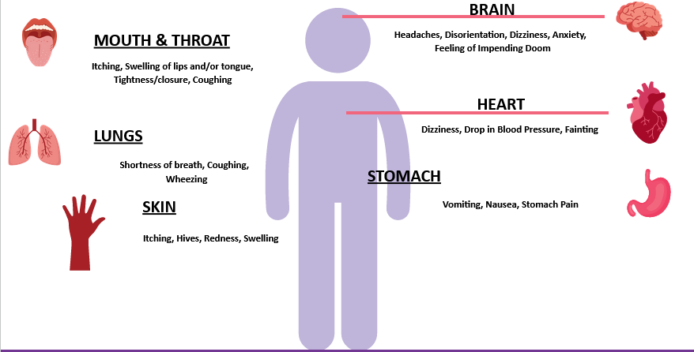
Symptoms of an Allergic Reaction
Notes:
Figure provided by Dr. Gupta

Slide 21
Anaphylaxis - Patterns
Uniphasic (most): typically peaks within 1 hour and resolves within hours
Biphasic: recurrence of symptoms after apparent resolution, and without further exposure
Up to 8 hours later and rarely, much later
Unknown incidence, from 1-23% in literature
Associations with increased severity of initial reaction, delayed epinephrine administration, fatal reactions
Lieberman P et al., J Allergy Clin Immunol 2010;126:477-80. Alqurashi W et al., Ann Allergy Asthma Immunol 2015;115:217-23. Ko BS et al., Ann Allergy Asthma Immunol 2015;115:312-16
Lee S et al., J Allergy Clin Immunol Pract 2015;3:408-16
Notes:
I’ve never seen this
This is typically why patients are discharged on prednisone for 10 days, to help decrease risk for a biphasic reaction
However, practice parameters in 2020 say not to do this, but evidence is very low… so whatever

Slide 22
Risk factors for biphasic anaphylaxis
Factor | Odds ratio; (95% Confidence Interval)
More severe initial symptoms of anaphylaxis | 2.11; (1.23-3.61)
Need for >1 dose of epinephrine | 4.82; (2.70-8.58)
Wide pulse pressure | 2.11; (1.32-3.37)
Unknown trigger | 1.63; (1.14-2.33)
Cutaneous signs and symptoms | 2.54; (1.25-5.15)
Drug trigger in children | 2.35; (1.16-4.76)
Shaker MS, et al. J Allergy Clin Immunol 2020;145:1082-123

Slide 23
Anaphylaxis: Investigation
Suspected trigger
Amount/dose
Preparation of food (raw, cooked, baked)
Symptoms/timing – consistent with anaphylaxis?
Treatment: time given and response to treatment
Associated factors
Exercise
Medications
Food
Infection
Alcohol
Records of acute event (ER visit)
Helpful to see vital signs, physical examination
Notes:
Timing is so important
1-2 hours, likely, 5 hours or later… suspicious
Most common food allergens vs something like garlic
Did it get better with epi or not
Prior sensitization vs 1st time
ED- note of physical exam with rashes, swelling, breathing and VS are my big indicators that I look for

Slide 24
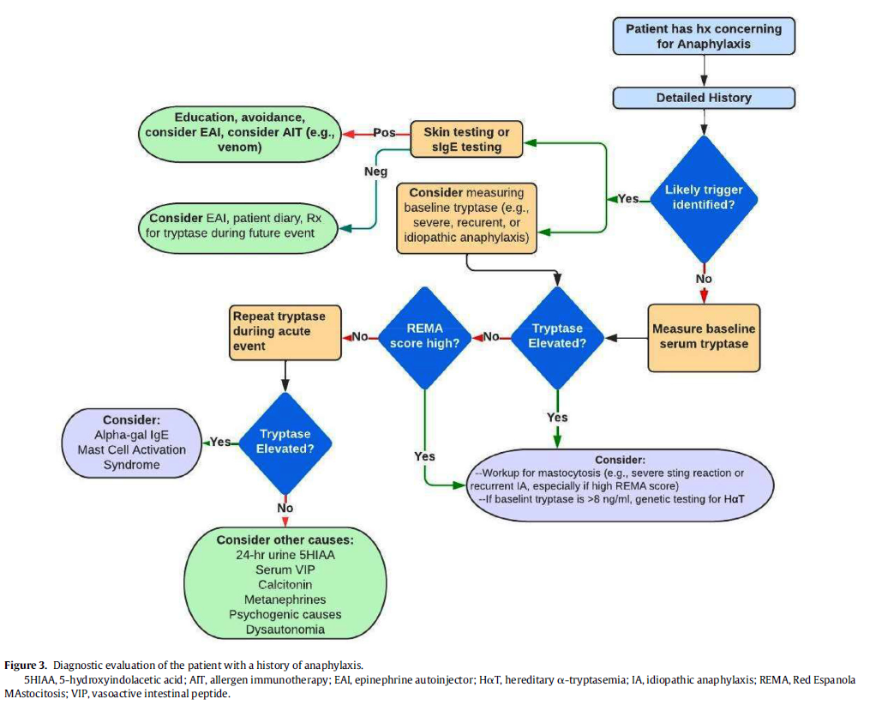
Anaphylaxis: Investigation
Golden DBK, et al. Ann Allergy Asthma Immunol. 2023
Notes:
Eai= epipen autoinjector
REMA score- mastocytosis score
Tryptase over 8- testing, labs may not read as abnormal if not over 10

Slide 25
Differential Diagnosis
Common entities Acute generalized hives Acute Asthma Syncope (faint, vasovagal episode) Panic attack Aspiration of a foreign body Cardiovascular event (myocardial infarction, pulmonary embolus) Neurologic event (seizure, stroke) | Nonorganic disease Vocal cord dysfunction Munchausen syndrome Shock Hypovolemic Cardiogenic Distributive (eg, spinal cord injury) Septic (might involve all of the above)
Postprandial syndromes Pollen-food syndrome Scombroidosis Monosodium glutamate Sulfites | Other Non allergic angioedema Red Man syndrome (vancomycin) Urticarial vasculitis Hyper – IgE urticaria syndrome Progesterone anaphylaxis Pheochromocytoma Idiopathic systemic capillary leak syndrome
Excess endogenous histamine Mastocytosis/clonal mast cell disorders Basophilic leukemia | Flush Syndromes Perimenopause, carcinoid; autonomic epilepsy, medullary carcinoma thyroid
Simons FER JACI 2010;125(2 ):S161-181
Notes:
There are so many things that can look like this
Vasovagal does not have urticaria, angioedema, or bronchospasm. Usually preceded by feeling nausea and flushed followed by tunneled vision and subsequent syncope. Commonly seen in young females during phlebotomy. Pt have bradycardia rather than tachycardia. Pallor rather than flushing.
Carcinoid syndrome do not have urticaria. They have elevations of 5-HIAA not seen in anaphylaxis.
Medications can cause Serum sickness, but wrong time course--usually occurs 8-10 days after drug exposure--leading to fever, rash, arthralgias, adenopathy, nephritis, and hepatitis. These pts do not have hypotension or tachy/bradycardias.
Mastocytosis has abnormal cutaneous lesions (urticaria pigmentosa) or evidence of bone marrow involvement eg pain abnormal radiographic studies or abnormal biopsy showing increased mast cells. Suspicion of diagnosis should be raised with the recognition of the classic reddish brown macular papular skin lesions with a positive Darier's sign.
HAE doesn’t have urticaria, bronchospasm, or flushing. Usually have a FH of recurrent episodes of angioedema.
Pheochromocytoma--elevated norepi/epi/metanephrines and metabolities.
In difficult cases you may measure serum tryptase level (Beta tryptase) as these mediators are elevated for up to 6 hours after anaphylaxis compared with histamine which is elevated only 1-2 hours.

Slide 26
Anaphylaxis: Diagnosis
Serum Tryptase
Mast cell mediator released early in a reaction
Ideally measure within 2 hours after symptoms onset
Often not detected in food-induced reactions (<20-35%)
May be elevated in mastocytosis, mast cell activation disorder, acute cardiac events, and chronic kidney disease, so elevated levels do not necessarily indicate anaphylaxis
Golden DBK, et al. Ann Allergy Asthma Immunol. 2023
Notes:
Why is it not in food related reactions- we don’t know
We don’t totally understand how food causes reactions from the gut, so trypase isn’t always elevated
Its an art
Tryptase can also be elevated with acute heart conditions and CKD

Slide 27
Tryptase
Significant acute tryptase elevation
= baseline tryptase(1.2) +2 ng/mL
High specificity, low sensitivity
Labs support diagnosis of anaphylaxis if positive, but do not rule it out if negative
Golden DBK, et al. Ann Allergy Asthma Immunol. 2023
Notes:
Please please please get a tryptase
This is so helpful for me

Slide 28
Anaphylaxis: In Search of the Culprit!
Directed testing (skin testing, serum specific IgE) based on patient history
Allergen specific IgE (positive skin test and or serum specific IgE) indicates sensitization
Not always clinically significant
Results must correlate with clinical history
Notes:
Allergy is an art
Food allergy testing is trash- no panels, it has an over 50% false positive rate
Each food has it’s own value to be considered “likely positive” and your lab will not show that
Only allergy test to specific triggers because clinical history matters more

Slide 29
Anaphylaxis: In Search of the Culprit!
Refer to Allergist/Immunologist for evaluation/management
May evaluate for specific IgE (skin and/or blood testing) to allergens such as:
Foods
Insect venoms
Medications
Latex
May consider challenge under medical supervision, depending on history/test results
Notes:
Come see me!
Challenges are the gold standard for many allergies

Slide 30
Treatment and Management

Slide 31
Epinephrine
The most effective treatment for anaphylaxis and should be first line agent used
α and β adrenergic receptor agonist
α reverses peripheral vasodilatation, hence increasing BP and coronary artery perfusion
β-1 inotropic/chronotropic effects increase heart rate, contraction strength
β-2 relaxes airway smooth muscle (bronchodilator)
No absolute contraindication for treatment of anaphylaxis
Failure to administer early in reaction repeatedly linked with fatalities
Do not rely on antihistamines, bronchodilators
Bock, S.A., et al. Fatalities due to anaphylactic reactions to foods. J Allergy Clin Immunol. 2001 Jan; 107: 191–193. Shaker MS, et al. J Allergy Clin Immunol 2020;145:1082-123
Notes:
No one has an allergy to epi no matter what they say
Antihistamines do NOT treat anaphylaxis

Slide 32
Management: Immediate Treatment
EPINEPHRINE
Primary and most important treatment
Dose
Adults 0.3-0.5 mg IM
Children 0.15 mg IM
Keep patient lying down or in a semi-recumbent position
May place on side if unconscious or vomiting
Always give epinephrine first before asthma reliever inhaler for airway symptoms in patients with both asthma and anaphylaxis
***if treat with epi, need to go to ED ***
Lieberman P et al. / Ann Allergy Asthma Immunol 115 (2015) 341e384. Shaker MS, et al. J Allergy Clin Immunol 2020;145:1082-123
Notes:
Most epipens at 0.3, you can redoes after 5 minutes, sometimes bigger patients may need that second dose
If patients use epipen, they should go to the ED
Never advise patients to see if epipen works, even for my patients with a history of recurrent anaphylaxis, not worth the risk
Recent Ref. Practice parameter: P. Lieberman et al. / Ann Allergy Asthma Immunol 115 (2015) 341e384
Now 3 doses of EPI

Slide 33
Outdated Epinephrine Loses Efficacy
With time, percent of dose and bioavailability reduced
Improper storage and exposure to sunlight/heat increase degradation
Degradation often occurs without a color change in the epinephrine solution
BUT EXPIRED EPINEPHRINE IS BETTER THAN NO EPINEPHRINE!
Simons FER et al. J Allergy Clin Immunol 2000;105:1025-30
Notes:
In a study by Simons et al (2000), outdated, unused EpiPen (n=28) and EpiPen Jr (n=6) auto-injectors were obtained from patients at risk for anaphylaxis for the purpose of evaluating content and bioavailability. As the age of the auto-injectors increased, the amount of active epinephrine decreased. Moreover, the bioavailability of the drug was significantly reduced relative to in-date auto-injectors (P<.05).
Out-of-date injectors with low levels of epinephrine did not always change color.
Simons FER, Gu X, Simons KJ, Outdated EpiPen and EpiPen Jr autoinjectors: Past their prime? J Allergy Clin Immunol. 2000;105:1025-30.

Slide 34

New Alternatives* to Auto-Injectors
Epinephrine Nasal Sprays
neffy®– ARS Pharmaceuticals
Epinephrine Sublingual Film
AQST-109 - Aquestive Therapeutics
*Neffy® was approved by the FDA 8/2024. All other products are in development
L3 L3
L3 L3
L3 L3
L3
L3 L
L3
Notes:
*Neffy® was approved by the FDA 8/2024. All other products are in development and not FDA approved as of the 8/2024. We include these to raise awareness about these potential options in the future.
Neffy is now something patients can use, nasal spray
Should be done in the same nostril if second dose is needed, efficacy is same as epipen
Studied even through congestion, but no structure issues like polyps
I haven’t gotten it covered by insurance but maybe someday
Sublingual film still under fda review

Slide 35
3 R’s of an Anaphylaxis Emergency Action Plan
Recognize symptoms early
Respond quickly
Review what caused the reaction
Notes:
An anaphylaxis plan should have three Rs:
Recognize symptoms early.
React quickly.
Review what caused the reaction after things calm down. This piece of the plan will help ensure that you aren’t going to repeat the same mistake and will provide an opportunity to fine tune the plan as needed. Be sure to have the parents’ and child’s perspective so that everyone gains confidence in avoiding future episodes.

Slide 36
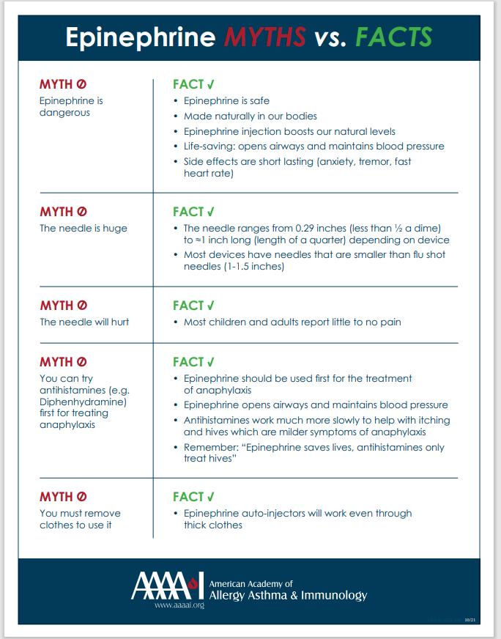
For Patients and Providers
Educational materials
Anaphylaxis Symptoms, Diagnosis, Treatment & Management | AAAAI
Wallet card
Anaphylaxis-Card.pdf (aaaai.org)
Epinephrine-MythFact_2.pdf (aaaai.org)

Slide 37
When in Doubt, Inject Epinephrine!
Please remember….

Slide 38

Questions?
Please don’t.
Hesitate to ask.

