Slide 1

Curious Cases and Clinical Conundrums in Dermatology
Katy Duffy, PA-C
Forefront Dermatology, Clive, IA
Iowa Physician Assistant Society Spring Meeting 2026

Slide 2
Disclosures
Incyte Advisory Board

Slide 3
Learning Objectives
1 - Develop a broad differential diagnosis list for various rashes
2 - Recognize skin cancers and know when as well as what type of biopsy is appropriate
3 - Acknowledge challenges in diagnostics and treatment of various inflammatory skin conditions

Slide 4
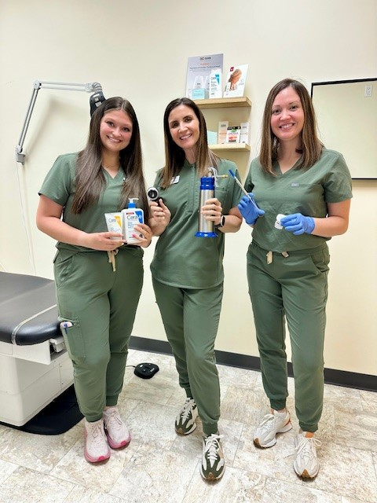
The Life of a Derm Girl…

Slide 5
Are you ready for it?

Slide 6
The Case of the Persistent Cyst
HPI:
59 year old male presents for skin exam and also complains of a tender spot on his back present for 4 weeks; no prior treatment
Exam:
1 cm erythematous, fluctuant, tender nodule
Plan:
Inject with 0.2cc 10mg/cc intralesional triamcinolone
Follow up in 1-2 weeks

Slide 7
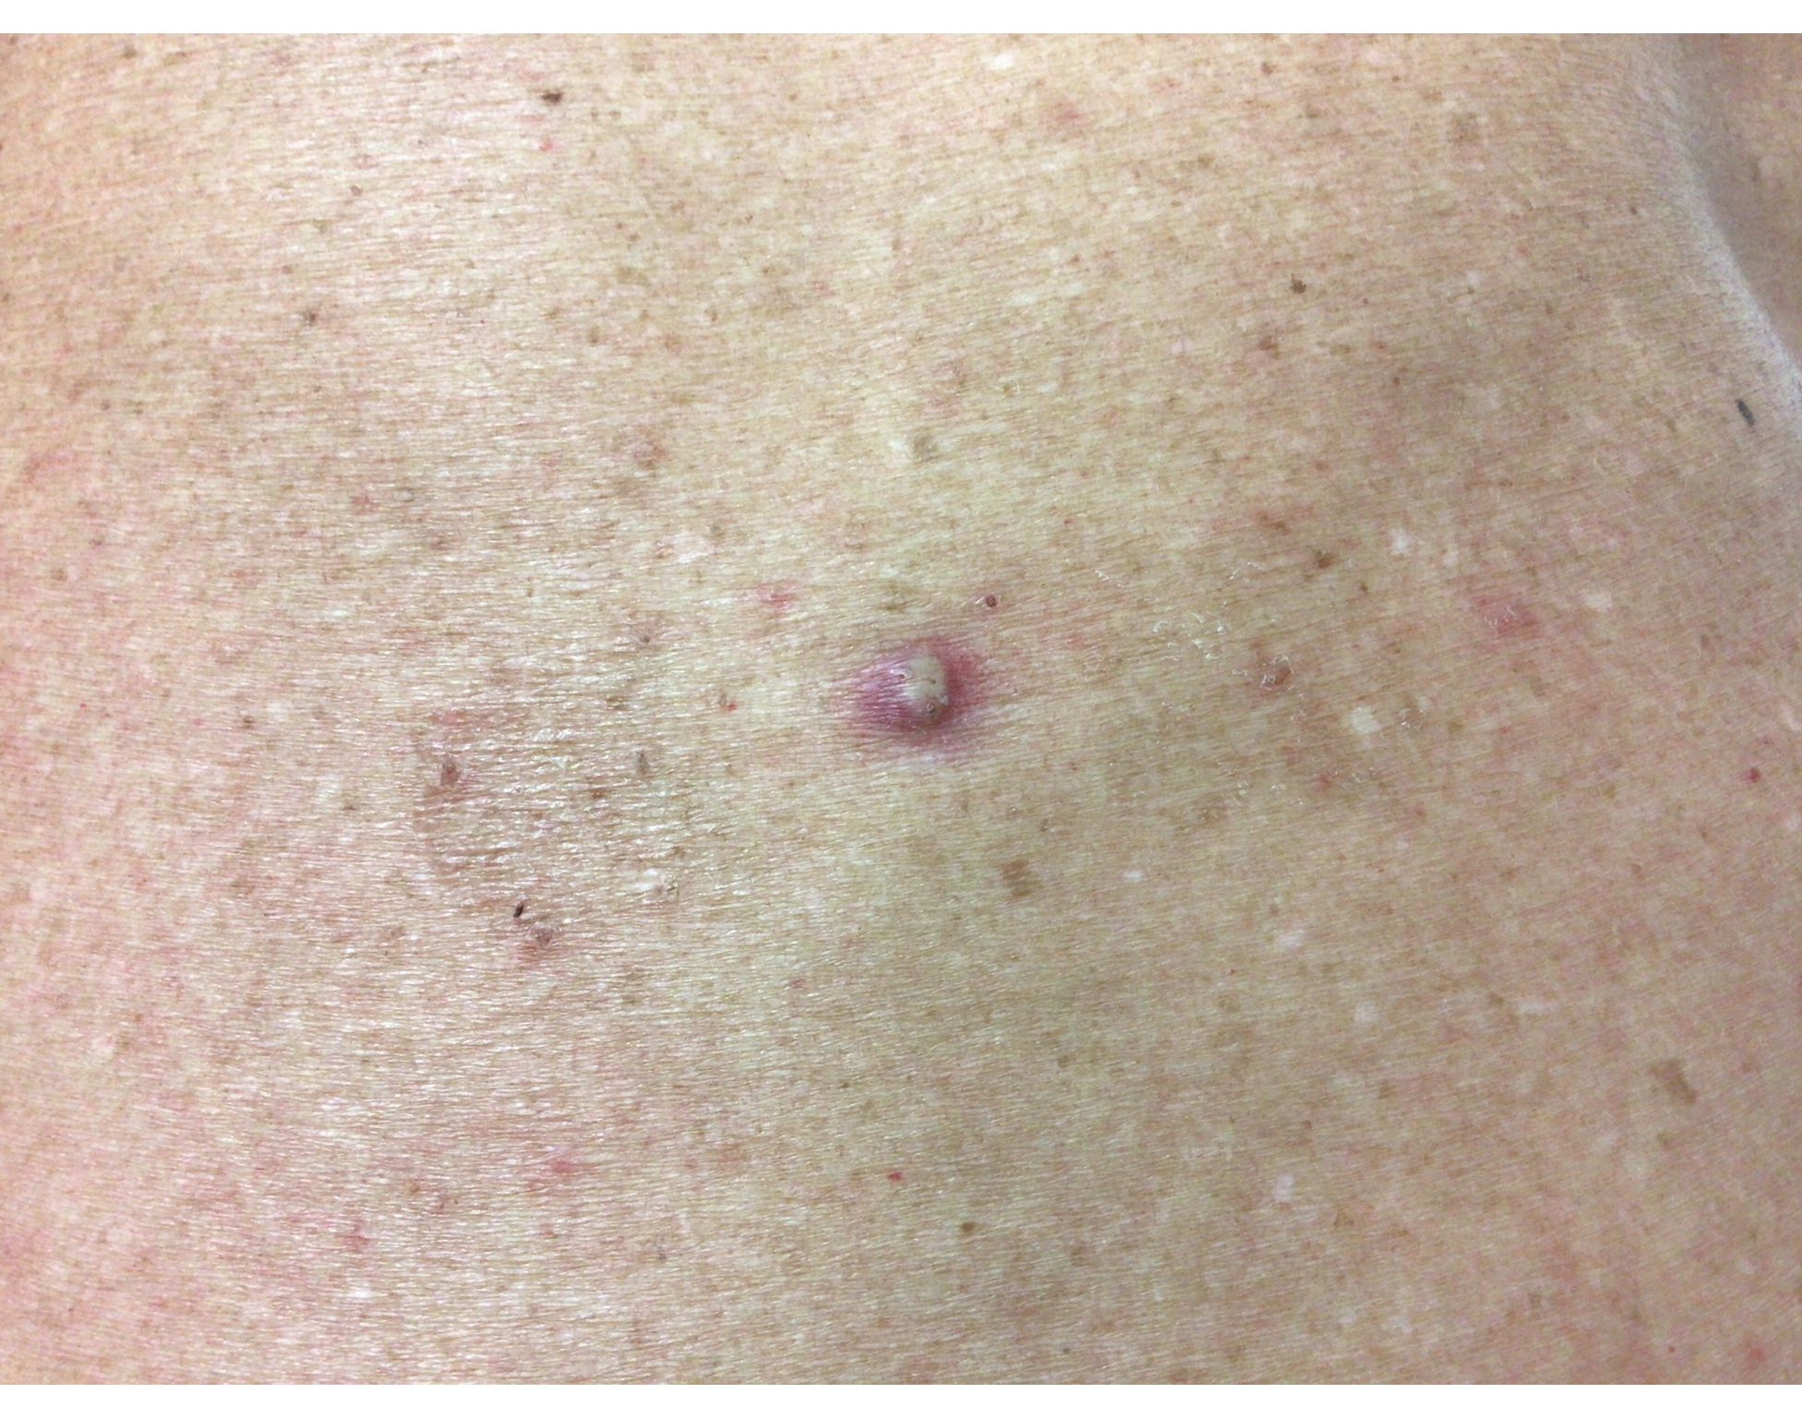
The Case of the Persistent Cyst
Follow up 10 days later:
Noticed initial improvement, now painful again. Thinks it is infected because it has drained a bit. Denies fever and chills.
Exam:
1 cm erythematous nodule with punctum and slight yellow purulence
Plan:
inject with 0.5cc 10mg/cc intralesional triamcinolone; I&D with slight drainage; start doxycycline 100mg BID x 10 days

Slide 8
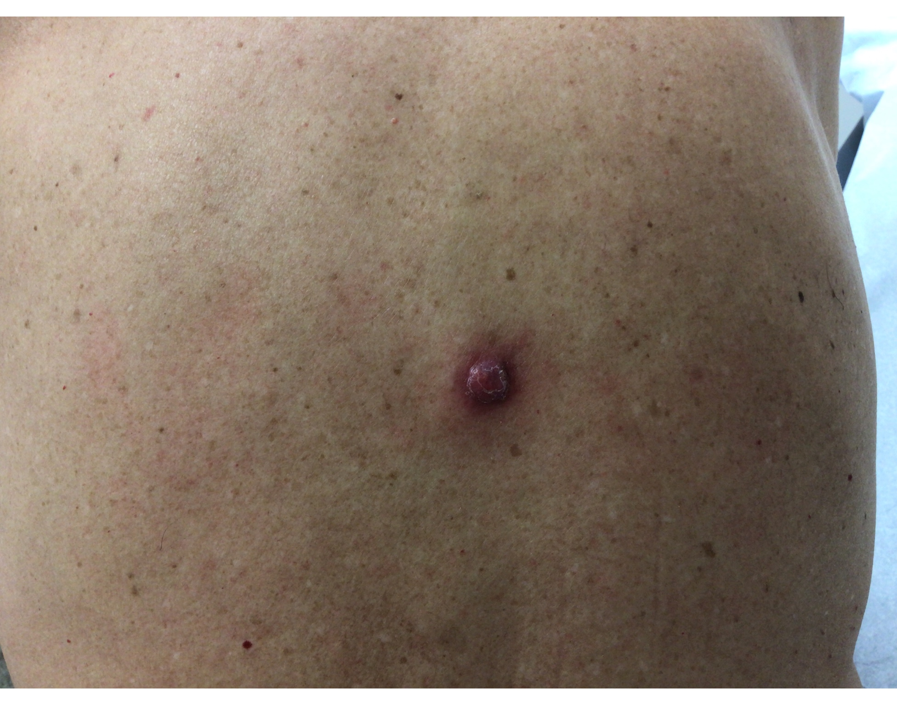
The Case of the Persistent Cyst
Follow up 2.5 weeks later:
Improved after doxy and I&D; now painful again, growing. Can’t sleep on his back or sit back in a chair. Denies fever and chills.
Exam:
1.5cm erythematous tender nodule with surrounding erythema
Plan:
Bacterial culture
Inject with 0.5cc 10mg/cc intralesional triamcinolone; I&D with minimal bloody, cheesy material expressed
Restart doxycycline 100mg BID x 10 days
Schedule excision

Slide 9
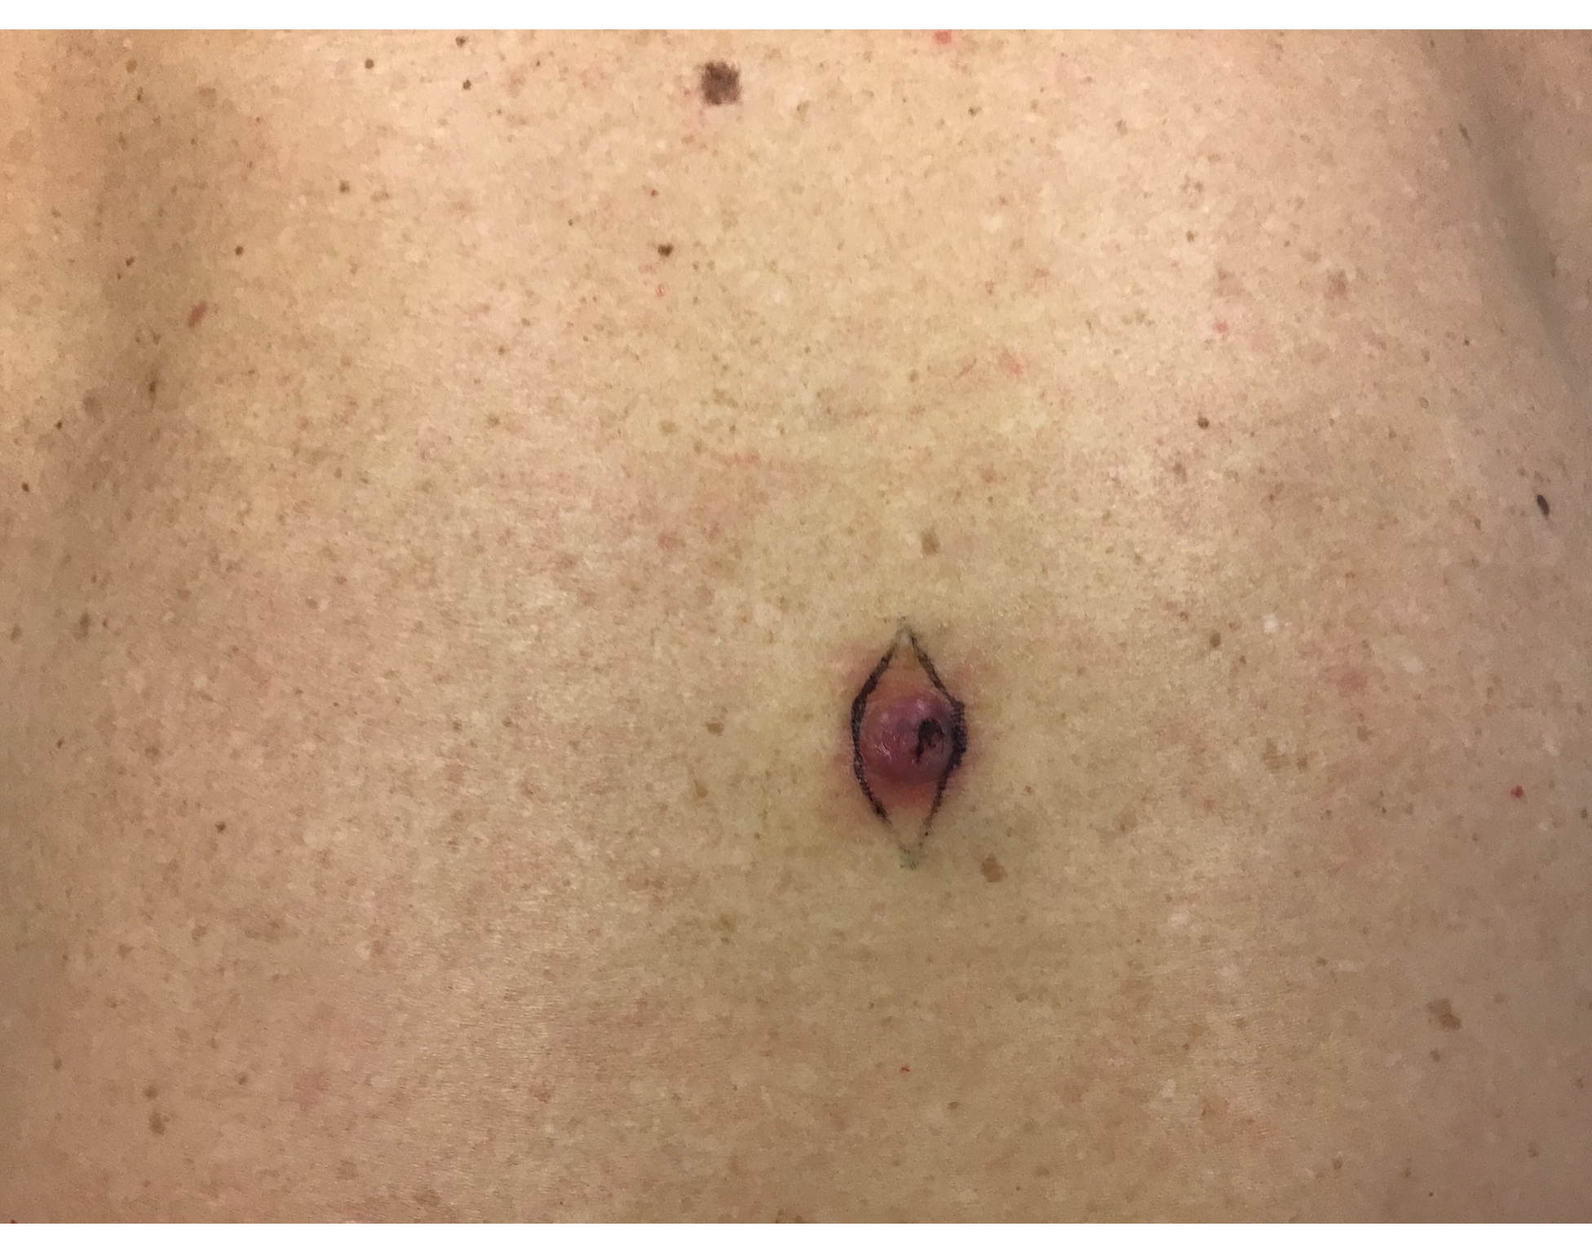
The Case of the Persistent Cyst
Follow up 3 days later for excision

Slide 10
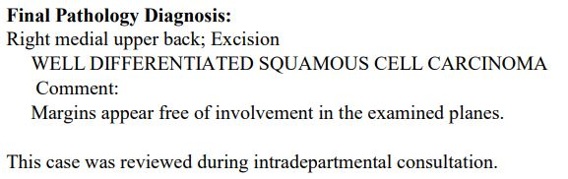
The Case of the Persistent Cyst

Slide 11
It was rare
I was there
I remember it all too well…

Slide 12
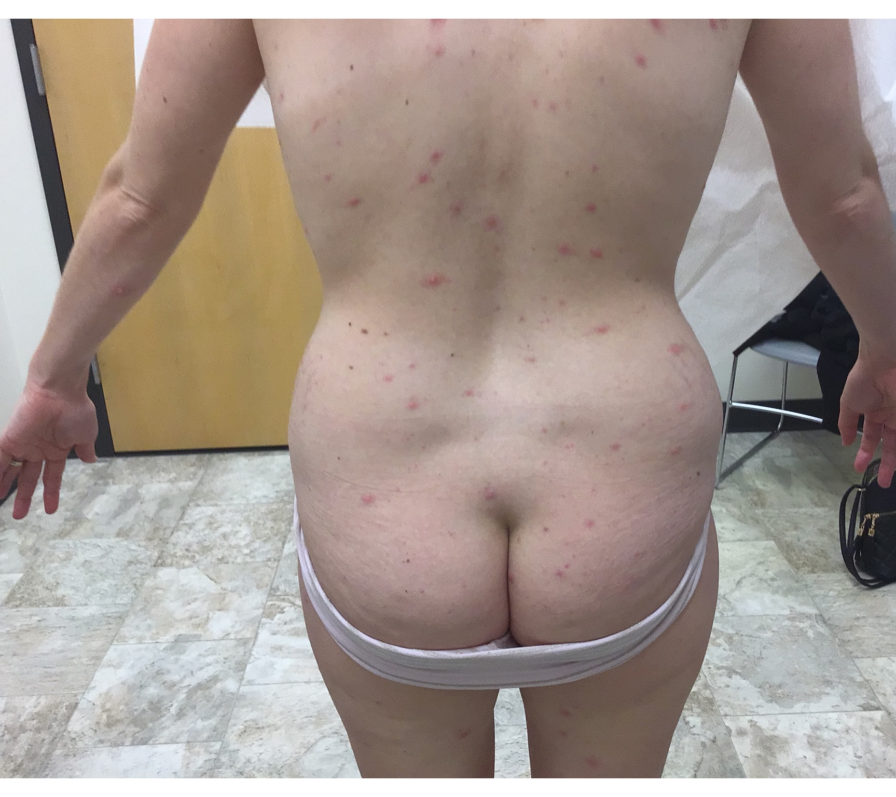
Case #1
November 2022
30 y/o F presents with blistering rash x 5 days
Began on chest as a few “pimples” then spread w/ associated body aches, fatigue, low grade fever 100ºF
Urgent care: negative COVID; sent home with 7 days prednisone
Rash worsened next day, went to another urgent care; thought Staph infection because husband had MRSA 3 weeks prior
  started trimethoprim/sulfamethoxazole
In derm office: no longer having fever, chills, myalgia or fatigue; rash is pruritic, but not painful

Slide 13
Case #1 cont.
Social History
Works from home
Has 2 children
Married in a monogamous heterosexual relationship
Travel history: none
Misc.
  No close contacts with similar rash or symptoms
  Children are up to date with recommended vaccines
  She is pretty certain she has had all age recommended vaccines, including chicken pox and COVID

Slide 14
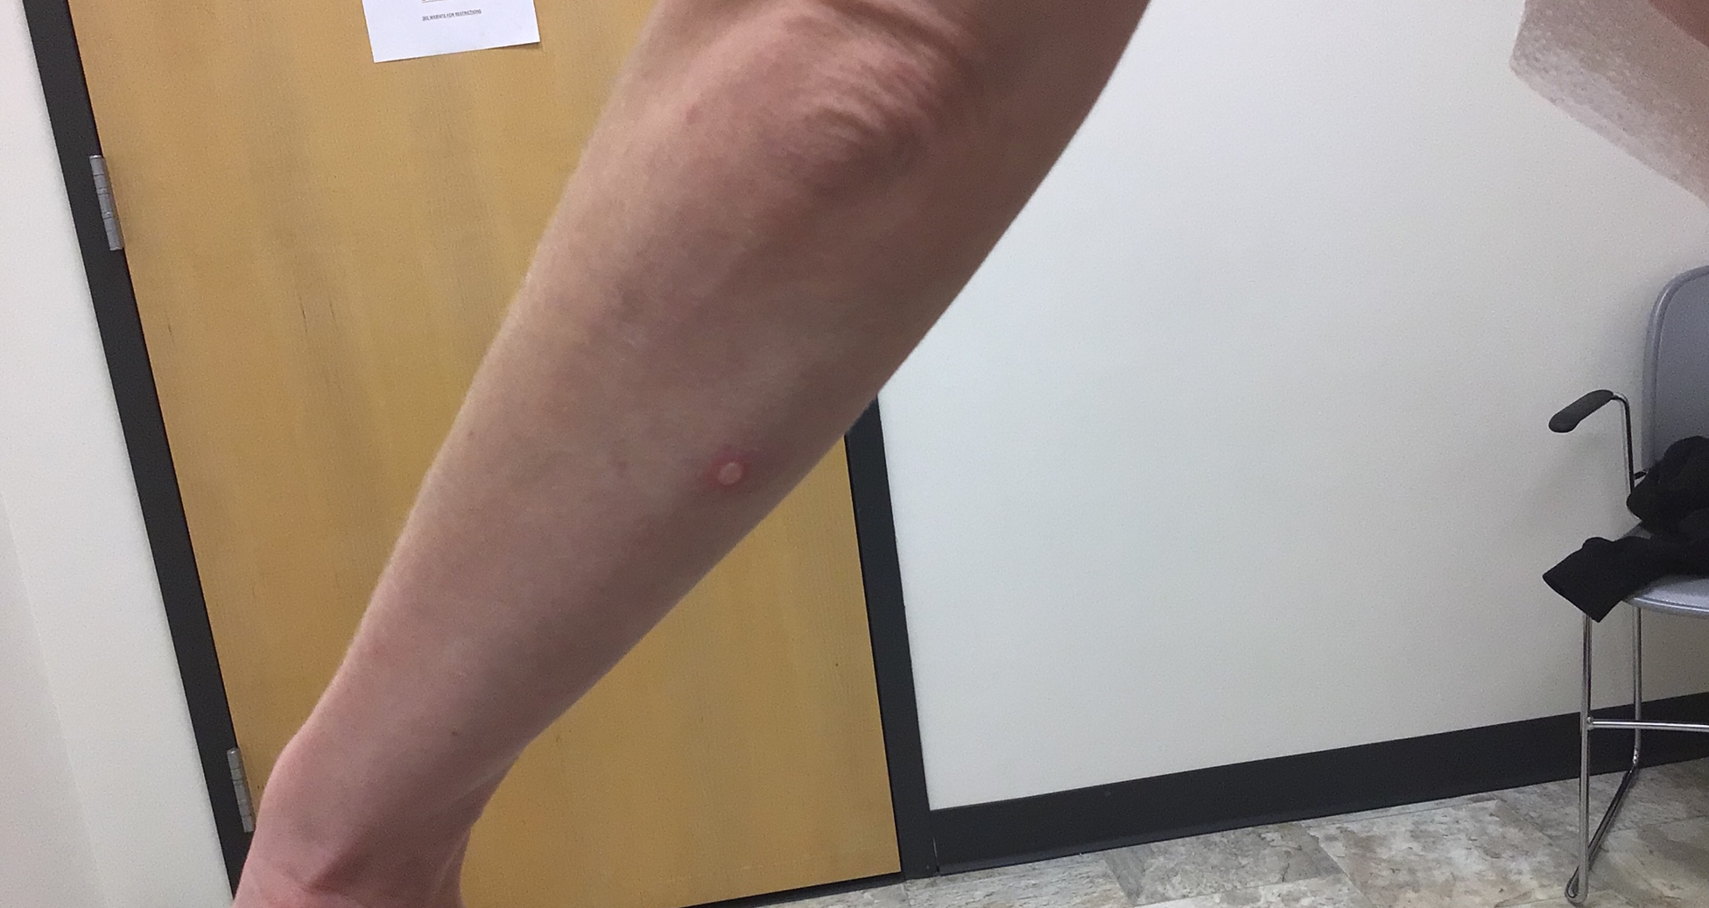
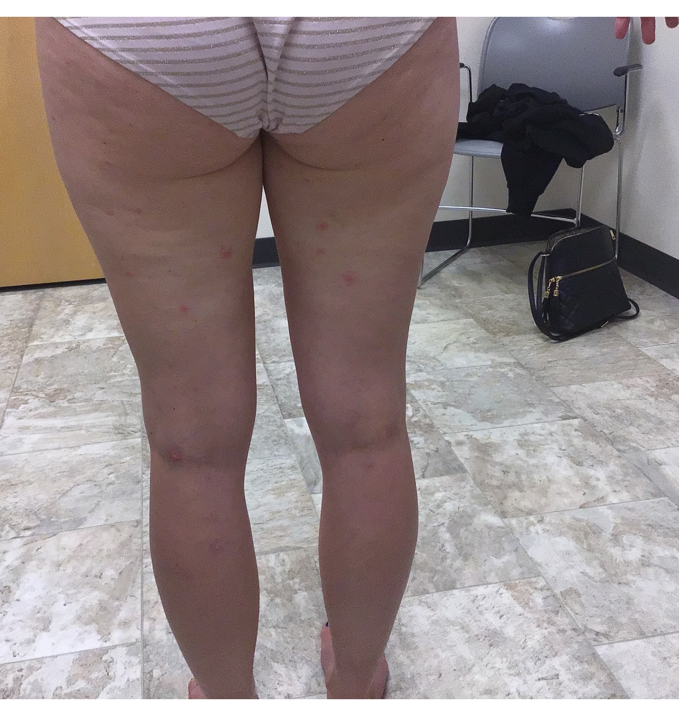
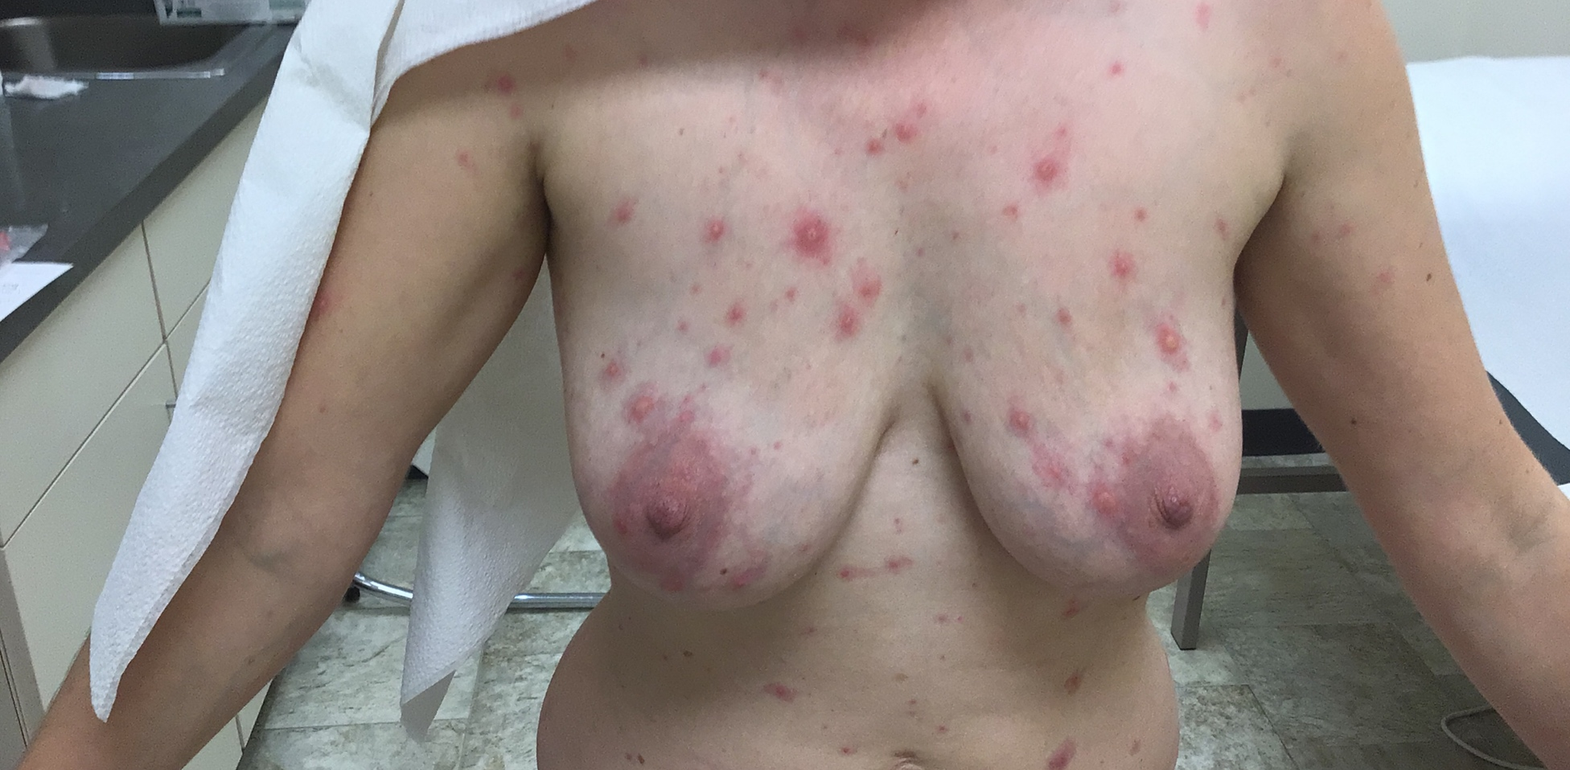

Slide 15

Hassan ML. Biden administration declares the monkeypox outbreak a public health emergency | CNN Politics. CNN. Published August 4, 2022. https://www.cnn.com/2022/08/04/politics/monkeypox-public-health-emergency/index.html

Slide 16
Differential Diagnoses
Mpox
Varicella Zoster
Disseminated Zoster
Bullous Impetigo
Bullous Pemphigoid
Sweet’s Syndrome

Slide 17
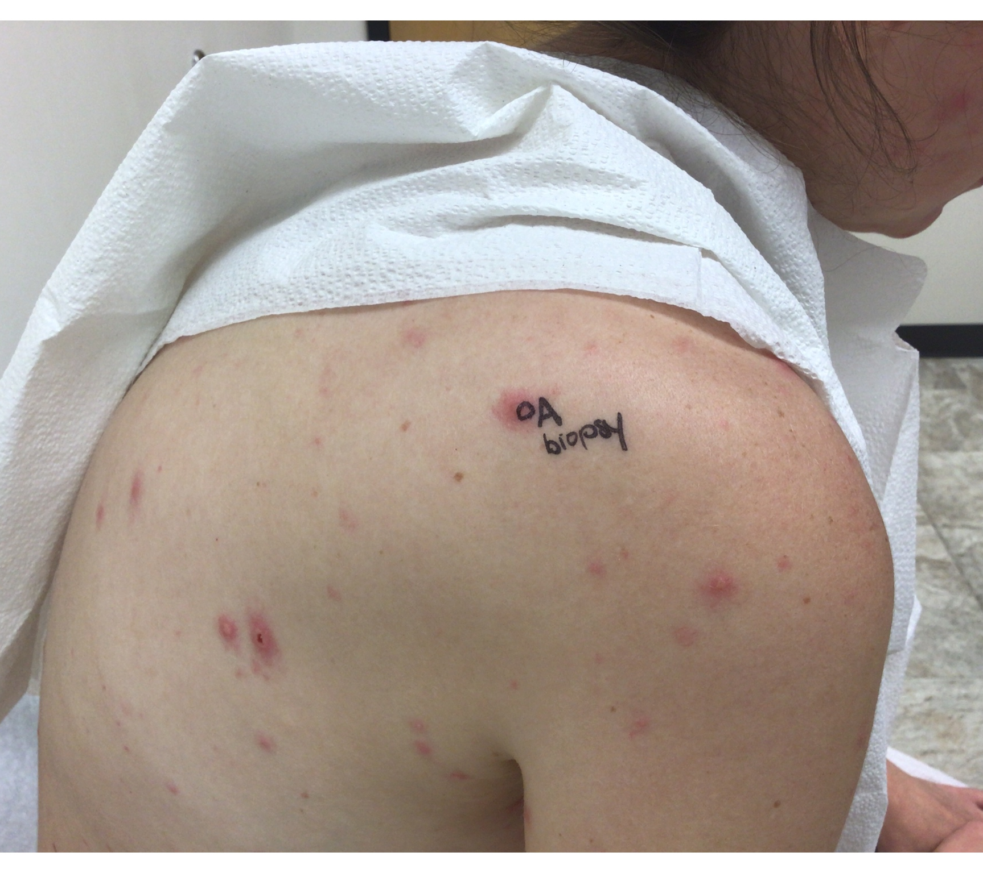
Plan
Punch Biopsy
Viral Culture
Mpox Culture
Aerobic Bacterial Culture
Triamcinolone 0.1% ointment BID
Valacyclovir 1gm TID x 7 days
Cont. TMP-SMX

Slide 18
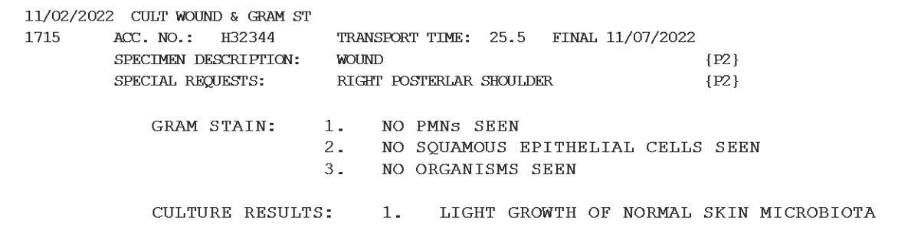
Results: Bacterial Culture

Slide 19
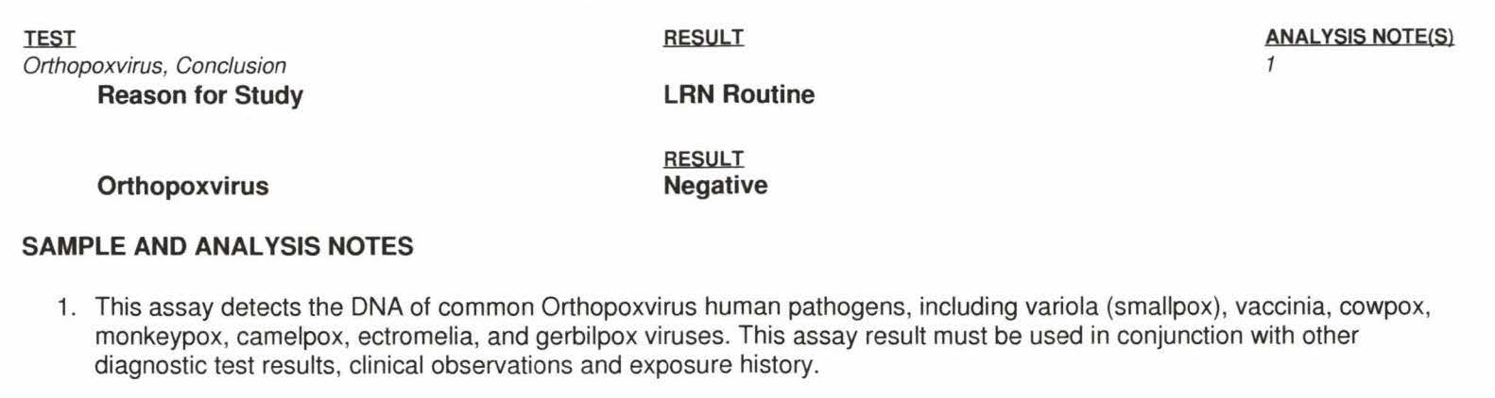
Results: Mpox DNA

Slide 20
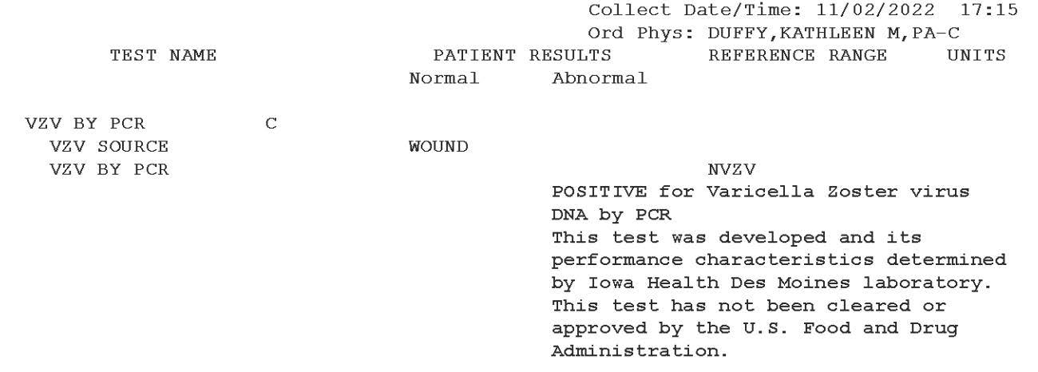
Results: Viral Culture

Slide 21
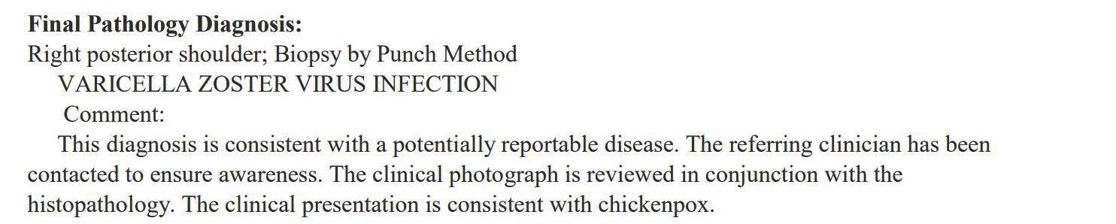
Results: Punch Biopsy

Slide 22

Follow up 6 Days Later
Plan Continued
Discontinued valacyclovir after 3 days due to nausea with each dose
On day 8 of TMP-SMX, having fevers, feeling “sun burnt” with new rash different from original rash
Verified she never had chicken pox or the vaccine as a child
Husband’s “MRSA infection” on the buttocks was clinically diagnosed; likely was VZV
Image generated from ChatGPT with prompt “create a cartoon image of a chicken with chicken pox”

Slide 23
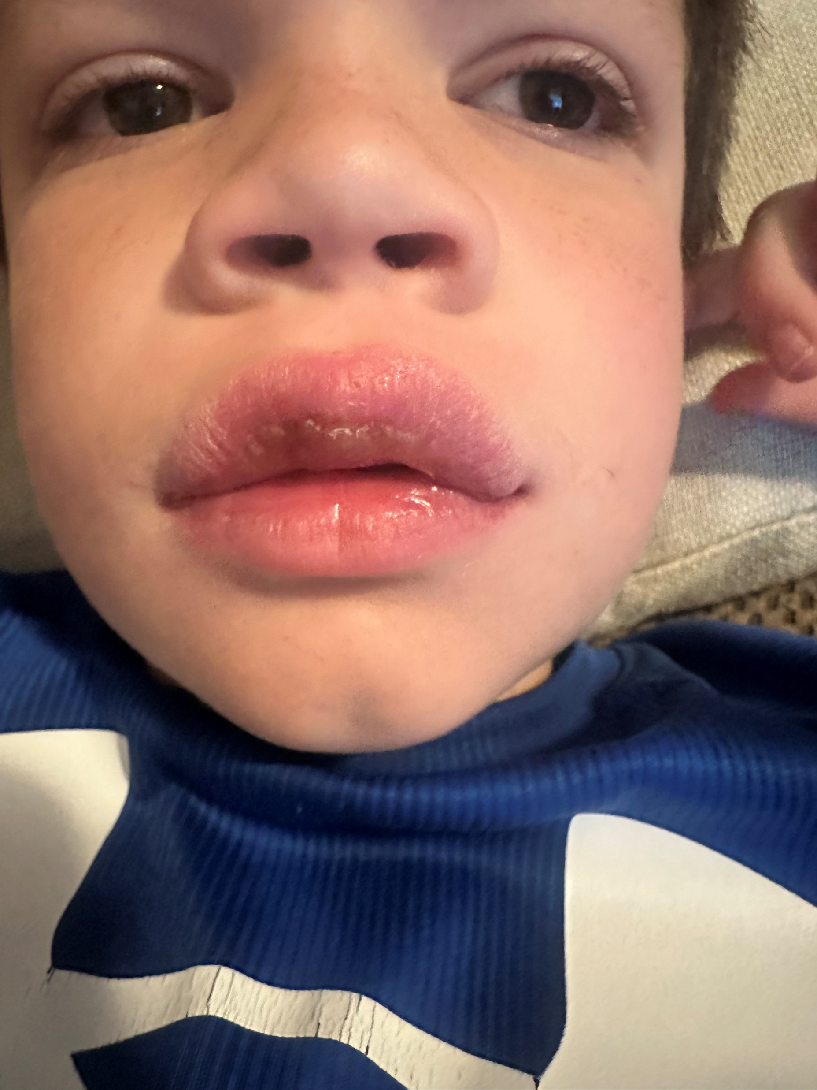
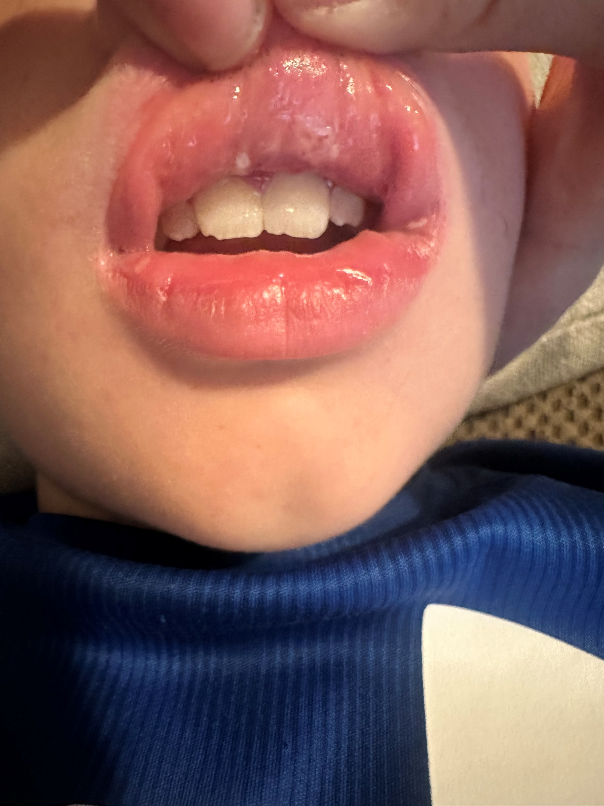
Case #2: Lips
9 y/o male swollen lips and sores inside mouth x 2 days
Associated symptoms: none
PMH: had croup 9 days prior, treated in urgent care with in-office steroid and recovered as expected
  No hx of HSV or known exposure
  No rash elsewhere
Meds: none

Slide 24
Case #2: Lips
Exam
No acute distress
White ulcers and an intact vesicle on upper mucosal lip with mild edema
No rash elsewhere
Assessment/Plan
Consult with collaborating doc
PCR swab for bacterial and viral molecular testing
Empirically treat for HSV and start acyclovir 400mg 5x daily for 7 days

Slide 25
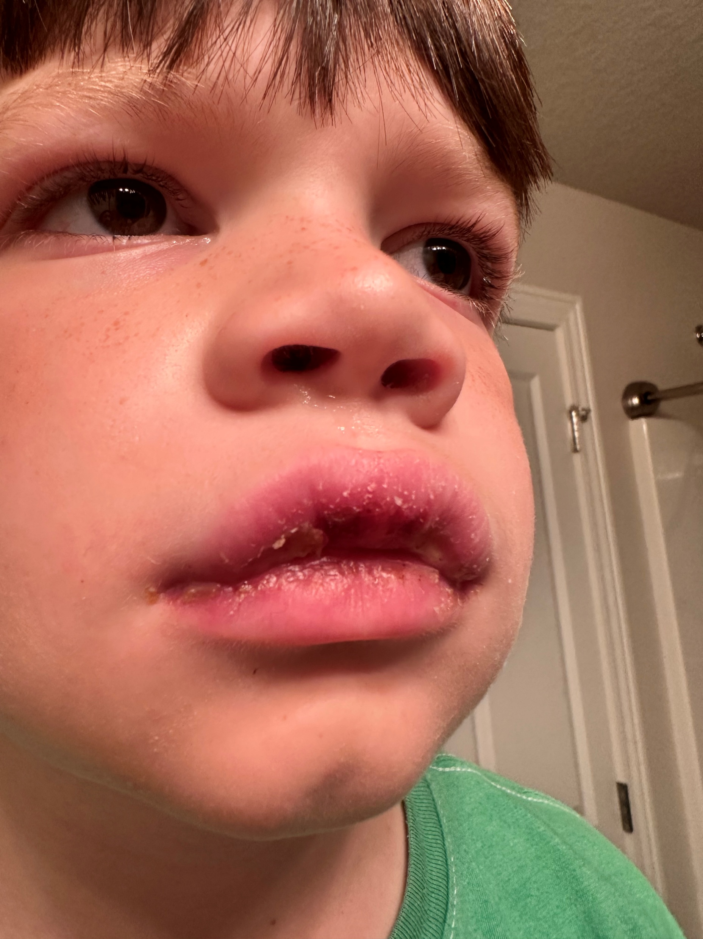
Day 3
Lips worsening, more crusting, swelling and sores on lips and inside mouth
Low grade fever
Not wanting to eat
No rash elsewhere

Slide 26
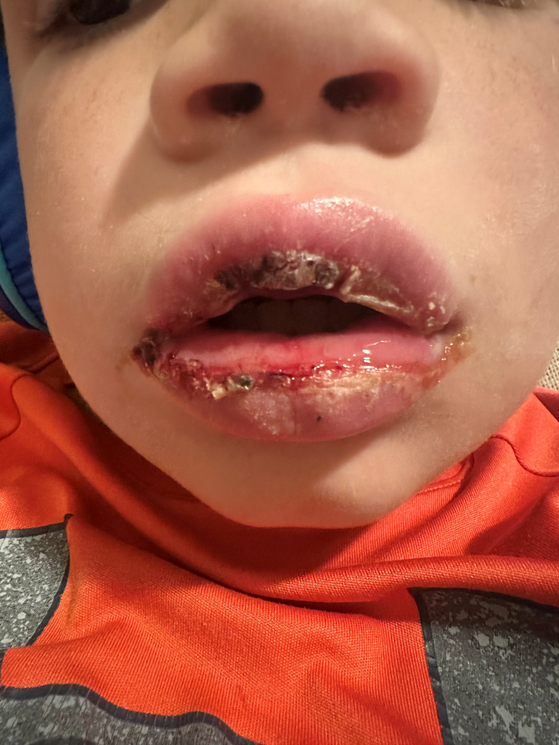
Day 4
Worsening → more edema, now significant crusting and sloughing, more sores inside mouth
Low grade fever, no rash elsewhere
Mom has mupirocin ointment at home and has started that already

Slide 27
PCR Result
Peptostreptococcus anaerobius
  This is considered normal flora, but has increased virulence with mixed bacteria, suspect anaerobic infection if the wound has a foul smell
Prevotella spp.
  Normal flora of the skin, consider treatment at moderate to high detection
Recommended antibiotic: Amoxicillin-clavulanate
  Started this x 10 days
  D/c acyclovir

Slide 28
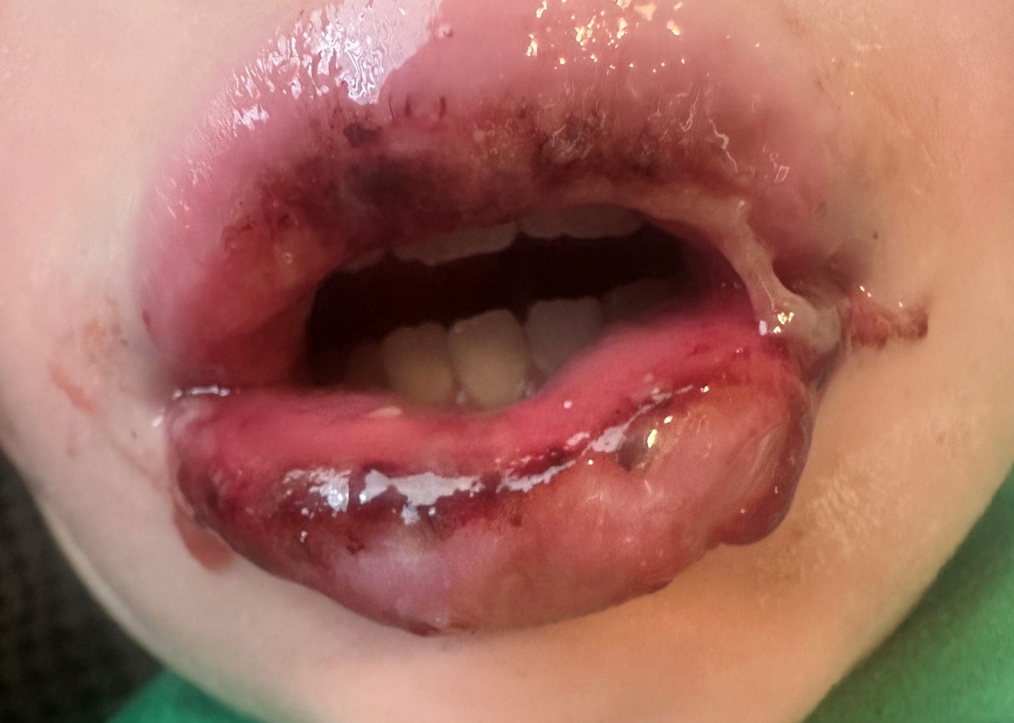
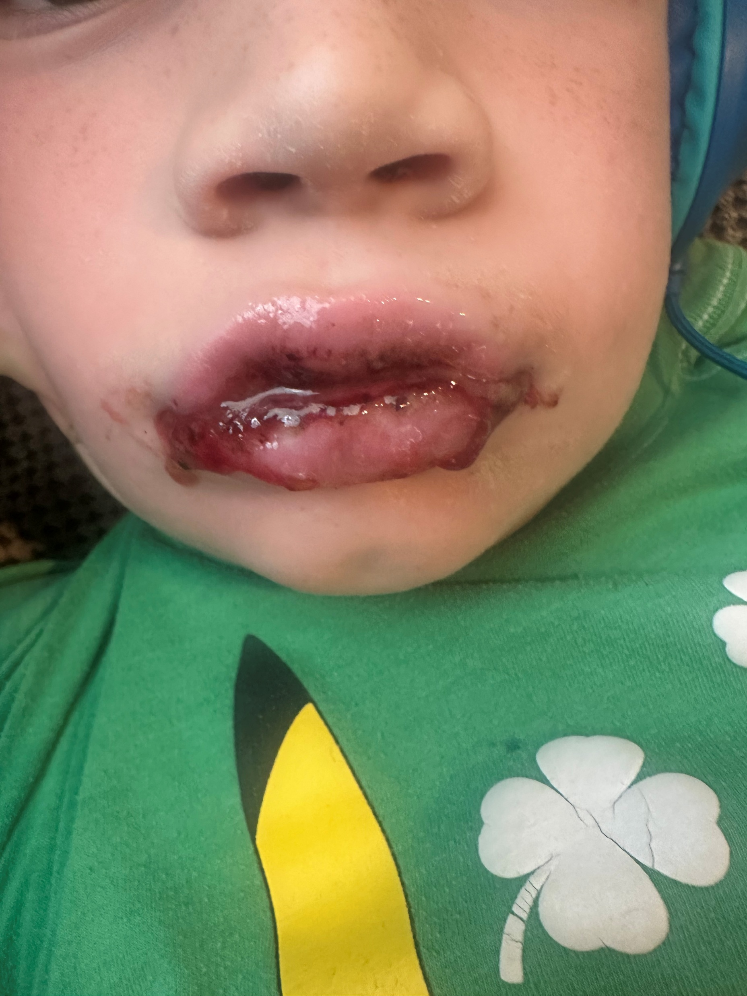
Day 6
Fever gone, continued sloughing, less crusting
Still no fever or other rash, eating a little better
Mom wanting to know what is going on?!

Slide 29

Its me,
Hi,
I’m the mom, it’s me

Slide 30
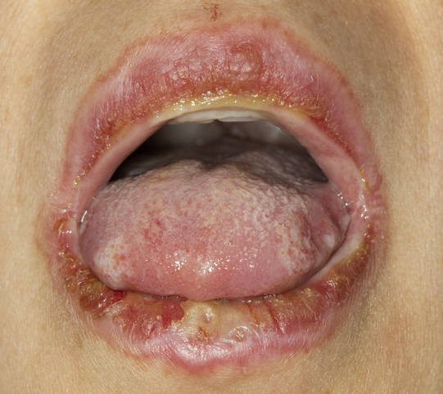
MIRM? (Mycoplasma Induced Rash and Mucositis)
Established as a diagnosis in 2015 to distinguish it from SJS, TEN and EM¹
What makes it different from SJS, TEN or EM?
  Mostly pediatric patients
  Mucosal involvement with little to no cutaneous involvement, but may have vesiculobullous rash
  Preceding fever, cough and M. pneumonia infection
Photo from:Fournier S, Anne-Sophie Smilga, Veillette H, Legare ME, Gilbert M. A rare case of Mycoplasma-induced rash and mucositis in a 44-year-old female patient. JAAD Case Reports. 2020;6(12):1333-1335. doi:https://doi.org/10.1016/j.jdcr.2020.09.014
¹ Damari N, Goodman A, Bridges C. Diagnosis and management of reactive infectious mucocutaneous eruption. Journal of Hospital Medicine. 2025;20(11). doi:https://doi.org/10.1002/jhm.70099

Slide 31
RIME: Reactive Inflammatory Mucocutaneous Eruption
Defined by Dr. Michele Ramien and colleagues in 2018 to distinguish patients who have erosive mucositis and cutaneous lesions caused by infection rather than a drug¹
Has been associated with several infectious etiologies other than M. pneumo¹
    Chlamydia pneumoniae
    Human metapneumovirus
    Rhinovirus
    Enteroviruses
    Adenovirus
    Influenza A & B
    SARS-CoV-2
    Parainfluenza virus type 2
1 Ramien ML. Reactive infectious mucocutaneous eruption: Mycoplasma pneumoniae-induced rash and mucositis and other parainfectious eruptions. Clin Exp Dermatol. 2021;46(3):420-429. doi:10.1111/ced.14404.

Slide 32
RIME Fast Facts
Predominantly affects mucous membranes, with little to no skin involvement in the form of ulcers, erosions, hemorrhagic crust and vesicobullous lesions
  94-100% oral
  82-92% ocular
  63-78% urogenital
  Less common nasal, esophageal and anal membranes
More common in children, slight male predominance, relatively favorable course
Usually presents about 1 week after URI and lasts 7-14 days

Slide 33
Differential Diagnoses for RIME
EM Major (typically lacks preceding URI and has more classic targetoid lesions)
  SJS - medication within prior 2 months, severe, life-threatening, Nikolsky sign
  Kawasaki disease
  Pemphigus vulgaris
  Severe Hand Foot and Mouth disease
  Autoinflammatory disease

Slide 34
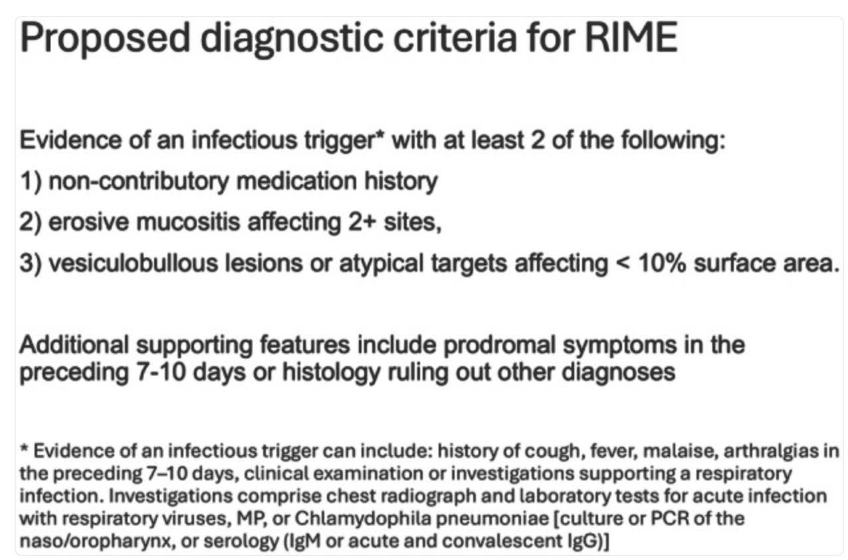
Damari N, Goodman A, Bridges C. Diagnosis and management of reactive infectious mucocutaneous eruption. J Hosp Med. 2025 Nov;20(11):1212-1216. doi: 10.1002/jhm.70099. Epub 2025 Jul 7. PMID: 40619921; PMCID: PMC12579755.

Slide 35
Treatment of RIME
  No established guidelines; supportive care (skin care, fluids, nutrition, pain management)
  Treat underlying/inciting infection with proper antibiotics
  Dermatology consult to differentiate between more serious conditions (SJS, TEN)
  Ophthalmology consult if ocular involvement
  Severe cases → Systemic steroids, IVIG, cyclosporine

Slide 36
Case 3: More Blisters!
60 y/o white male presents for skin exam
Sister deceased from metastatic melanoma, concerned about brown spots on his back.
Also has a rash on knees and elbows for years diagnosed as psoriasis. Uses triamcinolone, which helps with the itch, but it has only ever cleared when he has been on prednisone for poison ivy
Meds: amitriptyline, pregabalin

Slide 37
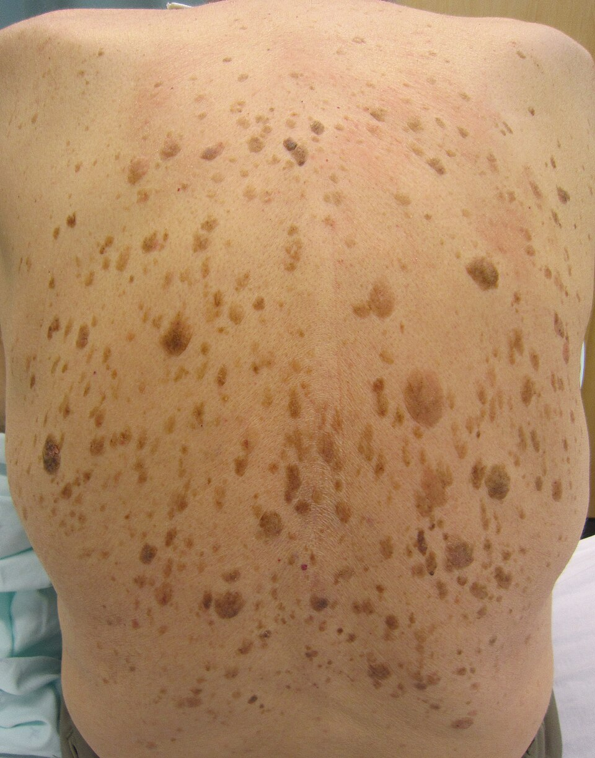
Exam
  Multiple brown, waxy papules and plaques on trunk
    Reassured these are benign seborrheic keratoses
  Multiple erythematous excoriated papules as well as a few vesicles over elbows, knees and scalp
    His “psoriasis”
Photo Credit: Wikipedia “seborrheic keratosis”

Slide 38
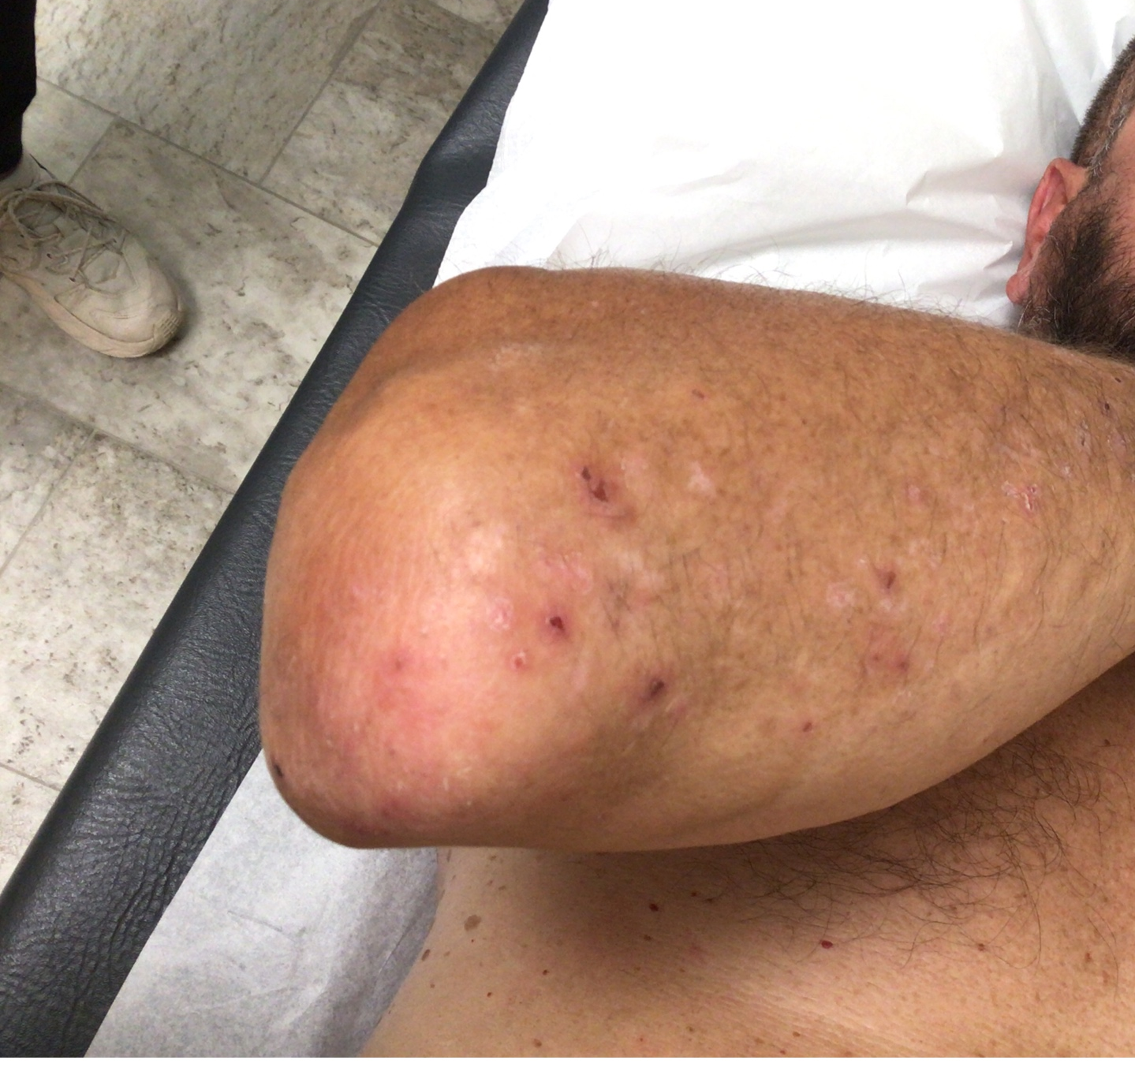
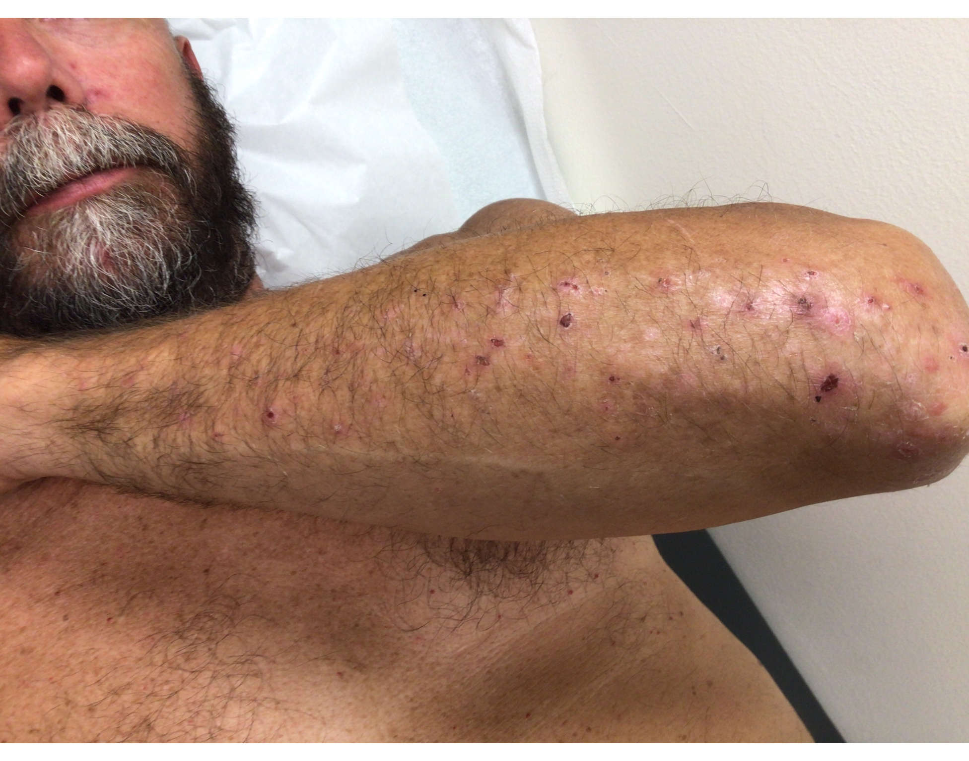
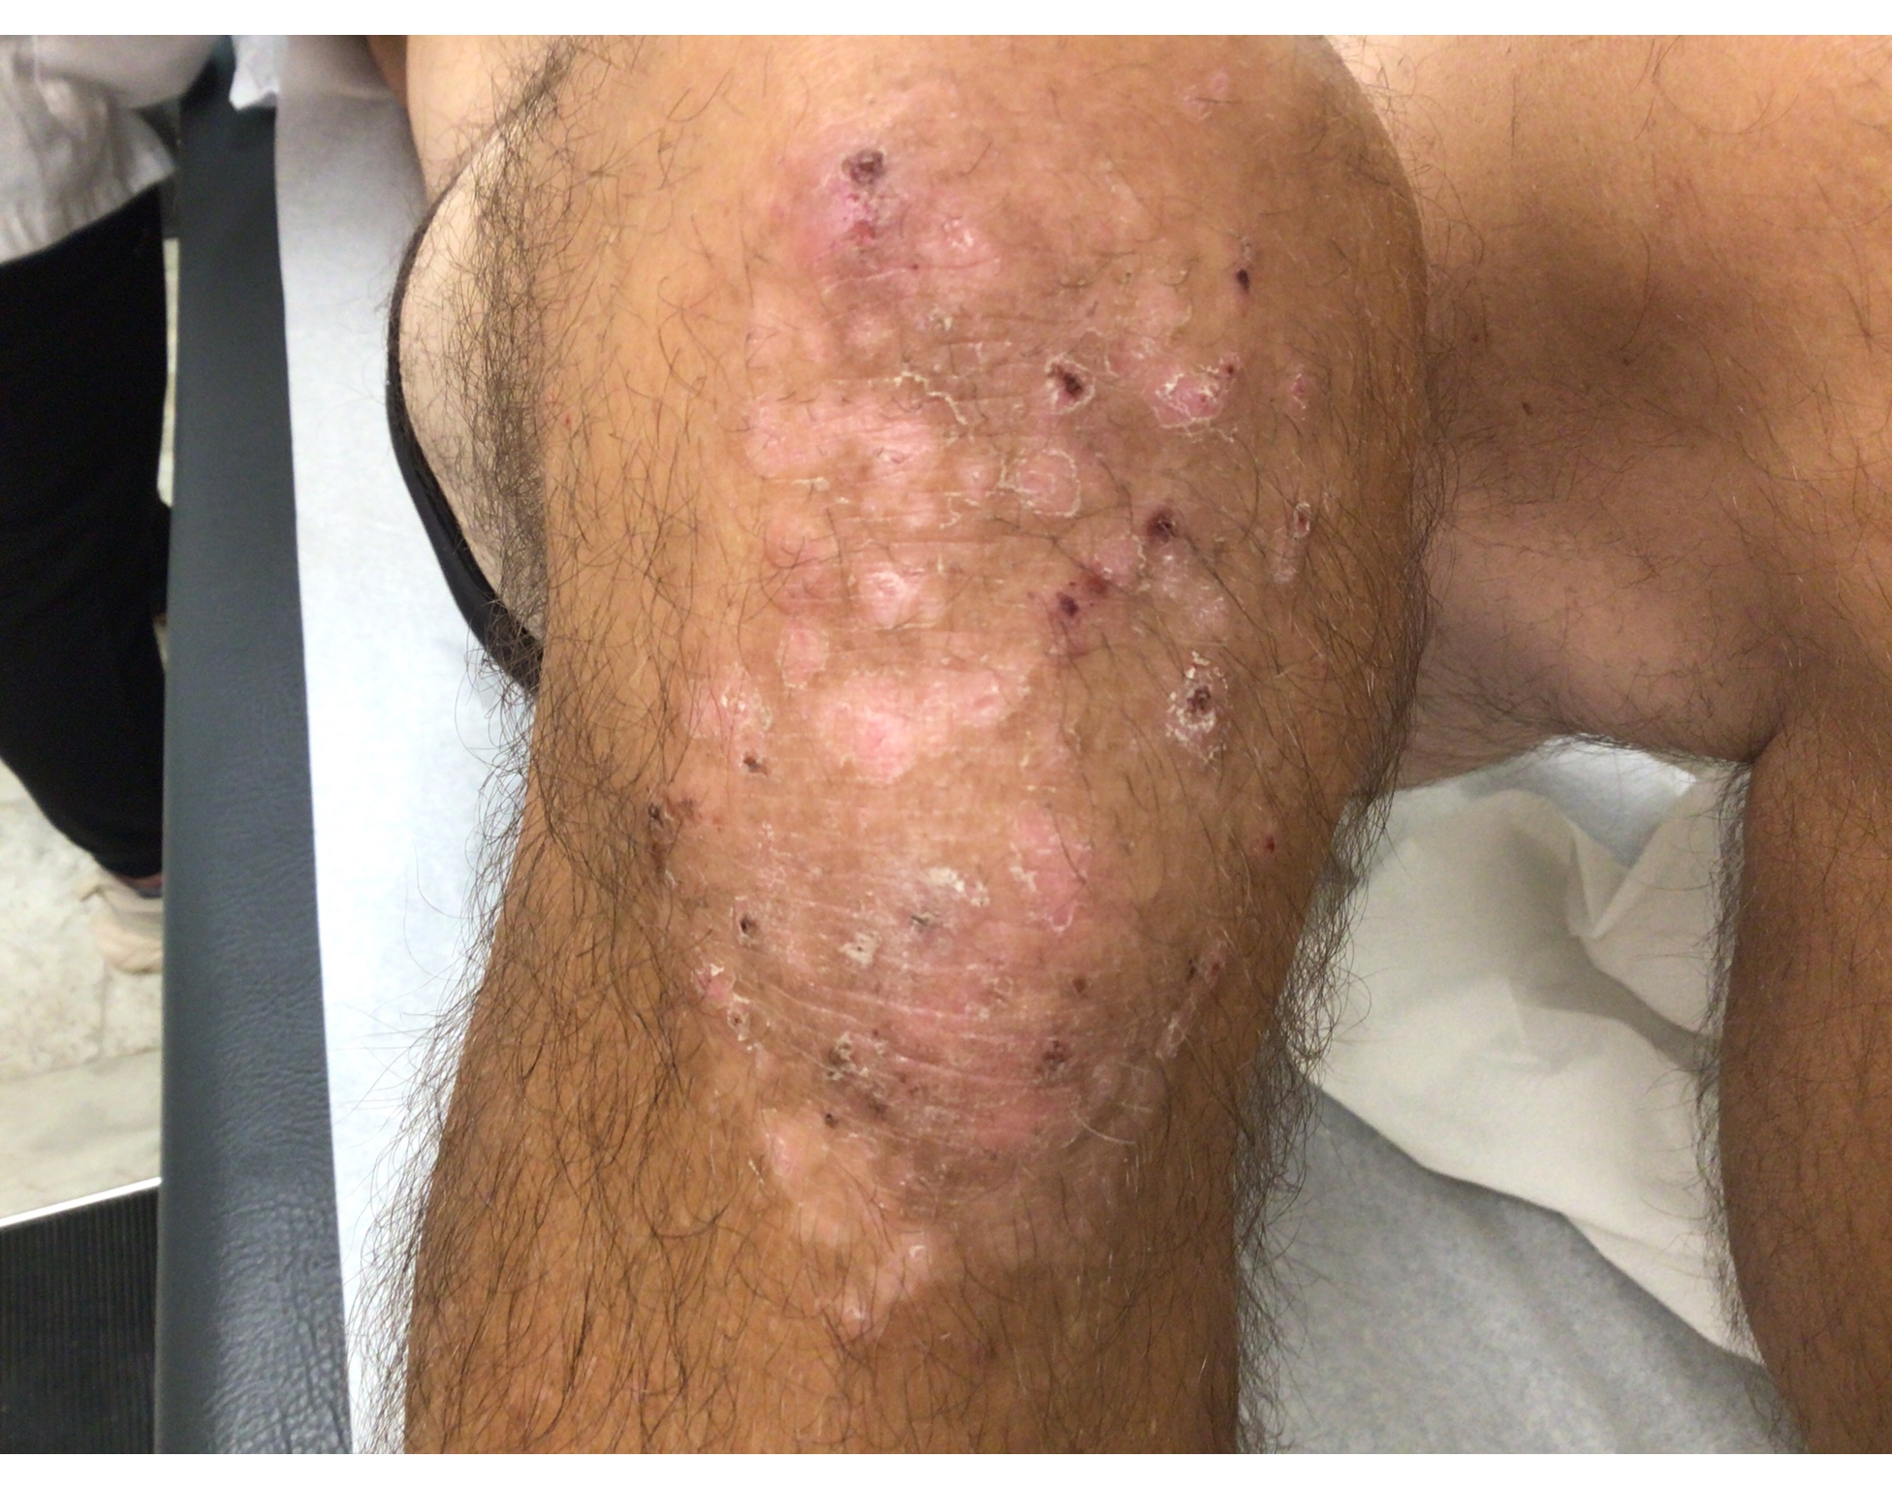
Exam

Slide 39
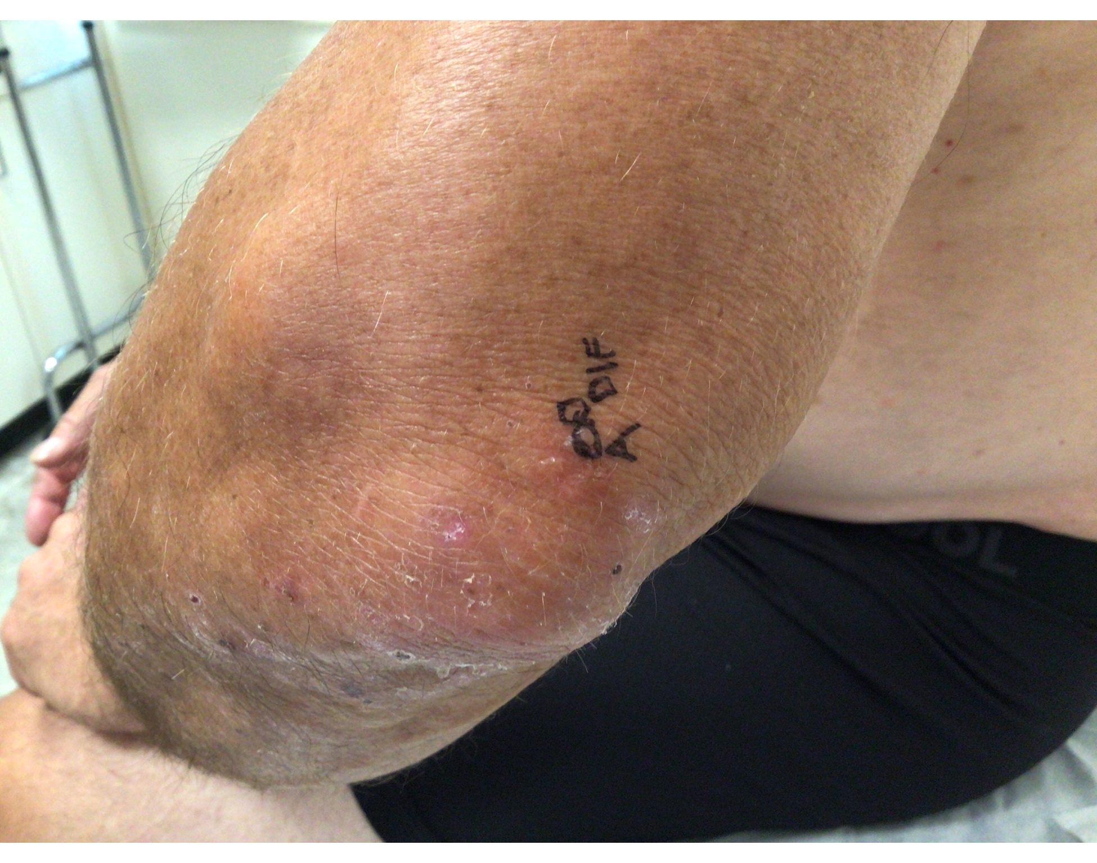
Plan
4mm punch biopsy x 2
  One for H&E is lesional on a vesicle
  One for DIF is perilesional
Ddx: dermatitis herpetiformis vs psoriasis vs eczema vs prurigo nodularis
Start clobetasol 0.05% ointment BID 2 weeks on, 1 week off, repeat cycle PRN until clear

Slide 40
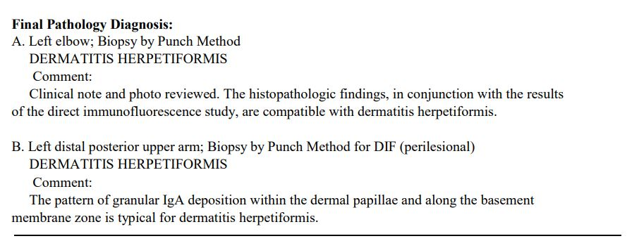
Results

Slide 41

Follow Up Plan
Discuss importance of gluten free diet, but wait until after seeing GI
Continue clobetasol
Refer to GI
Follow up:
  GI confirmed Celiac
  Consider dapsone, but he is doing well with clobetasol, working on GF diet
Photo credit: Deposit Photos

Slide 42
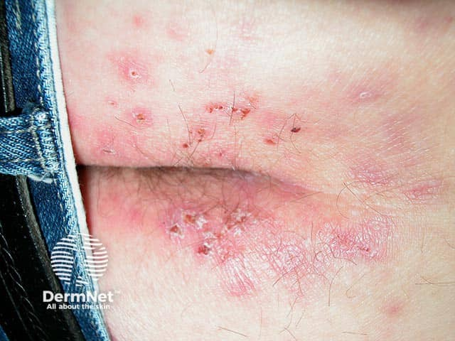
DH Fast Facts
  Autoimmune condition where IgA antibodies deposit into the papillary dermis; closely associated with gluten sensitive enteropathy
  Most common in caucasians, usually diagnosed between ages 15-50; male:female ratio 2:1
  Intensely pruritic papules and vesicles; often times the vesicles are not visible because they have been scratched open
  Most common affected areas are scalp, elbows, knees and buttocks
Photo Credit: DermNet NZ https://dermnetnz.org/images/dermatitis-herpetiformis-images

Slide 43
DH Fast Facts
  More than 90% of DH have gluten sensitive enteropathy, but only 15-20% of those with Celiac will develop DH¹
  Skin biopsy is gold standard for diagnosis and all confirmed DH should be worked up by GI
  Treatment: gluten free diet, topical steroids, oral dapsone
1 Shields BE, Gelfand JM, Allen-Taylor L, Rosenbach M. Prevalence of Dermatitis Herpetiformis Within the iCureCeliac Patient-Powered Research Network-Patient Characteristics and Dietary Counseling. JAMA Dermatol. 2020 Dec 1;156(12):1374-1376. doi: 10.1001/jamadermatol.2020.3431. PMID: 33026427; PMCID: PMC7542518

Slide 44
I knew you were trouble when you walked in

Slide 45
82 year old female presents with the following chief complaint,
“I have this doodad on my nose…”

Slide 46
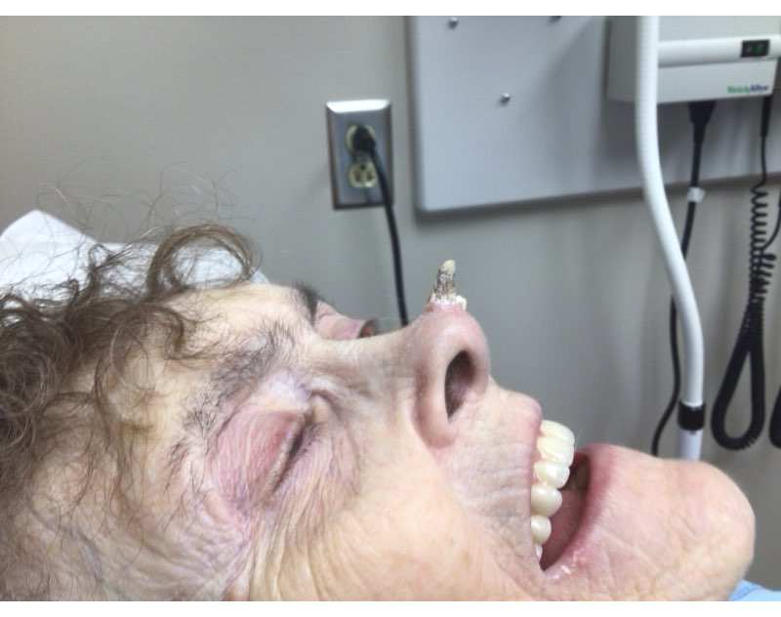
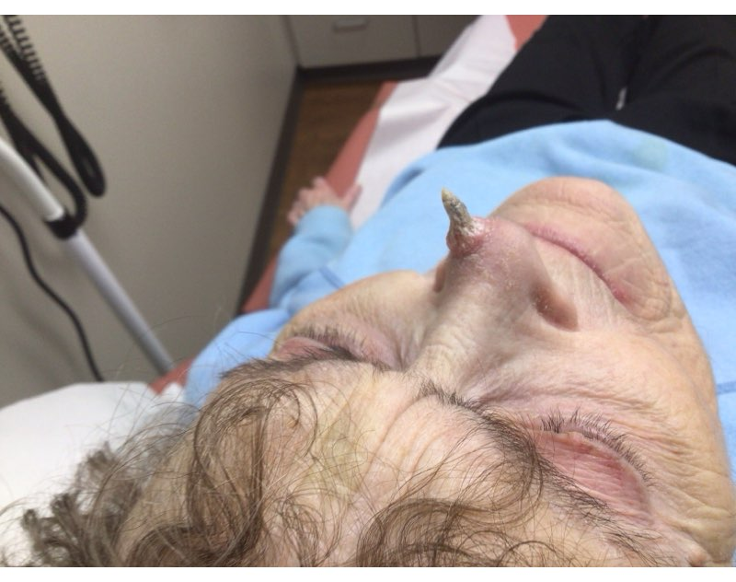
The “doodad”

Slide 47
How should I biopsy?
Shave? Excise? Punch?
Most likely SCC that will require Mohs

Slide 48
The “doodad”
Plan: shave biopsy
Result: Well differentiated squamous cell carcinoma
Treatment: Mohs

Slide 49
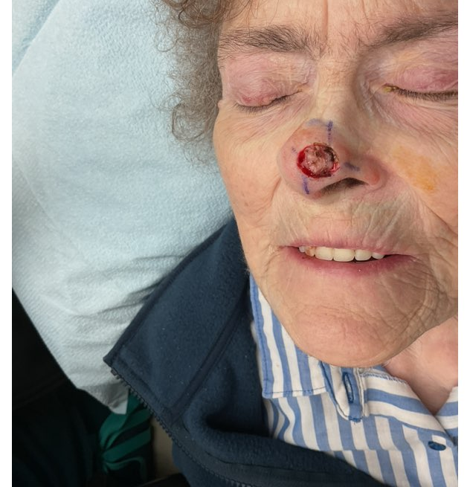
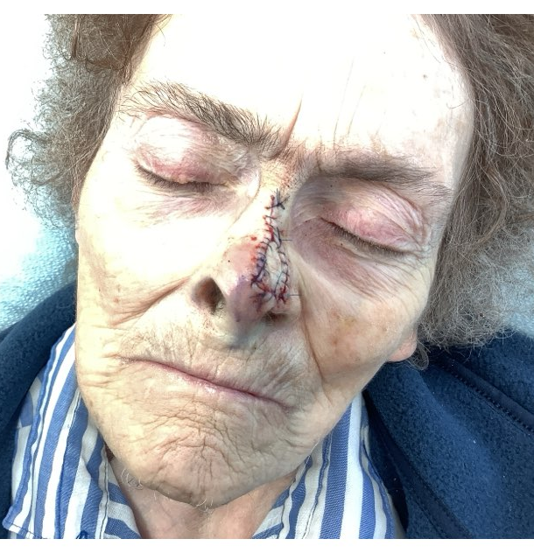

Slide 50
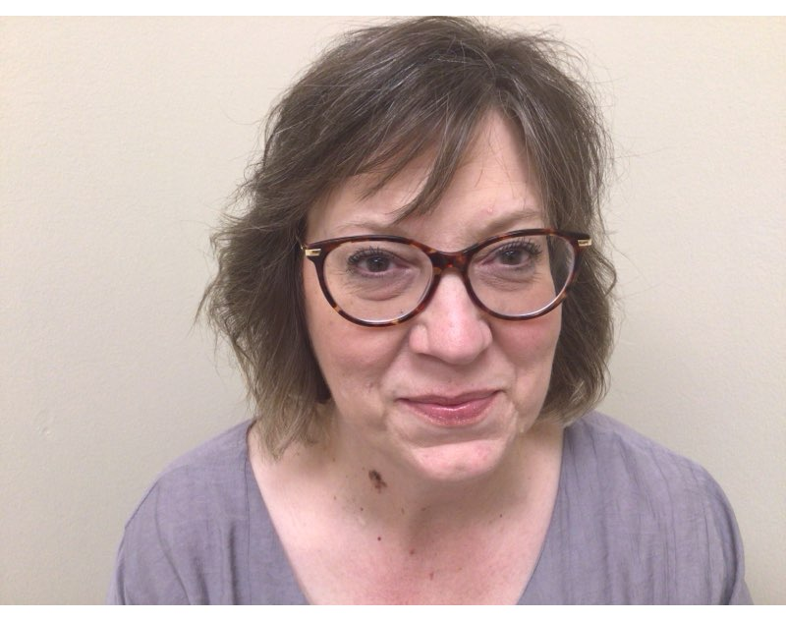
Trouble…
58 yr old F presents for full body skin exam
Mother has had melanoma
Last derm exam was over 10 years ago
Spot on neck has been present over a decade, seems to be getting bigger and darker

Slide 51
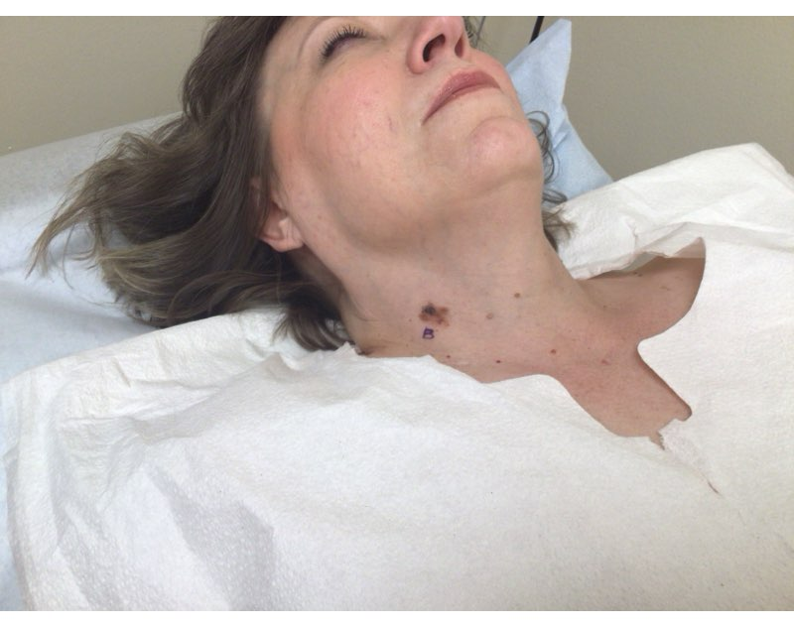
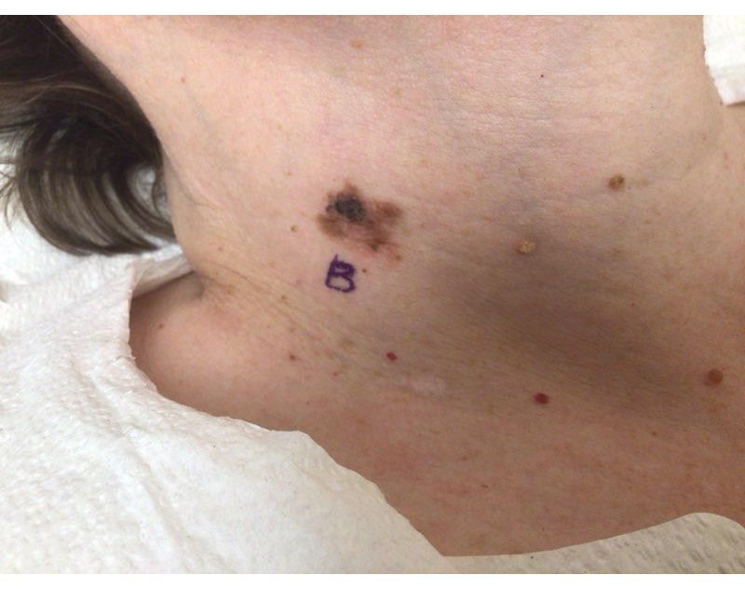
How should I biopsy this?
1.5 cm asymmetric brown-pink plaque with irregular pigment

Slide 52
Biopsy Considerations When Melanoma is of Concern
  Size
  Location
  Depth
  Want to get the entire lesion if possible
  Biopsy Types
    Shave
    Punch
    Excisional

Slide 53
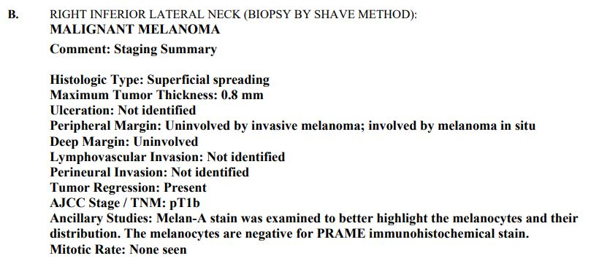
Pathology Results

Slide 54
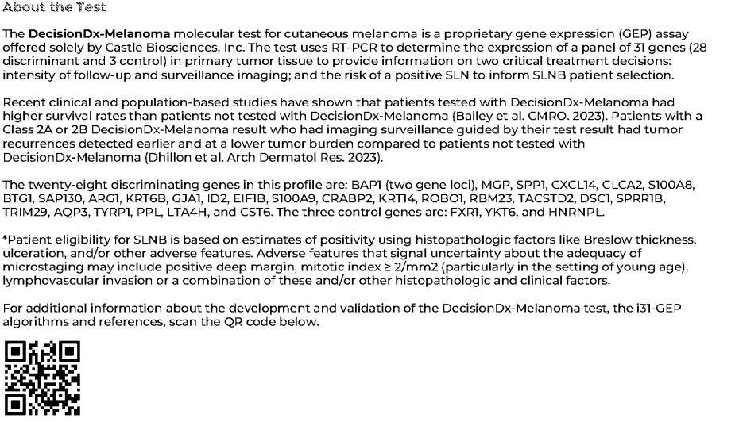
Plan
Send to surgical oncology for wide local excision with sentinel lymph node biopsy
Order CASTLE Biosciences DecisionDx Melanoma gene expression assay

Slide 55
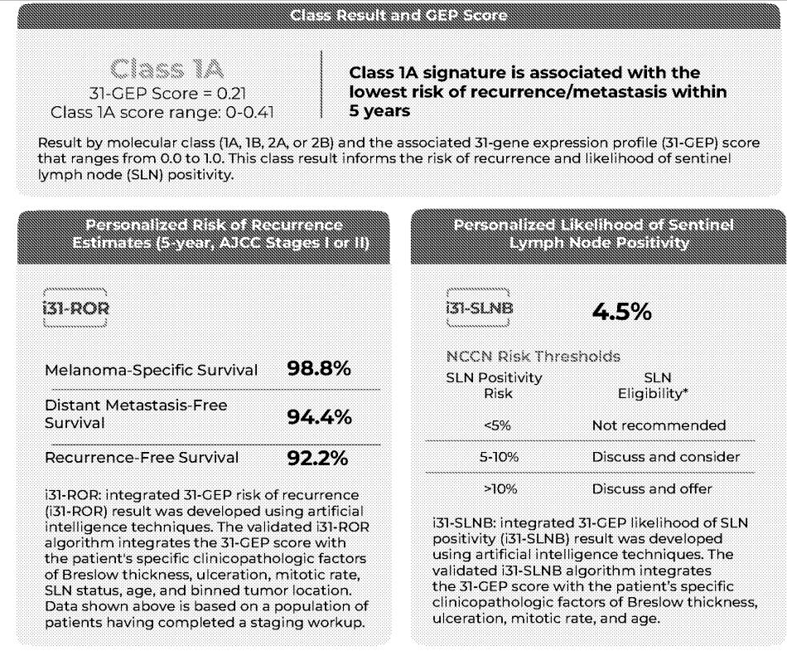
Outcome
WLE done by ENT
- 3 left lateral sentinel lymph nodes (contralateral to the MM) removed: all negative
CASTLE Biosciences Result: Class 1A
- Best possible score

Slide 56
More Trouble…
66 yr old Caucasian M presents as a new patient for a skin exam with a concern about a scaly spot on the right forearm
Has history of SCC and BCC; reports no family history of melanoma, BUT…
His daughter is a patient of mine, and I know she has had melanoma
He last saw a different derm a few years ago
I start the exam and see this…

Slide 57
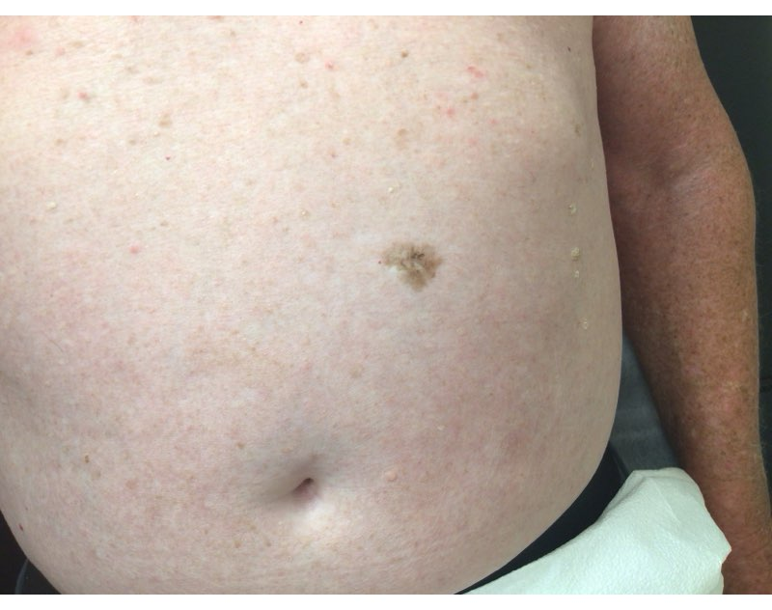
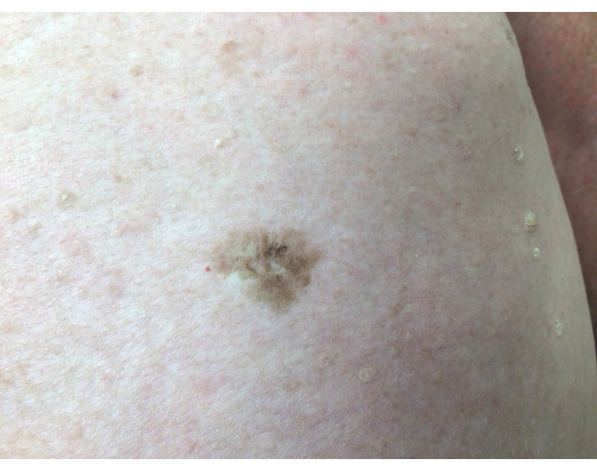
2 x 1.5cm irregular brown plaque - possible scar centrally from reported previous biopsy.
He reports prior derm did a biopsy “years ago” and it “was fine.” He reports it has looked like this for years and hasn’t changed. Declined to have a biopsy, but signed consent to obtain prior derm records with path report.

Slide 58
Previous Path Result
Partial biopsy in 2011 showed “dysplastic junctional nevus with mild atypia” – plan to continue to monitor;
Exam notes state the site was 1cm at that time
Plan – call patient to let him know I received results and recommend the site is biopsied once again based off my concern for its appearance as well as growth since prior biopsy; he is agreeable
Now to decide, how to biopsy this 2cm lesion…

Slide 59
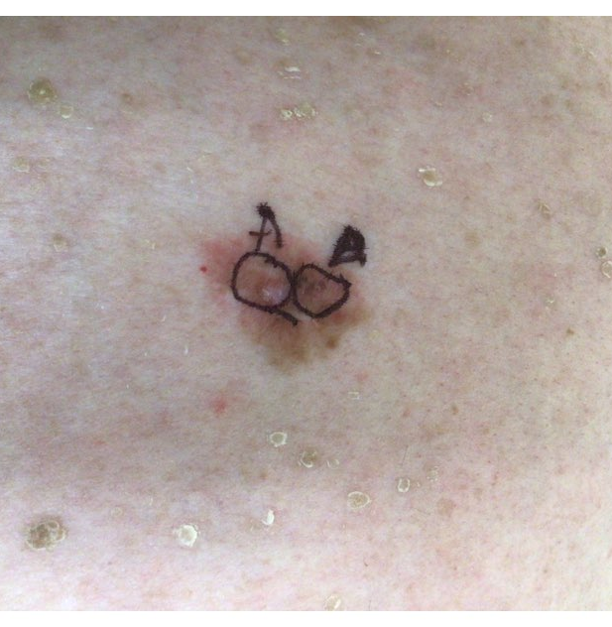
Scouting Biopsies
2, 6mm punch biopsies in the most atypical appearing areas

Slide 60
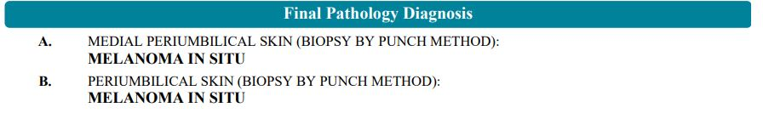
Results
Plan: wide local excision in office with supervising physician

Slide 61
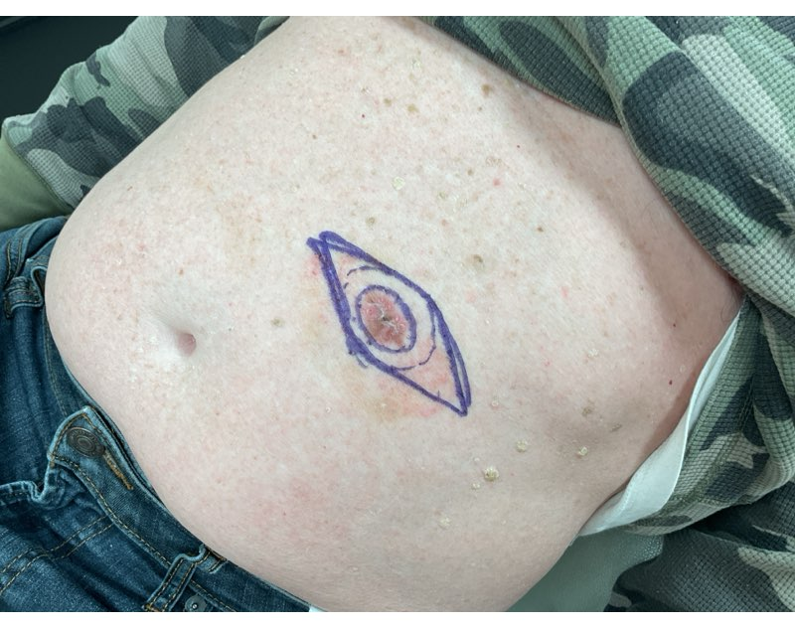
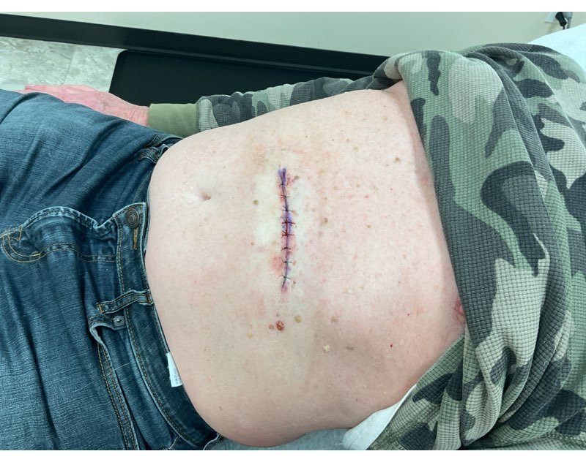
WLE with 1 cm margins

Slide 62
“Never be so kind, you forget to be clever
Never be so clever, you forget to be kind…
Never be so polite, you forget your power
Never wield such power, you forget to be polite”
- Taylor Swift in “Marjorie”

Slide 63
Thank you for your attention!
Questions?
Email: Katyduffy12@gmail.com

