Slide 1
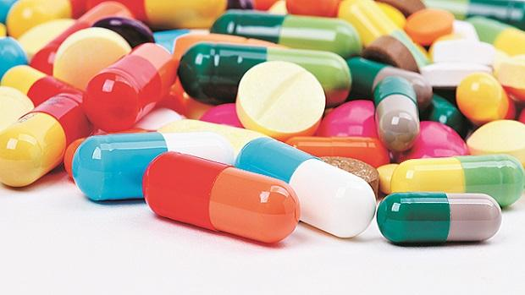
Drug Allergy
Vuong Nayima, D.O.
Internal Medicine Allergy/Immunology

Slide 2


Slide 3
Topics in Allergy/Immunology
Allergic Rhinitis (25%)
Asthma (8%)
Drug Allergy (35-50%)
Urticaria (20%)
Atopic Dermatitis (10-20%)
Food Allergy (8%)
Non-Allergic Rhinitis
Stinging Insect Allergy
Angioedema
Eosinophilic Esophagitis
Immune Deficiency
Pruritus
Anaphylaxis
Hereditary Angioedema
Contact Dermatitis
Urticarial Vasculitis
Mastocytosis
Exercise-Induced Bronchospasm
Innate Immunity
Adaptive Immunity
Neutropenia
Allergic Bronchopulmonary Aspergillosis
Allergy Diagnostics
Latex Allergy
Metal Allergy
Chronic Cough
Eosinophilic Esophagitis
Food protein-induced enterocolitis syndrome (FPIES)
Hypersensitivity pneumonitis
Human Microbiome
Nasal Polyps
Aspirin-exacerbated respiratory disease
Environmental and occupational pollutants
Hypereosinophilic syndrome

Slide 4

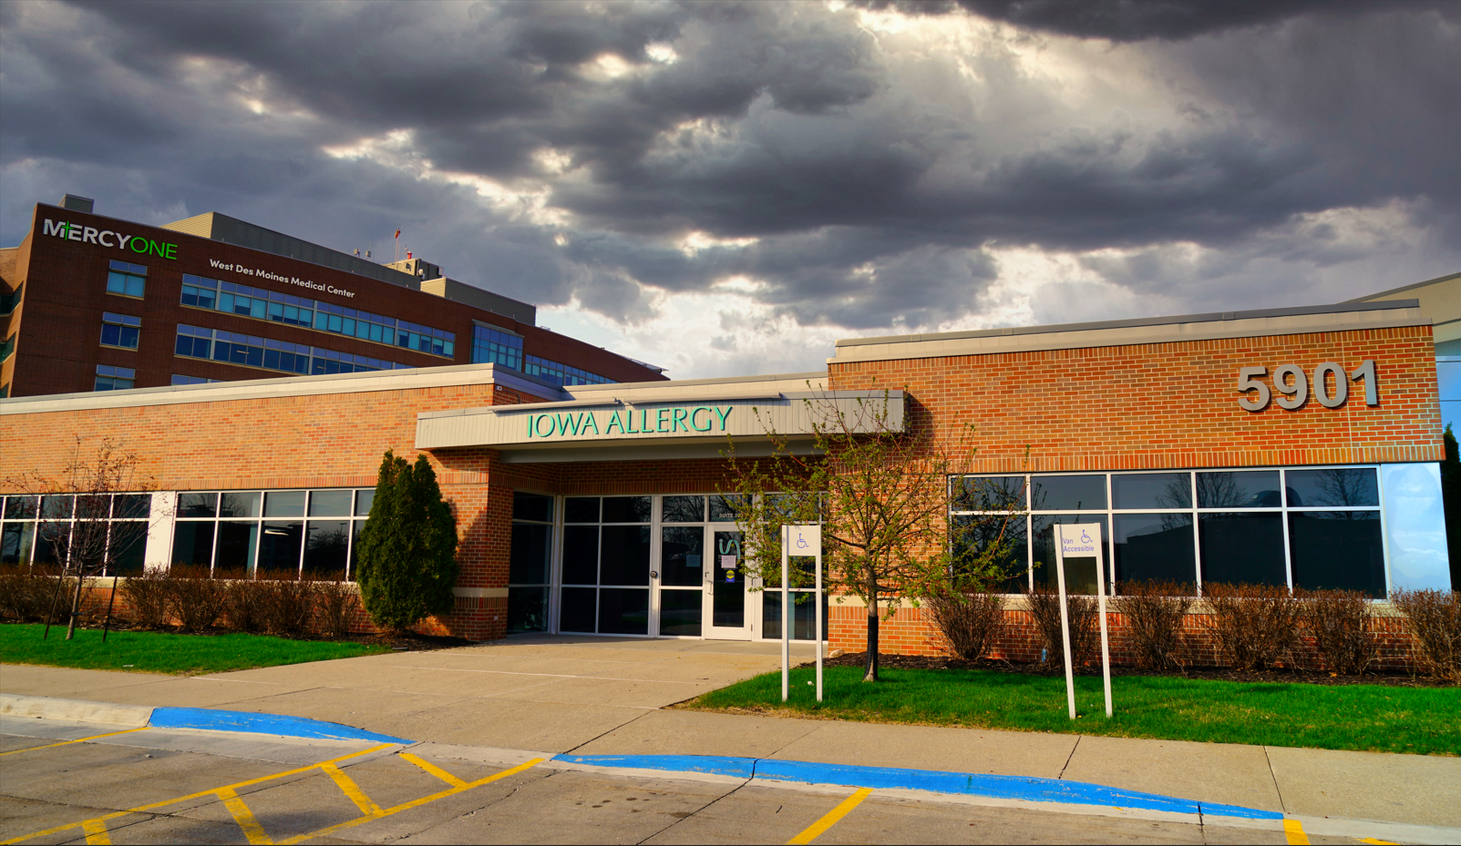
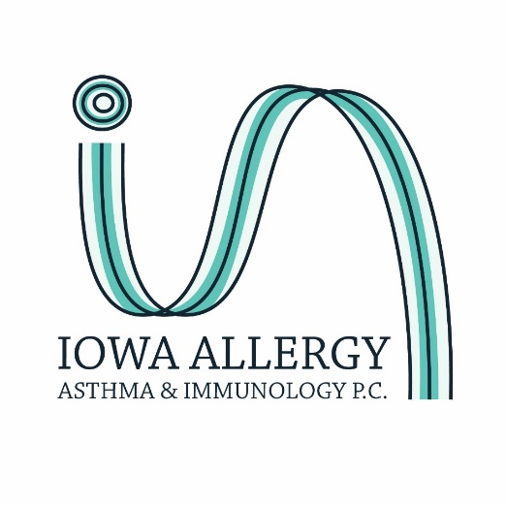
Ankeny
West Des Moines
Residents: Pediatrics, Family Practice, Internal Medicine

Slide 5
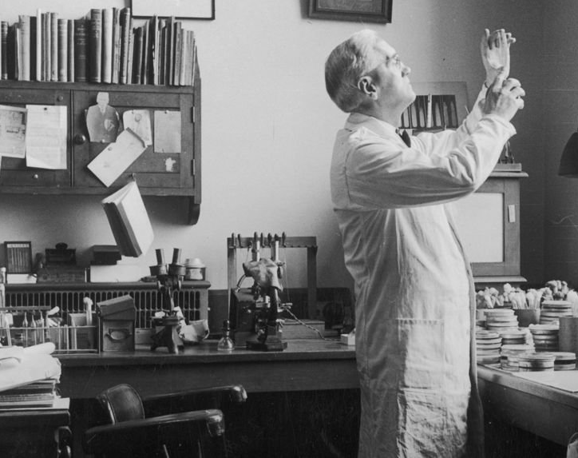
Penicillin History
Alexander Fleming (Scottish) discovered penicillin in 1928.
Fleming (described as careless) returned from vacation to find mold accidentally growing on staph culture plate.
Noticed the mold prevented the growth of staphylococci.

Slide 6
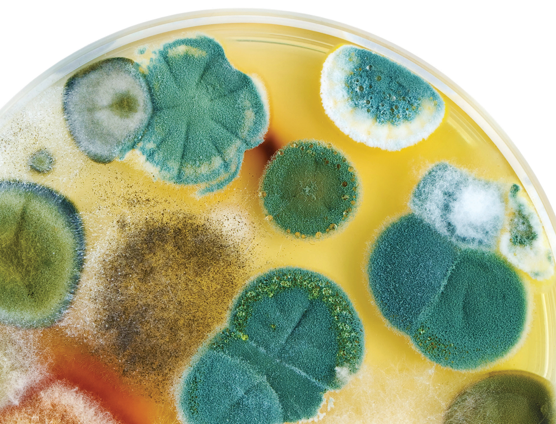
Penicillin History
Fleming described the colony as a “fluffy white mass which rapidly increases in size and after a few days sporulates” and changes color.

Slide 7
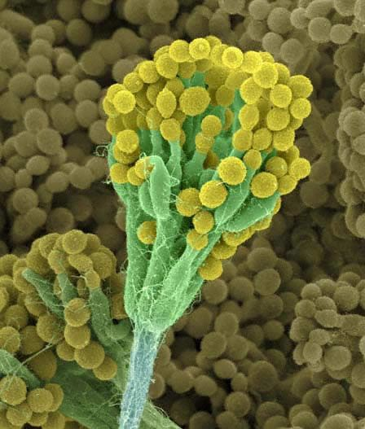
Penicillin History
Genus: Penicillium

Slide 8
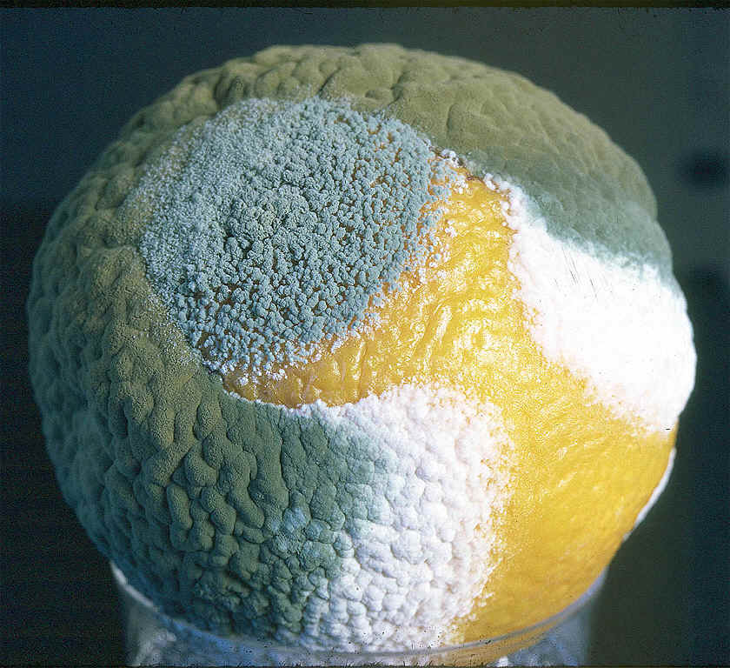
Penicillin History
“One sometimes finds what one is not looking for. When I woke up just after dawn on Sept. 28, 1928, I certainly didn’t plan to revolutionize all medicine by discovering the world’s first antibiotic, or bacteria killer. But I guess that was exactly what I did.”

Slide 9

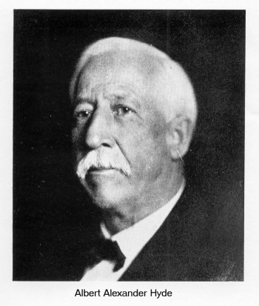
Penicillin History
First patient: In 1941, Albert Alexander (Oxford) scratched his face on a rose bush and became infected.
Injected with penicillin regularly over four days, greatly improved. Even with extracting penicillin from his urine and re-injecting it, supplies ran out before his cure was complete. Relapsed and died a month later.

Slide 10
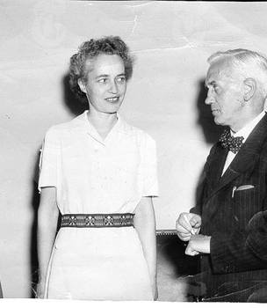
Penicillin History
1942
First American patient: Anne Miller. Septic after a miscarriage with high fever for weeks. Surgery and blood transfusions had not helped.
By chance, another patient at the same hospital knew a British scientist working on developing penicillin.

Slide 11

Penicillin History
Miller’s doctor used that connection to get the government to release 1 tablespoon of penicillin. Half of the entire store of antibiotic in the US at the time.
Within a day, her temperature was back to normal. Miller was cured.
Miller died at age 90 in 1999.

Slide 12
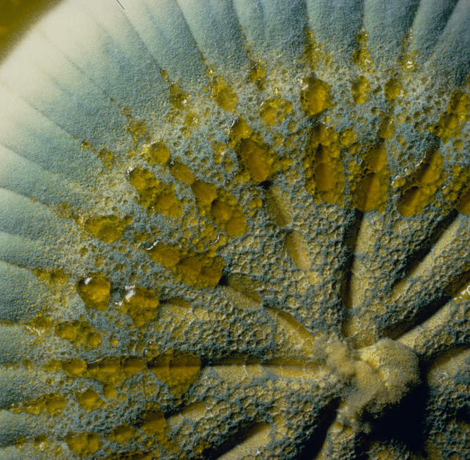
Penicillin History
Only 400 million units of penicillin available during first half of 1943
When WWII ended, U.S. companies were making 650 billion units a month

Slide 13
Why Do We Care About Penicillin History?
Reminder that many drugs (especially antibiotics) we have created were/are miracles, don’t take them for granted
Diagnosing or Misdiagnosing a drug allergy can be life-altering for a patient
IGNORING a drug allergy can also adversely affect patients

Slide 14
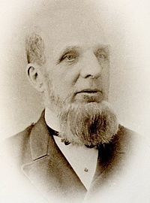
Skin Testing
First described in 1867 by Dr. Charles Blackley, skin tests (prick/puncture and intradermal/intracutaneous) have evolved as reliable, cost effective techniques for the diagnosis of IgE-mediated diseases. (B)
Prick/puncture tests are used to confirm clinical sensitivity induced by aeroallergens, foods, DRUGS, venom, and a few chemicals

Slide 15
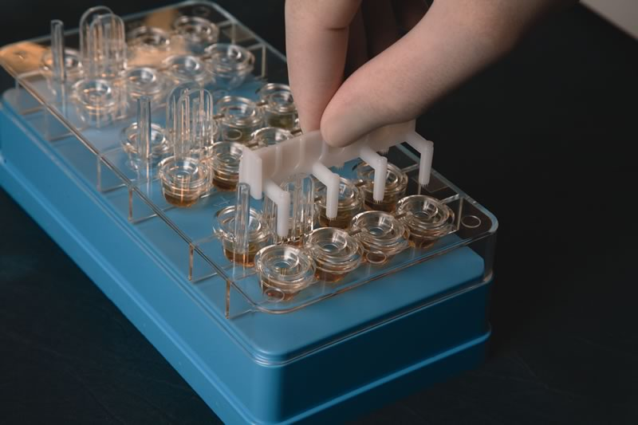

Slide 16
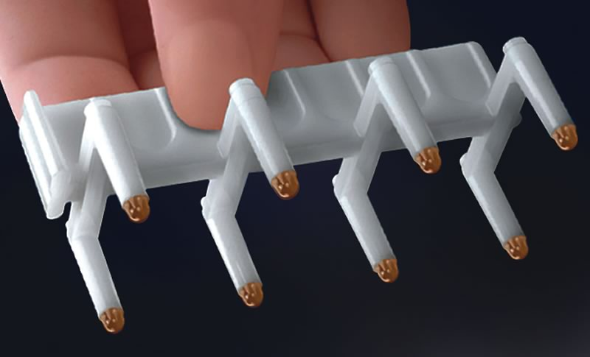
Multi-Test II

Slide 17
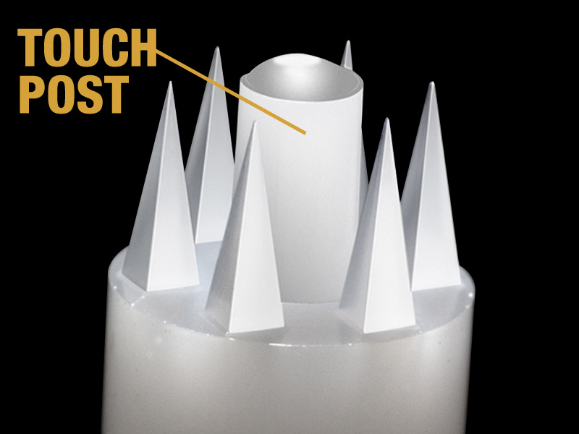

Slide 18
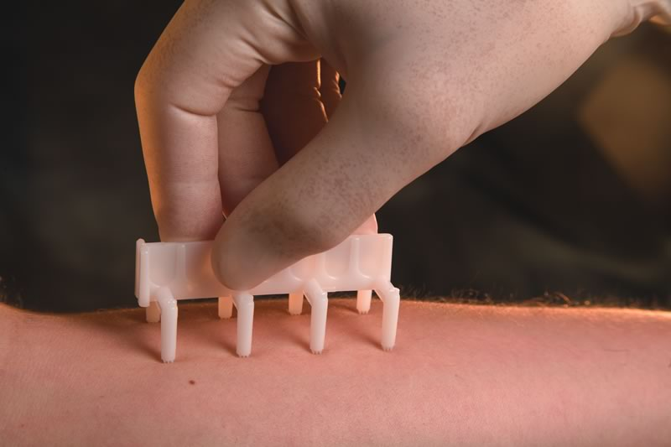
Prick/puncture tests are used to confirm clinical sensitivity induced by drugs, aeroallergens, foods, venom, and a few chemicals

Slide 19
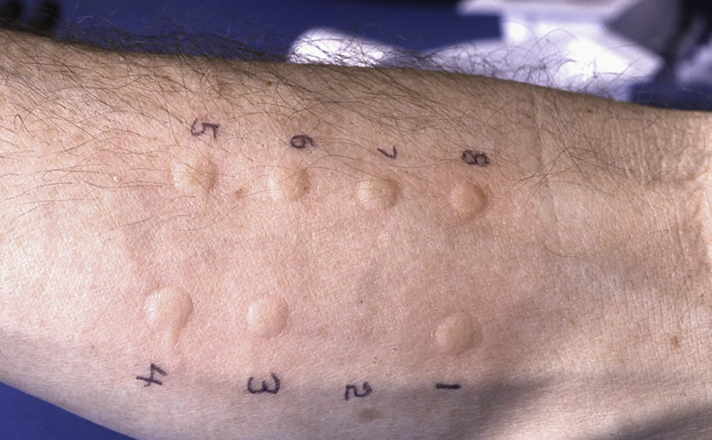

Slide 20
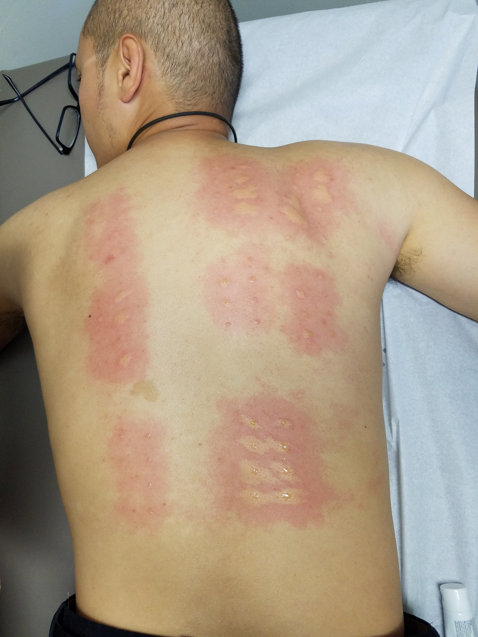
Real Life
Deaths have been reported from skin testing (extremely rare)

Slide 21
What does “Allergy” mean?
Everyone thinks they’re allergic to something
Careful about use of the word

Slide 22
My own definition
A clinically relevant, reproducible reaction to an antigen, involving the immune system

Slide 23
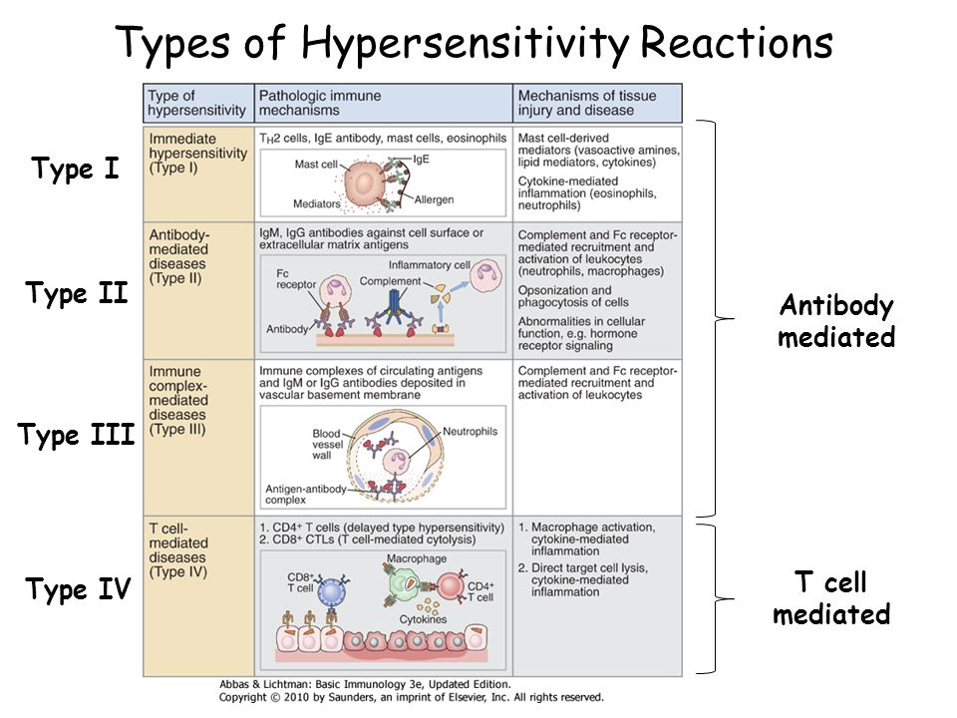
0
Timing?

Slide 24
Minutes to Hours
Minutes to Hours
Hours to Weeks
Days to Weeks

Slide 25
Drug Allergies
Initially one of my favorite topics
Easy? Sometimes
Different drug classes follow different rules
Is it a true “allergy” or adverse reaction/intolerance? Or reaction is from something else?
Validated testing available?
Risk/benefit of challenging/desensitization?
Probability of cross-reactivity for a given drug class?
Risk/benefit of alternatives?
Treating through severe reactions?

Slide 26
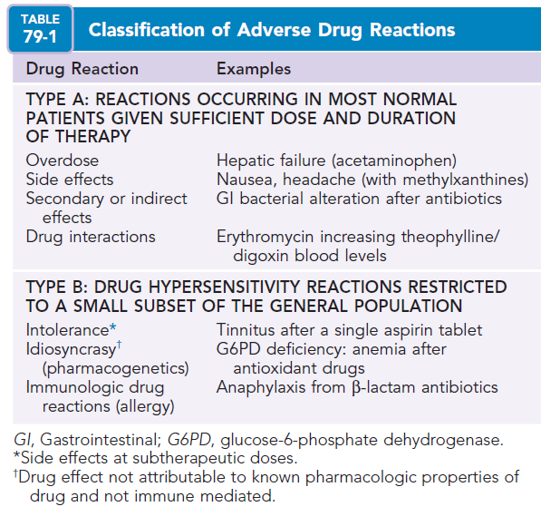
Generally Predictable
Generally UNPREDICTABLE

Slide 27
Generally Predictable Most Drug Reactions
Generally UNPREDICTABLE
Only 10% to 15% of all ADRs
“Allergy” only comprises of a small subset of drug reactions

Slide 28
Adverse Drug Reactions (ADRs)
ADRs have been reported to affect 10% to 20% of hospitalized patients and up to 25% of outpatients
In the US, about 1 of every 300 hospitalized patients dies from an ADR, and 6% to 10% of these reactions may be allergic in origin
What type of reaction (I-IV) is penicillin allergy?

Slide 29
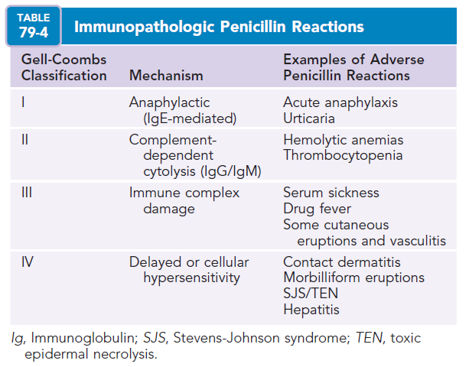

Slide 30
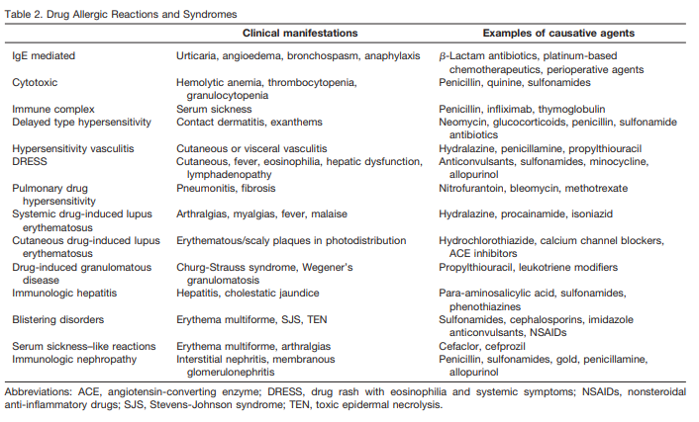

Slide 31
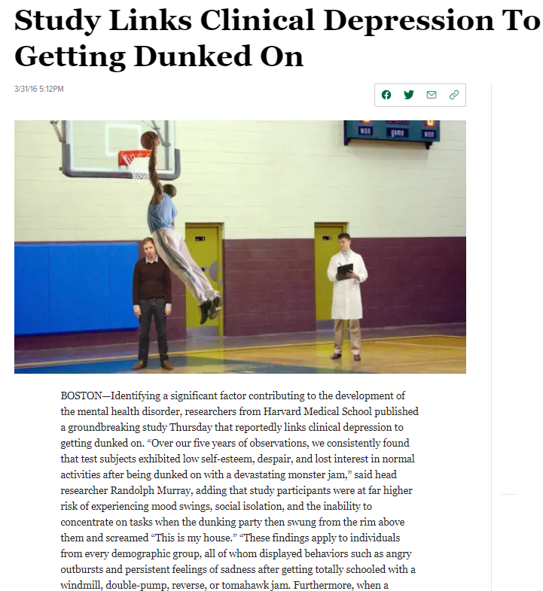

Slide 32
Drug Allergy?
Anyone learned this in school for your first H&P?
How many lectures have you sat through for drug allergy?
Isn’t it weird???

Slide 33
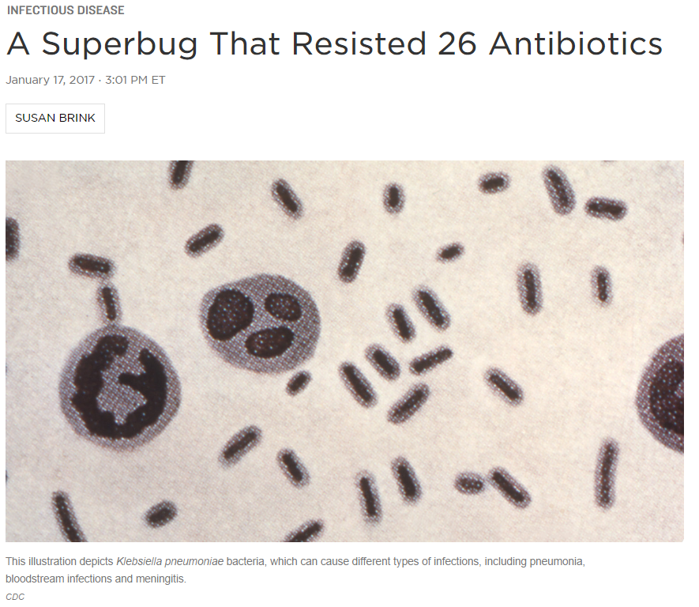
Why so Important?
Antibiotic Stewardship
Pan-Resistant New Delhi Metallo-Beta-Lactamase-Producing Klebsiella pneumoniae
Essentially all US antibiotics

Slide 34


1% percent of E. coli & Klebsiella carry the mcr-1 gene (transferable between bacterium)
Resistance to colistin

Slide 35
Not unique; 80% of antibiotics in the USA are used for livestock to speed growth
Overprescribing of antibiotics or using more broad spectrum antibiotics than necessary due to drug “allergies” contribute to the problem

Slide 36
Some countries (Mexico, Viet Nam, China, India, etc.) don’t require rx for antibiotics
Patients in these countries treat themselves to whichever antibiotic at whatever dose and duration they want
When we give in to patients for antibiotics or don’t attempt to clear their antibiotic allergy a similar phenomenon happens
News Flash: bacteria and their resistance travels globally

Slide 37
Why So Important? Side Effects
FDA 2016: serious side effects associated with fluoroquinolone antibacterial drugs generally outweigh the benefits for patients with acute sinusitis, acute bronchitis, and uncomplicated UTIs who have other treatment options
Fluoroquinolones should be reserved for those who do not have alternative treatment options

Slide 38
Why So Important? Side Effects
Associated with disabling and potentially permanent serious side effects that can occur together include:
tendon rupture
blood sugar fluctuations
muscle/joint pain
peripheral neuropathy
depression/psychosis
memory impairment/disorientation
cardiac arrhythmias
phototoxicity
Side effects had continued for an average of 14 months to as long as 9 years after stopping the medication

Slide 39

Till I Collapse
Women are caught in webs, spin 'em and hock venom Adrenaline shots of penicillin could not get the illin' to stop Amoxicillin's just not real enough

Slide 40
Why So Important? Works better and is first line for most infections – Indeed penicillin CAN get the illin’ to stop
Penicillin first line:
Strep (pharyngitis, endocarditis, CAP, etc.)
MSSA
Syphilis
Otitis Media
Meningitis
H pylori
Intra-abdominal infections
List goes on

Slide 41
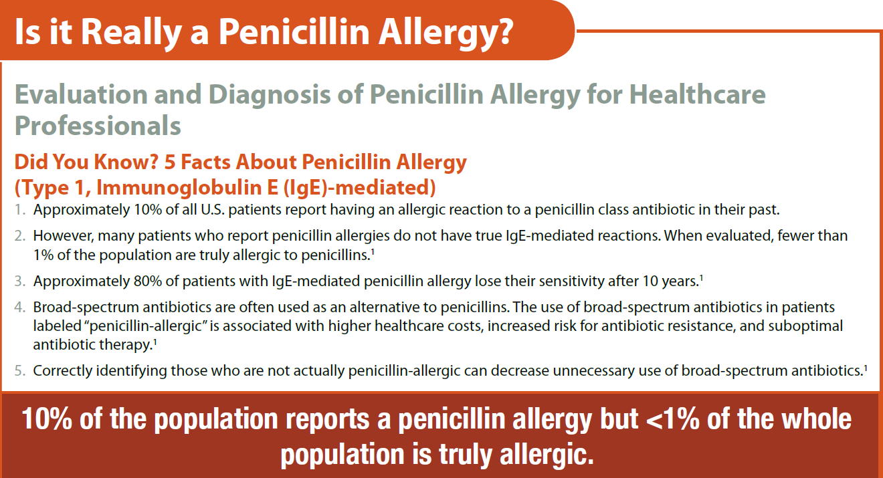

Slide 42
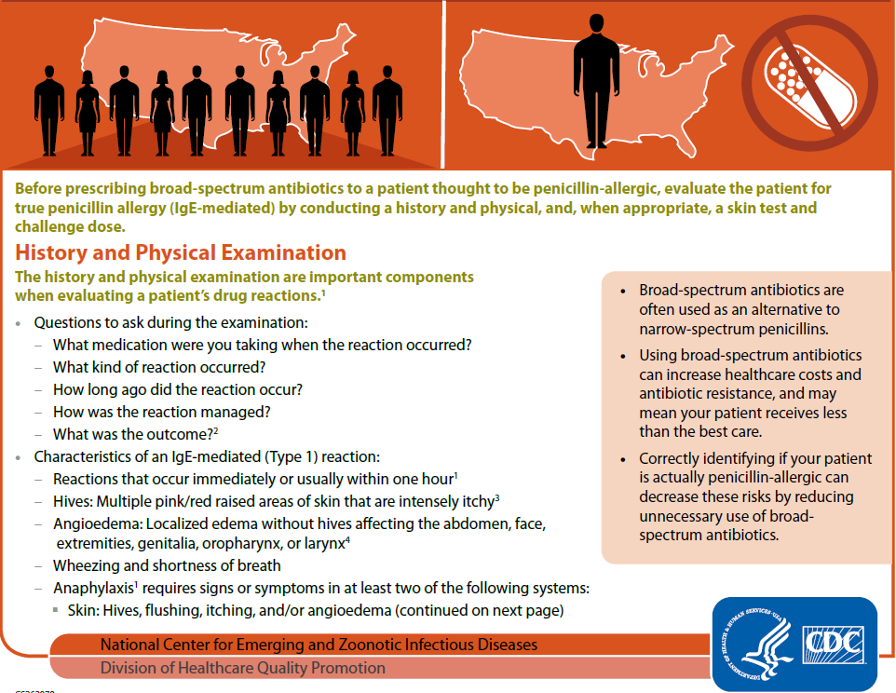

Slide 43
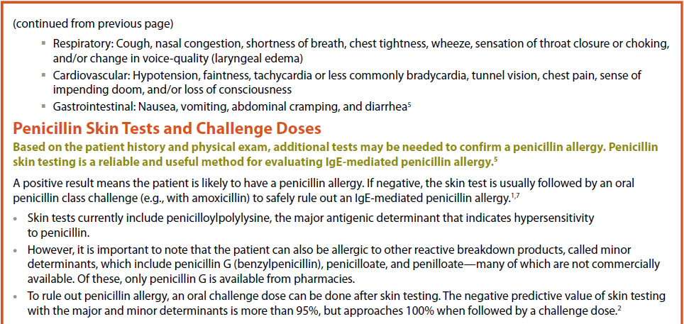

Slide 44
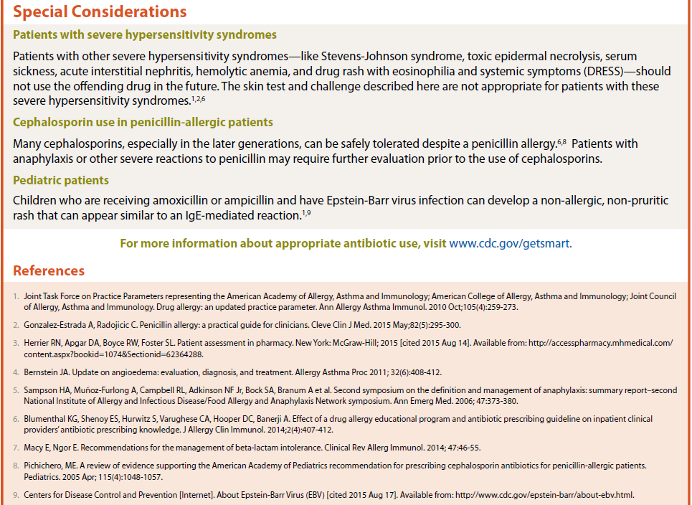

Slide 45

Penicillin Allergy
Study at American College of Allergy, Asthma & Immunology 2016
Surveyed inpatient providers from different specialties regarding penicillin allergy. Total of 276 surveys
Clinical vignettes presented regarding penicillin allergy

Slide 46
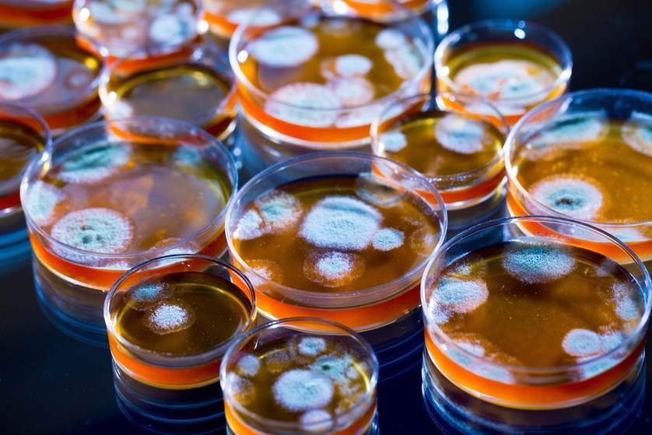
Penicillin Allergy
42.4% of respondents believed that penicillin allergy does not resolve over time
In the vignettes provided, only 20.0% identified appropriate patients for penicillin skin testing
How many here didn’t know that you can outgrow penicillin allergy?

Slide 47
Words From Other Physicians
“Once an allergy always an allergy”
“You’re allergic to penicillium (mold), you can’t take penicillin (drug) and need an epipen”
“You have a penicillin allergy but it’s up to you if you want to get tested and get it cleared”
“You’ll probably never need penicillin again”

Slide 48


The Immune System is NOT Static

Slide 49
Name the two criteria for referral for penicillin testing
1. History of penicillin allergy
2. Possess skin
An “allergy” is often a permanent thing on a patient’s chart unless someone actively addresses it
What if you don’t have skin?
Usually someone will raise their hand at this time during lecture. To ask?

Slide 50
Elective Penicillin Skin Testing – Co$t Savings
236 outpatients
83% penicillin skin test-negative
Average antibiotic cost per penicillin skin test-negative patient
$71.17 during year before penicillin skin test
$49.63 during year after penicillin skin test
P value = 0.0001
Macy E. JACI 1998; 102:281-5

Slide 51
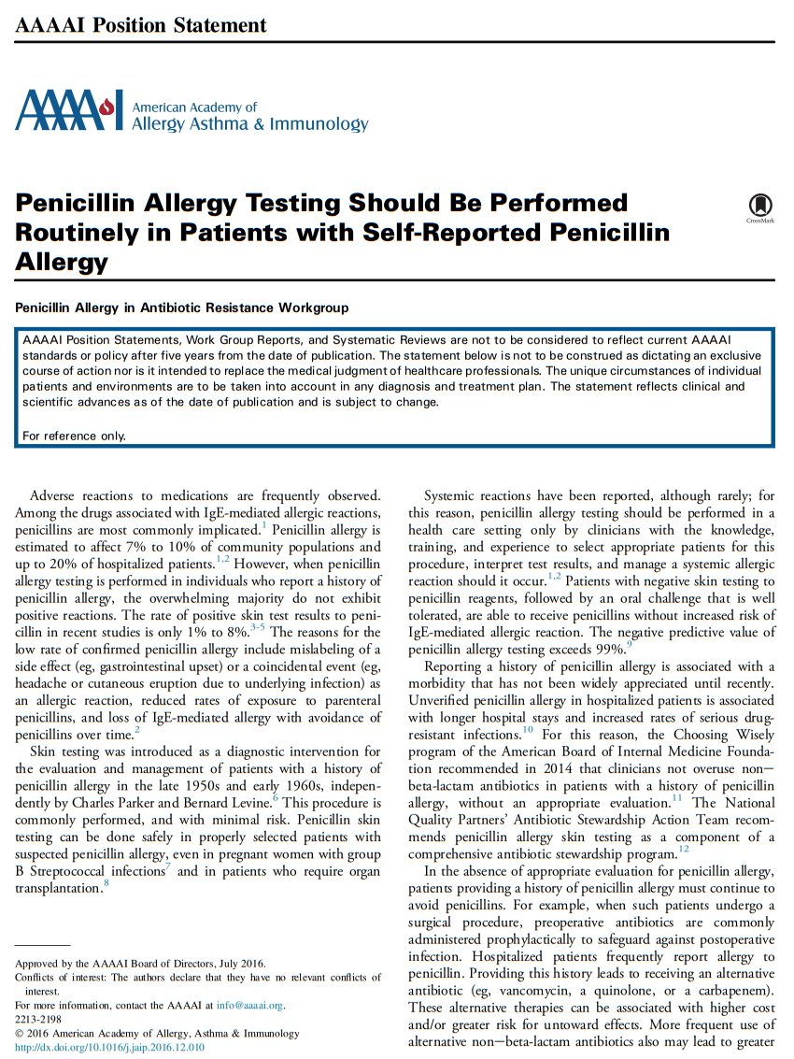

Slide 52
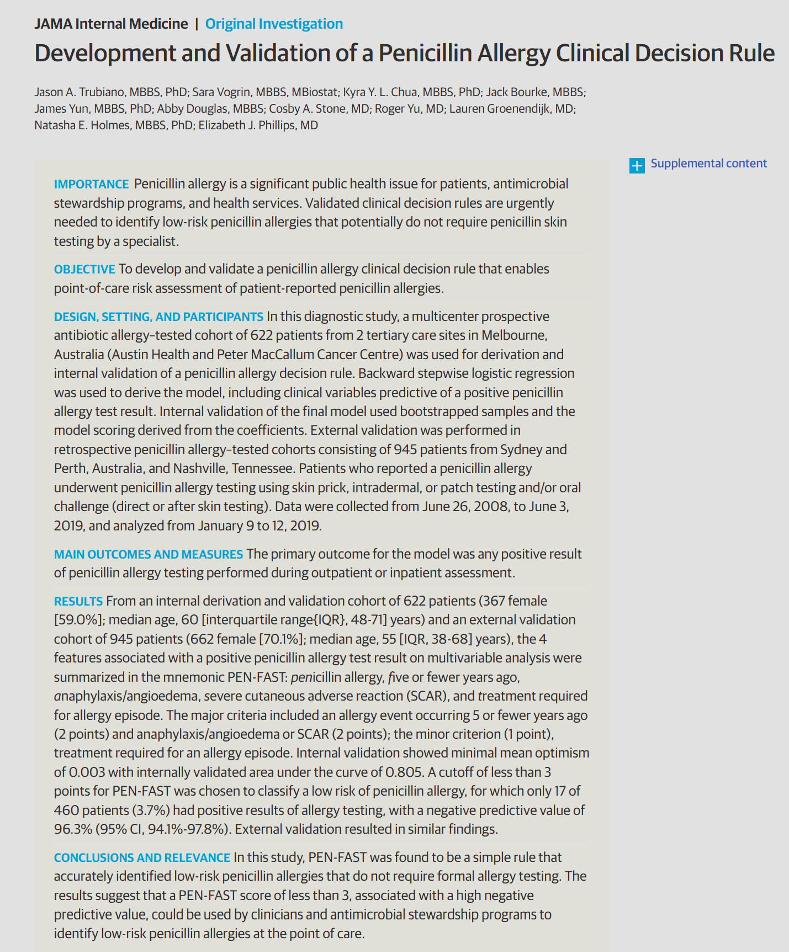
©2020

Slide 53
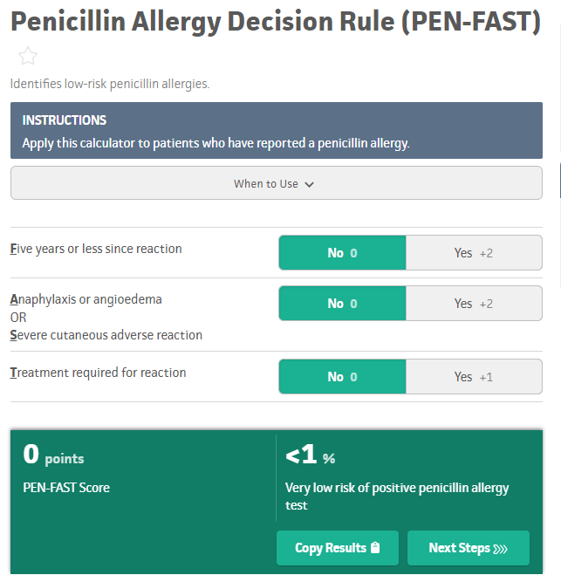
PEN-FAST score of less than 3 is associated with a high negative predictive value, can identify low-risk penicillin allergies that can potentially skip skin testing and go directly to oral challenge in a primary care setting
What is a challenge?

Slide 54
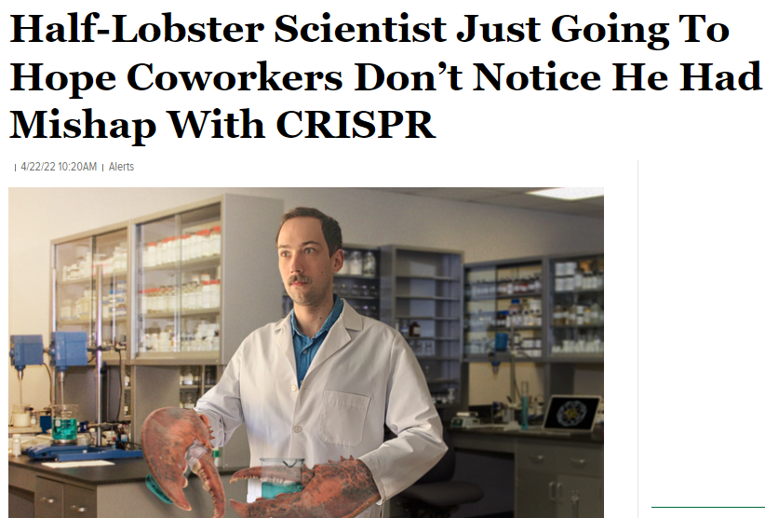
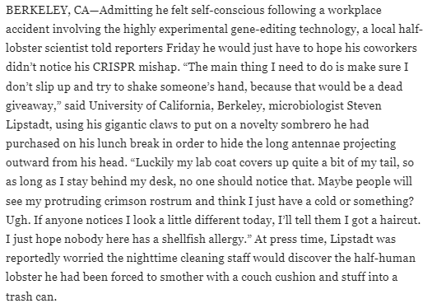

Slide 55
DRESS Syndrome- Drug Rash with Eosinophilia and Systemic Symptoms
Type IV reaction
Major cause of hospitalization for dermatological complications in patients treated with anticonvulsants ( also NSAIDs, antibiotics, allopurinol, etc.)
Incidence of 1 in 1000-10,000 per exposure to offending drugs
Typically occur within 2 to 6 weeks after initiating drug therapy
Fatal in 5-10% of cases

Slide 56
DRESS Syndrome- Drug Rash with Eosinophilia and Systemic Symptoms
Common presentation: fever, rash and lymphadenopathy
Common labs: eosinophilia, leukocytosis and lymphocytosis
Liver involvement range from a transitory increase in LFTs to fulminant hepatic failure
Other potentially fatal complications are hypersensitivity myocarditis, pericarditis, pneumonitis, nephritis

Slide 57
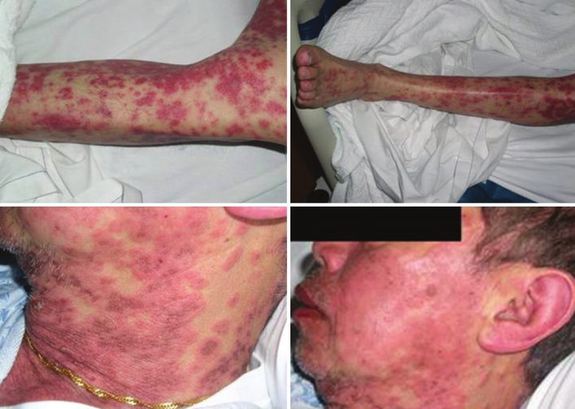
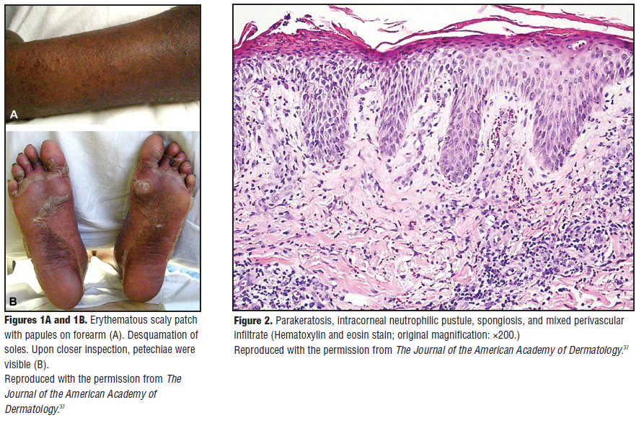
Drug rash with eosinophilia and systemic symptoms syndrome due to anti-TB medication. Kaswala
J Family Med Prim Care 2013

Slide 58
Most Common Cause of Fatal Anaphylaxis?
A) Medications
B) Venom (bees, wasps, hornets, fire ant)
C) Food
D) Environmental/chemical (pollen, mold, latex)
E) Other/Idiopathic
Surprising? Why?

Slide 59
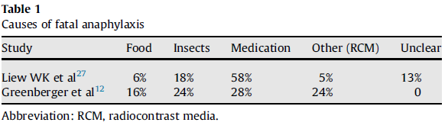

Slide 60
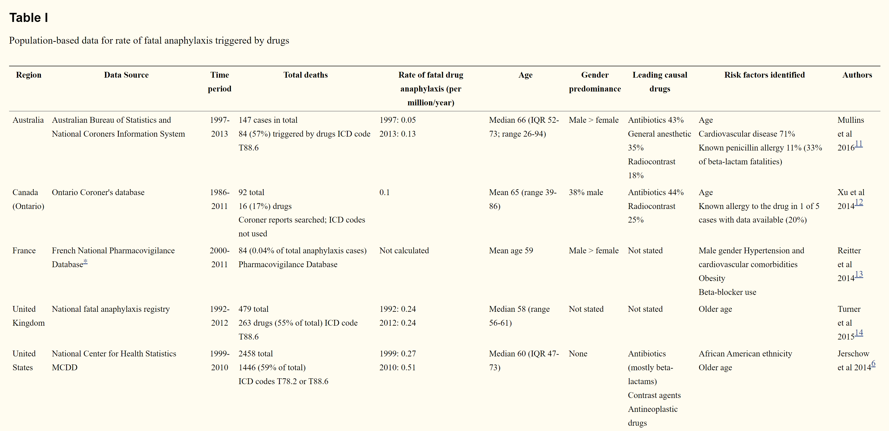

Slide 61


Slide 62
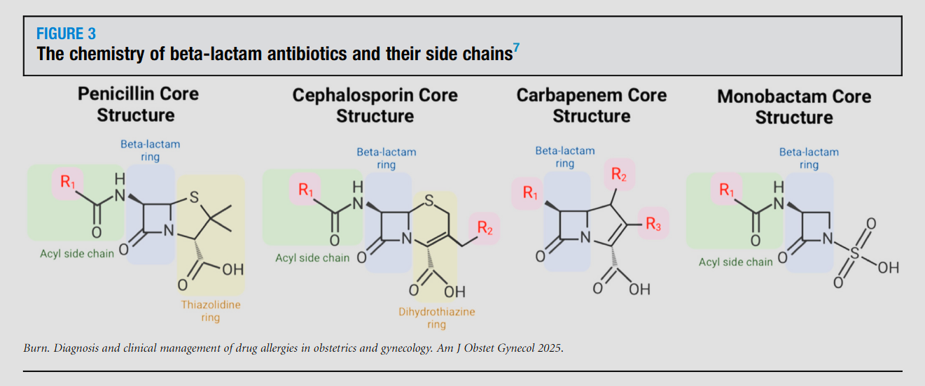
Cephalosporin Administration to Patients With a History of Penicillin Allergy? (IgE)

Slide 63
Cross-reactivity
Cross-reactivity between penicillins and 1st and early (before 1980) 2nd gen cephalosporins has been reported to occur in up to 10% of penicillin allergic patients
3rd gen; 2–3 % of penicillin-allergic patients
However, contamination of these early cephalosporins with trace amounts of benzylpenicillin resulted in overestimation of cross-reactivity
Anecdotally false

Slide 64
Cross-reactivity
Meta-analysis of between 1966 and 2005, comparing reactions to cephalosporins in penicillin-allergic and non-penicillin-allergic patients
Significant increase (OR = 4.8) in allergic reactions to all 1st gen cephalosporins (e.g. cephalothin, cephaloridine, cephalexin), but NO increase with 2nd or 3rd gen cephalosporins
There are many other studies with slightly different cross-reactivity rates
Who do you listen to??

Slide 65
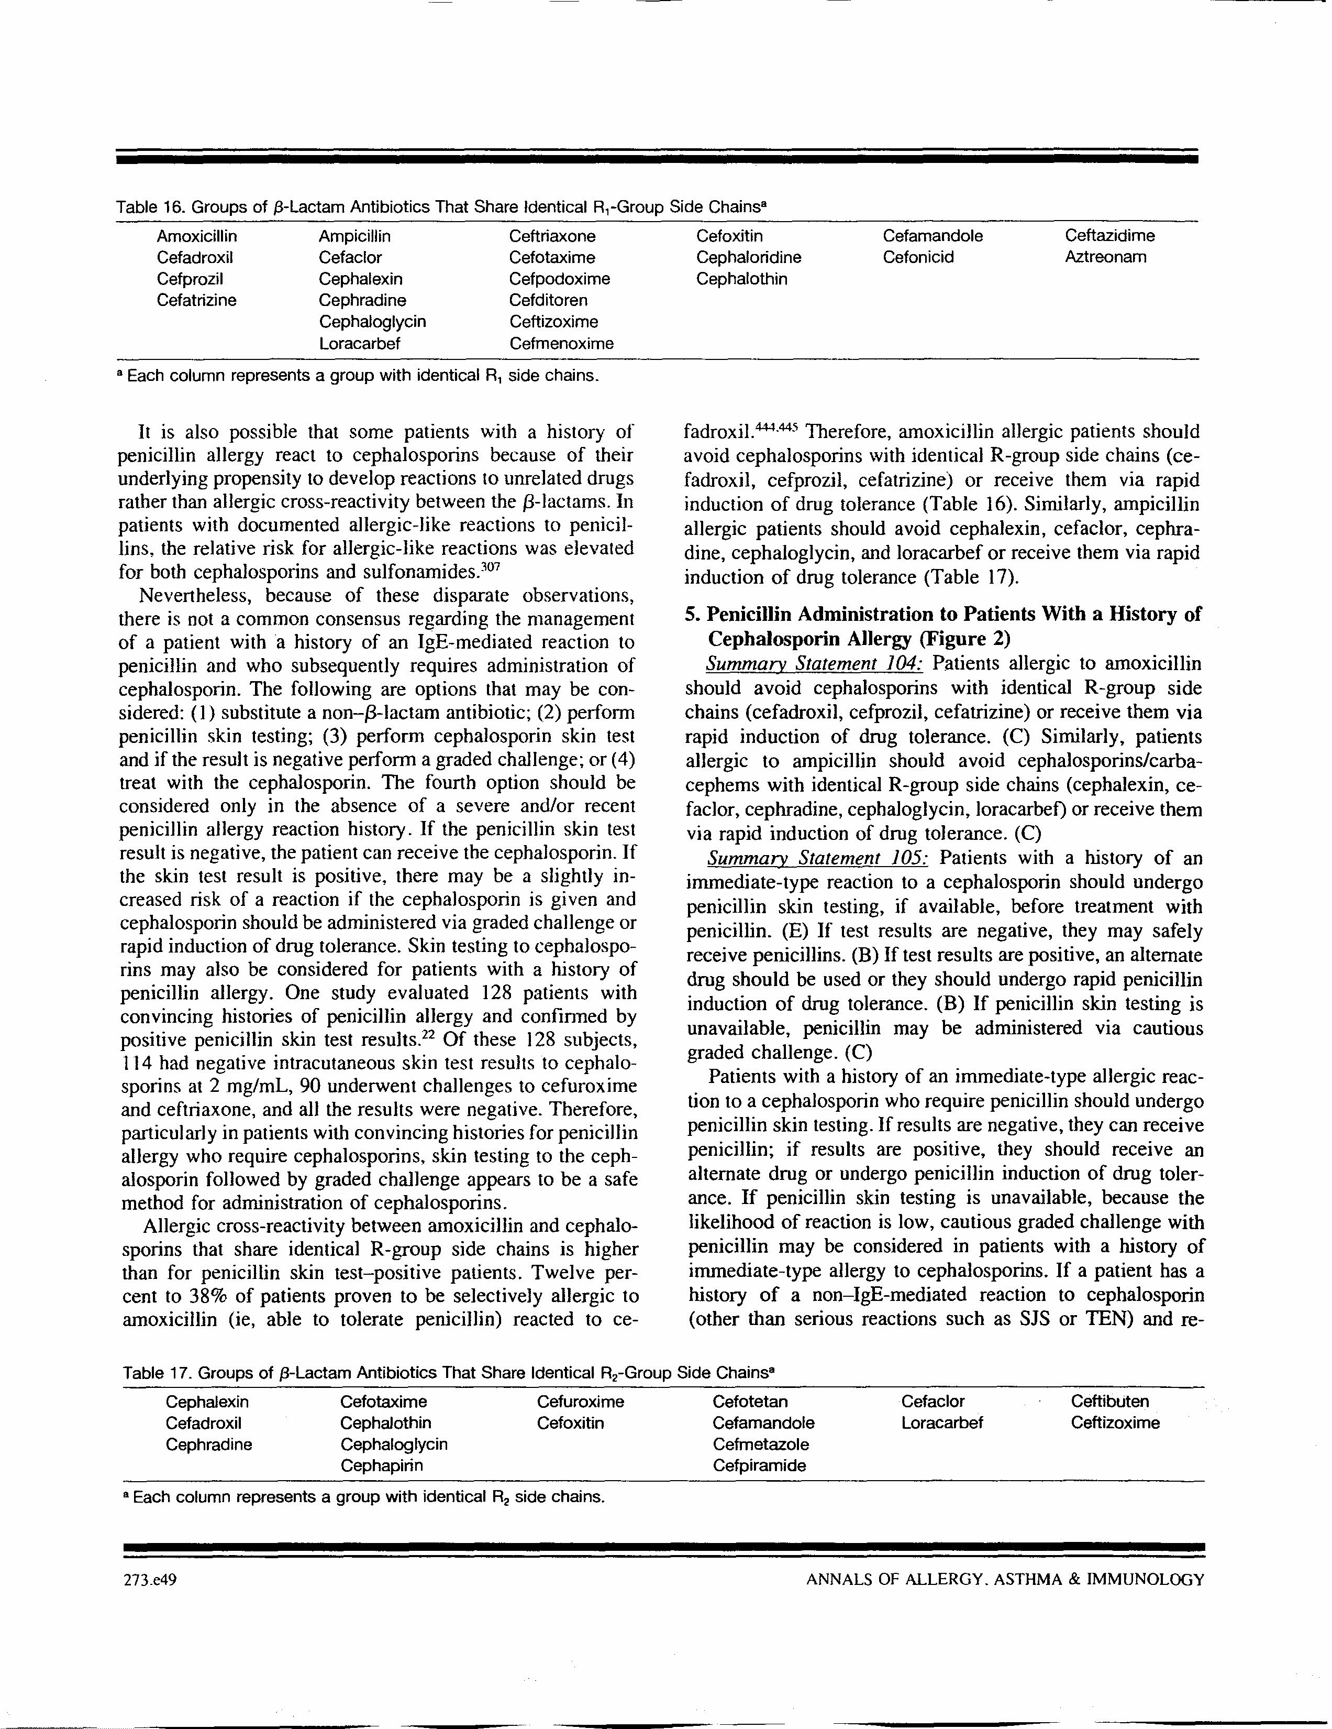
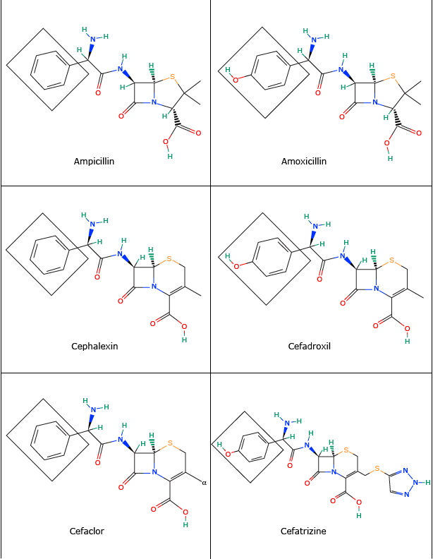
Cross-reactivity rates as high as 30% when identical/similar side chains

Slide 66


Slide 67
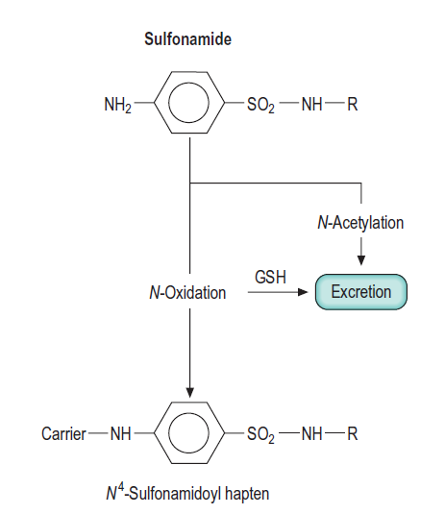
Sulfa Allergy: Can’t take other “sulfa” drugs?
Sulfonamide antimicrobials (e.g. sulfamethoxazole, sulfadiazine, sulfisoxazole, sulfacetamide) have certain structures
Metabolism yields the predominant N4-sulfonamidoyl hapten

Slide 68
Sulfa Allergy: Can’t take other “sulfa” drugs?

Slide 69
Sulfa Allergy: Can’t take other “sulfa” drugs?
Nonantibacterial sulfonamides often called sulfonamide derivatives since derived from sulfonamide antibacterials
No studies to support the contraindications and warnings
New drugs with sulfonamide structures often given “sulfa class effect” warning

Slide 70
Drug Allergy: An Updated Practice Parameter 2010
There is no evidence to suggest allergic cross-reactivity between sulfonamide antibiotics and nonantibiotic sulfonamides. (C)
Absence of cross-reactivity between sulfonamide antibiotics and sulfonamide nonantibiotics. Strom et al, NEJM 2003:
Retrospective cohort study from pool of 8 million patients in the UK
Of 969 patients with an allergic reaction after a sulfonamide antibiotic, 96 (9.9%) had an allergic reaction after subsequently receiving a sulfonamide nonantibiotic
Of 19,257 who had no allergic reaction after a sulfonamide antibiotic, 315 (1.6%) had an allergic reaction after receiving a sulfonamide nonantibiotic
CROSS-REACTIVITY??

Slide 71
Conclusion
Allergy to a sulfonamide antibiotic increases rate of allergic reaction to sulfonamide nonantibiotic, but this association appears to be due to a predisposition to allergic reactions in general rather than to cross-reactivity with sulfonamide-based drugs
This confounds many studies on drug allergy; patients predisposed to drug allergies (multiple drug allergy syndrome)

Slide 72


Slide 73
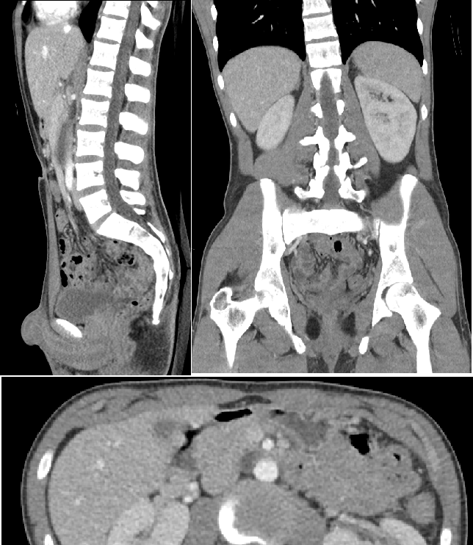
Radiocontrast Media Anaphylactoid Reactions
RCM reactions occur 1% to 3% of patients who receive ionic radiocontrast media and less than 0.5% of patients who receive nonionic agents
Severe life-threatening reactions occur in 0.22% of patients receiving ionic RCM and 0.04% of patients receiving nonionic RCM

Slide 74
Radiocontrast Media Anaphylactoid Reactions
Risk factors for anaphylactoid reactions to RCM
Female sex, asthma, history of previous anaphylactoid reaction to RCM
Beta-blocker exposure and/or cardiovascular conditions has greater risk for more serious reactions

Slide 75

Radiocontrast Media Anaphylactoid Reactions
No convincing evidence that individuals with seafood allergy are at elevated risk for reaction to RCM compared with the general population
The pathogenesis of anaphylactoid reactions is unrelated to iodine. Rates of reactions to low-osmolar contrast agents are significantly lower than rates observed with conventional contrast, content of iodine is similar

Slide 76
Radiocontrast Media Anaphylactoid Reactions
Management of a patient who requires RCM and has had a prior anaphylactoid reaction to RCM includes the following:
(1) determine whether the study is essential
(2) determine that the patient understands the risks
(3) ensure proper hydration
(4) use a nonionic, iso-osmolar RCM, especially in high-risk patients (asthmatic patients, patients taking beta-blockers and those with cardiovascular disease)
(5) use a pretreatment regimen that has been documented to be successful in preventing most reactions
One reported regimen consists of prednisone, 50 mg, at 13, 7, and 1 hour before the procedure; diphenhydramine, 50 mg, at 1 hour before the procedure; and either ephedrine, 25 mg, or albuterol, 4 mg, at 1 hour before the procedure

Slide 77
Malpractice Award in Iowa
2015: 40-year-old Carrie DeJongh, who died on June 9, 2015 while receiving a CT scan awarded a $29.5 million verdict by Sioux County jury
DeJongh was at the center to receive a CT scan. She had an allergic reaction to the contrast dye given to her for the scan and went into anaphylactic shock and lost consciousness
Doctor administering the scan gave DeJongh Benadryl but failed to immediately take her vital signs and did not administer epinephrine, which could have reversed her anaphylactic shock, attorney stated

Slide 78
Radiocontrast Media Anaphylactoid Reactions
Delayed reactions to RCM, occurring between 1 hour and 1 week after administration, occur in approximately 2% of patients. Usually mild, self-limited cutaneous eruptions and do not require any treatment. Although SJS, DRESS, TEN can occur

Slide 79
Aspirin/NSAIDs – anaphylaxis or anaphylactoid
Aspirin/NSAIDs can cause a spectrum of drug allergic reactions;
Exacerbation of underlying respiratory disease (aberrant arachidonic acid metabolism)
Urticaria/angioedema (may or may not cross-react depending on mechanism)
Anaphylaxis (generally no cross-reactivity between NSAIDs)
Rarely pneumonitis and meningitis
Selective COX-2 inhibitors are generally well tolerated in patients with chronic idiopathic urticaria, although there may be rare exceptions

Slide 80


Slide 81
Steroid allergy- possible?
Yes!
First documented allergy to CS in the 1950s to topical and injected hydrocortisone
CS allergy following topical application ranges from 0.2% to 5% (contact dermatitis)
Reactions (anaphylaxis) following systemic use of CS about 0.1%
ABCD classification system of CS based on structural and clinical characteristics determine cross-reactivity rates

Slide 82
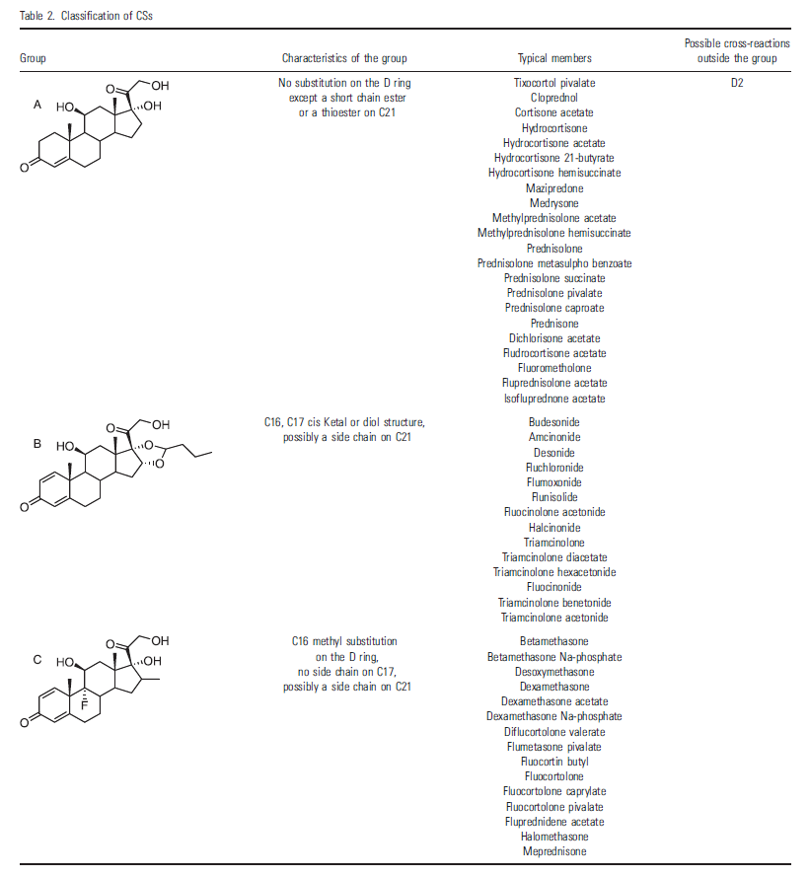
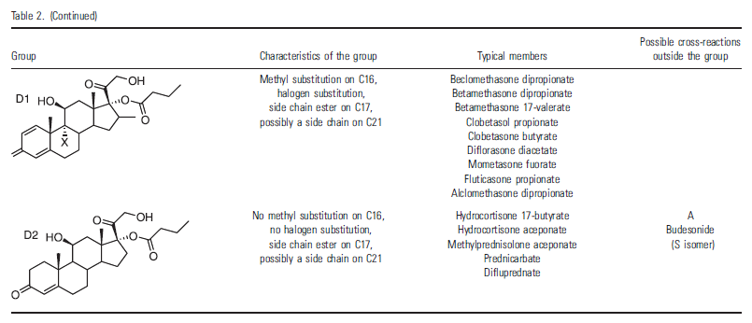

Slide 83
Steroid allergy- possible?
Summary Statement 140: Most reported reactions to corticosteroids involved intravenous methylprednisolone and hydrocortisone, and preservatives and diluents have also been implicated. (C)

Slide 84
Antihistamine allergy possible?
Yes!
Rare: 104 cases identified between 1949 – 2013, which included:
Urticaria
Angioedema
Anaphylaxis
Fixed drug eruptions
Allergic contact
Photosensitive dermatitis
Generalized nonspecific rashes

Slide 85

Local Anesthetic Allergy
Most adverse reactions to local anesthetics are not due to IgE-mediated mechanisms but are due to nonallergic factors
vasovagal responses
anxiety
toxic reactions including dysrhythmias
idiosyncratic reactions due to inadvertent IV epinephrine
Documentation of IgE-mediated reactions is extremely rare

Slide 86
Local Anesthetic Allergy
Summary Statement 145: To exclude the rare possibility of an IgE-mediated reaction to local anesthetics, skin testing and graded challenge can be performed in patients who present with a reaction history suggestive of possible IgE-mediated allergy to these drugs. (B)

Slide 87
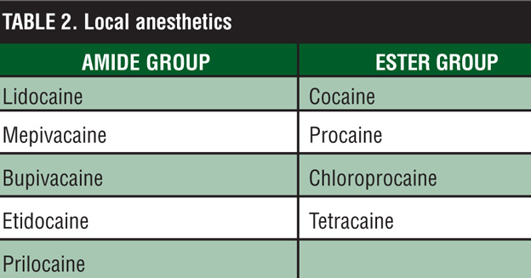
Local Anesthetic Allergy
Local anesthetics are either group 1 benzoic acid esters or group 2 amides
On the basis of patch testing, the esters cross-react with each other, but they do not cross-react with amide drugs. Unknown relevance this has on immediate-type reactions to local anesthetics
Testing reagent should not contain epinephrine or other additives, such as parabens or sulfites

Slide 88


Slide 89
Gadolinium-based Contrast Allergy
112 immediate hypersensitivity reactions (0.079%) of 141,623 total doses
Among the 6 evaluated MR contrast media, gadodiamide had the lowest rate (0.013%) of immediate hypersensitivity reactions, while gadobenate dimeglumine had the highest rate (0.22%)
Risk factors
Female patients
Allergies
Asthma
Higher frequency of exposure to MR contrast
Patients with a previous history of immediate hypersensitivity reactions had a 30% recurrence after re-exposure to MR contrast

Slide 90
Gadolinium-based Contrast Allergy
The most common symptom was urticaria (91.1%), and anaphylaxis occurred in 11 cases (9.8%). The mortality rate was 0.0007% because of one fatality.
76yo F w/hypotension, dyspnea, nausea, and decreased consciousness after gadobutrol injection. Died despite prompt cardiopulmonary resuscitation
Breakdown of reactions
Mild reactions – 83%
Moderate reactions – 7.1%
Severe reactions – 9.8%
The over incidence of mild, moderate, and severe reactions – are 0.066%, 0.006%, and 0.008%, respectively

Slide 91
Gadolinium-based Adverse Reactions
Mild reactions are the most common clinical manifestation
Rate between 0.07% and 2.4%
Rash, itch, cough, hives, sneezing, nasal stuffiness, mild eye swelling, mild facial swelling, vomiting, nausea, perspiration, warmth, anxiety, flushing, altered taste
Moderate reactions
rate between 0.004%–0.7%
Dyspnea, bronchospasm, symptomatic tachycardia, symptomatic bradycardia, mild laryngeal edema, hypotension

Slide 92
Gadolinium-based Adverse Reactions
Severe reactions endangering patient’s life
rate bewteen 0.001%–0.01%
Severe respiratory distress, responsiveness, arrhythmia, convulsion, cardiopulmonary arrest, progressive angioedema, marked hypotension

Slide 93
Fluoroquinolone Allergy?

