Slide 1
Oncologic and Hematologic Emergencies
Amy McGraw, PA-C
Mission Cancer + Blood, part of University of Iowa Health Care

Slide 2
Oncologic Emergencies
Neurologic:
Increased intracranial pressure
Spinal cord compression
Metabolic:
Tumor lysis syndrome
Hypercalcemia
Syndrome of Inappropriate AHD (SIADH)
Cardiac:
Superior Vena Cava Syndrome
Malignant effusions

Slide 3
Neurologic
Increased intracranial pressure
Spinal cord compression

Slide 4
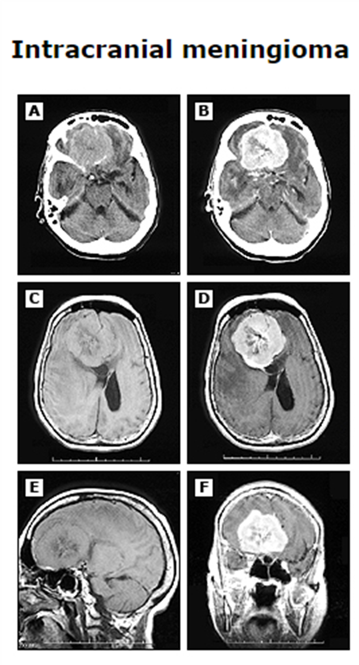
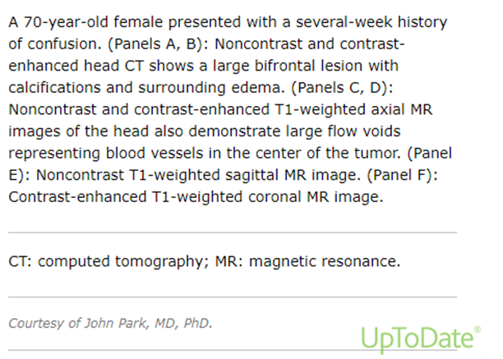
Increased ICP secondary to brain tumor (primary or metastatic)
Increased Intracranial Pressure (ICP)
Highly variable presentation
Headache, nausea, vomiting, seizures, vision changes, weakness
Physical exam findings
Neurologic deficits: including sensory or motor changes, seizures.
Diagnosis
CT scan
MRI Brain
Tissue sampling

Slide 5
Increased ICP secondary to brain tumor
Imaging findings
Midline shift, vasogenic edema, mass effect, effacement of sulci, etc.
Treatment:
corticosteroids to reduce intracranial swelling/pressure, Neurosurgery consult for interventions as needed.
Anti- seizure medication (IE Keppra)
Rad onc consultation

Slide 6
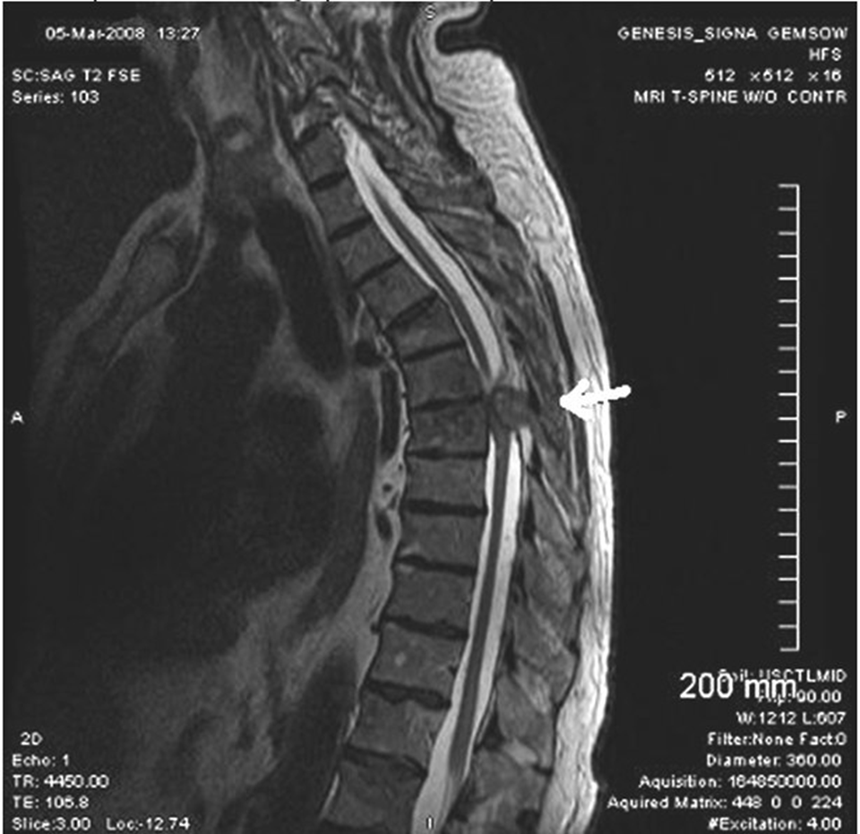
Malignant Spinal Cord Compression
High degree of clinical suspicion in all cancer patients (more likely solid tumors, however hematologic process possible)
Back pain – presenting symptom in up to 95% of patients
Motor and sensory neurologic findings
Weakness, neuropathy
Incontinence and saddle anesthesia in cauda equina lesion

Slide 7
Malignant Spinal Cord Compression
Evaluation
Urgent recognition to prevent permanent damage
MRI is gold standard imaging modality
Treatment
Corticosteroids
Emergent neurosurgical consultation
Emergent radiation oncology consultation
Possible chemotherapy (if indicated)

Slide 8
Metabolic
Tumor Lysis Syndrome (TLS)
Hypercalcemia
SIADH

Slide 9
Tumor Lysis Syndrome
Common malignancy related implications when initiating treatment– Lymphoma, Leukemia, SCLC
Massive tumor cell lysis and release of uric acid, phosphate and potassium into circulation with resulting decrease in calcium
Elevated Uric acid
Elevated phosphorus
Elevated potassium
Decreased calcium
This results in damage to renal tissue, specifically deposition of uric acid/calcium phosphate in renal tubules leading to acute renal injury

Slide 10
Tumor Lysis Syndrome
Prevention
Identification of risk (malignant process and high burden of disease vs. low burden)
Underlying renal disease/neoplastic process/markers
Allopurinol ppx, IVF ppx
Treatment
Aggressive IV hydration
Urinary alkalinization – bicarbonate to increase uric acid excretion
Hypouricemic agents – allopurinol, rasburicase (IV)

Slide 11
Hypercalcemia of Malignancy
Tumor secretion of Parathyroid related protein (PTHrP) (Humoral Hypercalcemia)
Increased bone resorption and increased renal tubular calcium reabsorption
Most common cause in nonmetastatic solid tumors and NHL
SCC, RCC, bladder, breast, lung, ovarian, prostate, colorectal
NHL, CML, leukemia, lymphoma
Bone mets
Tumors produce factors that increase osteoclast production, results in bone resorption
breast cancer most common
Also - Multiple myeloma
Tumor production of 1,25-dihydroxyvitamin D
Hodgkin’s Lymphoma
Ectopic PTH secretion
Rare
Other causes
Coexisting Primary hyperparathyroidism
High dose antiestrogens (IE tamoxifen, fulvestrant, anastrozole)
Notes:
3 major mechanisms (ectopic tumoral secretion of PTH is rare)
Labs: Elevated serum PTHrP, very low / suppressed PTH (endogenous PTH is suppressed by PTHrP-mediated hypercalcemia), variable calcitriol

Slide 12
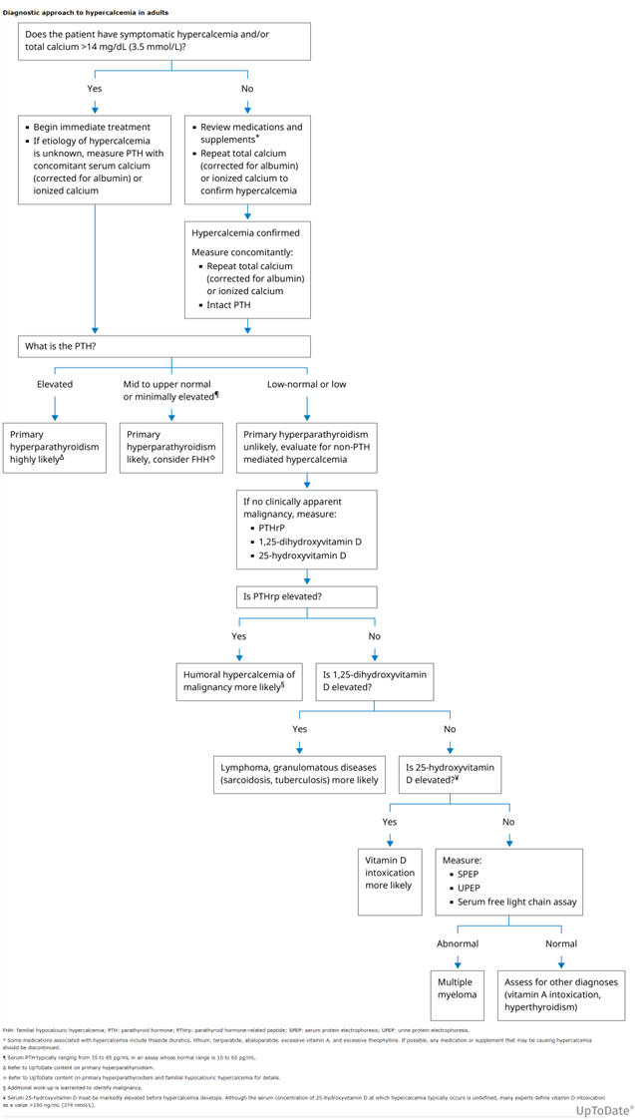
Hypercalcemia of Malignancy
Always correct calcium with albumin, whether high, low or normal reading
MD Calc!
See Algorithm

Slide 13
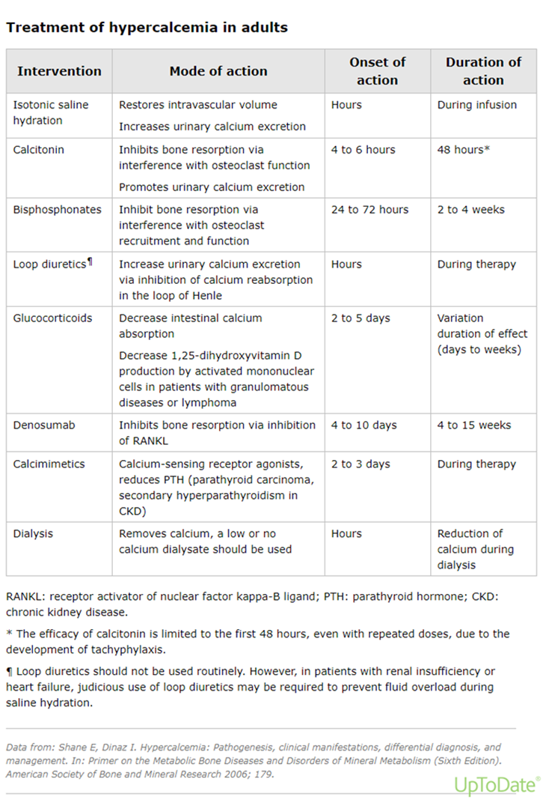
Hypercalcemia of Malignancy
Indications to treat: symptoms of any kind or asymptomatic with serum calcium >14 mg/dL
Symptoms of hypercalcemia
Polyuria, polydipsia, dehydration, anorexia, nausea, muscle weakness, and changes in sensorium
Saline Hydration, Calcitonin, Bisphosphonates – renal dosing, Loop diuretics, Glucocorticoids, Denosumab, Calcimimetics, Dialysis

Slide 14
SIADH Syndrome of Inappropriate antidiuretic hormone secretion
Hyponatremia
Ectopic production of ADH by tumor
Most common SCLC
Less commonly seen with head/heck cancers, olfactory neuroblastoma, and extrapulmonary small cell carcinomas (neuroendocrine)

Slide 15
Cardiac
SVC Syndrome
Malignant Effusions

Slide 16
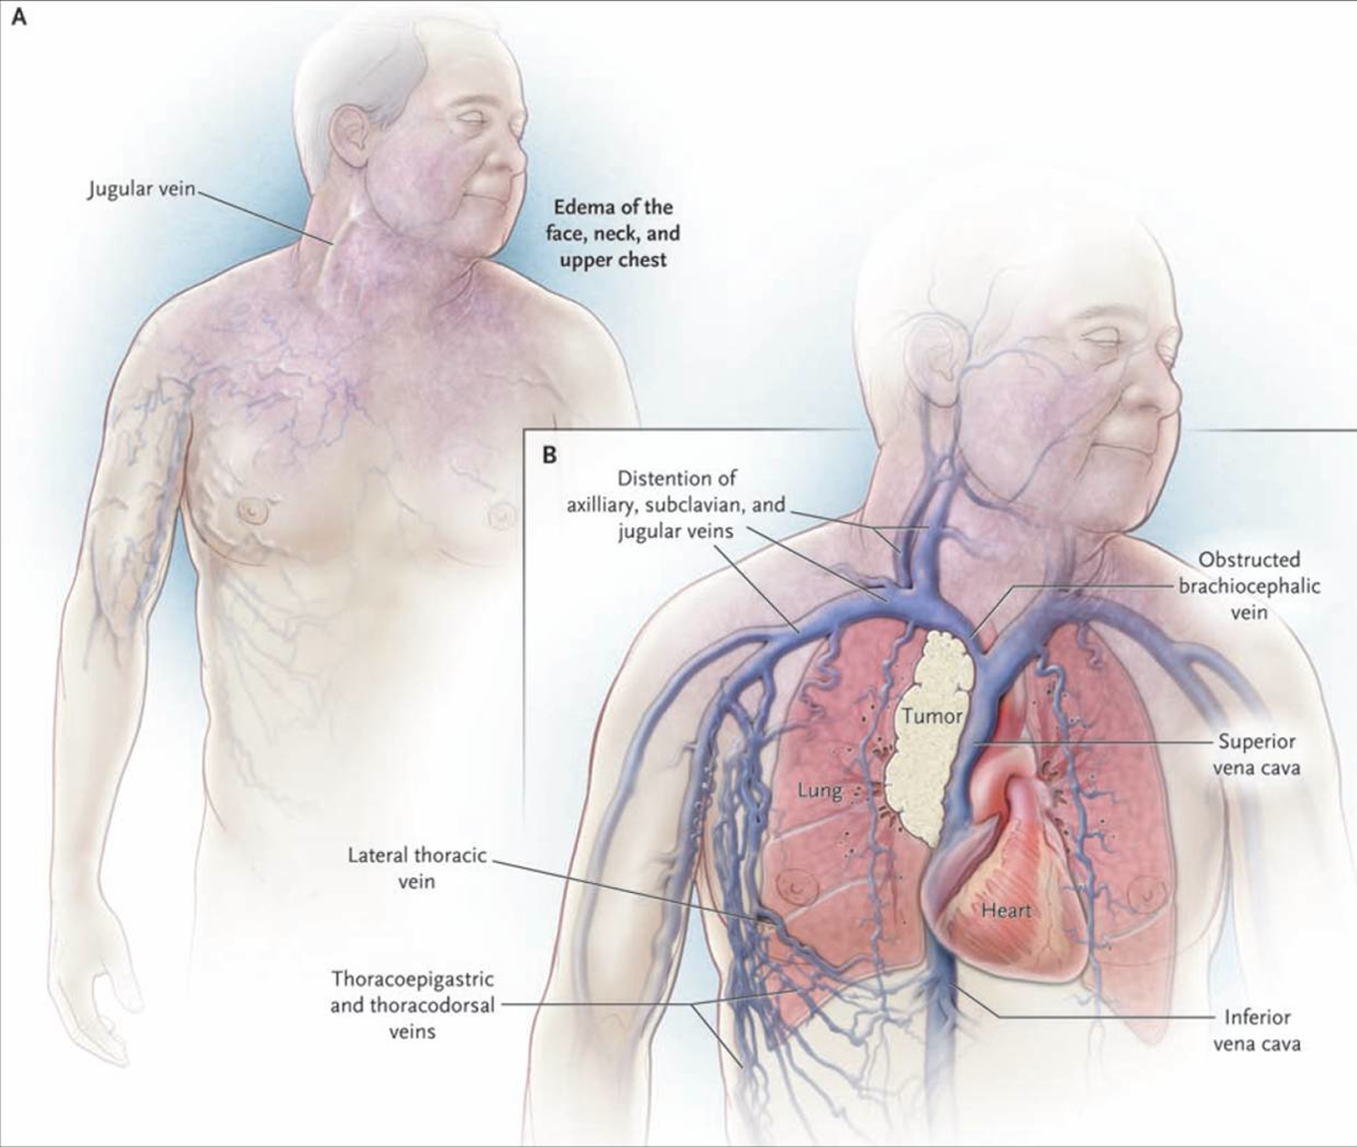
Superior Vena Cava (SVC) Syndrome
Pathophysiology
Direct invasion or external compression of SVC
Collateral veins arise from azygos, internal mammary, lateral thoracic, paraspinous or esophageal venous systems
Vessels dilate over several weeks
Increased central venous pressures can develop rapidly
Notes:
An obstructed SVC will initiate collateral venous return to the heart from the upper half of the body –

Slide 17
Superior Vena Cava (SVC) Syndrome Etiology
Intrathoracic malignancies (60-95% cases)
Lung Cancer: Non-small cell lung cancer, small cell lung cancer
Non-Hodgkin's Lymphomas
Generally due to extrinsic compression with adenopathy
Non-Malignant Causes (5-40%)
Thrombosis, iatrogenesis (pacemaker leads/venous access ports), infections
Fibrosing mediastinitis, post-radiation fibrosis

Slide 18
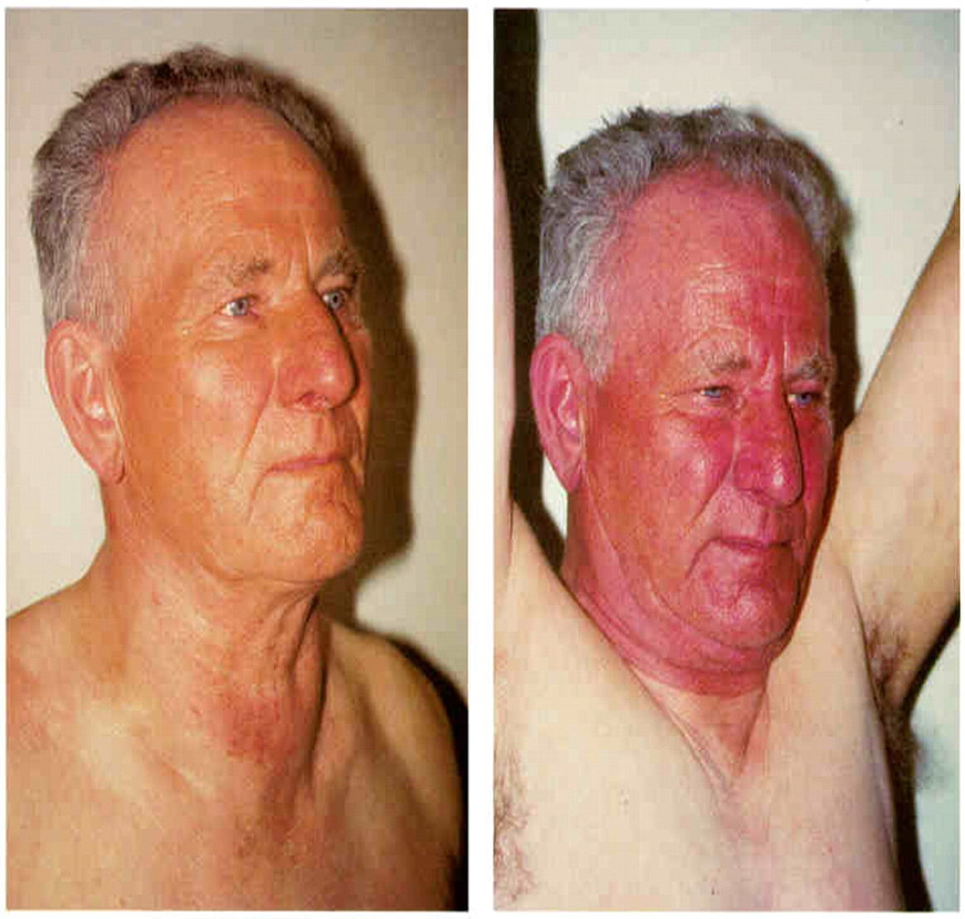
Superior Vena Cava (SVC) Syndrome Presentation
Signs and symptoms
Onset from days to weeks
Face/neck swelling, conjunctival suffusion, distended neck and chest veins
Cough, dyspnea, orthopnea, upper extremity swelling
Pemberton Sign — thoracic outlet restriction (see picture)
Notes:
Emergencyeducation.net

Slide 19
Superior Vena Cava (SVC) Syndrome Diagnosis
High clinical suspicion in known cancer patients
Clinical signs or symptoms of concern
Radiographic imaging
CT scan: Can define the cause, level of blockage, map collaterals (strong specificity and sensitivity)
Bilateral upper extremity venography – Gold Standard
Histologic diagnosis – clinical suspicion of primary process
Solid tumor
Sputum cytology, nodal biopsy
Bronchoscopy, IR guided biopsy,
Lymphoma: Consider marrow assessment if tissue difficult to obtain

Slide 20
Superior Vena Cava (SVC) Syndrome Treatment
Treatment of underlying process
Chemotherapy
Radiation + Chemotherapy
Emergent stent placement by IR to facilitate drainage
Elevation of head to support drainage
Glucocorticoids, consideration of diuretics
Thrombosis – anticoagulation
Iatrogenic – removal foreign object

Slide 21
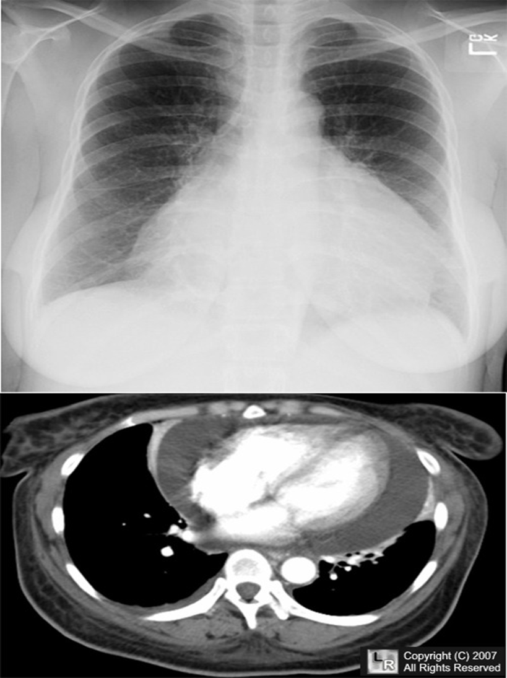
Pericardial Effusion
Associated with malignancy in ~13-23% of cases, sometimes this is the presenting sign
Presentation
Tamponade: Shortness of breath, chest discomfort, peripheral edema, fatigue
Without tamponade present, there are no consistent identifying signs or symptoms for pericardial effusion
Physical exam: sinus tachycardia, Beck’s triad (JVD, hypotension, muffled heart sounds)

Slide 22
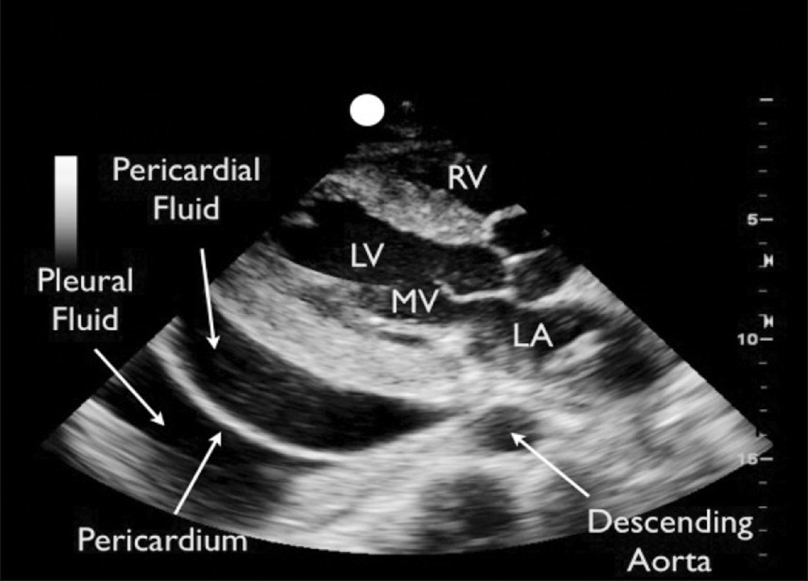
Pericardial Effusion Dx and Tx
Echocardiogram
Rapid diagnosis
Evaluation for right heart strain, tamponade
Consult cardiology for consideration of drainage
Emergent drainage vs. catheter drainage, pericardial window or balloon pericardiotomy
Notes:
Pericardiocentesis, pericardial window – removing a small part of the pericardium (sac surrounding the heart)

Slide 23
Malignant Pericardial Effusion Dx and Tx
EKG
Radiographic imaging – Echo, can use CT and MRI if needed
Pericardial fluid drainage
Cytology
Flow cytometry (Lymphoma, Leukemia)
Treatment directed at underlying cause

Slide 24
Hematologic Emergencies
Leukostasis
Febrile Neutropenia
Disseminated Intravascular Coagulation (DIC)

Slide 25
Leukostasis Systemic compromises due to stasis in microvasculature (tumor cell clogging)
Clinical presentation:
Hypoxia, headache, neurologic symptoms, fevers, AKI, priapism, bowel infarction, limb ischemia
Laboratory abnormalities:
Leukocytosis
Increased PT/PTT (coagulopathies/DIC)
Elevated serum potassium (destruction of leukemic blasts)
Thrombocytosis – automated counters because blast fragments can be counted as platelets – manual/PBS
TLS (elev uric acid, elev K, elev phos, dec Ca)
Hyperleukocytosis:
total white blood count >50,000-100,000/uL
Most common in AML, CML (blast crisis)
Less common in CLL, unless WBC >400,000
If untreated, mortality rate 20-40% at one week

Slide 26
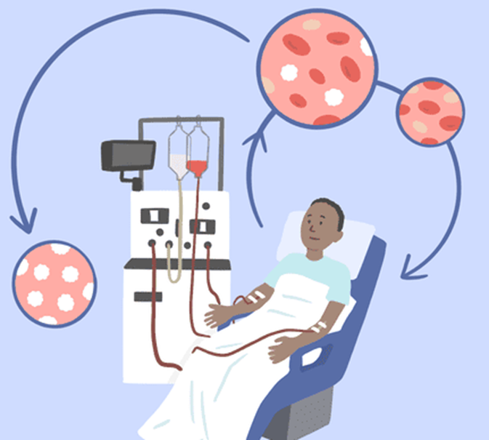
Leukostasis Tx
Cytoreduction
Hydroxyurea
Leukapheresis
Induction chemotherapy
Supportive care
Electrolyte monitoring
Transfusion as needed

Slide 27
Neutropenic Fever
Neutropenia is most common in patients undergoing chemotherapy with anticipated nadir of counts ~10-14 days after treatment
Patients with hematologic malignancies (leukemia and lymphoma) are at high risk of prolonged neutropenia secondary to the disease processes effect on blood counts in addition to chemotherapy treatment
Neutropenia : ANC < 0.5, or </=1.0 and anticipated decline
Fever: >/= 101⁰ F or >/= 100.4 for > 1 hour
Mortality rate if left untreated: 6.8-9.5%
Rapid identification and treatment cornerstone of care

Slide 28
Neutropenic Fever Treatment
Look for infectious cause
Pan-culture: urine culture, blood culture x 2
If indicated: Chest XR, respiratory film array, stool film array
Empiric IV Antibiotics
Cefepime or Zosyn +/- vancomycin

Slide 29
Disseminated Intravascular Coagulation (DIC) AKA Consumptive Coagulopathy
Hemorrhages / thromboses: Can present acutely vs subclinical / chronic depending on the cause
Most common causes: severe sepsis, malignancy, trauma, OB complications
Presentation / Symptoms:
Clots &/or bleeding from multiple sites – subsequent symptoms from these
Signs of end organ damage
PE findings:
Obvious bleeding, bruising, petechiae, purpura, jaundice, necrosis, gangrene, cyanosis
Respiratory failure, neuro deficits
Notes:
hypercoagulable state then consumes clotting factors / platelets in a positive feedback loop

Slide 30
DIC
It takes a combination of Hx, PE, labs to dx or rule out DIC!
Labs:
Decreased platelets
Increased prothrombin time (PT) and partial thromboplastin time (PTT)
Decreased fibrinogen
Elevated D-dimer
PBS may show schistocytes
End-organ damage (IE renal failure, transaminitis)

Slide 31
DIC Tx
TREAT THE UNDERLYING PROBLEM!
Transfusion support?
Platelets: generally, transfuse if <10k **
Threshold may change pending active bleeding or invasive procedure preparation
If Acute Promyelocytic Leukemia (APL), 50k is the threshold
Cryoprecipitate: fibrinogen <100
Unless APL is the cause, then give 10 units if <150
FFP pending PT/PTT
PRBCs pending Hgb and bleeding
Heparin?
If extensive clotting is present
If not actively bleeding, should receive ppx anticoagulation with heparin or LMWH

Slide 32

Thank you!
Amy McGraw, PA-C
amcgraw@missioncancer.com

Slide 33
Sources
Dr. Angela Sandre Mission Cancer + Blood, UIHC Oncologic Emergencies Resident lecture power point
Uptodate.com
Verywellhealth.com
Emergencyeducation.net
Cancergrace.org
ncbi.nlm.nih.gov/books/NBK441834/

