Slide 1
A-fib: A Potpourri of Presentations (and Alliterations) Perseverations on Palpitations
Thomas Benzoni, DO, AOBEM, FACEP
April 14, 2026 @ 1430
DMU Olsen Center

Slide 2
Declarations
Agency
none
COI
None
FDA/off-label
Likely
Rules of engagement
Adult conversation

Slide 3
Objectives / Concepts to be covered
A fib defined; anatomy and physiology
Types of A fib reviewed
Presentation: symptoms, consequences
Diagnosis/detection
Actions to be taken
Treatments/updates on therapy
New ideas to take home
This is clinical synthesis.
(With side trips and changes)

Slide 4
Order of the day
Review normal cardiac conduction: have a starting/reference point
Discuss the conduction alterations in A fib
Analyze the hemodynamic consequences of A fib conduction
Derive the physiologic results of A fib conduction
Know the logical results of A fib and of the interventions
Decide rate vs rhythm control and invasive procedures
Have a plan to pick up A fib more frequently and accurately
Hold on, we’ll get there (with frequent asides)

Slide 5
Normal cardiac conduction
Start at the beginning (of conduction)

Slide 6
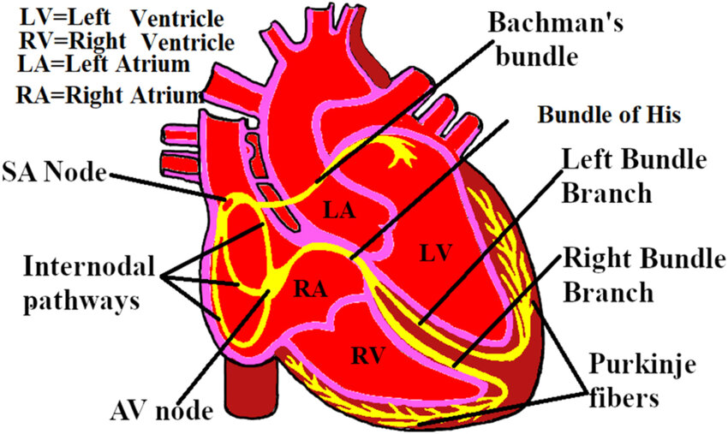
Source

Slide 7
Normal conduction/control of Heart rate
Specialized conduction tissue
Signal start at SA node
Sinoatrial: Sinus of the atrium
Carried to AV node
Via internodal pathways
Paused at AV node
“Placed on hold”
Conduction down His-Purkinje
Left and right bundles
Left splits; more territory to cover
Audience participation:
What is the heart’s innervation?
Sympathetic
Lower cervical, upper thoracic
Implication of cord transection
Parasympathetic (Vagus N )
Medulla oblongata (brainstem)
Effects of adrenal output
Pre a fib
Post a fib
Implications - an entire workshop

Slide 8
Conduction alterations in A fib
Heart’s shortcuts can be like many other….

Slide 9
Source

Slide 10
No SA node activity
Randomness governs:
~ atrial electrical activity
“Static electricity”
~ stimulation of AV node
~ conduction down main bundle
~ ventricular contractions
Audience participation:
What happens to atrial activity?
What does the radial pulse feel like?
What will a tracing show?
What will your dot phrase say?
Gotcha there!
How does the heart keep beating?

Slide 11
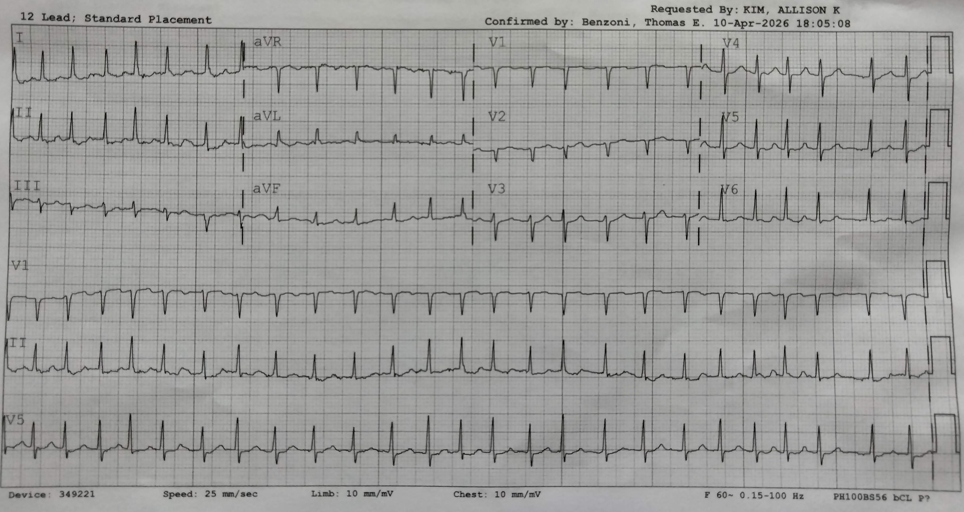

Slide 12
Hemodynamic consequences
What happens follows what happened.

Slide 13
Determinants of cardiac output
Cardiac output (CO) = SV x HR
Chamber volume
70% passive (diastolic) filling
30% atrial systolic filling
Loss of atrial “kick”
Stroke volume=(LVEDV-LVESV)
If LVEDV is lower, SV decreases
Random HR = Random CO
Audience participation:
What will you find on pulse palpation?
Might pulse amplitude vary beat-to-beat?
Does yours? Check now!

Slide 14
Physiologic results of A fib
These are predictable given the pathology.

Slide 15
What else happens absent atrial contraction?
Laminar flow, a review
A river flows swiftest at the center (unless rounding a bend.)
Eddy currents are on the edges.
Slowest flow
Occasionally reverse flow
Audience participation:
What happens to stagnant water?
Where in the heart will that occurrence take place?
What happens to blood that doesn’t move?

Slide 16
Logical results of A fib
You are where you are because that’s where you went.

Slide 17
Consequences of A fib
Derivative ideas
Cardiac reflexes
Carotid, vagal, etc.
Lack of atrial “kick”
Lower LVEDV effects on SV
Atrial laminar blood flow
Eddy currents at edges
Audience participation:
Getting used to this method?
What happens without nerves?
Carotid bulb? Mammalian diving?
Are you sure this is total?
Decreased LVEDV; now what?
Remember CO formula?
Eddy currents = stagnant blood
What structure is on the LA edge?

Slide 18
Available interventions
What you do depends on what they have…maybe.

Slide 19
Interventions
Problem identification
Absence of “atrial kick”
Decreases LVEDV
Clots (the biggy)
From sludging/eddy currents
Audience participation:
Prolong diastole
“Rate control”
Yup, even with hypotension.
“Rhythm control”
May not be permanent.
Address lack of atrial contraction
Cardiovert
Clots: anticoagulants, devices
DOACs
Auricle occlusion devices (ref)

Slide 20
Results of interventions
All actions have consequences; who bears them?

Slide 21
Interventions and consequences
Medical interventions
Rate control meds
Anticoagulants
Procedural interventions
Atrial occlusion
Ablation and similar procedures
Audience participation:
What are consequences of meds?
Beta blockers
Ca++ channel blockers
Anticoagulants
“Blood thinners”; viscosity unchanged
How do you decide to stop Rx?
Same as any Rx
What is the goal of the Rx?

Slide 22
Rate vs rhythm control
It’s not that easy…

Slide 23
You got rhythm?
Controversial topic
Rhythm control is preferred.
Maintain cardiac reflexes.
No anticoag needed.
Maybe…
Rate control may be adequate.
Proven to have A fib; can’t “unprove”
Meds often the same
Except auricle occlusion
Rate control still needed.
Audience participation:
What is true of all A fibbers?
Proven to have disease
What is the proper comparator group?
(This applies to all interventions.)

Slide 24
Initial interventions
What to do in the office; DO NOT SEND to the ER!

Slide 25
Initial interventions: begin with the end in mind
A fib RVR: slow the rate!
Electrical:
Cardioversion
Synchronized to R wave
“Shocking” turns OFF the heart!
You are not jump starting!
Risk (chance) of harm vs benefit
Chemical
Beta blocker (preferred)
Ca⁺⁺ channel blocker (maybe)
Class 3 antiarrhythmic (amiodarone)
Likely admission with Ca & amiodarone
Audience participation:
Whence the damage from RVR?
Mechanism: fibrosis
What are immediate problems?
Demand ischemia
What is the value of lab data?
“If you don’t want to find a fever, don’t take a temperature.” (HoG)
Trop elevates from demand, not MI.
Workup of causes belongs in office.
See your favorite text.

Slide 26
Risk/chance
Same words, often taken differently

Slide 27
Risk for, not from, A fib
Familiar list
Age; you live long enough…
(therefore female)
Family history
Lifestyle
Alcohol
Tobacco
Street drugs
Hard exertion
Stress
Audience participation:
Which are modifiable?
OK, age and sex…
What are common factors?
Epinephrine
Myocardial fibrosis

Slide 28
A fib detection
How to detect it more frequently and accurately.

Slide 29
How to detect A fib…
Symptoms
Weakness, palpitations
Signs
EKG (incidental)
Auto-read makes errors…
EKG (symptom based)
Accidental
Wearables monitoring
Workup
CVA
Audience participation:
What are the consequences of diagnosing A fib when the patient does not have the disorder?
Axiom: It’s difficult for a patient to get better on your therapy for a disease that they don’t have.
What other consequences are there to incorrect diagnosis?

Slide 30
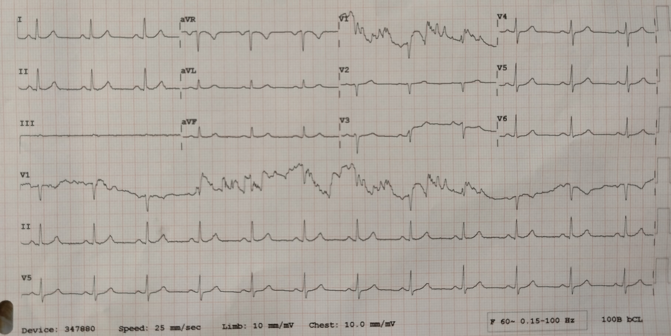

Slide 31
Points to ponder
Why don’t we see PEs = CVAs? (IDK either)

Slide 32
Resources
CHA₂DS₂-VASc Score for Atrial Fibrillation Stroke Risk (MDCalc)
Left auricle occlusion devices (ESC position)
A Comparison of Rate Control and Rhythm Control in Patients with Recurrent Persistent Atrial Fibrillation (NEJM 2002)
A really good 7-minute summary of an approach (VuMedi)

