Slide 1
Forward Momentum: Empowering PAs to Shape the Future of Healthcare
Todd Pickard, DMSc, PA-C, DFAAPA, FASCO
President
Notes:
Notes

Slide 2

Impact of the PA Profession
APPROXIMATELY
MORE THAN
PROJECTED
190,000
590 MILLION
20%
PAs IN
THE UNITED STATES
PATIENT
INTERACTIONS PER YEAR
GROWTH IN EMPLOYMENT BY 2034
NCCPA, 2025
NCCPA, 2025. All data based on clinically practicing PAs in the U.S.
Bureau of Labor Statistics
U.S. NEWS & WORLD REPORT BEST JOBS
#5
#2
#3
BEST 100 JOBS
BEST HEALTHCARE JOBS
BEST STEM JOBS

Slide 3
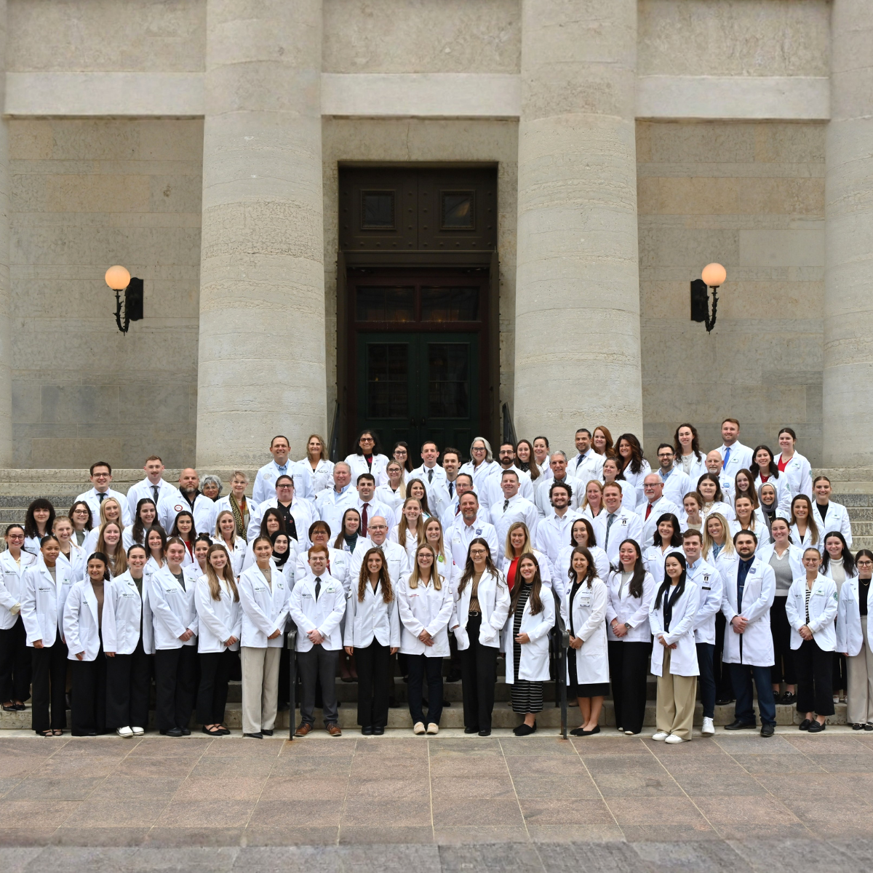
State Advocacy Wins
2025
2026
35 States
passed practice modernization laws
6 States
joined the PA Licensure Compact
2 States
adopted the physician associate title
Several Bills
to modernize PA practice nearing enactment
5 States
joined the PA Licensure Compact, with 7 more advancing legislation
Recent Wins
Maine and Virginia Achieved Optimal Practice Environments
Kansas Enacted Key Modernizations
Iowa achieved title change

Slide 4
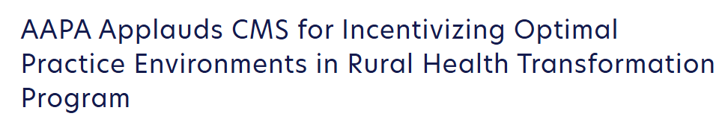
Rural Health Transformation Program
All 50 states
received funding
11 states
intend to introduce the PA Licensure Compact
“By allowing clinicians to practice at the top of their license, states can increase their health service supply. Rural populations will benefit from the preventative health impact of increased primary care options as well as decreased time to wait for appointments.”
CMS Funding Notice
10 states
recognize that modernizing scope of practice laws would strengthen their rural health systems

Slide 5
Department of Education Student Loan Negotiated Rulemaking
Tied to implementation of One Big Beautiful Bill Act (H.R. 1), enacted in July
Cut GRAD Plus and set caps on loans
Proposed rule issued on 1/29 by ED includes definition of “professional program” that excludes PAs
Proposed cap under new rule:
$20,500 per year (standard graduate loan limit)
$100,000 aggregate total max
!!Not enough to cover most PA program tuition, fees, housing, and clinical training costs
AAPA Statement on Department of Education's Proposed Rule on Federal Student Loans
“This proposed student loan rule is deeply flawed, outside the Department’s authority, fundamentally inconsistent with the language of H.R. 1 and the Trump Administration’s rural healthcare workforce priorities. By excluding PAs and many other essential healthcare professions from the higher professional loan limit category, the Department has put forward a proposal that will decimate the healthcare workforce pipeline at a time of historic shortages. ”
Todd Pickard, DMSc, PA-C, DFAAPA, FASCO

Slide 6
More Than 1 in 3 PAs and PA Students Would Have Left Healthcare if Federal Loans Were Capped
37% would have no longer pursed a healthcare career
PAs and PA Students, n=4179

Slide 7





8 in 10 Expect Decreasing Numbers of PA School Applicants
If federal student loan borrowing for PA education is capped at $20,500 per academic year, what impact do you think it will have on the following aspects of the PA profession?
84%
79%
78%
Decrease the number of applicants to PA school
Reduce the number of PAs practicing in rural areas
Reduce the number of PAs practicing in medically underserved communities
PAs and PA Students, n=4046

Slide 8
AAPA’s Response
PUBLIC COMMENTS
STRATEGIC ENGAGEMENT
COMMUNITY MOBILIZATION
AAPA submitted strong comments that outline legal arguments
Securing meetings with Administration officials to apply pressure
More than 75+ interactions with Members of Congress and staff
42,000+ petition signatures
1,700+ personal stories from PAs and PA students
2,000 comments submitted by PAs and PA students

Slide 9



Slide 10

2026
TRENDY Award Winner
941 MILLION+
PAsGoBeyond.com
Campaign impressions to date

Slide 11
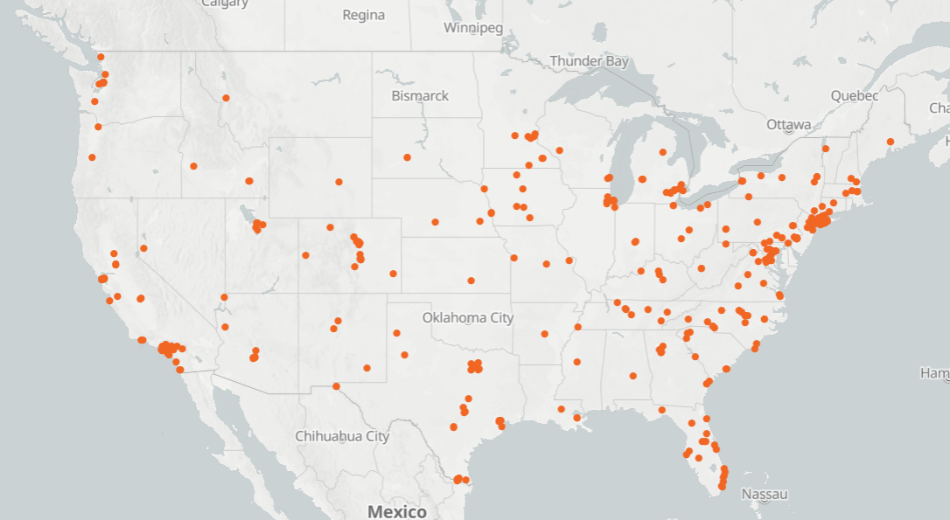

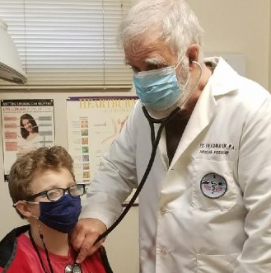
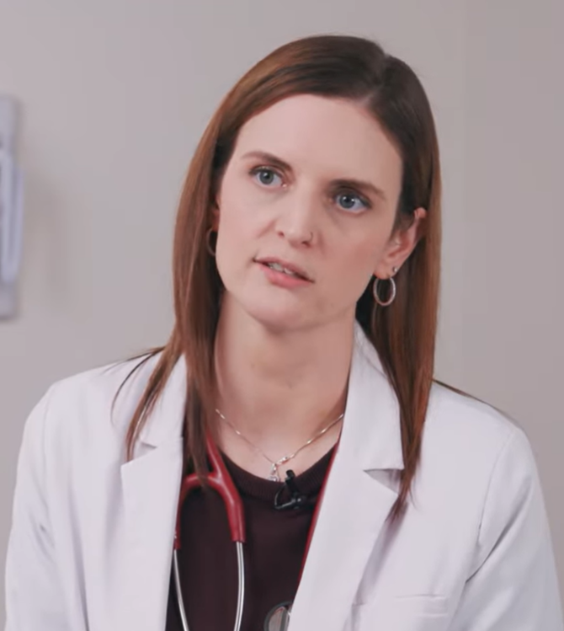

Mapping PA Excellence
ED FRIEDMANN
SHARE A STORY
LAURA CUNNINGHAM

Slide 12



Listening to Members: Delivering What Matters
Investing in the Next Generation
23,000 PA student members—75% of all PA students nationwide
136 programs participating in cohort billing program
Strengthening Early-Career Support
New conference events and webinars
Extended new graduate discount
Ready, Set, Practice
Expanding CME Options
JAAPA CME worth two credits each
InNetwork CME for Plus and Premium members

Slide 13
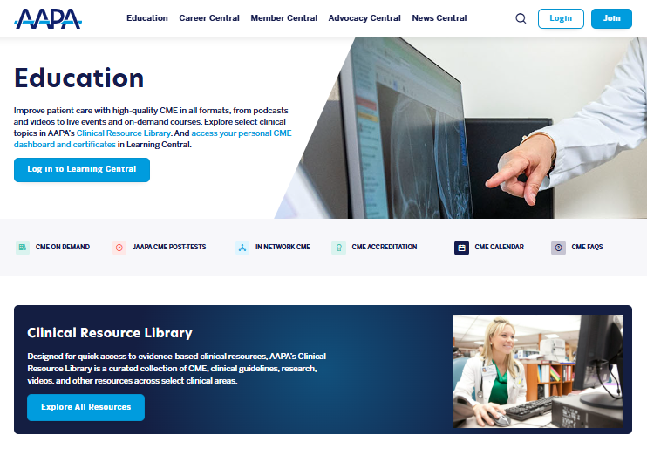



New Education Offerings

Slide 14


The Newly Refreshed Learning Central
Improved navigation and usability
Dynamic dashboards with personalized recommendations
Full mobile access
And more!

Slide 15
Thank You

