Slide 1


2026 Legislative Forecast
IPAS Fall CME
Monday, October 20, 2025

Slide 2

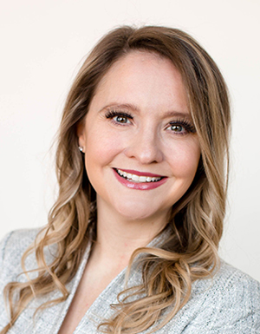
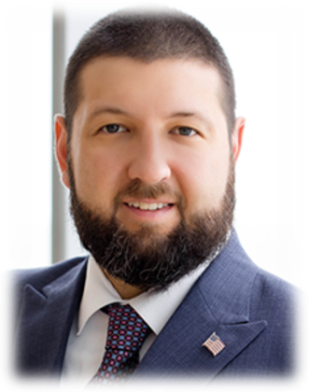
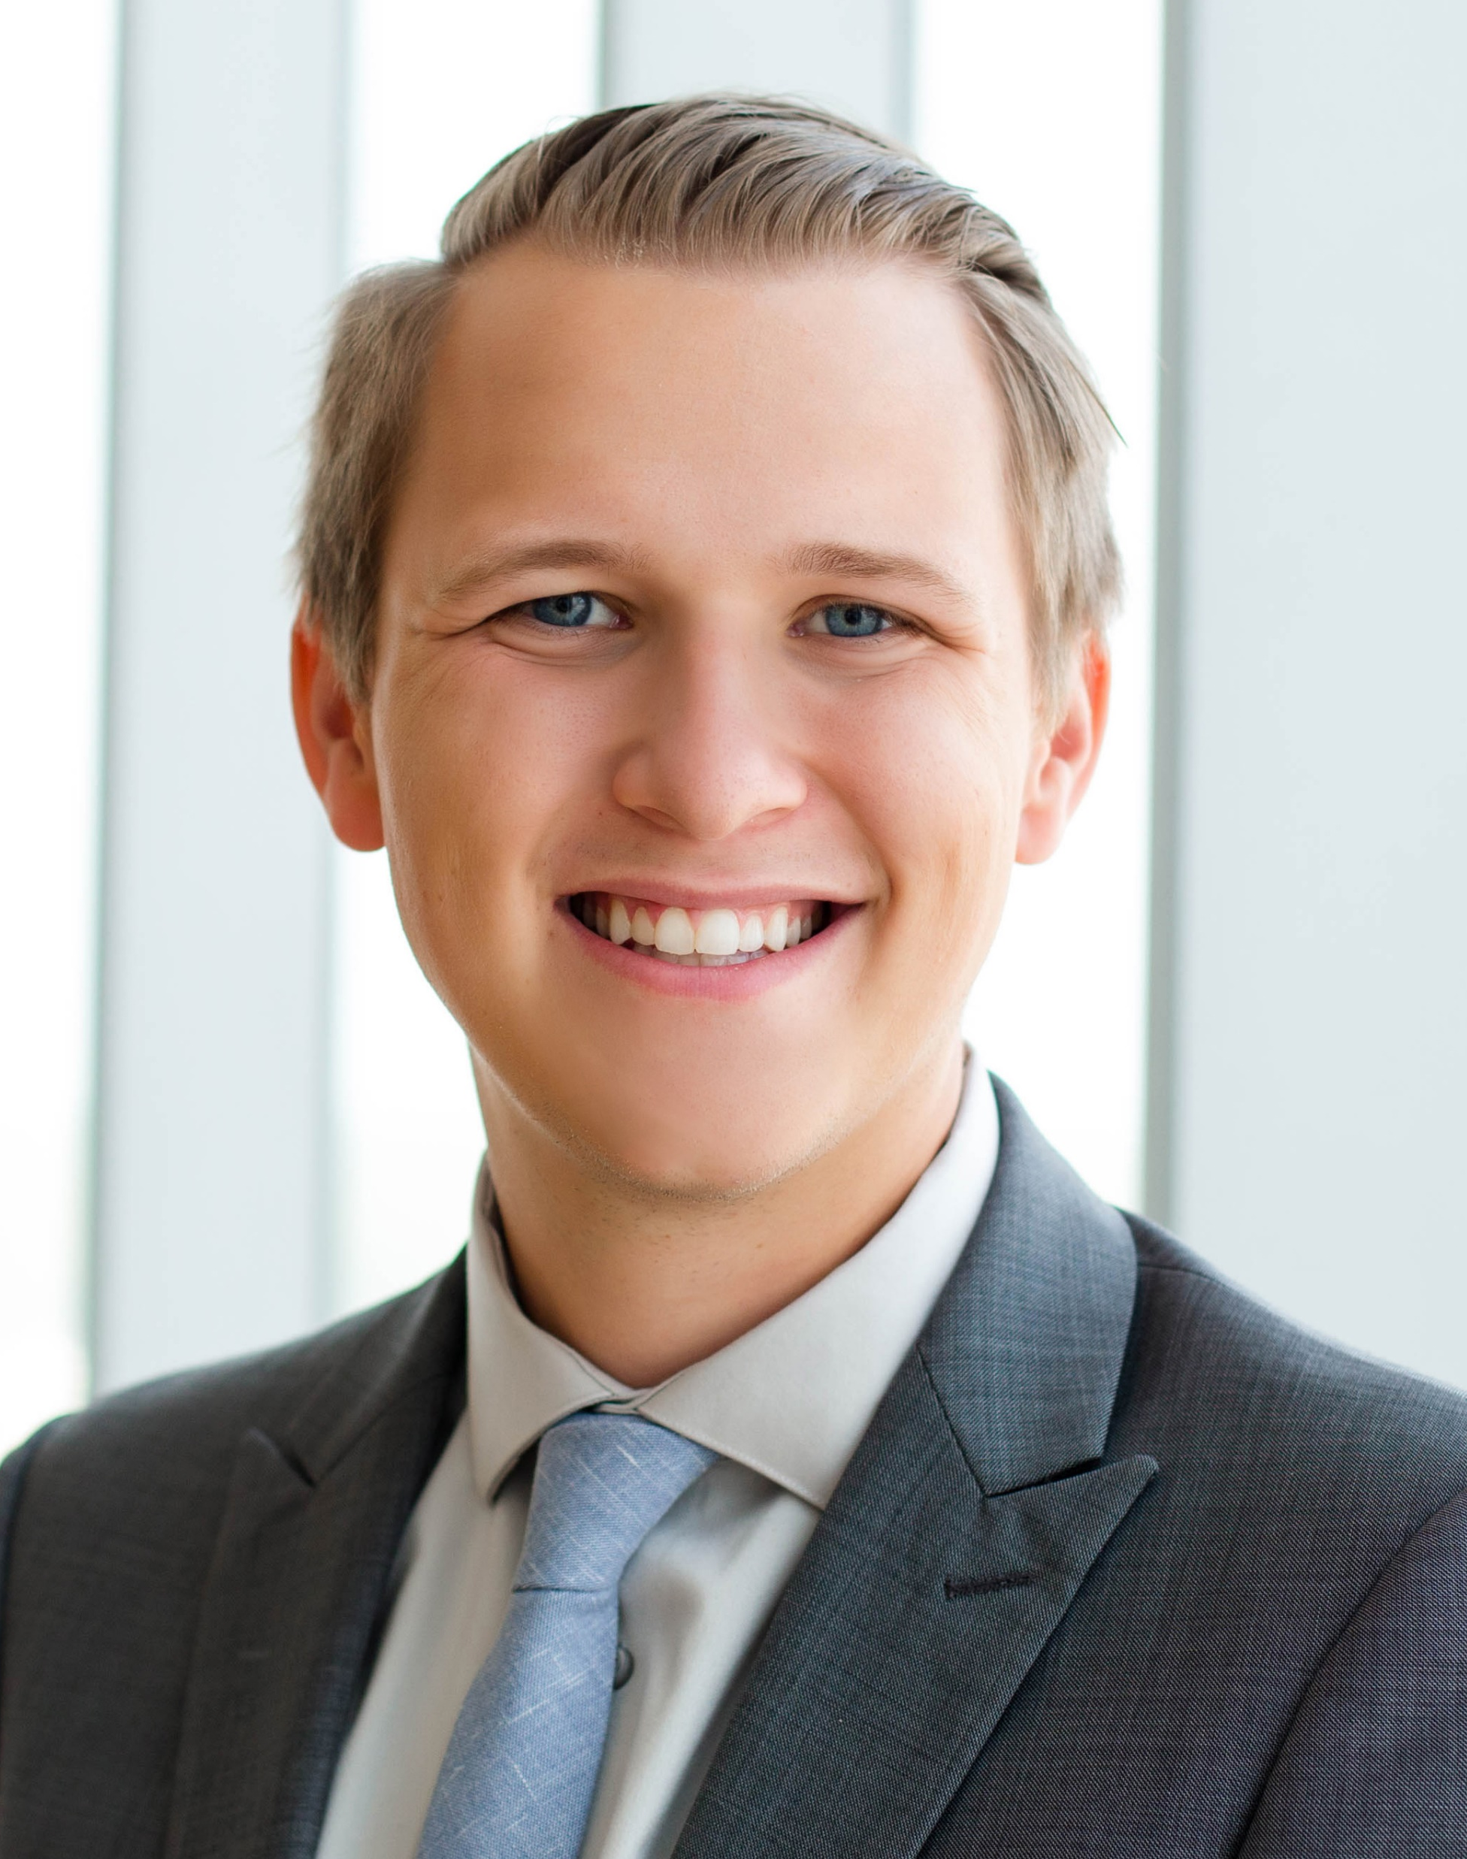
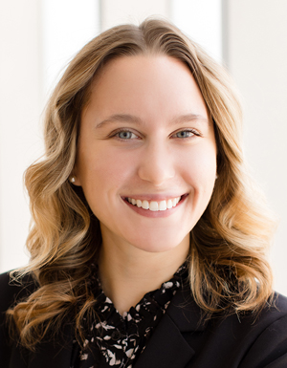
Dentons Davis Brown
Government Relations Team
Sydney Gangestad
Government Relations Special Counsel
Sydney.Gangestad@dentons.com
Logan Murray
Government Relations Special Counsel
Logan.Murray@dentons.com
Jacob Schrader
Government Relations Associate
Jacob.Schrader@dentons.com
Stephanie Kiel
Government Relations Coordinator
Stephanie.Kiel@dentons.com

Slide 3
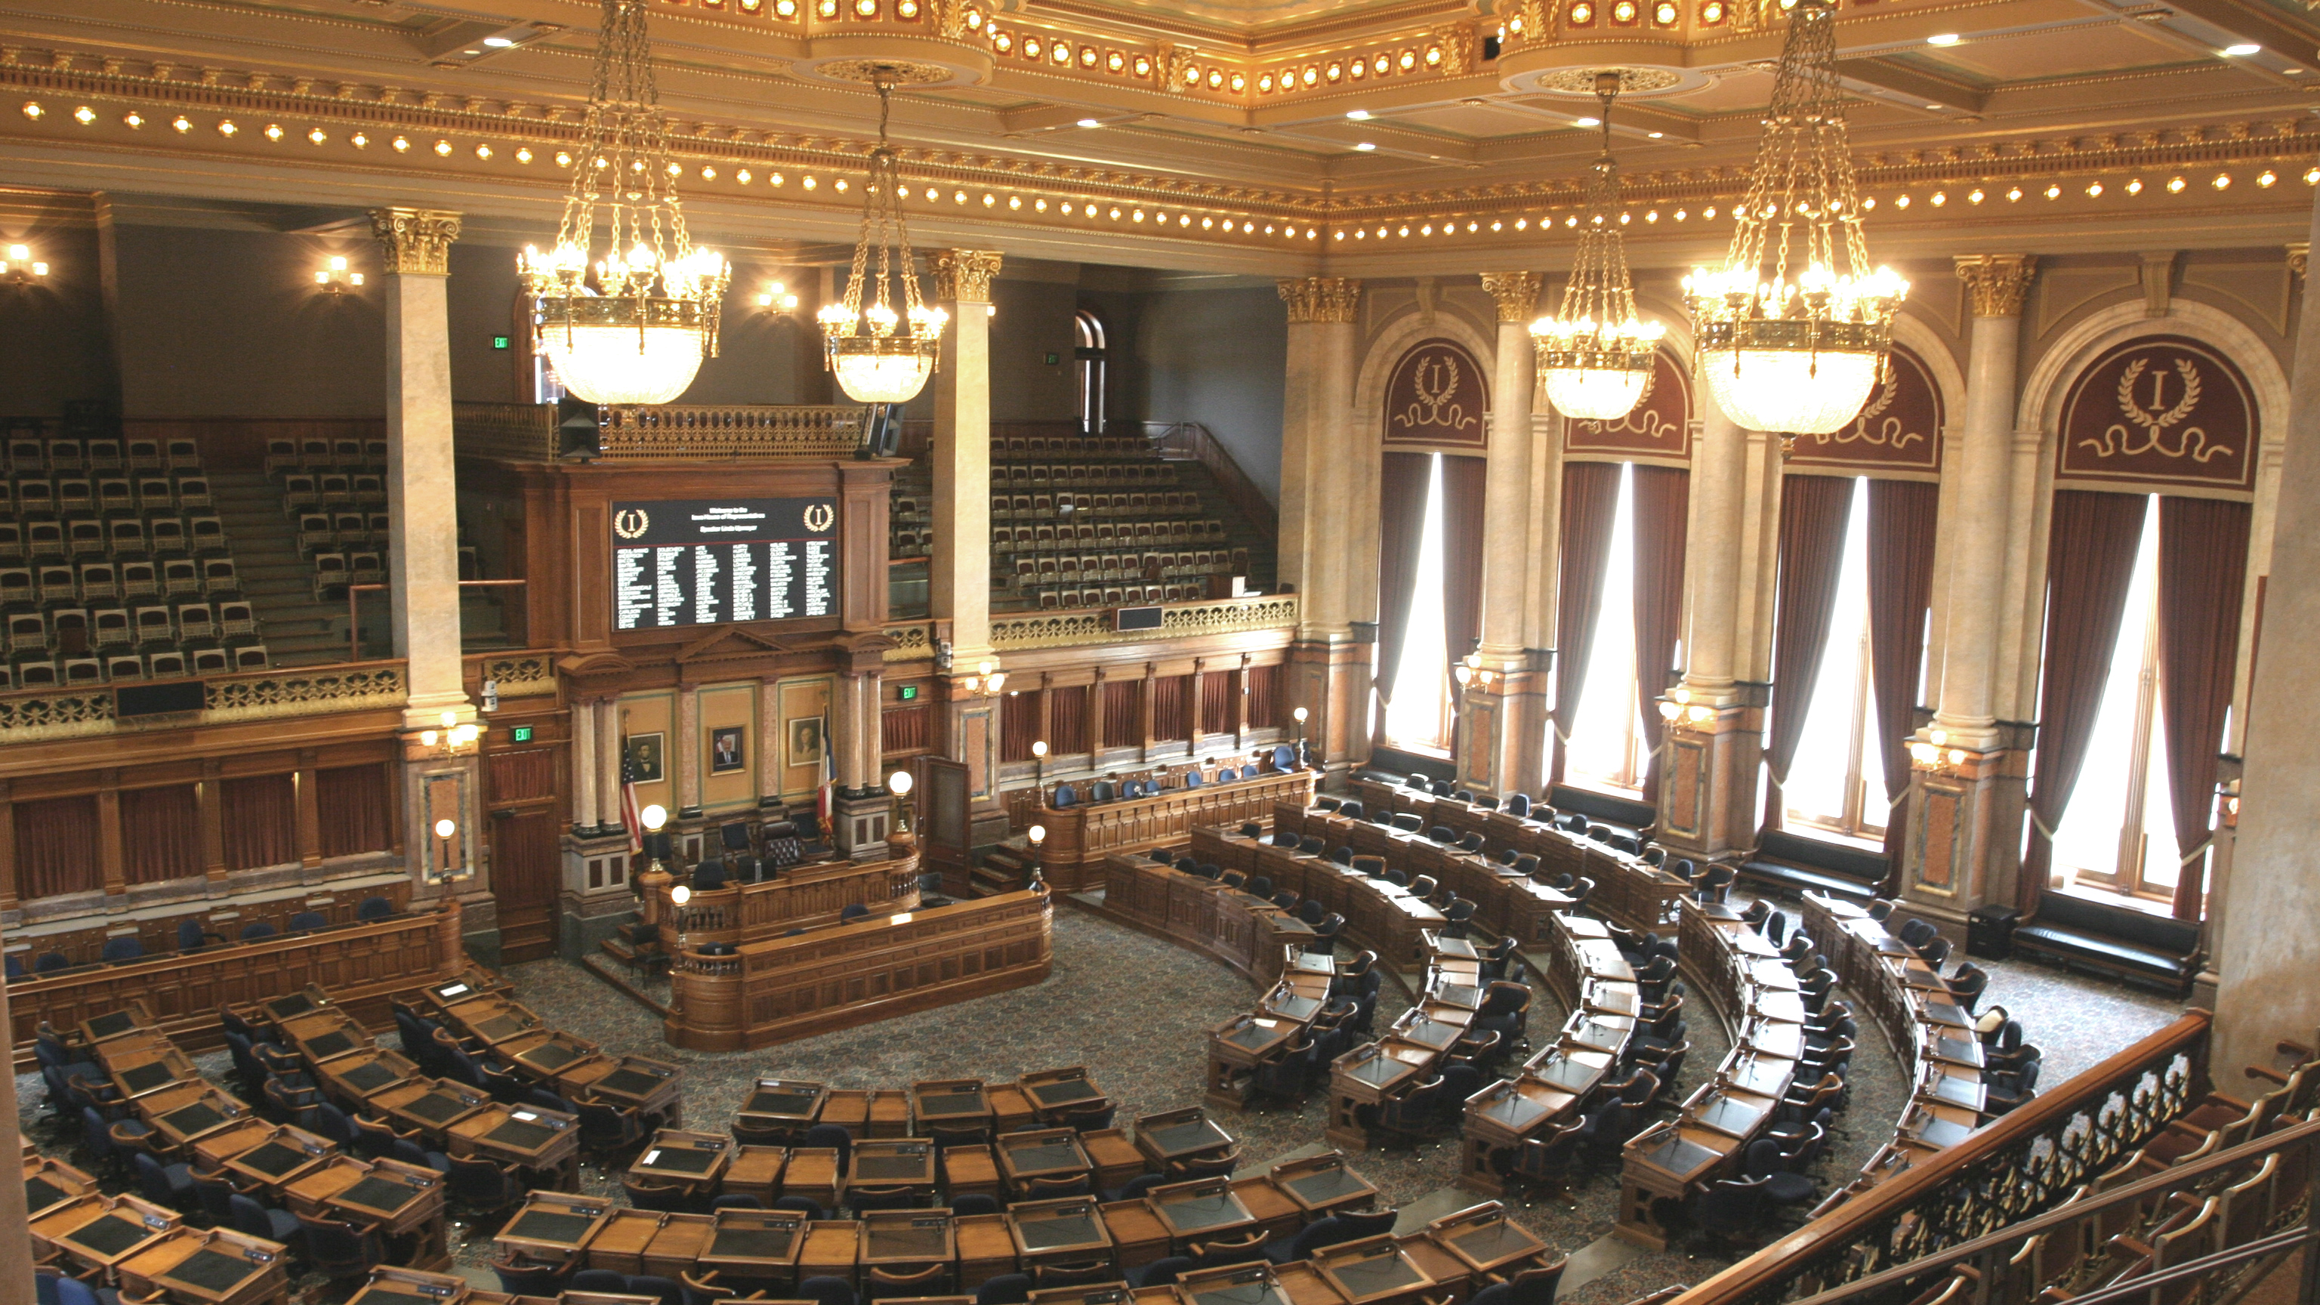
2026 Legislative Session

Slide 4
2026 Legislative Session Timeline
Jan. 12
First Day of Session
Mar. 20
Second Funnel
Apr. 21
100th Day of Session
Feb. 20
First Funnel
???
Adjournment Sine Die

Slide 5
2026 State Issues To Watch
State Budget
Property Tax
Education Funding and Policy
Energy
HHS/Medicaid
Eminent Domain

Slide 6
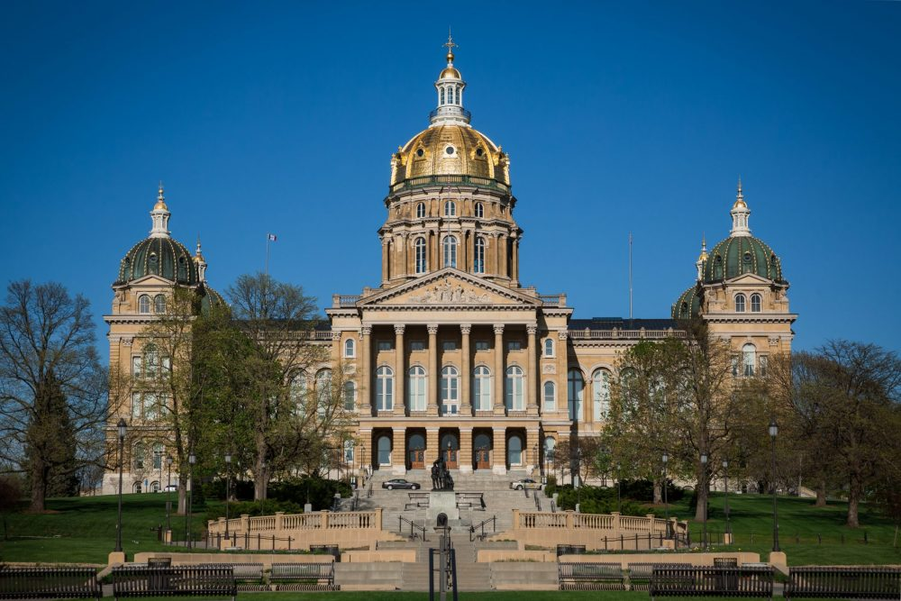
Under the Dome
91st General Assembly*
*Two special elections in progress

Slide 7
Leadership 91st General Assembly
Majority Leader Mike Klimesh
President Amy Sinclair
Minority Leader Janice Weiner
Speaker Pat Grassley
Majority Leader Bobby Kaufmann
Minority Leader Brian Meyer
Iowa State Senate
Iowa State House

Slide 8
New Committee Chair Assignments
Agriculture
Representative Derek Wulf
HHS
Representative Jeff Shipley
Local Government
Representative Brook Boden
Natural Resources
Representative Devon Wood
International Relations
Commerce
Representative David Young
Representative Austin Harris
Transportation
Representative Tom Determann
Ways and Means
Representative Carter Nordman
Education Appropriations
Representative Dan Gehlbach
HHS
Senator Kara Warme
ARRC Co-Chair
Senator Dave Rowley
Representative Megan Jones
Veterans Affairs

Slide 9
FY 2026 Budget Breakdown

Slide 10
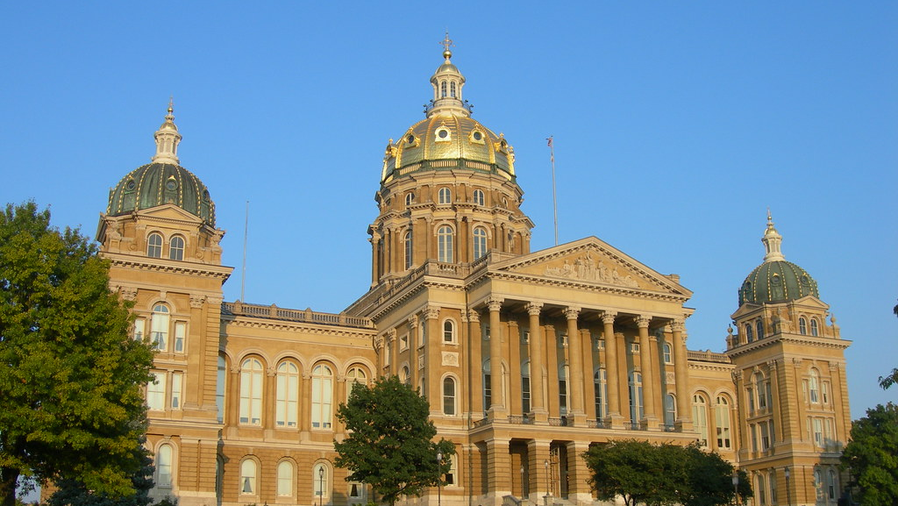
IPAS Policy Priorities

Slide 11

PA Title Change
Evolving the PA profession’s title from physician assistant to physician associate to ensure patients understand the role of PAs in healthcare delivery, reduce confusion, and reflect the current practice of PAs in Iowa.

Slide 12
PA Title Change
U.S. Army announced their change of the title “Physician Assistant” to Physician Associate” within their armed forces branch
Three states have enacted statutory changes (Oregon, Maine, and New Hampshire).
30 Constituent Organizations have completed their title change efforts, including state and national organizations.
Letters of support from 4 out of 5 educational institutions in Iowa with a PA educational program

Slide 13
PA Title Change
WILL
Help patients to better understand PA’s education, training, and their role in health care delivery
WILL NOT
Change what PAs do or impact a PA’s scope of practice

Slide 14
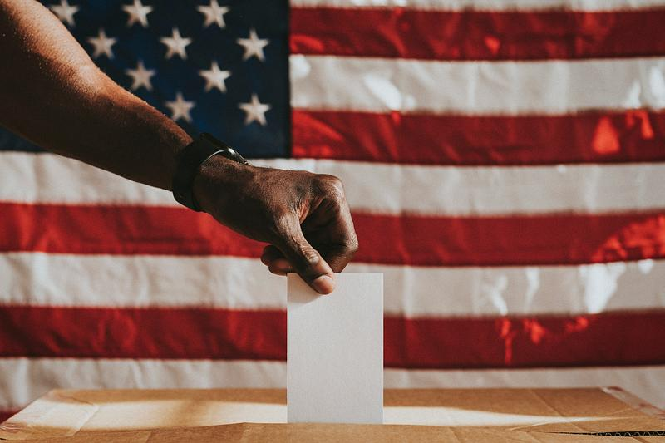
2026 Elections

Slide 15
Iowa Governor Race
Confirmed Running
State Rep. Eddie Andrews (R) | Adam Steen (R)
Former. State Rep. Brad Sherman (R) | State Auditor Rob Sand (D)
Zach Lahn (R) | Julie Stauch (D)
Paul Dahl (D)
Exploratory Committee
U.S. Rep. Randy Feenstra (R) | State Sen. Mike Bousselot (R)

Slide 16
Iowa Statewide Races
Attorney General | State Auditor | Secretary of State
Attorney General Brenna Bird (R, Incumbent) | Lieutenant Governor Chris Cournoyer (R) | Secretary of State Paul Pate (R, Incumbent)
Nate Willems (D) | Abigail Maas (R) | Ryan Peterman (D)

Slide 17
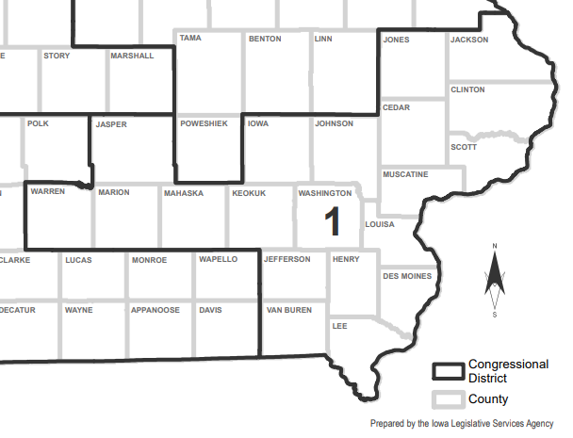

US Congress
IA-01
Iowa’s First Congressional District
U.S. Rep. Mariannette Miller-Meeks (R, Incumbent)
David Pautsch (R)
Christina Bohannan (D)
Travis Terrell (D)
Taylor Wettach (D)

Slide 18
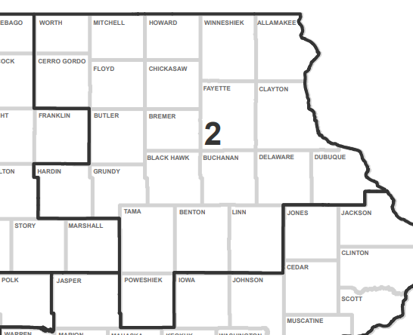
US Congress
IA-02
Iowa’s Second Congressional District
Former State Rep. Joe Mitchell (R)
State Sen. Charlie McClintock (R)
State Rep. Shannon Lundgren (R)
State Rep. Lindsay James (D)
Kathy Dolter (D)
Guy Morgan (D)
Clint Twedt-Ball (D)
Don Primus (D)

Slide 19
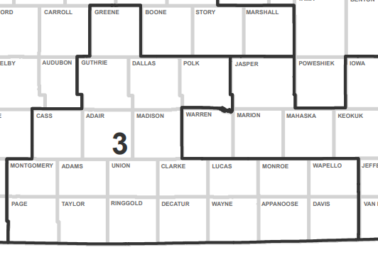
US Congress
IA-03
Iowa’s Third Congressional District
U.S. Rep. Zach Nunn (R, Incumbent)
State Sen. Sarah Trone Garriott (D)
State Rep. Jennifer Konfrst (D)
Xavier Carrigan (D)
Tracy Limon (D)

Slide 20
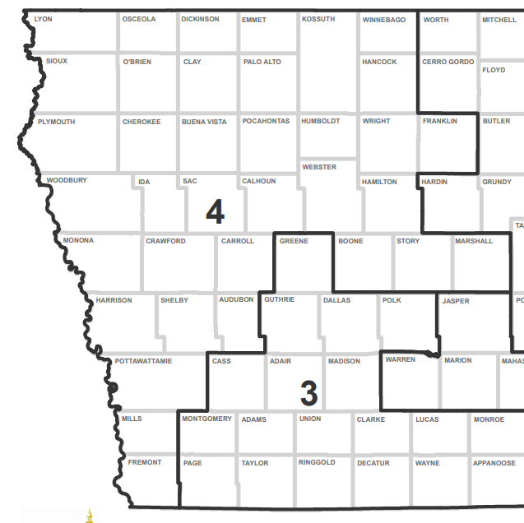
US Congress
IA-04
Iowa’s Fourth Congressional District
State Rep. Matt Windschitl (R)
Chris McGowan (R)
Ryan Rhodes (R)
Christian Schlaefer (R)
Ashley WolfTornabane (D)
Dave Dawson (D)
Stephanie Steiner (D)

Slide 21
US Senate Race
US Senate (IA)
U.S. Rep. Ashley Hinson (R) | Jim Carlin (R)
John Berman (R) | State Sen. Zach Wahls (D)
State Rep. Josh Turek (D) | Bob Krause (D)
Richard Sherzan (D) | Nathan Sage (D)

Slide 22
Thank you!
Sydney Gangestad
Logan Murray
Special Counsel
Special Counsel
+ 515 246 7968
Sydney.Gangestad@dentons.com
+ 515 246 7896
Logan.Murray@dentons.com

