Slide 1
Classic Liver Disease
Amol Agarwal, MD
Gastroenterologist, Iowa Digestive Disease Center
Iowa PA Society Lecture April 2026

Slide 2
Case #1
A 42-year-old woman presents with 3 months of fatigue, pruritus, and intermittent right upper quadrant discomfort. Laboratory studies show AST 485 U/L and ALT 612 U/L, total bilirubin 2.1 mg/dL, alkaline phosphatase 135 U/L, and serum IgG 2,450 mg/dL (elevated). Serologic testing reveals a positive anti–smooth muscle antibody (1:160) with negative hepatitis A, B, and C studies. Liver biopsy demonstrates interface hepatitis with prominent lymphoplasmacytic infiltrates extending from portal tracts into the lobule.

Slide 3
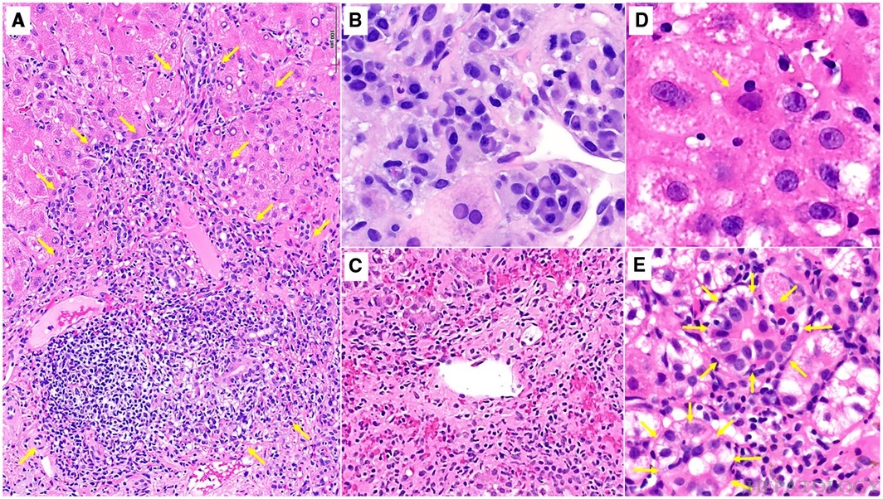

Figure 3
Copyright © 2026 Wolters Kluwer. Published by Lippincott Williams & Wilkins.

Slide 4
Case: Autoimmune Hepatitis
A 42-year-old woman presents with 3 months of fatigue, pruritus, and intermittent right upper quadrant discomfort. Laboratory studies show AST 485 U/L and ALT 612 U/L, total bilirubin 2.1 mg/dL, alkaline phosphatase 135 U/L, and serum IgG 2,450 mg/dL (elevated). Serologic testing reveals a positive anti–smooth muscle antibody (1:160) with negative hepatitis A, B, and C studies. Liver biopsy demonstrates interface hepatitis with prominent lymphoplasmacytic infiltrates extending from portal tracts into the lobule.

Slide 5
Figure 3
Diagnosis and Management of Autoimmune Hepatitis in Adults and Children: 2019 Practice Guidance and Guidelines From the American Association for the Study of Liver Diseases
Mack, Cara L.; Adams, David; Assis, David N.; Kerkar, Nanda; Manns, Michael P.; Mayo, Marlyn J.; Vierling, John M.; Alsawas, Mouaz; Murad, Mohammad H.; Czaja, Albert J.
Hepatology72(2):671-722, August 2020.
doi: 10.1002/hep.31065
Histological features characteristic of AIH. (A) Lymphoplasmacytic inflammatory infiltration of the portal tract and interface hepatitis involving >50% of the portal tract circumference (arrows; hematoxylin and eosin; magnification, ×200). (B) Plasma cell predominance in a portal inflammatory infiltrate (hematoxylin and eosin; magnification, ×600). (C) Perivenulitis of a central vein (hematoxylin and eosin; magnification, ×400). (D) A hepatocyte undergoing emperipolesis (arrows; hematoxylin and eosin; magnification, ×600). (E) Rosettes of regenerating hepatocytes (arrows; hematoxylin and eosin; magnification, ×600). Photomicrographs are courtesy of Sadhna Dhingra, M.D., Department of Pathology, Baylor College of Medicine, Houston, TX.
Copyright © 2026 Wolters Kluwer. Published by Lippincott Williams & Wilkins.

Slide 6
Autoimmune Hepatitis: Definition
Autoimmune hepatitis is a chronic inflammatory liver disease caused by loss of immune tolerance to hepatocytes, leading to progressive hepatocellular injury.
It is characterized by elevated transaminases, increased serum IgG levels, and the presence of characteristic autoantibodies (most commonly anti–smooth muscle or antinuclear antibodies).
Untreated disease can progress to fibrosis and cirrhosis, but most patients respond well to immunosuppressive therapy such as corticosteroids with or without azathioprine.

Slide 7
Autoimmune Hepatitis: Epidemiology
Autoimmune hepatitis affects individuals of all ages but most commonly presents in women, with a female-to-male ratio of approximately 3–4:1.
It has a bimodal age distribution, with peaks in adolescence/young adulthood and again in middle age.
The disease occurs with an estimated prevalence of 10–25 cases per 100,000 population

Slide 8
Autoimmune Hepatitis: Clinical Presentation
Spectrum of Severity: Presentation varies from an insidious onset of fatigue, malaise, and jaundice to acute liver failure. Approximately 25–30% of patients already have established cirrhosis at diagnosis, which may manifest as portal hypertension (ascites or splenomegaly) despite a lack of prior symptoms.
Classic Physical Findings: Patients often exhibit jaundice and tender hepatomegaly during flares. In younger female patients, amenorrhea is a frequent systemic hallmark, alongside cutaneous signs of chronic liver disease like spider angiomata and palmar erythema.
Extrahepatic Manifestations: Clinical suspicion should increase if the patient has concurrent autoimmune disorders. This includes "sicca symptoms" (dry eyes/mouth), polyarthritis of the small joints, or cutaneous findings like acne and hirsutism, which can occur even prior to starting corticosteroid therapy.

Slide 9
Autoimmune Hepatitis: Diagnosis
Hepatocellular Injury Pattern: Laboratory tests reveal a sharp rise in Aminotransferases (AST and ALT), often exceeding 10x the upper limit of normal, with a characteristic elevation in Total IgG (Hypergammaglobulinemia).
Classic Autoantibodies:
Type 1 AIH (Most common): Positive Antinuclear Antibody (ANA) and/or Anti-Smooth Muscle Antibody (ASMA).
Type 2 AIH (Often Pediatric, more acute): Positive Anti-Liver Kidney Microsomal-1 (LKM-1) or Anti-Liver Cytosol-1 (LC-1) antibodies.
The "Gold Standard": A liver biopsy is required for definitive diagnosis. It classically shows interface hepatitis (lymphoplasmacytic infiltration across the limiting plate) and abundant plasma cells.

Slide 10
Autoimmune Hepatitis: Treatment
Induction Therapy: The mainstay of treatment is Corticosteroids (Prednisone or Budesonide), either alone or in combination with Azathioprine. Budesonide is preferred in non-cirrhotic patients to minimize systemic side effects.
Maintenance Goals: Once biochemical remission is achieved (normalized AST/ALT and IgG), steroids are tapered to the lowest effective dose or discontinued, while Azathioprine is typically continued long-term to prevent relapse.
Monitoring & Failure: Patients require lifelong monitoring for relapse (common in >50%). Those who fail first-line therapy may require Mycophenolate Mofetil (MMF) or Tacrolimus; liver transplant is the final option for refractory cases.

Slide 11
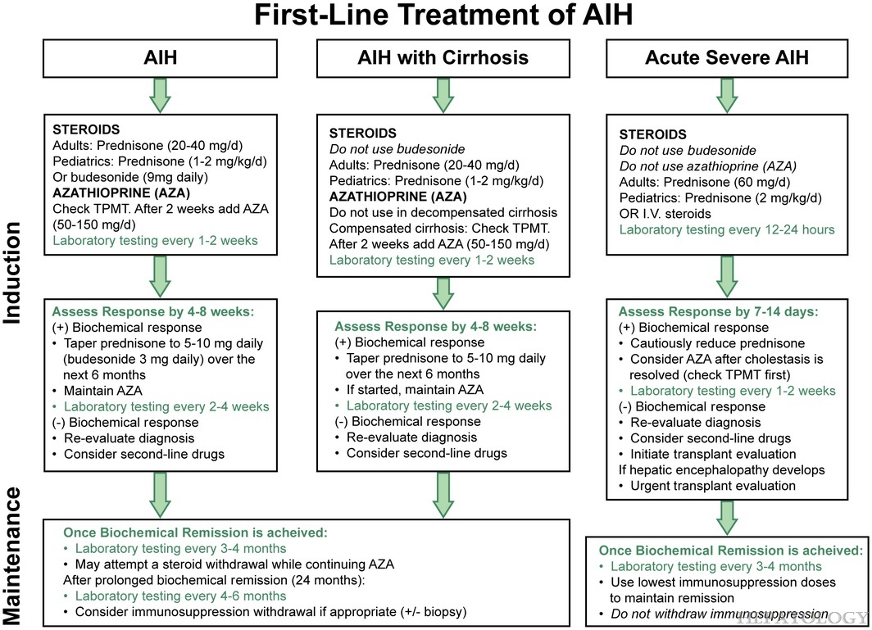
Figure 4
Diagnosis and Management of Autoimmune Hepatitis in Adults and Children: 2019 Practice Guidance and Guidelines From the American Association for the Study of Liver Diseases
Mack, Cara L.; Adams, David; Assis, David N.; Kerkar, Nanda; Manns, Michael P.; Mayo, Marlyn J.; Vierling, John M.; Alsawas, Mouaz; Murad, Mohammad H.; Czaja, Albert J.
Hepatology72(2):671-722, August 2020.
doi: 10.1002/hep.31065
First‐line treatment of AIH in adults and children, recognizing adjustments based on the presence of cirrhosis or an acute severe presentation.
Copyright © 2026 Wolters Kluwer. Published by Lippincott Williams & Wilkins.

Slide 12
Questions on Autoimmune Hepatitis?

Slide 13
Case #2
A 52-year-old woman presents to her primary care physician complaining of progressive fatigue and intense generalized pruritus that is worse at night. On physical examination, she exhibits excoriations on her arms and legs, along with mild hepatomegaly and xanthelasmas around her eyelids.
Laboratory evaluation reveals a significant cholestatic pattern, with an Alkaline Phosphatase (ALP) of 450 U/L (normal <120 U/L) and a Gamma-Glutamyl Transferase (GGT) of 185 U/L, while her bilirubin remains only mildly elevated. Serologic testing is notable for an Antimitochondrial Antibody (AMA) titer of 1:160, and her serum cholesterol is markedly increased.

Slide 14
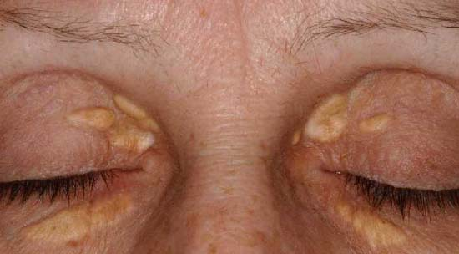
PBC: Xanthelasma
Soft, yellowish cholesterol deposits on the eyelids caused by chronic cholestasis and the resulting severe hyperlipidemia.
https://thebileflow.wordpress.com/2011/02/04/pathology-xanthelasma-of-pbc/

Slide 15
Case #2: Primary Biliary Cholangitis (PBC)
A 52-year-old woman presents to her primary care physician complaining of progressive fatigue and intense generalized pruritus that is worse at night. On physical examination, she exhibits excoriations on her arms and legs, along with mild hepatomegaly and xanthelasmas around her eyelids.
Laboratory evaluation reveals a significant cholestatic pattern, with an Alkaline Phosphatase (ALP) of 450 U/L (normal <120 U/L) and a Gamma-Glutamyl Transferase (GGT) of 185 U/L, while her bilirubin remains only mildly elevated. Serologic testing is notable for an Antimitochondrial Antibody (AMA) titer of 1:160, and her serum cholesterol is markedly increased.

Slide 16
PBC: Definition
Disease Definition: A chronic autoimmune liver disease characterized by the progressive, non-suppurative destruction of small intrahepatic bile ducts. It is a major cause of chronic cholestasis, typically affecting middle-aged women.
The "Vanishing Bile Duct" Syndrome: The immune system targets cholangiocytes (cells lining the bile ducts), leading to inflammation and duct loss. Over time, the inability to drain bile causes it to back up, damaging liver tissue and leading to biliary cirrhosis.
Key Antigen Target: The immune attack is specifically directed at the PDC-E2 subunit of the pyruvate dehydrogenase complex. This triggers a T-cell mediated response that selectively destroys the small interlobular and septal ducts while leaving the larger extrahepatic ducts intact.

Slide 17
PBC: Epidemiology
Demographic Predominance: The disease shows a striking sex bias, with females representing roughly 90% of cases. It is most commonly diagnosed in middle-aged women, typically between the ages of 35 and 60.
Prevalence and Geography: It is most prevalent in Northern Europe and North America, with estimated rates of 20 to 40 cases per 100,000 people. While once considered rare, improved screening for Alkaline Phosphatase (ALP) has led to increased detection worldwide.
Genetic and Environmental Risk: There is a strong genetic component; first-degree relatives of patients have a significantly higher risk of developing the disease. Environmental triggers, such as smoking, recurrent urinary tract infections, and exposure to certain chemicals (e.g., in hair dye), are also linked to its onset.

Slide 18
PBC: Rule of 90s
90% Female: The disease has a powerful gender predilection, typically appearing in women during their 4th to 6th decades of life.
90% AMA Positive: The Antimitochondrial Antibody is highly specific; its absence should prompt clinicians to look for "AMA-negative PBC" or alternative diagnoses.
90% Elevated ALP: A cholestatic pattern on liver function tests—specifically a marked rise in Alkaline Phosphatase—is almost universally the first biochemical sign.

Slide 19
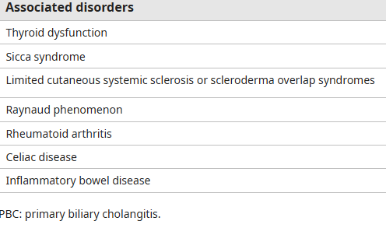
PBC: Associated Disorders

Slide 20
PBC: Clinical Presentation
Asymptomatic Beginnings: Up to 50–60% of patients are asymptomatic at the time of diagnosis, often identified through incidental findings of elevated Alkaline Phosphatase (ALP) on routine blood work.
The "Classic" Duo:
Fatigue: The most common symptom (up to 80%), often debilitating and not correlated with the severity of the liver disease.
Pruritus (Itching): Often the presenting symptom; typically worse at night and on the palms and soles.
Physical Exam Findings:
Hyperpigmentation: Darkening of the skin due to melanin deposition (not jaundice).
Xanthomas/Xanthelasmas: Soft, yellow plaques around the eyes or on extensor surfaces due to severe hyperlipidemia.
Hepatomegaly: Enlarged, firm liver found in later stages of the disease.

Slide 21
PBC: Diagnostic Workup
Step 1: Identify Cholestasis: Begin with a patient (often a middle-aged female) showing an isolated, persistent elevation of Alkaline Phosphatase (ALP).
Step 2: Serologic Testing: Order an Antimitochondrial Antibody (AMA). If the titer is >1:40, the diagnosis is more likely.
Step 3: Imaging (Rule Out Obstruction): Perform a Right Upper Quadrant Ultrasound to exclude extrahepatic biliary obstruction
Step 4: Liver Biopsy (If Needed): Biopsy is not required if ALP is elevated and AMA is positive. It is reserved for "AMA-negative" cases or if an "overlap syndrome" with Autoimmune Hepatitis is suspected
Most cases of PBC diagnosed without a liver biopsy

Slide 22
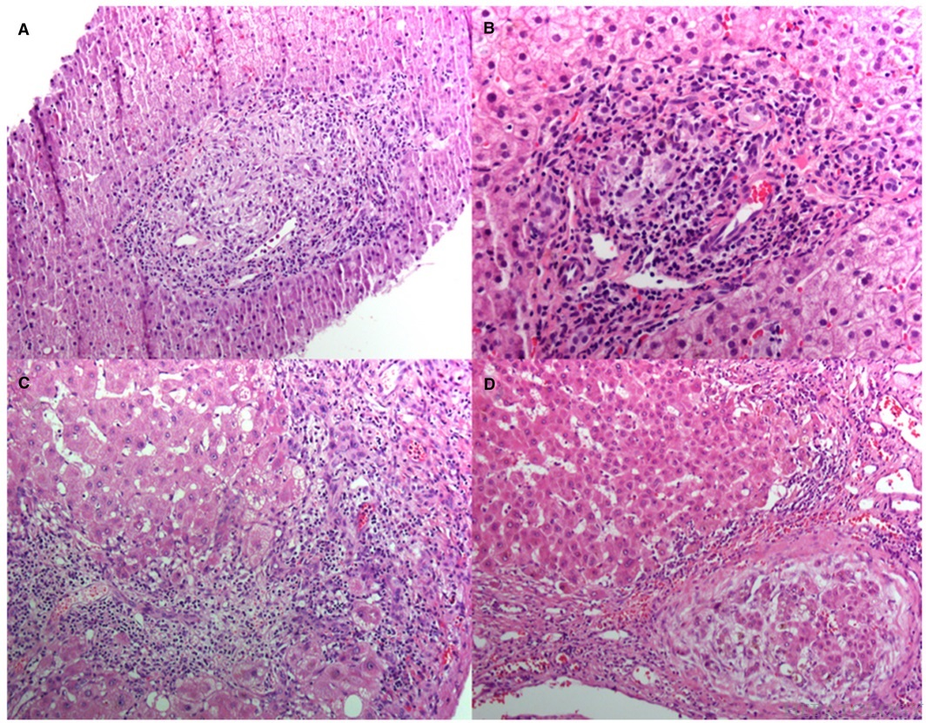
Figure 1
Copyright © 2026 Wolters Kluwer. Published by Lippincott Williams & Wilkins.

Slide 23
Figure 1
Primary Biliary Cholangitis: 2018 Practice Guidance from the American Association for the Study of Liver Diseases
Lindor, Keith D.; Bowlus, Christopher L.; Boyer, James; Levy, Cynthia; Mayo, Marlyn
Hepatology69(1):394-419, January 2019.
doi: 10.1002/hep.30145
(A) Stage 1 PBC with portal inflammation and a florid ductal lesion; hematoxylin‐eosin, magnification 20x. (B) Stage 2 PBC with portal inflammation, focal interface hepatitis, and bile ductular proliferation; hematoxylin‐eosin, magnification 40x. (C) Stage 3 PBC with bridging inflammation; hematoxylin‐eosin, magnification 20x. (D) Stage 4 PBC showing cirrhosis with ductopenia; hematoxylin‐eosin, magnification 20x. Courtesy of Dr Monica Tulia Garcia‐Buitrago. [Correction added on December 17, 2018, after first online publication: Acknowledgment for Dr Monica Tulia Garcia‐Buitrago was added.]
Copyright © 2026 Wolters Kluwer. Published by Lippincott Williams & Wilkins.

Slide 24
Sidebar on Alkaline Phosphatase
Multi-Organ Distribution: ALP is an enzyme found in various tissues, primarily concentrated in the liver (specifically, bile duct epithelial cells) and bone (osteoblasts). Significant amounts are also present in the placenta during pregnancy, the intestines, and the kidneys, meaning an elevation is not always specific to hepatic pathology.
We get referral for elevated ALP all the time even if not liver in origin
GGT as a Localizing Tool: To determine if an elevated ALP is hepatic in origin, clinicians measure Gamma-Glutamyl Transferase (GGT). Because GGT is found in the biliary tree but not in bone, a concurrent rise in both ALP and GGT strongly localizes the source to cholangiocyte injury or biliary obstruction; a normal GGT suggests a bone-related etiology.
Isoenzyme Fractionation: When the source of ALP elevation remains ambiguous, isoenzyme fractionation (often via electrophoresis or heat stability testing) can be performed. This laboratory technique separates the distinct molecular forms of the enzyme—such as Alpha-1 (liver) and Alpha-2 (bone)—to definitively identify which organ system is contributing to the rise.
Which disease would have primarily or exclusively elevation in bone-specific ALP?

Slide 25
PBC: Disease-Modifying Treatment
First-Line Therapy (UDCA): Ursodeoxycholic acid (13–15 mg/kg/day) remains the foundation of treatment. Hydrophilic bile acid that provides "cytoprotection" by diluting toxic bile acids and stabilizing the cell membranes of cholangiocytes.
Second-Line Standard (PPAR Agonists): For the ~40% of patients with an inadequate response to UDCA (persistent ALP >1.67x ULN), two new agents are now the preferred additions:
Seladelpar: A selective PPAR-delta agonist. It is uniquely effective because it significantly reduces pruritus while lowering ALP and normalizing bilirubin levels in many patients.
Elafibranor: A dual PPAR-alpha/delta agonist. It reduces bile acid synthesis and inflammation. Clinical trials (ELATIVE) showed it is highly effective at achieving biochemical response in UDCA non-responders.

Slide 26
PBC: Liver Transplant
Rate of Cirrhosis: PBC typically progresses slowly, but untreated patients face a 7% annual risk of developing cirrhosis. Achieving biochemical response with UDCA or PPAR agonists significantly halts this progression, granting patients a near-normal life expectancy.
-Biochemical response as decrease in ALP to <1.67x the ULN, ideally ~1x ULN
Transplant Success: PBC carries some of the best post-transplant outcomes in hepatology. Indications include decompensated cirrhosis (ascites, encephalopathy) or refractory pruritus, with 5-year survival rates reaching 80–85%.
Recurrence in Graft: The disease recurs in the new liver in about 20–25% of cases by 10 years. While common, recurrence is usually managed medically and rarely results in graft loss or the need for re-transplantation.

Slide 27
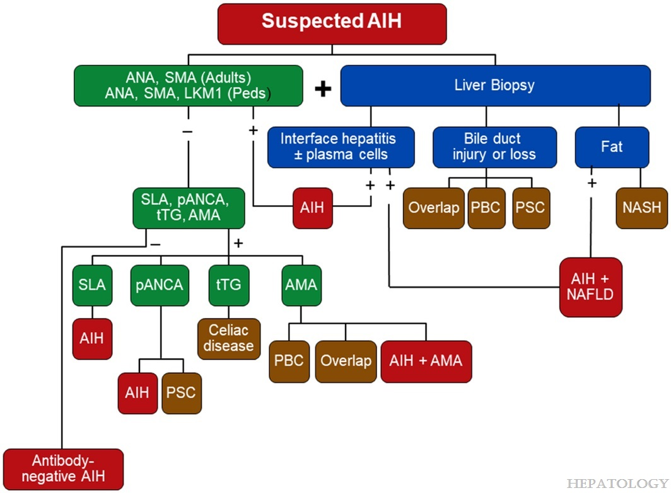
Diagnosis and Management of Autoimmune Hepatitis in Adults and Children: 2019 Practice Guidance and Guidelines From the American Association for the Study of Liver Diseases
Mack, Cara L.; Adams, David; Assis, David N.; Kerkar, Nanda; Manns, Michael P.; Mayo, Marlyn J.; Vierling, John M.; Alsawas, Mouaz; Murad, Mohammad H.; Czaja, Albert J.
Hepatology72(2):671-722, August 2020.
doi: 10.1002/hep.31065
Diagnostic algorithm for the evaluation of suspected AIH after exclusion of viral, drug‐induced, hereditary, and metabolic diseases. ANA and SMA should be assessed in adults (green panel), and antibodies to LKM1 should be assessed later if ANA and SMA are absent. ANA, SMA, and LKM1 should be assessed in all pediatric patients at presentation (green panel). The findings of the liver biopsy (dark blue panels) could support the diagnosis of AIH (dark red panel) or suggest alternative diagnoses that might include an overlap syndrome, PBC, PSC, AIH with NAFLD, or NASH (brown panels). The absence of ANA, SMA, and LKM1 justifies additional serological tests (green panel) that can include antibodies to SLA, atypical pANCA, tissue transglutaminase, and AMA. Seropositivity for one of these autoantibodies could support the diagnosis of AIH (dark red panels) or suggest other diagnoses including celiac disease (dark brown panels). Abbreviations: Peds, pediatric patients; tTG, tissue transglutaminase.
Copyright © 2026 Wolters Kluwer. Published by Lippincott Williams & Wilkins.

Slide 28
Questions on PBC?

Slide 29
Case
A 50-year-old male presents with fatigue, joint pain (arthralgia), and signs of cirrhosis on routine lab work. Physical examination reveals bronze hyperpigmentation of the skin and an enlarged liver (hepatomegaly). Laboratory studies demonstrate elevated serum ferritin and high transferrin saturation.

Slide 30
Case: Hereditary Hemochromatosis
A 50-year-old male presents with fatigue, joint pain (arthralgia), and signs of cirrhosis on routine lab work. Physical examination reveals bronze hyperpigmentation of the skin and an enlarged liver (hepatomegaly). Laboratory studies demonstrate elevated serum ferritin and high transferrin saturation.

Slide 31
Hemochromatosis: Definition
Iron Overload Syndrome
Can Be Genetic (Primary) or acquired (Secondary)
Secondary hemochromatosis is from excessive iron supplementations (often from blood transfusion)
Increased iron absorption leads to abnormal Fe deposition in multiple organs – including the heart, pancreas, pituitary gland, and most importantly the liver
The body has no active iron excretion mechanism. Iron loss is limited to small amounts via:
Sloughed skin and gut epithelial cells
Minor bleeding or menstrual bleeding

Slide 32
Hemochromatosis: Genetics
-85%-90% of patients who have HH are homozygous for the C282Y mutation in the HFE gene
-A minority of patients are compound heterozygotes, meaning they one allele with the C282Y mutation and the other allele has the either the H63D or the S65C mutation.

Slide 33
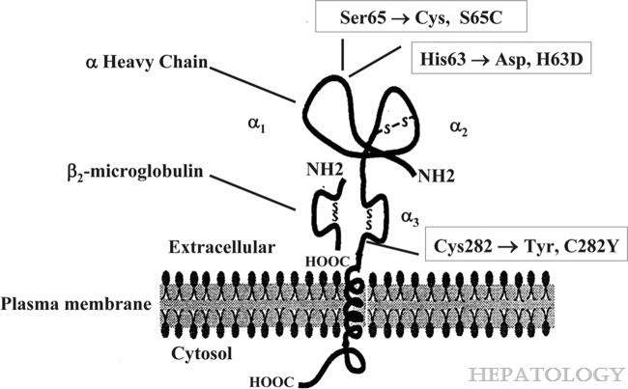
Fig. 1
Diagnosis and management of hemochromatosis: 2011 Practice Guideline by the American Association for the Study of Liver Diseases
Bacon, Bruce R.; Adams, Paul C.; Kowdley, Kris V.; Powell, Lawrie W.; Tavill, Anthony S.
Hepatology54(1):328-343, July 2011.
doi: 10.1002/hep.24330
Schematic representation of the protein product of HFE. Most of the protein is extracellular. There is a short cytoplasmic tail and three extracellular alpha loops. The three principal mutations are identified.
Copyright © 2025 Wolters Kluwer. Published by Lippincott Williams & Wilkins.

Slide 34
Hemochromatosis: Pathophysiology
HFE gene mutation → inappropriately low hepcidin production Defective HFE (most commonly C282Y) impairs hepatocyte sensing of body iron stores, so hepcidin is not upregulated despite iron overload.
Low hepcidin → uninhibited ferroportin activity Ferroportin on enterocytes and macrophages remains active, causing excessive dietary iron absorption and increased release of stored iron into plasma.
Chronic iron loading → parenchymal iron deposition Persistent elevation of circulating iron leads to progressive deposition in liver, pancreas, heart, and endocrine organs, causing organ damage.

Slide 35
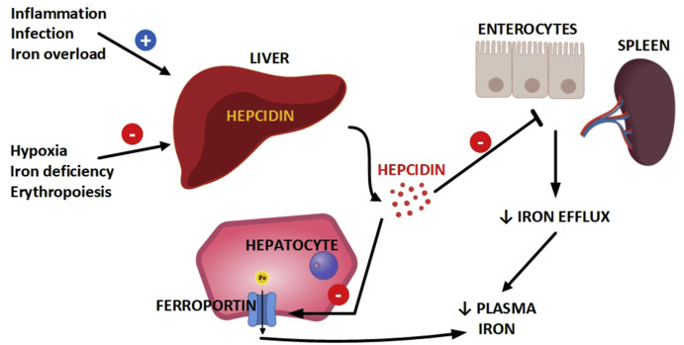
Normal Hepcidin Physiology

Slide 36
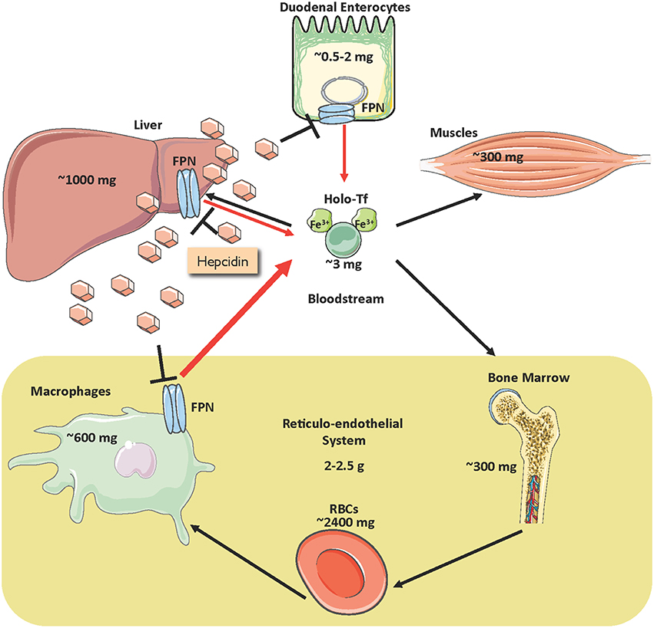

Slide 37
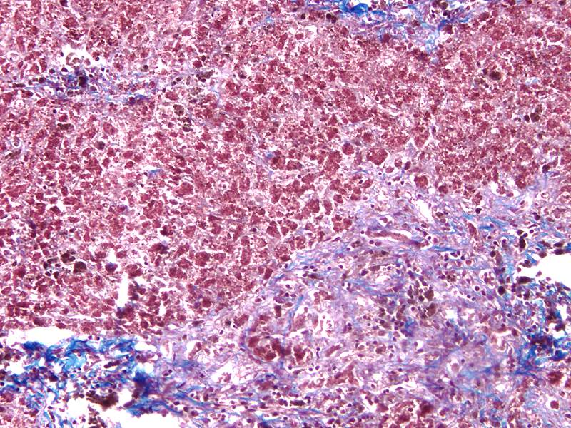
Hemochromatosis
Progressive iron deposition causes hepatomegaly, fibrosis, and cirrhosis.
Can be reversed (except for cirrhosis)

Slide 38
Hemochromatosis
Clinically,
Hepatomegaly (95%)
Gray hyperpigmentation (90%)
Fatigue (74%)
Secondary diabetes (65%) (secondary because its not a primary pancreatic disorder)
Arthropathy (40%)
Cardiac involvement (15%)
Secondary hypogonadism is d/t depression of Hypothalamic pituitary axis
25-30% risk of hepatocellular cancer in patients with cirrhosis

Slide 39
Hemochromatosis
Diagnosis suggested by lab testing for iron studies
High serum Fe, ferritin, and transferrin saturation (>45%).
Transferrin itself is low because body is downregulating it
Blood assay for HFE gene
Symptomatic hemochromatosis is 10x more frequent in men —> why?

Slide 40
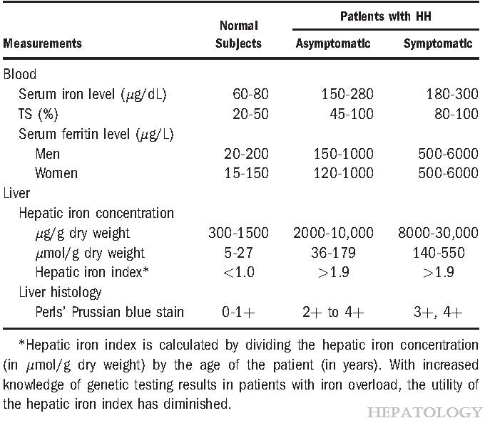
Table 7
Diagnosis and management of hemochromatosis: 2011 Practice Guideline by the American Association for the Study of Liver Diseases
Bacon, Bruce R.; Adams, Paul C.; Kowdley, Kris V.; Powell, Lawrie W.; Tavill, Anthony S.
Hepatology54(1):328-343, July 2011.
doi: 10.1002/hep.24330
Laboratory Findings in Patients with HH
Copyright © 2025 Wolters Kluwer. Published by Lippincott Williams & Wilkins.

Slide 41
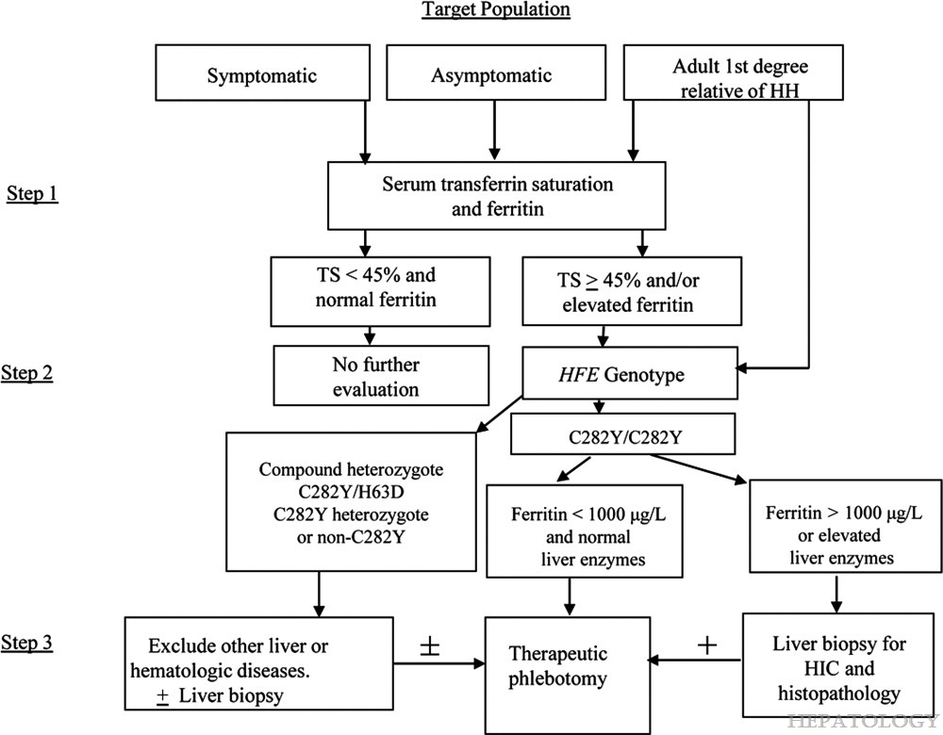
Fig. 3
Diagnosis and management of hemochromatosis: 2011 Practice Guideline by the American Association for the Study of Liver Diseases
Bacon, Bruce R.; Adams, Paul C.; Kowdley, Kris V.; Powell, Lawrie W.; Tavill, Anthony S.
Hepatology54(1):328-343, July 2011.
doi: 10.1002/hep.24330
An algorithm can provide some further direction regarding testing and treatment for HH. The algorithm is modified from the version used in the previous AASLD guidelines.
Copyright © 2025 Wolters Kluwer. Published by Lippincott Williams & Wilkins.

Slide 42
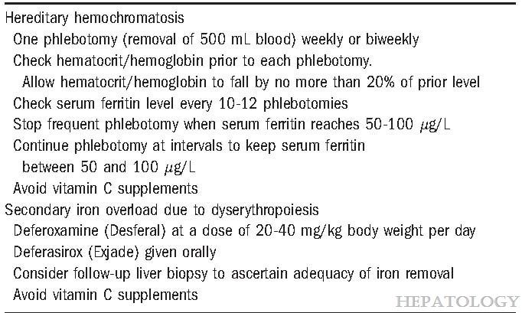
Table 9
Diagnosis and management of hemochromatosis: 2011 Practice Guideline by the American Association for the Study of Liver Diseases
Bacon, Bruce R.; Adams, Paul C.; Kowdley, Kris V.; Powell, Lawrie W.; Tavill, Anthony S.
Hepatology54(1):328-343, July 2011.
doi: 10.1002/hep.24330
Treatment of Hemochromatosis
Copyright © 2025 Wolters Kluwer. Published by Lippincott Williams & Wilkins.

Slide 43
Questions on Hereditary Hemochromatosis?

Slide 44
Case
A 18-year-old adolescent presents with a new onset of behavioral changes, tremors, and acute liver failure. On physical examination, a Kayser-Fleischer (K-F) ring—a greenish-brown discoloration at the edge of the cornea—is noted. Laboratory tests reveal low serum ceruloplasmin and high urinary copper excretion.

Slide 45
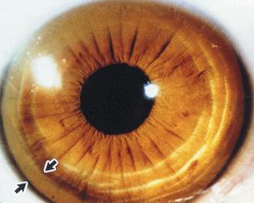

Slide 46
Case: Wilson Disease
A 18-year-old adolescent presents with a new onset of behavioral changes, tremors, and acute liver failure. On physical examination, a Kayser-Fleischer (K-F) ring—a greenish-brown discoloration at the edge of the cornea—is noted. Laboratory tests reveal low serum ceruloplasmin and high urinary copper excretion.

Slide 47
Wilson Disease - Definition
Impaired copper excretion into the bile with subsequent accumulation of copper in body tissues (especially the liver).
Genetically Determined - autosomal recessive - mutation in ATPase copper transporting beta (ATP7B), which is expressed mainly in hepatocytes.
Liver disease or neurologic/psychiatric dysfunction in adolescents.

Slide 48
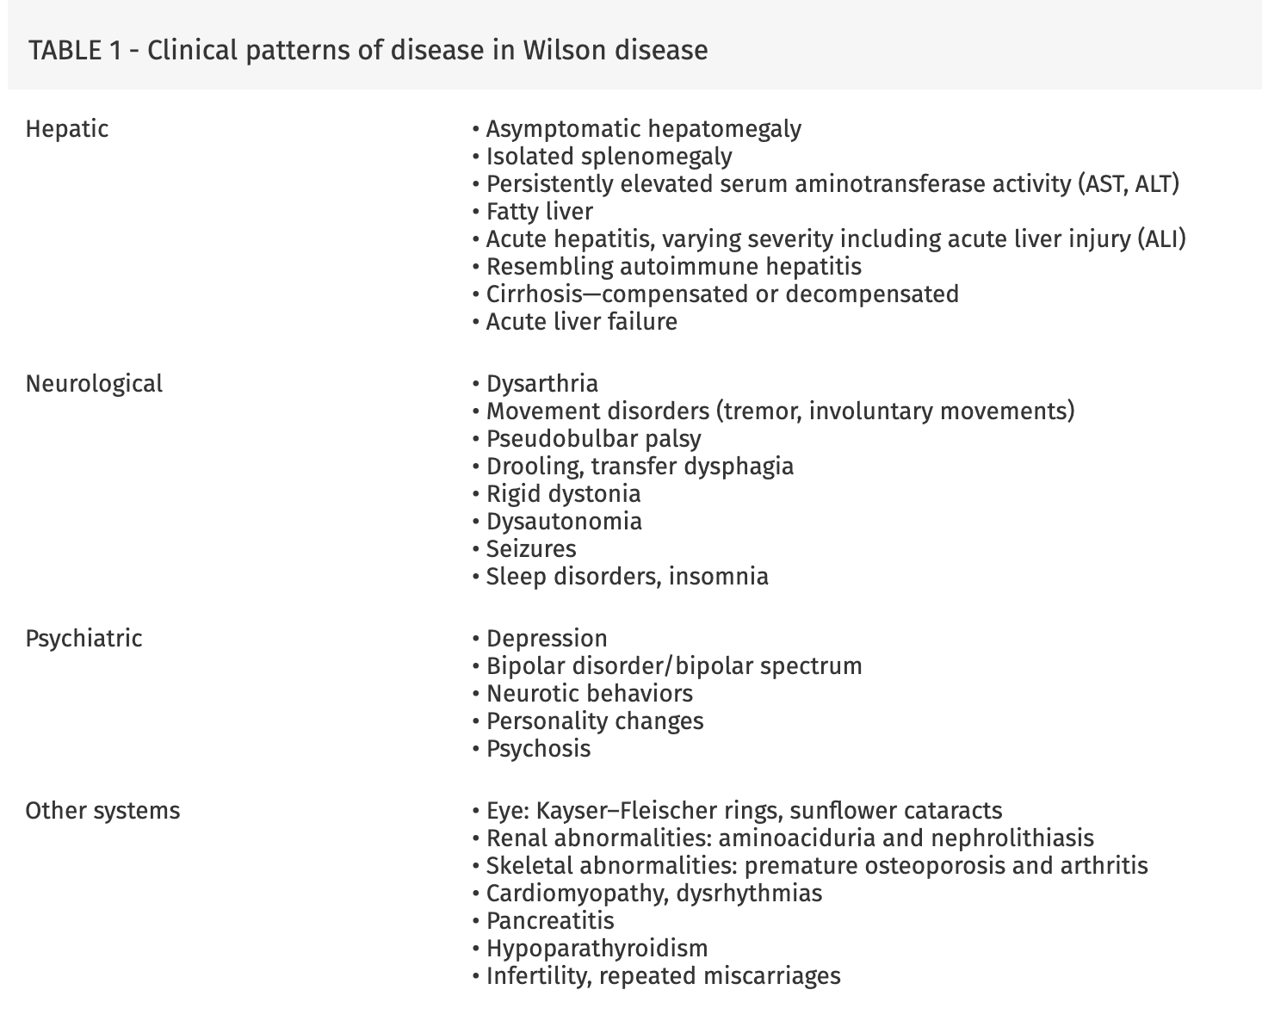
Clinical Pattern of Wilson Disease Are Highly Variable
Source: AASLD

Slide 49
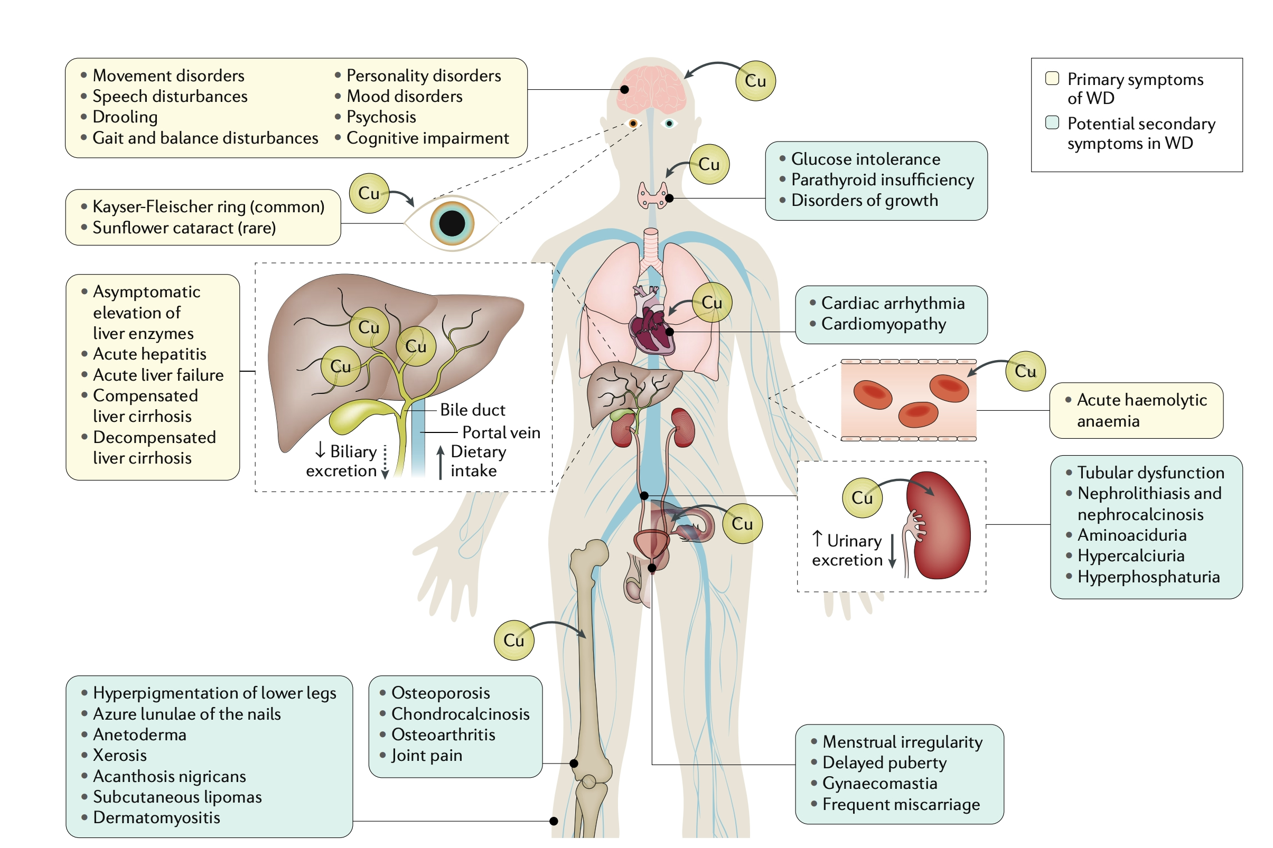
Członkowska, A et al. Wilson disease. Nat Rev Dis Primers 4, 21 (2018).

Slide 50
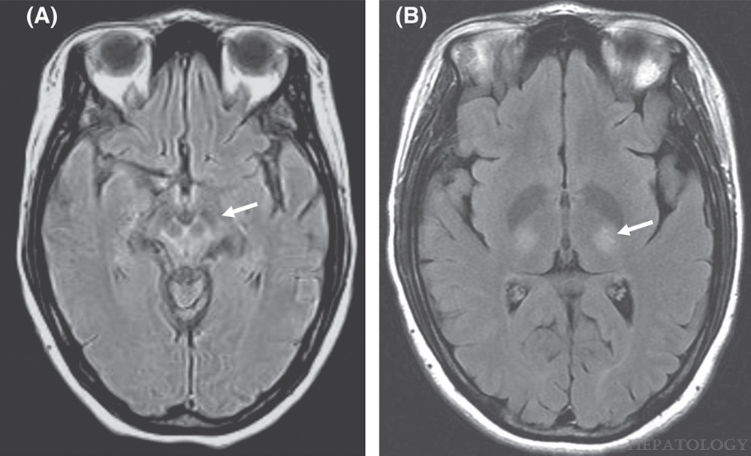
FIGURE 1 - Copper Deposition in the midbrain
A multidisciplinary approach to the diagnosis and management of Wilson disease: 2022 Practice Guidance on Wilson disease from the American Association for the Study of Liver Diseases
Schilsky, Michael L.; Roberts, Eve A.; Bronstein, Jeff M.; Dhawan, Anil; Hamilton, James P.; Rivard, Anne Marie; Washington, Mary Kay; Weiss, Karl Heinz; Zimbrean, Paula C.
Hepatology82(3):E41-E90, September 2025.
doi: 10.1002/hep.32801
Magnetic resonance images of a 32‐year‐old woman with Wilson disease. (A) Flair image of the midbrain showing the “face of the giant panda sign” (arrow). (B) T2 image showing thalamic lesions (arrow).
Copyright © 2026 Wolters Kluwer. Published by Lippincott Williams & Wilkins.

Slide 51
Liver biochemistries (Hepatic function panel - AST, ALT, ALP, TBil)
Complete blood count and international normalized ratio (INR)
Serum ceruloplasmin and, in some patients, serum copper;
Basal 24‐h urinary copper excretion;
Slit‐lamp or optical tomography examination for KF rings;
Molecular genetic investigation of ATP7B (depending on logistics)
Basic Workup for Suspected Wilson Disease

Slide 52
An extremely low serum ceruloplasmin level (<5 mg/dl) more strongly suggests a diagnosis of WD than modestly subnormal levels.
Serum ceruloplasmin by itself is insufficient for making a diagnosis of WD.
Serum ceruloplasmin within the normal range does not exclude the diagnosis of WD.
Basal 24‐h urinary excretion of copper in WD is typically >100 μg/24 h (>1.6 μmol/24 h) in symptomatic patients. Can be lower in asymptomatic patients
Liver biopsy allows quantification of liver tissue copper.
Hepatic parenchymal copper content more than >250 μg/g dry weight occurs in most patients; a lower content still above normal occurs less frequently but should prompt other confirmatory testing.
In untreated patients, normal hepatic copper content (<50 μg/g dry weight) almost always excludes a diagnosis of WD.
Basic Workup for Suspected Wilson Disease

Slide 53
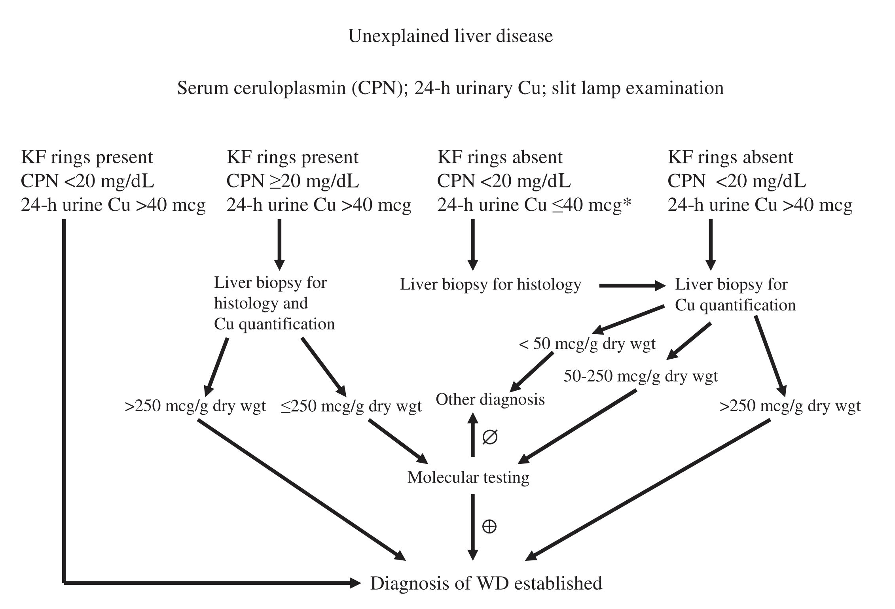
Roberts EA et al. Diagnosis and treatment of Wilson disease: an update. Hepatology 2008; 47: 2089– 2111

Slide 54
Wilson Disease
Kayser-Fleischer rings are pathognomonic
Hemolysis is common
Ceruloplasmin is low
24 hour Urinary copper level is high
Liver biopsy can confirm the diagnosis with high copper levels.

Slide 55
Wilson Disease
Treatment
Chelation with penicillamine or trientine or zinc salts
Liver transplant is curative

Slide 56
Questions on Wilson Disease?

Slide 57
Gilbert Syndrome
Common, asymptomatic condition
Benign elevation in total bilirubin - all due to an elevation in indirect/unconjugated bilirubin
Direct bilirubin is normal
Pathophysiology is due to reduced bilirubin UDP glucoronosyl transferase activity
Often found incidentally when getting a fasting comprehensive metabolic panel with elevated Total Bilirubin, diagnosis is essentially confirmed by verifying it is indirect only and that patient was fasting
Patients can become visibly jaundiced due to physiologic stress which could including fasting but also illness, sleep deprivation, emotional stress, this is expected to resolve when the inciting stressor is eliminated

Slide 58
Learning Objectives
Discuss clinical and biochemical presentation of Major Immune-Mediated Liver Disorders: Autoimmune Hepatitis and Primary Biliary Cirrhosis
Discuss clinical features associated with infiltrative liver disorders (diseases of accumulation): Wilson disease and hemochromatosis
Discuss benign Gilbert disease

Slide 59
Thank You!

