Slide 1
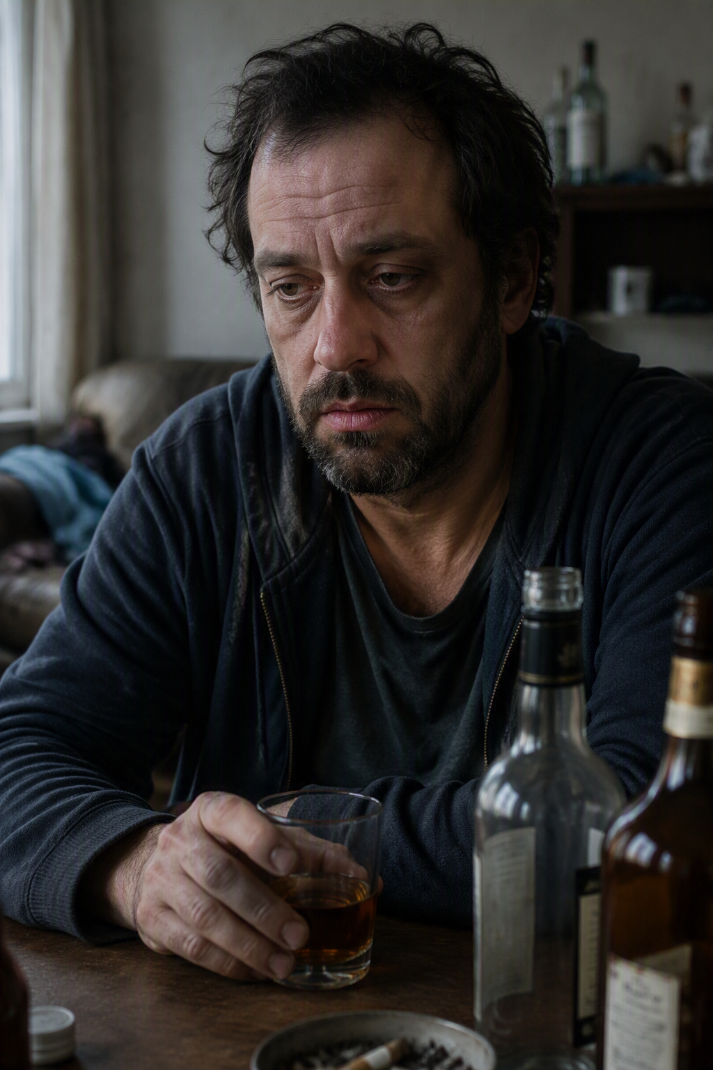
Case Study 1
Mr C is an adult living independently with a long history of alcohol dependency. He has capacity to make decisions regarding his care, treatment, and lifestyle and understands the risks associated with his alcohol use. He has experienced repeated hospital admissions, falls, and incidents where he has been found unconscious in the community. His physical health has deteriorated significantly due to poor liver function.
A. Presenting Problems
Current Concerns
Dangerous levels of alcohol consumption.
Repeated hospital admissions.
Frequent falls and risk of serious injury.
Episodes of being found unconscious in the community.
Deteriorating liver function.
Refusal to engage with treatment and support services.
High likelihood of serious harm or death.
Ongoing self-neglect despite understanding the risks.
B. Intervention
Multi-Agency Actions Completed
Safeguarding enquiries completed.
Multi-agency risk meetings held.
Collaborative risk assessment formulated.
Extensive work undertaken by substance misuse services.
Funding secured for a rehabilitation placement.
GP and hospital services involved.
Outreach and assertive engagement attempted.
Housing, social care, and voluntary sector support coordinated.
Advocacy offered.
Emergency and contingency plans developed.

Slide 2
Case Study 1
C. Onward Referrals
Substance Misuse Services.
Rehabilitation Programme.
GP.
Hospital Services.
Adult Social Care.
Advocacy Services.
Housing Support.
Voluntary Sector Organisations.
D. Outcome
Current Position
Individual continues to decline support and treatment.
Rehabilitation placement was not progressed due to non-engagement.
Risks remain critical despite extensive interventions.
All available community support options have been explored.
Professionals remain concerned about the risk of significant harm or death.
What Next?
Reason for PREP
All reasonable interventions have been exhausted, and agencies require PREP oversight to explore any remaining positive risk enablement options and provide strategic multi-agency support.

Slide 3

Case Study 2
Mrs D is an older adult living with her adult son, who is financially dependent on her. Mrs D has capacity to make decisions regarding her care, finances, and accommodation. Professionals have concerns regarding potential coercion, restricted access to services, and increasing vulnerability.
A. Presenting Problems
Current Concerns
Deterioration in physical health.
Deterioration in mental wellbeing.
Concerns regarding financial abuse.
Son may be preventing access to support services.
Potential undue influence over care and financial decisions.
Limited opportunities for professionals to engage directly.
Ongoing concerns regarding safety and wellbeing.
Risk of significant harm if circumstances continue unchanged
B. Intervention
Multi-Agency Actions Completed
Multi-agency safeguarding meetings convened.
Social care assessments completed.
Capacity assessments undertaken and reviewed.
Mental health services involved.
Financial safeguarding concerns investigated.
Advocacy arranged.
Family network explored.
Police involvement completed with no further action.
Legal advice obtained.
Inherent jurisdiction considered but threshold not met.
Comprehensive risk management plans implemented.

Slide 4
Case Study 2
C. Onward Referrals
Adult Social Care.
Advocacy Services.
Mental Health Services.
Housing Services.
Financial Safeguarding Processes.
Legal Consultation.
D. Outcome
Current Position
Risks remain unresolved despite extensive intervention.
Professionals continue to have concerns regarding coercion and vulnerability.
No further legal remedies currently available.
Existing interventions have not reduced the level of risk.
Concerns remain regarding the possibility of serious harm.
What Next?
Reason for PREP
All reasonable safeguarding, legal, health, and social care interventions have been undertaken. Strategic multi-agency oversight is required to consider further options and collective risk ownership.

Slide 5
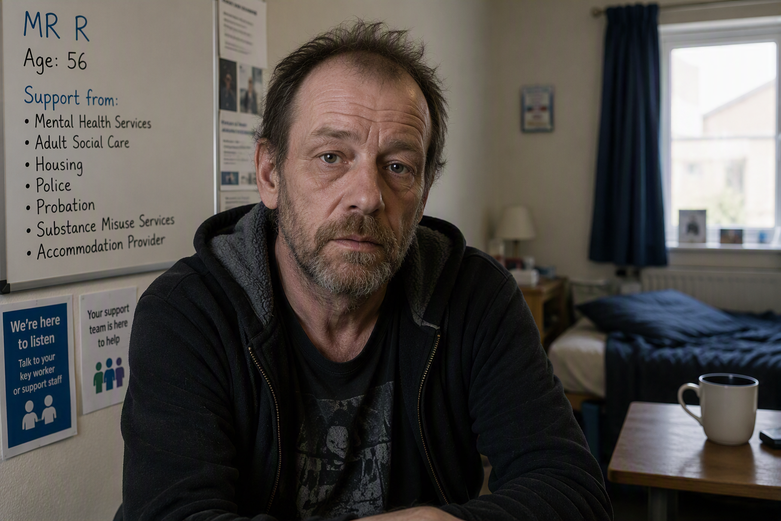
Mr R is a 56-year-old man living in supported accommodation. He has a diagnosis of schizophrenia alongside a long history of substance misuse. He is supported by multiple agencies including Mental Health Services, Adult Social Care, Housing, Police, Probation, Substance Misuse Services, and his accommodation provider.
Case Study 3
A. Presenting Problems
Current Concerns
Ongoing substance misuse.
Repeated fire-related incidents.
Smoking in prohibited areas.
Storage of cigarettes and lighters despite risks.
Verbal aggression towards staff and residents.
Increased risk to other residents within the service.
Concerns regarding placement sustainability.
High risk of homelessness if placement breaks down.
Significant risk of serious injury or death.
Continues to make unwise decisions despite having capacity.

Slide 6
Case Study 3
B. Intervention
Multi-Agency Actions Completed
Multiple safeguarding enquiries completed.
Multi-agency risk management meetings convened.
Mental Capacity Act considerations completed.
Community Mental Health Team involvement.
Mental Health Act assessment undertaken.
Substance misuse services engaged.
Fire & Rescue Service RA completed.
Housing and commissioning teams involved.
Placement reviews completed.
Positive risk management plans developed.
Increased staffing and supervision implemented.
Alternative placements explored.
Regular review of risk assessments.
Senior management escalation across agencies.

Slide 7
Case Study 3
C. Onward Referrals
Community Mental Health Team.
Substance Misuse Services.
Fire and Rescue Service.
Housing Services.
Supported Living Provider.
Adult Social Care.
Commissioning Teams.
D. Outcome
Current Position
Risks remain critical despite sustained intervention.
Placement provider expresses concerns regarding ongoing viability.
Alternative solutions have not been identified.
Potential for serious harm remains significant.
Multi-agency partners remain unable to sufficiently reduce risks.
What next?
Reason for PREP
The combination of substance misuse, fire risk, placement instability, and risks to others presents a highly complex situation. PREP is requested to provide strategic oversight and identify any remaining positive risk management opportunities.

Slide 8

Case Study 4
A 45-year-old male lives alone in rented accommodation. He has a history of depression and anxiety but currently manages his own affairs and retains capacity. He works part-time and has supportive family members.
A. Presenting Problems
Current Concerns
Increasing social isolation.
Low mood.
Poor sleep.
Missed GP appointments.
Refusal of counselling support.
Increased alcohol consumption at weekends.
Family concerns regarding future deterioration.
B. Intervention
Actions Completed So Far
GP review completed.
Mental health support offered.
Social prescribing referral made.
Welfare checks completed.
Family discussions facilitated.
Depression and anxiety screening undertaken.
Voluntary sector support identified.

Slide 9
Case Study 4
C. Onward Referrals
Talking Therapies.
Social Prescribing Team.
Community Support Groups.
GP Follow-Up.
D. Outcome
Current Position
Remains engaged with professionals.
Risks are currently low to moderate.
No safeguarding concerns identified.
Additional support options remain available.
No immediate risk of serious harm or death.
What next?
Why This Does Not Meet PREP Criteria
What Would Need to Happen Before PREP Could Be Considered?
Risk is not critical.
Engagement with services continues.
Existing pathways remain available.
Multi-agency intervention has not been exhausted.
Risks can be managed through existing health and community support pathways.
Significant escalation in risk.
Repeated disengagement from all services.
Frequent crisis presentations or hospital admissions.
Serious concerns regarding self-neglect or safety.
Multi-agency interventions exhausted with risks remaining critical.

Slide 10
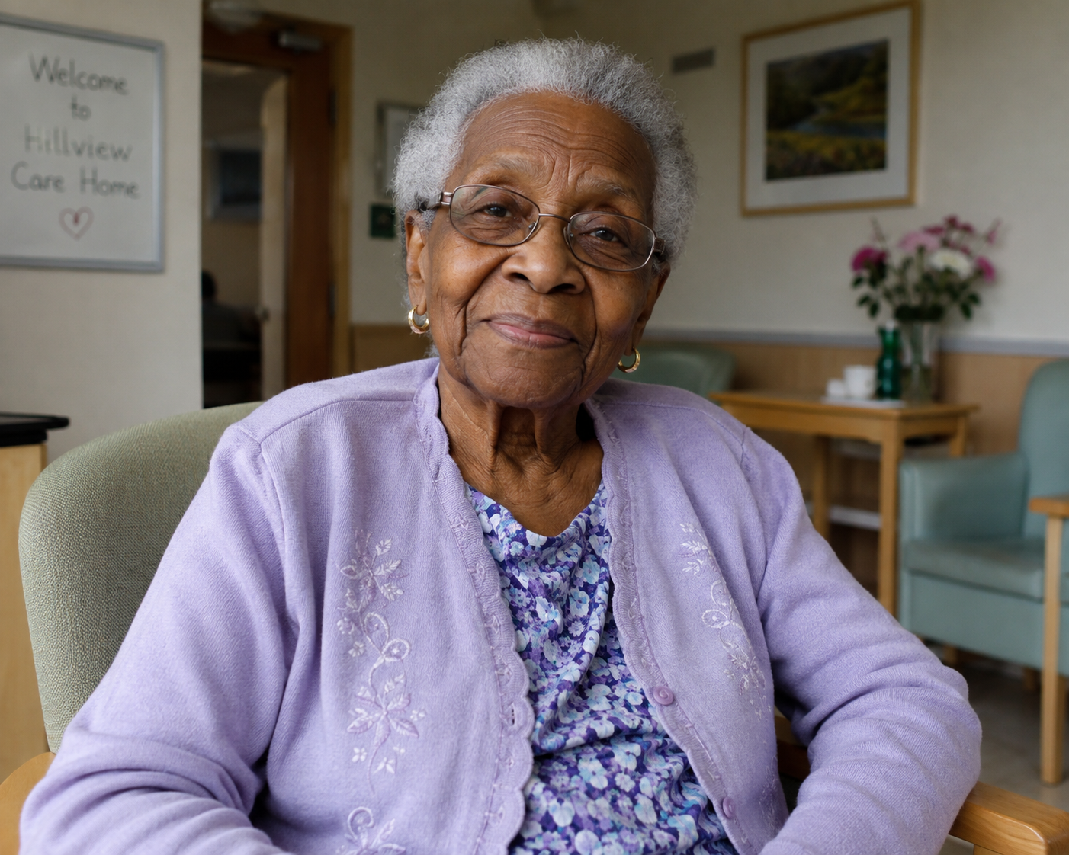
Case Study 5
An 82-year-old woman resides in a residential care home and has a diagnosis of dementia. She lacks capacity regarding care and accommodation decisions. Her family remains actively involved in planning and reviewing her care.
A. Presenting Problems
Current Concerns
Occasional attempts to leave the care home.
Distress when routines change.
Refusal of personal care.
Episodes of aggression towards residents.
Increasing confusion.
Family concerns regarding safety.
B. Intervention
Actions Completed So Far
Capacity assessment completed.
Best Interest meeting undertaken.
Mental Health Team involved.
Care plan reviewed and updated.
Family meetings completed.
Environmental adaptations implemented.
GP review undertaken.

Slide 11
Case Study 5
C. Onward Referrals
Older Adults Mental Health Team.
GP.
Occupational Therapy.
Ongoing Care Home Reviews.
D. Outcome
Current Position
Risks are understood and actively managed.
Family and professionals work collaboratively.
Care plans remain effective.
Current placement remains stable.
Further interventions remain available.
What Would Need to Happen Before PREP Could Be Considered?
What next?
Why This Does Not Meet PREP Criteria
Continued escalation of behaviours despite intervention.
Repeated serious incidents placing herself or others at risk.
Breakdown of current placement.
Multiple agencies unable to reduce ongoing critical risk.
Exhaustion of care, safeguarding, legal, and health interventions with a significant risk of serious harm remaining.
Risks are being managed successfully.
Existing care arrangements remain effective.
No critical risk of serious harm or death.
Multi-agency intervention has not been exhausted.
PREP escalation would be premature.

