Slide 1
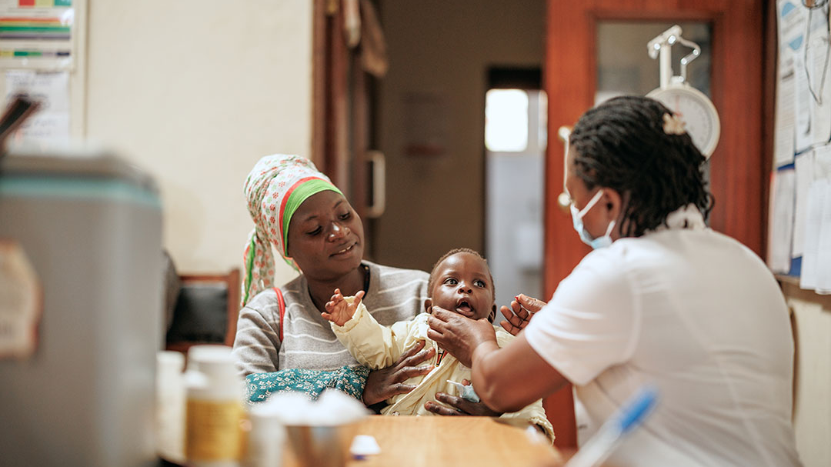
Bridging Evidence and Practice: Prevalence, Determinants, and Perspectives on Missed-Opportunities for Vaccination in Ebonyi State, Southeast Nigeria
Dr Chika J Anyigor
Public Health Department, School of Society, Community, and Life Science, Bedfordshire University

Slide 2
Study Overview & Key Findings
Bridging Evidence and Practice: MOV in Ebonyi State, Nigeria
Children 0–23 months, 12 health facilities_
Background
- MOV = Missed-Opportunities for Vaccination
- Major barrier to IA2030 targets, worsened post-COVID-19
- Sub-national evidence from Nigeria is limited
Methods
Design: Cross-sectional mixed-methods study
Quantitative: 423 caregivers, interviewer-administered questionnaires, SPSS analysis
Qualitative: FGDs + KIIs with caregivers & health workers, http://ATLAS.ti thematic analysis

Slide 3
Key Results
MOV Prevalence: 5.9%
Highest MOV: Follow-up doses — _Pentavalent-Dose-2_ & _PCV-Dose-2_
Significant Predictors:
1. Caregiver knowledge of VPDs & schedule
2. Child’s sex
3. Distance to vaccination site
Qualitative Themes:
Caregivers: Value vaccines, but face forgetfulness, logistics, stockouts
Health workers: Prioritize acute care, but support "vaccination-on-contact"

Slide 4
Conclusion
Closing the Gap: Actionable Insights for IA2030
Conclusion
MOV remains a preventable gap driven by:
1. Caregiver factors: Knowledge gaps, forgetfulness
2. Child factors: Sex disparities
3. Health-system factors: Distance, stockouts, missed sick-child visits

Slide 5
Recommendations
1. Strengthen "Vaccination-on-Contact": Vaccinate eligible children during any health-facility visit
2. Improve Caregiver Education: On VPDs, schedules, and importance of completing multi-dose vaccines
3. Enhance Service Access: Address distance barriers and reminder systems
4. Ensure Reliable Vaccine Supply: Prevent stockouts at facility level
Significance
Findings offer transferable lessons for LMICs to close immunization gaps and support post-pandemic recovery toward IA2030 goals.

