Slide 1
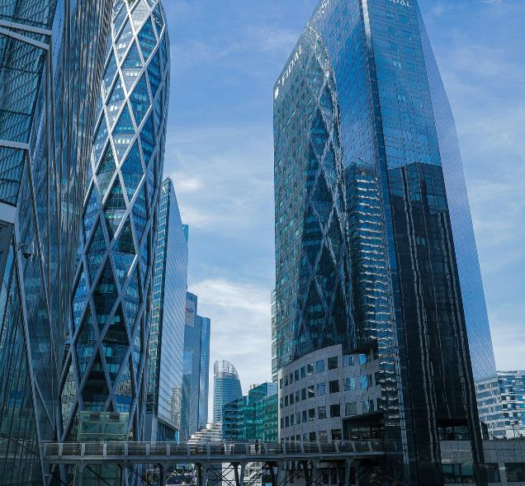
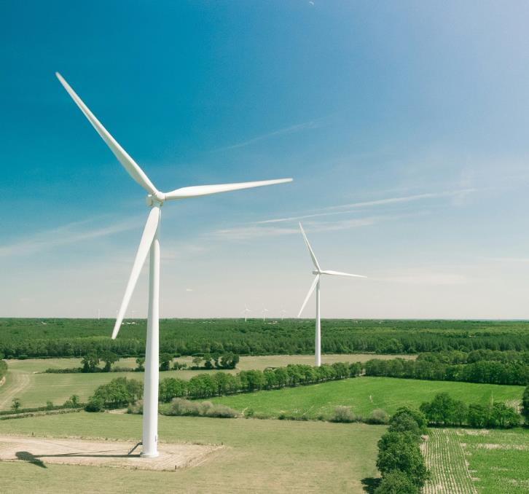





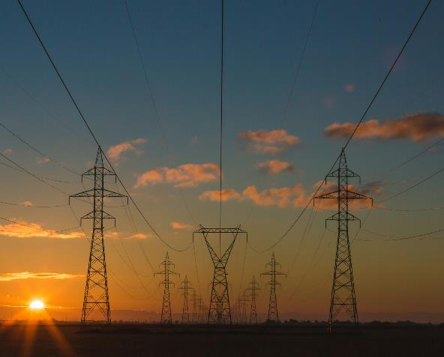
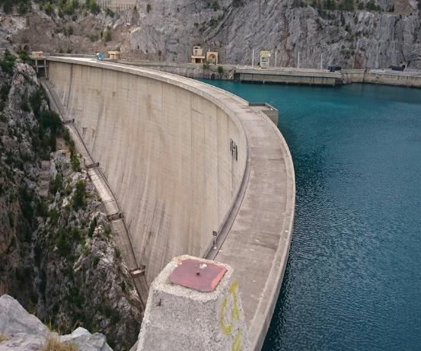
OCTOBER 6-10, 2025
FRANCE ENERGY TRANSITION
& INNOVATION TOUR 2025
Australian Trade & Investment Delegation
Connecting Australian businesses with France’s leading energy transition and innovation ecosystem

Slide 2
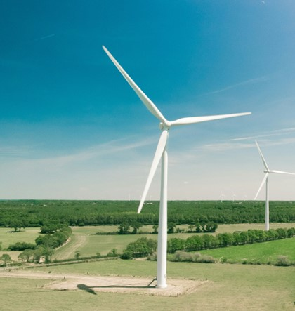



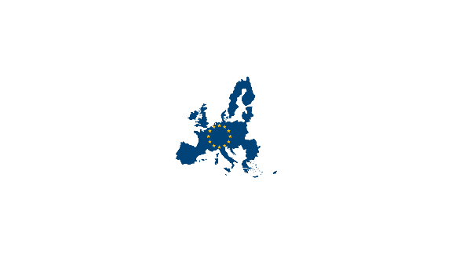

BACKGROUND
The French-Australian Chamber of Commerce & Industry (FACCI), the Franco-Australian Indo-Pacific Centre for Energy Transition (FACET), the Embassy of France to Australia, Business France, and La French Tech Australia invite you to join the France Energy Transition & Innovation Tour 2025, a unique opportunity to explore France’s leadership in clean energy and innovation.
The France Energy Transition & Innovation Tour 2025, supported by both governments, will explore the vital connection between the French and Australian energy industries, offering participants first-hand exposure to France’s world-leading expertise in renewable energy, hydrogen, energy storage, and electrification.
Our objective is to create business-to-business opportunities for Australian companies, particularly those in the clean energy sector, by facilitating high-level networking, site visits, and strategic discussions with France’s top industry players, research institutions, and policymakers.
This delegation will provide exclusive access to cutting-edge technologies, innovative energy solutions, and investment opportunities, helping Australian businesses forge valuable partnerships within France’s dynamic energy ecosystem and the broader European market.
WHY FRANCE?
A Leader in Energy Transition
Innovation & Industrial Strength
Ambitious Energy Targets
Carbon neutrality by 2050
40% of France's energy mix from renewables in 2040 (27% achieved in 2023)
Doubling photovoltaic energy & biogas by 2030
Quadrupling geothermal energy and expanding offshore wind farms
Home to global energy giants: EDF, Engie, TotalEnergies, VINCI Energies…
Leading in renewable energy (hydro, geothermal, offshore wind, floating offshore wind, biomass, waste to energy) industry decarbonisation and hydrogen in Europe
Top European producer of high-efficiency heating/cooling through heat pumps
A Gateway to European Markets
Investment & R&D Hub
Access to 450 million consumers across the EU
Strategic position for scaling energy projects internationally
Strong government incentives & funding for energy transition
Cutting-edge research in hydrogen, energy storage, efuel and smart grids
A thriving ecosystem for partnerships and technological collaboration

Slide 3
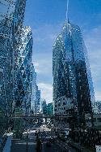

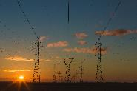
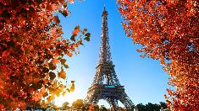
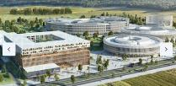



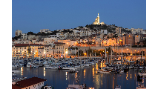
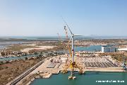
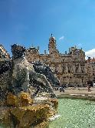
MISSION’S AGENDA
Tuesday 7/10
DAY 2 – PARIS & SUBURBS Paris-Saclay: The Heart of Innovation
Paris-Saclay isn’t just a research hub, it’s where business and technology converge. With 50% of France’s most innovative companies based here, alongside 1,000 deep-tech startups and major industrial players, this visit offers direct access to cutting-edge clean energy solutions.
Wednesday 8/10 & Thursday 9/10
Monday 6/10
DAY 3 & 4 – GRENOBLE Grenoble – AI & Energy Powerhouse
Home to over 600 startups and industry leaders in AI-driven energy solutions, Grenoble is where research meets real-world application. In collaboration with CEA, Europe’s top patent producer in energy transition tech, you’ll explore groundbreaking advancements in hydrogen, smart grids, and advanced batteries.
The FACET symposium will be held on Day 3 and will pivot to a blend of institutional discussions, cross-sector panel discussions, and expert-led sessions.
Day 4 will include industrial visits: hydrogen, hydropower, next-generation batteries, smart grids, efuel production, and waste-to-energy facilities, among others.
DAY 1 – PARIS
Meet France’s Largest Energy Companies
in Paris
Kick off your journey in the French capital by engaging with senior executives from the country’s top energy and sustainability firms. This is your opportunity to forge strategic partnerships before diving into France’s world-class innovation ecosystem.
The day will include a visit to Station F, the world’s largest startup incubator.
Monday 13/10
Friday 10/10
OPTIONAL – MARSEILLE Extend your mission
Explore Marseille’s cutting-edge floating offshore wind and port decarbonisation projects, as well as e-Fuel production facilities. Gain firsthand insights into France’s leadership in maritime energy and connect with key industry players.
DAY 5 – LYON Pollutec 2025
Join one of the world’s leading trade shows for environmental and energy solutions, featuring 2,200 exhibitors and 50,000+ professionals from 120 countries, with tailored B2B meetings to connect Australian delegates with key industry players.

Slide 4






WHY YOU SHOULD PARTICIPATE
Access the energy ecosystem and key decision makers through business introductions and networking sessions
Develop a firsthand understanding of France’s transition towards Net Zero
Gain firsthand insights into the French market and stay informed about recent trends and reforms in France's energy sector, unlocking new opportunities for Australian energy companies.
Express Your Interest Now!
WHO SHOULD PARTICIPATE
Investors and Venture Funds
Are you an Australian company in the energy sector or affiliated industries looking to expand your network and explore cutting-edge innovations in France? This Delegation Tour is for you!
Including impact investors focused on sustainable energy, and private equity firms investing in infrastructure and cleantech innovation.
Energy Companies
Innovation-Driven Startups
Large companies and SMEs involved in the production of renewable energy, including wind, solar, hydroelectric, and biomass energy; Energy Network Operators such as electricity grids, smart grid systems and gas network.
Emerging Australian startups in green tech, such as climate-tech, AI for energy transition and transportech, energy efficiency, and emissions monitoring.
Government and Policy Makers
Universities and Research Institutions / Academic institutions
Including national and regional energy ministers, advisors, and public sector leaders who shape policy, regulation, and strategic investment in the energy transition, as well as local government representatives and municipal authorities leading clean energy and sustainability initiatives.
R&D teams within companies or independent innovation hubs focused on exploring new technologies and solutions for sustainable energy. This includes specialised labs dedicated to advancing clean energy solutions and initiatives aimed at developing the skills necessary for the energy transition.

Slide 5



IN PARTNERSHIP WITH TEAM FRANCE BUSINESS
TEAM FRANCE BUSINESS in Australia brings together several services and operators to support businesses and public authorities, including the Embassy of France, Business France, the French-Australian Chamber of Commerce and Industry (FACCI), the Franco-Australian Centre for Energy Transition (FACET), and La French Tech Australia.
New initiative supported by both French and Australian governments, the Franco-Australian Indo-Pacific Centre for Energy Transition (FACET) seeks to accelerate French-Australian projects in the energy transition, focusing on key areas such as e-fuels, hydrogen, photovoltaics (PV), energy storage, critical minerals, and the future of electric networks and grids.
The French-Australian Chamber of Commerce & Industry (FACCI) is a leading business network dedicated to fostering trade, investment, and innovation between France and Australia. Through strategic partnerships, industry events, and tailored support, FACCI connects businesses across key sectors, helping them expand, collaborate, and thrive in both markets.
The Embassy of France to Australia plays a key role in fostering diplomatic, economic, scientific, and cultural cooperation between France and Australia. Through strategic partnerships and initiatives, the Embassy supports bilateral trade, innovation, and sustainability efforts, reinforcing the strong relationship between both nations.
Launched in France in 2014, La French Tech began as an accreditation for cities with thriving tech startup ecosystems. Today, it recognizes and supports innovative French Tech communities worldwide. In 2023, La French Tech Australia was re-accredited for another three years, reinforcing its role in connecting and supporting French and Australian tech entrepreneurs.
Business France’s mission is to inform and support foreign investors in France while promoting the country’s economic appeal, its companies, and its regions. Supporting businesses in their international growth and export development, the agency also manages and expands the Volontariat International en Entreprises (V.I.E.) programme, fostering global career opportunities for young professionals.

Slide 6
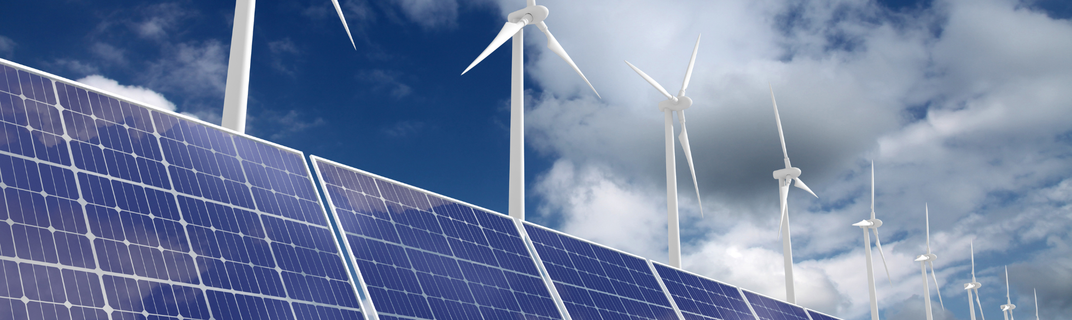
Registrations
include
Registrations
do not include
Investment
Full Meeting program participation
Meals and receptions during program
Ground transportation during program
Special invitations and cultural activities
Accommodations from Sunday 5th to Friday 10th*
International Airfare
Insurance
Visas and Visa Assistance
Incidentals
Optional Day in Marseille (cost TBC)
 | FACCI MEMBERS | NON-MEMBERS
SINGLE PASS | AUD $4,500 | AUD $5,500
DOUBLE PASS | AUD $ 7,500 | AUD $ 8,000
*Should you wish to organise your own accommodation, you can contact us to benefit from a preferential rate.

Slide 7
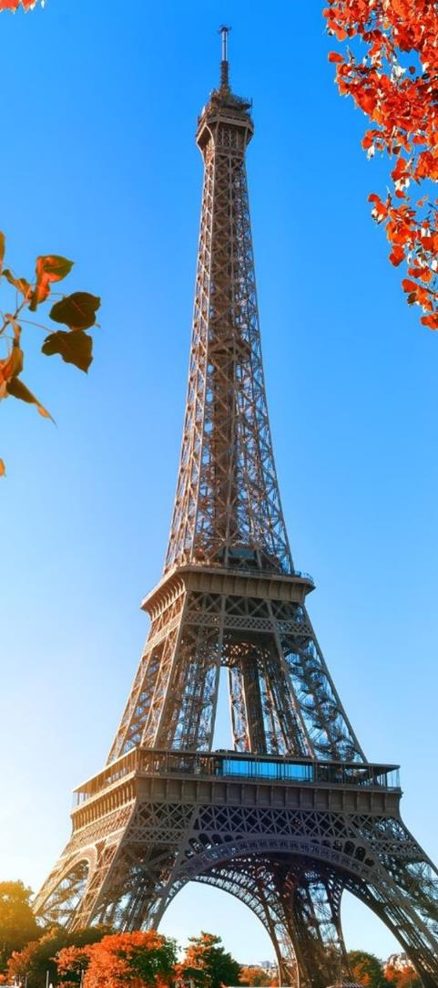


OCTOBER 6-10, 2025
CALL FOR EXPRESSION OF INTEREST (EOI)
We are accepting expressions of interest to join the France Energy Transition & Innovation Tour 2025 until 15 August 2025.
Limited places are available to ensure high-level access.
To express your interest in this trade delegation, please contact:
Paul Moing
Melanie Ducros
Head of the Victorian Chapter at FACCI
Franco-Australian Centre for Energy Transition (FACET)
Paul.moing@facci.com.au
&
mducros@swin.edu.au
Secure Your Spot Now!

