Slide 1
Survey of Likely General Election Voters
Mississippi Statewide
October 1 – 2, 2026 | n=501 | ±4.38%

Slide 2


Insights & Analysis
Voters split 43/45 on the state's direction. The Republican edge rests on partisanship, not on satisfaction with where Mississippi is headed.
  20% of Republicans say the state is on the wrong track. Independents say so 34/54, Black voters 14/76, and CD2 voters 27/66.
Voters' top issues are inflation (22%), crime (19%), healthcare (15%) and taxes (14%). These priorities split sharply by party.
  Republicans prioritize crime (26%), inflation (21%) and taxes (18%). Democrats lead with healthcare (28%) and inflation (24%).
Voters say they are more likely, 42/24, to back a candidate who supports school choice. The effect is mostly partisan.
  Republicans say more likely 52/17, while Independents split 32/30. Among college graduates it nets almost nothing at 37/36.
Restoring the ballot initiative wins 72/8. No other issue in the poll unifies voters like this, though only 6% call it their top priority.
  Republicans support it 78/5, Independents 75/10 and Democrats 66/11. It is softest among voters under 55 (64/11) and parents (63/14), though both still support it strongly.

Slide 3
Insights & Analysis
Homestead tax relief is popular: 57/25 for all homeowners and 70/15 for those 65+. Voters lack consensus on replacement revenue (35% local, 29% state, 36% unsure).
  Voters 55+ back the 65+ version 78/14, compared with 60/17 among voters under 55. Homeowners support it 75/15 and renters 52/17.
  Republicans back full repeal 67/17, while Democrats split 40/39. Voters prefer eliminating property tax over car tags 51/35, but Black voters prefer car tags 46/38.
Voters oppose continuing to recruit data centers 48/28. Concern about electricity costs outweighs the promise of jobs across nearly every group.
  Women oppose it 20/51 and voters under $50K oppose it 20/51. Even voters earning $100K+ oppose it 40/50, and definite Republican voters support it only 43/36.
The school district consolidation is tied at 37/38.
  Consolidation faces opposition from voters under $50K (25/50), Black voters (24/49) and women (30/42). Men (46/33) and Republicans (47/32) support it.
After hearing the test score argument, support grew from 41% to 50% and opposition fell from 39% to 27%. The margin went from +2 to +23, a +21 net shift.
  10% of all voters moved directly from oppose to support. Swing voters flipped from 31/43 to 41/31.

Slide 4
Insights & Analysis
The most persuadable audiences are older, non-college and rural.
  Women 55+ (31% of voters) move +41 net. That is nearly double the +21 topline and far ahead of men 55+, who move +19.
  Voters 55+ without a degree (39%) move +40, versus +16 for college-educated seniors. White non-college voters (42%) move +34, versus +11 for white college graduates.
  Rural voters (43%) move +34, compared with +17 in small towns and +10 in suburbs. CD1 (25%) moves +35, while CD2 shows no net movement.
The test score argument drives movement in every audience above, but it barely registers with parents.
  Parents move just +4 net (48/35 to 50/33), versus +28 for non-parents. Voters under 55 move only +8.

Slide 5
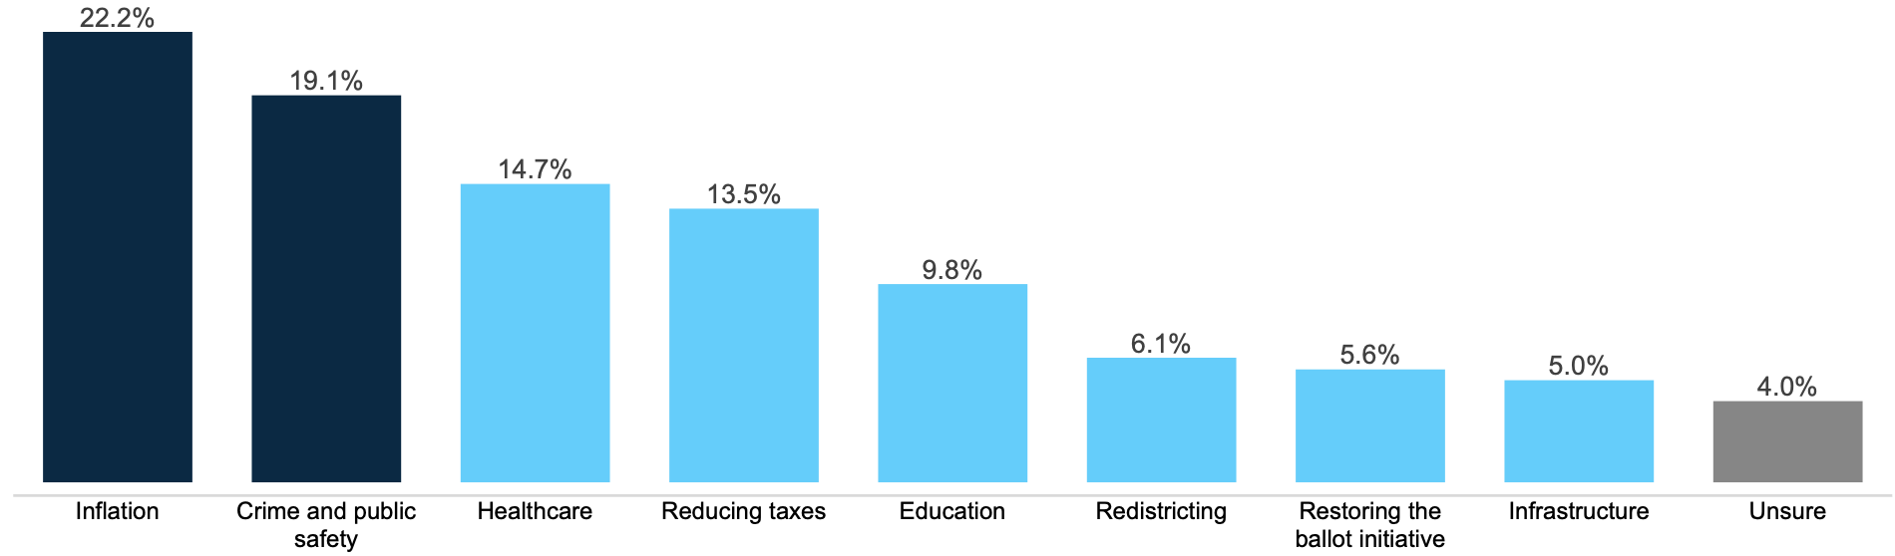
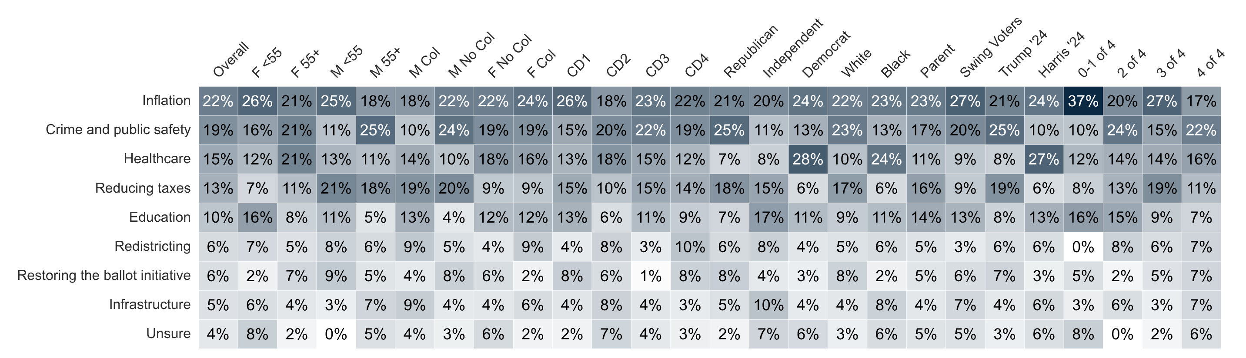
Top Priority
Which one of the following issues is the most important to you in the election for Mississippi State House of Representatives?

Slide 6
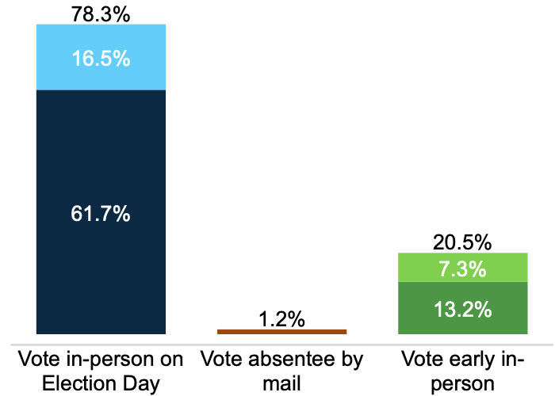
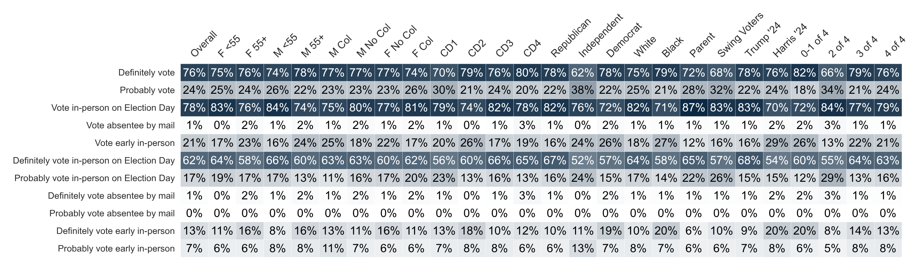
Vote Method
How do you plan to vote in the November general election for U.S. Congress, Mississippi State Legislature, and other state offices?

Slide 7
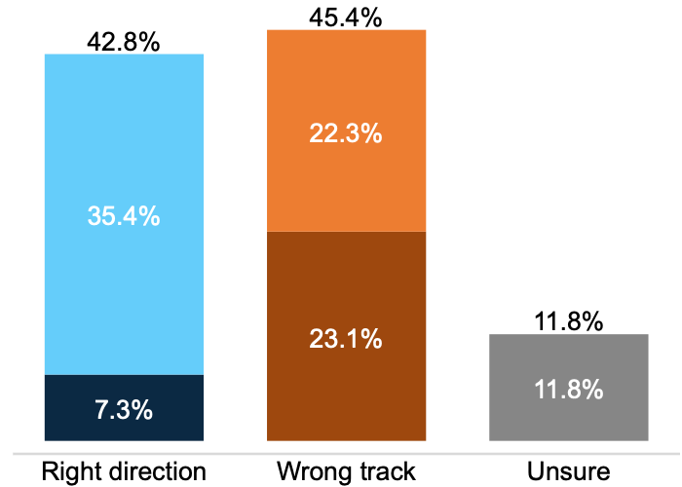
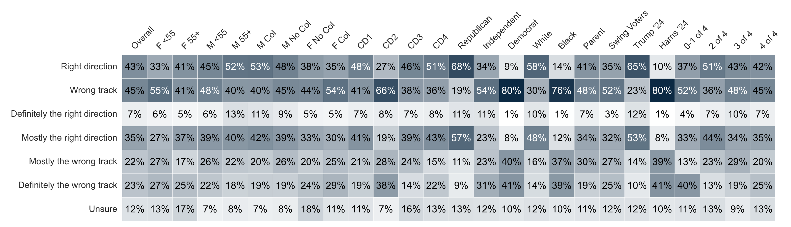
State Direction
Generally speaking, would you say things in Mississippi are headed in the right direction or off on the wrong track?

Slide 8
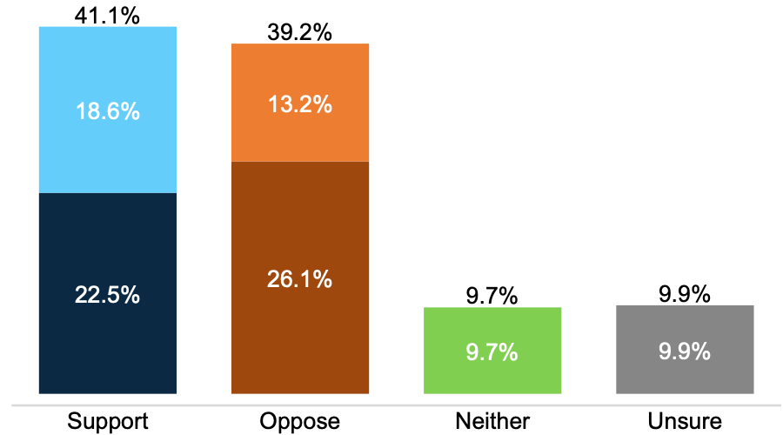
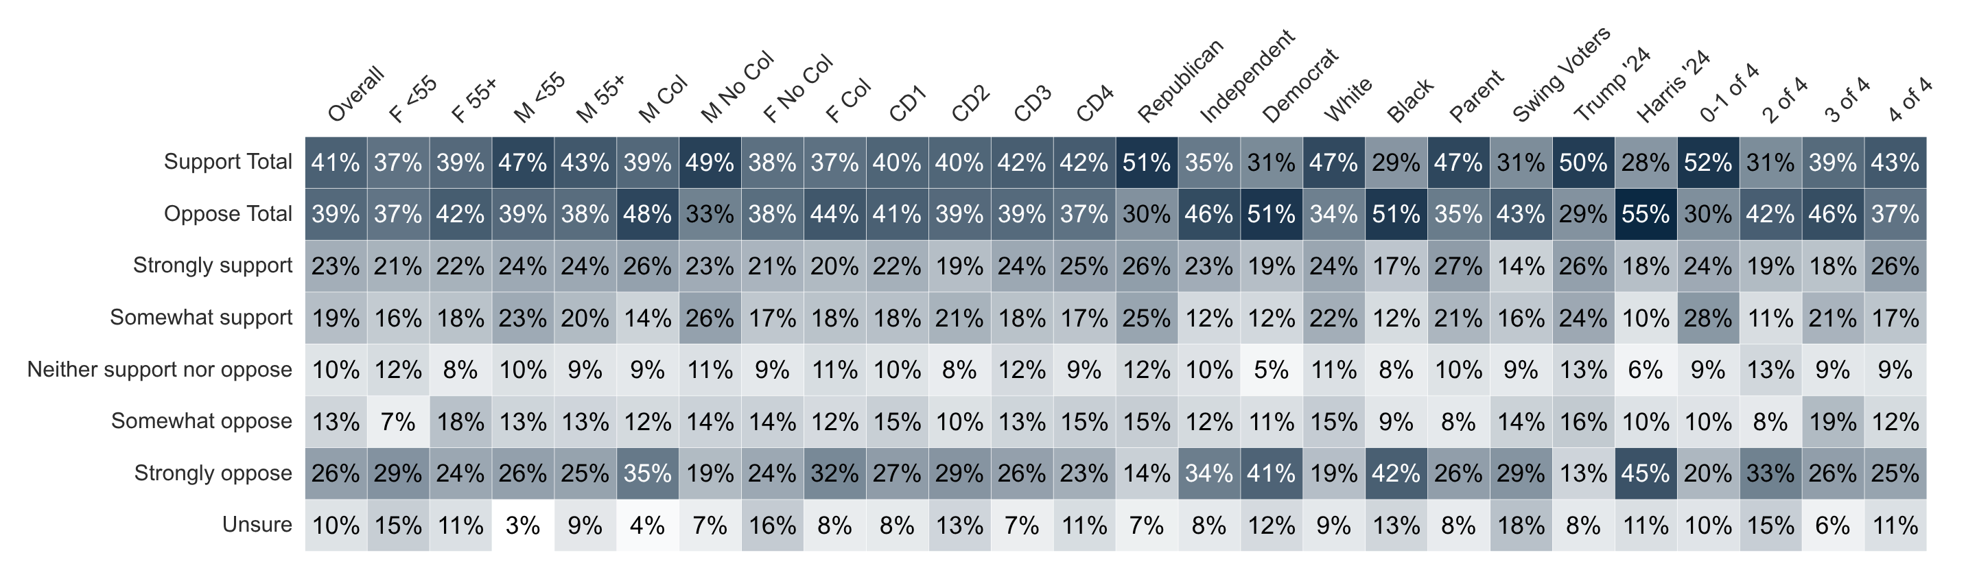
Initial School Choice
Last session, the Mississippi House of Representatives passed legislation creating the Magnolia Student Accounts program, which would let eligible families use a portion of public education funding for approved expenses like private school tuition, tutoring, or transportation. Do you support or oppose this program?

Slide 9
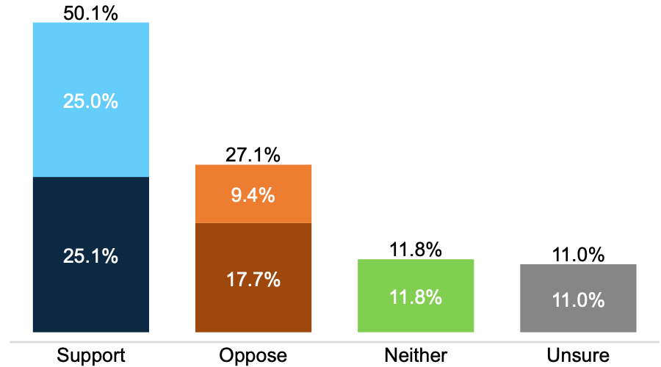
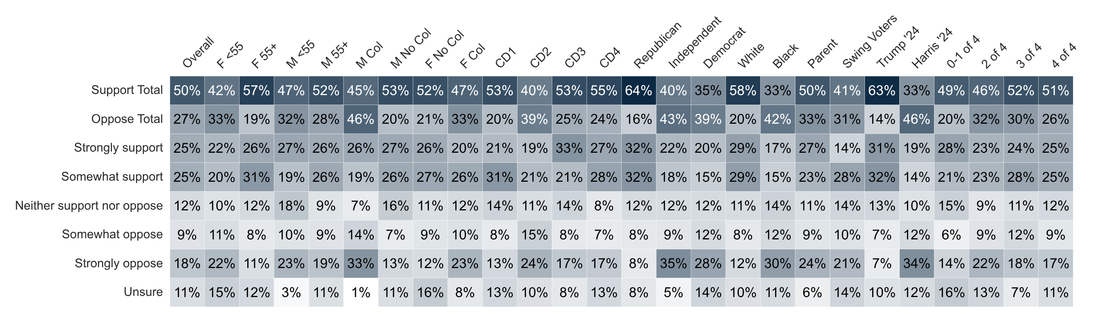
Informed School Choice
Supporters point to other states with existing school choice programs, where student test scores have improved in both public and private schools as a result of increased options and competition. Knowing this, do you support or oppose creating a school choice program in Mississippi like the one described in the last question?

Slide 10
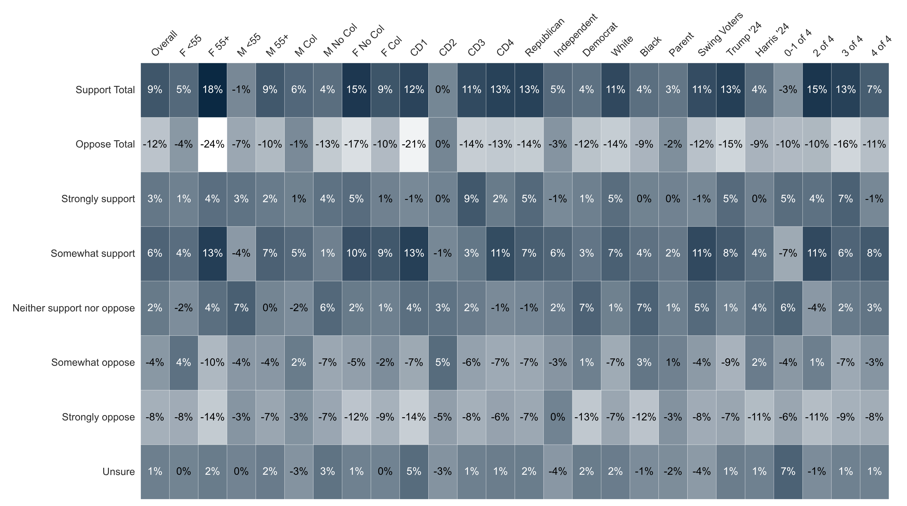
Percent Change: Initial to Informed School Choice

Slide 11
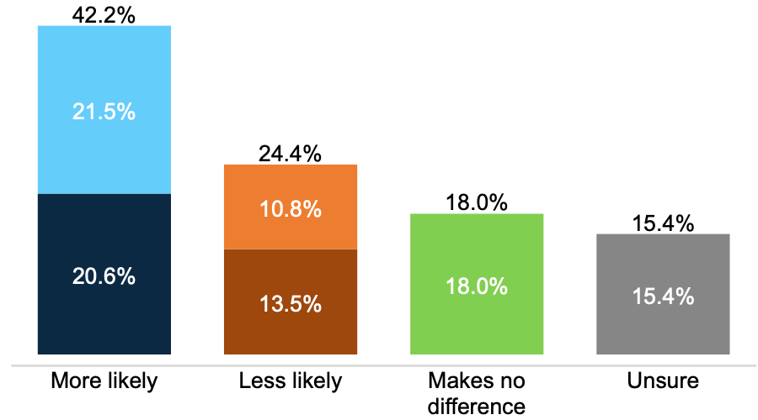
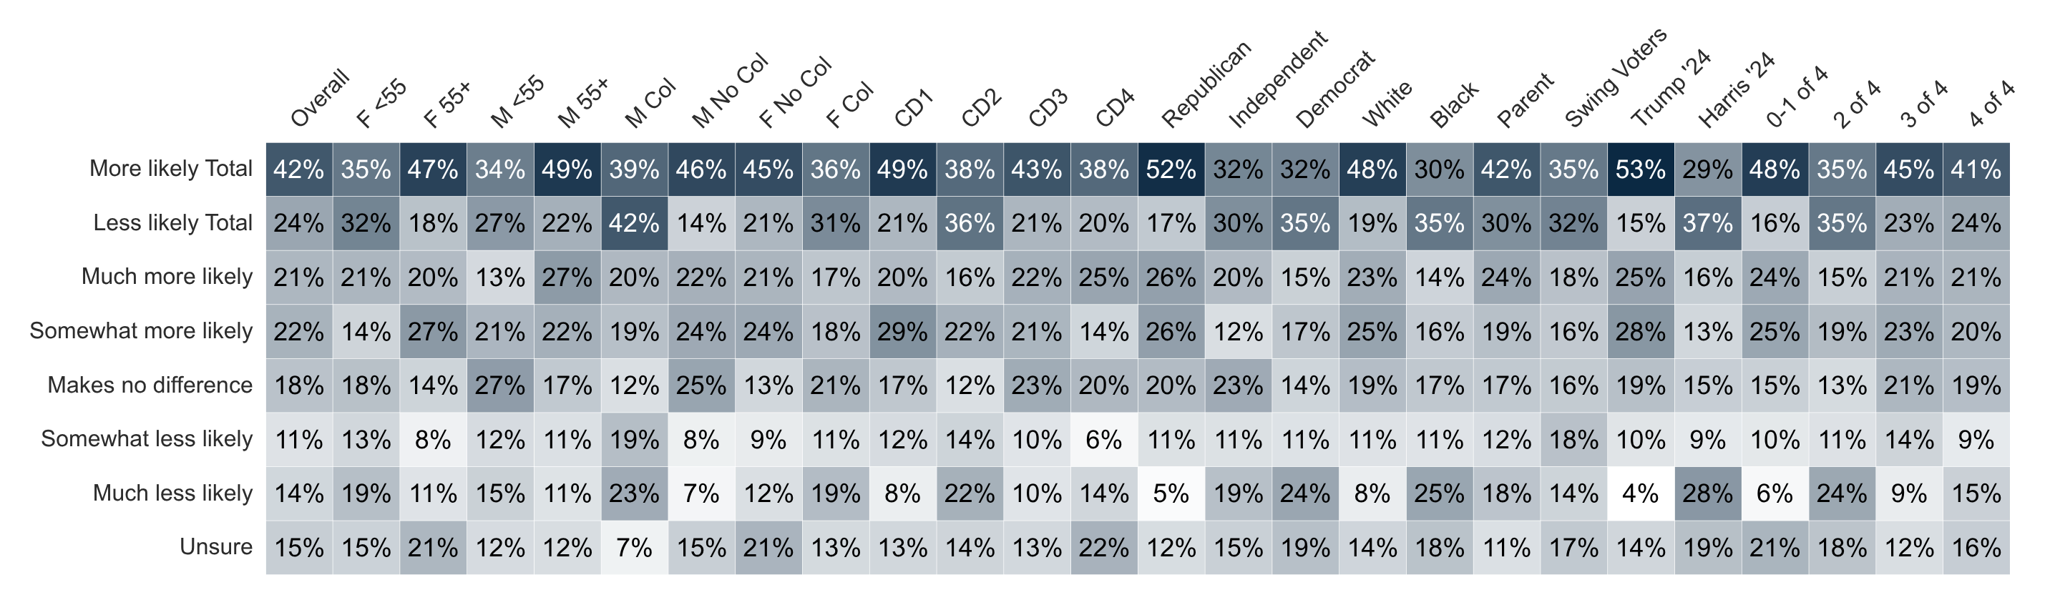
School Choice Candidate Impact
If a candidate supports school choice in Mississippi, would you be more or less likely to support the candidate?

Slide 12
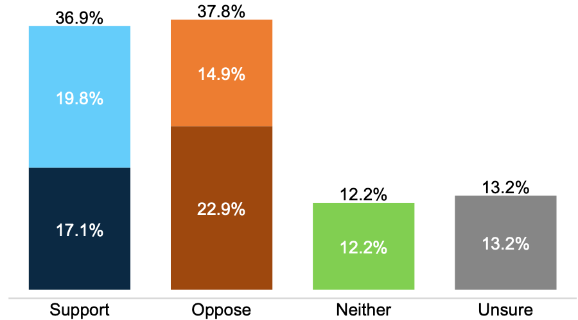
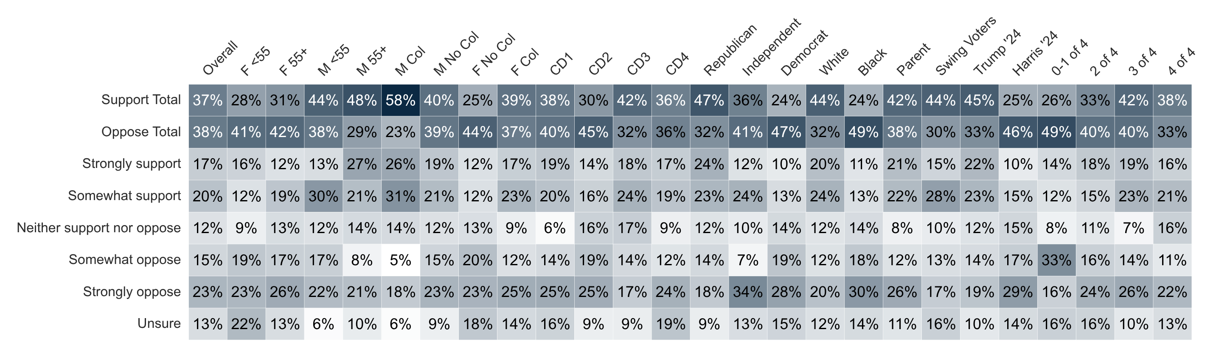
School District Consolidation
Some Mississippi lawmakers are considering consolidating school districts to reduce administrative costs — combining districts that currently each have their own superintendent, central office, and school board into a single district with one superintendent, one central office, and one school board, while keeping local schools open. Do you support or oppose this kind of school district consolidation?

Slide 13
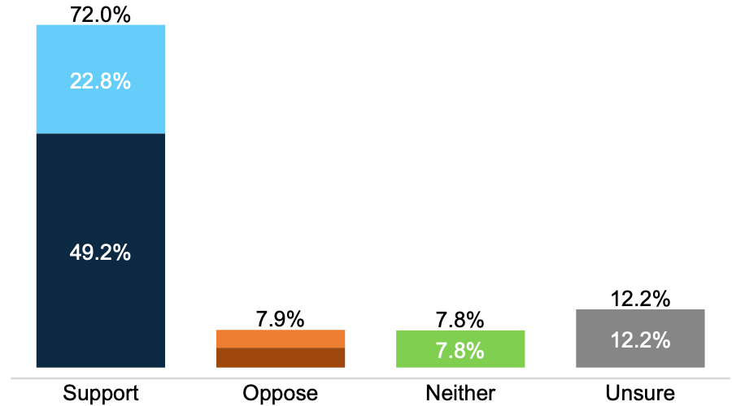
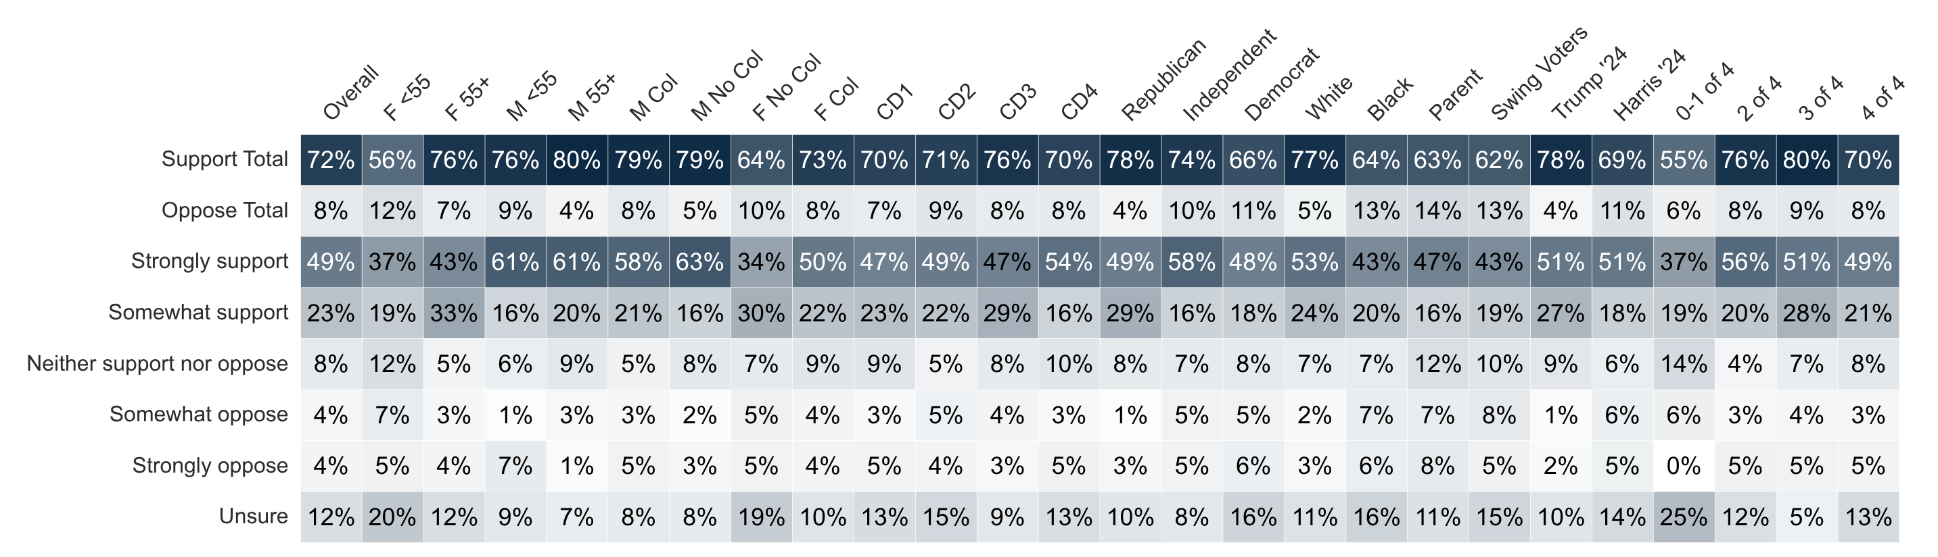
Ballot Initiative Restoration
Mississippi voters lost the ability to place laws or constitutional amendments directly on the statewide ballot in 2021, after the state Supreme Court struck down the process on a technicality. Since then, voters have had no way to bypass the Legislature to change state law. Do you support or oppose restoring a ballot initiative process that would let Mississippi voters gather signatures to place proposed laws or constitutional amendments on the statewide ballot?

Slide 14
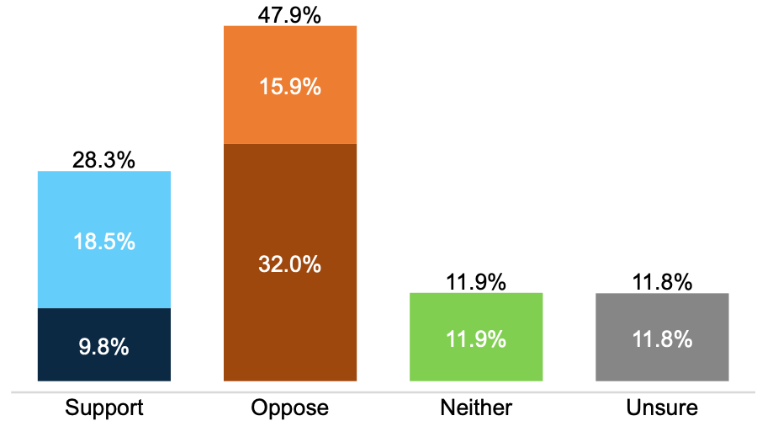
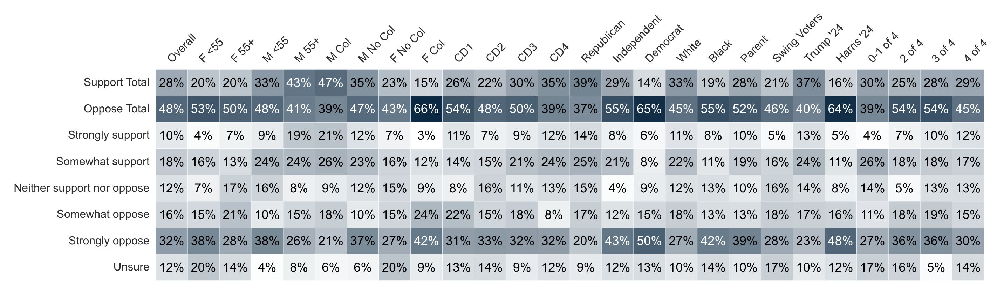
Data Centers
Mississippi has recruited several large data center projects in recent years by offering companies tax exemptions in exchange for jobs and investment. Some residents and officials have raised concerns that these projects could raise electricity costs for everyday Mississippians, while supporters cite job creation and investment in local communities. Do you support or oppose the state continuing to recruit data centers to Mississippi?

Slide 15
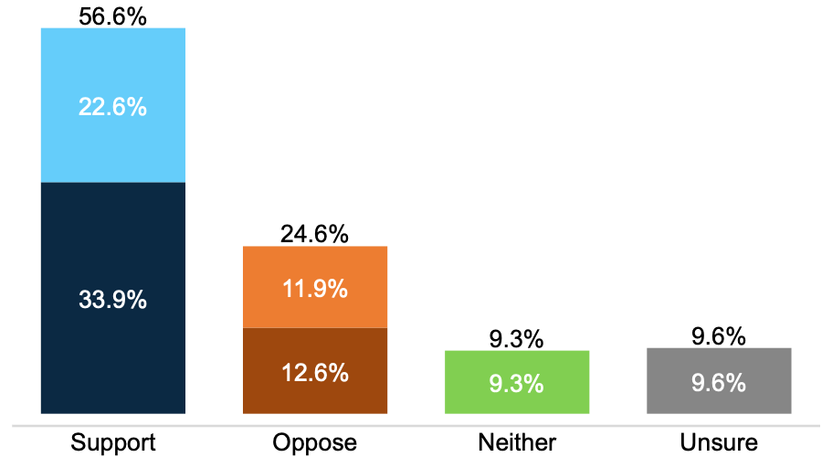
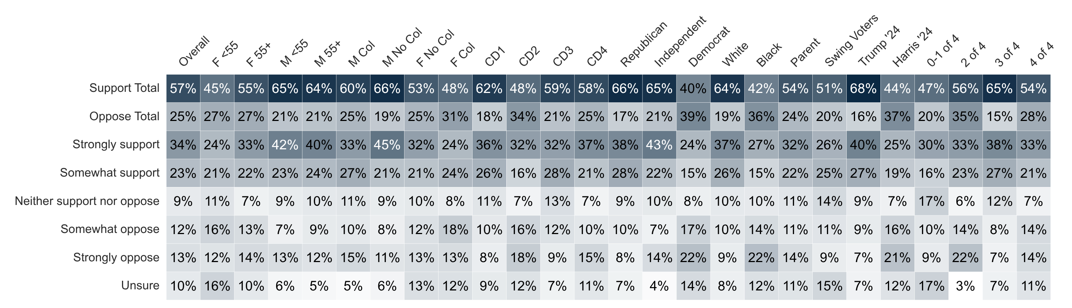
Property Taxes – All Homesteads
Some Mississippi lawmakers have proposed eliminating property taxes on homestead property — the tax homeowners pay on their primary residence — and offsetting the lost revenue to counties by raising the state sales tax or levying a local option sales tax. Do you support or oppose eliminating property taxes on homestead property in Mississippi?

Slide 16
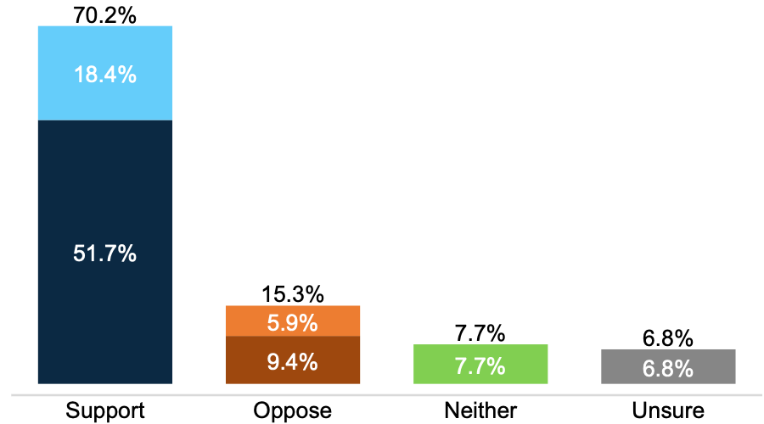
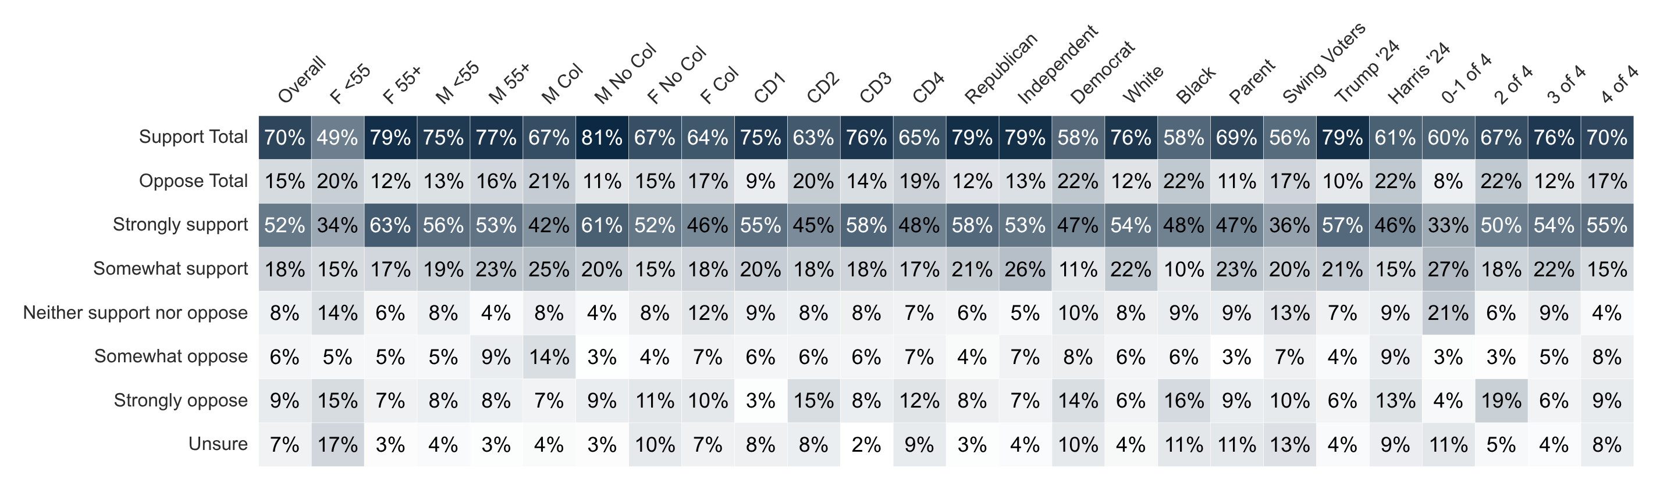
Property Taxes – 65+
Some Mississippi lawmakers have proposed eliminating property taxes on homestead property — the tax homeowners pay on their primary residence — for homeowners age 65 and older, and offsetting the lost revenue to counties by raising the state sales tax or levying a local option sales tax. Do you support or oppose eliminating property taxes on homestead property for Mississippians age 65 and older?

Slide 17
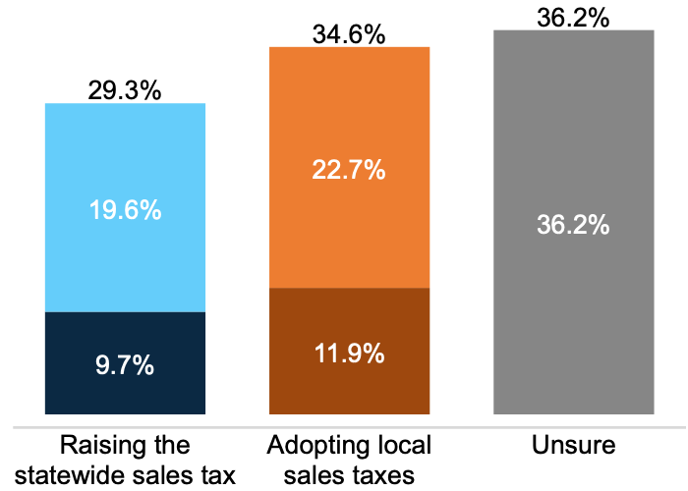
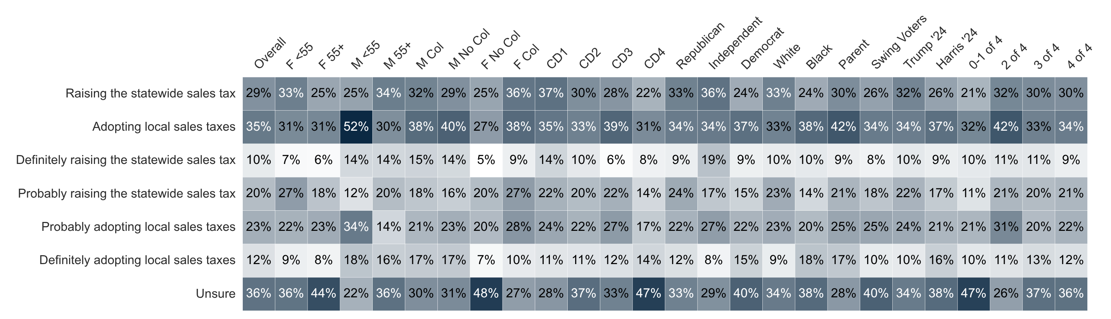
Preference for Property Tax Issue
If Mississippi eliminates property taxes on homestead property, the lost revenue to counties would need to be made up in some way. Which of the following would you prefer: raising the statewide sales tax, which is currently 7%, or establishing a local option sales tax that cities and counties could choose to adopt?

Slide 18
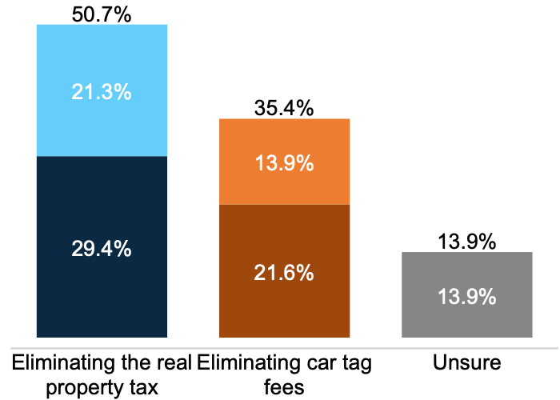
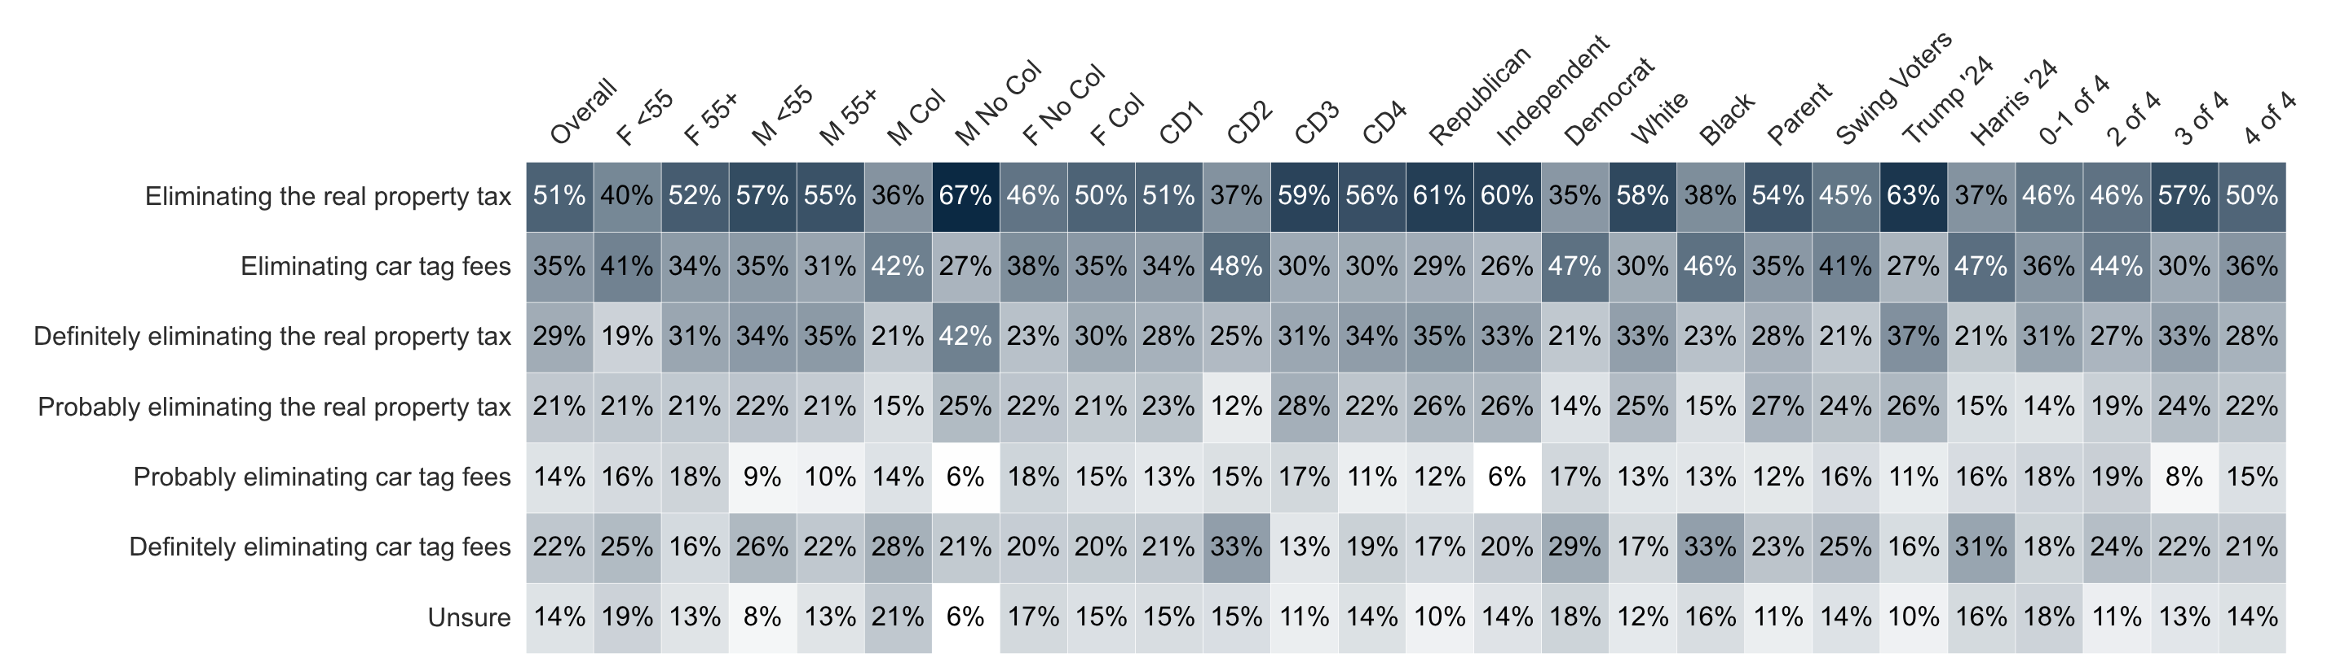
Property Tax vs. Car Tags
Mississippi lawmakers are considering different ways to reduce taxes on residents. Which of the following would you prefer: eliminating the real property tax on homestead property, or eliminating car tag fees?

Slide 19
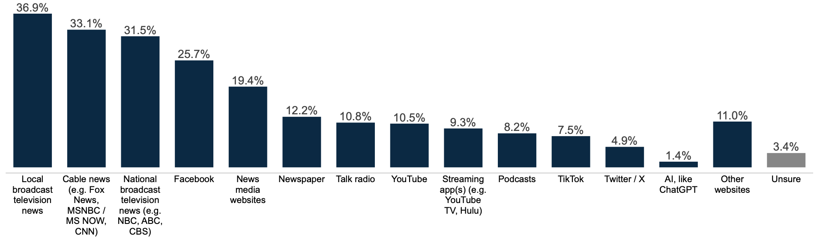
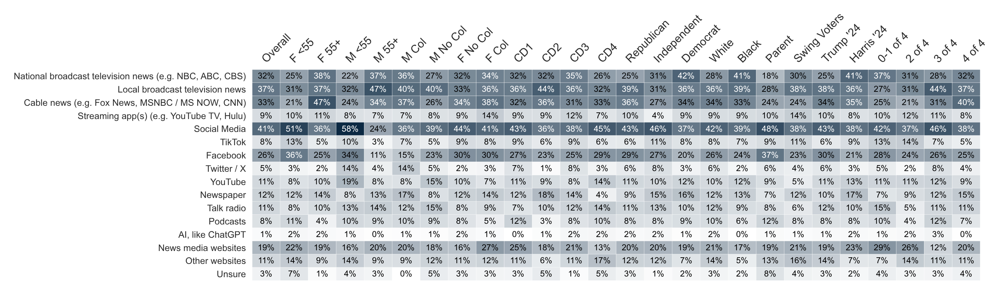
News Source
What are your primary sources for news? Select up to three options.

Slide 20


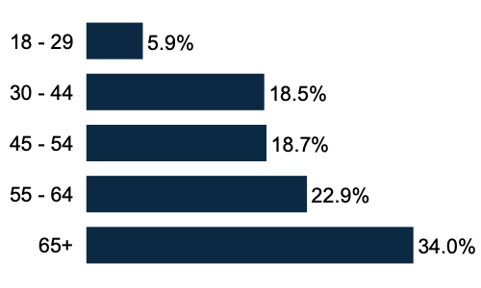
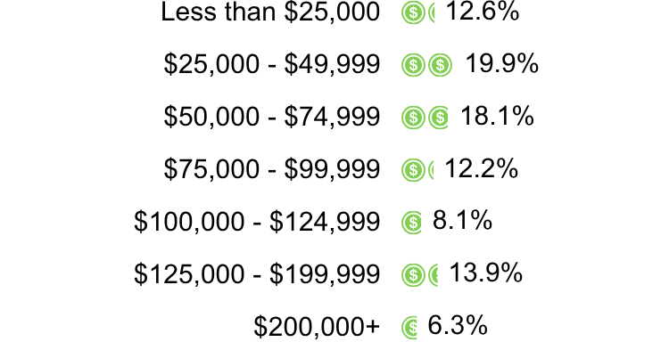
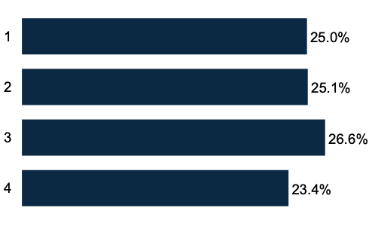

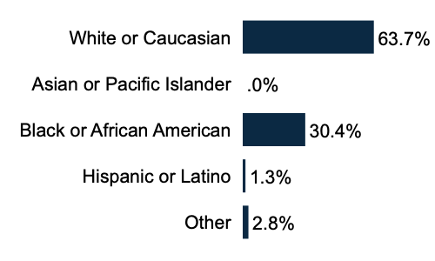
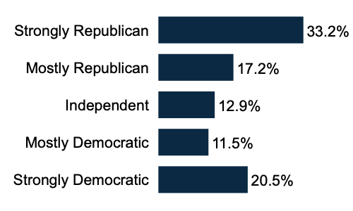
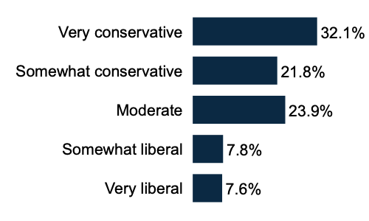
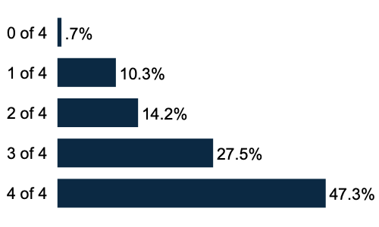
Demographics
Sex
Age Range
Household Income
56.8% Female
43.2% Male
Geo - CD
Education
Race/Ethnicity
36.3%
have at least
a College degree
62.7% have no college degree
Partisanship
Ideology
General Election X of 4
Sample size: 501

