Slide 1
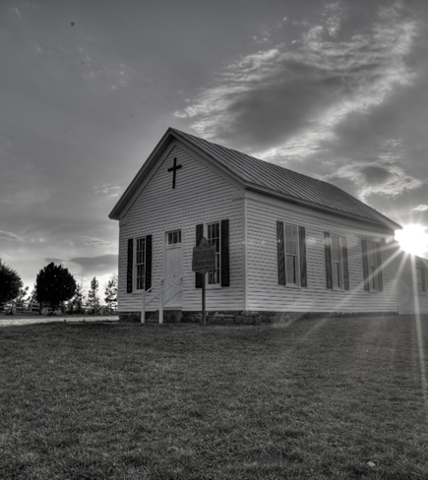
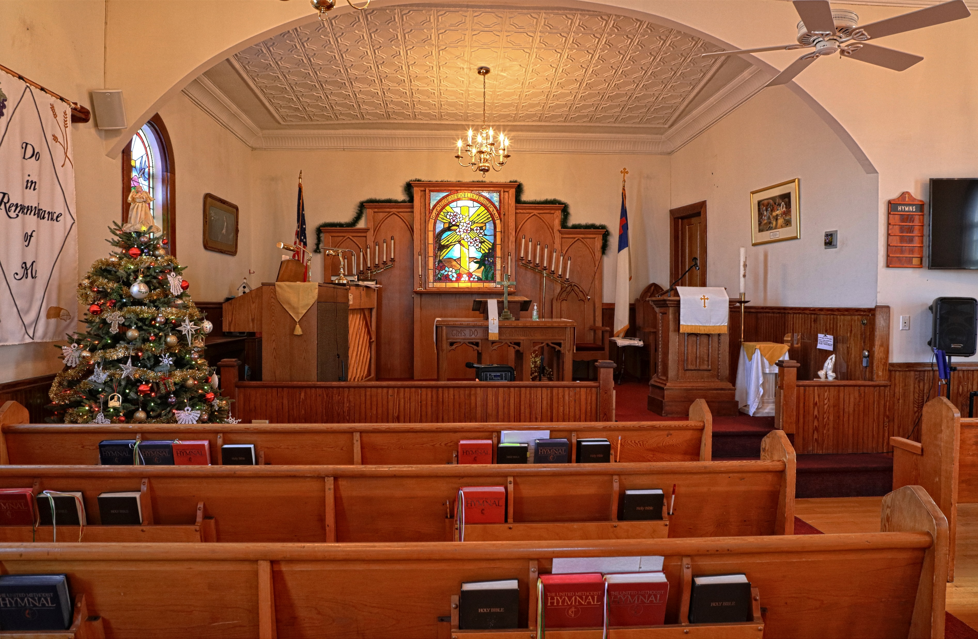
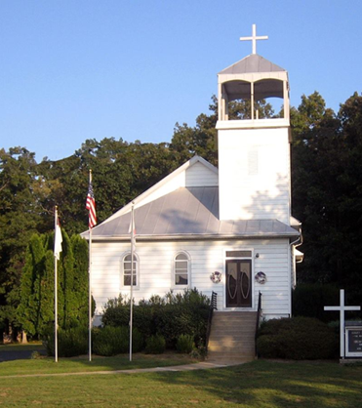

WELCOME!
Asbury United Methodist Church
Open Doors with Loving Hearts
July 5, 2026

Slide 2
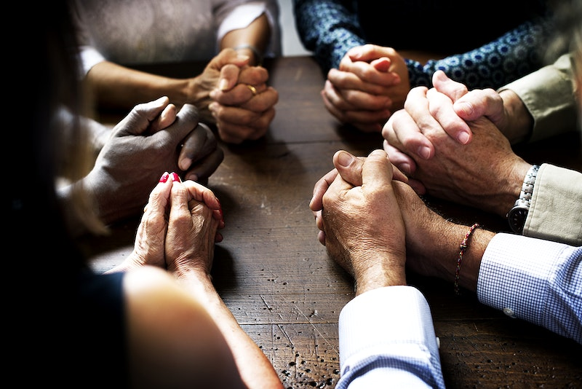

PRELUDE

Slide 3
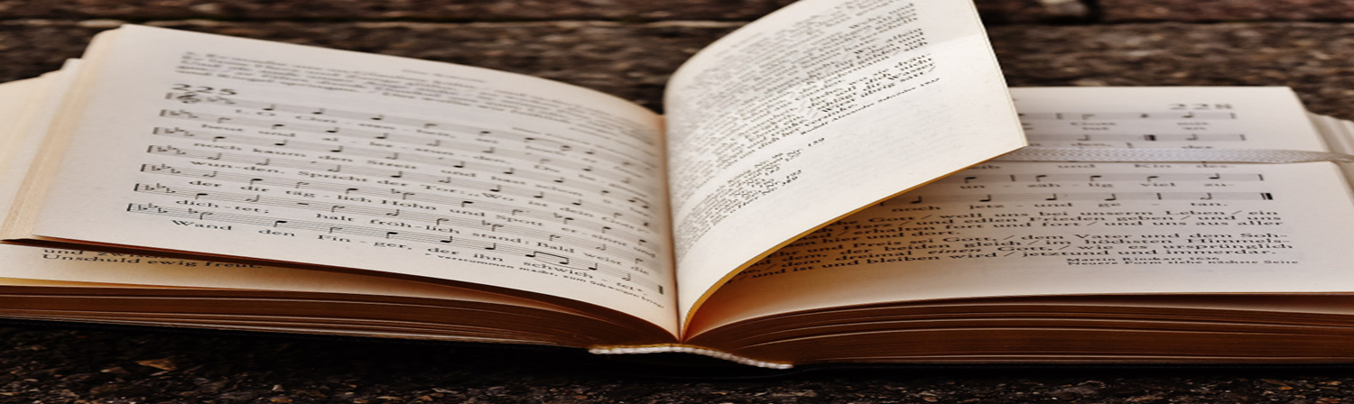
CENTERING SONG
We Have Come into this House

Slide 4
Sweet, Sweet Spirit
(Verse)
We Have Come into this House
We have come into His house And gathered in His name to worship Him
We have come into His house And gathered in His nameto worship Him

Slide 5
We have come into His house And gathered in His name to worship Christ the Lord.
Worship Him, Christ, the Lord.
.

Slide 6
Sweet, Sweet Spirit
(Refrain)
So, forget about yourself And concentrate on Him and worship Him
So, forget about yourself And concentrate on Him and worship Him

Slide 7
So, forget about yourself
And concentrate on Him
and worship Christ the Lord.
Worship Him, Christ, the Lord.

Slide 8
Let us lift up holy hands And magnify His name and worship Him
Let us lift up holy hands And magnify His name and worship Him

Slide 9
Let us lift up holy hands
And magnify His name
and worship Christ the Lord.
Worship Him, Christ, the Lord.

Slide 10
“DOXOLOGY”
Praise God, from whom all blessings flow; Praise Him, all creatures here below;
Praise Him above, ye heavenly host; Praise Father, Son, and Holy Ghost! Amen.

Slide 11
CALL TO WORSHIP

Slide 12

Leader: Come, let us worship the Lord, the Giver of every good and perfect gift.
People: We give thanks for His mercy, His faithfulness, and the freedom we have in Jesus Christ.
Leader: If the Son sets you free, you will be free indeed.

Slide 13
People: We come to worship the One who calls us to love, justice, peace, and faithful service.
All: Let us worship God with grateful hearts and joyful praise. Amen.

Slide 14
OPENING SONG
“Blessed Assurance ”

Slide 15
Take My Life, and Let It Be
(Verse 1)
Blessed Assurance
369
WORDS: Fanny J. Crosby, 1820-1915 )
1. . Blessed assurance, Jesus is mine! O what a foretaste of glory divine!
Heir of salvation, purchase of God, born of his Spirit, washed in his blood.

Slide 16
Refrain
r
This is my story, this is my song, praising my Savior all the day long; this is my story, this is my song, praising my Savior all the day long.

Slide 17

Take My Life, and Let It Be
(Verse 2)
2. Perfect submission, perfect delight, visions of rapture now burst on my sight; angels descending bring from above echoes of mercy, whispers of love.

Slide 18
Perfect submission, all is at rest; I in my Savior am happy and blest, watching and waiting, looking above, filled with his goodness, lost in his love.

Slide 19
OPENING PRAYER

Slide 20
Almighty and Everlasting God,
We gather in Your presence with grateful hearts, thankful for the blessings You have bestowed upon us and, above all, for the freedom we have through Jesus Christ. As we worship You today, cleanse our hearts of unrighteousness, renew our minds, and fill us with Your Holy Spirit. Teach us to love mercy, seek justice, walk

Slide 21
humbly with You and serve our neighbors in the spirit of Christ. May all that we say and do bring glory to Your holy name. Through Jesus Christ our Lord. Amen.

Slide 22
WELCOME
&
ANNOUNCEMENT

Slide 23


Birthday/Anniversary

Slide 24
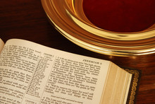
OFFERING
Praising God with Our Gifts
Open Doors with Loving Hearts

Slide 25
“OFFERTORY RESPONSE”
All Things Come Of Thee, O Lord, And Of Thine Own Have We Given Thee. Amen.

Slide 26
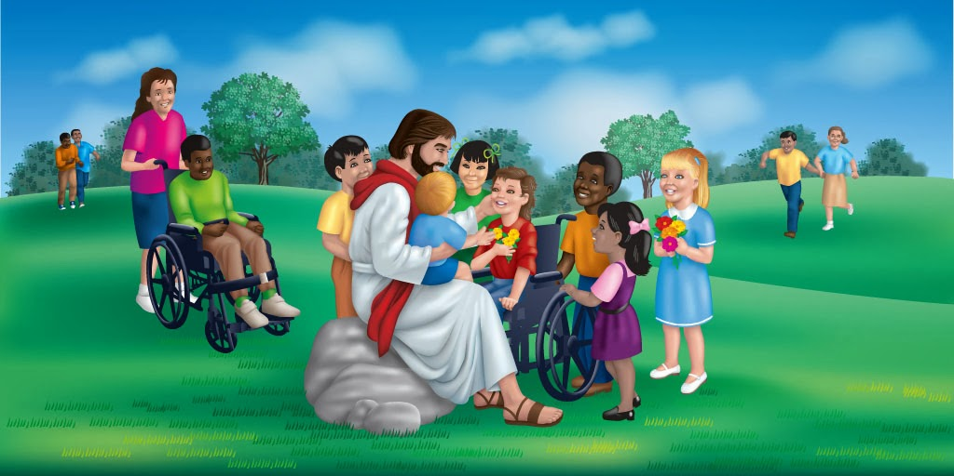
CHILDREN’S MESSAGE

Slide 27
PRAYER FOR ILLUMINATION
Lord, as we prepare to hear Your Holy Word, open our hearts and minds through the power of Your Spirit. Quiet every distracting voice and help us hear the voice of Christ speaking to His Church. As we reflect upon the blessings of freedom, remind us that true freedom is found in Your Son, Jesus Christ. Teach us to love mercy, seek justice, walk humbly with You, and serve one another. Amen.

Slide 28
Scripture
Matthew 22:21

Slide 29
21. "Render therefore unto Caesar the things that are Caesar's; and unto God the things that are God's."

Slide 30

Sermon: When the Cross Examines the Flag

Slide 31
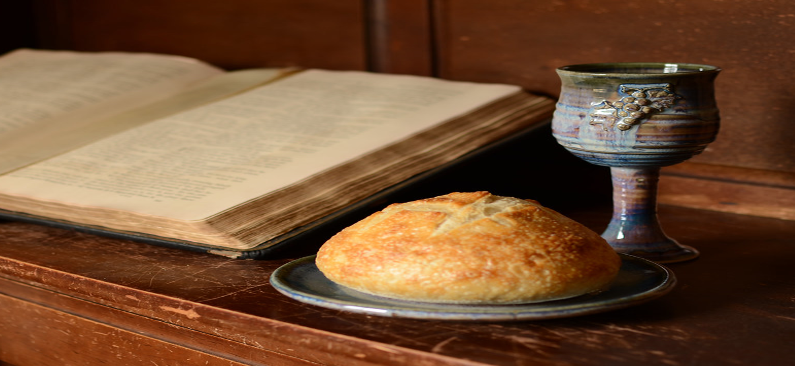

SERMON dead Religion and corrupt power.
SERMON

Slide 32
SERVICE OF WORD AND TABLE II
Christ the Lord invites to
his table all who love him,
who earnestly repent
of their sin
and seek to live in peace
with one another.

Slide 33
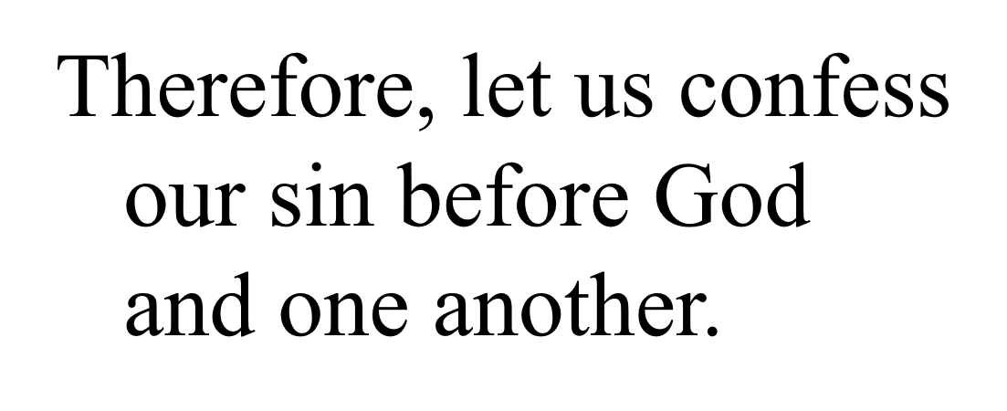

Slide 34
CONFESSION AND PARDON
Merciful God,
we confess that we have not
loved you with our
whole heart.
We have failed to be
an obedient church.

Slide 35
We have not done your will,
we have broken your law,
we have rebelled
against your love,
we have not loved
our neighbors,
and we have not heard the
cry of the needy.

Slide 36
Forgive us, we pray.
Free us for joyful obedience,
through Jesus Christ our Lord.
Amen.

Slide 37
Hear the good news:
Christ died for us while
we were yet sinners;
that proves God’s love
toward us.

Slide 38
In the name of Jesus Christ,
you are forgiven!
In the name of Jesus Christ,
you are forgiven!
Glory to God. Amen.

Slide 39
THANKSGIVING AND COMMUNION
The Lord be with you.
And also with you.
Lift up your hearts.
We lift them up to the Lord.

Slide 40
Let us give thanks
to the Lord our God.
It is right to give our
thanks, and praise.

Slide 41
It is right, and a good
and joyful thing,
always and everywhere
to give thanks to you,
Father Almighty,
creator of heaven and earth.

Slide 42
And so,
with your people on earth
and all the company of heaven
we praise your name and
join their unending hymn:

Slide 43
Holy, holy, holy Lord,
God of power and might,
heaven and earth are
full of your glory.
Hosanna in the highest.

Slide 44
Blessed is he who comes
in the name of the Lord.
Hosanna in the highest.

Slide 45
Holy are you, and blessed
is your Son Jesus Christ.

Slide 46
By the baptism of his suffering,
death, and resurrection
you gave birth to your church,
delivered us from slavery
to sin and death,
and made with us a
new covenant
by water and the Spirit.

Slide 47
On the night in which he
gave himself up for us,
he took bread,
gave thanks to you,
broke the bread,
gave it to his disciples
and said:

Slide 48
“Take, eat;
this is my body which is
given for you.
Do this
in remembrance of me.”

Slide 49
When the supper was over,
he took the cup,
gave thanks to you,
gave it to his disciples,
and said:

Slide 50
“Drink from this, all of you;
this is my blood
of the new covenant,
poured out for you
and for many
for the forgiveness of sins.

Slide 51
Do this, as often
as you drink it,
in remembrance of me.”

Slide 52
And so,
in remembrance of these your
mighty acts in Jesus Christ,
we offer ourselves in praise
and thanksgiving as a
holy and living sacrifice,
in union with Christ’s
offering for us,

Slide 53
as we proclaim the
mystery of faith.
Christ has died;
Christ is risen;
Christ will come again.

Slide 54
Pour out your Holy Spirit
on us gathered here,
and on these gifts of
bread and wine.

Slide 55
Make them be for us the body
and blood of Christ,
that we may be for the world
the body of Christ,
redeemed by his blood.

Slide 56
By your Spirit make us
one with Christ,
one with each other,
and one in ministry
to all the world,

Slide 57
until Christ comes in
final victory
and we feast at his
heavenly banquet.

Slide 58
Through your Son
Jesus Christ,
with the Holy Spirit
in your holy church,
all honor and glory is yours,
almighty Father,
now and forever.
Amen.

Slide 59
CELEBRATION OF HOLY COMMUNION
Breaking the Bread
and
Sharing the Cup

Slide 60
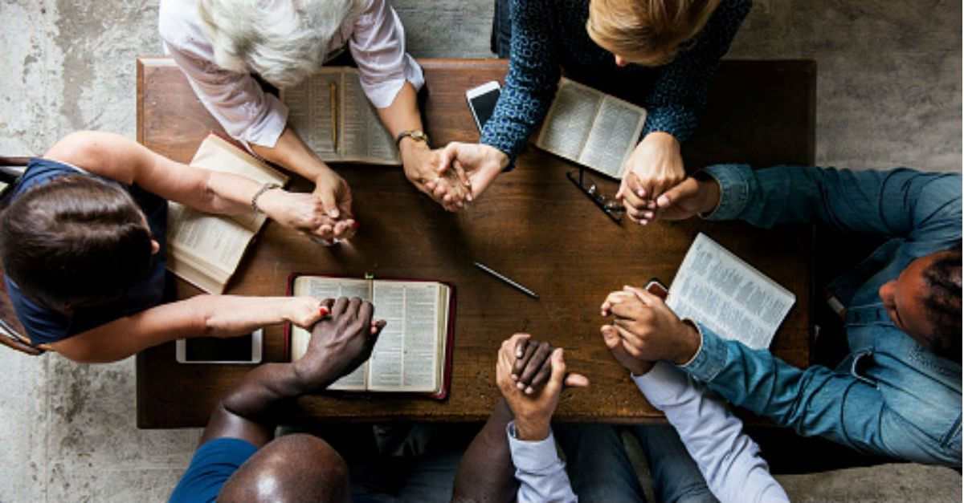
PRAYERS OF THE PEOPLE

Slide 61
The Lord’s Prayer
Our Father who art in heaven, hallowed be thy name thy kingdom come, thy will be done on earth as it is in heaven. Give us this day our daily bread; and forgive us our trespasses as we forgive those who trespass

Slide 62
against us. And lead us not into temptation, but deliver us from evil, for thine is the kingdom, and the power and the glory forever. Amen.

Slide 63
CLOSING SONG
“FREELY, FREELY”

Slide 64

Take My Life, and Let It Be
(Verse 1)
Freely, Freely
389
WORDS: Carol Owens in 1972 )
God forgave my sin in Jesus' name, I've been born again in Jesus' name, and in Jesus' name
I come to you, to share his love as he told me to.

Slide 65
Refrain
r
He said "Freely, freely you have received, freely, freely give. Go in my name, and because you believe, others will know that I live."

Slide 66
r
All power is given in Jesus' name, in earth and heaven in Jesus' name, and in Jesus' name
I come to you, to share his power as he told me to.
Refrain

Slide 67
BENEDICTION

Slide 68
Leader: Go in the peace of Christ, serving the Lord with gladness.
People: We will love, serve, and follow Christ wherever He leads.
Leader: May the grace of our Lord Jesus Christ, the love of God, and the fellowship of the Holy Spirit be with you all.
People: Amen.

Slide 69
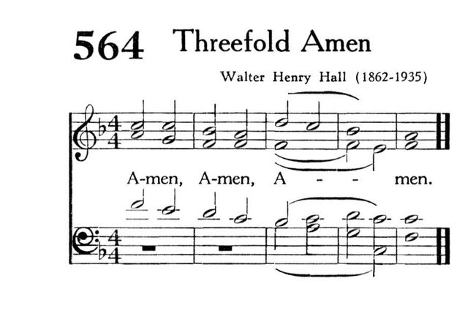

Slide 70

Carry out the light

