Slide 1
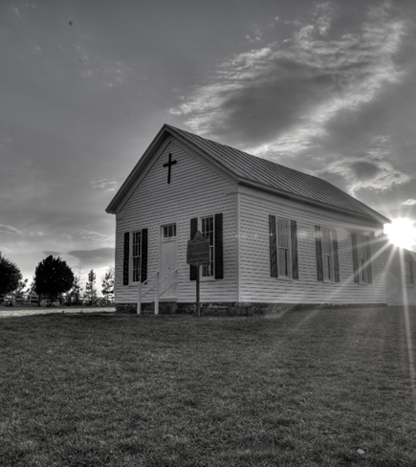
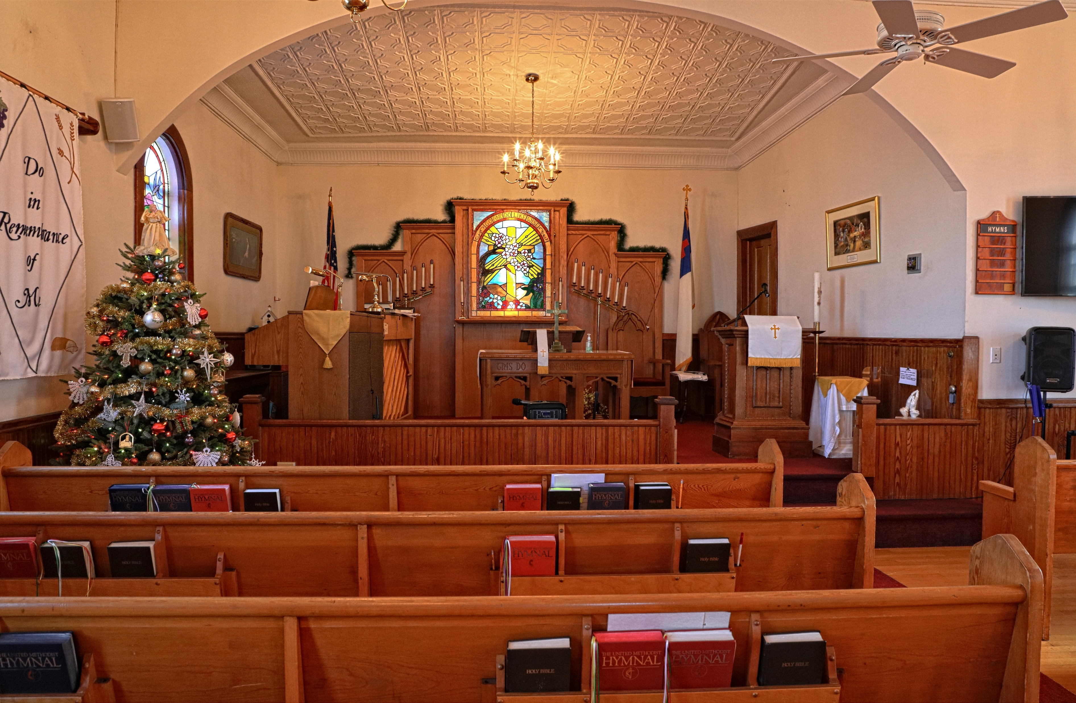
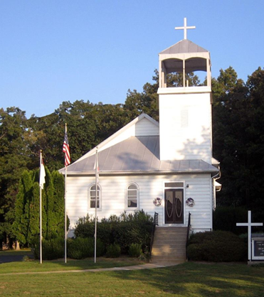

WELCOME!
Asbury United Methodist Church
Open Doors with Loving Hearts
July 58, 2026

Slide 2
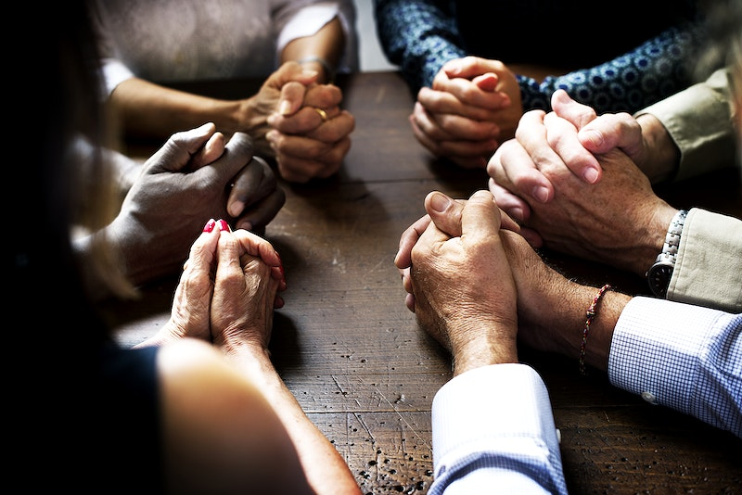

PRELUDE

Slide 3
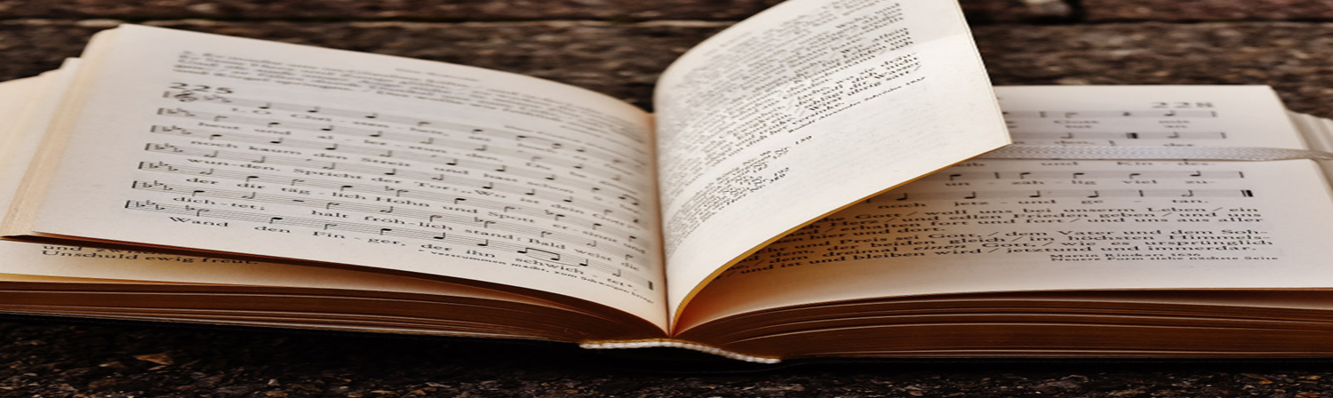
CENTERING SONG
SWEET, SWEET SPIRIT
UMH 334

Slide 4
Sweet, Sweet Spirit
(Verse)
Sweet, Sweet Spirit
334
WORDS: Doris Akers, 1962
There’s a sweet,
sweet Spirit
in this place,
and I know that it’s
the Spirit of the Lord
© 1962 Manna Music, Inc.

Slide 5
there are sweet
expressions
on each face,
and I know
they feel the presence
of the Lord.

Slide 6
Sweet, Sweet Spirit
(Refrain)
Refrain
Sweet Holy Spirit,
sweet heavenly Dove,
stay right here with us,
filling us with your love;

Slide 7
and for these blessings
we lift our hearts
in praise;

Slide 8
without a doubt
we’ll know
that we have
been revived
when we shall
leave this place.

Slide 9
“DOXOLOGY”
Praise God, from whom all blessings flow; Praise Him, all creatures here below;
Praise Him above, ye heavenly host; Praise Father, Son, and Holy Ghost! Amen.

Slide 10
CALL TO WORSHIP

Slide 11

Leader: Jesus Christ, our risen Lord, has called His Church into the world.
People: We come to worship and to renew our commitment to His mission.
Leader: Christ has all authority in heaven and on earth.

Slide 12
People: We will follow where He leads and serve where He sends.
Leader: Come, let us worship the Lord with gladness.
All: We worship Christ, who is with us always. Amen.

Slide 13
OPENING SONG
“I Am Thine, O Lord”

Slide 14
I Am Thine, O Lord
(Verse 1)
I Am Thine, O Lord
419
WORDS: Fanny J. Crosby 1875 (Heb. 10:22)
1. I am thine, O Lord,
I have heard thy voice,
and it told thy
love to me;

Slide 15
but I long to rise
in the arms of faith
and be closer
drawn to thee.

Slide 16
I Am Thine, O Lord
(Refrain)
Refrain
Draw me nearer,
nearer, blessed Lord,
to the cross where
thou hast died.

Slide 17
Draw me nearer, nearer,
nearer, blessed Lord,
to thy precious
bleeding side.

Slide 18
I Am Thine, O Lord
(Verse 2)
2. Consecrate me now
to thy service, Lord,
by the power of
grace divine;

Slide 19
let my soul look up
with a steadfast hope,
and my will be
lost in thine.

Slide 20
I Am Thine, O Lord
(Refrain)
Refrain
Draw me nearer,
nearer, blessed Lord,
to the cross where
thou hast died.

Slide 21
Draw me nearer, nearer,
nearer blessed Lord,
to thy precious
bleeding side.

Slide 22
I Am Thine, O Lord
(Verse 3)
3. O the pure delight
of a single hour
that before thy
throne I spend,

Slide 23
when I kneel in prayer,
and with thee, my God,
I commune as
friend with friend!

Slide 24
I Am Thine, O Lord
(Refrain)
Refrain
Draw me nearer,
nearer, blessed Lord,
to the cross where
thou hast died.

Slide 25
Draw me nearer, nearer,
nearer blessed Lord,
to thy precious
bleeding side.

Slide 26
I Am Thine, O Lord
(Verse 4)
4. There are depths
of love
that I cannot know
till I cross
the narrow sea;

Slide 27
there are heights of joy
that I may not reach
till I rest in
peace with thee.

Slide 28
I Am Thine, O Lord
(Refrain)
Refrain
Draw me near - er,
nearer, blessed Lord,
to the cross where
thou hast died.

Slide 29
Draw me nearer, nearer,
nearer blessed Lord,
to thy precious
bleeding side.

Slide 30
OPENING PRAYER

Slide 31
Precious Lord, We come into Your presence with grateful hearts, thankful for the gift of Your Son, Jesus Christ, who has called us into His service and entrusted us with His mission.
Forgive us for being distracted by our own concerns and losing sight of the purpose for which You established Your Church.

Slide 32
Renew within us a passion for the Gospel, a love for people, and a commitment to making disciples of Jesus Christ for the transformation of the world.
Fill us with the power of Your Holy Spirit. Open our hearts to hear Your Word, our minds to understand Your will, and our
hands to serve faithfully in Your Kingdom.

Slide 33
Help us to remember that the mission belongs to You, that Christ goes before us, and that Your presence sustains us in every season.
As we worship today, rekindle our faith, renew our vision, and strengthen our resolve to follow wherever You lead.

Slide 34
Through Jesus Christ our Lord, who lives and reigns with You and the Holy Spirit, one God, now and forever. Amen.

Slide 35
WELCOME
&
ANNOUNCEMENT

Slide 36


Birthday/Anniversary

Slide 37
Asbury UMC Choir

Slide 38

OFFERING
Praising God with Our Gifts
Open Doors with Loving Hearts

Slide 39
“OFFERTORY RESPONSE”
All Things Come Of Thee, O Lord, And Of Thine Own Have We Given Thee. Amen.

Slide 40
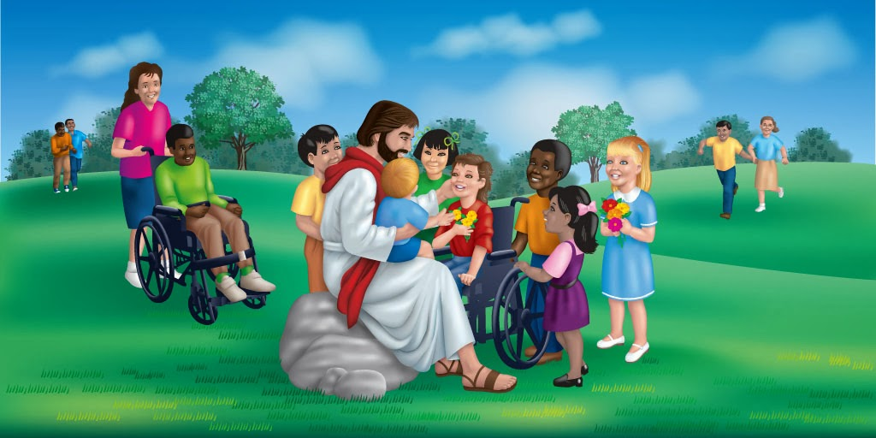
CHILDREN’S MESSAGE

Slide 41
PRAYER FOR ILLUMINATION
Lord, as Your Word is read and proclaimed, send Your Holy Spirit to enlighten our minds and open our hearts.
Remove every distraction that keeps us from hearing Your voice. Help us to understand Your truth, receive it with faith, and respond with obedience.

Slide 42
May Your Word challenge us where we need correction, encourage us where we need strength, an d inspire us to rediscover the mission Christ has entrusted to His Church. Transform us through the hearing of Your Word, that we may become faithful disciples who live for Your glory and serve in Your Kingdom. Amen.

Slide 43
Scripture
Matthew 28:18–20

Slide 44
18"And Jesus came and said to them, 'All authority in heaven and on earth has been given to Me. 19 Therefore, go and make disciples of all nations, baptizing them in the name of the Father and of the Son and of the Holy Spirit, teaching them to obey everything I have commanded you. 20 And surely, I am with you always, to the very end of the age.'"

Slide 45

SERMON
The Church Final Assignment
MATTHEW 28: 18-20

Slide 46
PRAYER OF CONFESSION
Lord, You have given all authority to Jesus Christ and called us to make disciples of all nations.
Yet we confess that we have often been content to gather rather than go, to preserve traditions rather than proclaim the Gospel,

Slide 47
and to be members rather than faithful disciples. Forgive us for the times we have failed to share Your love, encourage others in their faith, and live as witnesses to Your Kingdom. We offer ourselves anew to Your service, through Jesus Christ our Lord. Amen.

Slide 48
WORDS OF ASSURANCE
Christ came into the world not to condemn the world, but that the world through Him might be saved. In Jesus Christ, we are forgiven, restored, and sent forth in mission. Thanks be to God! Amen.

Slide 49
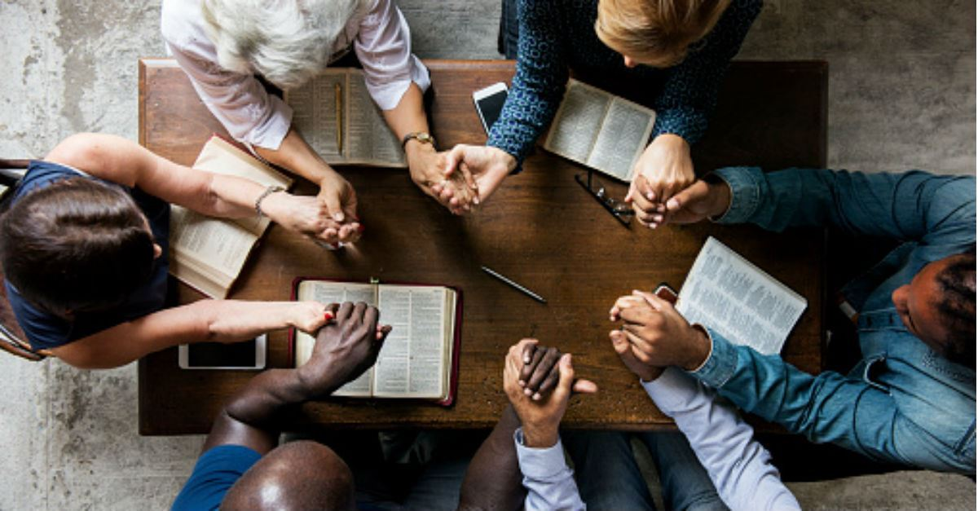
PRAYERS OF THE PEOPLE

Slide 50
The Lord’s Prayer
Our Father who art in heaven, hallowed be thy name thy kingdom come, thy will be done on earth as it is in heaven. Give us this day our daily bread; and forgive us our trespasses as we forgive those who trespass

Slide 51
against us. And lead us not into temptation, but deliver us from evil, for thine is the kingdom, and the power and the glory forever. Amen.

Slide 52
CLOSING SONG
“The Summons”

Slide 53
“Go Make of All Disciples”

Slide 54
The Summons
(Verse 1)
Go Make of All Disciples
Leon M. Adkins
571
1. Go make of all disciples
We hear the call O Lord
That comes from Thee our Father
In Thy eternal Word
Inspire our ways of learning
Through earnest fervent prayer
And let our daily living
Reveal Thee everywhere

Slide 55
2. Go make of all disciples
Baptizing in the name
Of Father Son and Spirit
From age to age the same
We call each new disciple
To follow Thee O Lord
Redeeming soul and body
By water and the Word

Slide 56
The Summons
(Verse 2)
3. Go make of all disciples.
We at Thy feet would stay
Until each life's vocation
Accents Thy holy way
We cultivate the nature
God plants in every heart
Revealing in our witness,
The Master Teacher's art.

Slide 57
4. Go make of all disciples.
We welcome Thy command
Lo I am with you always
We take Thy guiding hand
The task looms large before us
We follow without fear
In heaven and earth Thy power
Shall bring God's kingdom here.

Slide 58
BENEDICTION

Slide 59
Leader: Go in the peace of Christ, serving the Lord with gladness.
People: We will love, serve, and follow Christ wherever He leads.
Leader: May the grace of our Lord Jesus Christ, the love of God, and the fellowship of the Holy Spirit be with you all.
People: Amen.

Slide 60
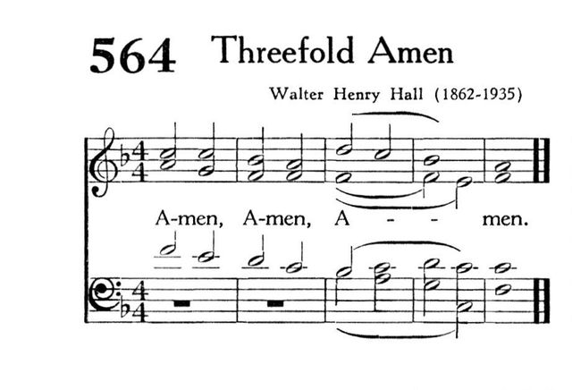

Slide 61

Carry out the light

