Slide 1
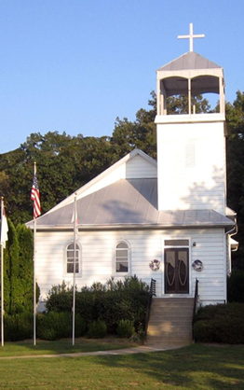
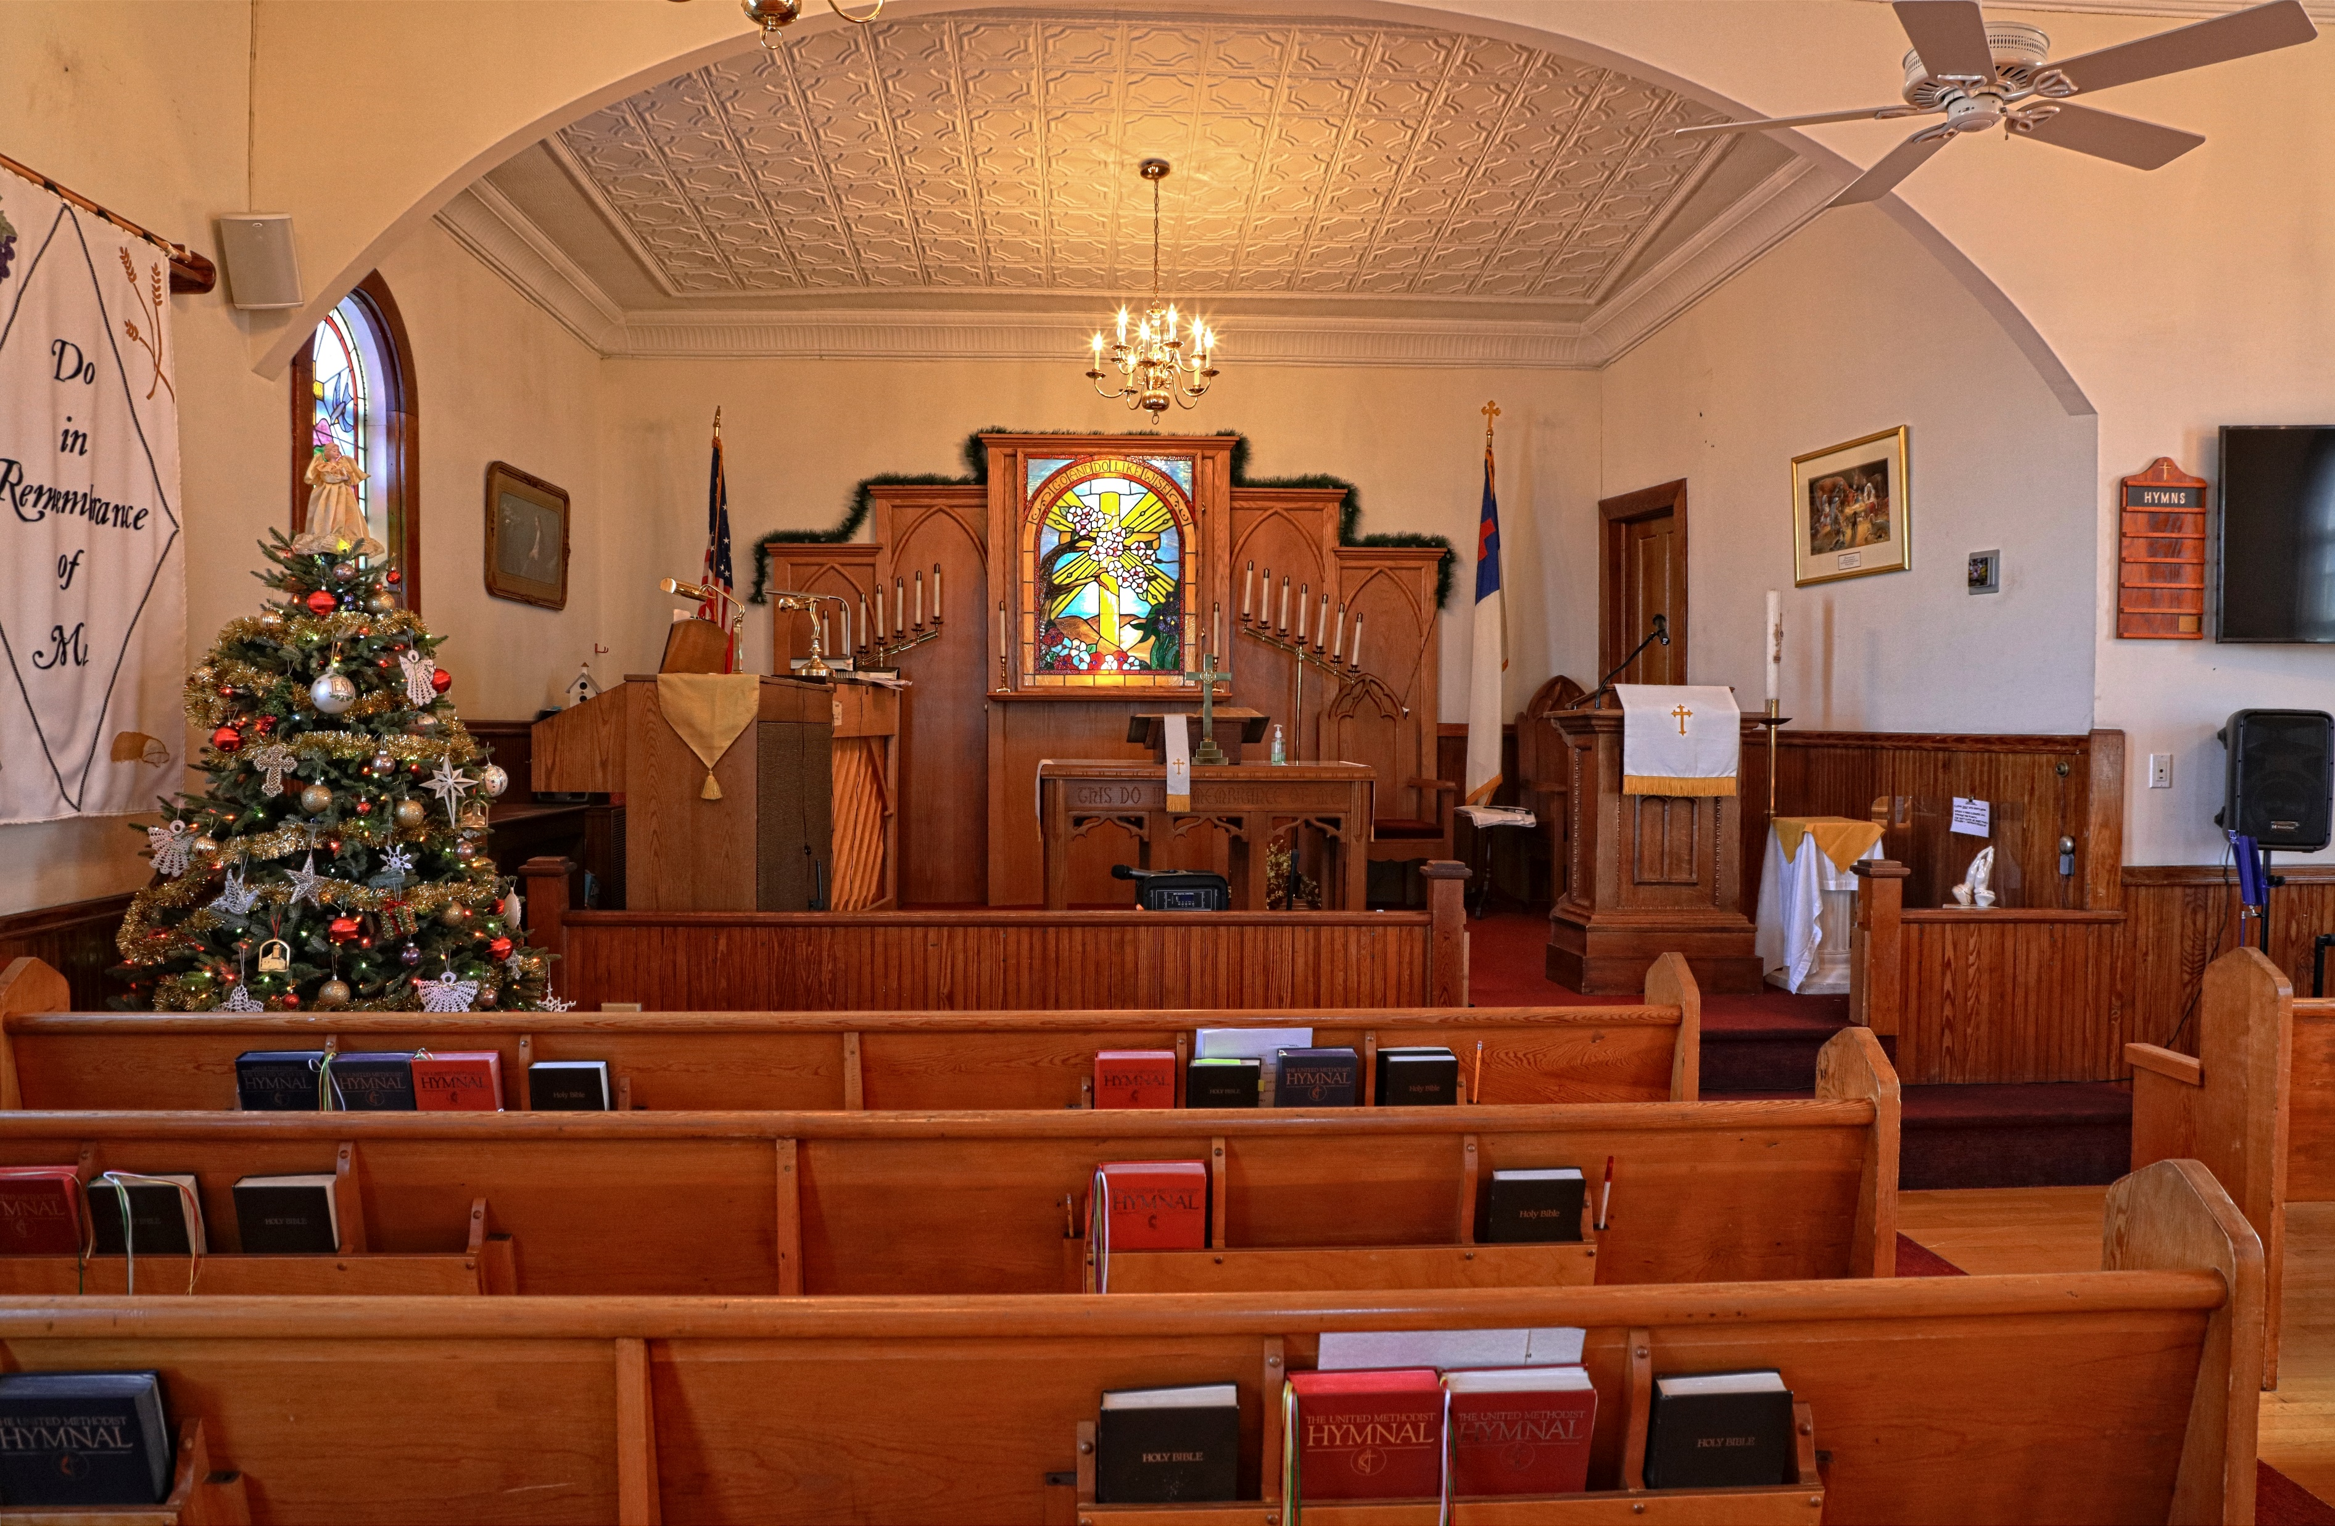
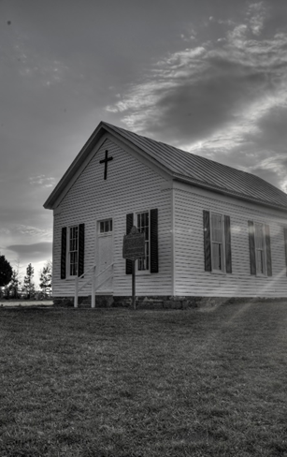

WELCOME!
Asbury United Methodist Church
Open Doors with Loving Hearts
AUGUST 3, 2025

Slide 2

CENTERING SONG
“Surely the Presence” UMH 328

Slide 3
Surely the Presence of the Lord
(Verse 1)
Surely the Presence
of the Lord
328
WORDS: Lanny Wolfe, 1977
Surely the presence
of the Lord is
in this place;
I can feel his mighty power and his grace.
© 1977 Lanny Wolfe Music

Slide 4
I can hear the brush
of angel’s wings,
I see glory on each face;
surely the presence
of the Lord is in this place.

Slide 5

GATHERING SONG
“Give Thanks”

Slide 6
Give Thanks
Give Thanks
Henry Smith (Luke 1:49-53)
2036
Give thanks
with a grateful heart,
give thanks to the Holy One,
give thanks because he’s
given Jesus Christ his Son.
© 1978 Integrity’s Hosanna! Music

Slide 7
Give thanks
with a grateful heart,
give thanks
to the Holy One,
give thanks because he’s
given Jesus Christ his Son.

Slide 8
And now let the weak say,
“I am strong”;
let the poor say,
“I am rich
because of what
the Lord has done for us.”

Slide 9
And now let the weak say,
“I am strong”;
let the poor say,
“I am rich
because of what
the Lord has done for us.”
Give thanks!

Slide 10


PRELUDE

Slide 11

WELCOME
&
ANNOUNCEMENTS

Slide 12


Birthday/Anniversary

Slide 13
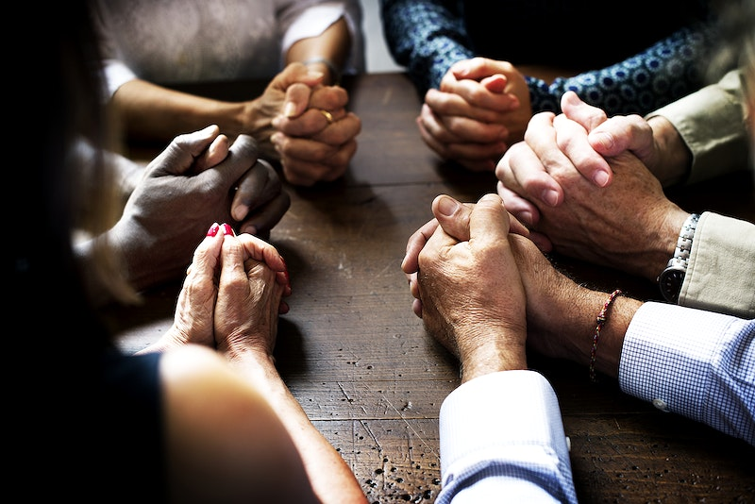
CALL TO WORSHIP

Slide 14

Leader: Give thanks to God,
People: For God's steadfast love lasts forever.
Leader: God accompanies us in our distress,
People: As we cross the threshold to worship's blessings.

Slide 15
Leader: Give thanks to our God,
People: For God's steadfast love abides with us.
Leader: Let us enter this space for worship,
All: Celebrating God's works for humankind.

Slide 16

OPENING SONG:
“Change My Heart, O God”

Slide 17
Change My Heart, O God
Change My Heart, O God
Eddie Espinosa (Isa. 64:8)
2152
Change my heart, O God,
make it ever true.
Change my heart, O God,
may I be like you.
© 1982 Mercy/Vineyard Publishing

Slide 18
You are the Potter,
I am the clay.
Mold me and make me,
this is what I pray.

Slide 19
Change my heart, O God,
make it ever true.
Change my heart, O God,
may I be like you.

Slide 20
OPENING PRAYER
Spirit of hope and renewal, as the dawn nudges us awake, summon us with your presence. Wrap us with the cloak of your wisdom and grace. As your light breaks the horizon

Slide 21
this day, help us see the love revealed in your realm. Nourish us with your wisdom and guide us with your hope, for we hunger to know you better. Amen

Slide 22
“One Bread, One Body”

Slide 23
One Bread, One Body
(Refrain)
One Bread, One Body
620
WORDS: John B. Foley, 1978 (1 Cor. 10:16-17; Gal. 3:28; 1 Cor. 12)
Refrain
One bread, one body,
one Lord of all,
one cup of blessing
which we bless.
© 1978, 1989 John B. Foley and North American Liturgy Resources

Slide 24
And we, though many
throughout the earth,
we are one body
in this one Lord.

Slide 25
One Bread, One Body
(1)
1. Gentile or Jew,
servant or free,
woman or man,
no more.

Slide 26
One Bread, One Body
(Refrain)
Refrain
One bread, one body,
one Lord of all,
one cup of blessing
which we bless.

Slide 27
And we, though many
throughout the earth,
we are one body
in this one Lord.

Slide 28
One Bread, One Body
(2)
2. Many the gifts,
many the works,
one in the Lord of all.

Slide 29
One Bread, One Body
(Refrain)
Refrain
One bread, one body,
one Lord of all,
one cup of blessing
which we bless.

Slide 30
And we, though many
throughout the earth,
we are one body
in this one Lord.

Slide 31
One Bread, One Body
(3)
3. Grain for the fields,
scattered and grown,
gathered to one, for all.

Slide 32
One Bread, One Body
(Refrain)
Refrain
One bread, one body,
one Lord of all,
one cup of blessing
which we bless.

Slide 33
And we, though many
throughout the earth,
we are one body
in this one Lord.

Slide 34

OFFERING:
Praising God with Our Gifts
Open Doors with Loving Hearts

Slide 35
“DOXOLOGY”
Praise God, from whom all blessings flow; Praise Him, all creatures here below;
Praise Him above, ye heavenly host; Praise Father, Son, and Holy Ghost! Amen.

Slide 36
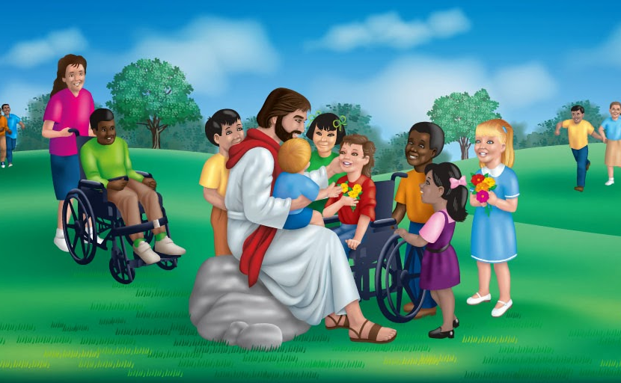
“CHILDREN’S MESSAGE”

Slide 37
“PRAYER FOR ILLUMINATION”
Lord, open our hearts and minds by the power of your Holy Spirit, that as the scriptures are read and your Word proclaimed, we may hear with joy what you say to us today. Amen.

Slide 38

Scripture
Luke 12:13-21

Slide 39
13 Someone in the crowd said to him, “Teacher, tell my brother to divide the inheritance with me.” 14 Jesus replied, “Man, who appointed me a judge or an arbiter between you?” 15 Then he said to them, “Watch out! Be on your guard against all kinds of greed; life does not consist in

Slide 40
an abundance of possessions.” 16 And he told them this parable: “The ground of a certain rich man yielded an abundant harvest. 17 He thought to himself, ‘What shall I do? I have no place to store my crops.’ 18 “Then he said, ‘This is what I’ll do. I will tear down my barns

Slide 41
and build bigger ones, and there I will store my surplus grain. 19 And I’ll say to myself, “You have plenty of grain laid up for many years. Take life easy; eat, drink and be merry.” ’20 “But God said to him, ‘You fool! This very night your life will be demanded from you. Then who will get what you

Slide 42
have prepared for yourself?’ 21 “This is how it will be with whoever stores up things for themselves but is not rich toward God.” 22 Then Jesus said to his disciples: “Therefore I tell you, do not worry about your life, what you will eat; or about your

Slide 43
body, what you will wear. 23 For life is more than food, and the body more than clothes.

Slide 44
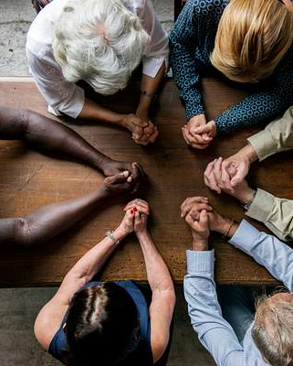
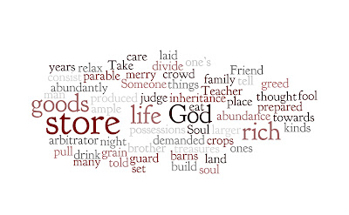
SERMON
“Search for Tomorrow”

Slide 45
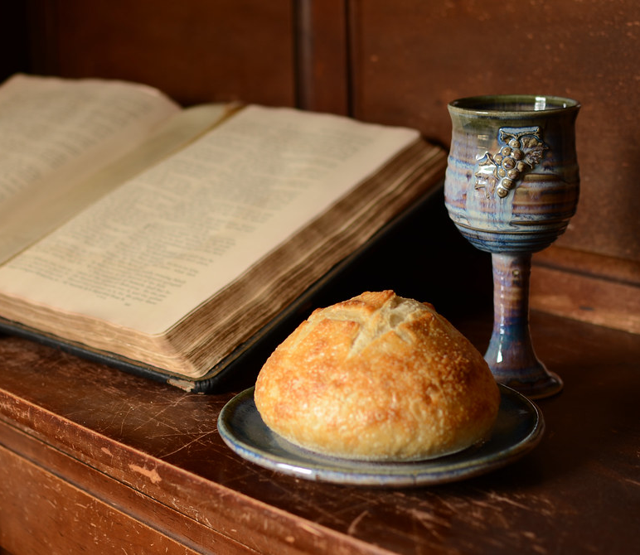
HOLY COMMUNION

Slide 46
Service Of Word and Table II
(Invitation)
A SERVICE OF WORD
AND TABLE II
Christ the Lord invites to
his table all who love him,
who earnestly repent
of their sin
and seek to live in peace
with one another.

Slide 47
Therefore, let us confess
our sin before God
and one another.

Slide 48
CONFESSION AND PARDON
Merciful God,
we confess that we have not
loved you with our
whole heart.
We have failed to be
an obedient church.

Slide 49
We have not done your will,
we have broken your law,
we have rebelled
against your love,
we have not loved
our neighbors,
and we have not heard the
cry of the needy.

Slide 50
Forgive us, we pray.
Free us for joyful obedience,
through Jesus Christ our Lord.
Amen.

Slide 51
Hear the good news:
Christ died for us while
we were yet sinners;
that proves God’s love
toward us.

Slide 52
In the name of Jesus Christ,
you are forgiven!
In the name of Jesus Christ,
you are forgiven!
Glory to God. Amen.

Slide 53
Service Of Word and Table II
(Great Thanksgiving)
THANKSGIVING AND COMMUNION
THE GREAT THANKSGIVING
The Lord be with you.
And also with you.
Lift up your hearts.
We lift them up to the Lord.

Slide 54
Let us give thanks
to the Lord our God.
It is right to give our
thanks, and praise.

Slide 55
It is right, and a good
and joyful thing,
always and everywhere
to give thanks to you,
Father Almighty,
creator of heaven and earth.

Slide 56
And so,
with your people on earth
and all the company of heaven
we praise your name and
join their unending hymn:

Slide 57
Holy, holy, holy Lord,
God of power and might,
heaven and earth are
full of your glory.
Hosanna in the highest.

Slide 58
Blessed is he who comes
in the name of the Lord.
Hosanna in the highest.

Slide 59
Holy are you, and blessed
is your Son Jesus Christ.

Slide 60
By the baptism of his suffering,
death, and resurrection
you gave birth to your church,
delivered us from slavery
to sin and death,
and made with us a
new covenant
by water and the Spirit.

Slide 61
On the night in which he
gave himself up for us,
he took bread,
gave thanks to you,
broke the bread,
gave it to his disciples
and said:

Slide 62
“Take, eat;
this is my body which is
given for you.
Do this
in remembrance of me.”

Slide 63
When the supper was over,
he took the cup,
gave thanks to you,
gave it to his disciples,
and said:

Slide 64
“Drink from this, all of you;
this is my blood
of the new covenant,
poured out for you
and for many
for the forgiveness of sins.

Slide 65
Do this, as often
as you drink it,
in remembrance of me.”

Slide 66
And so,
in remembrance of these your
mighty acts in Jesus Christ,
we offer ourselves in praise
and thanksgiving as a
holy and living sacrifice,
in union with Christ’s
offering for us,

Slide 67
as we proclaim the
mystery of faith.
Christ has died;
Christ is risen;
Christ will come again.

Slide 68
Pour out your Holy Spirit
on us gathered here,
and on these gifts of
bread and wine.

Slide 69
Make them be for us the body
and blood of Christ,
that we may be for the world
the body of Christ,
redeemed by his blood.

Slide 70
By your Spirit make us
one with Christ,
one with each other,
and one in ministry
to all the world,

Slide 71
until Christ comes in
final victory
and we feast at his
heavenly banquet.

Slide 72
Through your Son
Jesus Christ,
with the Holy Spirit
in your holy church,
all honor and glory is yours,
almighty Father,
now and forever.
Amen.

Slide 73
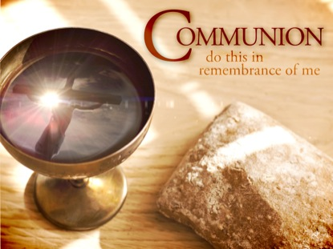
Breaking the Bread and Sharing the Cup

Slide 74

PRAYERS
OF THE
PEOPLE

Slide 75
The Lord’s Prayer
The Lord’s Prayer
Our Father who art in heaven, hallowed be thy name thy kingdom come, thy will be done on earth as it is in heaven.

Slide 76
Give us this day our daily bread;
and forgive us our trespasses as we forgive those who trespass against us. And lead us not into temptation, but deliver us from evil, for thine is the kingdom,
and the power and the glory forever. Amen.

Slide 77
CLOSING SONG
“The Summons”

Slide 78
The Summons
(Verse 1)
The Summons
John Bell
2130
1. Will you come and follow me
if I but call your name?
Will you go
where you don’t know
and never be the same?
© 1987 WGRG The Iona Community (Scotland), admin. by GIA Publications, Inc.

Slide 79
Will you let my love be shown,
will you let my name be known,
will you let
my life be grown in you
and you in me?

Slide 80
The Summons
(Verse 2)
2. Will you leave
yourself behind
if I but call your name?
Will you care
for cruel and kind
and never be the same?

Slide 81
Will you risk the hostile stare
should your life attract or scare?
Will you let
me answer prayer in you
and you in me?

Slide 82
The Summons
(Verse 3)
3. Will you let the blinded see
if I but call your name?
Will you set the prisoners free
and never be the same?

Slide 83
Will you kiss the leper clean,
and do such as this unseen,
and admit to
what I mean in you
and you in me?

Slide 84
The Summons
(Verse 4)
4. Will you love
the “you” you hide
if I but call your name?
Will you quell the fear inside
and never be the same?

Slide 85
Will you use the
faith you’ve found
to reshape the world around,
through my sight and
touch and sound in you
and you in me?

Slide 86
The Summons
(Verse 5)
5. Lord, your summons
echoes true
when you but call my name.
Let me turn and follow you
and never be the same.

Slide 87
In your company I’ll go
where your love
and footsteps show.
Thus I’ll move
and live and grow in you
and you in me.

Slide 88

BENEDICTION

Slide 89
May we secure the cords of kindness and the bands of love on the path forward. May we clothe ourselves in cloaks of renewal, building the realm of God here on earth. May we celebrate the steadfast love of God and embracing Christ's presence. Surely God journeys with us forever. Amen!

Slide 90
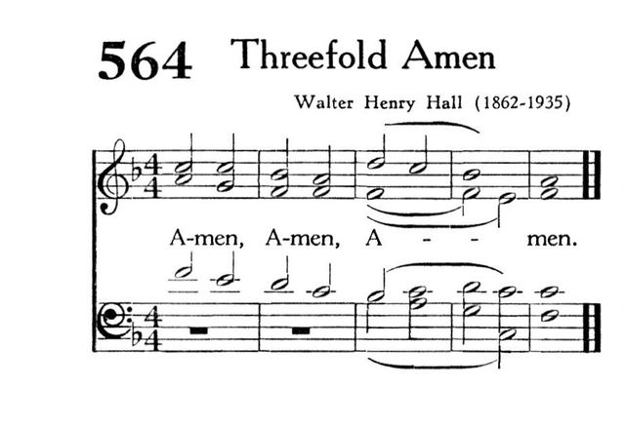

Slide 91

Carry out the light

