Slide 1






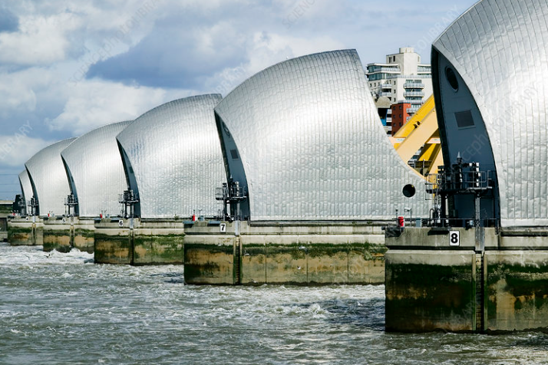

Rivers
The Thames
The Thames flows through London. It is 346 km (215 miles) long. There are many bridges crossing the Thames. Its source is in Kemble.
The Amazon
The Amazon flows through many South American countries. It is 6,400 km (4,000 miles) long. It is the second longest river in the world. Its source is in Lago Villlafro.
Source and Mouth
The source of a river is where it originates. The source is usually found in high places, such as hills or mountains. The mouth of a river is where it enters a lake, larger river or the ocean.
ESSENTIAL RIVERS VOCABULARY (with syllable bars added to help with spelling)
e/ro/sion | The process of being worn away by wind or water.
flood | An overflow of a large amount of water.
stream | A small, narrow river.
flood/plain | An area of low ground next to a river that often floods.
es/tu/a/ry | The mouth of a large river, where the tide and stream meet.
wa/ter/fall | A cascade of water falling from a height.
source | Where a river begins.
ir/ri/ga/tion | The supply of water that helps crops to grow, usually using channels.
sed/i/ment | The deposits of small stones and dirt that is dragged along by the current.
trib/u/tar/ies | A river or stream flowing into a larger river or lake.
ox/bow lake | A curved lake formed from a horseshoe bend in a river.
pol/lu/tion | The presence of harmful substances in the environment.
trans/port | Taking or carrying people or goods from one place to another.
cap/i/tal | The city where the government of the country functions.
trade | Buying and selling goods and services
Cities
Many cities are built along rivers for various different reasons. Easy transport Trade with other cities Water for drinking, cleaning and cooking Source of food (fish) More available jobs, such as fishing Rivers can irrigate crops
Flooding
Pupils will understand the theory of flooding: why and how rivers succumb to overbank flow.
Rivers flood for many reasons:
Heavy rainfall
Topography of the landscape
Morphology of rocks and soils
What do humans do to increase the likelihood of flooding?
MAKING LINKS TO PREVIOUS LEARNING
During Year 3 and 4, pupils will have learnt how to identify and label parts of a river. Pupils will have compared the Rivers Thames to the River Nile. Pupils will be able to explain evaporation and condensation and it’s place in the water cycle. During Year 5 and 6, pupils will have learnt about Rainforests and Brazil so will be familiar with the location of The Amazon.
River Pollution
Water pollution is when waste, chemicals or other particles cause a stream, river, lake or ocean to become harmful to living things that use the water to survive. Causes of pollution: Toxic chemicals from factories Oil spills Plastic waste Sewage Animal waste

