Slide 1
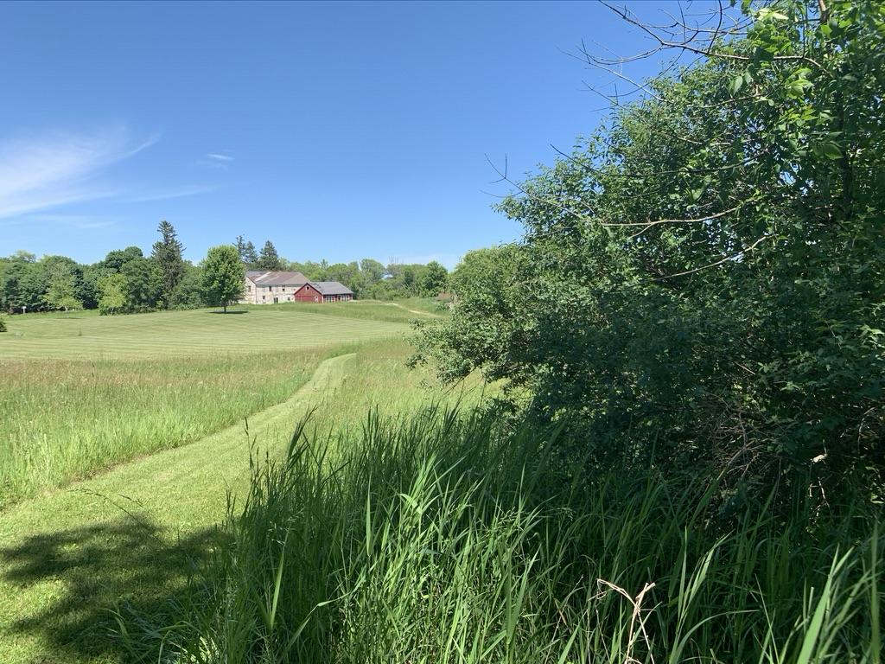
The Saxonia House property, 2022

Slide 2
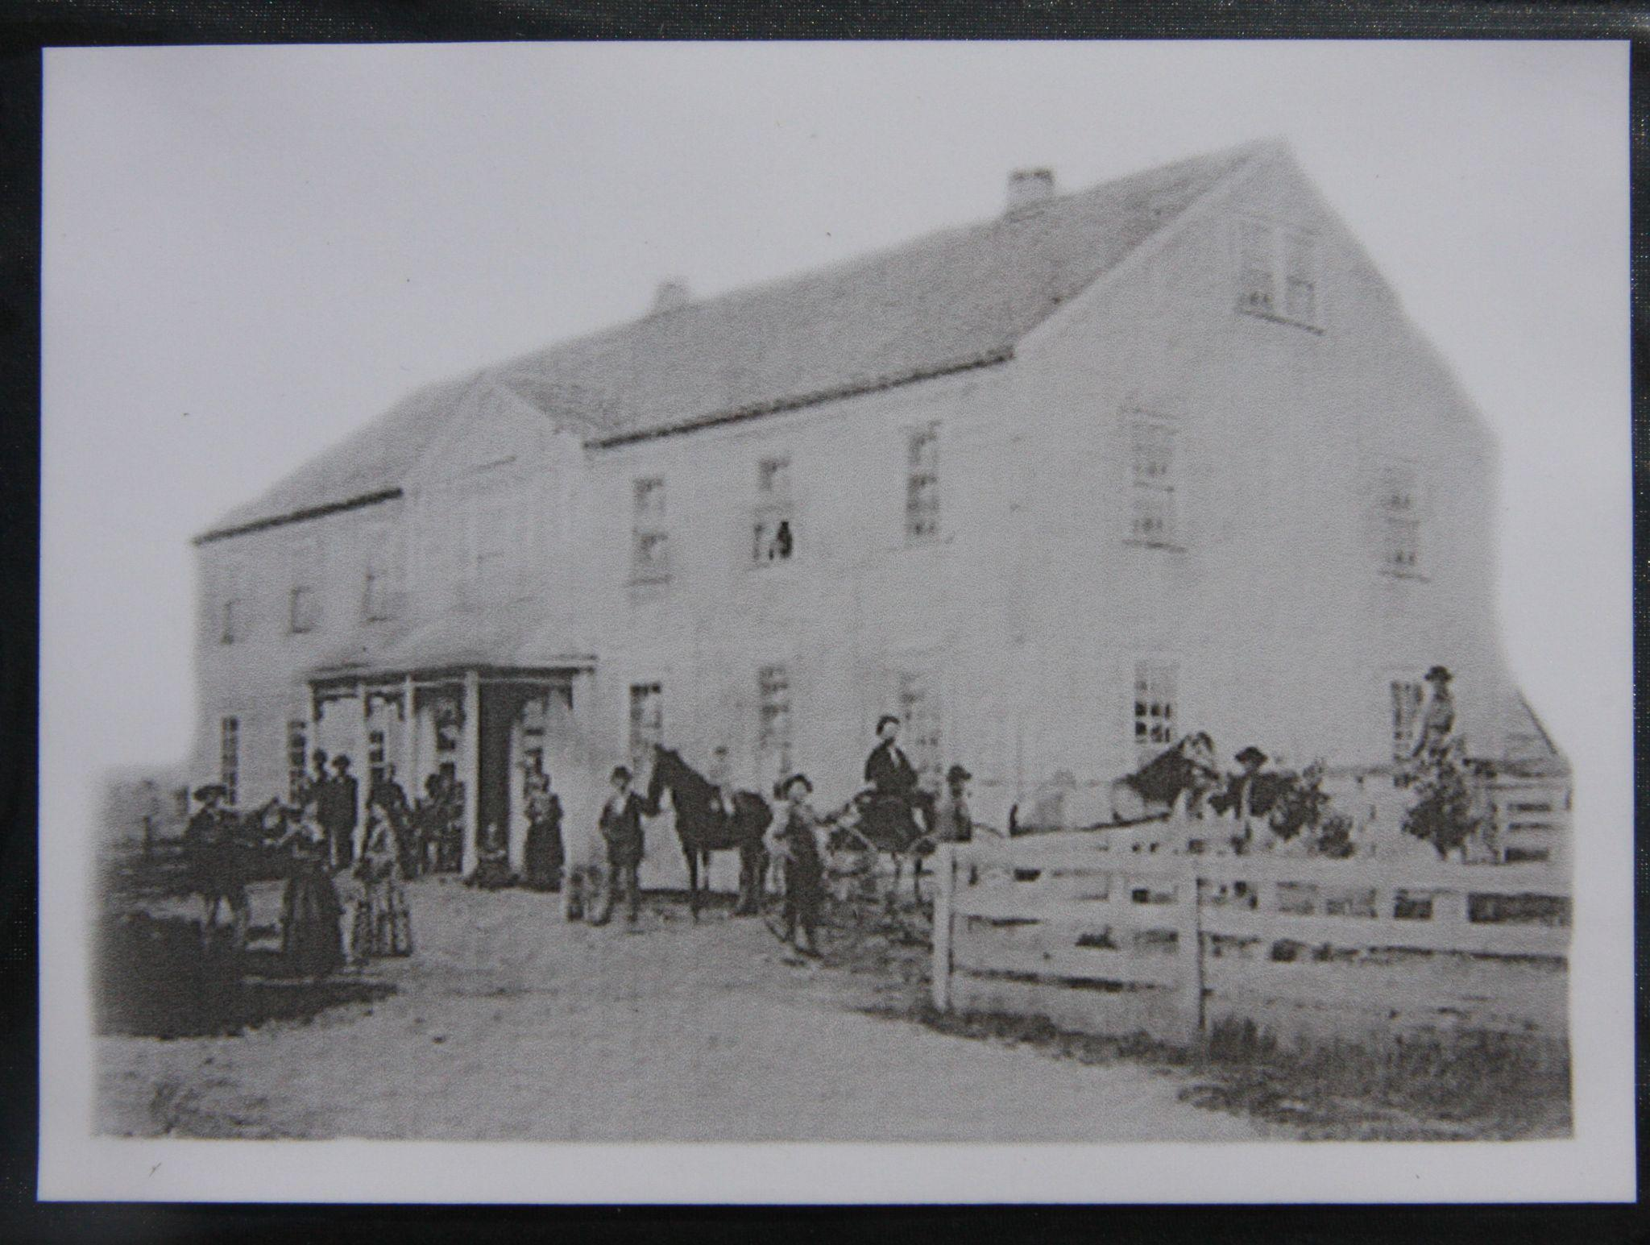
Earliest known photograph of the Saxonia House

Slide 3
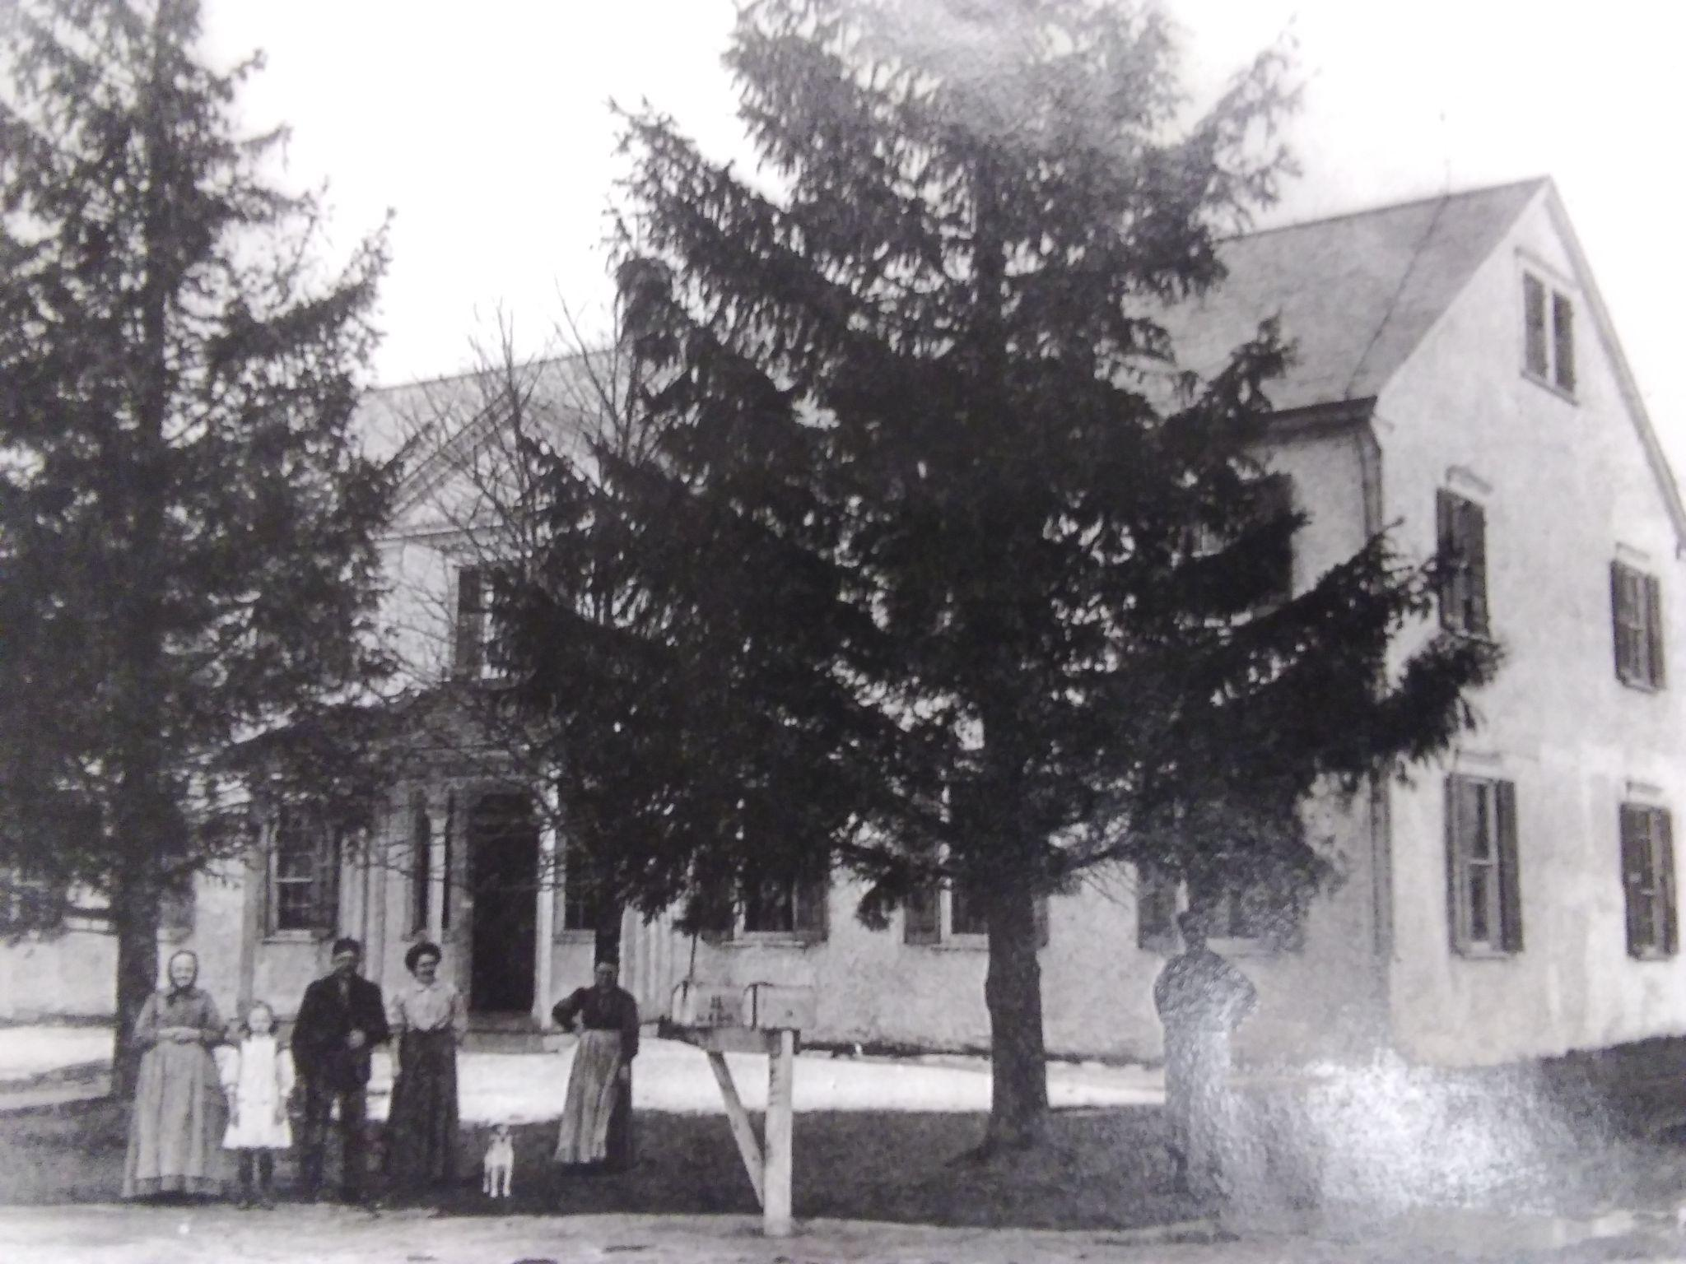
Liberta, Manilla, John, and (possibly) Bertha, Selma, and Hired Hand Richard Schmack

Slide 4
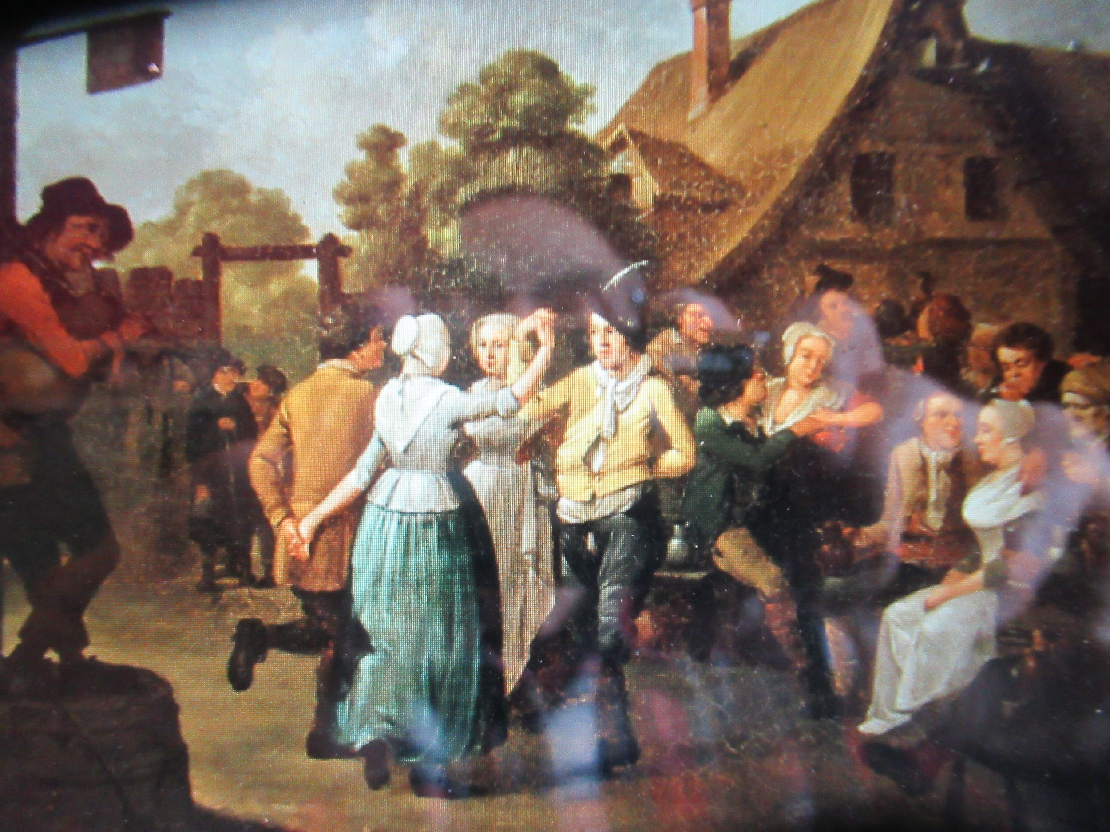
RECENT FINDINGS AND CELEBRATIONS!

Slide 5
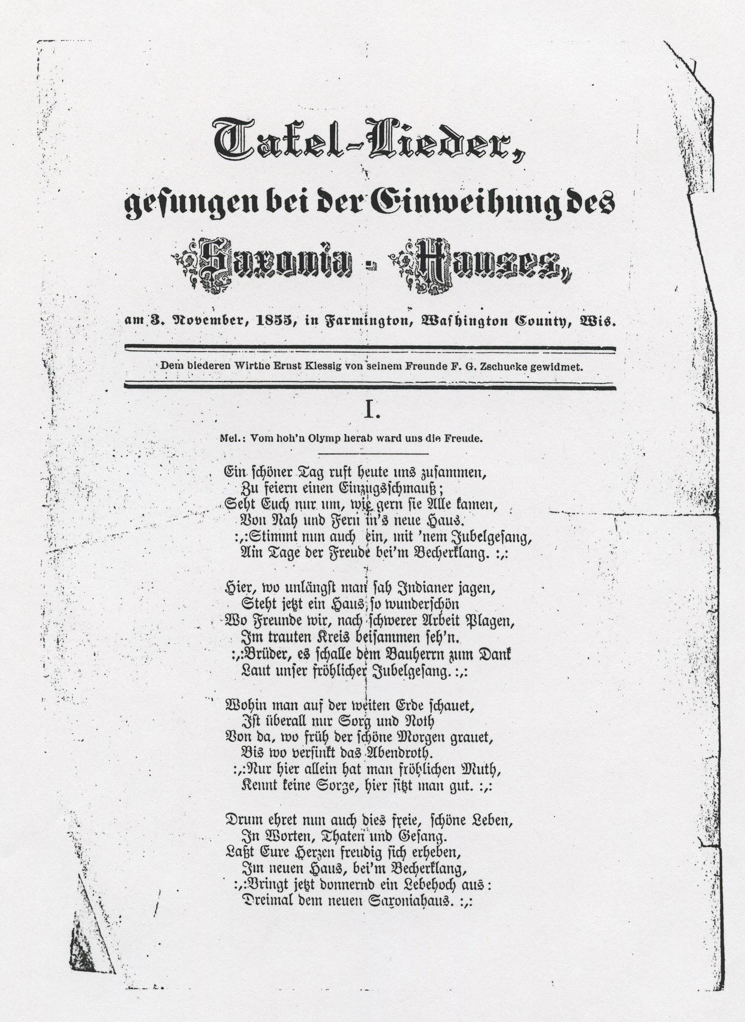
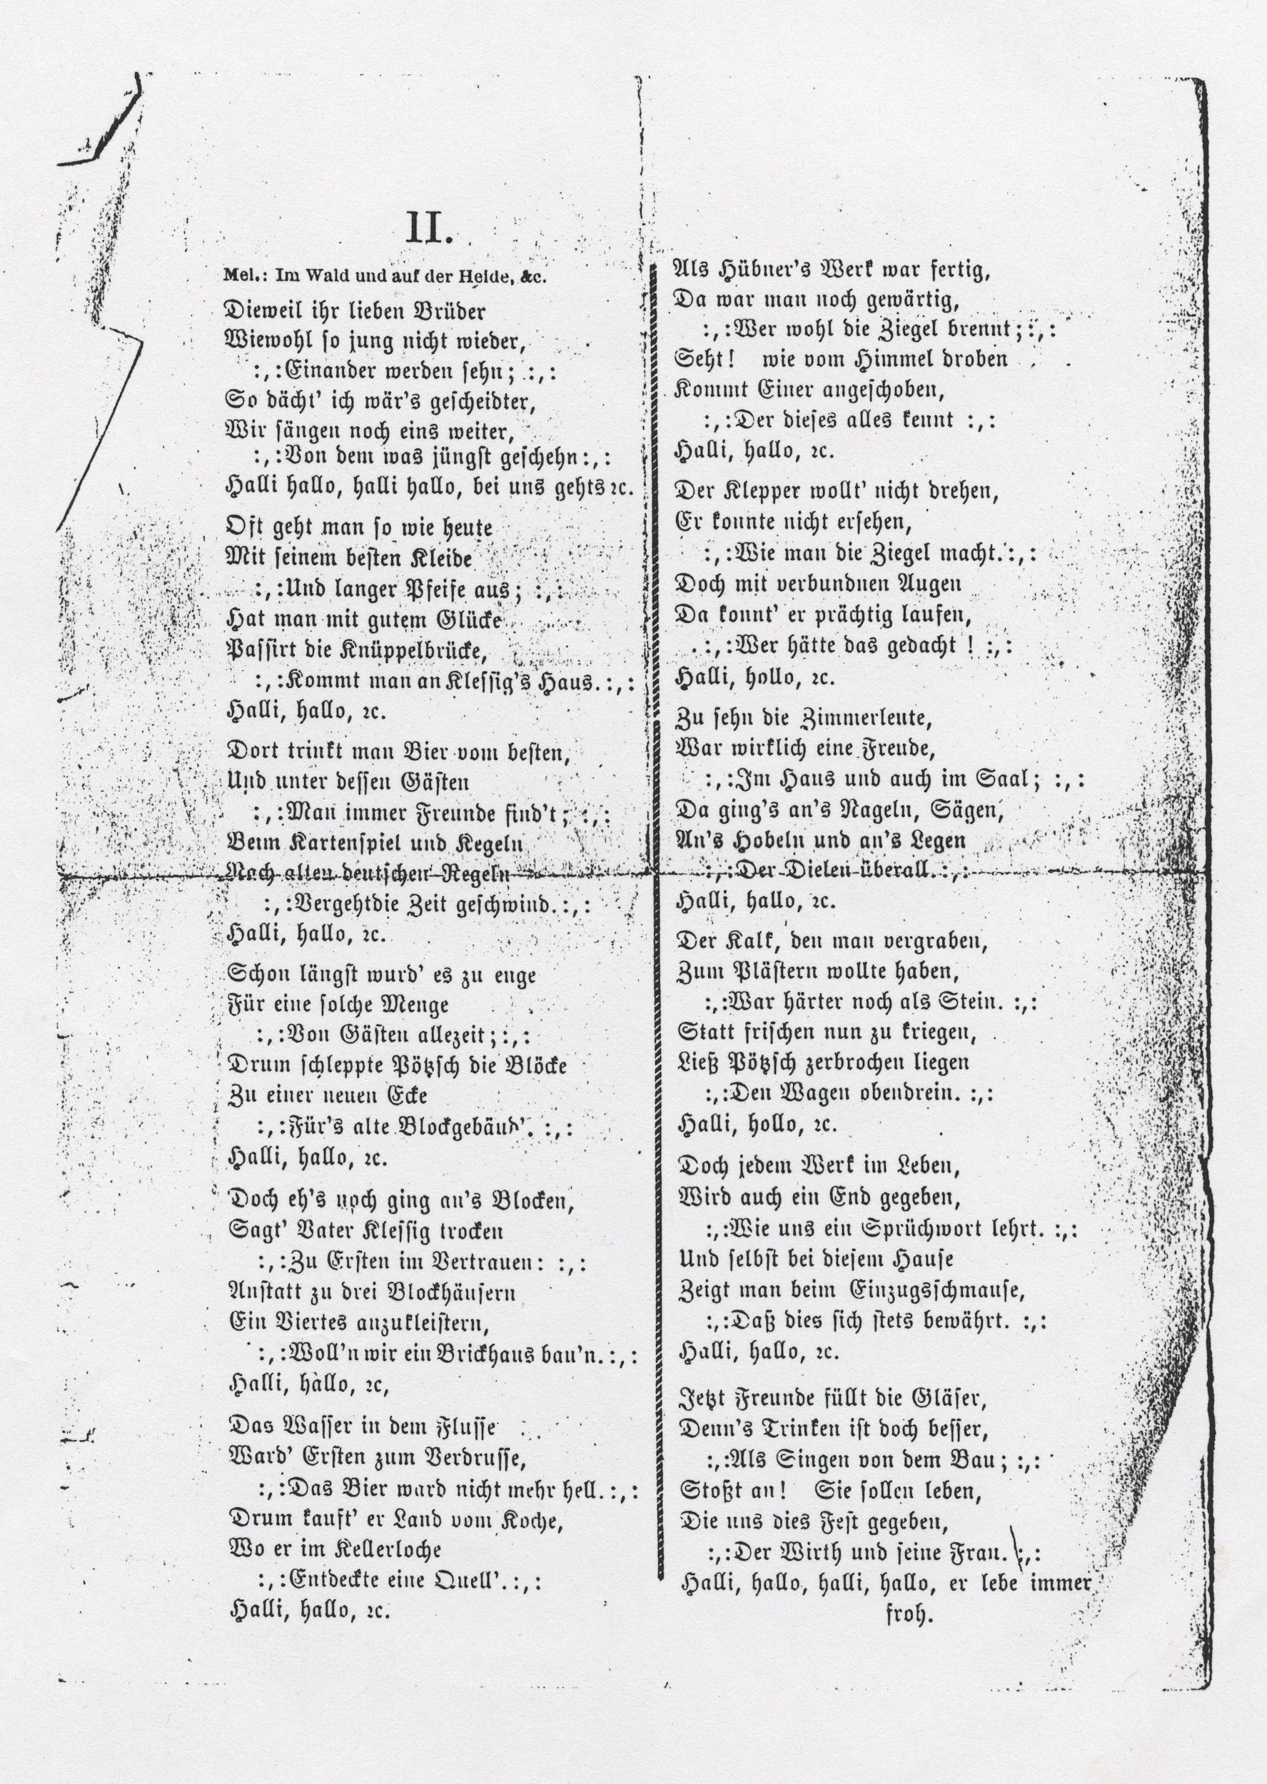
Dedication of Saxonia House: November 3, 1855
Notes:
Tell about where we found this document, and how we had it translated.

Slide 6
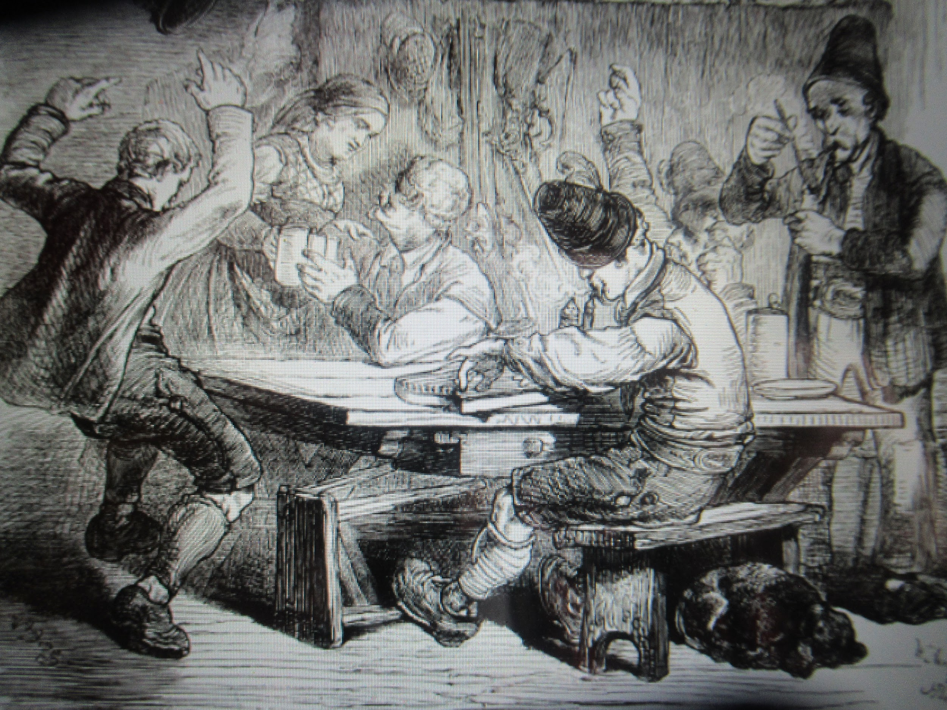
Translation by Randi Ramsden
Table Songs,
Sung at the dedication of the Saxonia-House
On November 3, 1855, in Farmington, Washington County, Wis.
Dedicated to the honest host Ernst Klessig from his friend F. G. Zschucke.

Slide 7

Translation, PArt 1 Melody: Vom hoh’n Olymp herab ward uns die Freude [Commercium song by Heinrich Christian Schnoor] https://www.youtube.com./watch?v=skI1DvZg4Nk
A beautiful day summons us today
To celebrate an opening feast;
Just look around, how gladly they all came,
From near and far to the new house.
Now join in, with a rejoicing song,
On the day of joy at the sound of the cups [as they clink for a toast].
Here, where recently one saw Native Americans hunt,
Now stands a house, so beautiful
Where us friends, after hard work,
See each other amongst friends.
Brothers, let sound in gratitude to the builder
Loud our cheerful rejoicing song.
Wherever one looks on the vast Earth,
Everywhere is sorrow and hardship
From where the beautiful morning rises
To where the red evening sky sets.
Only here one has joyful courage,
Knows no sorrow, here one sits well.
Therefore, honor now this free, beautiful life,
In words, deeds, and song.
Let your hearts joyfully soar,
In the new house, at the sound of the cups,
Now, let out a thunderous cheer:
The times to the Saxonia Haus.
Notes:
These slides would contain all of the Ramsden translation…

Slide 8
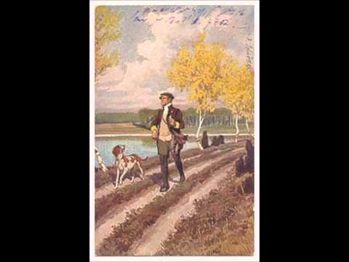
Translation Part 2 Melody: Im Wald und auf der Heide [German folk and hunting song] https://youtu.be/ae5xX_AwUCs
Often one goes out like today
In one’s best dress
And with a long pipe
Once one has, with good luck,
Passed the log bridge,
One arrives at Klessig’s house.
Hello, hello
There one drinks the best beer,
And among its guests
One always finds friends
While playing cards and ninepins
According to old German rules
Hello hello
For a long time it has been tight
For such a crowd
Of guests at all times.
So Pötzsch carried the blocks To a new corner
For the old block building.
Hello
But before construction even started, Father Klessig dryly said
First confidentially:
Instead of to three block houses Adding a fourth,
We want to build a brick house.
Hello
Because you dear brothers
Likely, this young, won’t
See each other again
I thought it would be wiser
We sang another one
Of what just happened
Hello, hello
at our place,
this is how it goes …

Slide 9
Translation part 2 continued
The water in the river
Was an annoyance at first,
The beer was no longer light.
So he bought land from the cook,
Where in the cellar
He found a well.
Hello
When Hübner’s work was done,
One was still wondering
Who would possibly burn the bricks
Look! As if from heaven above
One came,
Who knew all this
Hello
The lime, buried,
One wanted for plaster,
Was harder than stone.
Instead of getting [more] fresh,
Pötzsch left it broken
The wagon, too
Hello
But to every handiwork in life
There will be an end,
As the saying goes.
And even with this house
It shows at the opening feast
That it is always true.
Hello
The nag [old horse] didn’t want to turn,
He could not see,
How the bricks are made.
But with covered eyes
He could walk splendidly,
Who would have thought!
Hello
With ten carpenters
It was a pleasure,
In the house and in the hall, too
It began, the nailing, sawing
Planing and the laying
Of the floorboards everywhere.
Hello

Slide 10
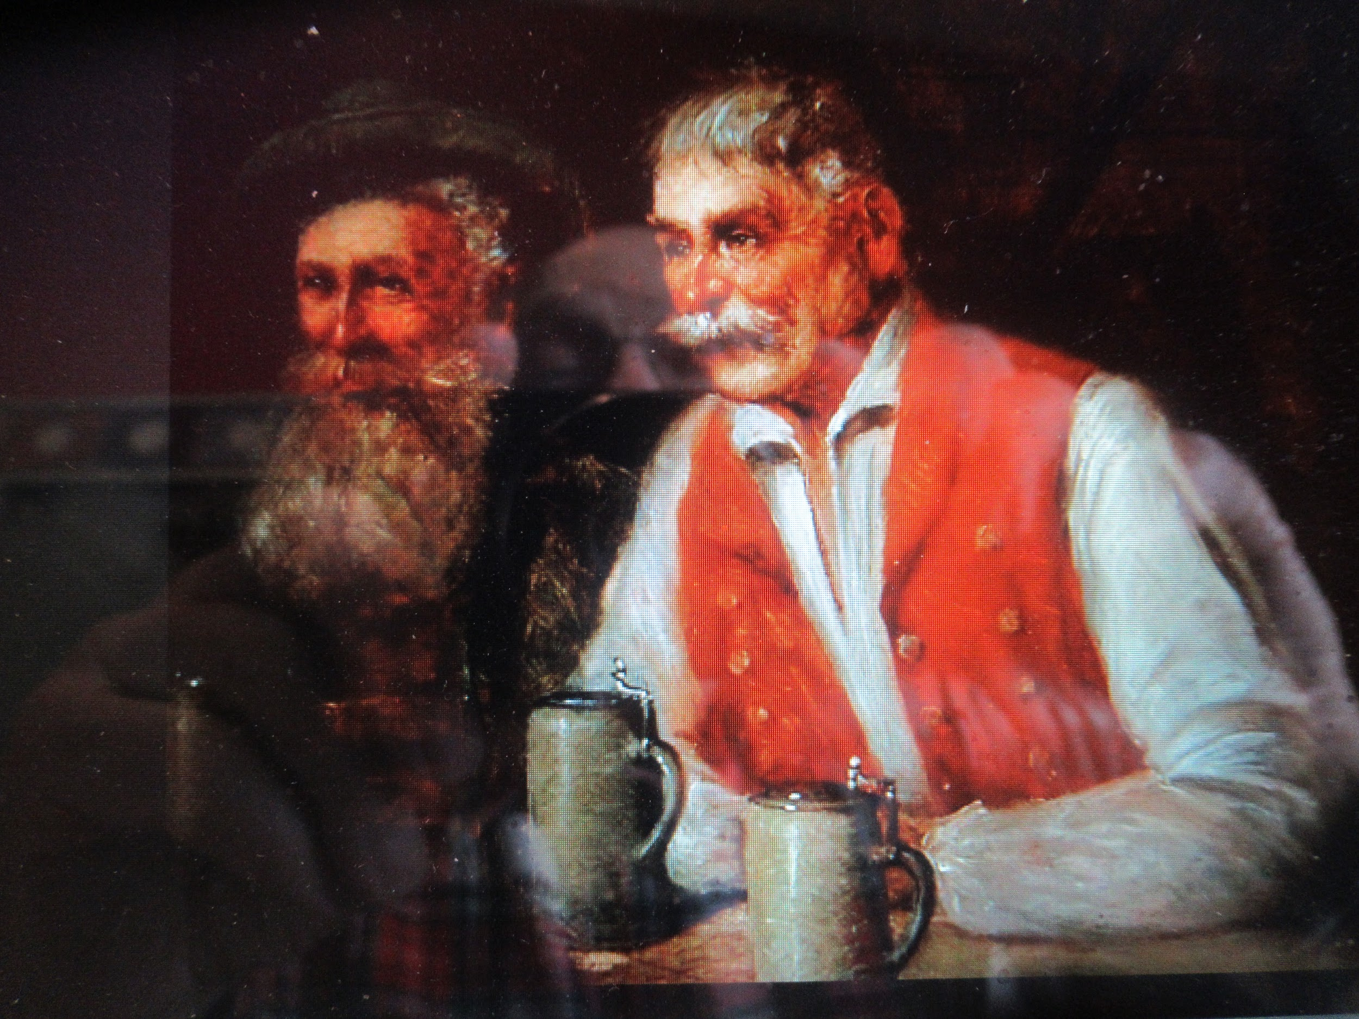
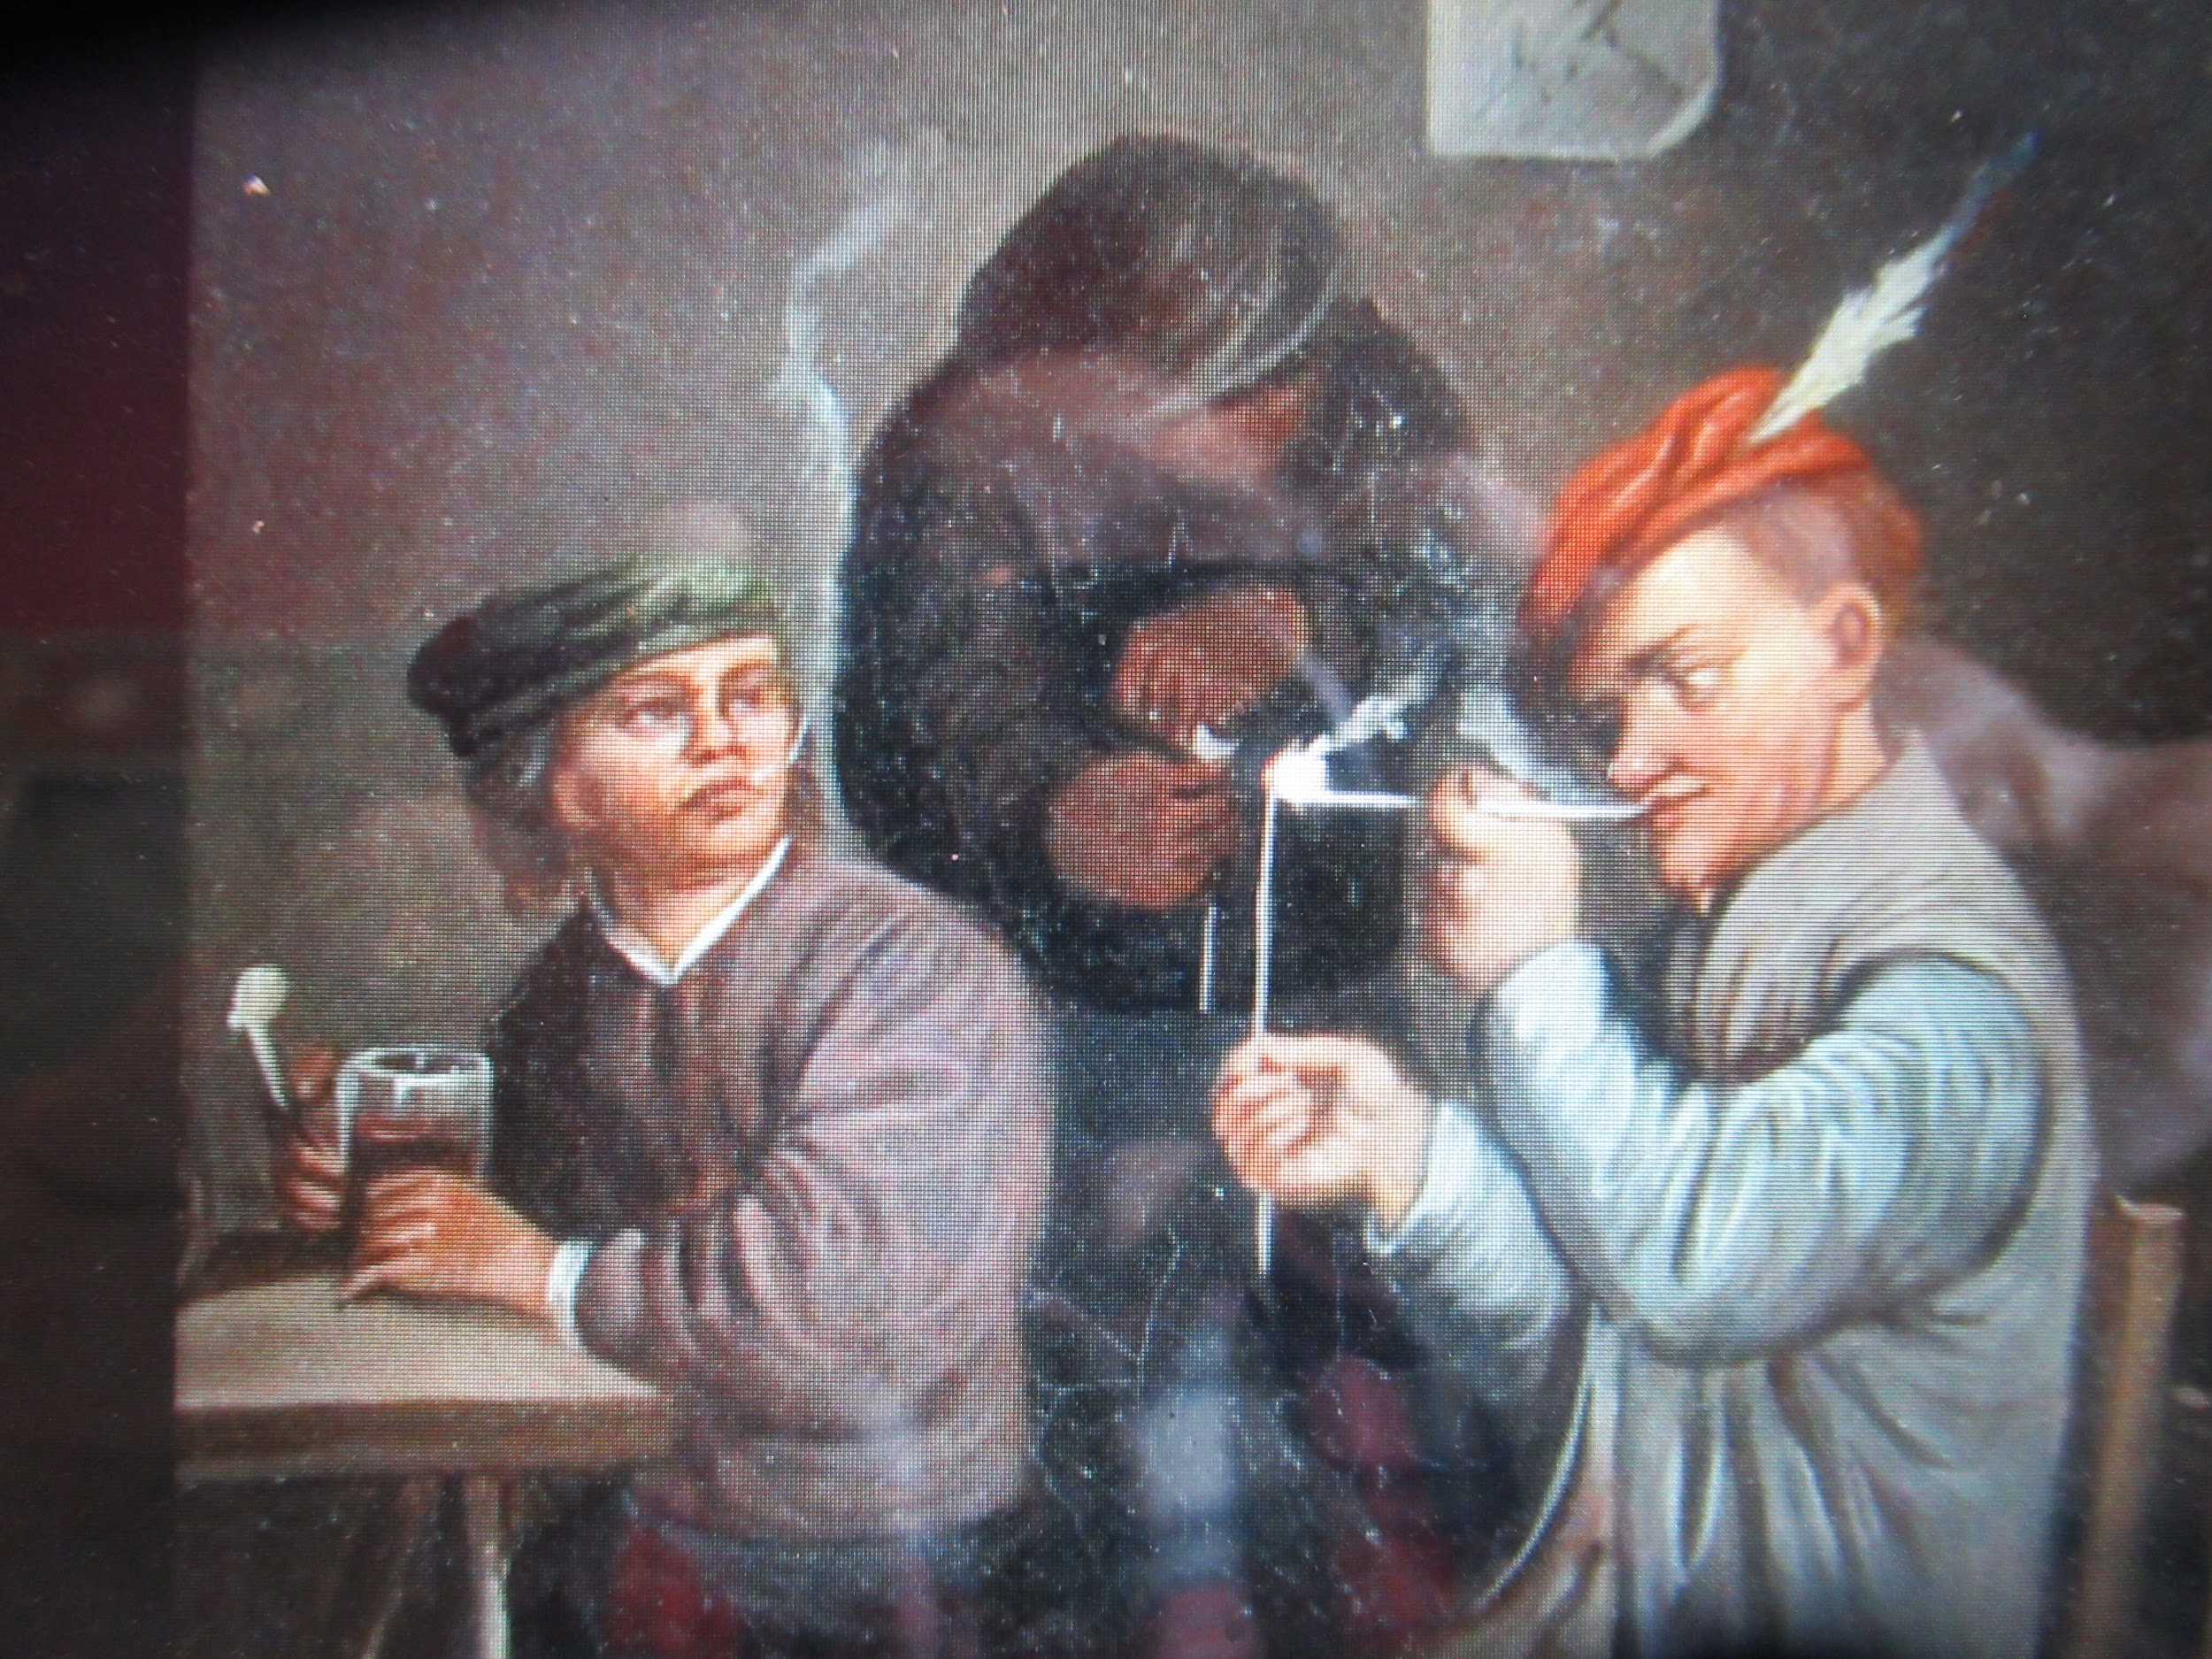
Translation, final stanza
Now friends, fill the glasses,
Because drinking is still better
Than singing of the construction
A toast!
They shall live
Who threw us this celebration, To the host and his wife.
Hello, hello,
may he always live joyfully.

Slide 11
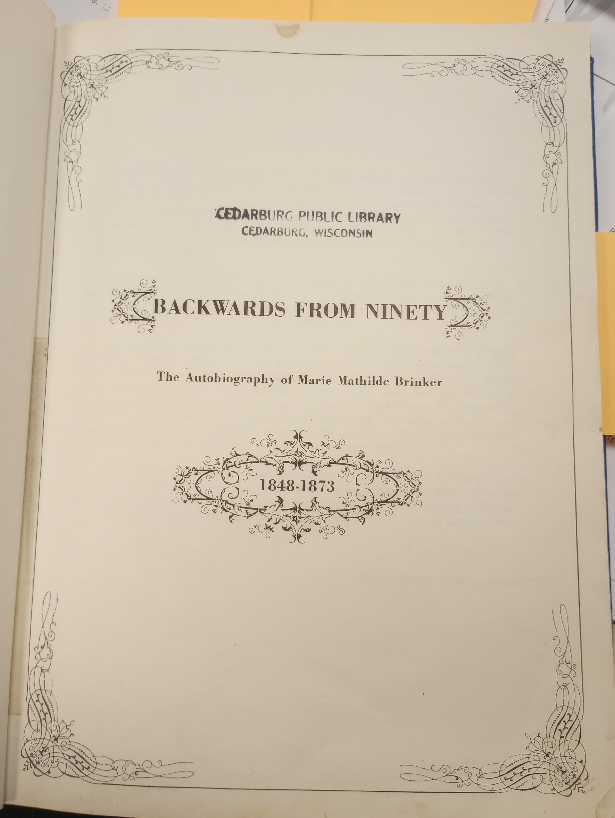
BACKWARDS FROM NINETY by Marie Mathilde Brinker
This autobiography was printed by
Serigraph Sales of West Bend
in August 1967. There are a
few copies left in local
Libraries.
(Excerpt read aloud pp 168-169)
Notes:
In the year 1865, Marie Brinker visited the Saxonia House with a friend, after church in Fillmore. We can imagine life in the busy house when Marie writes, "Mrs. Jaenig wanted us to look at her garden in the backyard. The Jaenigs were the brewery people and a dance hall was built onto the back of the house. The door being open, Minna led the way through that hall. Halfway though, the door in front opened and a young man entered"... p.150 . Later, in 1867, Marie gets a job teaching at the Fillmore School. She then moves in with the Jaenig's at Saxonia House because her mother had been friends with Mrs Liberta Klessig (now Jaenig), from earlier times when they had a grocery store in the Saxonia House. In Marie's words, "They were a large family, five Klessig children and two Jaenig. Mr. Jaenig was running a brewery. They no longer had a store or a saloon, just the brewery. There were 5 or 6 hired men, a hired girl and off and on extra woman to help. Mr. Jaenig's sister lived in a little one room block house on a lonely spot on the Jaenig property. The Jaenigs lived an immense house. I have forgotten how many rooms it had... The first evening I was almost bewildered and was glad when bedtime came and I was shown into the room that was to be mine....The township was Farmington but this place was Fillmore. The inhabitants were mainly Saxons. Their standard of living was above that of the Bavarians and Luxembourghers...very orderly with never any brawls or anything out of the ordinary happening....There was a small library above one of the stores. The brewery was not in the building in which we lived, but quite a distance behind it on the farm. The cellar where the beer was kept was about a half mile away. They were all Germans, not one of the children could speak a word of English." from pages 167-168. Marie also mentions that the master bedroom was downstairs in 1871: “Mrs Jaehnig was an invalid all that winter and her bedroom, being off the front room, where the organ stood, gave me little chance to practice.” p 204

Slide 12
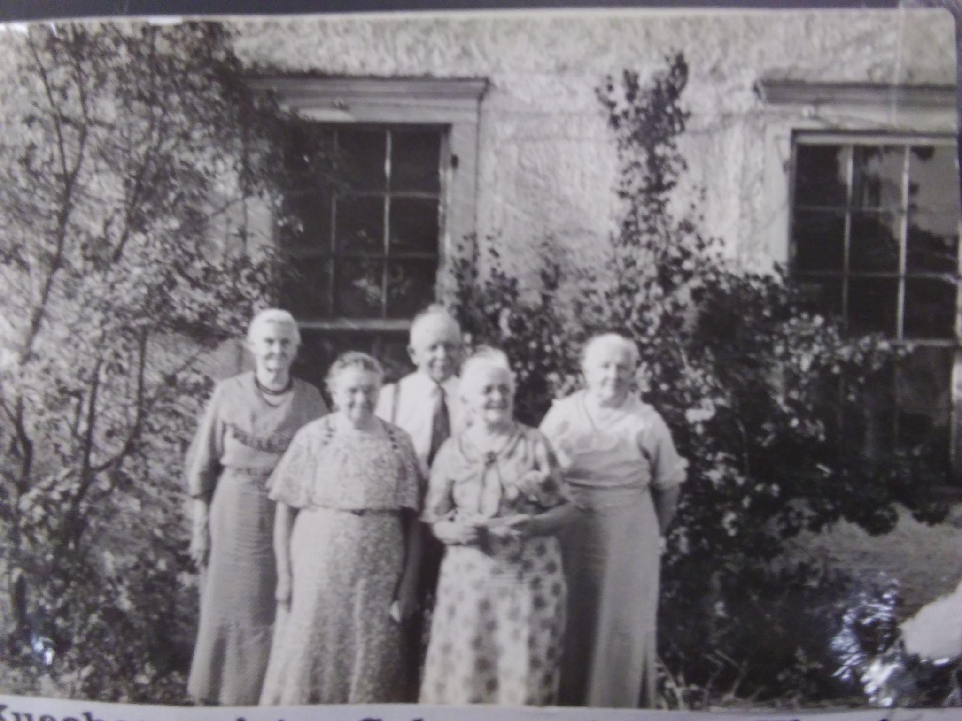
Marie Brinker, Bertha, John, Ida and Augusta

Slide 13
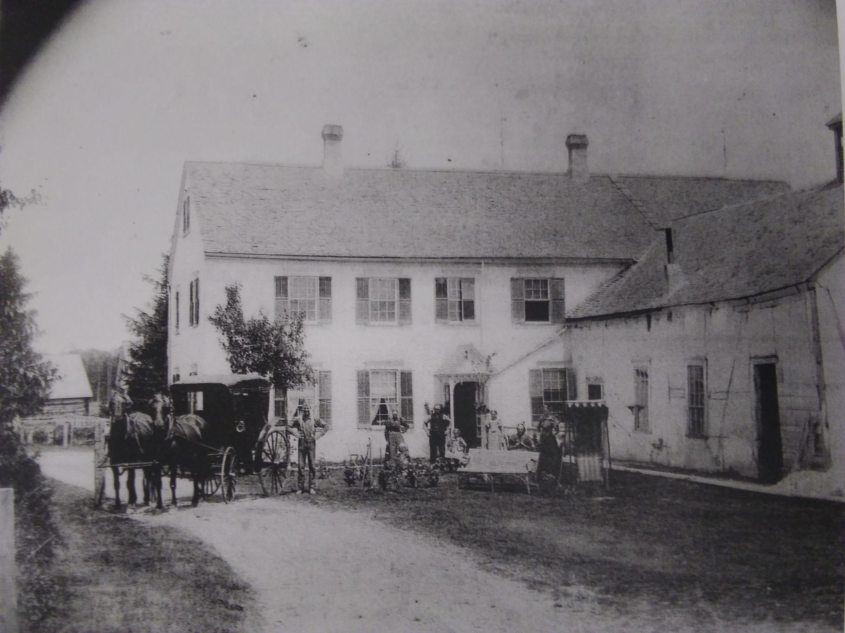
Rear of Saxonia House later 1800's

Slide 14
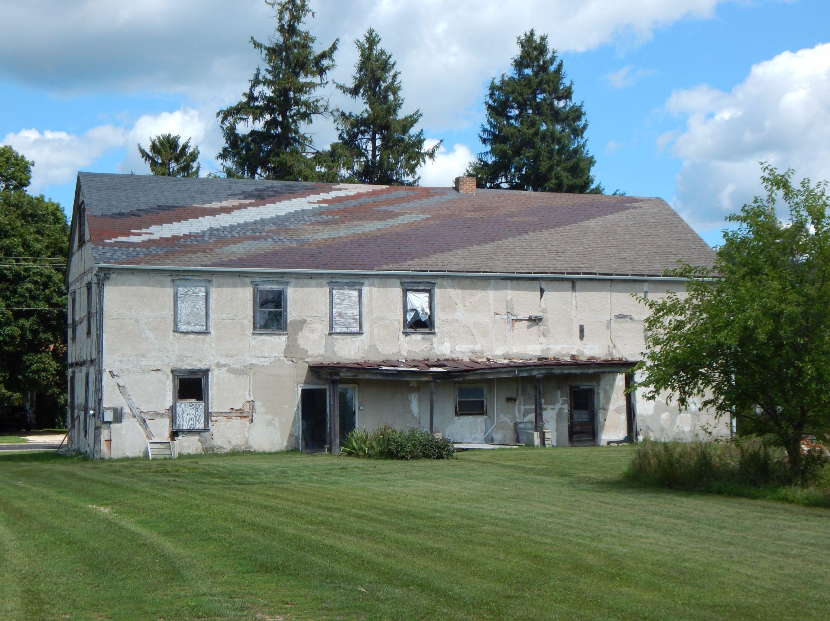
Rear of Saxonia House 2019

Slide 15
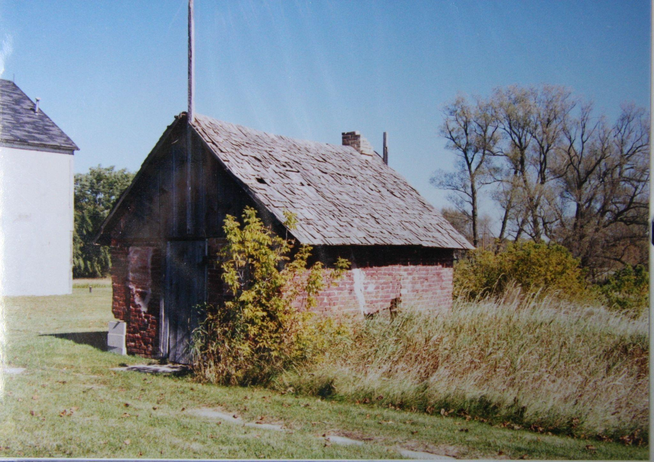
Bake house, early 2000s.

Slide 16
Work days findings!
Young and Alan started the important paint analysis process to determine the original paint colors for each room.
Rhonda found evidence of the original wall location between the kitchen and the tavern/dining room! Bucky used his fire department pole and hook to pull down the ceiling exposing the top timber of that missing wall that was taken out at the time when the two new bathrooms were installed. Now we almost know enough about the first floor to make up 1/4 scale working drawings for it's restoration to Phase I 1855-1862.

Slide 17
Workdays, continued
Using the photo that the artist used to make that great painting of the back yard, one can clearly see that the dance hall wing was completely stuccoed over from the beginning. Therefore for a phase I restoration none of the exterior timber/framing were visible. The photo shows how the stucco was falling off some of the Timbers but many still remained covered.
We found recycled parts of a half-timber building used to construct the granary room in the big cattle barn. These parts are probably from the dance hall after it was taken down. Our first Work Day in spring we should carefully dismantle and store all those parts. Flooring, rafters and wall studs for future use.
After all these years of wondering about what the attic floor looked like we realized that there are three short original flooring boards still in place at the SE corner of the attic.

Slide 18
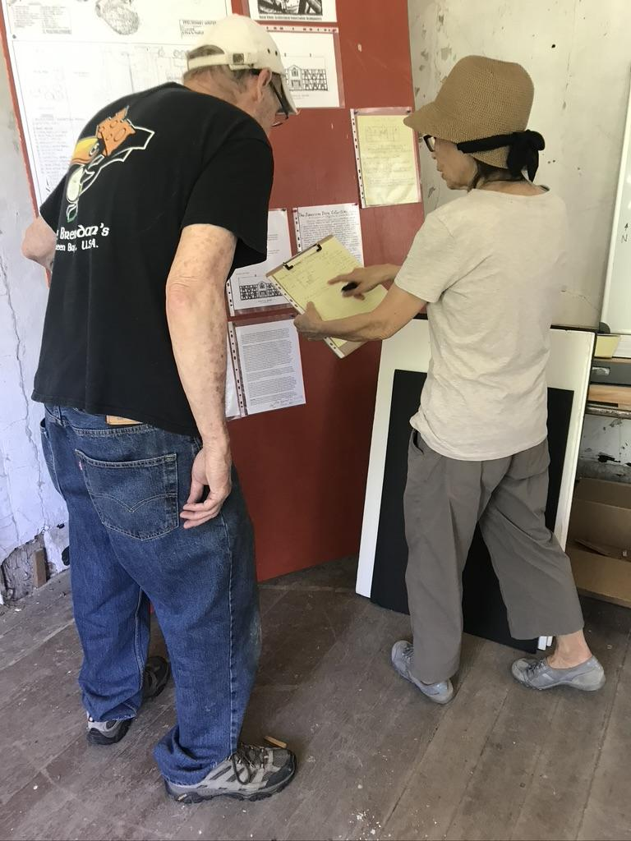
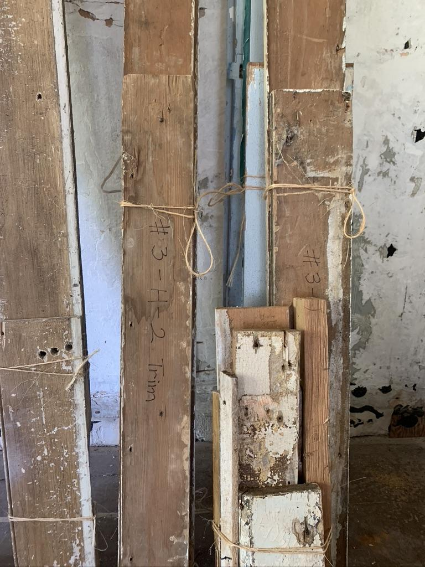

Slide 19
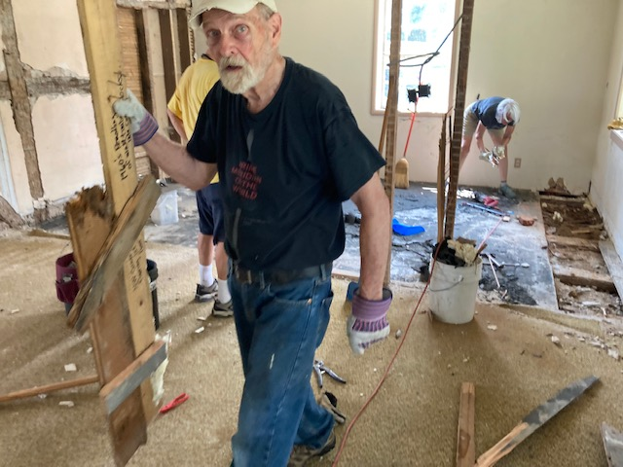

Slide 20
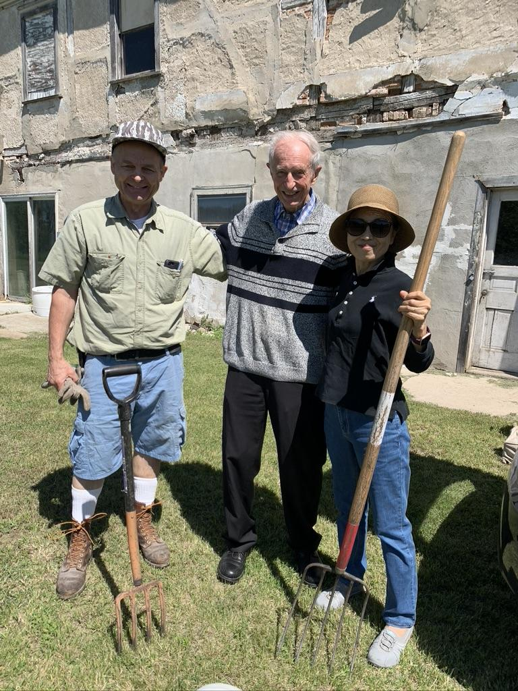
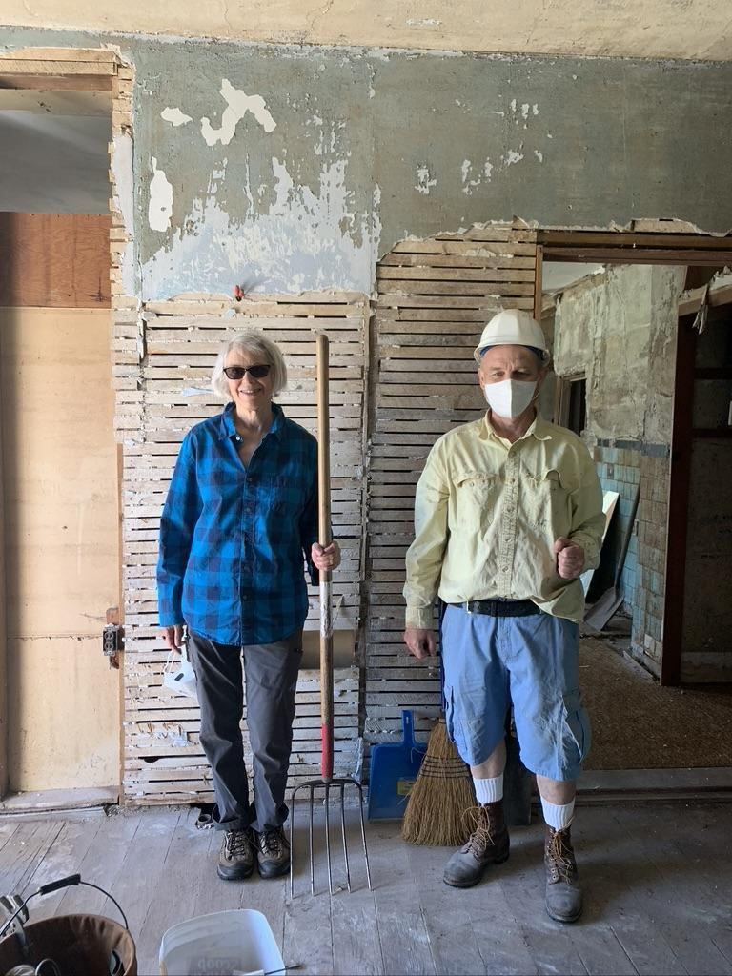

Slide 21
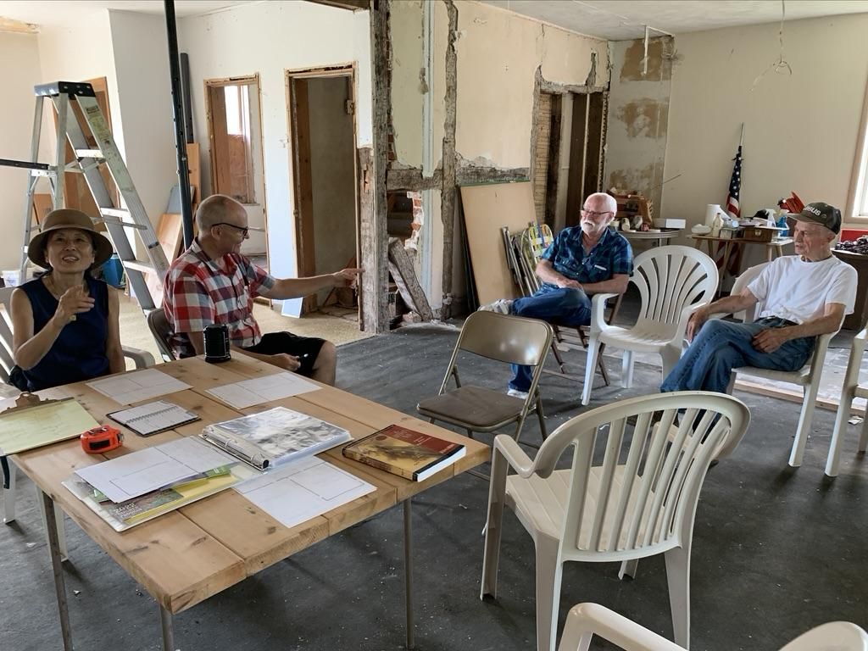

Slide 22
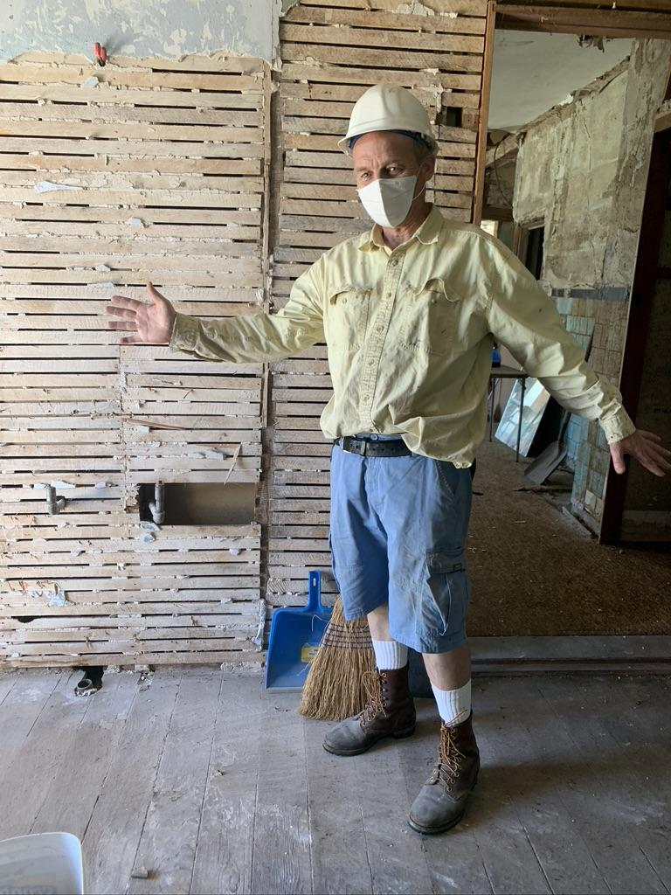

Slide 23
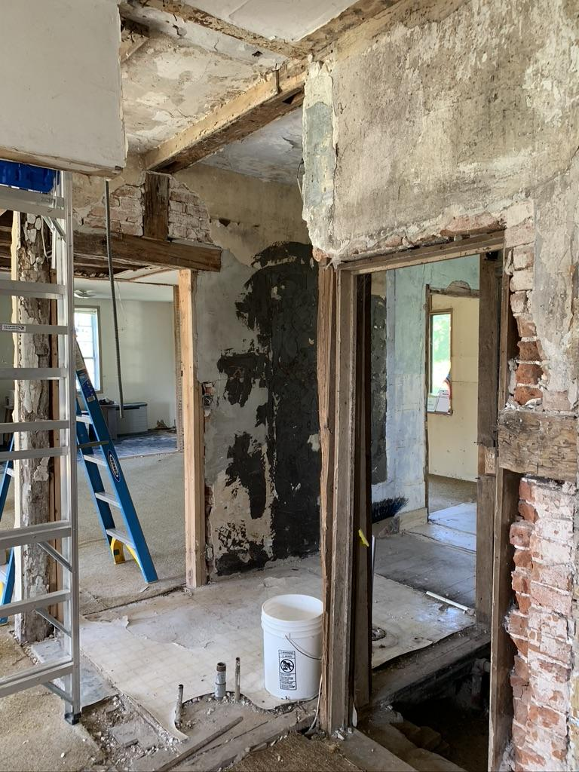
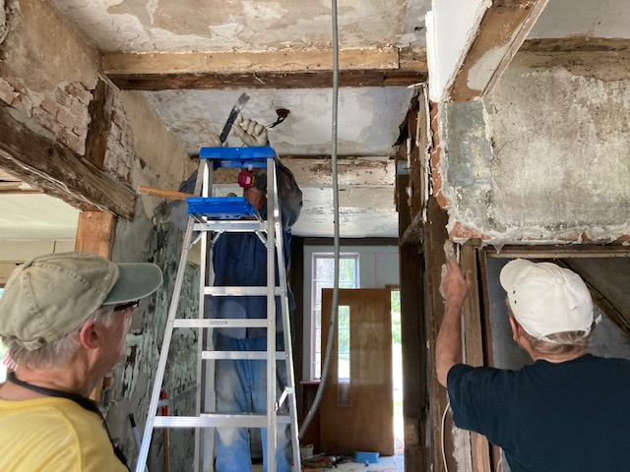

Slide 24
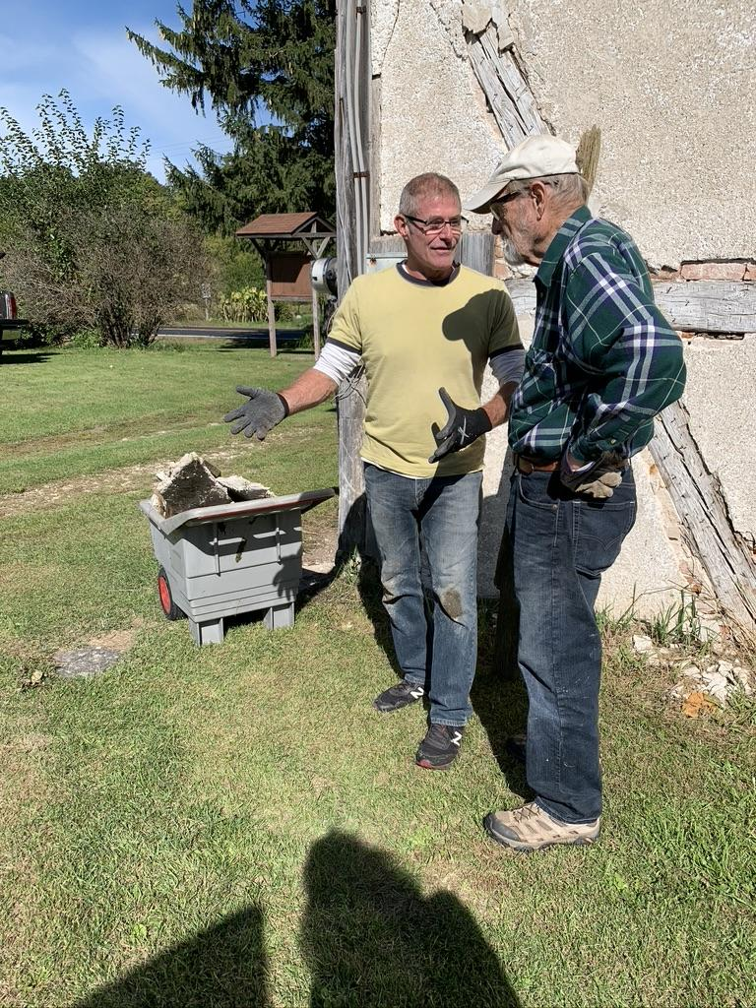
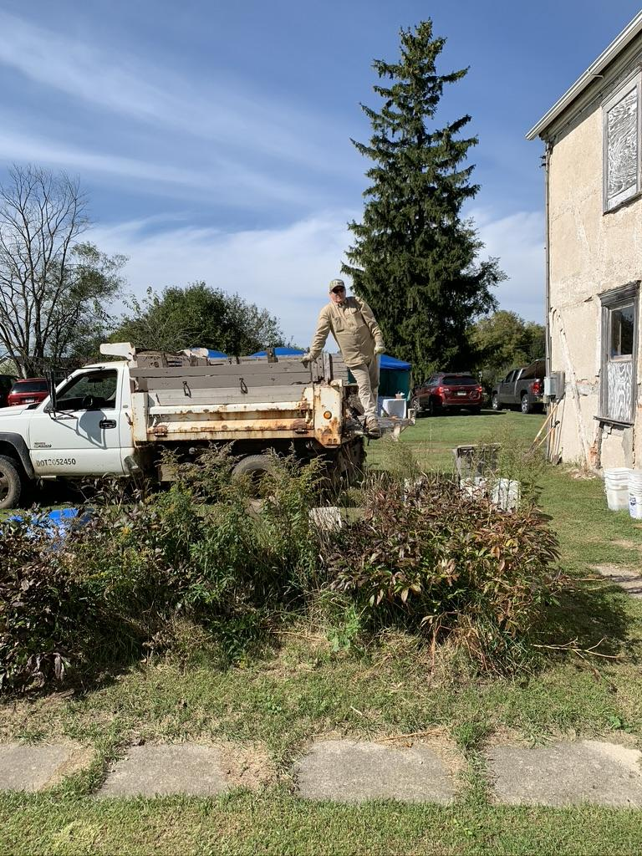

Slide 25
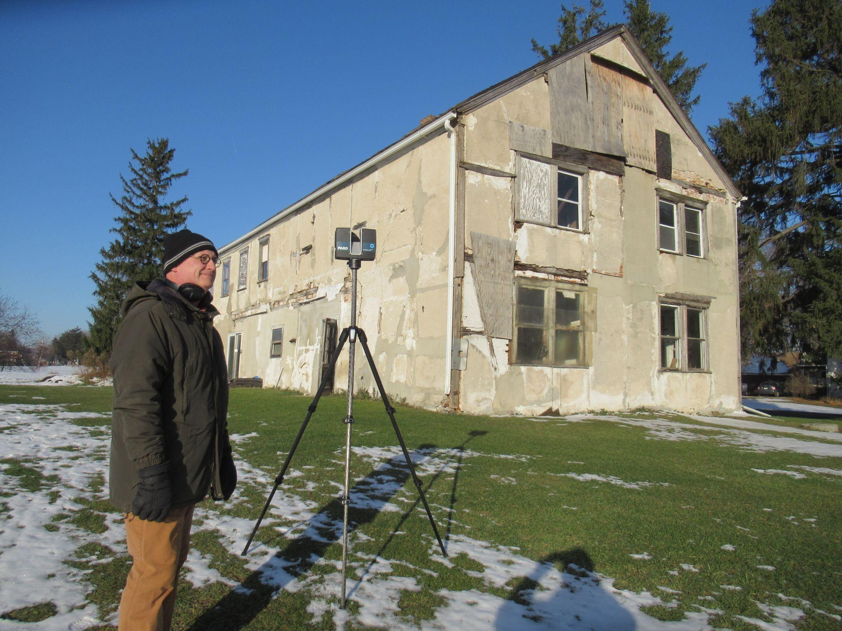
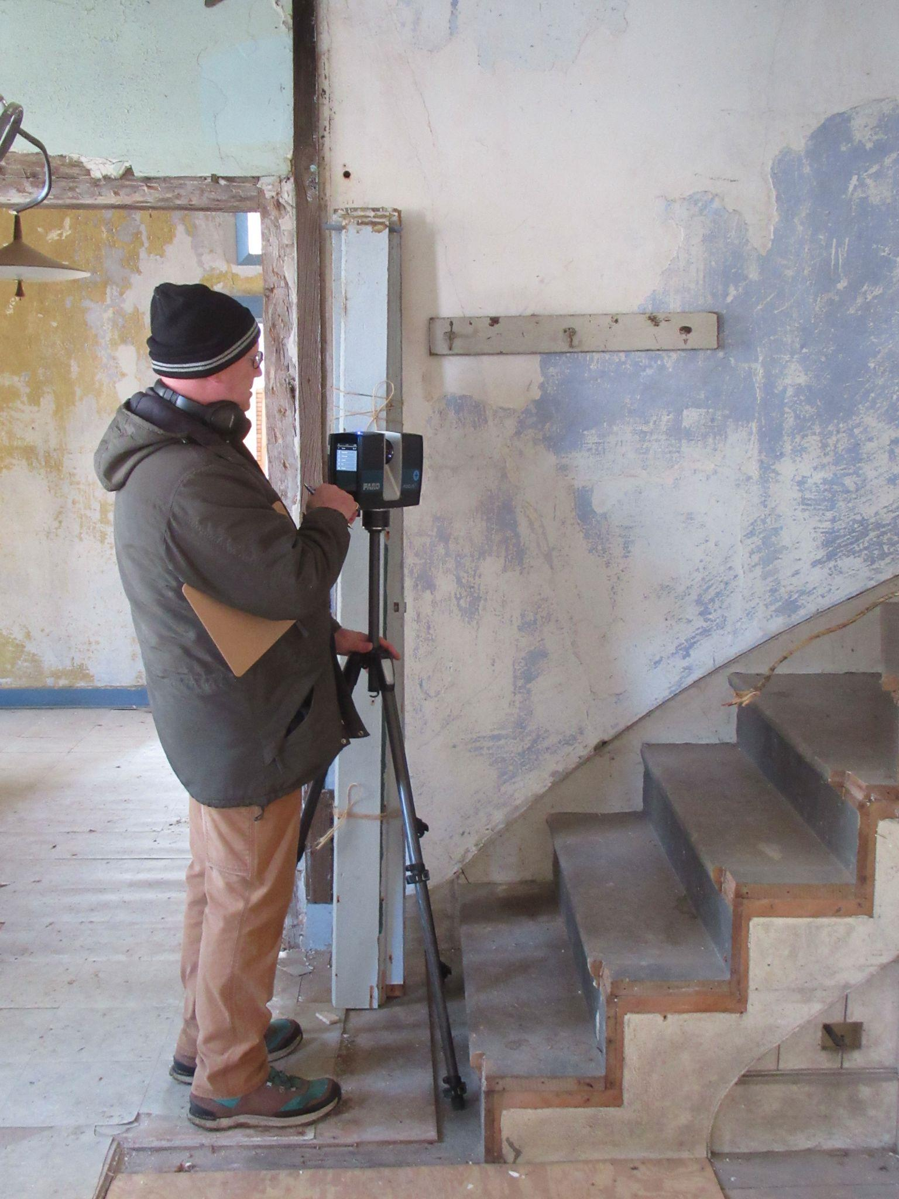

Slide 26
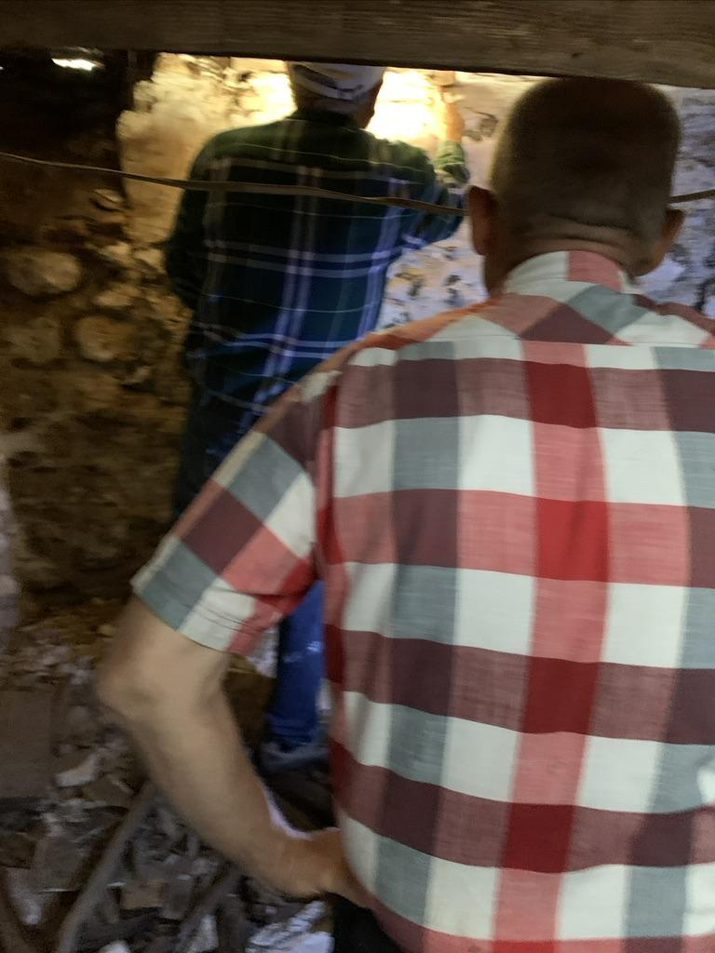
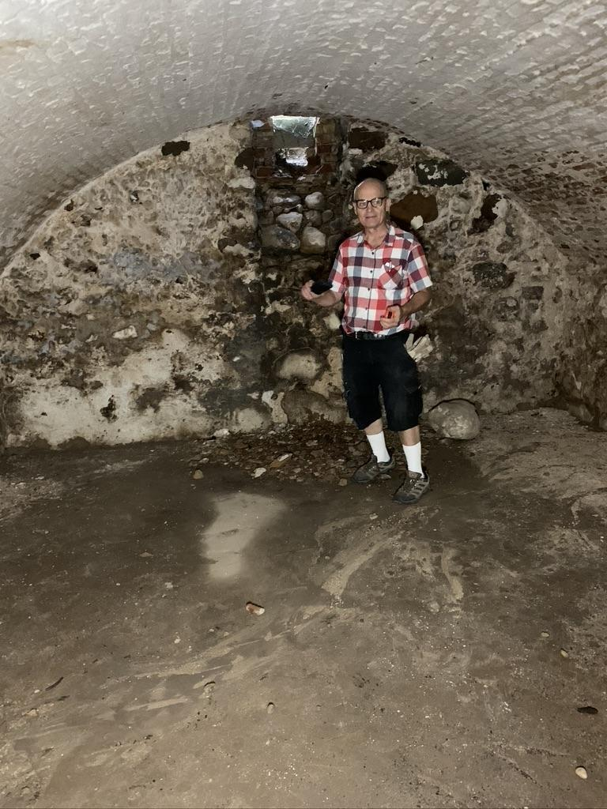
The cellar

Slide 27
