Slide 1
Working Therapeutically with Neurodivergent Clients
Ruth Millman and Danny van Deurzen-Smith

Slide 2
Neurodiversity
Neurodivergent
Neurotypicals
Dyspraxia
ADHD
Autism
Dyslexia
Tourettes
Dyscalculia

Slide 3
“Neurodiversity may be every bit as crucial for the human race as biodiversity is for life in general.”
Harvey Blume
“Neurotypical Syndrome - a neurobiological disorder characterised by preoccupation with social concerns, delusions of superiority, and an obsession with conformity”
John Donvan

Slide 4
Neurodivergent Features
Working Memory
Flexible Thinking
Self-monitoring
Emotional Control
Executive Functioning
Planning & Prioritising
Impulse Control
Task Initiation
Problem Solving

Slide 5
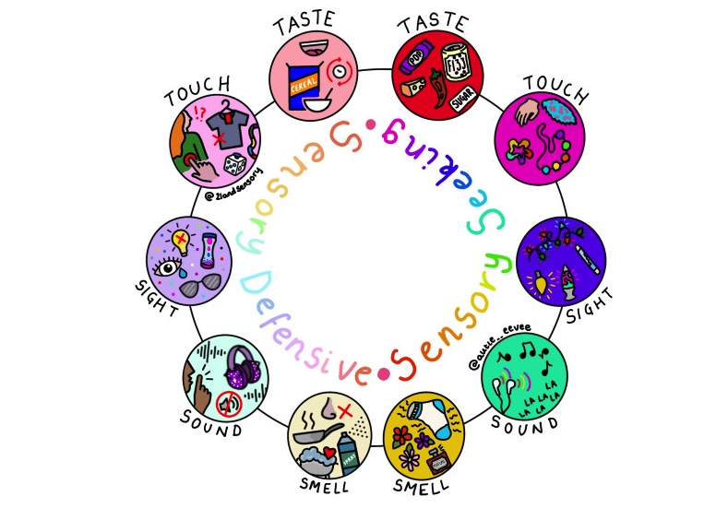


Sensory Differences

Slide 6
ADHD
Disorganisation
Innovative
Impulsivity
Hyper focus on interests
Hyperactivity
Creative
Easily distracted
Curious
Notes:
ADHD is a neurological condition that impacts the parts of the brain that help us plan, focus on, and execute tasks.
ADHD symptoms vary by sub-type; inattentive, hyperactive, or combined.
Often misdiagnosed in girls/women.
“Living with ADHD is like walking up a down escalator.You can get there eventually but the journey is exhausting.”

Slide 7
Autism
Attention to detail
Hyper focus
Preference for specific written information
Special interests
Routines & Rituals
Sensory differences
Executive functioning differences
Notes:
Differences in communication.
Difficulties picking up on ‘Neurotypical Wifi” (e.g. the non-verbal comm, facial expression, understanding unspoken social rules)
Autistic people are individuals. We are not all maths geniuses, we don’t all like trains. I am hopeless with technology and much prefer painting. There is no ‘typical Autistic.’ But I think we probably all like being respected and validated. – Jeanette Purkis

Slide 8
Dyspraxia
Difficulties with hand to eye coordination
Difficulties with coordination, movement, balance
Good strategic thinking
Creativity
Struggles with executive functioning
Good problem solver
Notes:
Dyspraxia is a specific learning difficulty affecting coordination, movement, balance and organisation abilities. Motor difficulties include poor hand to eye coordination and spatial awareness, which can make it difficult for people with dyspraxia to carry out everyday functions such as writing.
Labour MP Emma Lewell-Buck “My sense of direction is very poor,”. “Even if I have a map it may as well be a blank piece of paper. I have to find my way in an area through landmarks.” “We are the creators, the innovators. And dyspraxic people are fun to be around, because we do see things in a different way.”

Slide 9
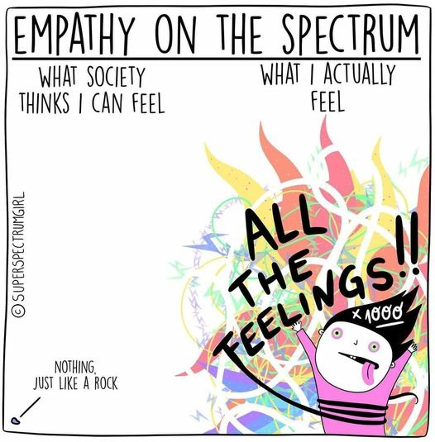
Emotions & Empathy
Busting the “lacking in emotions & empathy” myth
Highly empathetic and emotionally sensitive
Differences in interoception; alexthymia
Idiosyncratic emotional expression
Notes:
The idea that autistic or other ND people are not emotional or have no empathy is a total myth. In fact many ND people are emotionally sensitive & highly empathetic, and sometimes managing picking up on the emotions of others can be overwhelming.
There are differences in how some ND people experience emotions:
Some find it difficult to pick up on & understand what they are feeling and communicate these emotions, particularly in NT friendly ways; this is sometimes called “Alexthymia”. It is also linked to difficulties in interoception.
Consequently emotions can “come out of nowhere”
Hard to distinguish between you emotions or others.
Other people’s emotions can be really intense and overwhelming
May have an idiosyncratic display of emotion
Furthermore, if you are not tuned in to the NT wifi - you may notice that there is something wrong, but you can’t read all the unspoken NT communication to know what is actually happening.
Lack of clarity and past history of bullying etc - default setting of I’ve got everything wrong.
Alexithymia loosely translates to “no words for emotion.” Personality trait
1 in 10 people has alexithymia, but more common with depression, anorexia, ADHD
1 in 5 autistic people have alexithymia
People who have alexithymia may have have trouble identifying, understanding and describing emotions.

Slide 10
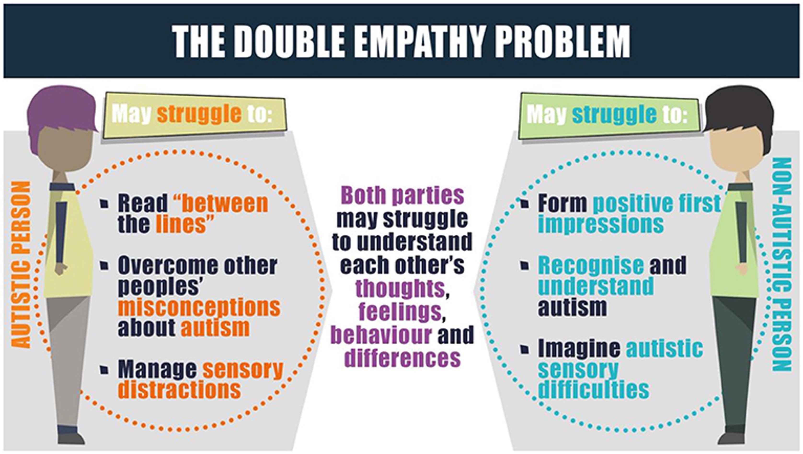
Notes:
A “disjuncture in reciprocity between two differently disposed social actors.”
(Milton, 2012)

Slide 11

ND Identity
Difference in use of terminology (e.g. ND / auti / aspie)
Identity first pronouns
Disability and/or difference
Unhelpful language (“mild” / “just a bit”)
Self–diagnosis – the importance of claiming an identity & lack of resources
#Actuallyautistic
Notes:
RM Corden, K., Brewer, R., & Cage, E. (2021). Personal Identity After an Autism Diagnosis: Relationships With Self-Esteem, Mental Wellbeing, and Diagnostic Timing. Frontiers in Psychology, 12.
https://theautisticadvocate.com/2019/03/an-autistic-identity/
https://neuroclastic.com/the-identity-theory-of-autism-how-autistic-identity-is-experienced-differently/

Slide 12
Masking or Camouflaging
Hiding particular behaviours, or adopting strategies to fit into neurotypical majority
Mimicking others, hiding stims
Exhausting, confusing in terms of self identity, isolating
Cross diagnosis & intersectional

Slide 13
Neurodiversity & Mental Health
Higher prevalence of many mental health diagnoses for ND people & sucidiality.
94% autistic people experiencing anxiety and 83% depression. (NAS study 2020)
80% of adults with ADHD have at least one coexisting psychiatric disorder [2, 3], mood and anxiety disorders, substance use disorders, and personality disorders.
Issues of misdiagnosis, overshadowing, lack of research
Notes:
1) NAS Study https://www.autism.org.uk/advice-and-guidance/topics/mental-health/anxiety
2) Torgersen T, Gjervan B, Rasmussen K. ADHD in adults: a study of clinical characteristics, impairment and comorbidity. Nord J Psychiatry. 2006;60(1):38–43. doi: 10.1080/08039480500520665. [PubMed] [CrossRef] [Google Scholar]
3) Sobanski E, Bruggemann D, Alm B, Kern S, Deschner M, Schubert T, et al. Psychiatric comorbidity and functional impairment in a clinically referred sample of adults with attention-deficit/hyperactivity disorder (ADHD) Eur Arch Psychiatry Clin Neurosci. 2007;257(7):371–377. doi: 10.1007/s00406-007-0712-8. [PubMed] [CrossRef] [Google Scholar]
55% dyspraxic teenagers frequently or nearly always anxious with the figure rising to 70% for people over 25 years of age.

Slide 14
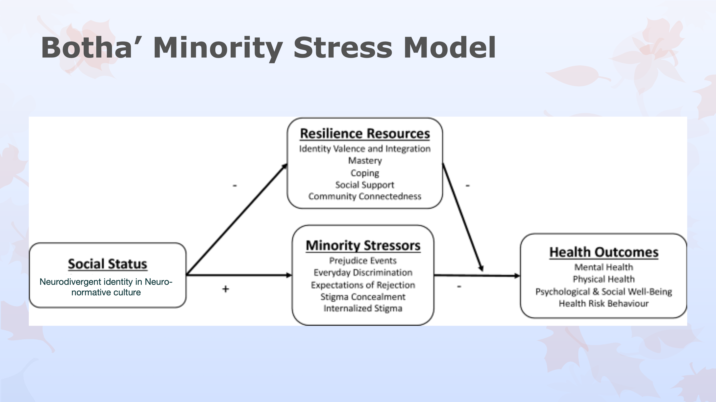
Model from M Botha 2019
Notes:
A major reason why ND people experience more mental health problems is linked to the difficulties of living in a NT world - sensory overload / social expectations.
Monique Botha is an autistic academic who has research how the minority stress model is linked ND levels of mental and physical ill health.
It is important to affirm that living in a neurotypical world is stressful, but also to highlight their strength and courage in whatever way this is demonstrated

Slide 15
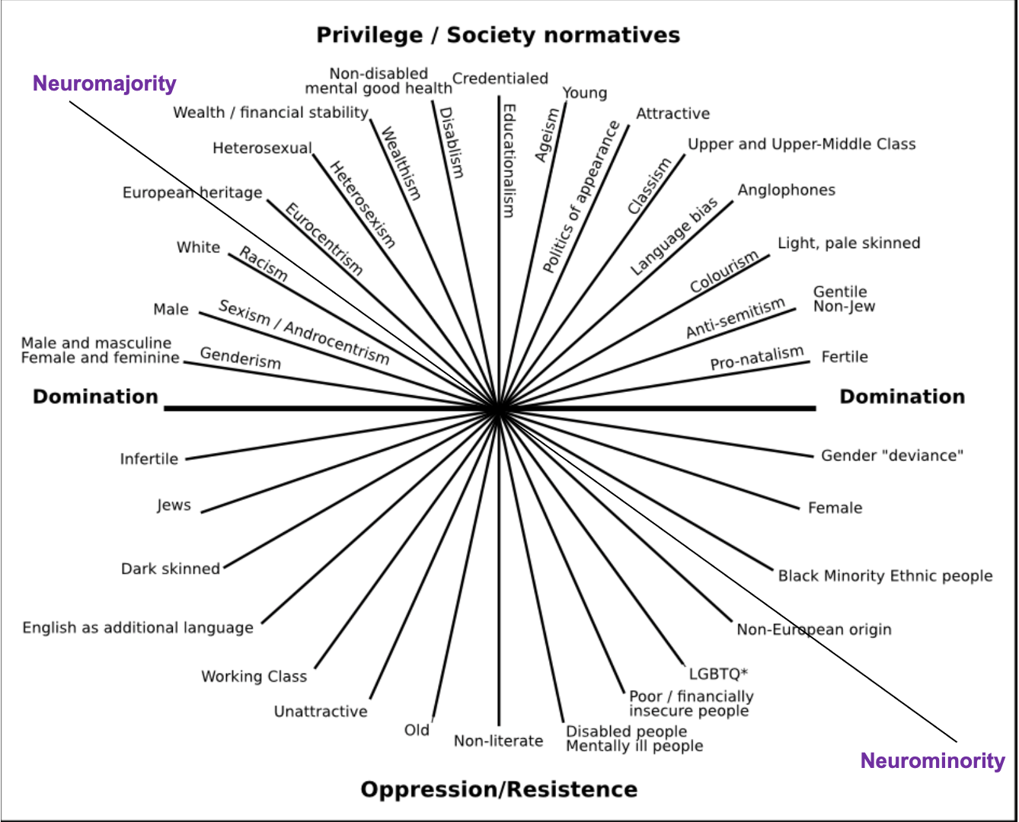
Notes:
Under/misdiagnosis of Autistic and ADHD women & girls
Higher prevalence of non-binary and gender diverse identities.
Lack of services/research
Neurodivergent people of colour
Discrimination regarding assessments – in US white children are about 19 percent more likely than black children and 65 percent more likely than Hispanic children to be diagnosed with autism.
https://www.spectrumnews.org/news/race-class-contribute-disparities-autism-diagnoses/

Slide 16

Gender & Autism
5 % of cisgender people have autism, whereas 24% of gender-diverse people do. Warrier et al 2020)
Gender-diverse people are more likely to have autistic traits and suspect undiagnosed autism
34% autistic gender diverse people said their gender diversity was questioned due to their autism (Strang et al 2018)
Crucial to openly and positively support self exploration
Supporting clients in talking about their gender identity
Notes:
Higher prevalence of gender diverse identities, but a lack of research and support for Neuroqueer individuals
Gender-diverse here is referring to trans and gender non-conforming identities.
https://www.frontiersin.org/articles/10.3389/fpsyt.2021.671448/full
https://link.springer.com/epdf/10.1007/s10803-018-3723-6?author_access_token=JaLKg_XCj1Qeikhk79Pr9Pe4RwlQNchNByi7wbcMAY6CmvT1Zb2Occ1Ii8qzO55IER__ENggoqztPMQ4GKs8d8US6jrGjymtXRjeekaGOFRVL8dtTCmMTB4noVryAgyfUmhATDCp5sqjLXuh0FqmyA==
Risk of suicide and mental health problems are extremely high for trans and non-binary people.

Slide 17
Emotional Processing
Sensory differences
Executive functioning
Communication differences
Stigma & discrimination
Emotional language
Emotional Processing
Notes:
Mazefsky, C.A., & White, S.W. (2014). Emotion regulation: concepts & practice in autism spectrum disorder. Child and adolescent psychiatric clinics of North America, 23 1, 15-24 .

Slide 18

Neurodivergence Informed Therapy
Notes:
Working in a “Neurodiversity paradigm” = “reconceptualisation of dysfunction as relational rather than individual” Botha & Chapman 2022

Slide 19
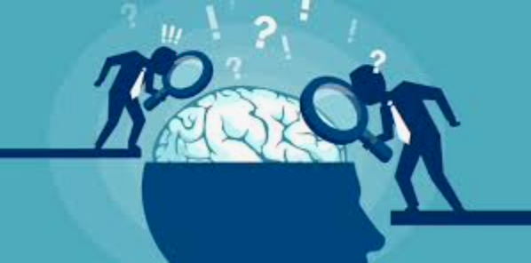

Diagnosis
At least 1 in 100 autistic people in the UK
Prevalence 3-4% ADHD in UK
Increasing prevalence (esp. women and girls) linked to changes in diagnosis
Diagnosis - validation / access to services / stigma
Greater time elapsed since diagnosis related to less dissatisfaction with autistic personal identity
https://www.ted.com/talks/steve_silberman_the_forgotten_history_of_autism
Notes:
1 in 10 UK people who are dyslexic
2% UK population are dyspraxic
787% increase in prevalence of autism between 1998-2018 (Underwood et al, 2022) Underwood, J. F., DelPozo-Banos, M., Frizzati, A., John, A., & Hall, J. (2022). Evidence of increasing recorded diagnosis of autism spectrum disorders in Wales, UK: An e-cohort study. Autism, 26(6), 1499-1508.

Slide 20

Pre-Diagnostic Support
Talk about neurodiversity and different brains
Be mindful of pathologising language
Be honest about the discrimination and challenges
Pros and cons of diagnosis
Signposting to YouTubers / insta / books
Practical support through diagnostic process
When to bring diagnosis into the discussion?

Slide 21
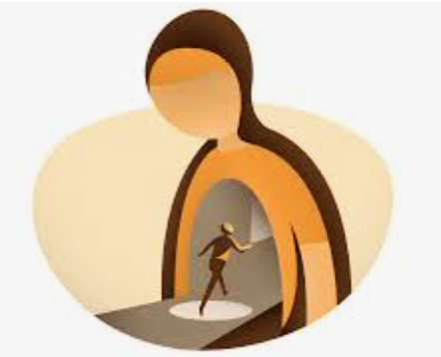
Post-Diagnostic Support
What’s me, what’s my ND?
Finding a sense of self outside/alongside medicalization.
Link between positive identity and higher self esteem
Process of “restorying” can continue many years post diagnosis
When and how to disclosure
Managing family / loved ones responses
Dropping the mask and a lost sense of self

Slide 22

Phenomenology
Openly exploring the client’s experience
Description, bracketing and horizontalisation
Elucidate their worldview
Constantly verify your understanding

Slide 23
A Shared Education
Psychoeducation - around emotions etc
Exploring and explaining social rules
Exploring and explaining different points of view in relational dynamics
Finding out about the client’s understanding, meanings, interests

Slide 24



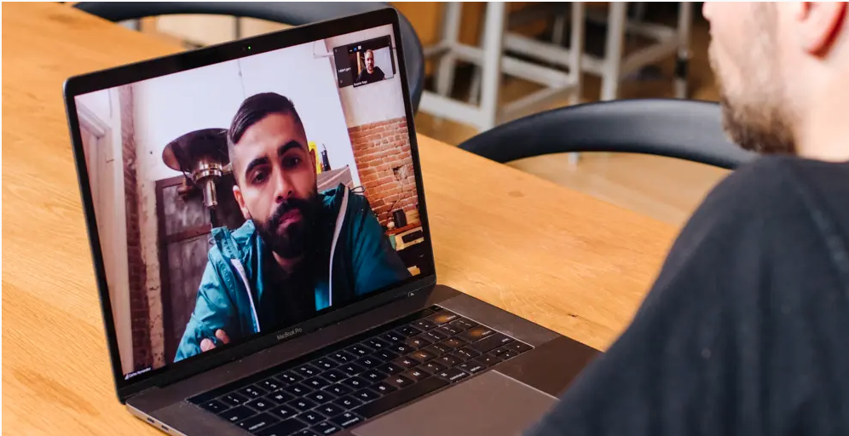
Environment
“Making space for all”
Notes:
Creating a Ecological Niche “Making space for all”- Chapman&Botha
Without these adaptions they can’t benefit from therapy!
IRL environment - lighting / noise / waiting room / clear signs / first and last appts
Online environment - preferences / sensory issues / clear expectations
Having photos of the rooms that you will be using.
Structure: Duration / Tel or face-to-face / Intervals between sessions / Importance of agenda-setting / Reminders for appts (e.g. by text)

Slide 25
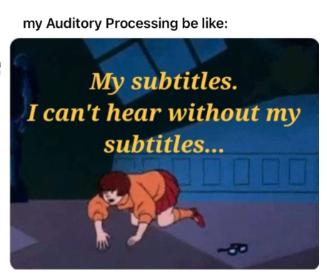

Language
Pace of language
Clarity of language (check it out)
Flexibility in communication (non-verbal when extremely anxious)
Idiosyncratic language and interests to create a shared world
Explicit about rules

Slide 26
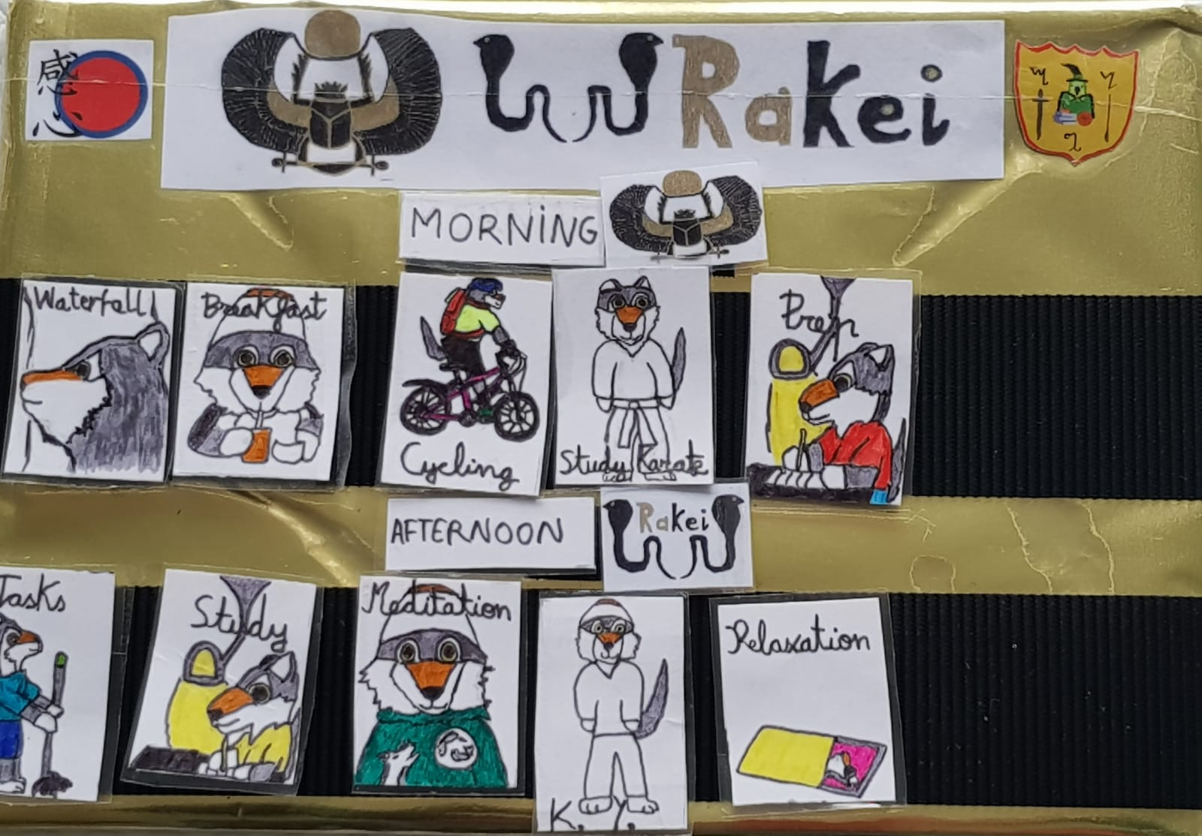

Slide 27
Exploring Emotions
Identifying physical expressions of emotions (Fit bits)
Creating an emotional language - interests, specific language
Linking and explaining your own emotional experience.
Linking emotions to theoretical framework

Slide 28
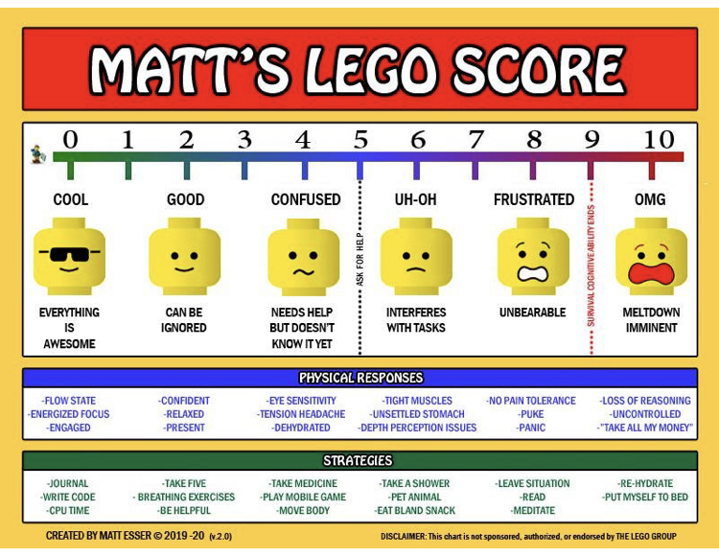

Slide 29

Directness & Defensiveness
Caution: Don’t make neurotypical assumptions
Neurotypical Privilege
“Abruptness” may not be aggressive
Lateness may not be “defensiveness”
Notes:
Neurotypical Privilege = discriminate or devalue ND experience. E.g. there are more gender diverse individuals in the ND population, and yet they are often discriminated against with some professionals arguing that their ND means that they are not able to fully understand their gender identity.
Being direct / abrupt is not necessarily intended to be aggressive or controlling. It may be linked to differences in communication style or anxiety due to feeling out of control.
Behaviours that are stereotypically seen as “defensive” may be linked to executive functioning differences or communication misunderstandings. E.g. clients repeatedly turning up late or missing appointments.

Slide 30
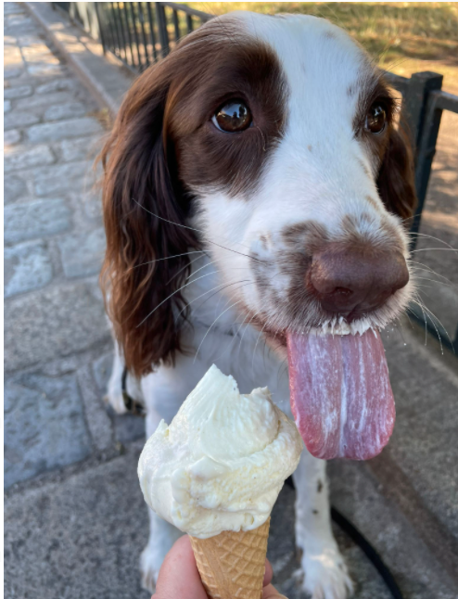
Flexibility & Creativity
Role play
Animals
Get creative and playful
Practical approaches

Slide 31
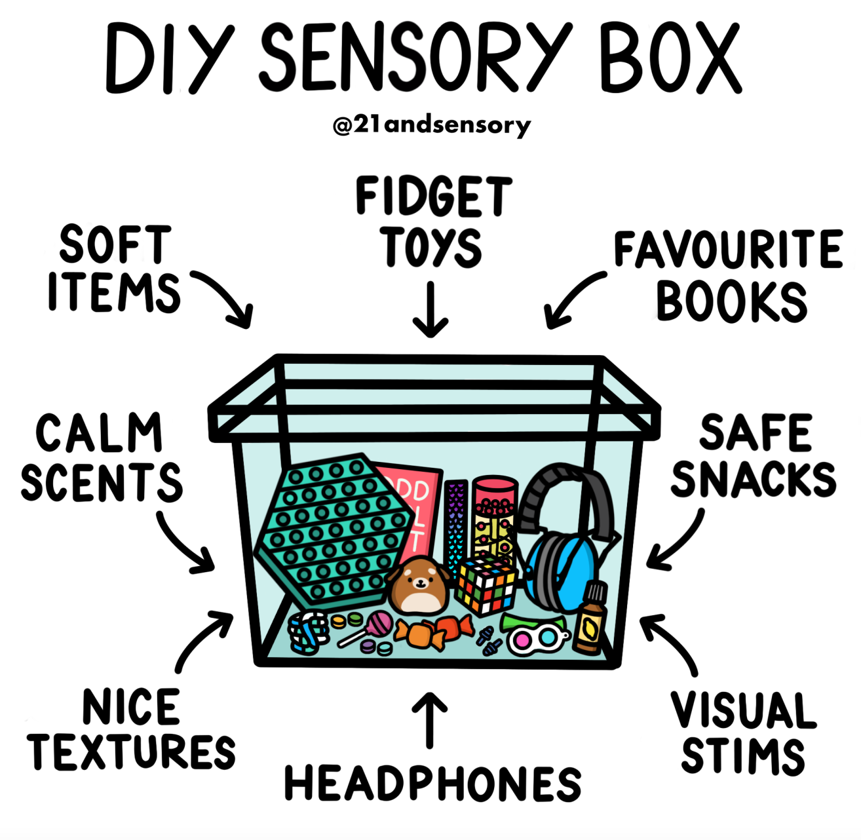



Slide 32
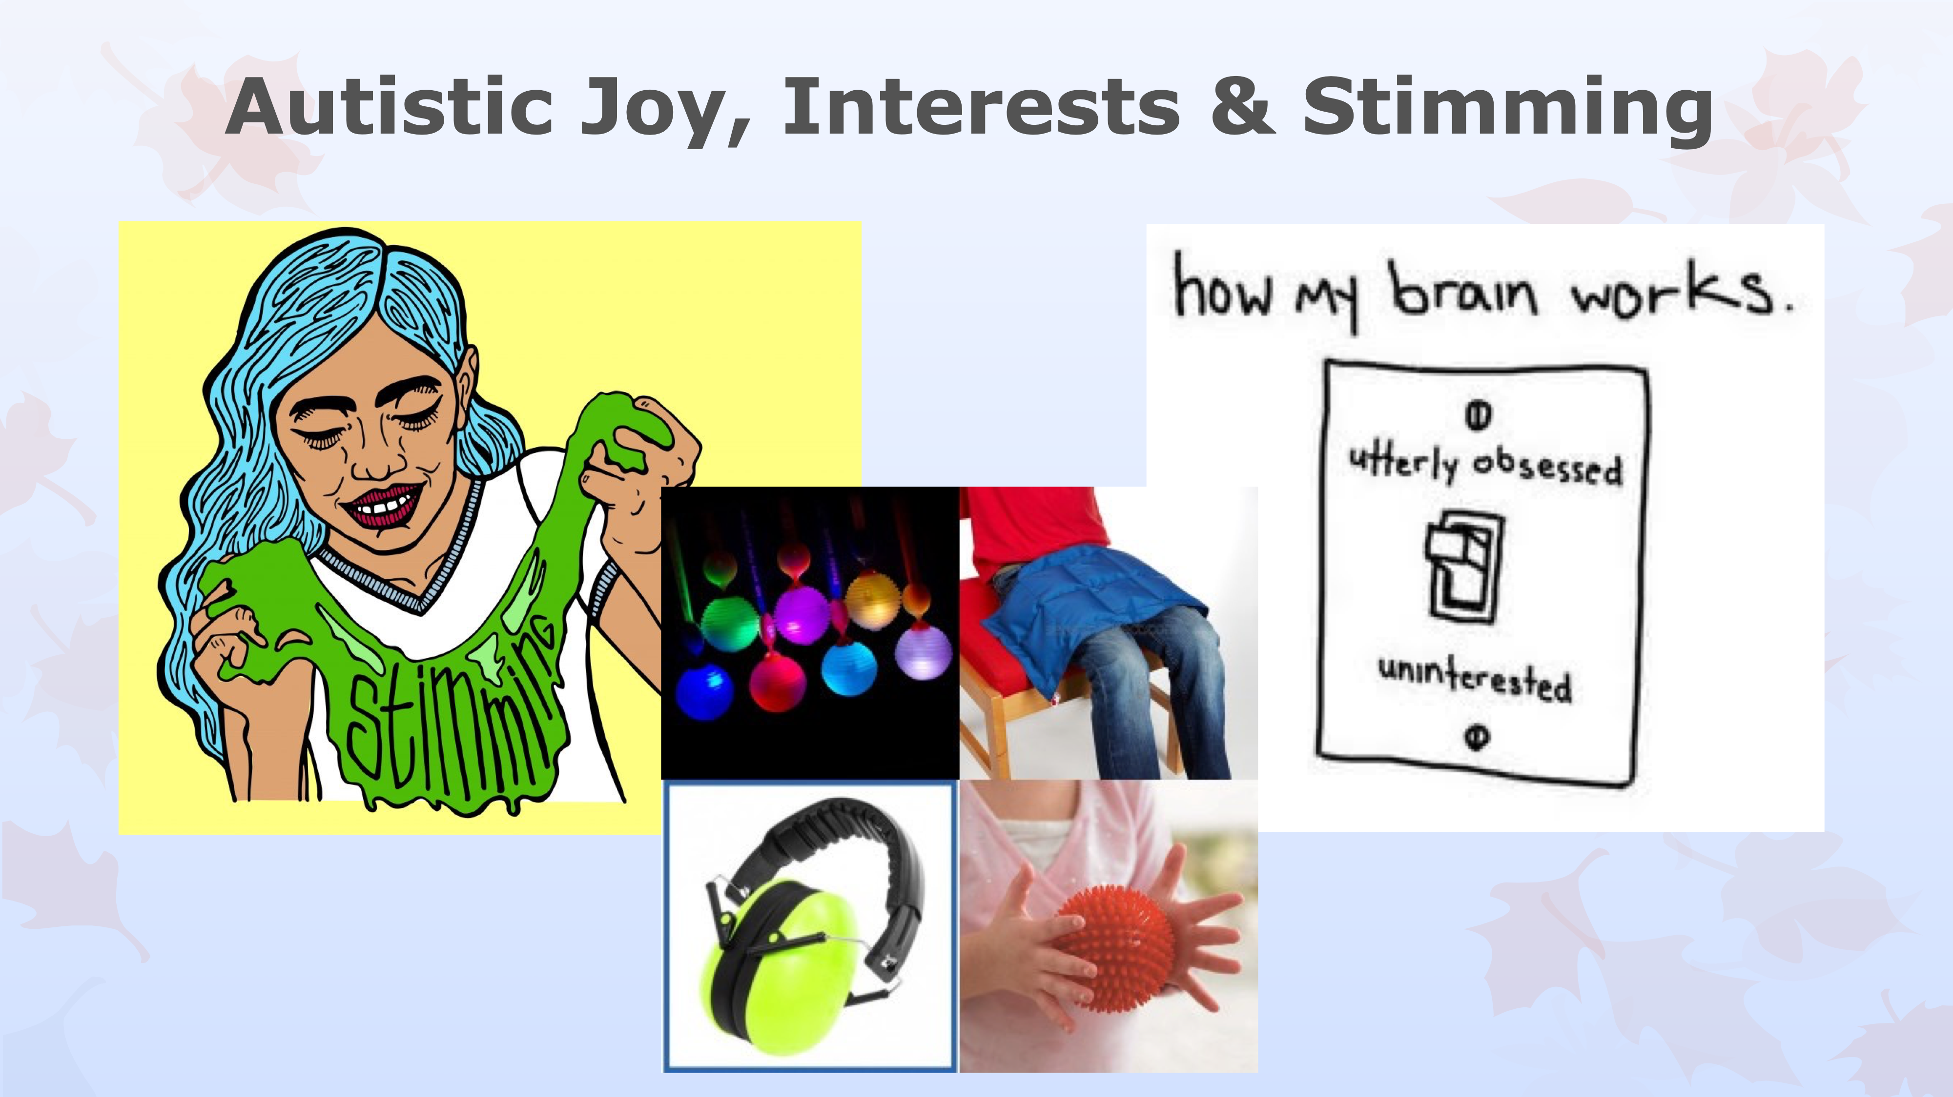

Slide 33
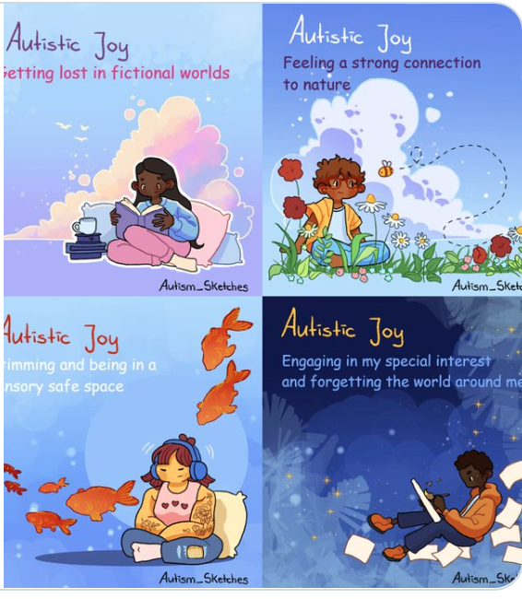
Celebrating ND
https://www.youtube.com/c/HowtoADHD?app=desktop
Neurodiversity Pride Day 16th June 2023
https://www.understood.org/en/articles/why-i-love-my-dyslexic-brain

Slide 34
Authenticity & relatedness
Being real (I-Thou not I-It)
Your relationship is key - it is a safe model
Being explicit about thoughts and feelings
Acknowledging your limitations and humanity
Affirming that an ND perspective on life struggles isn’t ‘wrong’ in fact it’s often painfully accurate!

Slide 35
REFERENCES:
For more information about neurodiversity see the videos below:
Tom on autism https://www.youtube.com/watch?v=zsVZ6vSDXpU
Sam on autistic girls and women https://www.youtube.com/watch?v=ixRSb00BplM
Dan on stimming: https://www.youtube.com/watch?v=wRJ3ZIwtNLs&feature=emb_title
Dan on dyslexia: https://www.youtube.com/watch?v=VBYunojAsW8&feature=emb_title
Taryam on ADHD: https://www.youtube.com/watch?v=ONuKw5QoJHk:
Books
Autism: A New Introduction to Psychological Theory and Current Debate Paperback by Sue Fletcher-Watson, Francesca Happé
CBT for Children and Adolescents with High-Functioning Autism Spectrum Disorders Paperback – Angela Scarpa, Susan Williams White, Tony Attwood
Cognitive-Behavioral Therapy for Adults with Autism Spectrum Disorder (Guides to Individualized Evidence-Based Treatment) by Valerie L. Gaus and Tony Attwood
Women and Girls with Autism Spectrum Disorder: Understanding Life Experiences from Early Childhood to Old Age Sarah Hendrickx (Author), Judith Gould (Author)

Slide 36
Cognitive-Behavioral Therapy for Adult ADHD: An Integrative Psychosocial and Medical Approach by J. Russell Ramsay
Mindfulness for Adult ADHD: A Clinician's GuideLidia Zylowska, John T. Mitchell
Neurodiversity, Autism and Recovery from Sexual Violence: A Practical Resource for All Those Working to Support Victim-Survivors Paperback Susy Ridout
NeuroTribes: The Legacy of Autism and How to Think Smarter About People Who Think Differently Steve Silberman,
Neurodiversity: From Phenomenology to Neurobiology and Enhancing Technologies Paperback Lawrence K. Fung MD PhD
The Power of Neurodiversity: Unleashing the Advantages of Your Differently Wired Brain Thomas Armstrong PhD
The Neurodiversity Reader: Exploring Concepts, Lived Experience and Implications for Practice Damian Milton
Autism Spectrum Disorders Through the Life Span Digby Tantam
Hodge, N. (2013). Counselling, autism and the problem of empathy. British Journal of Guidance & Counselling, 41(2), 105-116.
Koenig, K., & Levine, M. (2011). Psychotherapy for individuals with autism spectrum disorders. Journal of Contemporary Psychotherapy, 41(1), 29-36.
Murphy, S. M., Chowdhury, U., White, S. W., Reynolds, L., Donald, L., Gahan, H., ... & Press, D. A. (2017). Cognitive behaviour therapy versus a counselling intervention for anxiety in young people with high-functioning autism spectrum disorders: A pilot randomised controlled trial. Journal of Autism and Developmental Disorders, 47(11), 3446-3457.

Slide 37
Milton, D. E. (2012). On the ontological status of autism: the ‘double empathy problem’. Disability & Society, 27(6), 883-887.
Hesslinger, B., van Elst, L. T., Nyberg, E., Dykierek, P., Richter, H., Berner, M., & Ebert, D. (2002). Psychotherapy of attention deficit hyperactivity disorder in adults. European archives of psychiatry and clinical neuroscience, 252(4), 177-184.
Groß, V., Lücke, C., Graf, E., Lam, A. P., Matthies, S., Borel, P., ... & Comparison of Methylphenidate and Psychotherapy in Adult ADHD Study (COMPAS) Consortium. (2019). Effectiveness of psychotherapy in adult ADHD: what do patients think? Results of the COMPAS study. Journal of attention disorders, 23(9), 1047-1058.
Hendrickx, S. (2010). The adolescent and adult neuro-diversity handbook: Asperger's syndrome, ADHD, dyslexia, dyspraxia, and related conditions. Jessica Kingsley Publishers.
Simpson, B. (2020). An open letter to the psychotherapy and counselling profession: It is time to recognise the politics of training and practising with Tourette's syndrome. Psychotherapy and Politics International, 18(3), e1549.

Slide 38
https://www.autism.org.uk/what-we-do/news/adapt-mental-health-talking-therapies

Slide 39
Additional Slides

Slide 40
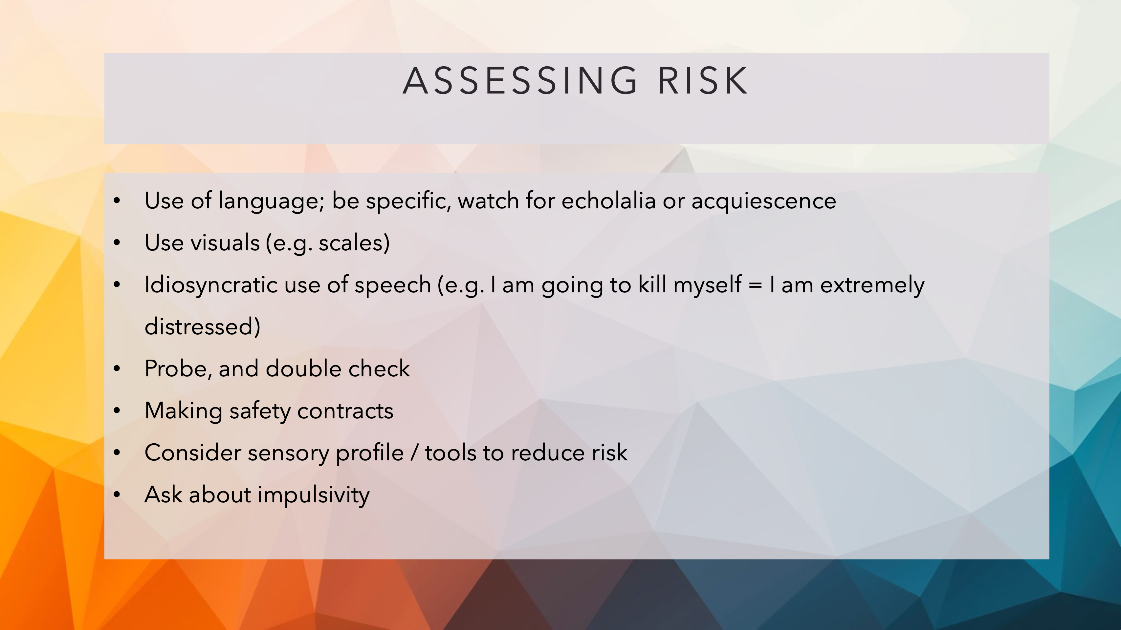

Slide 41
Reasons for seeking support
Anxiety and depression
Trauma
Bullying, discrimination and harassment
Diagnosis
Notes:
RM
NB - your assumptions about why ND person may come to therapy
Barriers to support
Lack of services
Inadequate ND training for professionals increasing misdiagnosis etc
Services that exist are often not ND friendly (e.g. telephone appt, DNA policies)
History of discrimination and low self esteem

