Slide 1

Counsellors’ Experience of Assessing & Managing Suicidality among Students in Third-level Institutions in Ireland
Hayley O’Gorman
MSc in Pluralistic Counselling and Psychotherapy

Slide 2
Suicide is the act of killing oneself intentionally (Joiner, 2005)

Slide 3

Why this Research Topic?
Clinically practice in a third-level institution.
Impact of suicide-specific training.
Counsellors are uniquely positioned to screen, identify, and assess suicide risk.
Notes:
That higher level of confidence and competence in assessing and managing suicide risk.

Slide 4

Aim & Objectives
Determine whether counsellors feel they have received appropriate professional training to assess and manage suicide risk.
1
Elicit counsellors’ view on suicide risk assessment methods they utilise in their respective HEI.
2
Ascertain if risk assessments are standardised.
3
To Explore Counsellors' Experience of Assessing and Managing Suicidality Among Students in Third-Level Institutions in Ireland

Slide 5

What does the Literature say…
Student Mental Health
Ireland: 7% (approx. 16,500) students sought the support of SCS (PCHEI, 2021 Report, cited in Howard et al., 2021).
Ireland/globally: Unique stressors: college students V age-matched peers (Horgan et al., 2018; Moskow et al., 2022).

Slide 6
Literature continued…
Suicidality among Students & Young People
Ireland/globally: Second leading cause of death among college students (Moskow, Lipson & Tompson, 2022; Wilcox et al., 2010).
Ireland/ Globally: Suicide is the 4th leading cause of death among the 15-19 age group (HSE, 2020; WHO, 2021).
Ireland: NRSF - 29% increase in self-harm in 10-24 age group in 10 years (cited in Fox et al., 2020).
Ireland/globally: Risk Factors: History of depression, SI, SB, SP, SA, and hopelessness (Dhingra et al., 2019; Hayes et al., 2020; Horgan et al. 2018).
Suicide Training
Counsellors’ sense of inadequate suicide training is linked to feelings of incompetency and even fear with ‘at risk’ client presentations (Kene et al., 2019; Lund et al., 2020).
HEA support counsellors in HEIs in Ireland with training in the Collaborative Assessment & Management of Suicidality (CAMS, Jobes, 2016) (Surdey et al., 2022).

Slide 7

Ideation-to-Action Theories of Suicide

Slide 8
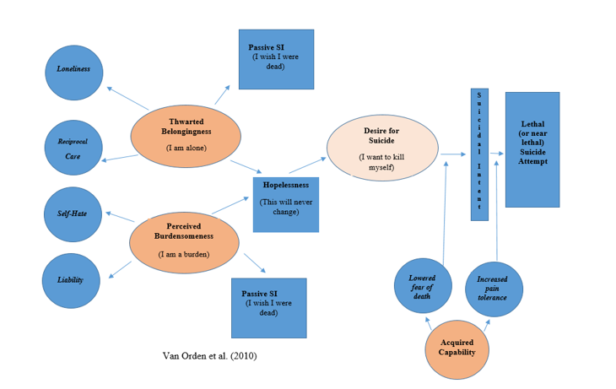
Interpersonal-Psychological Theory of Suicide (IPTS) (Joiner, 2005; Van Orden et al., 2010)

Slide 9
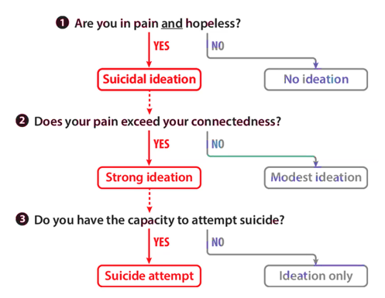
Three-Step Theory (3-ST) Klonsky & May (2015)

Slide 10
Methodology
Qualitative Study
Interpretive Phenomenological Analysis (IPA) (Smith, Flowers & Larkin, 2009)
Thematic Analysis (Braun & Clarke, 2006)
Six Participants
Semi-Structured Interviews
Ethical Considerations
Methodological Issues
Researcher bias / small sample size

Slide 11

Preliminary Findings Superordinate Themes
Suicide Screening / Risk Assessment
Collaboration
Challenges
Intervention Strategies
Suicide Training
Counsellors’ Experience of Assessing and Managing Suicidality among students in third-level institutes in Ireland

Slide 12

Theme 1: Suicide Training
Non-Clinical
HSE Safe Talk
Applied Suicide Intervention Skills Training (ASIST)
START Suicide Prevention training
Clinical-specific
CAMS
CAMS training completed by most Participants:
P4 described CAMS as:
“The most intense training in terms of clinical value in the room”.
Suicide Prevention & Self-Harm Mitigation Training completed by P2 (via STORM)
Adequately Trained
“Before CAMS, I would have had to very honesty say no” .(P1)
“I don’t feel adequately trained. That’s not to say I would feel completely incompetent in managing it either”. (P6)
Clinical Experience Asking direct questions” (P5, P6)….”and I’m not afraid of that”. (P5)

Slide 13

Theme 2: Suicide Screening/Risk Assessment
Screening – Psychometric Systems
The CORE-34 is a “very useful tool” ….“flags a conversation” (P3).
CCAPS-34 helps to “determine suicidality and determine risk” (P5).
Risk Assessment- CAMS
CAMS is implemented as a “second strategy”– “it is up to individual counsellors” (P3). P5 finds parts of CAMS very useful rather than using it in its “purest form”
P4, P1, and P2 “move straight to the CAMS and the stabilisation plan” (p4) where a ‘high risk’ level emerges at intake or during therapy.
Notes:
Clinical Outcomes in Routine Evaluation
Counseling Center Assessment of Psychological Symptoms .

Slide 14


Theme 3: Collaboration
Client-Therapist Collaboration
P3 highlighted the use of the “core conditions” and holding a “very deep respect of phenomenological inquiry”.
Team Collaboration
P5 stated, “it is never a one-person decision, it is always a team decision”.

Slide 15



Theme 4: Intervention Strategies
Stabilisation Plan
“I think that creates a sense of safety. There is something or someone behind that stabilisation plan” (P2).
Referral
Having a “good referral mechanism” (P4) is important (all Ps)
Psychoeducation
It is “part of you” not the “whole of you” (P3).

Slide 16


Theme 5: Challenges
Caseload
“How many ‘at risk’ clients would be inappropriate in a caseload?” (P5) or “how many CAMS clients is ethical on a caseload” (P4).
Whose Agenda does it Become

Slide 17
DISCUSSION
Suicide-Specific Training
Most of the participants are fully trained in CAMS.
All participants use evidence-based instruments
Some participants implement “full”-CAMS, others use aspects of CAMS, and/or psychometric screening tools.
All participants deem the ‘Stabilisation plan’ significant.
Risk exploration is a meaningful way to listen to client’s experience of suicide (Reeves, 2017).
Short-term Model
Mixed views: implementing a suicide-specific model for short-term counselling. Studies demonstrate positive outcomes (Pistorello et al., 2018, 21).
Potential Burnout
To exclusively work with suicidal client cases is unwise / unethical.
Notes:
Derived from the study is that…

Slide 18
Implications for Research
Introduce evidence-based suicide-specific therapeutic models into professional training programmes for clinicians.
Clear HEI policies around counsellors ‘at risk’ client caseload.
Further training on a national level in other evidence-based practices.
Future Research
Theory development in student suicidality.
Qualitative studies to examine barriers in utilising suicide risk assessments / frameworks in short-term therapy.

Slide 19

CONCLUSION
Students require increasingly flexible yet robust services in order to meet their unique
MH needs (BACP, 2019).
Suicide-specific training enhances counsellor confidence and competence.
Effective suicide risk assessment: history /current status of MH, suicidality, access to lethal means, and hopelessness (Jobes, 2016; Picard & Rosenfeld, 2021).
Opportunity to learn about the client’s story and discern how suicide fits into their life.
Notes:
Privileged opportunity

Slide 20
Thank you

Slide 21
REFERENCES
Braun, V., & Clarke, V. (2006). Using thematic analysis in psychology. Qualitative research in psychology, 3(2), 77-101
British Association for Counselling and Psychotherapy (2019). A pluralistic approach to student counselling: University and College Counselling. Retrieved from: A pluralistic approach to student counselling (bacp.co.uk)
Dhingra, K., Boduszek, D., & O’Connor, R. C. (2016). A structural test of the integrated motivational-volitional model of suicidal behaviour. Psychiatry Research, 239, 169– 178. https://doi.org/10.1016/j.psychres.2016.03.023
Fox T, Byrne D, Surdey J (2020). National student mental health and suicide prevention framework. Retrieved from: HEA – National Student Mental Health and Suicide Prevention Framework
Hayes, J.A., Petrovich, J., Janis, R. A., Yang, Y., Castonguay, L. G., & Locke, B. D. (2020). Suicide among college students in psychotherapy: Individual Predictors and Latent Classes. Journal of Counseling Psychology, 67(1), 104–114. https://doi.org/10.1037/cou0000384
Health Service Executive. (2020). Connecting for Life. Implementation plan 2020-2022. Retrieved from: https://www.hse.ie/eng/services/list/4/mental-health- services/connecting-for-life/publications/cfl-implementation-plan-dec-2020.pdf
Horgan, A., Kelly, P., Goodwin, J., & Behan, L. (2018). Depressive symptoms and suicidal ideation among Irish undergraduate college students. Issues in Mental Health Nursing, 39(7), 575–584. https://doi.org/10.1080/01612840.2017.1422199
Howard, E., Tayer Farahani, Z., Rashleigh, C., & Dooley, B. (2021). Developing a national database for higher education student counselling services: the importance of collaborations. Irish Journal of Psychological Medicine, 1–7. https://doi.org/10.1017/ipm.2021.78
Jobes, D.A. (2016). Managing suicidal risk: A collective approach (2nd ed.). New York: Guilford Press.
Joiner, T.E. (2005). Why people die by suicide. Cambridge, MA: Harvard University Press
Kene, P., Yee, E. T., & Gimmestad, K. D. (2019). Suicide assessment and treatment: Gaps between theory, research, and practice. Death Studies, 43(3), 164–172. https://doi.org/10.1080/07481187.2018.1440034

Slide 22
Lund, E.M., Schultz, J. C., Thomas, K. B., Nadorff, M. R., Chowdhury, D., & Galbraith, K. (2020). “It’s Awful When We Get It Wrong”: An exploratory qualitative study of vocational rehabilitation counselors’ perspectives on suicide. Omega: Journal of Death and Dying, 81(4), 551–566. https://doi.org/10.1177/0030222818783933
Moskow, D.M., Lipson, S. K., & Tompson, M. C. (2022). Anxiety and suicidality in the college student population. Journal of American College Health, ahead-of- print(ahead-of-print), 1–8. https://doi.org/10.1080/07448481.2022.2060042
Picard, E.H. & Rosenfeld, B. (2021). How clinicians incorporate suicide risk factors into suicide risk assessment. Crisis: The Journal of Crisis Intervention and Suicide Prevention, 42(2), 100–106. https://doi.org/10.1027/0227-5910/a000694
Pistorello, J., Jobes, D. A., Compton, S. N., Locey, N. S., Walloch, J. C., Gallop, R., Au, J. S., Noose, S. K., Young, M., Johnson, J., Dickens, Y., Chatham, P., Jeffcoat, T., Dalto, G., & Goswami, S. (2018). Developing adaptive treatment strategies to address suicidal risk in college students: a pilot sequential, multiple assignment, randomized trial (SMART). Archives of Suicide Research, 22(4), 644–664. https://doi.org/10.1080/13811118.2017.1392915
Pistorello, J., Jobes, D. A., Gallop, R., Compton, S. N., Locey, N. S., Au, J. S., Noose, S. K., Walloch, J. C., Johnson, J., Young, M., Dickens, Y., Chatham, P., & Jeffcoat, T. (2021). A randomized controlled trial of the collaborative assessment and management of suicidality (CAMS) versus treatment as usual (TAU) for suicidal college students. Archives of Suicide Research, 25(4), 765–789. https://doi.org/10.1080/13811118.2020.1749742
Reeves. (2017). In a search for meaning: Challenging the accepted know-how of working with suicide risk. British Journal of Guidance & Counselling, 45(5), 606–609. https://doi.org/10.1080/03069885.2017.1377338
Smith, J.A., Flowers, P. and Larkin, M. (2009) Interpretative Phenomenological Analysis: theory, method and research. London: Sage
Surdey, J., Byrne, D., & Fox, T. (2022). Developing Ireland’s first national student mental health and suicide prevention framework for higher education. Irish Journal of Psychological Medicine, 1–5. https://doi.org/10.1017/ipm.2022.10
Wilcox, H. C., Arria, A. M., Caldeira, K. M., Vincent, K. B., Pinchevsky, G. M., & O'Grady, K. E. (2010). Prevalence and predictors of persistent suicide ideation, plans, and attempts during college. Journal of Affective Disorders, 127(1), 287-294
World Health Organization. (June 2021). Suicide worldwide in 2019: Global health estimates. Geneva: Licence: CC BY-NC-SA 3.0 IGO. Retrieved: Suicide worldwide in 2019 (who.int)

