Slide 1


ANTITRUST LAW IN THE UNITED STATES: 2026
Presented by Ted Donner

Slide 2
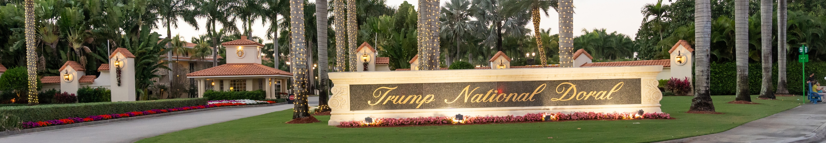
INTRODUCTION

Slide 3

AGENDA
Antitrust Law Overview
Federal, State & Private Enforcement
Lobbying & Industry Standards
Questions/Discussion

Slide 4

i. OVERVIEW

Slide 5

“ANTI-COMPETITIVE
BEHAVIOR”
WHY WE HAVE THESE PESKY ANTITRUST LAWS

Slide 6
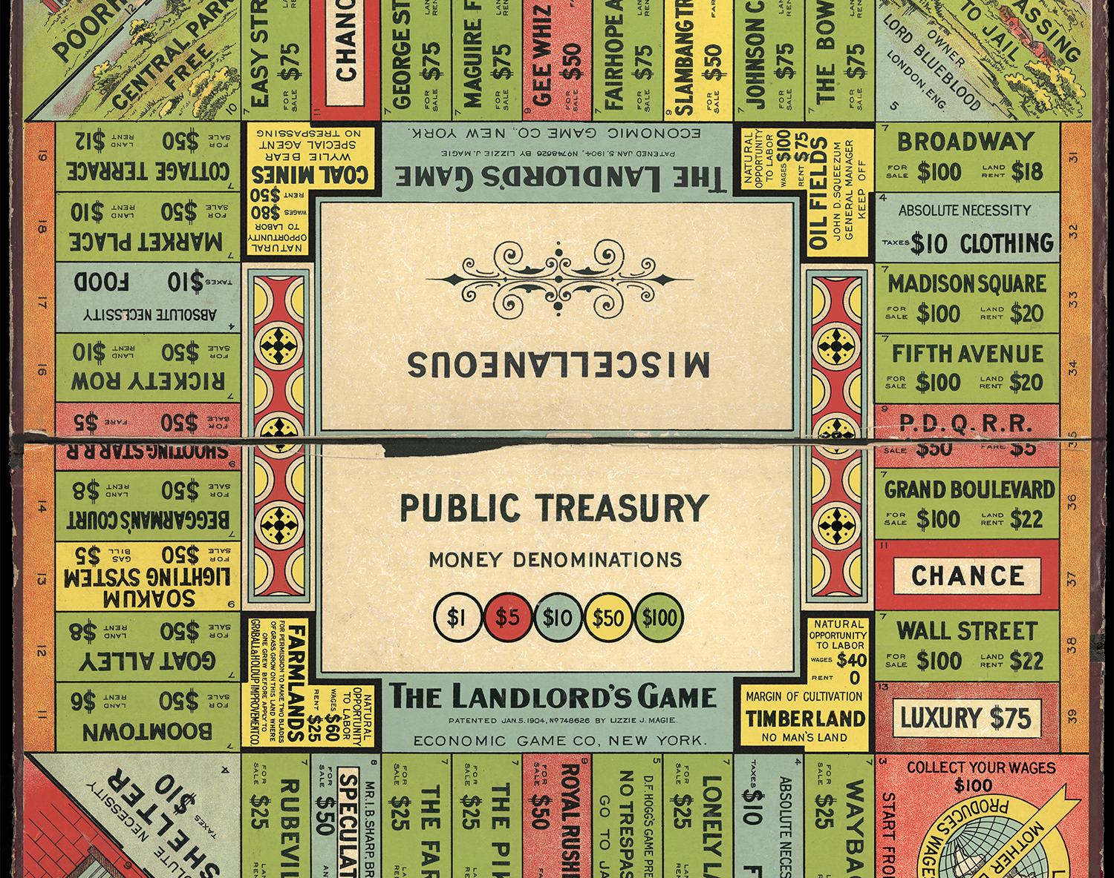
“LANDLORD’S GAME”
The Landlord’s Game was created by Elizabeth Magie in 1904, to teach about “Georgism,” an economic theory which focused on the idea that land, natural resources, and opportunities could be somehow equally shared. The game evolved into Monopoly by 1933.

Slide 7

"Wealth concentration only leads to permanent disparities, evidenced in economics as a game of Monopoly.“
-Pope Francis

Slide 8


Slide 9

II. Federal, state & private enforcement

Slide 10
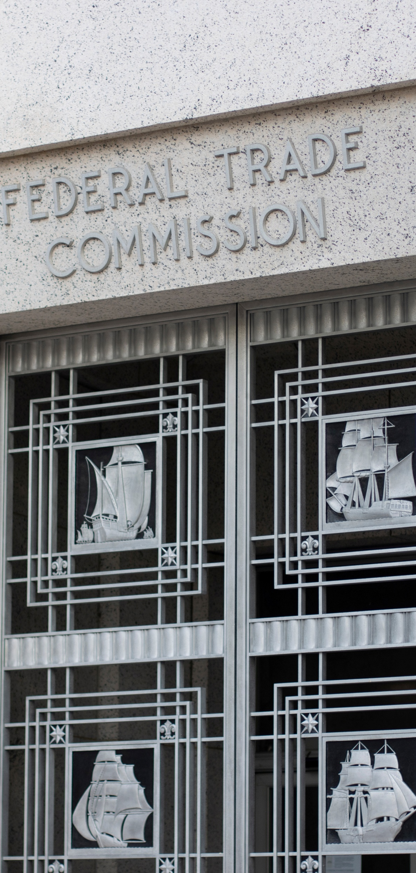
SHERMAN ANTITRUST ACT OF 1890
Section 1 prohibits “every contract, combination… or conspiracy, in restraint of trade.” Section 2 restrains businesses that “monopolize, or attempt to monopolize… any part of the trade or commerce.”

Slide 11
Clayton Antitrust Act of 1914
Clayton prohibits price discrimination, as well as exclusive dealing and tying agreements which have an anti-competitive effect. It also restrains companies who seek to merge or acquire competing businesses when that may tend to create a monopoly.

Slide 12
Federal Trade Commission Act of 1914
The FTC was created by this act to enforce antitrust laws. Section 5 of this Act bans “unfair methods of competition,” providing flexibility to FTC to pursue action against a company even if their actions involve conduct not specifically addressed by Sherman or Clayton.

Slide 13

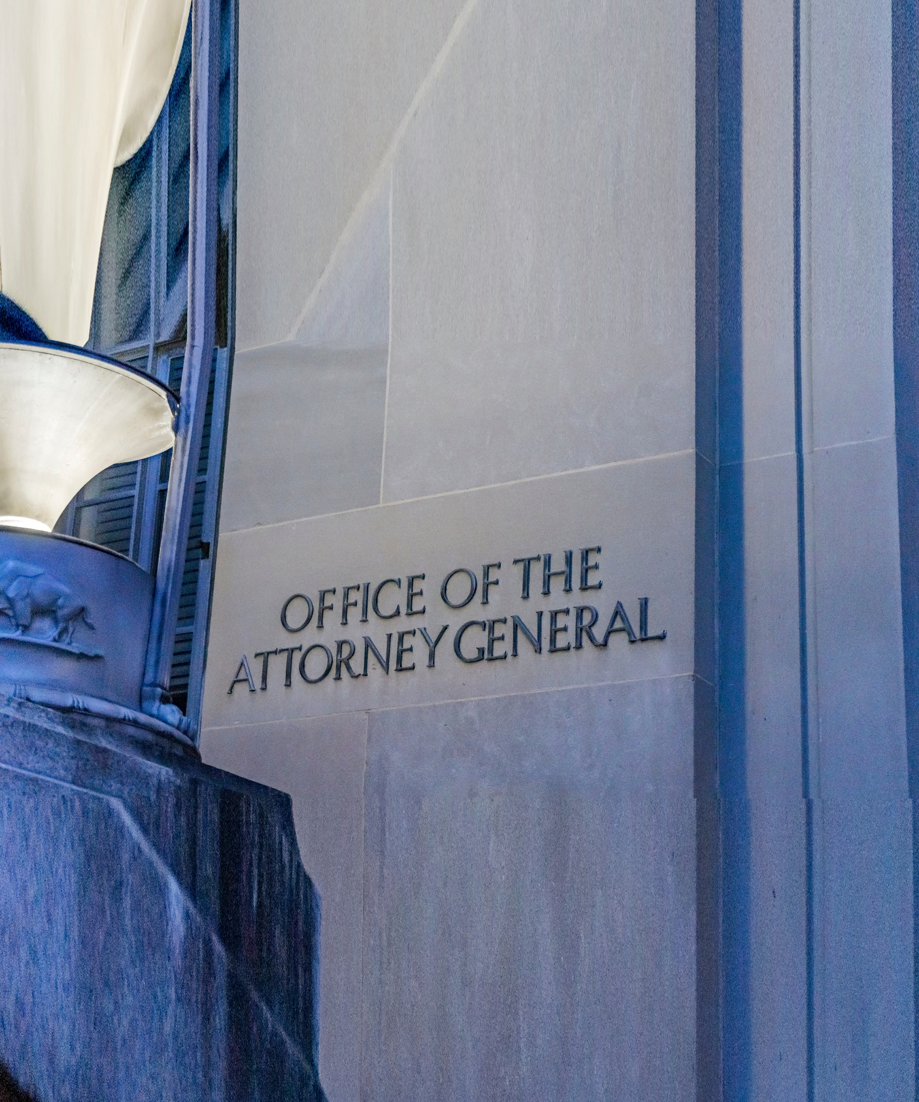
STATE law & private civil actions

Slide 14
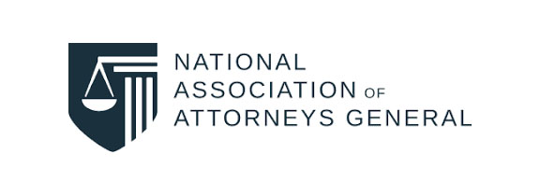
“The National Association of Attorneys General was founded in 1907 initially to create a forum for state attorneys general to discuss a common approach to antitrust issues related to the Standard Oil Company. Since then, antitrust efforts have consistently been a core aspect of the attorney general’s role…. Attorneys general have the ability to enforce both federal and state antitrust laws on behalf of the state and its citizens, both individually and as part of a multistate group.”

Slide 15

III. Lobbying and industry standards
“[A] trade association may help establish industry standards that protect the public or allow components from different manufacturers to operate together. The association also may represent its members before legislatures or government agencies, providing valuable information to inform government decisions. When these activities are done with adequate safeguards, they need not pose an antitrust risk.”
-Federal Trade Commission, Spotlight on Trade Associations

Slide 16


Slide 17

THANK YOU!
Ted A. Donner
(630) 917-6800
tdonner@donnerco.com
http://donnerco.com

