Slide 1
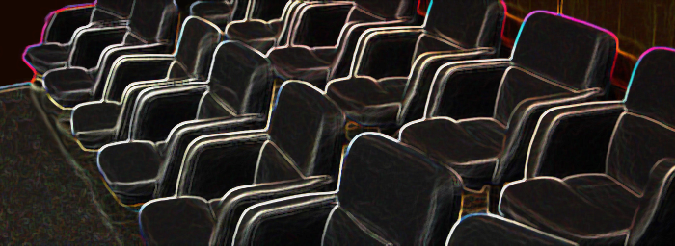
Law of Jury Selection
Fall 2025, Class Two: Group Dynamics and Pre-Trial Conferences

Slide 2
I. TWELVE ANGRY MEN

Slide 3

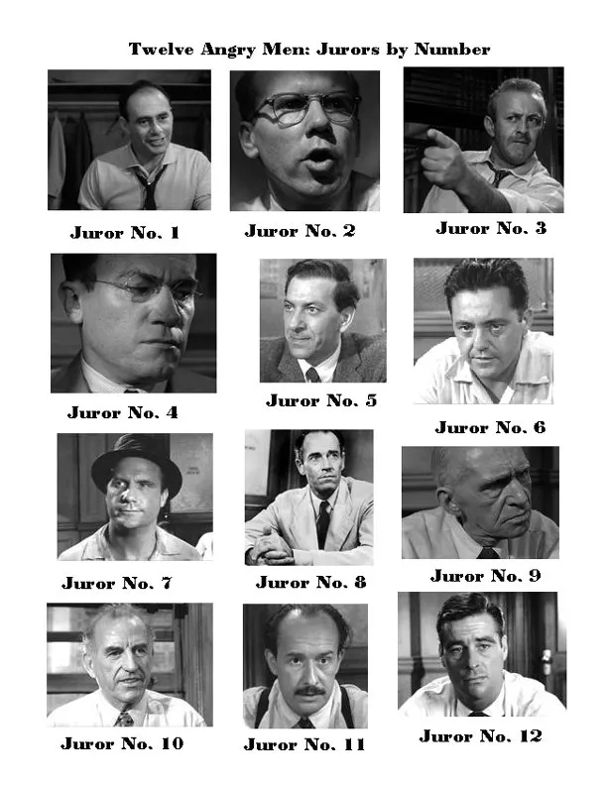

Slide 4
II. PRE-TRIAL CONFERENCES

Slide 5

Pre-Trial Conferences
Witness lists;
Exhibits (stipulations as to foundation and authenticity);
Stipulations as to any uncontested facts;
Experts (objections to qualifications);
Pre-trial motions; motions in limine; and
Jury Instructions

Slide 6
Law of Jury Selection
Fall 2025, Class Two: Group Dynamics and Pre-Trial Conferences

