Slide 1

Empowering People Through Standards: Workforce Training for the TEC Sector
Alyson Scurfield
Chief Executive
TSA and TEC Quality

Slide 2

An opportunity for TEC: NHS Reform TEC is Key to the Government Agenda
Prime Minister Sir Kier Starmer has promised:
“the biggest re-imagining of our NHS since its birth”
Outlining three big shifts for the NHS:
Moving care from hospitals to the community
Shifting services from analogue to digital
Moving away from treating sickness to prevention
He also declared that the Government’s 10-year plan for the NHS will ‘have the fingerprints of NHS staff and patients all over it.’
Notes:
In the wake of the Lord Darzi report Kier Starmer has responded

Slide 3


The National Workforce Strategy
Empowering the future workforce by utilising technology and digital
Opportunity to embed supporting tools and awareness of TEC within educational qualifications
Develop a UKAS assurance scheme to ensure quality, safety and digital skills, public sector training tools for digital assessment enhanced by virtual reality hardware
https://www.skillsforcare.org.uk/Workforce-Strategy/resources/Supporting-resources/A-Workforce-Strategy-for-Adult-Social-Care-in-England.pdf
July 2024
Supported by members of the TEC Quality Board of Directors
Sir David Pearson
Co-Chair
Anna Severwright
Steering Group Member
Alyson Scurfield Expert Panellist
Notes:
Workforce strategy provides strong reference to technology and digital to empower the future workforce
Strong opportunity to embed supporting tools and awareness of TEC within educational qualifications
Develop a UKAS assurance scheme to ensure quality, safety and digital skills, public sector training tools for digital assessment enhanced by virtual reality hardware
TSA have been influential in the development of the ASC workforce strategy and will be supporting the delivery of the strategy and TSA will be involved in the implementation

Slide 4
Core Knowledge & Skills: Ensuring Workforce
Competency
Julie Stone
Online and Higher Education Consultant TSA

Slide 5
Drivers of Change
Prevention – Avoid hospital admission
Integration of health and social care
Different roles and skills in technology
SHAPE OF CARE
Expectations changing
18-year-olds – most racially and ethnically diverse generation in history
Work/life balance important
Technical Infusion – Online learning will continue to grow
Micro-learning – more traction
Lifelong Leaning – on the rise
SHAPE OF EDUCATION
SHAPE OF WORK
Notes:
The Skills for Care, Adult Workforce Strategy highlighted earlier by Robin – highlights that there are 3 key drivers of change, Shape of Care/Shape of Work and Shape of Education. The Shape of Care is looking at more prevention and avoiding hospital admission – with such growth anticipated in the aging population over the next few decades – both health and social care will struggle to cope – we must address prevention as apriority to avoid hospital admission – there is a need to look more closely at the integration of health and social care – and the relationship between these two areas more closelyt and different roles are emerging to support the rise in technology enabled care – Shape of work – expectations are changing – People are looking to build stronger relationships with people they are looking after, in the next few years we will see the largest number of 18 year olds than we have seen for decades, they will be the most racially and ethnically diverse generation in history – they will be driven by pride, passion and the requirement to have a good work/life balance – I can see opportunities and challenges here – the social care sector is tought, but it is rewarding and if the Skills for Care Strategy and Labour’s commitment are actioned then with regard to pay and structure – Social Care roles will be an opportunity - Some say it took a pandemic to really drive forward technology in Education but what is predicted and what we see happening is online learning continuing to grow – most universities now have an online offer, micro-learning is ganing more traction along with lifelong learning to ensure ongoing learning activity and continuing professional development to ensure the upskilling of staff – but we are also seeing digital skills being required to ensure skills align to organisational need and professional practice – how do we balance these aspects – are we balancing these aspects he reason we must all all three must work together to secure the workforces of the future to realise the ambitions for Social Care

Slide 6


Transformation through education ……

Slide 7
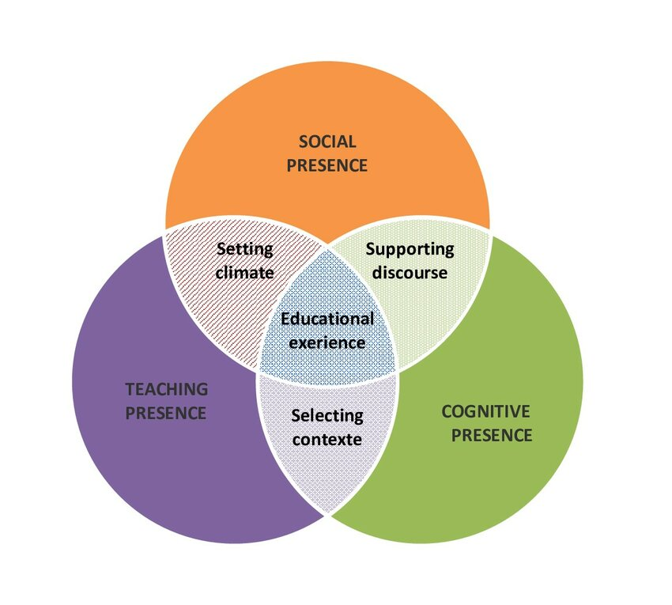
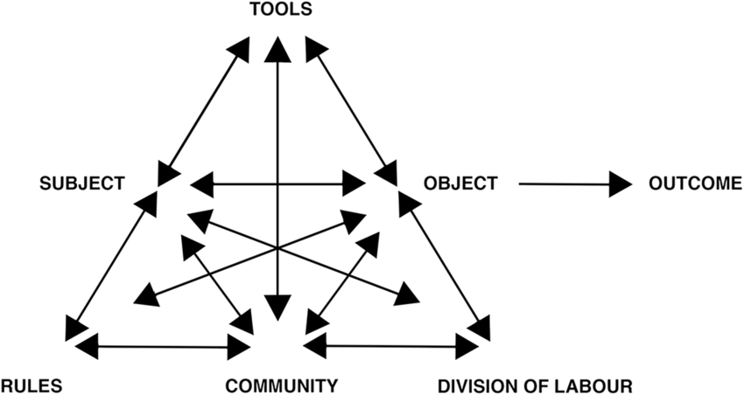


Designing for Impact
Engstrom’s Activity & Social Theory
Community of Inquiry
Blooms Taxonomy
Notes:
We have to get this right, we have to make impact – Lots of online design principles – need to develop with the end-user in mind? Need to be clear on the purpose of the learning development – critical part of understanding the requirements – important for FE/HE discussions

Slide 8
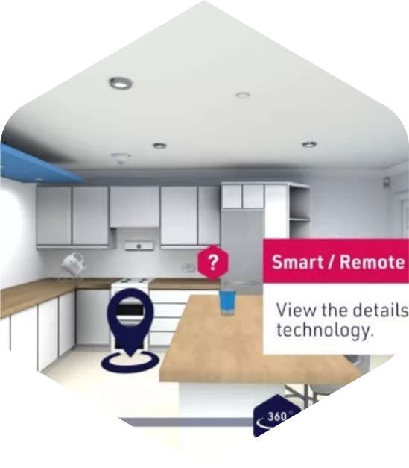

Defining standards, raising quality, improving outcomes
What to do?
Policy Standards
Risk-based
Quality
Standards
Framework
Achieving
Accreditation
Status (Audit)
Call Handling
Assessing & Installation
Responder
How to do it:
Core Workforce Knowledge
Moving to a Digital Mindset
Virtual Property Portfolio
E-learning: TEC Explorer
TEC Expert
Notes:
HERE IS TSA’s FUTURE DIRECTION OF TRAVEL – with workforce a significant feature - HOW MIGHT WE WORK WITH YOU? Robin and I have been discussing how we can work together to enable a greater digital mind-set/enhanced TEC awareness – creating a future that we know MUST be different – Robin ….. How can we prepare students for a digital-first mindset – so they enter the workforce aware of the technology enabled care that is available to ‘do things differently’

Slide 9
Connect with TSA https://www.tsa-voice.org.uk/contact/ TEC Voice https://www.tsa-voice.org.uk/news_and_views/tec-voice/
Thank you

Slide 10
Working with the TEC Sector, for the TEC Sector
Lisa Brumwell
Operations Director Astraline

Slide 11

Our Approach
One of the areas of risk areas identified by members
Feedback from audit process of challenges and best practice
One of the 6 workstreams Sector Risk and Innovation Group (SRIG) focus on
Collaborative approach - ICG formed with TSA QSF Accredited members
Modules reviewed for ‘look and feel’

Slide 12

What is different?
The learning design approaches are drawn from strong academic Higher Education principles for online learning
Improved pricing mechanism
Annual update of the materials to ensure currency of content and addressing ‘real’ problems
CPD accredited offering credits for learners

Slide 13

Benefits to Service Providers
Standardisation of training, compliance and competence across the sector
Supplements and enhances existing in-house training programmes
Mitigates risk and provides assurance to stakeholders
Improved recruitment and retention - investment and development of colleagues and professional qualification
Supports other business initiatives (IIP, Top 100 Best Companies to Work For)

Slide 14
Connect with TSA https://www.tsa-voice.org.uk/contact/ TEC Voice https://www.tsa-voice.org.uk/news_and_views/tec-voice/
Thank you

Slide 15
Combining the QSF Audit Process and Our Workforce Offer
Helen Loveday
Head of Quality and Improvement TEC Quality

Slide 16

Quality Standards Framework and UKAS Accreditation
Elevating standards and driving continuous improvement in technology enabled care
TEC Quality is the only UKAS accredited Auditing Scheme in the UK for Technology Enabled Care
The United Kingdom Accreditation Service (UKAS) is the national accreditation body for the United Kingdom, appointed by Government to ensure Quality and Safety
www.tecquality.org.uk

Slide 17
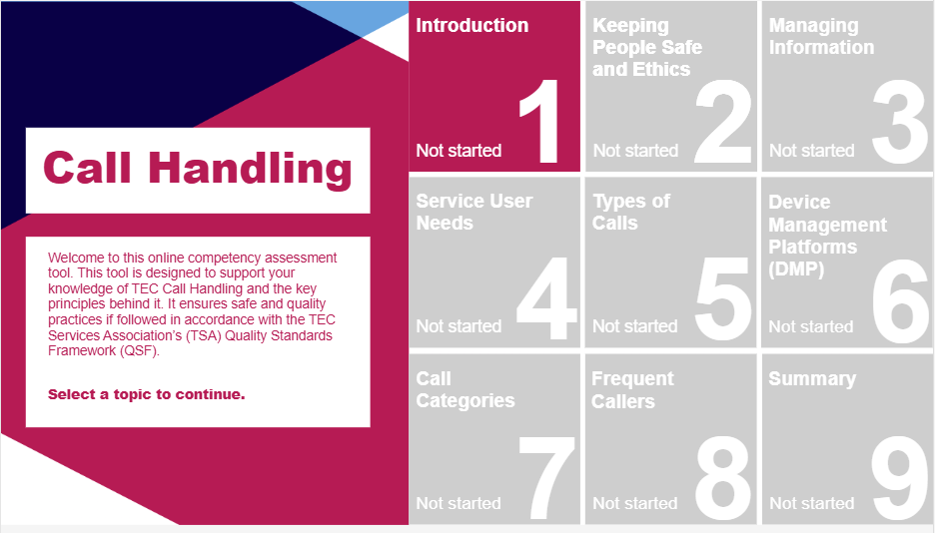
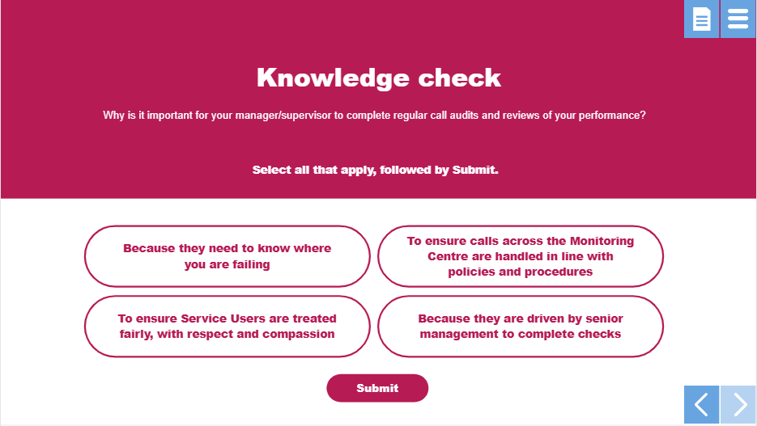
Who this is for? QSF certified organisation that deliver:
TEC Monitoring
Referral, Assessment, Installation and Maintenance of TEC
(not organisations installing/maintaining hardwired systems only)
TEC Response Service
What is included in the E-learning training:
Easy to use platform for Employees and Managers
Training through an e-learning platform
Video welcome and introduction to ‘set the scene’
Clear learning outcomes identified across the modules
Questions to test learning throughout the modules
Re-enforcing of process for frontline staff
Links to other guidance or information
Versioned programme of training – updated annually.
Module assessment to test competency
Organisations will have admin rights to add/delete learners
Organisations will have a reporting mechanism for their staff.

Slide 18
The E-learning Process and Cycle – 2025 – 2028
4 year programme model
Year 1 Programme 1
June 2025 – December 2026
Training Material Launched June 2025 – cohort 1 – June to June
Dec 2025 – cohort 1a – December to December
Year 4 Programme 4
June 2028 – December 2029
Revised training material launched
June 2028 – cohort 1
Dec 2028 – cohort 1a
Year 2 Programme 2
June 2026 – December 2027
Revised training material Launched
June 2026 – cohort 1
Dec 2026 – cohort 1a
Year 3 Programme 3
June 2027 – December 2028
Revised training material launched
June 2027 – cohort 1
Dec 2027 – cohort 1a
*All organisations will have access to a full year of training material
Notes:
Content for a whole year. Each programme runs for a year.
To support new staff they recruit throughout the year.
Staff can access as a refresher throughout the year.

Slide 19
Implementation plan for QSF Certified Organisations:
Programme 1 (example) 2025
Programme 1
Audit Month | Invoice Month | Training Available
June 2025 | April 2025 | June 2025 (cohort 1)
July 2025 | May 2025 | June 2025
Aug 2025 | June 2025 | June 2025
Sept 2025 | July 2025 | June 2025
Oct 2025 | Aug 2025 | June 2025
Nov 2025 | Sept 2025 | June 2025
Dec 2025 | Oct 2025 | June 2025
Jan 2026 | Nov 2025 | Dec 2025 (cohort 1a)
Feb 2026 | Dec 2025 | Dec 2025
Mar 2026 | Jan 2026 | Dec 2025
April 2026 | Feb 2026 | Dec 2025
May 2026 | Mar 2026 | Dec 2025
Employee numbers gathered through the DAP pre- questionnaire on a rolling basis.
Option for these organisations to be invoiced earlier if they wish to have access to the training made available sooner.
Notes:
Content for a whole year. Each programme runs for a year.
To support new staff they recruit throughout the year.
Staff can access as a refresher throughout the year.

Slide 20
Price Banding for E-learning modules based on number of employees delivering frontline operations
All organisations would have access to all 3 training modules for their employees.
TEC Monitoring – 1.5 hours of training
Assessment, Installation and Maintenance of TEC Social Alarms and Proactive and Preventative TEC – 1 hour of training
TEC Responder Services – 45 min of training
Cost per Employee on average £25 per head based on a fair cost per user at the top end of the banding this reduces to £21.25
Organisations will sit in an employee band which will allow for movement of staffing levels
As a Benchmark you would normally expect to pay between £20 - £25 per head per 30 minutes of training
Invoice will be aligned to the current QSF audit invoice unless organisations in the second cohort wish to pull their training forward
Invoiced amount covers cost of running the courses e.g. platform, administration, continued development of training modules over project timeline, development of further training e.g. fire module
Review of costs at end of each programme year
*(For QSF Certified Organisations only that complete a combination of Service Delivery Modules)

Slide 21

Updates to the QSF
An update of the TQ Handbook will include a Training section in 2025.
It will be a mandatory requirement of the audit to achieve accreditation from June 2025.
There will also be additions to the criteria through the Scheme Change Process:
Sept/Oct 2025
Working towards all frontline staff completing the TSA/TQ Workforce Development Core Modules as part of the mandatory requirement to achieve QSF certification, in line with their audit cycle
Sept/Oct 2026
All frontline staff must complete the relevant programme for the TSA/TQ Workforce Development Core Modules as part of the mandatory requirement to achieve QSF certification, in line with their audit cycle
Notes:
Talk about reporting for Auditors/Auditees. The training will support, enhance and measure competence and gives overall reassurance that your staff are competent.

Slide 22
Next Steps
The recording of this webinar will be made available through the TQ website – audit toolkit page
A Q & A sheet will be available and can be accessed via the audit toolkit page
Demonstration of the first module will be available for Auditees to see at ITEC 2025
Our TQ support team are available on a 1:1 basis if you require further information and will reach out to you in April for your 2 x Trainer/Admin contacts
A train the trainer session to manage the platform administration function will be completed via MS Teams
A fire e-learning module will be developed, scheduled for inclusion in 2026
Notes:
Following consultation today, organisations are asked to complete a short survey at the end of this webinar - The answers to these questions are important in defining the workforce offer.
SRIG – will continue to work on the 3-core e – learning modules. This will also include the development of the reporting function for Auditors/Auditees currently being mapped.
Talk about reporting for Auditors/Auditees.
Next steps for organisations.

Slide 23
Connect with TSA https://www.tsa-voice.org.uk/contact/ TEC Voice https://www.tsa-voice.org.uk/news_and_views/tec-voice/
Thank you

Slide 24
Closing Statements
Alyson Scurfield
Chief Executive
TSA and TEC Quality

Slide 25









Single day tickets from £205
Baroness Tanni Grey-Thompson
Paralympic Icon, Campaigner and Parliamentarian 2025 Conference Chair
Stephen Kinnock MP
Minister of State for Care
Confirmed Plenary Speaker
Two days with a gala dinner ticket from £399
2025 Conference Themes
From Analogue to Digital – Leading the Transformation
Harnessing the Power of Data for Proactive and Preventative Care
Quality, Safety, and Continuous Improvement: Developing Quality Frameworks
Headline Sponsors:
Early Bird Bookings Until 7 February
https://itecconf.org.uk

