Slide 1


TEC Quality
Scheme Change Process
TEC and Community Equipment Providers
May 2024
Helen Loveday
Head of Quality and Improvement

Slide 2

Agenda
Reasons for Scheme Change
Module Affected by the Scheme Change
Scheme Change Timeline and Consultation Process
The 10 Common Standards
Service Delivery Modules
Next Steps
Any Questions

Slide 3

Reasons for the Scheme Change Process:
The emphasis of this Scheme Change Process is to ensure that the QSF remains current, robust and agile particularly in a challenging and changing environment as we transition through Analogue to Digital, move to new ways of working and use new equipment.
The Scheme Change Process Incorporates Changes through:
-Feedback from our Auditors and Auditees
-Changes in line with new or revised British Standards
-From the work through the Special Interest Groups
-From our work with our Partners e.g. NFCC, NHSE
-Analysis of complaints or comments

Slide 4
General housekeeping of the original Gap Analysis Document as we move onto a Digital Auditing Platform:
Removal of the wording ‘P & P’ (Proactive and Preventative) applies to this criteria
Removal of duplications
Merging of criteria - to minimise criteria and upload as we move onto the Digital
Auditing Platform
Added Application Guidelines to the Digital Auditing Platform in some areas
There are 18 new criteria across the Common Standards and 6 Service Delivery Modules:
The addition of Co-production to the Partnership Working Module
Refreshed the Supply module into a general sections and into categories based on equipment supplied
There are number of amended criteria:
Reinforced some criteria through our work with the NFCC and processes for fire.
Amended to clarify wording in revised criteria.
Removed the individual criteria grading system - move to a self-assessment model and removal of some criteria that are no longer required.
Reasons for the Scheme Change Process:

Slide 5
Modules Affected by the Changes
Common Standards
User and Carer Experience
User and Service Safety
Effectiveness of Service
Information Governance
Partnership Working and Integrated Services
Business Continuity
The Workforce
Service Delivery Modules
TEC Monitoring
Assessment of and Installation of TEC
TEC Responder
Supply Sector and Solutions Provider
Community Equipment
Other Changes
Updates to the QSF Handbook
.

Slide 6

TEC Quality 2024
QSF Scheme Change Timeline
By End of March
Gather SIG outputs referred to TQ and all other planned revisions to the scheme
By Mid-April
TQ complete Drafts of amendments to modules, guidance and all other documentation
1st May- TQ Board Mtg.
Scheme Changes to be approved by TQ Board to move to formal Consultation Process.
14^{th.} & 15th May –
TQ Auditee
Scheme change workshops
Formal Consultation Process commences
31st May – Consultation ends
18th June
Conduct workshop on the final changes to the scheme and publish revised documentation.
Update TQ website
By 14th June
TQ Board final sign off of Scheme Changes.
By 5th June
Review and amend scheme requirements following consultation.
Revise relevant modules and scheme change document
27th August
Auditor meeting
Conduct training for Auditors
30th September 2024
Commence auditing against revised criteria

Slide 7
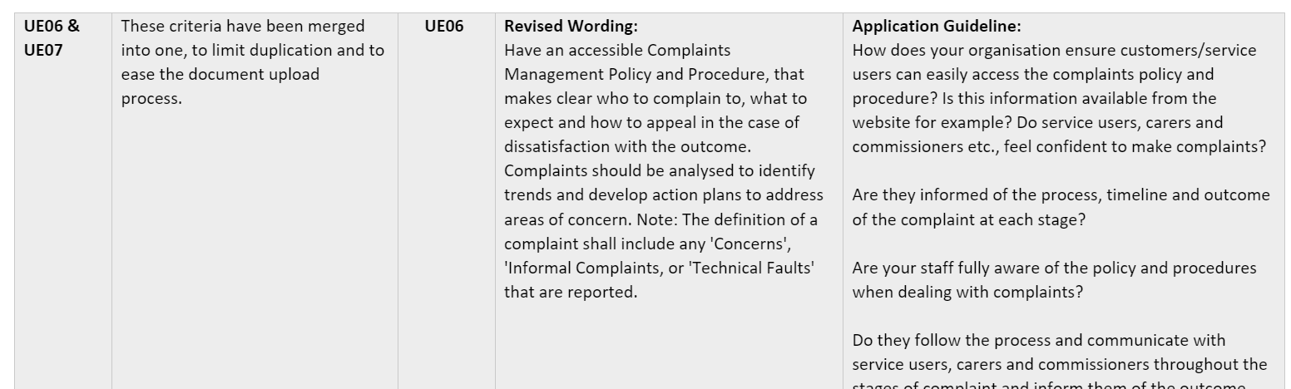
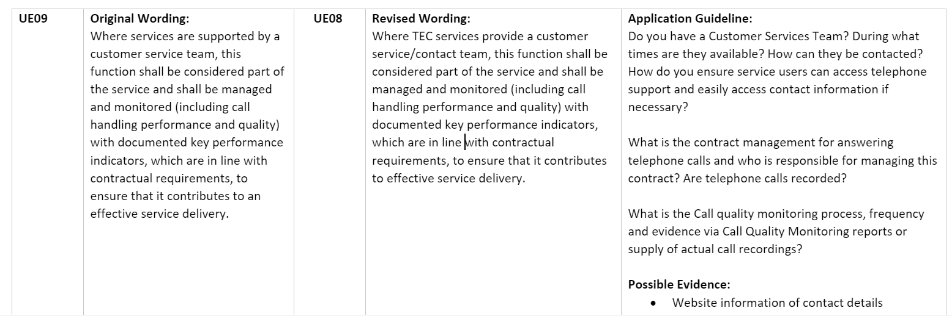
The 10 Common Standards – Completed by all Organisations:
User and Carer Experience v. 4.1 – 2 revised criteria

Slide 8
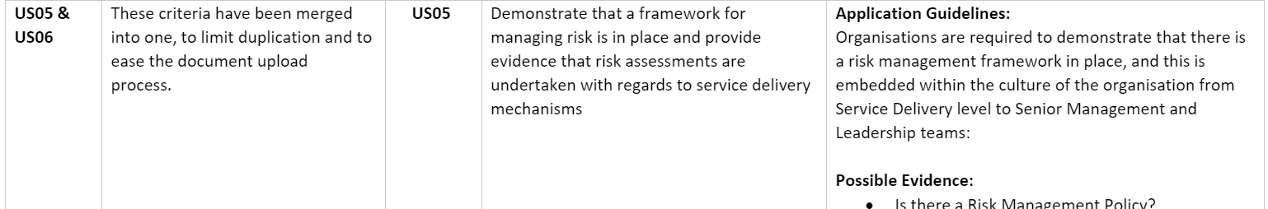
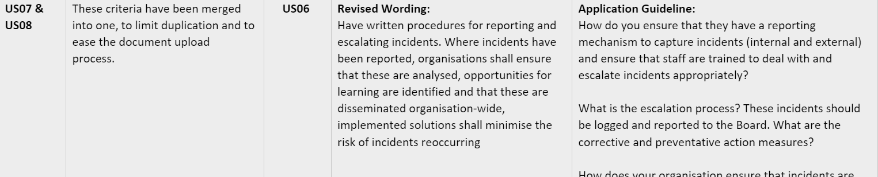

Continued:
User and Service Safety v. 4.2 – 3 revised criteria and 1 merge

Slide 9
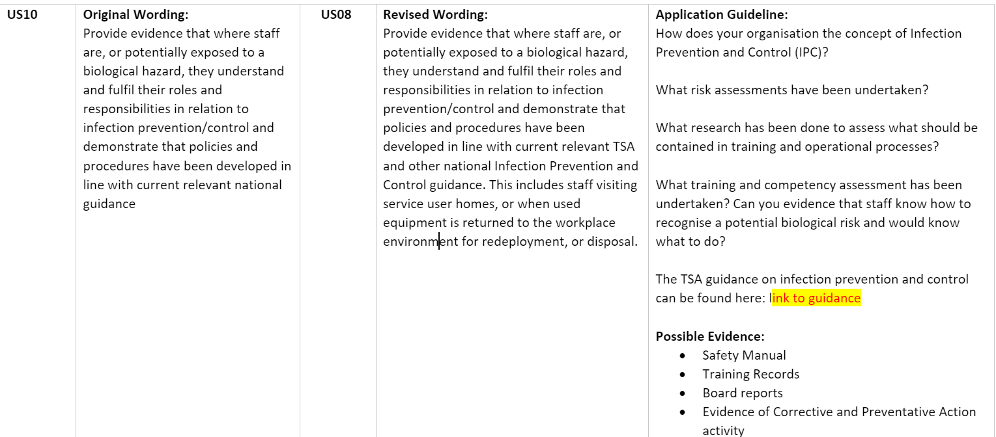
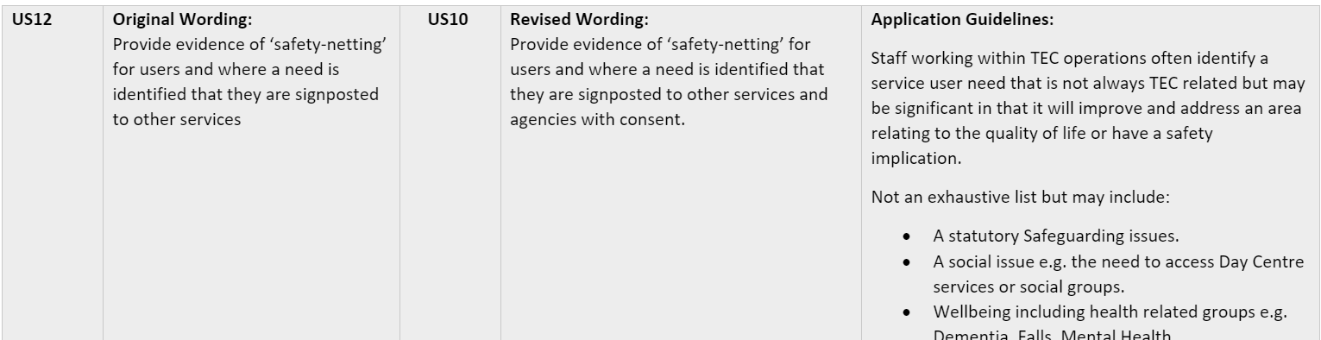
Continued:
User and Service Safety v. 4.2 – 3 revised criteria and 1 merge

Slide 10
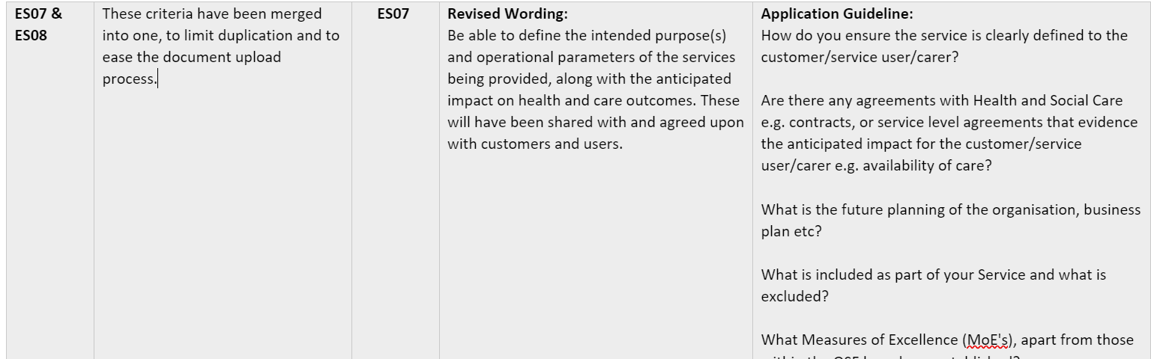
Effectiveness of Service v. 3.2 – 1 merge

Slide 11
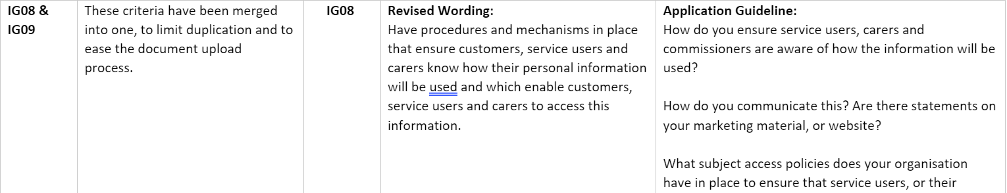
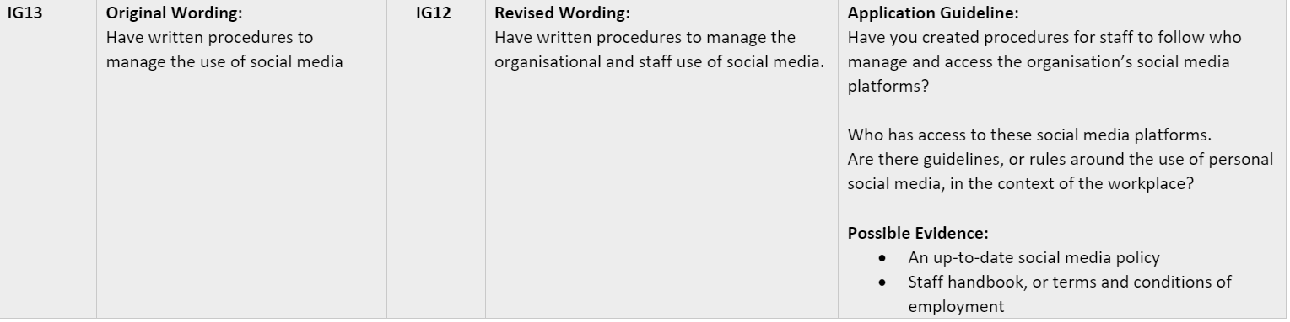
Information Governance v. 4.1 – 3 revised criteria and 1 merge

Slide 12
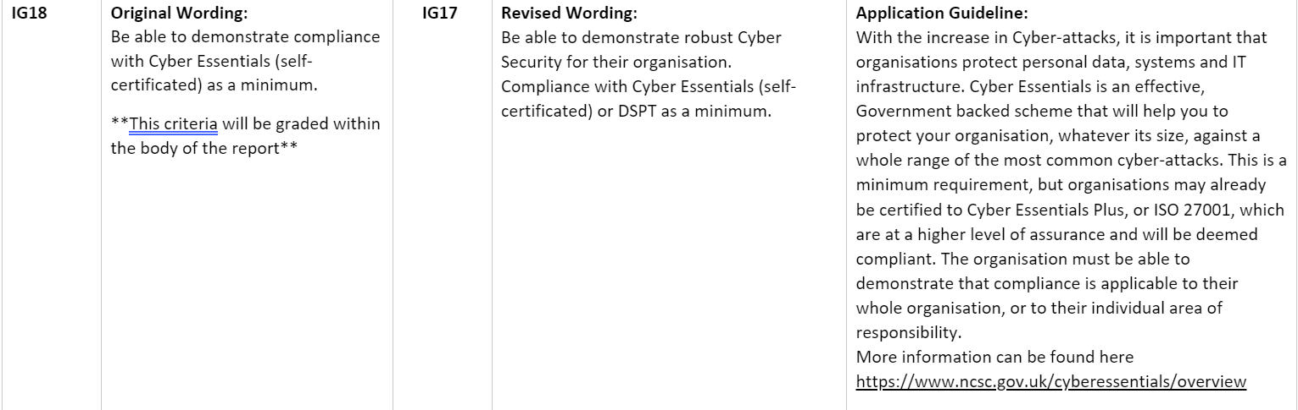
Continued:
Information Governance v. 4.1 – 3 revised criteria

Slide 13
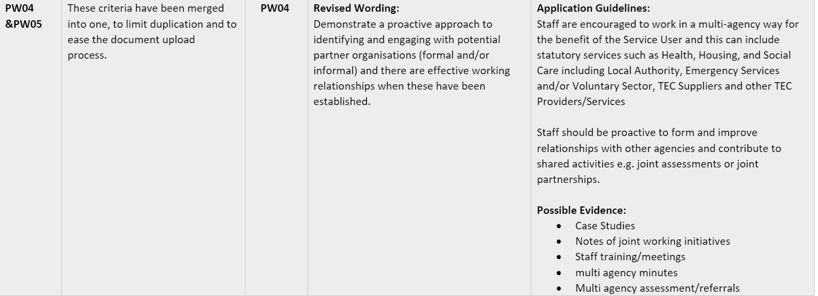
Partnership Working and Integrated Service v. 3.0 – 1 revised criteria and 1 new criteria

Slide 14
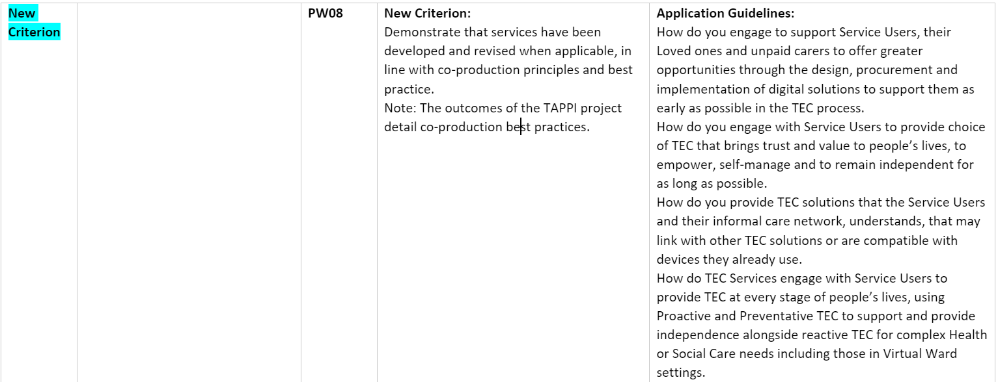

Partnership Working and Integrated Service v. 3.0 – 1 revised criteria and 1 new criteria
https://www.tsa-voice.org.uk/news_and_views/tsa-news/bridging-the-language-gap-implementing-tec-so-we-can-all-live-gloriously-ordinary-lives-/

Slide 15
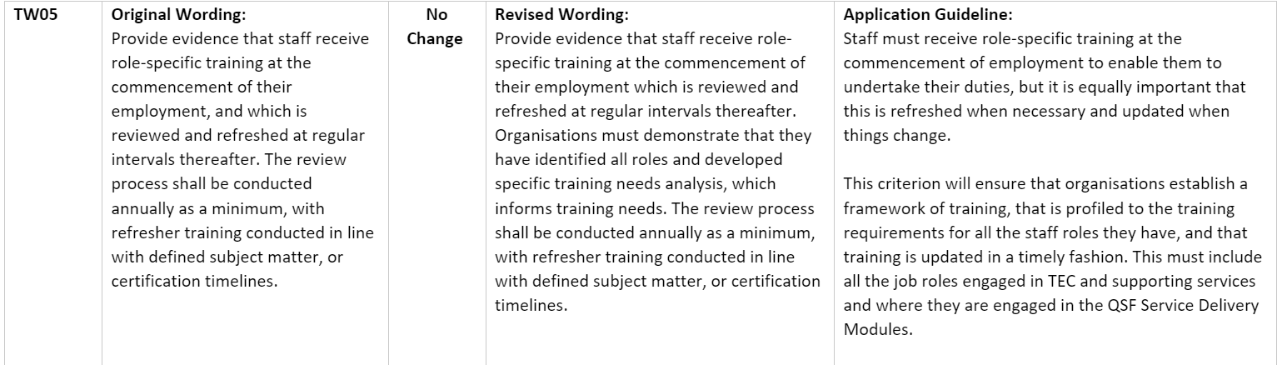
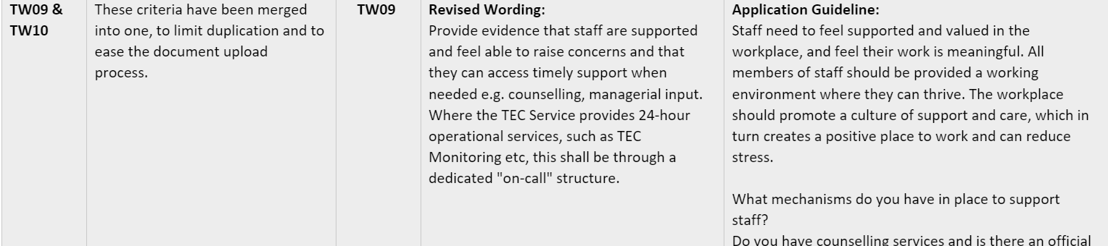
The Workforce v. 3.3 – 2 revised criteria

Slide 16
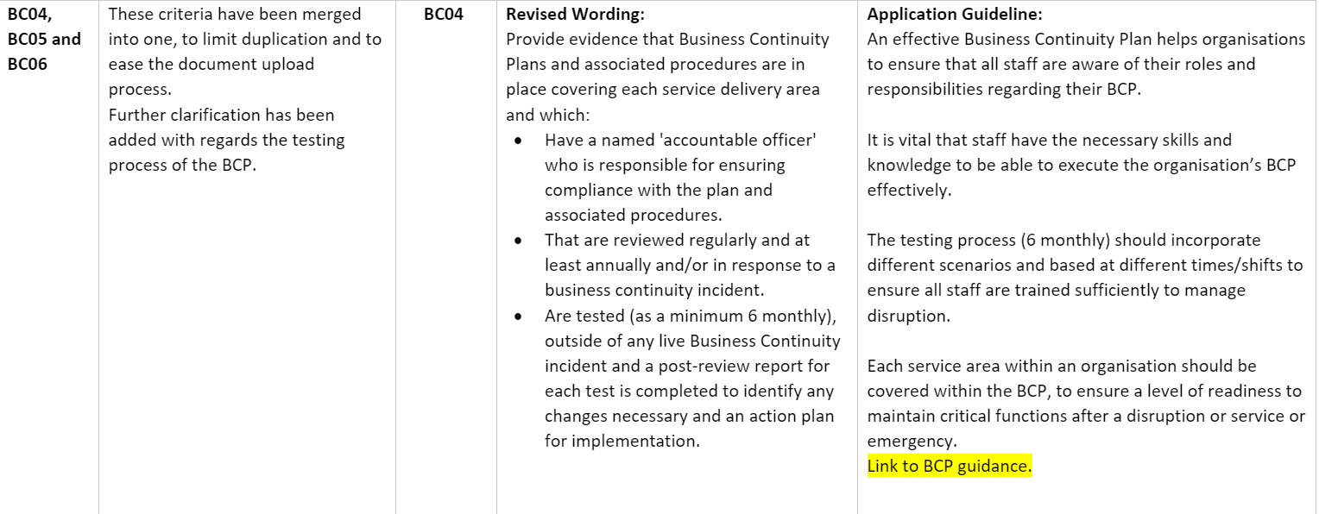
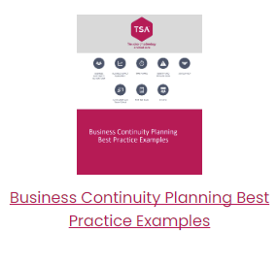
Business Continuity v. 3.2 – 2 revised criteria and one new criteria.

Slide 17
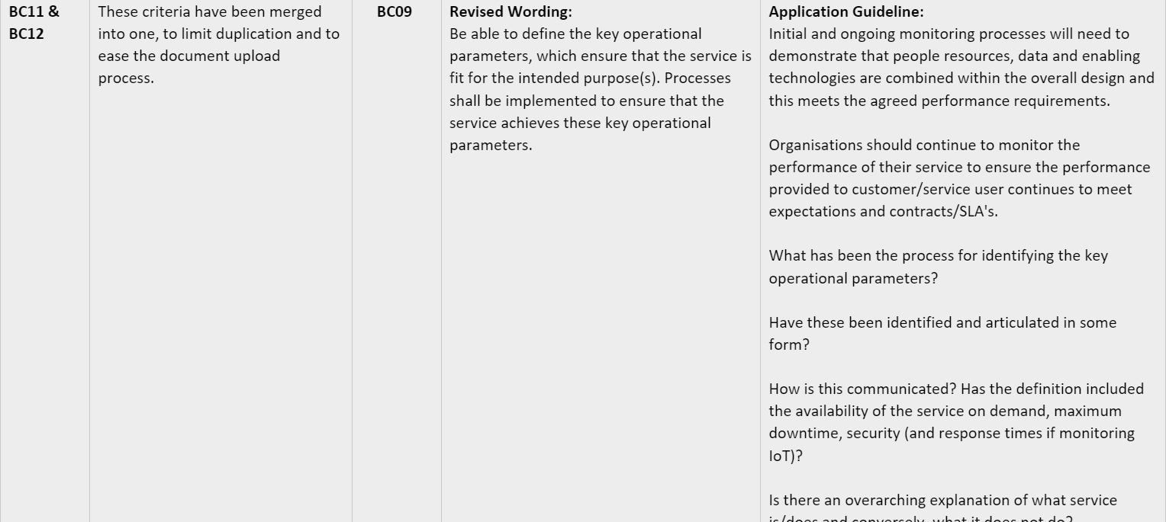
Continued:
Business Continuity v. 3.2 – 2 revised criteria and one new criteria

Slide 18
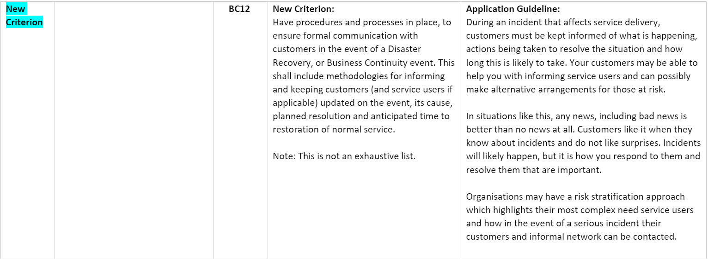

Continued:
Business Continuity v. 3.2 – 2 revised criteria and one new criteria

Slide 19
Ethics – No changes
Performance and Contract Management – no changes.
Ethics
 | No Changes
Performance and Contract Management
 | No Changes

Slide 20
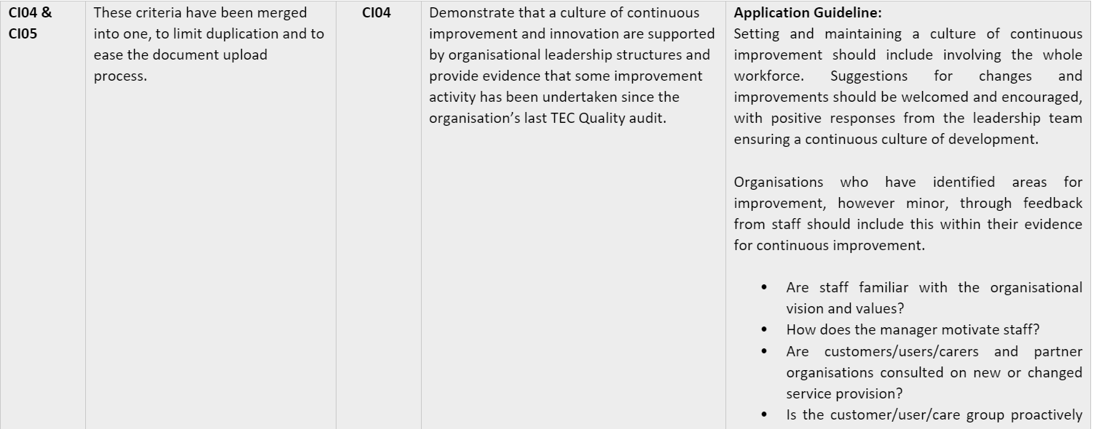
Continuous Improvement and Innovation v. 3.1 – 1 merged criteria

Slide 21
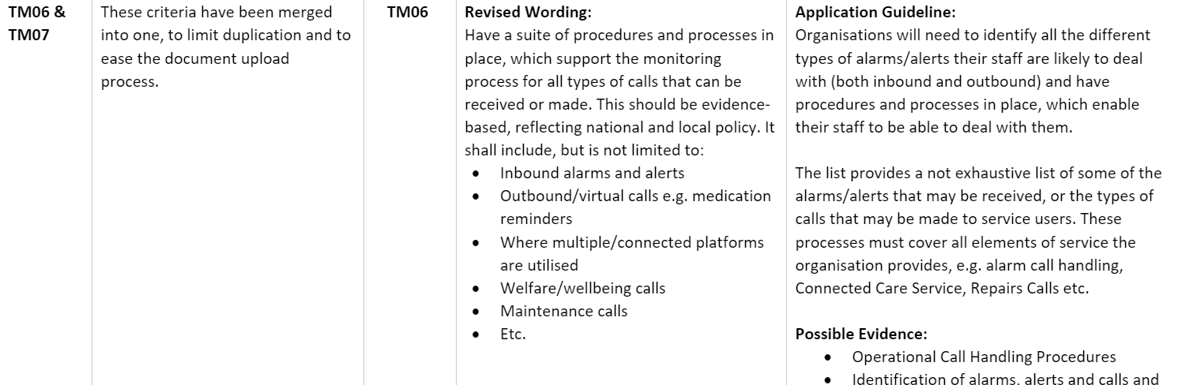
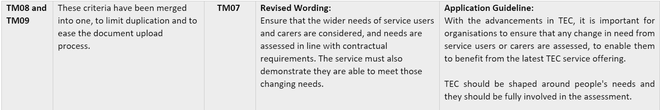
The Service Delivery Modules – Relevant to the services provided by your Organisation
TEC Monitoring Module v. 4.4 – 4 merged criteria, 3 new criteria, 4 criteria removed, 3 revised wording.

Slide 22
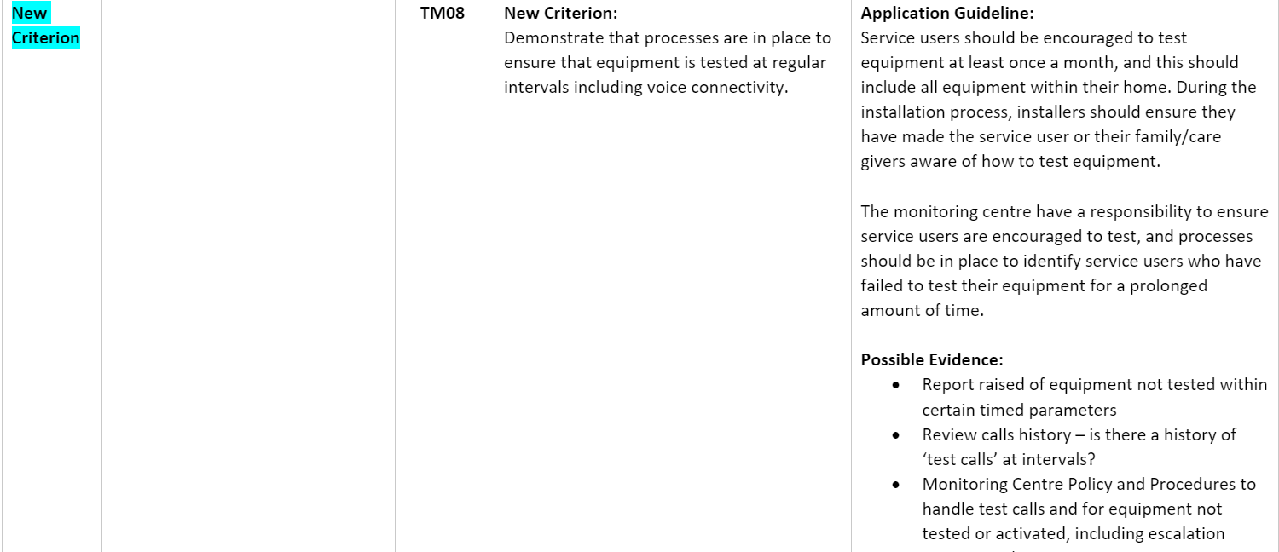
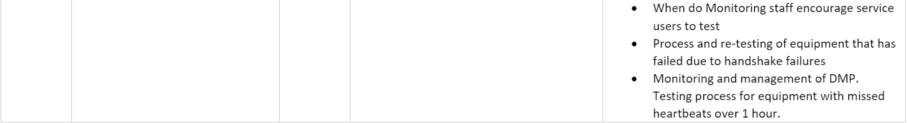
Continued:
TEC Monitoring Module v. 4.4 – 4 merged criteria, 3 new criteria, 4 criteria removed, 3 revised wording.

Slide 23
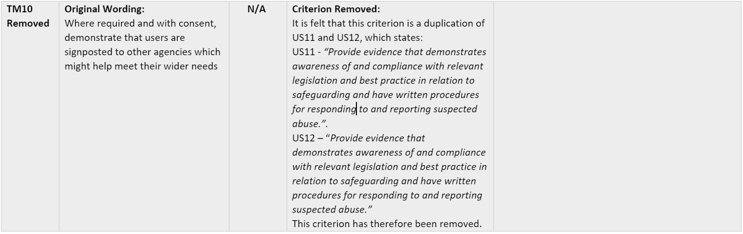
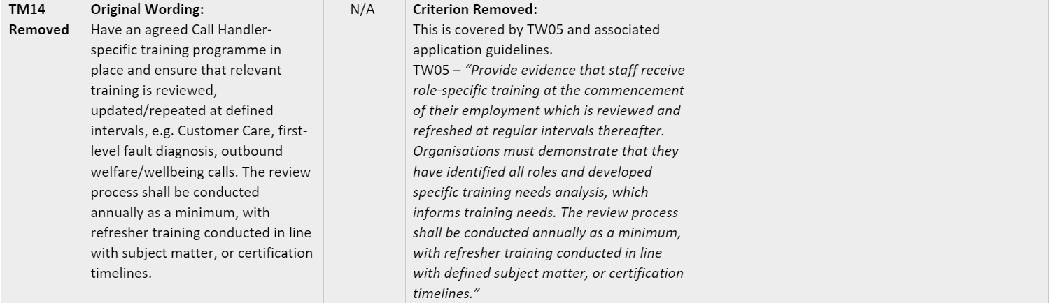
Continued:
TEC Monitoring Module v. 4.4 – 4 merged criteria, 3 new criteria, 4 criteria removed, 3 revised wording.

Slide 24
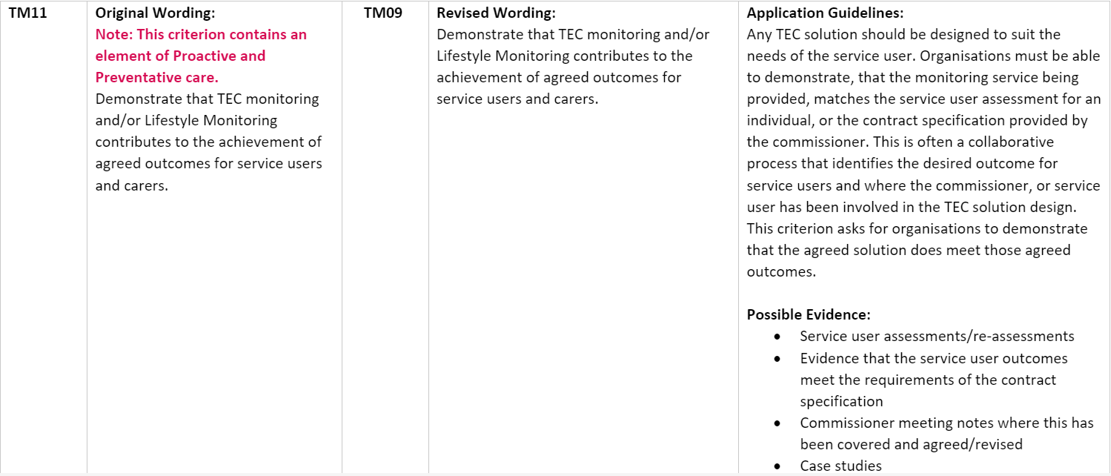
Continued:
TEC Monitoring Module v. 4.4 – 4 merged criteria, 3 new criteria, 4 criteria removed, 3 revised wording.

Slide 25
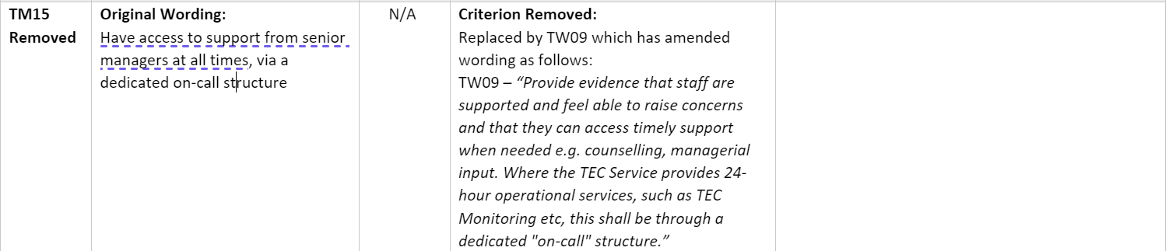

Continued:
TEC Monitoring Module v. 4.4 – 4 merged criteria, 3 new criteria, 4 criteria removed, 3 revised wording.

Slide 26
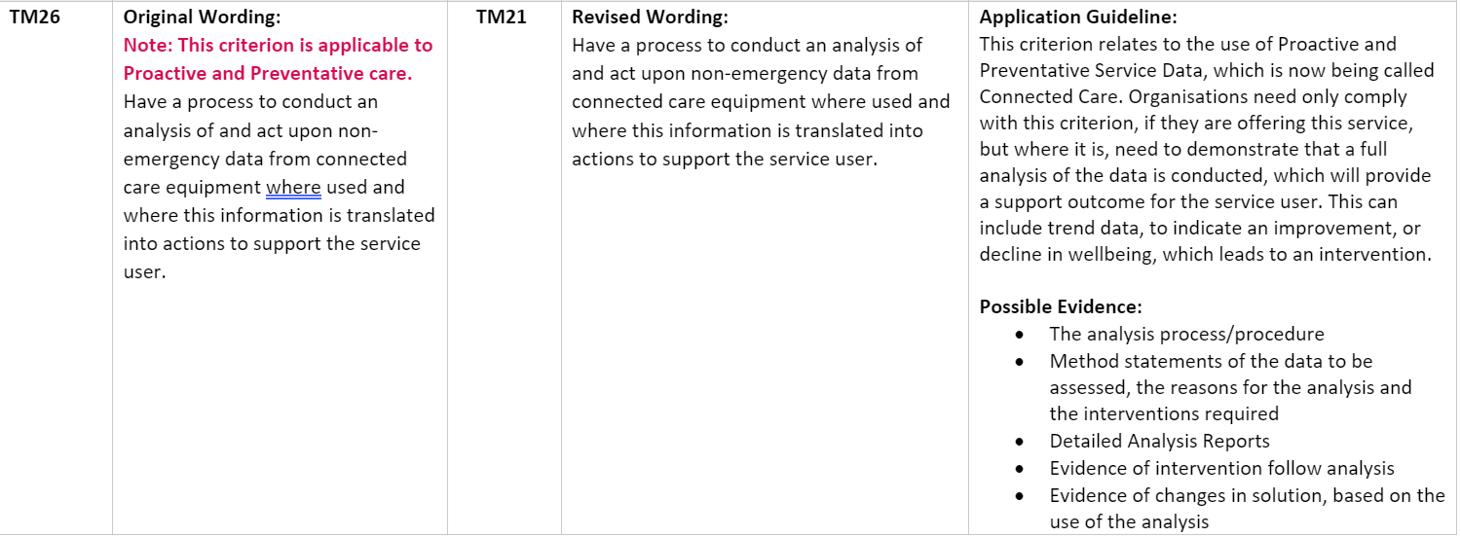
Continued:
TEC Monitoring Module v. 4.4 – 4 merged criteria, 3 new criteria, 4 criteria removed, 3 revised wording.

Slide 27
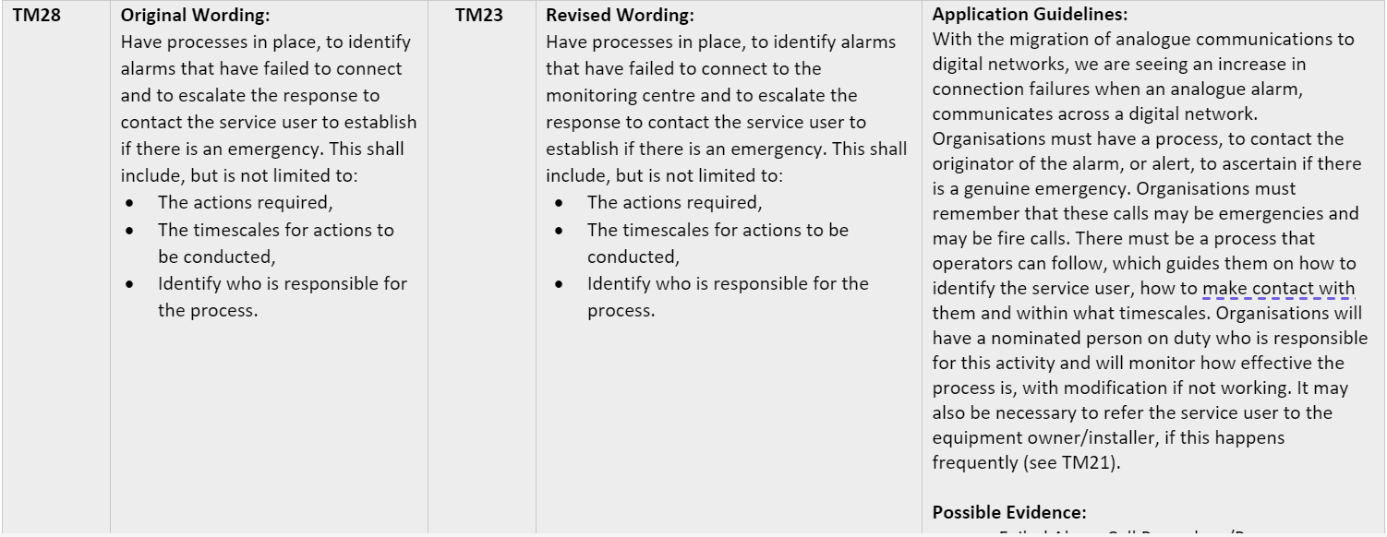
  Continued:
  TEC Monitoring Module v. 4.4 – 4 merged criteria, 3 new criteria, 4 criteria removed, 3 revised wording.

Slide 28
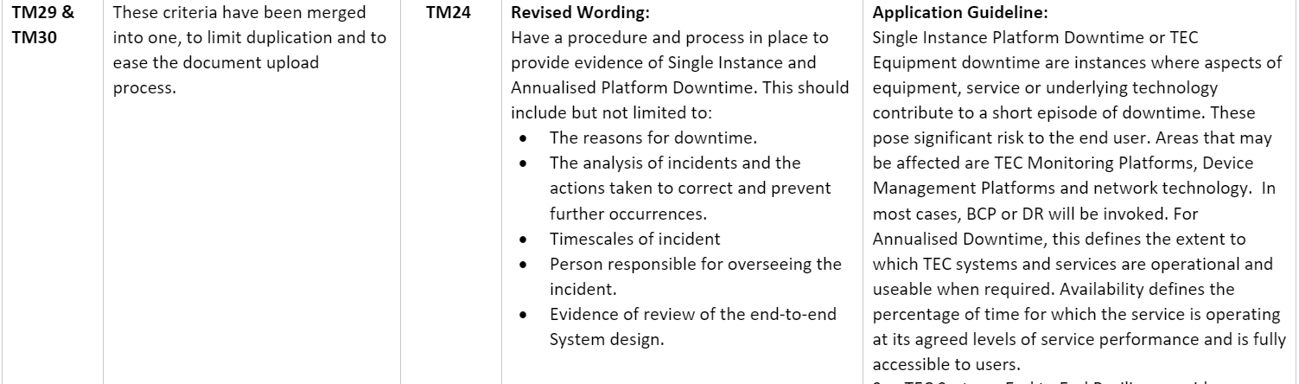
Continued:
TEC Monitoring Module v. 4.4 – 4 merged criteria, 3 new criteria, 4 criteria removed, 3 revised wording.

Slide 29
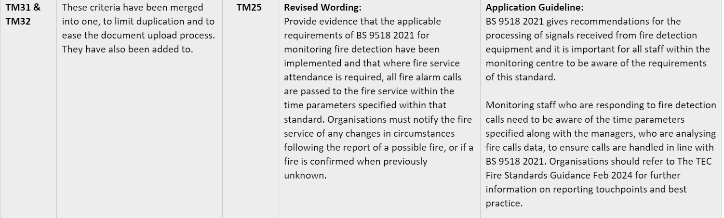

Continued:
TEC Monitoring Module v. 4.4 – 4 merged criteria, 3 new criteria, 4 criteria removed, 3 revised wording.

Slide 30
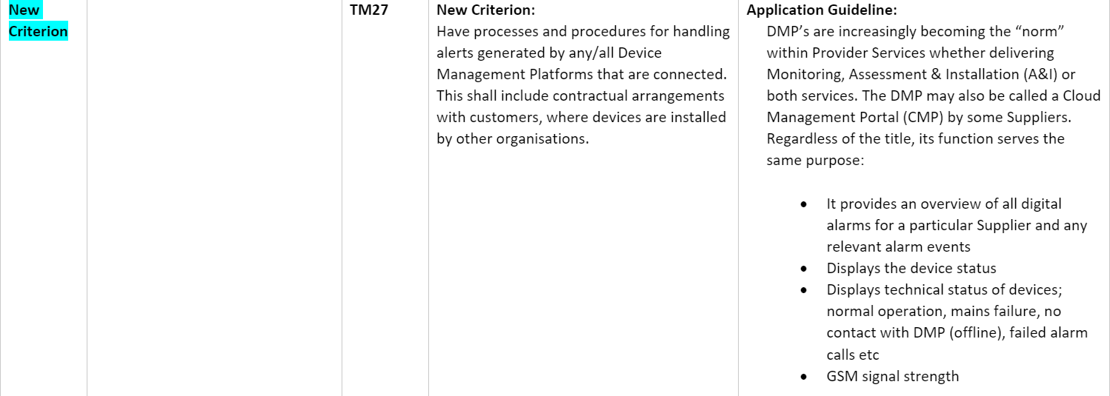
Continued:
TEC Monitoring Module v. 4.4 – 4 merged criteria, 3 new criteria, 4 criteria removed, 3 revised wording.

Slide 31
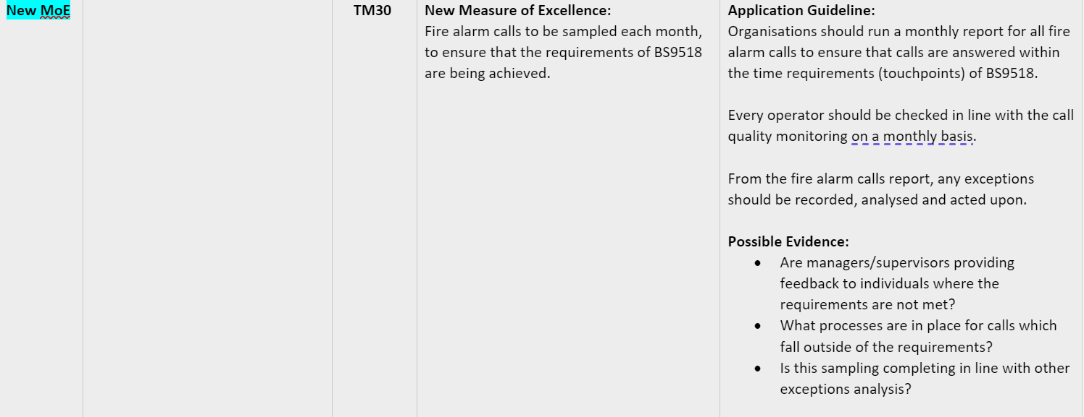
Continued:
TEC Monitoring Module v. 4.4 – 4 merged criteria, 3 new criteria, 4 criteria removed, 3 revised wording.

Slide 32
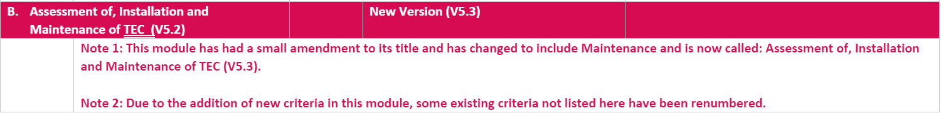

Assessment of, Installation and Maintenance of TEC v. 5.2 – 1 new key outcome, 3 new criteria, 4 merges, 3 revised criteria and 1 removed criteria.
New British Standards BS8684 – TEC – Assessment of user needs and risks, system design, installation and maintenance - Code of Practice.

Slide 33
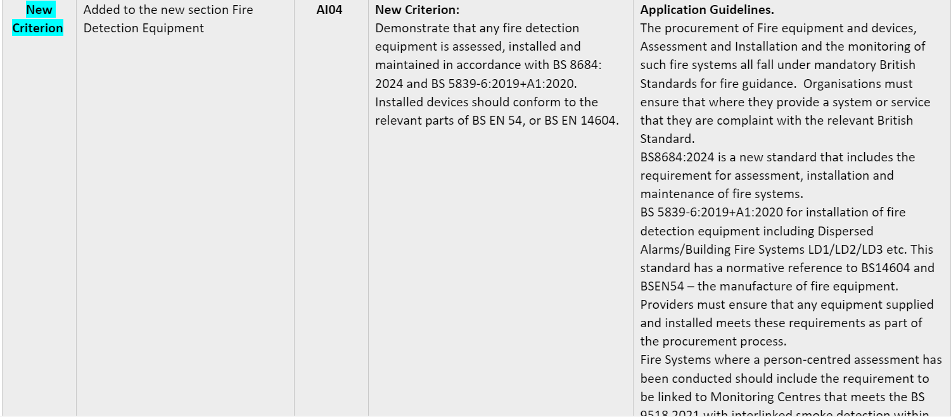
Assessment of, Installation and Maintenance of TEC v. 5.2 – 1 new key outcome, 3 new criteria, 4 merges, 3 revised criteria and 1 removed criteria.

Slide 34
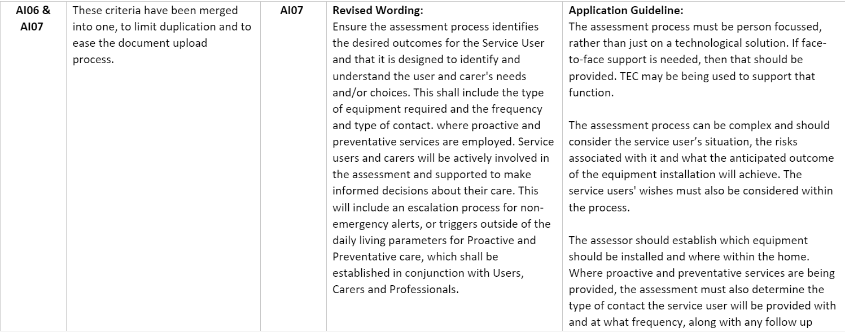
Assessment of, Installation and Maintenance of TEC v. 5.2 – 1 new key outcome, 3 new criteria, 4 merges, 3 revised criteria and 1 removed criteria.

Slide 35
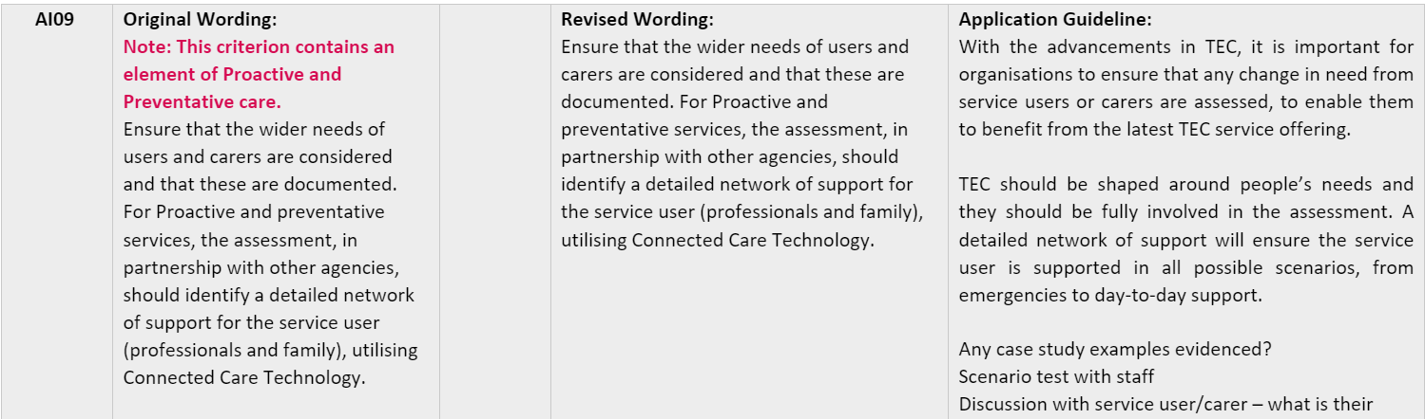
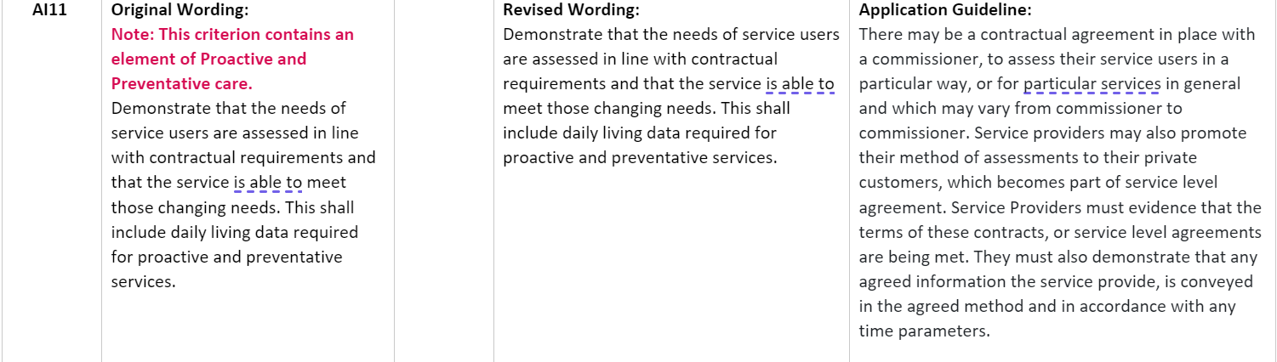
Assessment of, Installation and Maintenance of TEC v. 5.2 – 1 new key outcome, 3 new criteria, 4 merges, 3 revised criteria and 1 removed criteria.

Slide 36
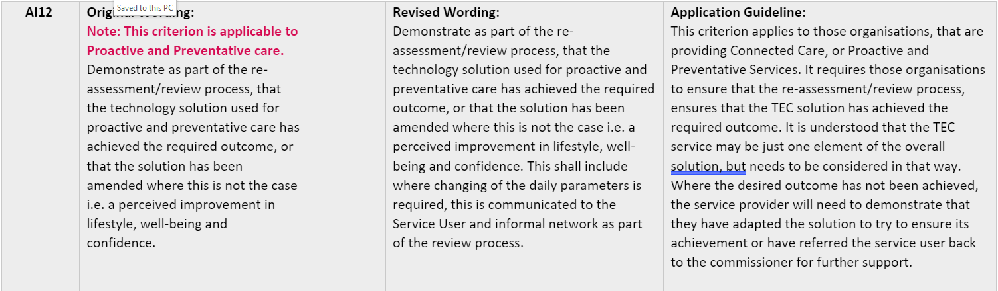
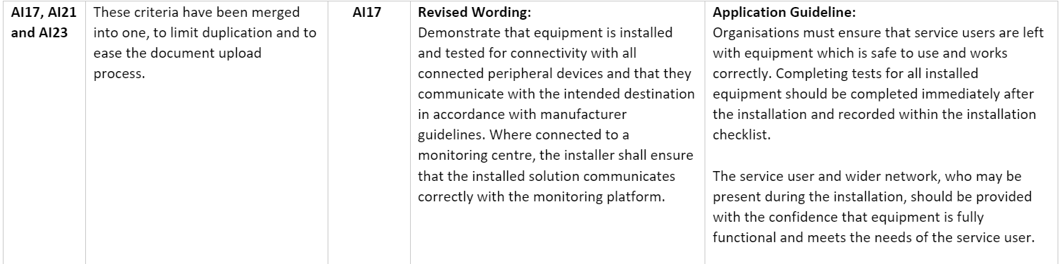
Assessment of, Installation and Maintenance of TEC v. 5.2 – 1 new key outcome, 3 new criteria, 4 merges, 3 revised criteria and 1 removed criteria.

Slide 37
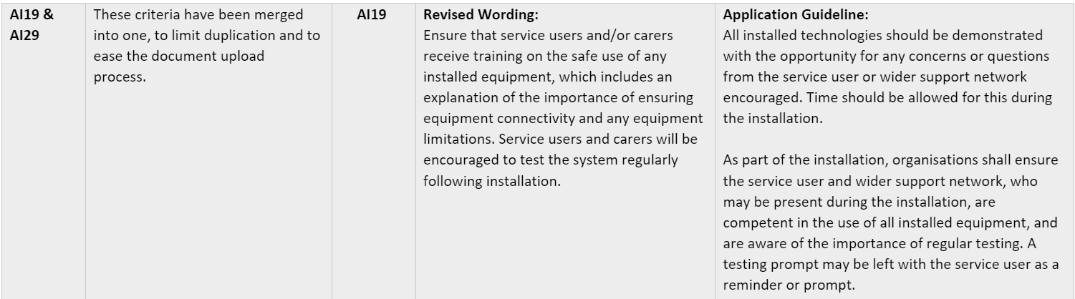
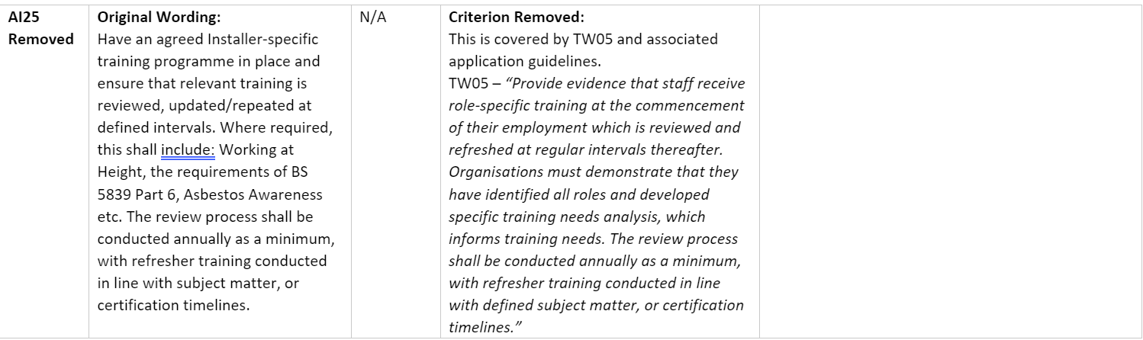
Assessment of, Installation and Maintenance of TEC v. 5.2 – 1 new key outcome, 3 new criteria, 4 merges, 3 revised criteria and 1 removed criteria.

Slide 38
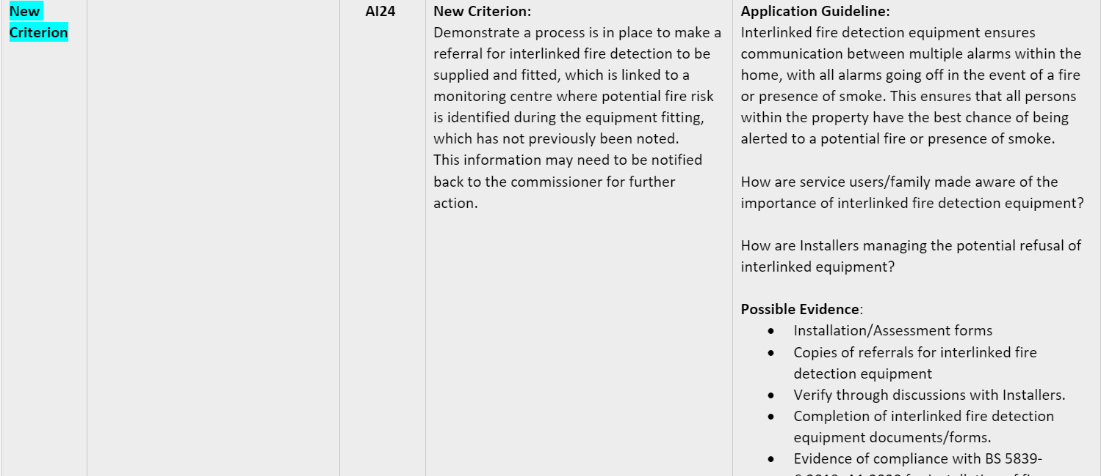
Assessment of, Installation and Maintenance of TEC v. 5.2 – 1 new key outcome, 3 new criteria, 4 merges, 3 revised criteria and 1 removed criteria.

Slide 39
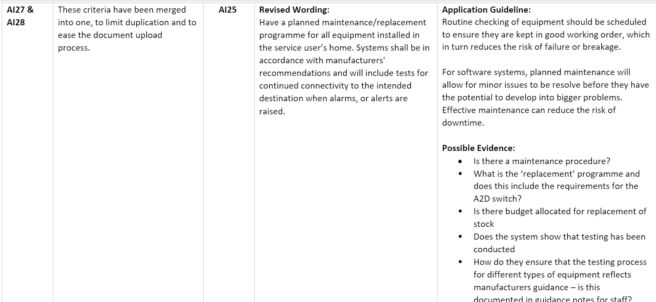
Assessment of, Installation and Maintenance of TEC v. 5.2 – 1 new key outcome, 3 new criteria, 4 merges, 3 revised criteria and 1 removed criteria.

Slide 40
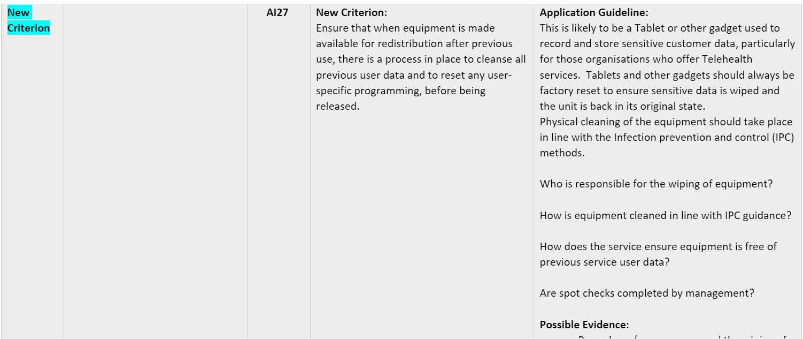
Assessment of, Installation and Maintenance of TEC v. 5.2 – 1 new key outcome, 3 new criteria, 4 merges, 3 revised criteria and 1 removed criteria.

Slide 41
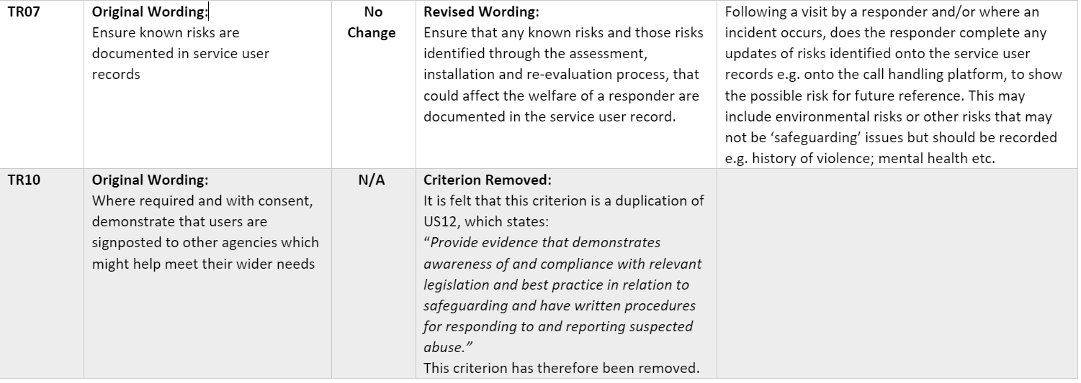
TEC Response Services v. 3.1 – 1 merged criteria, 2 removed criteria, 5 revised criteria.

Slide 42
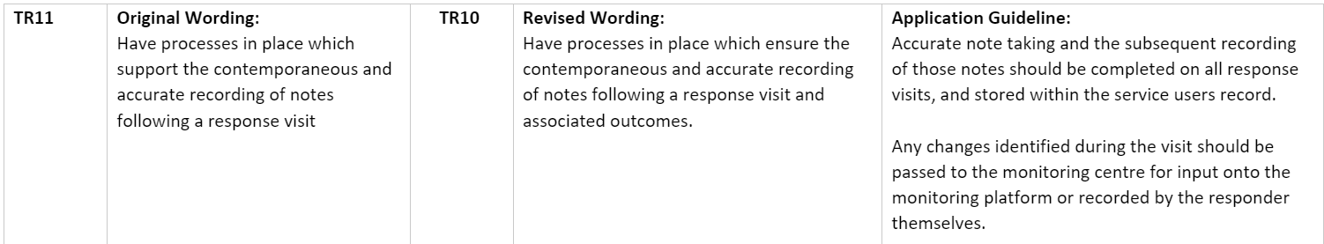
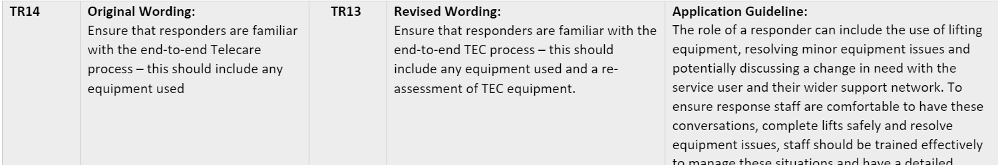
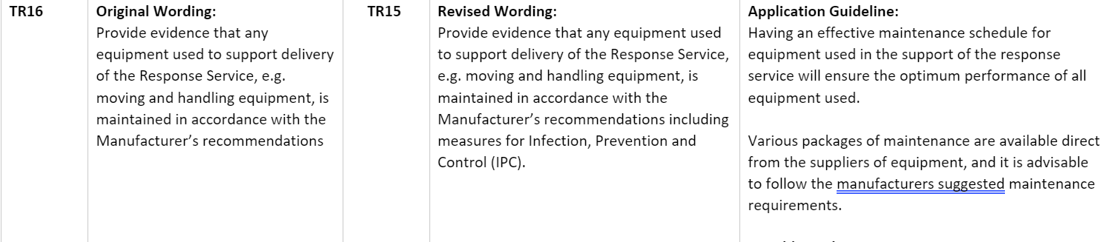
Continued:
TEC Response Services v. 3.1 – 1 merged criteria, 2 removed criteria, 5 revised criteria.

Slide 43
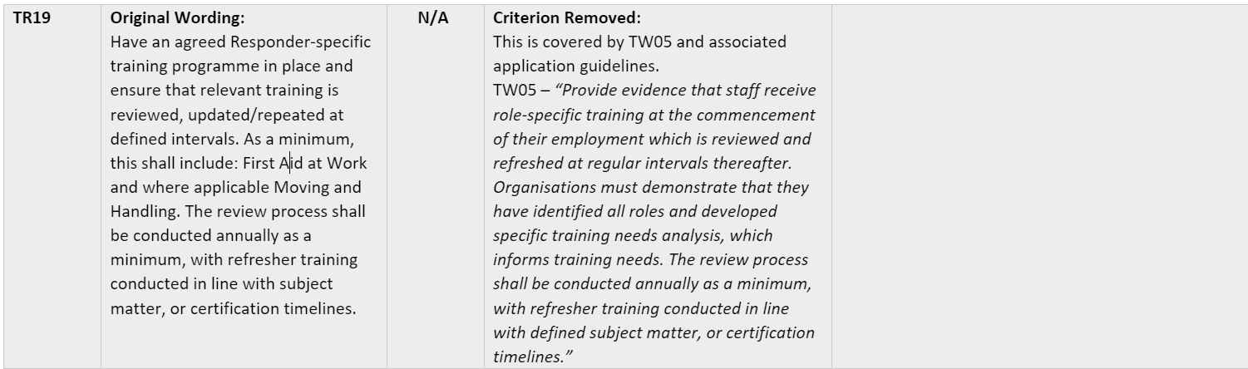

Continued:
TEC Response Services v. 3.1 – 1 merged criteria, 2 removed criteria, 5 revised criteria.

Slide 44

Continued:
TEC Response Services v. 3.1 – 1 merged criteria, 2 removed criteria, 5 revised criteria.

Slide 45


Telehealth Monitoring v. 1.4 – 1 removed criteria, 1 new criteria.

Slide 46

Equipment and Wheelchair Services v. 3.1 – 2 new, 2 removed criteria, 1 merged, 4 revised criteria.

Slide 47


Equipment and Wheelchair Services v. 3.1 – 2 new, 2 removed criteria, 1 merged, 4 revised criteria.

Slide 48


Equipment and Wheelchair Services v. 3.1 – 2 new, 2 removed criteria, 1 merged, 4 revised criteria.

Slide 49


Equipment and Wheelchair Services v. 3.1 – 2 new, 2 removed criteria, 1 merged, 4 revised criteria.

Slide 50

Equipment and Wheelchair Services v. 3.1 – 2 new, 2 removed criteria, 1 merged, 4 revised criteria.

Slide 51

Next Steps for the Formal Consultation Process
The Formal Consultation Process ends at 5pm on the 31st May.
Any comments should be via Email to admin@tecquality.org.uk
All comments will be tabled and available for viewing by the Auditees.
The Webinar on the 18th June, 2024 will be to advise organisations of any changes to the proposed scheme change document.

Slide 52

All information and documents can be found on the Audit Toolkit page
This will include access to the recording today.
All documentation goes live on 16th May on the audit toolkit page
Scheme handbook change on the Modules page of website

Slide 53

Thank you
Contact: helen.loveday@tecquality.org.uk

