Slide 1
High Level B2B Market & Customer Segmentation Approach
Define the overall market for the organization
Create macro market segments
Evaluate Market segments on a set criteria
Select target market(s)
Create customer segments
Choose a target customer segments & build profiles
Develop positioning strategy
Develop and implement marketing mix
Measure & improve performance

Slide 2













Types of
B2B Customer Segmentation Approaches
Geographic
Segmentation
Demographic
Segmentation
Firmographic
Segmentation
Technographic
Segmentation
Strong B2B segmentation blends multiple lenses to reveal clear, actionable groups you can target, position for, and win.
Psychographic
Segmentation
Behavioral
Segmentation
Segmentation
by Buyer Committee Role
Value-Based
Segmentation
Intent-Based
Segmentation
Segmentation
by Buyer
Journey Stage
Needs-Based
Segmentation
Personality-Based
Segmentation
Notes:
We have corresponding approaches with further detail for each
Key point: you want to go where the customer naturally are and where growth is, but you also need to find who your are best positioned to win with

Slide 3

Honing In: TAM ➤ SAM ➤ SOM ➤ ICP
Understanding of the total market is critically important to begin the drill down and target refining process
TAM Leverage marketing tactics for awareness
SOM
Leverage sales to drive consideration
Total Addressable Market
SAM
Reachable and relevant portion of the TAM
ICP
Serviceable Addressable Market
Serviceable Obtainable Market
Ideal Customer Profile
Notes:
Let’s create a voice that speak to our ICP, not our TAM
This funnel to paying customers does not begin with a target that has come to a company but rather demands that an entire market is taken into account and drives choices through the process to arrive at a reasoned high priority target

Slide 4
Criteria for a market and customer segment
Homogeneous | This means that the consumers allocated to each segment should be similar in some relevant way | This is the basis of market segmentation - that the consumers in each segment are similar in terms of needs and/or characteristics
Heterogeneous | Each segment of consumers should be relatively unique, as compared to the other segments that have been constructed | This demonstrates that the consumers in the overall market have been effectively divided into sets of differing needs
Measurable | Some form of data should be available to measure the size of the market segment | Measurements are very important to be able to evaluate the overall attractiveness of each segment
Substantial | The market segment should be large enough, in terms of sales and profitability, to warrant the firm’s possible attention | Each firm will have minimum requirements for the financial return from their investment in a market, so it is necessary to only consider segments that are substantial enough to be of interest
Accessible | The market segment should be reachable, particularly in terms of distribution and communication | Each segment needs to be able to be reached and communicated with on an efficient basis
Actionable/ Practical | The firm needs to be able to implement a distinctive marketing mix for each market segment | The range of segments identified generally need to be defined for the capabilities and resources of the organization, so very specialized segments may not be appropriate
Responsive | Each market segment should respond better to a distinct marketing mix, rather than a generic offering | The key outcome of the STP process is to develop a unique marketing mix for a specified target market, if the segment will not be more responsive to a distinct offering, then the segment can probably be combined with another similar segment

Slide 5








Types of
B2B Decision Makers
User
Detractor
Initiator
B2B Segmentation requires a complete map of buying influencers and deciders
Influencer
Gatekeeper
Champion
Decider
Budget
Owner

Slide 6
Market Analysis - CRM
 | Sales CRM | Marketing Automation | Customer Support / Helpdesk | Revenue Operations Platform | Vertical-Specific CRM
Representative Company | Salesforce | Marketo | Zendesk | Clari | Veeva
Market Size | ~$30B global CRM sales software | ~$7B marketing automation | ~$10B customer service software | ~$5B revenue intelligence / RevOps | ~$8B vertical CRM (aggregate)
# of Accounts in Market | ~300,000 | ~200,000 | ~250,000 | ~50,000 | ~150,000
Growth Rate | 10–12% CAGR | 12–14% CAGR | 14–16% CAGR | 18–22% CAGR | 10–12% CAGR
Barriers to Entry | High (platform lock-in, ecosystem) | Medium–High (switching cost, data) | Medium (workflow + data lock-in) | High (data accuracy + trust) | High (domain expertise, compliance)
Strategic Alignment | Core GTM system of record | Demand generation engine | Retention & service motion | Forecasting & revenue predictability | Industry-specific workflows
Competitive Intensity | Very High | High | High | Medium–High | Low
Market Economics | Enterprise & SMB mix | Enterprise-weighted | SMB → enterprise | Enterprise-weighted | Enterprise & mid-market
Example Customers | Shopify, Snowflake, Zoom | Adobe, SAP, ServiceNow | Airbnb, Slack, Shopify | Okta, ZoomInfo, Snowflake | Pfizer, Merck, GSK
% of Total Revenue | 100% | 100% | 100% | 100% | 100%
Average ACV | $50K–$150K | $40K–$120K | $20K–$80K | $60K–$200K | $75K–$250K
Average Gross Retention | ~90–92% | ~88–90% | ~90–92% | ~92–95% | ~93–96%
Average Growth | 15–20% | 15–25% | 20–25% | 25–30% | 12–18%
Net Revenue Retention | 110–120% | 105–115% | 110–120% | 120–130% | 115–125%
Average Sales Cycle | 60–180 days | 45–120 days | 30–90 days | 90–180 days | 120–270 days
Notes on Buying Journey | Sales-led, multi-stakeholder | Marketing-led, ROI-driven | Ops-led, pain-driven | Exec + RevOps led | Compliance-driven, long evaluation

Slide 7
Customer Segmentation - CRM
 | Inbound-Led Growth Teams | Outbound / Sales-Led B2B Teams | Lifecycle & Retention Teams | Complex Enterprise Journeys
Customer Description | Demand-first marketing orgs | Sales-driven GTM orgs | Post-acquisition focused | Large, multi-business orgs
Typical Company Profile | SaaS, content-led B2B, digital brands | B2B services, SaaS, industrial | SaaS, subscription, marketplaces | Global B2B or B2C enterprises
Primary Motion | Inbound → nurture → convert | Outbound → support sales | Activate, retain, expand | Orchestrate at scale
Primary Buyer | Head of Growth, Demand Gen | VP Sales, RevOps | Lifecycle / CRM leader | CMO, Marketing Ops
Primary Need State | Turn attention into pipeline | Support sales with better leads | Increase LTV & retention | Coordinate complex journeys
Core Problems to Solve | • Lead quality• Attribution | • Sales–marketing disconnect• Poor handoffs | • Churn• Low activation• Expansion gaps | • Data silos• Governance• Consistency
Buying Trigger | Growth plateau | Sales inefficiency | Revenue leakage | Platform sprawl
Brand Recognition Required | Medium | Medium | Medium | Very High
Competitive Intensity | High | High | Medium–High | Very High
Right to Win | Strong | Strong | Strong | Moderate
Ability to Differentiate | High (clarity + ROI) | Medium–High | High (insight-driven) | Low–Medium
Price Sensitivity | Medium | Medium | Medium | Low
Average ACV | $15K–$50K | $25K–$80K | $30K–$100K | $150K+
Sales Motion | Hybrid / PLG | Sales-led | Sales-assisted | Enterprise sales
Sales Cycle | 30–90 days | 60–120 days | 60–120 days | 6–12 months
Retention Potential | High | High | Very High | Very High
Strategic Value | Pipeline growth engine | Sales acceleration | Durable revenue growth | Large but slow

Slide 8


Target Customer Profile: B2B SaaS Leader
GOALS & OBJECTIVES
Revenue Strategy: Increase revenue, grow MoM, hit sales goals with efficient ROI
Process Optimization: Get maximum productivity from salespeople by empowering them with what they need (tech & training)
Scale: Efficiently scale (grow headcount) & outpace the competition
NEEDS
RevOps and sales experts
Change mgt. support
Do more with less
Increased visibility into sales metrics and the inputs that get me to revenue
MOTIVATIONS
Achieve growth & profitability
Build high performing teams
Get acquired or go public
Organizational impact
OBJECTIONS
Value equation is weak (high cost w/ ambiguous results)
Lack of faith in strategy or execution
PAIN POINTS/FEARS
IDEAL CLIENT PROFILE
Most Urgent & Important: Don’t know where to start or what the real problems are
Having a strategy, but not being able to execute it
Siloed teams
Reactive vs. proactive efforts
Sales teams missing quota
Inaccurate forecasts
Churn of top talent
Data quality and integrity
PERSONALITY
Strategic
Industry: B2B SaaS & PE/Growth Equity
HR tech, Real Estate Tech, FinTech, Sales Tech
Data Driven
Urgency
Positions: CEO, VP of Sales, Chief Sales Officer, Chief Revenue Officer, VP of Sales Tech, VP of Ops, VP of Enablement, Director of Inside Sales
Adaptable/
Innovative
Company Details: Mid-sized & growing towards Enterprise, 200-700 employees, sales Team 30+, at least 7 years in business, between $30-$75 million in revenue
BUYING INFLUENCE
KEY MOMENTS & BEHAVIORS
Experience rapid growth or expansion w/ difficulty scaling processes, headcount, and sales tech
Shifts in market dynamics or increases competitive pressure
Interest in adopting new sales approaches or technology and need help
Recognition of inefficient processes that need upgrading
Data
Trust the team
Ability to execute
Speed of results
Notes:
Ideally, you should only have one ICP (ideal customer profile). You can have as many profiles as you want, but one ICP should be your focus.
Are we clear on an emotional benefit that will matter?
Don’t go too broad OR too narrow
Are these the people who are buying now that you want more of?
Qualitative: Are they customers you enjoy serving? Is the sales process painless? Propensity to become an evangelist and refer? Easy to deliver value and get good reviews?
Quantitative: Is their sales cycle long or short vs. the average sales cycle? What is their LTV relative to others? AOV (average order value)? Is the TAM (total addressable market big enough)?

Slide 9

Bonus Slides
Strategy Kiln

Slide 10
Definitions of Segmentation, Targeting, and Positioning
Marketing Segmentation
The process of splitting a market into smaller groups with similar product needs or identifiable characteristics, for the purpose of selecting appropriate target markets.
Targeting (or target market selection)
An organization's proactive selection of a suitable market segment (or segments) with the intention of heavily focusing the firm’s marketing offers and activities towards this group of related consumers.
Positioning (or product positioning)
The target market’s perception of the product’s key benefits and features, relative to the offerings of competitive products.

Slide 11
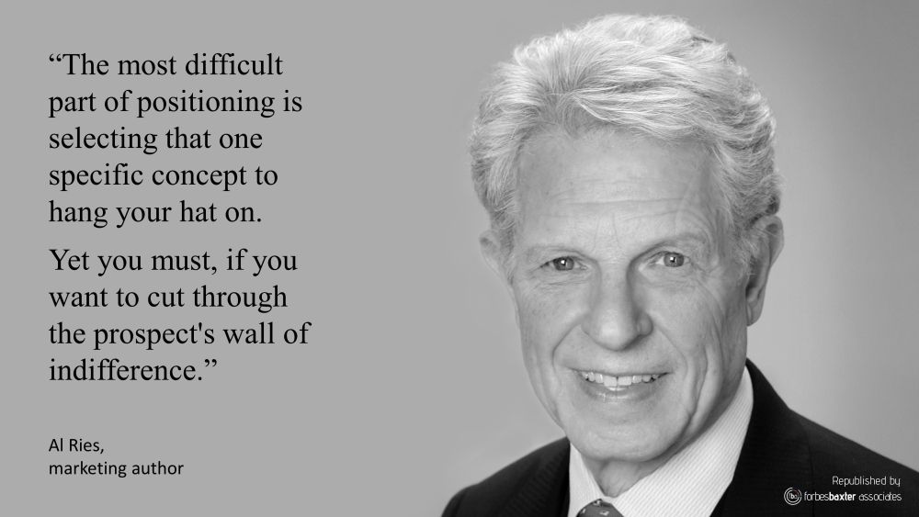

Honing in:
Notes:
Key to positioning is keeping it direct and clear to one main idea or value that is compelling

Slide 12
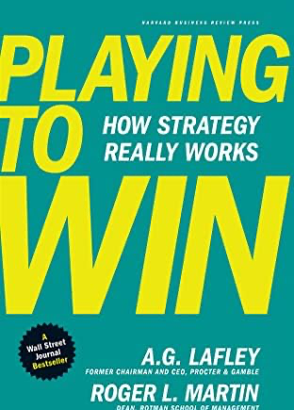
The Strategic Thinking Choice Cascade
What are our goals & objectives?
Where do we want to be, by when?
Vision / Values? Growth?
Revenue?
Market Leadership?
Where will we play?
Focus on which: Industries in which to play?
Products?
Delivery channels? Customers?
Geographies? Narrow versus broad focus?
How to win?
What is our value proposition?
What capabilities must be in place to succeed?
What are the key activities that drive success?
How will we make it happen?
Manufacturing? Technology?
People? Alliances?
What management systems are required?
These are critical question to help us target opportunities
What are our sources of advantage?
What organizational structure?
What distinguishes us from competitors?
What reward systems?
Notes:
STP is a critical component of where to play and how to win

Slide 13
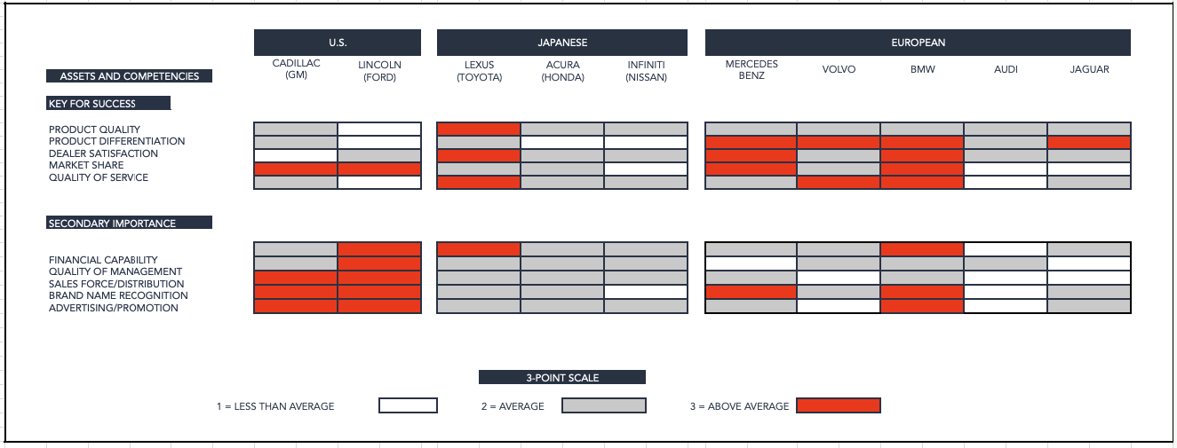
David Aaker’s Competitive Analysis Grid Click here to get an excel file you can download and edit yourself
Notes:
Another example of a competitor analysis visualization, this time from David Aaker, using a 3-point scale and different levels of importance for assets and competences. This examples looks at different car manufacturers.

Slide 14
Customer Problems vs. Our Ability to Deliver Solutions Example
What Troubles Our Customer? (Customer Problems) | Customer Need or Pain Level | How Well We Deliver a Solution | Our Solutions and Offerings/Benefits | Advantage vs. Competition
Don’t know where to start or which CRM is right | 8 | 10 | 8 | 10
CRM is in place but not adopted by sales | 8 | 8 | 8 | 8
Data is fragmented across tools (CRM, marketing, support) | 10 | 7 | 10 | 7
Lack of pipeline visibility and forecasting accuracy | 8 | 8 | 8 | 8
Difficulty integrating CRM with existing stack (marketing, RevOps, support) | 9 | 9 | 9 | 9
Sales and marketing misalignment around leads and handoffs | 8 | 8 | 8 | 8
Focus where we can consistently deliver value beyond competitors now and in the future
Notes:
Multiple ways to evaluate the target

Slide 15
Step 3 - Evaluate the proposed market segments for viability
Now that we have developed some market segments we may be required to evaluate them to ensure that they are useable and logical. This would happen in a real-life firm, but it may not form part of your particular task.
Evaluation Criteria | Our Assessment
Homogeneous | Segments should be similar in needs
Heterogeneous | Assumes that age groups vary in needs, which is likely in this market
Measurable | Market research data can be utilized
Substantial | Given the segments are relatively broad, they should be individually substantial
Accessible | Various merchandising techniques can be used to promote and reach each of these segments
Actionable/Practical | The firm has the capabilities to market to each segment, if required
Responsive | Each market segment should respond better to a distinct marketing mix, rather than a generic offering

Slide 16

Strategic Market Positioning
Before diving into the market analysis, take a moment to consider your position in the market and the appropriate go-to-market for your product. This will influence the markets you target. Add your logo and move it into the appropriate quadrant to orient your company's positioning.
Product Uniqueness vs. Product Complexity
Niche | Premium
Volume | Value
Your Logo Here
Unique
Product Uniqueness
Commodity
Simple
Complex
Product Complexity

Slide 17
Strategic Market Positioning
Before diving into the market analysis, take a moment to consider your position in the market and the appropriate go-to-market for your product. This will influence the markets you target. Add your logo and move it into the appropriate quadrant to orient your company's positioning.
New/Existing Market vs. Product
Market Development | Diversification
Market Penetration | Product Development
New
Your Logo Here
Markets
Existing
Existing
New
Products

Slide 18
Strategic Market Positioning
Before diving into the market analysis, take a moment to consider your position in the market and the appropriate go-to-market for your product. This will influence the markets you target. Add your logo and move it into the appropriate quadrant to orient your company's positioning.
Sales Involvement vs. Average Deal Size (ACV)
High-Touch
Sales Involvement
No-Touch
Your Logo Here
$100 $1,000 $10,000 $100,000 $1,000,000
Average Deal Size (ACV)

Slide 19
Reinforce high-level where to play choices
All value models are supported, but market winners generally lean into one
Value Discipline | Brand Type | Level of Value Expectation
Operational Excellence | Biggest | Discount
Customer Intimacy | Best | Value
Product Innovation | Niche | Premium
- | Price | Luxury
What capabilities truly drive the way you deliver value? | How do you want your brand to be perceived? | What level of value do you provide?
Treacy-Weirsema Value Discipline Model | McKinsey Brand Type Model | Price to Value Experience Position

Slide 20
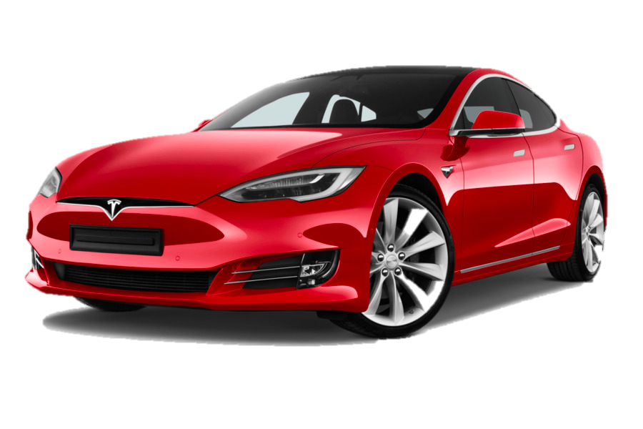
The U.S. based Inflation Reduction Act of 2022 drives favorable tax structures Tesla can capitalize on in Auto & Solar Panel divisions
High gas prices in 2022 have accelerated the adoption of EV; increasing both Tesla & competitor sales, which further fuels the red ocean of competition
- Tesla -
Five C’s
Analysis
Context
Customers
Competitors
Implications
Brand perception among older customers is high while younger customers view the brand less favorably, & this is worsening
Tesla’s mono-segmentation (mainly affluent, environmentally conscious men) limits customer expansion
China represents the greatest territory for customers growth
The blue ocean is now red, with luxury (Audi, BMW) and mass brands (Kia, Ford) offering EVs rivaling our technology from a range & efficiency standpoint
Build quality is cited as weaker than luxury brands like Lexus & Benz
Technology such as self-driving AI still industry leading
Tesla’s lead in brand differentiation & technology are becoming pressured by rival companies investing big in EVs
Previously deprioritized areas such as build quality & marketing may need resource investment
Dive deeper into Tesla’s brand metrics to uncover why younger consumers view the brand less favorably & craft a strategy to improve brand image
Continue vertical integration & investment in China to reduce costs & drive growth, respectively
Collaborators
Company
Although strategic battery supplier relationships, esp. Panasonic, are strong, Tesla should become more vertically integrated to reduce costs
Supply chain issues due to the pandemic continue to be an issue, but Tesla’s strong supplier relationships & emphasis on in house software development have
placed them in a good position
Auto revenue increased +70% in 2021 vs. YA
Recent Elon media coverage (e.g. Twitter take over) is hurting the brand
Elon’s “Zero Marketing Budget” philosophy is working, but novel marketing & PR approaches will be needed in order to expand the customer base
*Information provided is for example purposes only
Notes:
The marketing 5 Cs framework is a model used to analyze and develop effective marketing strategies. It focuses on five key elements that should be considered when crafting a marketing plan. The 5 Cs stand for:
Company: This refers to the company itself, its mission, vision, values, resources, capabilities, and competitive advantages. Understanding the company's strengths, weaknesses, and positioning is crucial for developing a successful marketing strategy.
Customers: This element involves analyzing the target customers, including their needs, wants, preferences, behaviors, demographics, and psychographics. Developing a deep understanding of the customer is essential for creating effective marketing campaigns and delivering value.
Competitors: This involves studying the competitive landscape, including direct and indirect competitors, their strategies, strengths, weaknesses, and market positioning. Competitor analysis helps identify opportunities, threats, and ways to differentiate and gain a competitive advantage.
Collaborators: This refers to the company's partners, suppliers, distributors, and other stakeholders that play a role in the value chain. Building strong relationships with collaborators can enhance the effectiveness of marketing efforts and create mutual benefits.
Context: This element considers the external factors that can influence marketing efforts, such as economic, social, technological, legal, and environmental factors. Understanding the context helps identify potential challenges and opportunities, and adapt marketing strategies accordingly.
By analyzing and aligning these five elements, the 5 Cs framework provides a comprehensive approach to marketing strategy development. It helps companies understand their internal capabilities, target customers, competitive environment, collaborator relationships, and external context, enabling them to create more effective and integrated marketing plans that address all relevant factors.

Slide 21
Analytical approach to your targeting and prioritization strategy
Your strategic approach will vary based on the quadrant you’re in
Improve or Ally | Maintain and Improve | Invest/Grow
Worth Improving? | Selectivity Earnings | Maintain Position
Harvest/Divest | Is it Worth Keeping? | Benefit While it Lasts
High
Industry Attractiveness
Medium
Low
Low
Medium
High
Competitive Strength

Slide 22

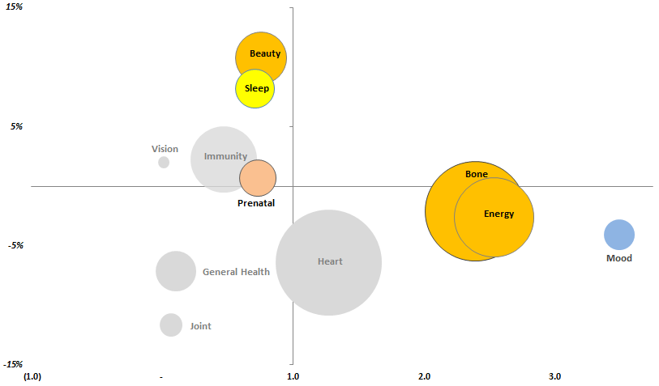
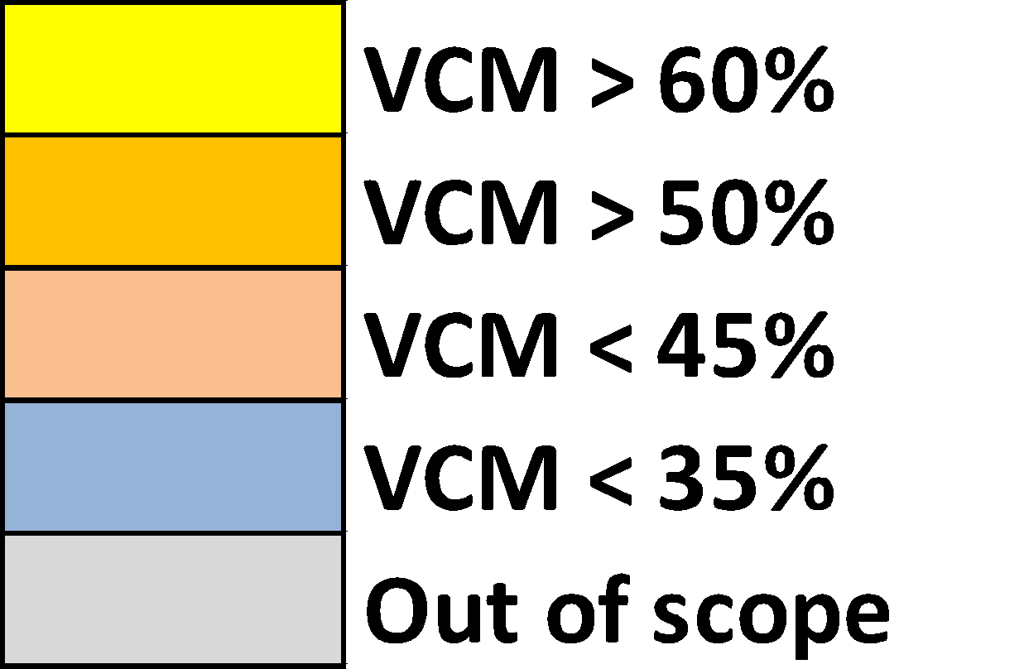


Recommendation for Base Need State Focus
Market Position and %VCM inform our prioritization
?
Grow
Category Growth
Defend
$
Relative Market Share
Source: Nielsen xAOC

Slide 23

Our Mission
Tech Adoption Profile: Early Adopters
Inspire with exclusive innovation
Mindset
How do we win?
Growth mindset: Willing to spend and take measured risks if it helps grow or deliver on brand’s value proposition; cost not usually a major barrier, understand true cost of tech debut
Want to be influential and disruptive: Focused on bringing novel tech to market early, offering customers something new
Motivated by enhancing user experience: Will push vendors to provide a superior experience for clients, and willing to pay for the privilege
More likely to seek consultative partnerships: Like to work specialists in respective fields, even if they have their own payments team
Fear of falling behind: If not ahead, they are behind; always keep an eye out for new opportunities and tech advancements
Lead with a growth story: Help manage complex payments environments so they can focus on growth
Recommend enhancements to user experiences: Enabling optimized checkout, relevant payment methods, and rewards services will increase reach, engagement, and conversion
Prove we are innovative and tech-forward: Position solution as flexible, innovative, and scalable, show our future-ready roadmap
Be a consultative partner: Tout deep expertise, make confident recommendations; they are happy to outsource payments tech
Show how payments can power innovation in other areas: Showcase next-gen capabilities; access new revenue streams (e.g. Airbnb booking experiences)
Background
Early Adopters are companies that seek out and leverage cutting-edge technology. Known as disruptors or leaders in their industries, they see that payments go beyond transactional necessity and enable other business objectives.
Pain Points
How do we lose?
Lack of resources to achieve all tech goals: Developer resources are limited, tend to want to work on flashier front-end projects rather than back-end processes
Streamlined integration and reporting: May be working with various systems and seek simple, elegant solutions that compliment them
Customer Insights: As big believers in data, always looking to learn more about customers
Fraud: Being more focused on digital means having to fend off more fraud incidents
Compliance: Can be very important; emphasis varies depending on level of regulation in the vertical or region of operations
Positioning us as a payments provider: Instead, frame us as a future-forward, cloud-based tech platform
Stressing the power of our platform without emphasising the customer: Show how our solution will help find new customers, get closer to current ones, and drive repeat business and satisfaction
Forgetting to reinforce the basics: Industry-leading uptime, reliability, and cost efficiency ar estill key components of a winning PSP relationship
Failing to communicate flexibility and options: Show the potential of the platform - even if functionality will not be used in full; demonstrate the solution is modular and built for scale and will not inhibit growth
How are decisions made?
Companies at the forefront of tech tend to seek out the latest and greatest solutions. They may have more agile decision-making processes, but still need buy0in from relevant groups. IT/Tech stakeholders tend to have a louder voice at tech-forward companies. Triggering events could include global expansion, streamlining operations, and/or upgrading user experience.

Slide 24
Meet the Team
Strategy Kiln

Slide 25








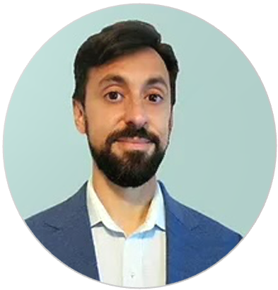
A boutique marketing strategy firm with a seasoned team of top level marketers.
Unlike standard agencies, we dive deep to understand your business and identify critical success factors to fuel predictable growth.

Slide 26
Send an e-mail: questions@strategykiln.com
Simplify & Intensify your Marketing with Strategy Kiln
Reach Out
Learn More About Services
Services to Gain Insight &
Grow Strategically
Market Segmentation
Strategic Positioning
Blue Ocean Strategy
Value Proposition Design
SWOT Assessment
Website Design
Digital Sales Funnel
SEO & SEM
LinkedIn Ads Management
Email Strategy
Paid Social Media
Need help?
We can develop and execute your marketing strategy
Book Time Via Calendly
https://calendly.com/adamcfischer/conversation-with-adam

Slide 27

YOUR STRATEGY TEAM
ADAM FISCHER
CASSANDRA VIGNIERI
Your
Team
DIGITAL MARKETING STRATEGY
SEO & CONTENT STRATEGY
15+ years of marketing experience at Fortune 500 companies & start-ups managing $1MM to $15MM annual budgets
Omni-channel launches with full-funnel digital & traditional strategy
Paid search (Google), paid social (Facebook), and SEO expertise
At CVS Health: Led MinuteClinic Total Search strategy to improve keyword quality score, ROI, and dominate both channels
At a $1B unicorn start-up: Achieved +70% sales growth through a hyper-local digital strategy to secure $115MM in Series C funding
12+ years of experience leading SEO and content strategy for mega brands like Monster and Internet Brands (Parent Co. of WebMD)
Expertise is multiple verticals including law, the automotive sector, staffing, consumer goods, and financial services
Passion for developing strategies to increase online presence, improve conversion and user experience, and drive revenue
Expert insight on trends and advancements in SEO, UI/UX, and Google algorithm updates
Deep Thinking
Simplicity
Boldness
Empathy
Impact
- Strategy Kiln Values -

Slide 28


YOUR STRATEGY TEAM
ANDREAS VON ALTENBERG
SETH FINK
Your
Team
WEBSITE DEVELOPMENT & BRAND DESIGN
BRAND STRATEGY & OPERATIONS EXPERTISE
10+ years as a strategy, marketing, web development consultant
Expert skills in creating high performing websites that convert
Brand strategy, design, logo development, and persuasive copywriting
Founder of Story Time, an E-Learning platform where children and learners can read interactive children's books in diverse languages
30+ Years of senior executive & strategy consulting experience at premier firms like Deloitte, PWC, & Anderson Consulting
Significant retail experience including the launch of the NBA and NBC retail stores in NYC and the UPS retail store nationwide launch
Extensive global business insights, country management, & new product launch experience
Operational assessment and optimization expertise, including multiple years with Walmart
Deep Thinking
Simplicity
Boldness
Empathy
Impact
- Strategy Kiln Values -

Slide 29

YOUR STRATEGY TEAM
JOSE PONCE
WILLIE PEACOCK
Your
Team
TECHNICAL SEO & ADVANCED OPTIMIZATION
GOOGLE AND BING SEM/PPC
15+ years of hands on SEO experience as well as Director level leadership
Expert skills in technical SEO and on page optimization to get results faster than anyone else you’ve worked with – get measurable outcomes within 3 months as opposed to 6+ months with average SEO partners
Broad expertise in website development and paid SEM, allowing him to deliver unified SEO + SEM solutions
Willie is a lawyer, marketing, and technology enthusiast currently getting an MBA from the University of Chicago
He has 10+ years of SEM experience working with budgets up to $1MM per month, with a focus on B2B companies and startups
His clients have stayed with him for years because he understands SEM at a deeper level and can drive results based on experience, knowing your business, and staying on top of cutting edge trends and Google updates
Deep Thinking
Simplicity
Boldness
Empathy
Impact
- Strategy Kiln Values -

Slide 30
YOUR STRATEGY TEAM
ZACH HADDAD
MARK FERREIRA
Your
Team
SEM & PAID SOCIAL EXPERT
CONVERSION TRACKING & TECHNICAL EXPERTISE
Almost 10 years managing multi-million dollar paid search accounts across Google and Bing
Well balanced sense of how to make integrated campaigns come together, with core expertise is search
Broad expertise in website development and SEO, allowing him to deliver unified SEO + SEM solutions
10+ years as a technical consultant in healthcare driving the medical record database infrastructure of top hospital networks including the Cleveland Clinic and University of Michigan Hospital
Expertise in Google Analytics, Google Tag Manager, and Search Console
Website development and conversion rate optimization skills to ensure paid and organic campaigns drive to enhanced landing page experiences
Deep Thinking
Simplicity
Boldness
Empathy
Impact
- Strategy Kiln Values -

