Slide 1
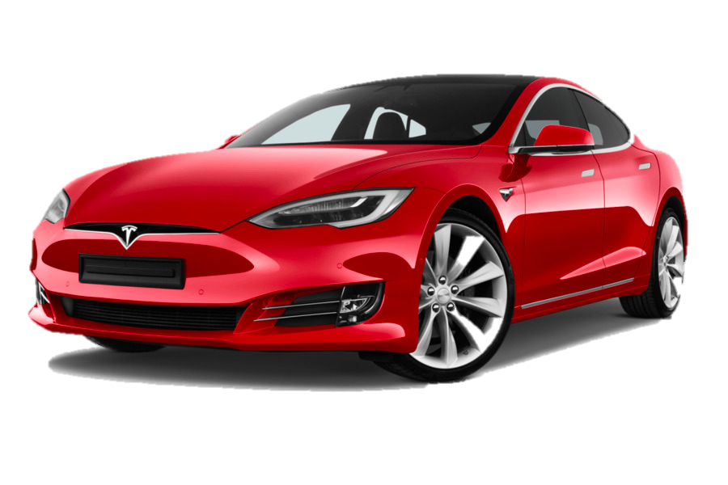

5Cs Marketing Framework Tesla Examples & Templates
Strategy Kiln

Slide 2



The U.S. based Inflation Reduction Act of 2022 drives favorable tax structures Tesla can capitalize on in both Auto & Solar Panel divisions
High gas prices in 2022 have accelerated the adoption of EV; increasing both Tesla and competitor sales, which further fuels the red ocean of competition
5Cs Template
Context
Customers
Competitors
Implications
Brand perception among older customers is high while younger customers view the brand less favorably, & this is worsening
Tesla’s mono-segmentation (mainly affluent, environmentally conscious men) limits customer expansion
China represents the greatest territory
for customers growth
The blue ocean is now red, with luxury (Audi, BMW) and mass brands (Kia, Ford) offering EVs rivaling our technology from a range & efficiency standpoint
Build quality is cited as weaker than luxury brands like Lexus & Benz
Technology such as self driving AI still industry leading
Tesla’s lead in brand differentiation & technology are becoming pressured by rival companies investing big in EV
Previously deprioritized areas such as build quality & marketing may need resource investment
Dive deeper into Tesla’s brand metrics to uncover why younger consumers view the brand less favorably & craft a strategy to improve brand image
Continue vertical integration & investment in China to reduce costs & drive growth, respectively
Collaborators
Company
Although strategic battery supplier relationships, esp. Panasonic, are strong, Tesla should become more vertically integrated to reduce costs
Supply chain issues due to the pandemic continue to be an issue, but Tesla’s strong supplier relationships & emphasis on in house software development have
placed them in a good position
Auto revenue increased +70% in 2021 vs. YA
Recent Elon media coverage (e.g. Twitter take over) is hurting the brand
Elon’s “Zero Marketing Budget” philosophy is working, but novel marketing & PR approaches will be needed in order to expand the customer base
*Information provided is for example purposes only

Slide 3
5Cs Template
Competition
Collaborators
The blue ocean is now red, with luxury (Audi, BMW) and mass brands (Kia, Ford) offering EVs rivaling our technology from a range & efficiency standpoint
Although strategic battery supplier relationships, esp. Panasonic, are strong, Tesla should become more vertically integrated to reduce costs
Tesla’s lead in brand differentiation & technology are becoming pressured by rival companies investing big in EV
Dive deeper into Tesla’s brand metrics to uncover why younger consumers view the brand less favorably & craft a strategy to improve brand image
Continue vertical integration & investment in China to reduce costs & drive growth, respectively
Brand perception among older customers is high while younger customers view the brand less favorably, & this is worsening
Recent Elon media coverage (e.g. Twitter take over) is hurting the brand
Customer
The U.S. based Inflation Reduction Act of 2022
drives favorable tax structures Tesla can capitalize on
in both Auto & Solar Panel divisions
High gas prices in 2022 have accelerated the adoption
of EV; increasing both Tesla and competitor sales,
which further fuels the red ocean of competition
Context

Slide 4
Marketing 5Cs Framework Alternate Layout Option
External
Internal
Context
Customers
Competitors
Collaborators
Company
The essential question: can you articulate what your relationship with your customers is like?
How are your customers changing, and how will you adapt to better solve their problems & serve their needs vs the competition?
Given our 5Cs analysis, how well positioned are we in the face of challenges and opportunities?
How have we tracked vs. goals & objectives in the past?
PESTEL Analysis
Political
Economic
Social
Technology
Legal
Environmental
Who are the market share leaders & why?
Who has gained/lost share & why?
Any new business models introduced that are small now but growing fast?
Upstream and downstream partners
Technology partners
Suppliers
Key Observations & Implications
Key Observations & Implications
Key Observations & Implications
Key Observations & Implications
Key Observations & Implications

Slide 5
Context
The best place to start a 5Cs analysis is with context, looking at the external macro trends shaping the context your business operates in
What’s happening in our industry and how are we positioned to win?
5Cs Situational Analysis
Customers
Competitors
Implications
This section should highlight the most important linkages uncovered through your 5Cs analysis
Develop implications (the “so what”) based on your data and observations
Provide high level next steps on what needs to be done to take this data and drive further insights and strategy
The essential question: can you articulate what your relationship with your customers is like?
How are your customers changing, and how will you adapt to better solve their problems & serve their needs vs the competition?
Who are the market share leaders & why?
Who has gained/lost share & why?
Any new business models introduced that are small now but growing fast?
Collaborators
Company
Do we have the right business partners across all aspects of the business?
Who wants to partner & win as much as you do?
What tools & technology can give us a competitive advantage?
Given our 5Cs analysis, how well positioned are we in the face of challenges and opportunities?
How have we tracked vs. goals & objectives in the past?
How adaptable is our company to face needed changes to win?

