Slide 1
Slide Style Guidelines
Please Delete This Slide Before Submitting​
Section Header Slides
Font Size/type: 60 Calibri Light
Font Color and Style: White -Bold
General Slides
Title
Font Size/Type: 44 Calibri Light
Font Color and Style: White -Bold
Body text
Font Size/Type: 26-28 Calibri Light for main point and 22-24 Calibri Light for sub bullets
No more than 5 Main bulleted statements per slide
Font color and style: Black -Normal
Reference
Font Size/type: no smaller than 10 Calibri Light

Slide 2
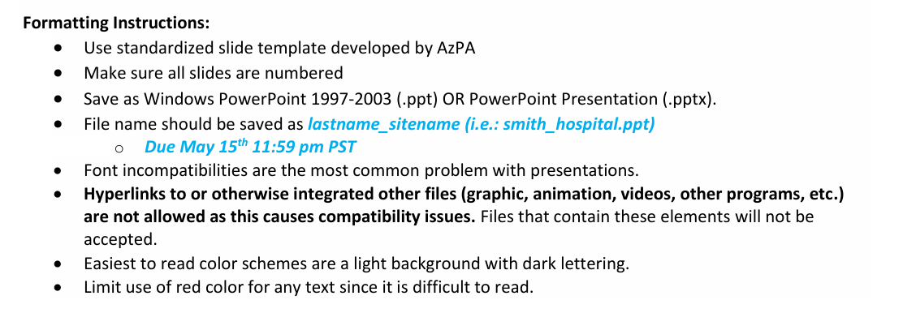
Slide Style Guidelines
Please Delete This Slide Before Submitting​

Slide 3

TITLE OF PRESENTATION - Full name - Position - Residency program & location
IRB status here

Slide 4

Insert Biosketch Here
Speaker 1: Name

Slide 5

Insert Biosketch Here
NOTE: Mentors are individuals who may or may not be speaking but mentored the other speaker(s) and reviewed the content in the case the speaker is a resident or student.
Mentor Name

Slide 6
Disclosure Statement
Speaker Name(s), faculty for this CE activity, has no relevant financial relationship(s) with ineligible companies to disclose.
OR
Speaker Name(s), faculty for this CE activity, has the following relevant financial relationship(s) to disclose:
List company/relationship/position
This slide and this language is required by ACPE – DO NOT DELETE THIS SLIDE.
All speakers should be listed.
If you need to add a company specific disclosure, please place on an additional slide.

Slide 7
Disclosure Statement
None of the planners for this activity have any relevant financial relationships to disclose with ineligible companies.
This slide and this language is required by ACPE – DO NOT DELETE THIS SLIDE.

Slide 8
Disclosure(s)
Full name of all investigators
Conflict of Interest (stating that investigators have none, or stating disclosures)
Sponsorship (did the speaker receive funding to support their research)
Propriety information (state that the research is subject to different interpretation)
Educational in nature (state that speaker agrees that their presentation abides by the non-commercial guidelines)

Slide 9
Institution
Include general institution information – demographics, bed size, type of facility in relation to project

Slide 10
Slide Title
To create additional slides with this format –right click then hit duplicate

Slide 11
Background
Notes:
Background 6.) Methodology 7.) Results 8.) Conclusion/Discussion

Slide 12
Methodology
Notes:
Background 6.) 7.) Results 8.) Conclusion/Discussion

Slide 13
Results
Notes:
Background 6.) 7.) Results 8.) Conclusion/Discussion

Slide 14
Conclusion/Discussion

Slide 15
References
Use AJHP reference style
Seibert HH, Maddox RR, Flynn EA, Williams CK. Effect of barcode technology with electronic medication administration record on medication accuracy rates. Am J Health-Syst Pharm. 2014; 71:209-18.​
GlaxoSmithKline. Zofran (ondansetron hydrochloride) prescribing information. http://us.gsk.com/products/assets/us_zofran.pdf (accessed 2014 Jan 27).​
Trastuzumab [monograph]. In: Micromedex Drugdex [online database]. Greenwood Village, CO: Truven Health Analytics (accessed 2014 Mar 21).​
Institute for Safe Medication Practices. ISMP’s list of high-alert medications in acute care settings (2014). www.ismp.org/Tools/institutional highAlert.asp (accessed 2016 May 12).​

Slide 16
QUESTIONS?

