Slide 1

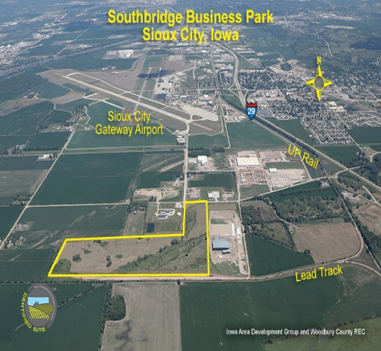
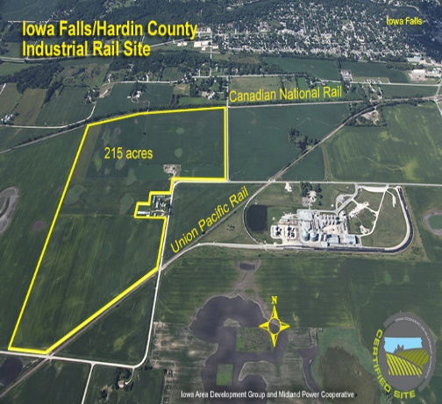
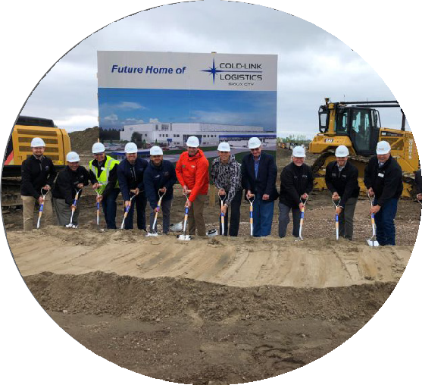
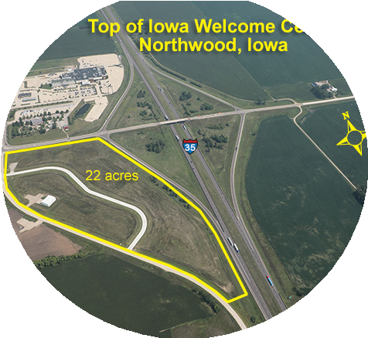
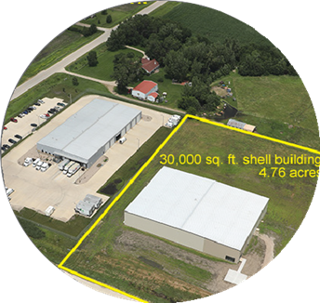
Iowa Area Development Group
Partners in Progress for Business and Community Development

Slide 2

Who We Are
Iowa Area Development Group (IADG) is the Business and Community Development Leader for Iowa’s Member Owned Utility
Sponsors & Partners:
______________________________
150 Member Owned Utilities:
Rural Electric Cooperatives
Member Municipal Electric Systems
Independent Telecommunications Companies
IADG also does work outside of Iowa.

Slide 3

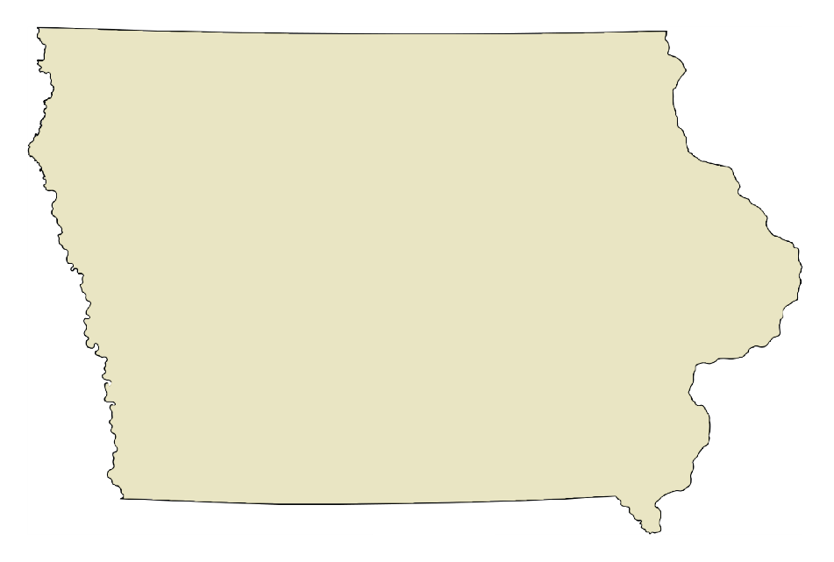

Sponsors and Partners
ELECTRIC UTILITIES
Iowa Area Development Group is the business and community development leader for over 150 Member-Owned Electric
Cooperatives, Municipal Utilities & Telecommunication Companies.
Ripple Effect, a partnership alliance between Aureon and Iowa Area Development Group, is designed to advance the business and community development vitality of rural Iowa by joining local Independent Telecommunications Companies and their communities in their economic development initiatives.
INDEPENDENT TELECOMMUNICATIONS COMPANIES

Slide 4
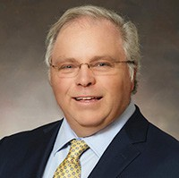
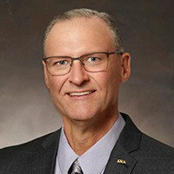
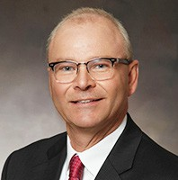
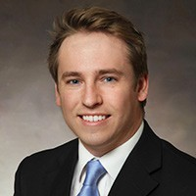
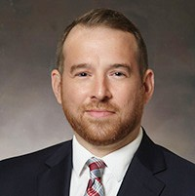
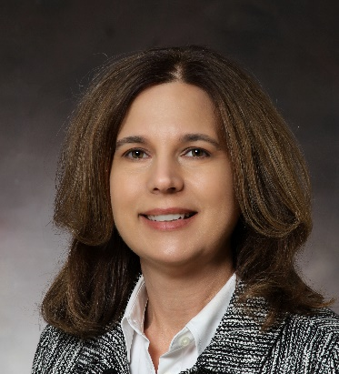
Meet the Team
Bruce Nuzum President / CEO
Bruce Hansen
V.P. Business Development
Brian Tapp
V.P. Value-Added Agriculture
Ethan Pitt
V.P. Community Initiatives & Ripple
Effect Program Director
Steven Benne
V.P. Development Finance
Susie Wilhite
Office Manager

Slide 5






What We Do
Site & Building Selection for Clients
Technical Assistance & Data Resources Incentive Financial Packaging
Marketing Support: Electronic / Trade Shows / Prospecting
Community Resources & Services
IADG Community Foundation
Existing Business Programs & Support

Slide 6
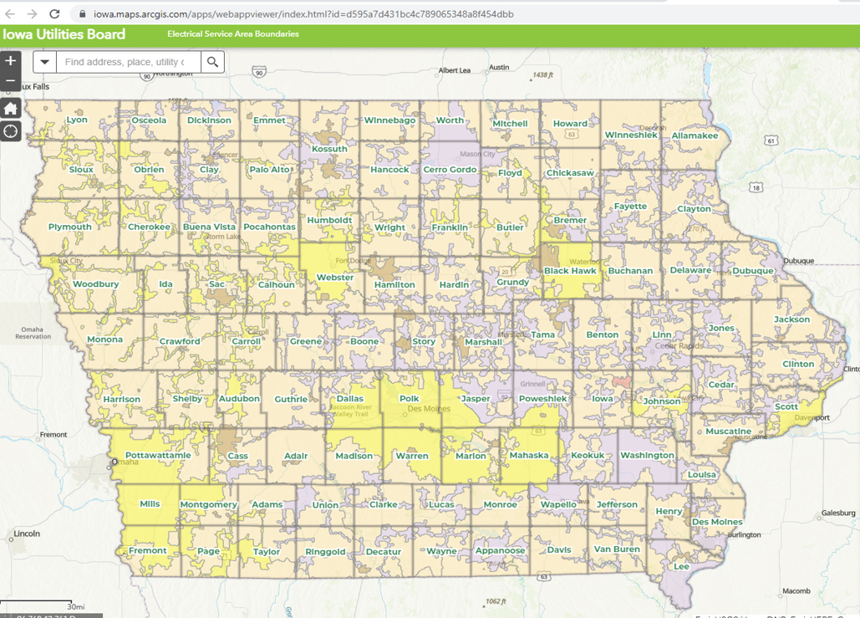
Iowa Service Territory Map
https://iowa.maps.arcgis.com/apps/webappviewer/index.html?id=d595a7d431bc4c789065348a8f454dbb

Slide 7
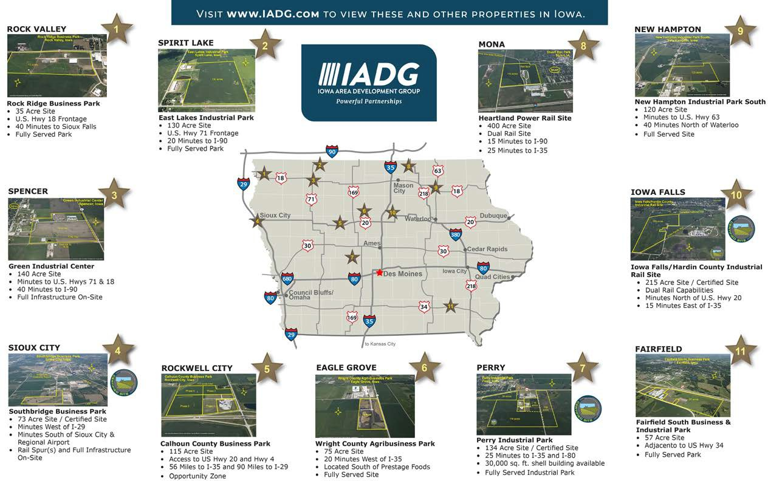
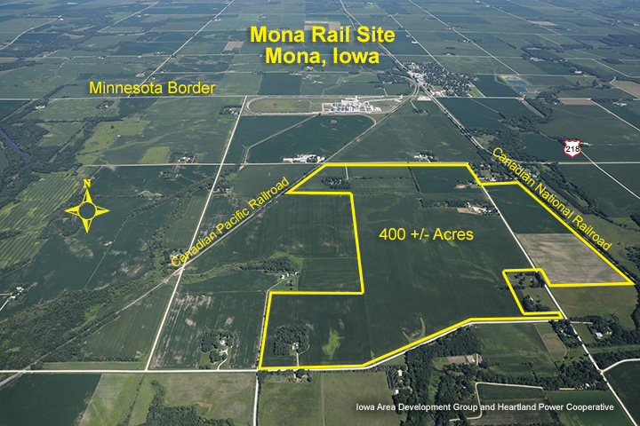
Confidential Site Selection Assistance
...over 150 properties statewide

Slide 8





Accomplishments
Projects - Over 2,530
Investment - Over $14.1 Billion
Jobs (new and retained) - Over 58,500
Spec. Buildings - 76 with 2.2 million sq. ft. building space Industrial Parks - 95 with 7,239 acres industrial land

Slide 9
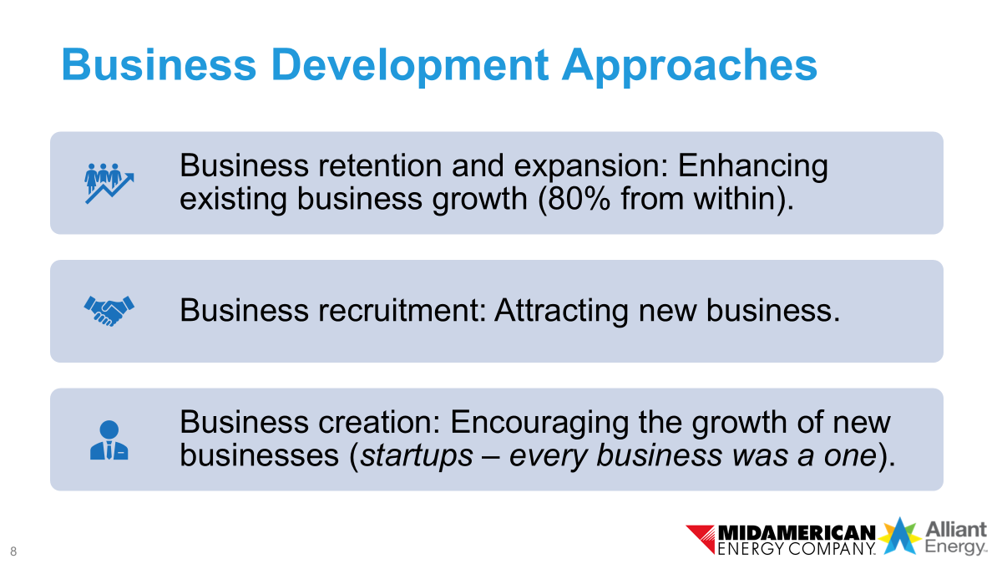


Slide 10
Existing Business Reminders:
Some Good To Know Items
  Sales Tax Exemption on Energy for Processing
    ...**Other / R&D, Sales & Use Tax
  USDA Programs / IADG $250 Million
  IADG Energy Bank / 1% Money
  CIRAS / Strategic Advisors

Slide 11
Community Development Efforts
  USDA Grant Program for Community Project Sponsored by the Utility
  Local Revolving Loan Funds (RLFs)
  Ripple Effect Program Through Aureon the Independent Telcos
  FIND Program Through Delta Dental
  IADG Community Foundation

Slide 12




Stay Connected
We are looking forward to staying in touch! If you need anything, please don’t hesitate to contact us.
We are here to help you be successful in Iowa!
Bruce Hansen, Vice President Business Development
bhansen@iadg.com
515.975.1862 C
www.IADG.com Facebook: /IADG.ia

