Slide 1
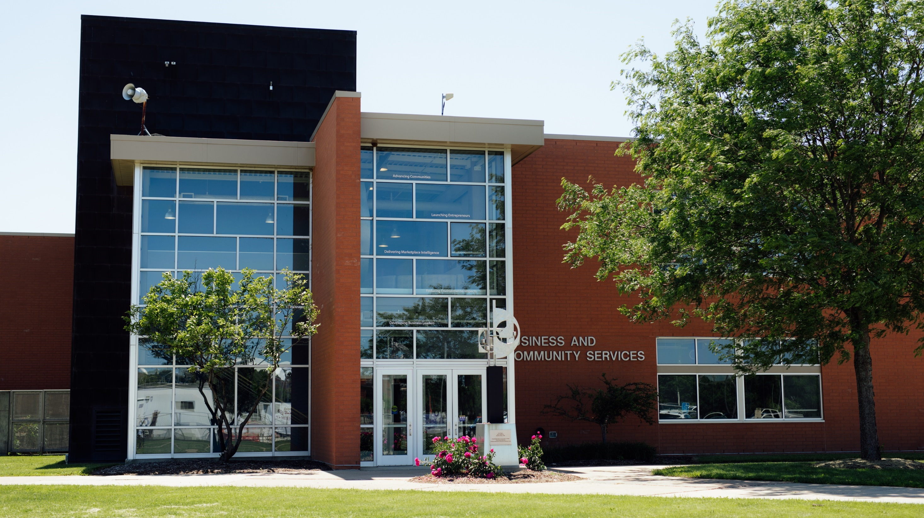



Slide 2
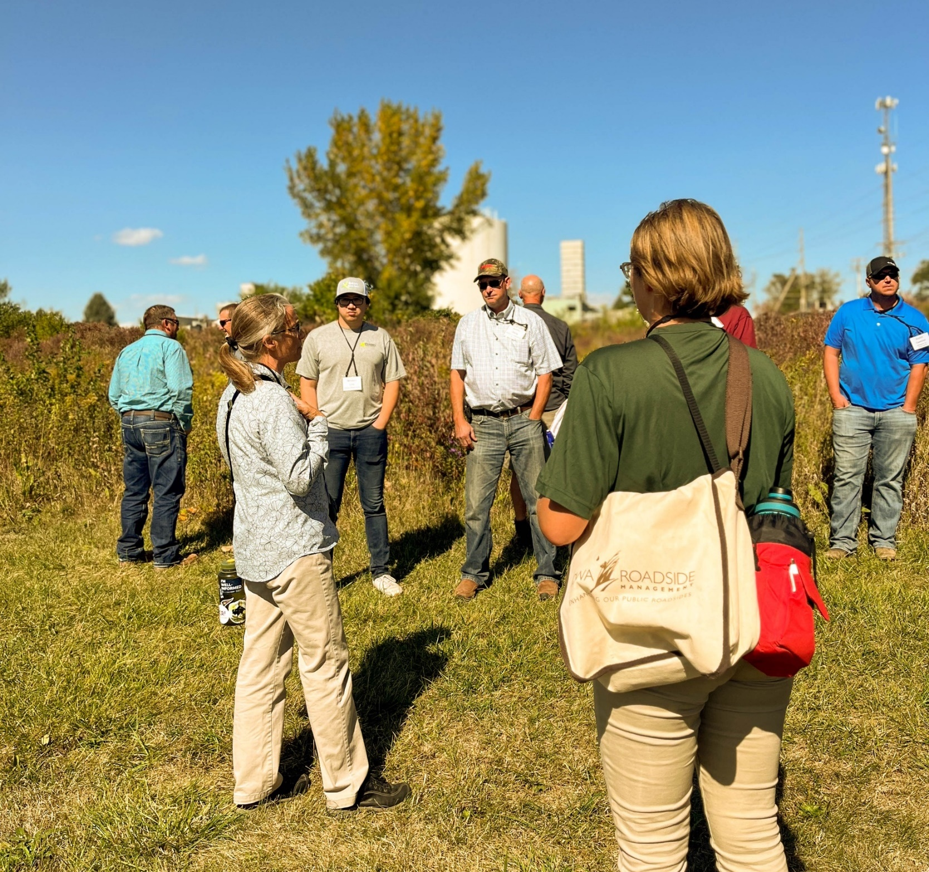
Building a Better Iowa
Part of the Wilson College of Business
Provide a wide array of services – for businesses, communities and organizations
Each year, BCS assists clients in all 99 Iowa counties — for 25 years straight.
BCS.UNI.EDU

Slide 3
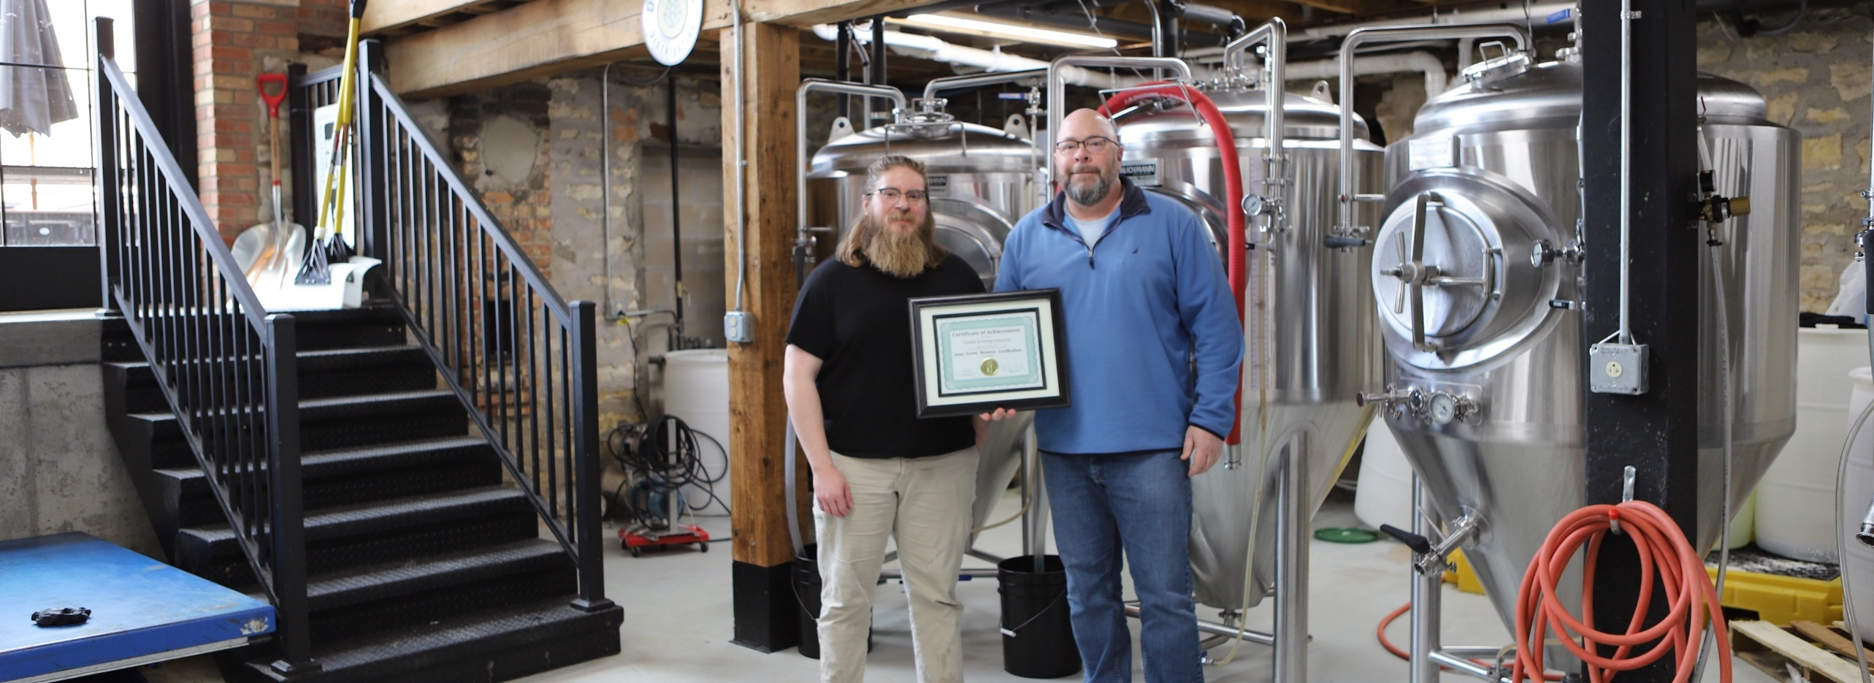












12 specialized programs
Entrepreneurship and Small & Medium Business
Community & Economic Development
Market Research
Environment & Sustainability
Metal Casting & Foundry 4.0

Slide 4
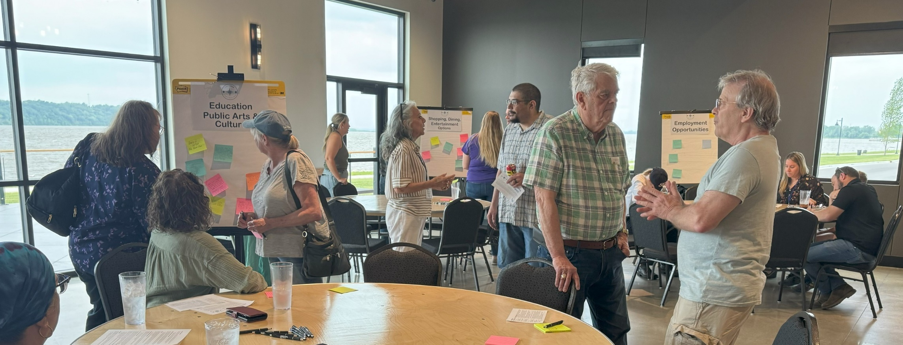

FACILITATION COUNSELING TRAINING RESEARCH BOARD MANAGEMENT
INSTITUTE FOR DECISION MAKING
Economic/Community Development Strategic Planning
Applied Research (TIA, Economic Impact Analysis), Surveys and Data Analytics
Professional Development and Training: Heartland Basic, BRE Academy, ED 101, Board Retreats…
Other planning: workforce, disaster recovery, marketing

Slide 5
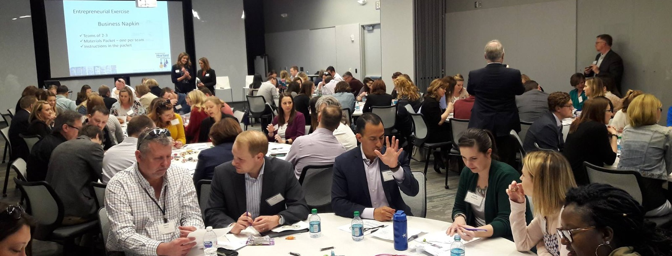



BUSINESS VALUATION EMPLOYEE OWNERSHIP OPERATIONAL EXCELLENCE SUCCESSION PLANNING
ADVANCE IOWA
Business growth – strategic planning, continuous improvement, Industry 4.0/5.0 technology solutions and assessments
Business transition planning – business valuations, continuity consultations, ESOP pre-feasibility, employee ownership guidance and support
Workshops and presentations
Annual Conference October 1st
Ankeny
Notes:
Annual Conference October 1st in Ankeny

Slide 6
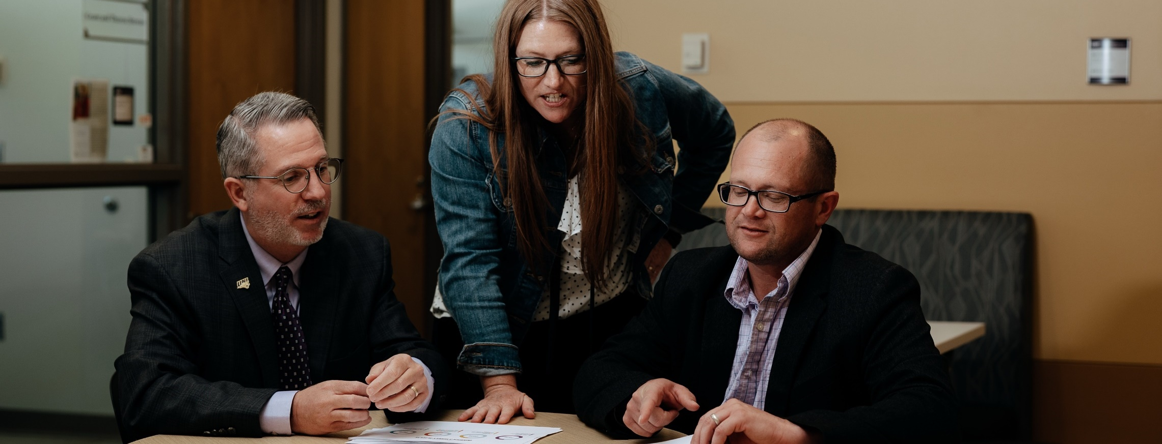

COMPETITOR ANALYSIS PRODUCT INTELLIGENCE CUSTOMER INTELLIGENCE STRATEGIC DECISIONS
STRATEGIC MARKETING SERVICES
Research and analysis on marketplace trends, opportunities and threats
Customer satisfaction and perception research
With Regent's Innovation Funds, SMS provides research at a reasonable cost, making valuable market research accessible to Iowa companies and organizations

Slide 7
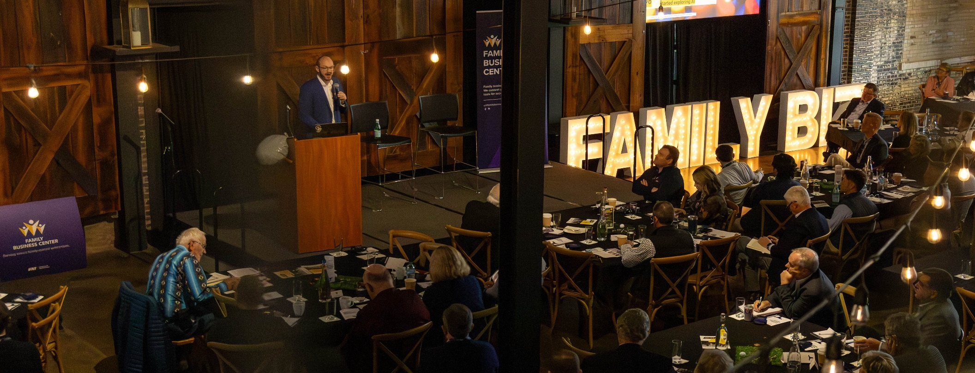
GENERATIONAL SUCCESSION PLANNING FAMILY GOVERNANCE COMMUNICATION NETWORKING
FAMILY BUSINESS CENTER
Generational succession planning to family-owned firms of all sizes and industries
Peer groups, events, board bootcamps, and 1:1 consulting
Academic courses supporting degrees or certificates in Business, Marketing and Entrepreneurship.

Slide 8
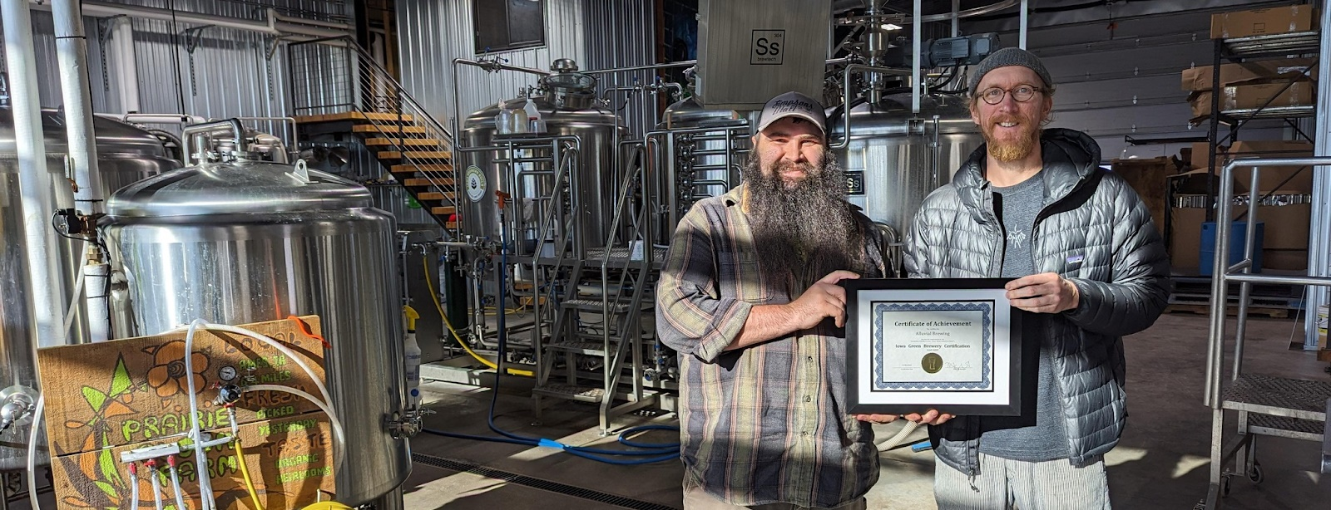

COMPLIANCE ASSISTANCE ENERGY EFFICIENCY ON-SITE REVIEWS FOOD WASTE REDUCTION
IOWA WASTE REDUCTION CENTER
Technical assistance in environmental cost efficiencies, regulation compliance, and waste reduction for small- and medium-sized businesses
Industrial painter training
Green Brewery Certification Program

Slide 9
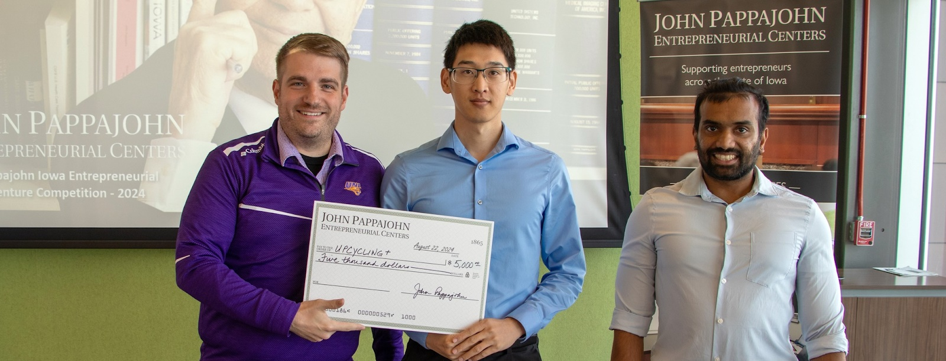

ENTREPRENEURS TECHNICAL ASSISTANCE VENTURE COMPETITIONS INTELLECTUAL PROPERTY
JOHN PAPPAJOHN ENTREPRENEURIAL CENTER
Entrepreneurship education offering a Minor and a Certificate in Entrepreneurship
R.J. McElroy Student Incubator
IASourceLink
Entrepreneurial Support and Mentoring
Small Business Development Center

Slide 10


