Slide 1
Global Business Services
Anne McMahon | Iowa Economic Development Authority

Slide 2
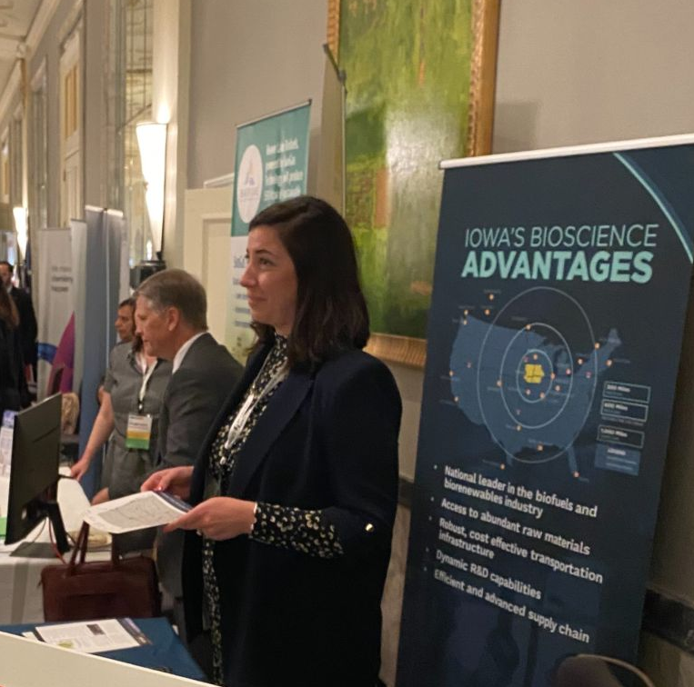
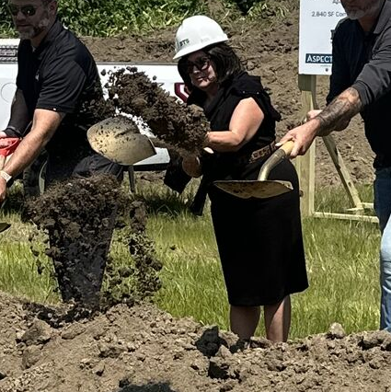
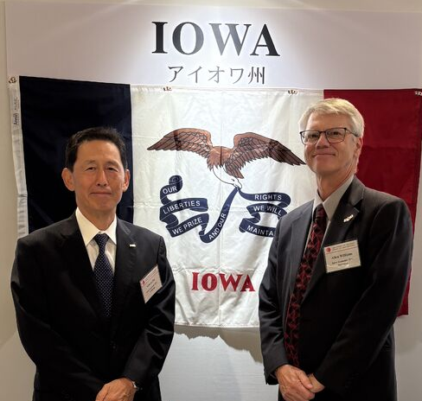
Global Business Services
Business Development
International Trade
Partner State Program

Slide 3
Business Development
Expands and attracts business development in Iowa
Fields of focus and expertise:
  Advanced Manufacturing
  BioScience
  Renewable Fuels
  Insurance / Financial Services
Exercises Economic Development Approaches
  Understand and nurture existing industry
  Entrepreneurial development
  Recruit new industry

Slide 4

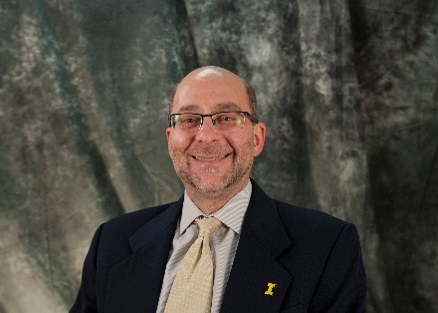
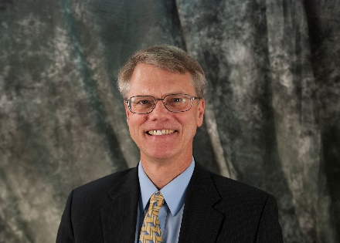
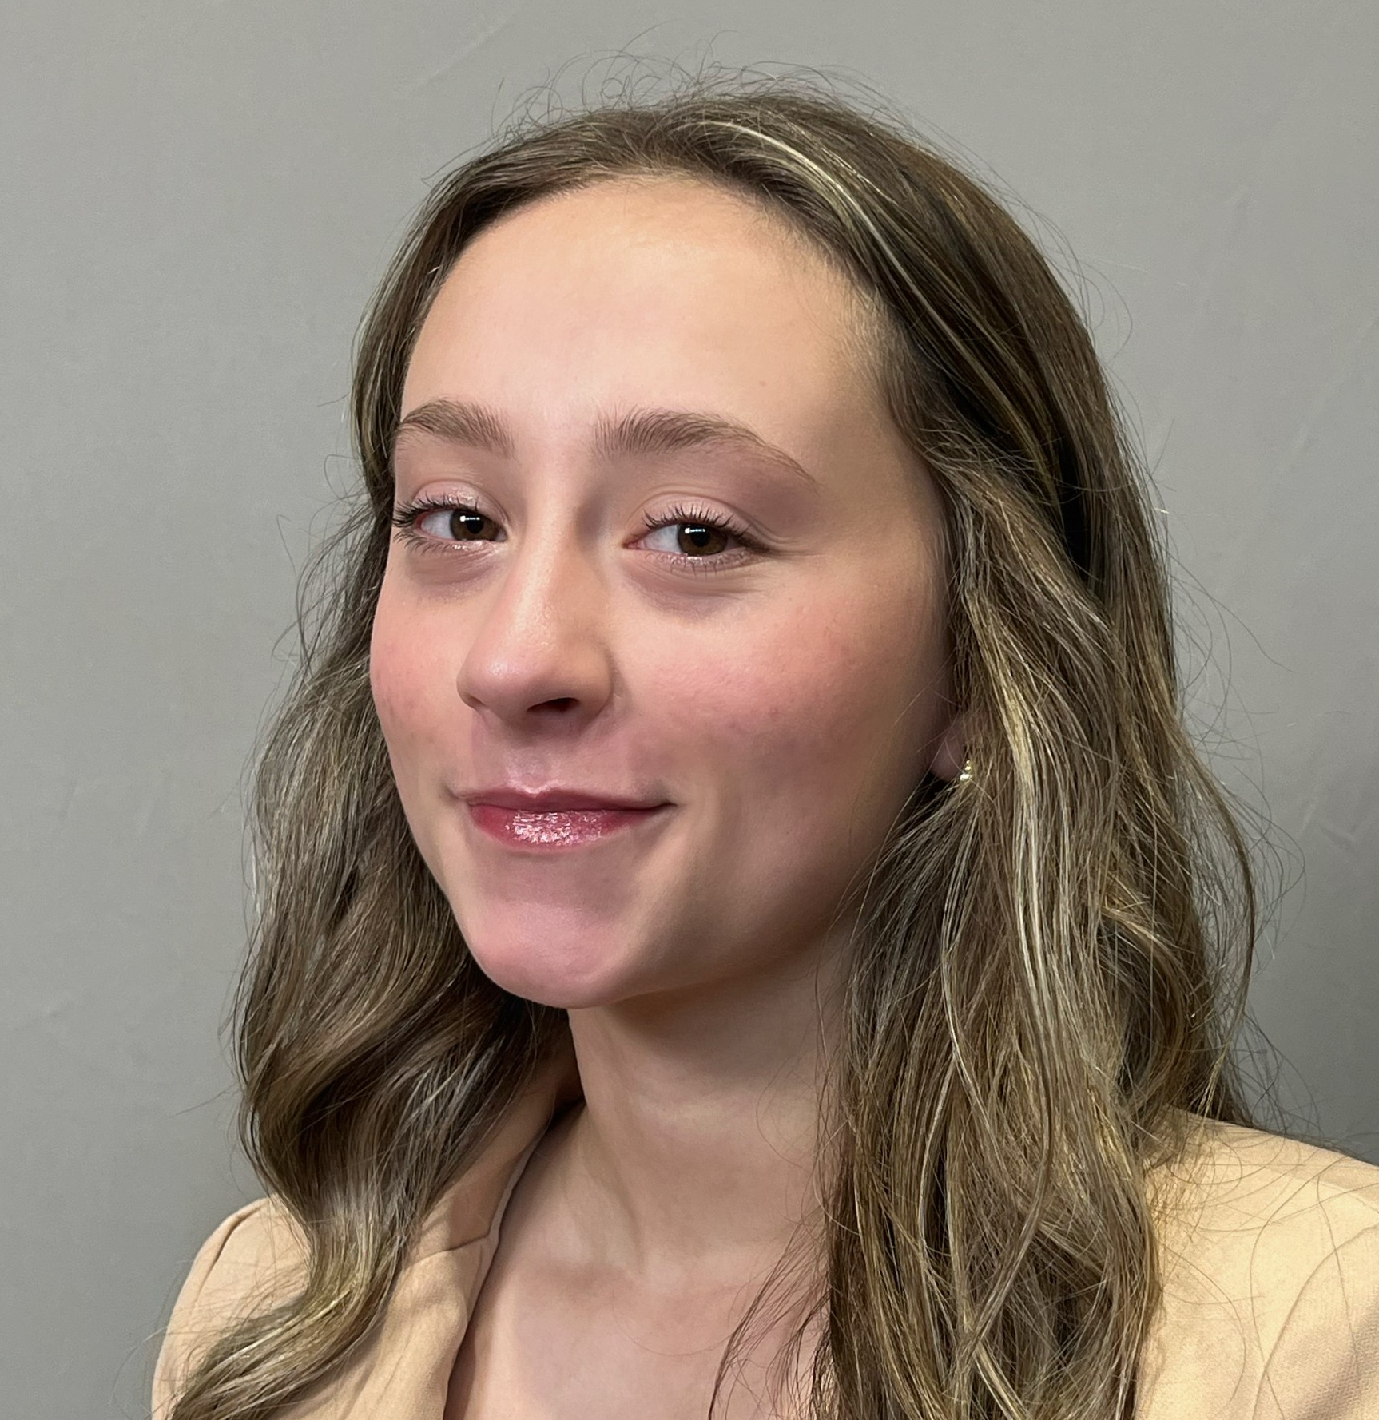

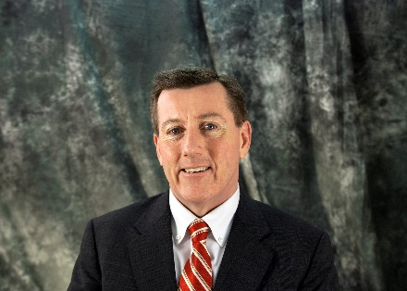
Business Development Team
Mark Laurenzo
  Business Development Manager
  Biosciences; Renewable Fuels;
  FDI - Europe
Rick Peterson
  Chief Economic Growth Officer
Allen Williams
  Business Development Manager
  Advanced Manufacturing; FDI - Asia
Madi Nelson
  Global Business Team Coordinator
Anne McMahon
  Business Development Manager
  Innovation; Existing Industry
Michael Gould
  Business Development Manager
  Insurance & Financial Services;
  Exisiting Industry

Slide 5
Business Development Highlights
The IEDA’s business development contacts:
Work directly with companies on expansion and retention projects
  Existing industries
  Recruitment of businesses
Position Iowa as the location for business and business growth
Address all questions and information needs of businesses
Work directly with community/county/regional economic developers

Slide 6
Importance of Existing Industry
70-80% of job creation comes from existing industry.
  Creating jobs from existing Iowa companies is key to growing our state’s economy.
IEDA works closely with community/county/regional economic development contacts to communicate with existing industry and to understand their needs.
Out-of-state headquarter calls are important.
  Governor Trips and Project Manager Territory Sales Trips

Slide 7
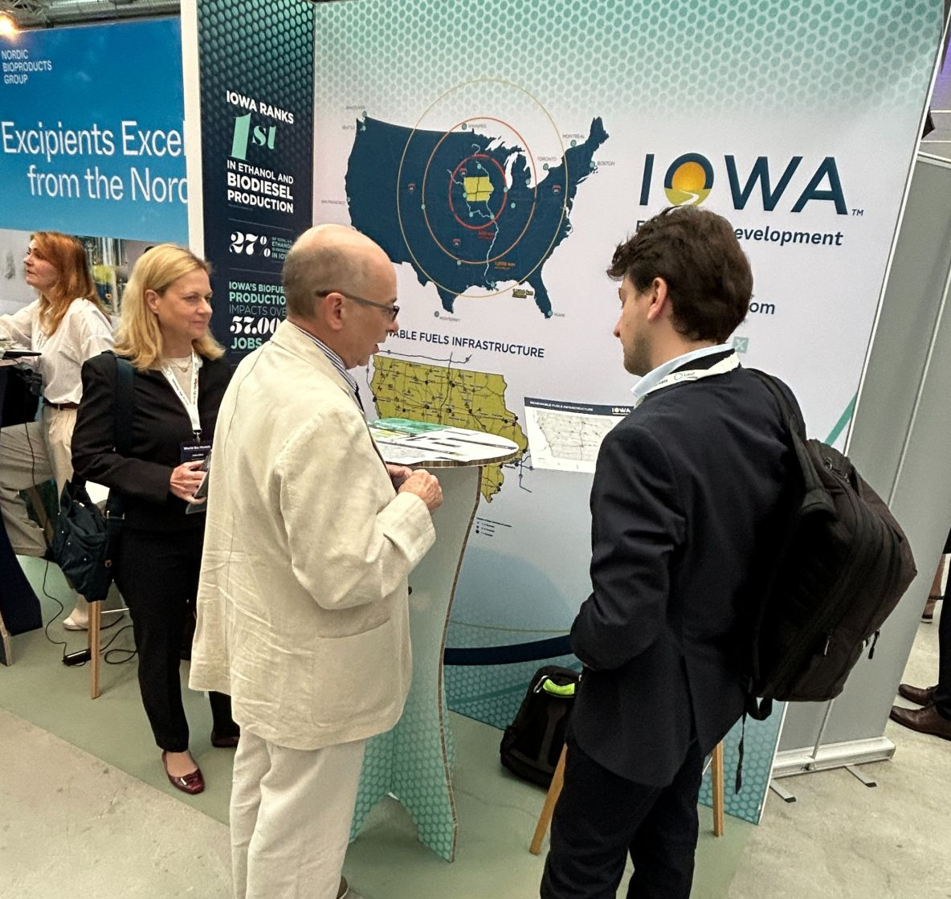
How We Market Iowa
Trade shows and industry conferences​​
Governor business calls
Site selector engagement​
Economic development partners​
IEDA website​
LOIS (Location One Information System)​

Slide 8
Iowa’s Value Proposition
Central U.S. location with global supply chain access
Low cost of living and doing business
Right-to-work state
Educated workforce with customized training
Business incentives and financial assistance
National leader and innovator in renewable energy
Notes:
Central North America geographic location for effective global supply chain logistics
Low cost of living and doing business
Right-to-work state
Refundable research and development activities tax credit
Educated, productive and stable workforce
Flexible job training programs that provide customized training for new and current employees
Direct financial assistance and tax benefit programs for job creation and new capital investment projects
National leader and key innovator in renewable energy and sustainability

Slide 9
Iowa Business Advantages
Tax reform:
  Flat income tax for all Iowans – reached 3.8% in 2025!
  Also eliminated taxes on retirement income and inheritance.
  Lowers Corporate income tax rate gradually to 5.5%
Single-factor, non-unitary corporate income tax structure
No personal property tax in Iowa
No property tax on new machinery and equipment purchases
No sales and use tax on industrial machinery and equipment purchases
No sales tax on materials used in the manufacturing process
No sales tax on purchases of electricity or natural gas used directly in the manufacturing process

Slide 10
Business Recruitment Process – How We Work
Identify the needs of client/project​
Perform research – Utilize LOIS​
Issue RFI's​
Compile responses and present to client​
Support client evaluation and site selection​
Manage ongoing communication throughout project​
Present available incentives and coordinate with IEDA finance team​

Slide 11
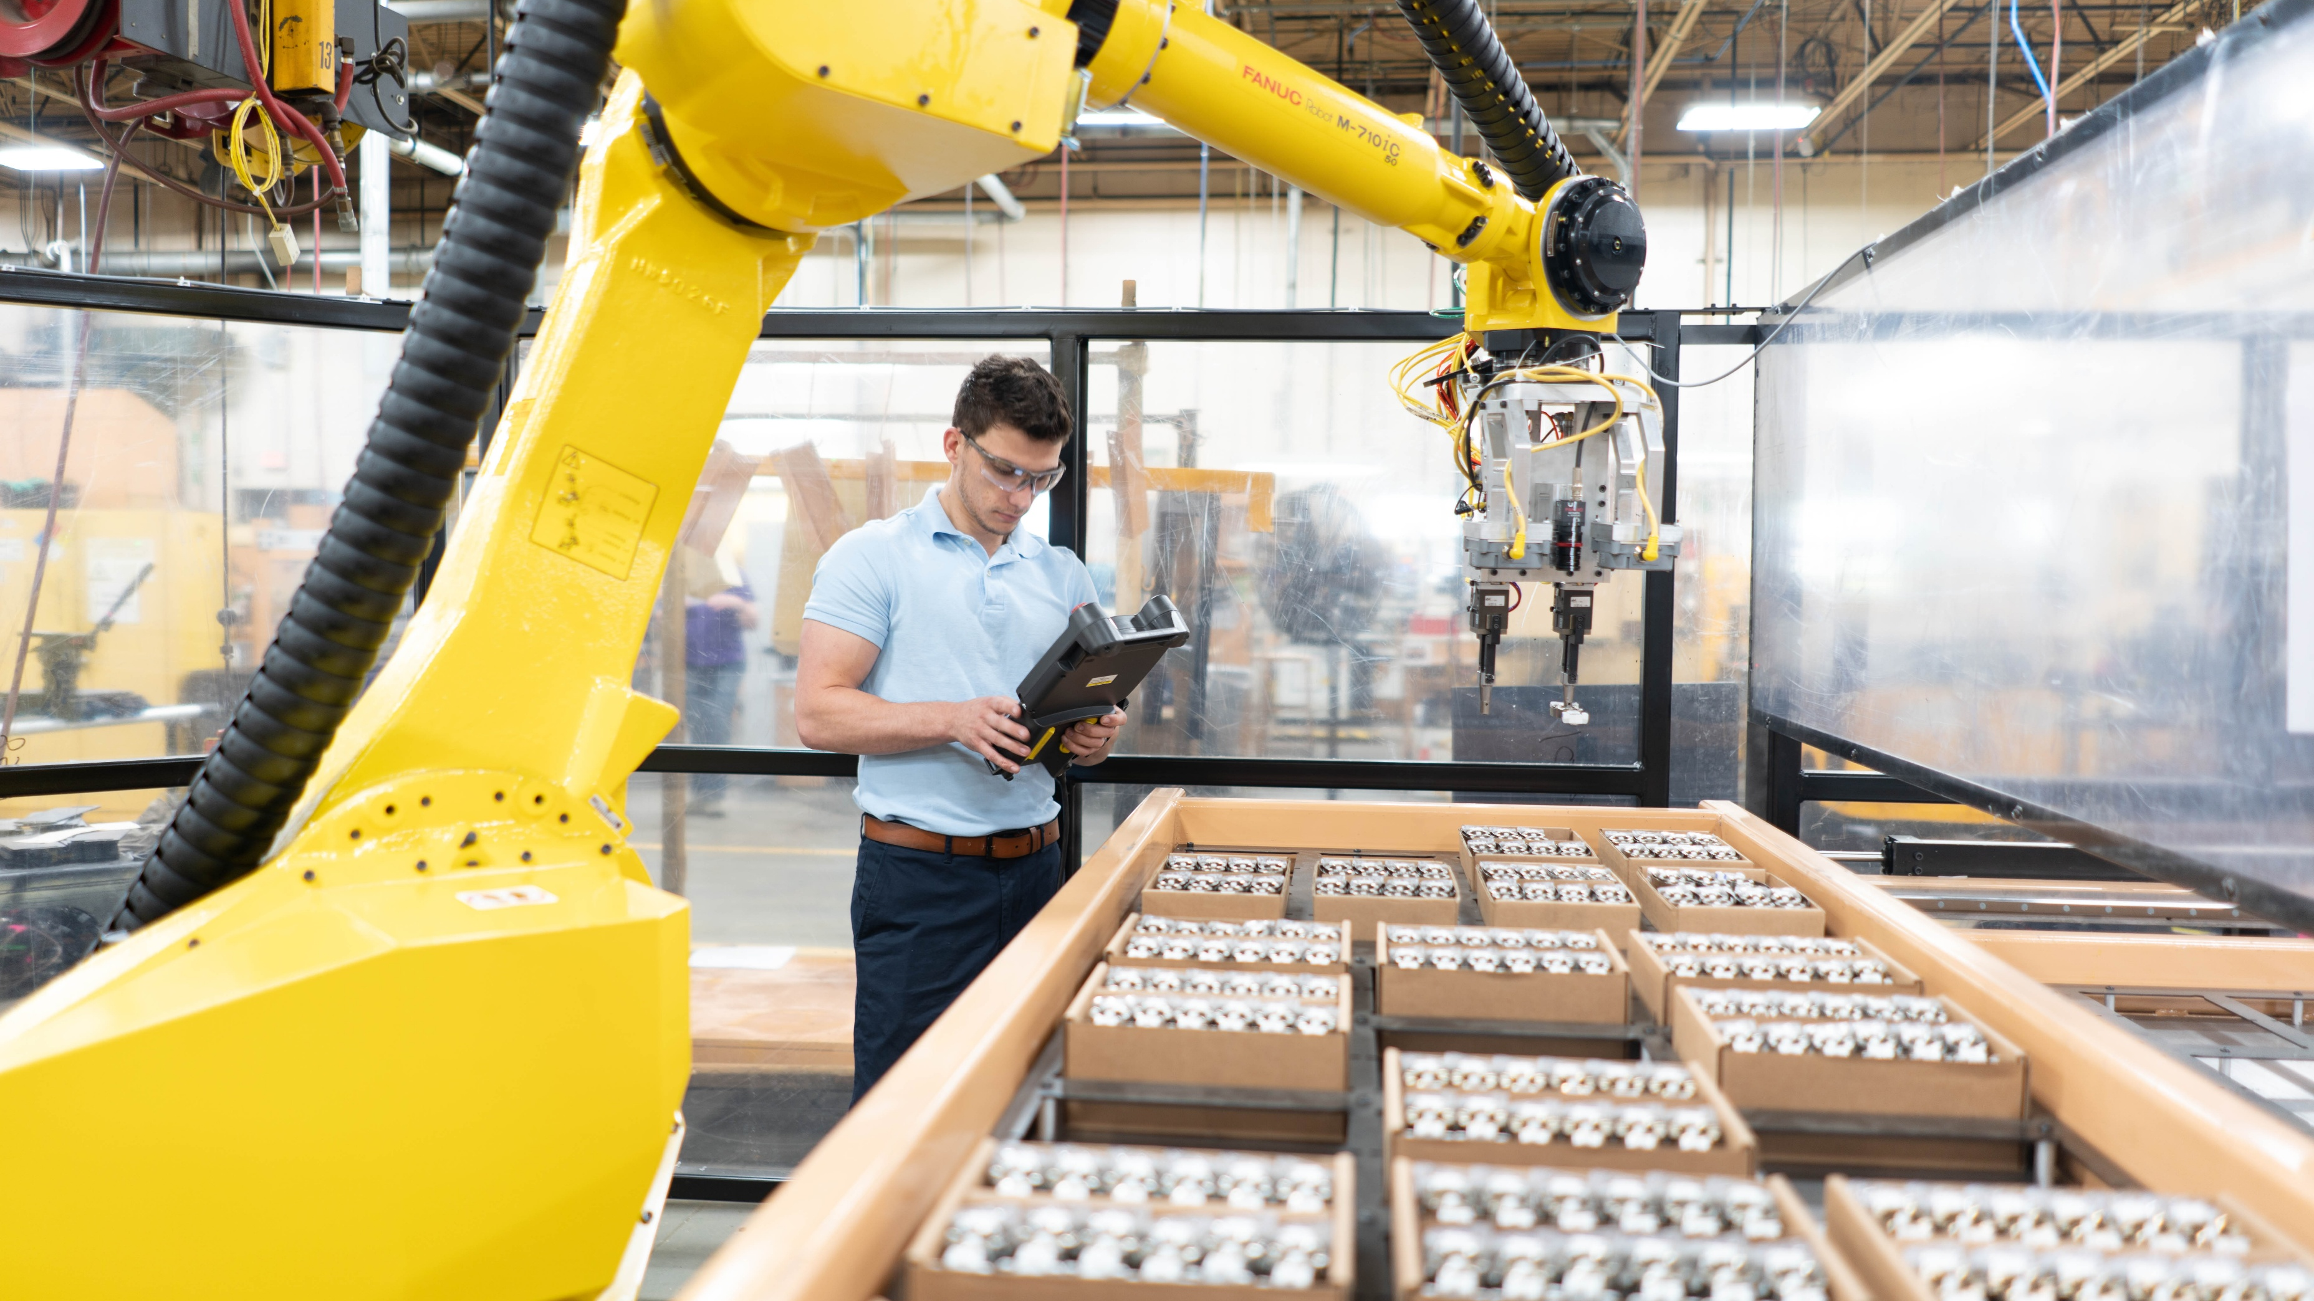
Business Incentives for Growth (BIG)
Designed to attract and retain high-impact, innovation-driven projects
Project eligibility
  Limited to Iowa’s targeted industries: advanced manufacturing, insurance/finance, biosciences, innovation/technology
  Based on capital investment/quality of jobs
  Demonstrates impact to state GDP and economic diversification
  Increase efficiency, productivity and competitiveness
  Significantly enhances facilities
  Deferred maintenance is not eligible
Allows projects in rural communities (counties with a pop. less than 20,000) to receive more incentives (up to 7.5% vs. up to 5%)
The new workforce training fund adds a targeted, project-specific training component focused on upskilling employees and aligning workforce investments with long-term employer competitiveness

Slide 12
Business Incentives for Growth (BIG)
  Negotiated incentives:
    Investment tax credit – performance-based, earned when qualifying assets are placed in service, and spread over five years
      If the credit exceeds Iowa income taxes owed, the difference is refunded
    Refund of sales tax paid on construction materials
  Refundable tax credit
    Up to 5% of qualifying capital investment; allows projects in rural counties (population less than 20,000) to receive up to 7.5%
    Based on capital investment/quality of jobs
    Only projects that demonstrate extensive economic impact will be awarded the maximum amount of tax incentives
  No community matching funds required but city or county resolution of project support is required
Sunset High Quality Jobs (HQJ) program December 31, 2025

Slide 13
Global Business Contacts
Rick Peterson
  Chief Economic Growth Officer
  IEDA PDI Board Member
  Rick.Peterson@IowaEDA.com
  +1 515.348.6192
Allen Williams
  Business Development Manager
  Advanced Manufacturing;
  FDI – Asia
  Allen.Williams@IowaEDA.com
  +1 515.348.6194
Anne McMahon
  Business Development Manager
  Innovation; Existing Industry
  Anne.McMahon@IowaEDA.com
  +1 515.348.6195
Brad Frisvold
  International Marketing Manager
  Agricultural Trade Promotion
  Brad.Frisvold@IowaEDA.com
  +1 (515) 491-9669
Michael Gould
  Insurance & Financial Services; Existing Industry
  Michael.Gould@IowaEDA.com
  +1 515.348.6189
Mark Laurenzo
  Business Development Manager
  Biosciences; Renewable Fuels;
  FDI – Europe
  Mark.Laurenzo@IowaEDA.com
  +1 515.348.6191
Leigh Carlson
  International Relations Coordinator
  Leigh.Carlson@IowaEDA.com
  +1 (515) 346-4359
Madi Nelson
  Global Business Team Coordinator
  Madison.Nelson@IowaEDA.com
  +1 (515) 348-6239
Lisa Day
  Grants Manager
  Lisa.Day@IowaEDA.com
  +1 (515) 348-6159

Slide 14
THANK YOU
Anne McMahon | Business Development Manager
Iowa Economic Development Authority

Slide 15



PDI Conference | September 25, 2026

Slide 16
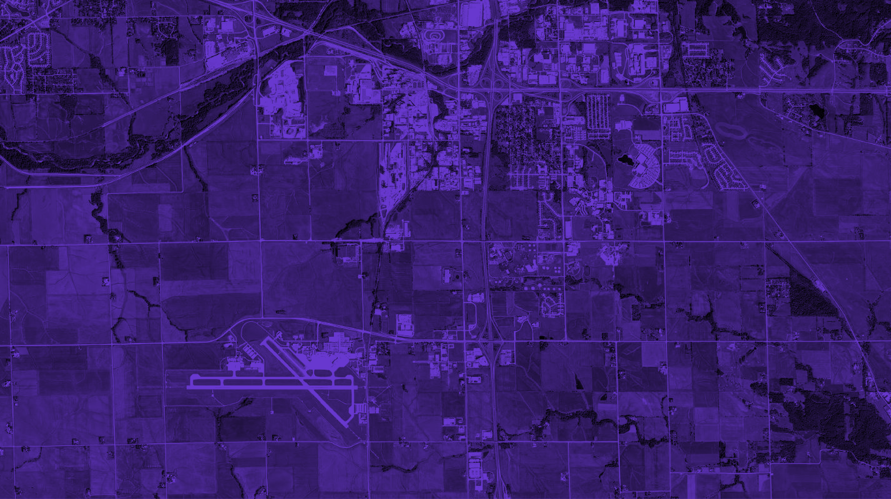
IEDA Goals For Sites
SITE QUANTITY
Increasing the number of qualified opportunities in the property portfolio
SITE QUALITY
Improving the characteristics of sites and parks through readiness efforts
Site readiness helps achieve both these goals.

Slide 17

Site Readiness Journey
Site readiness identifies and mitigates potential risks before they become obstacles, enabling greater transparency, efficiency, and collaboration when prospects evaluate a site.
Ready to Construct
Graded Pad
Building Under Construction
Detailed Information
Due Diligence Completed
Concept Plan
General Information
Listing Agreement
Basic Maps
Raw Land

Slide 18
Building on the Success of Certification
50+
Certified Sites
10,000+
Acres
$2+ Billion
Investment
10,000+
Jobs
While certification remains the gold standard, stakeholder feedback identified opportunities to broaden participation and support communities throughout their readiness journey:
  Expand accessibility for communities of all sizes and resource levels
  Recognize and communicate incremental progress toward certification
  Provide clear next-step guidance for properties and property representatives
  Engage more communities earlier through a scalable readiness framework

Slide 19



SiteReady Iowa: A Site Readiness Program

Slide 20



A Roadmap to More Competitive Sites
The SiteReady Iowa Program creates a structured pathway for communities to market, evaluate, and advance sites for industrial development.

Slide 21
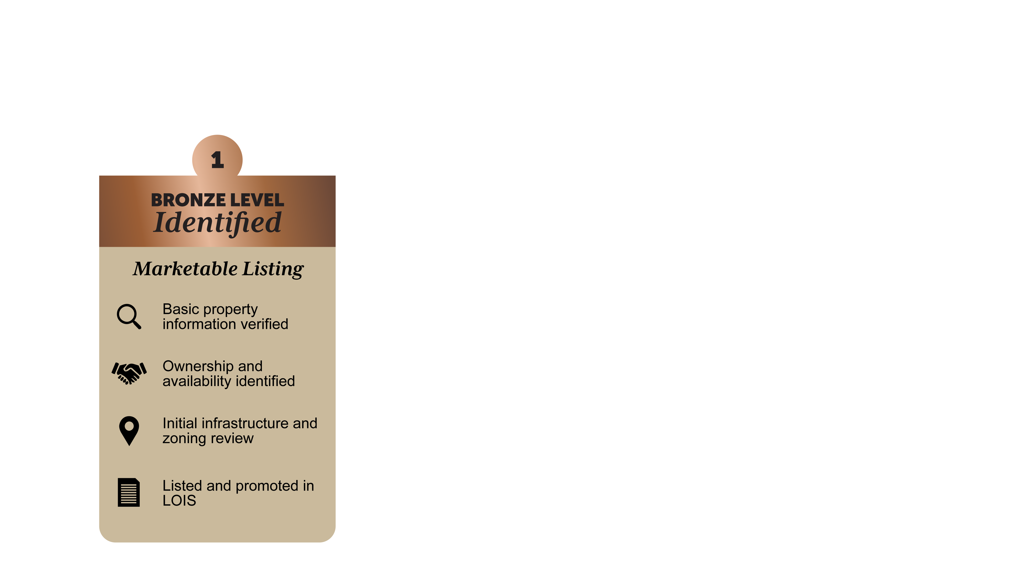
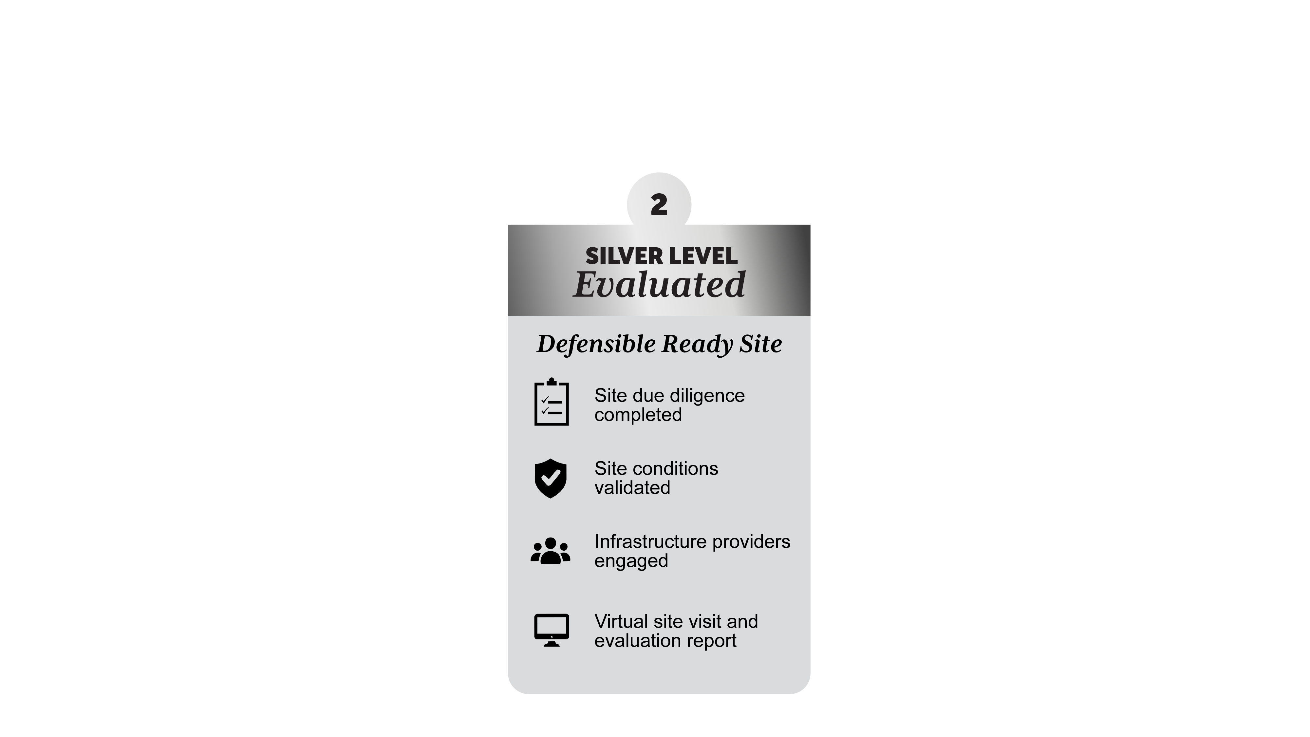
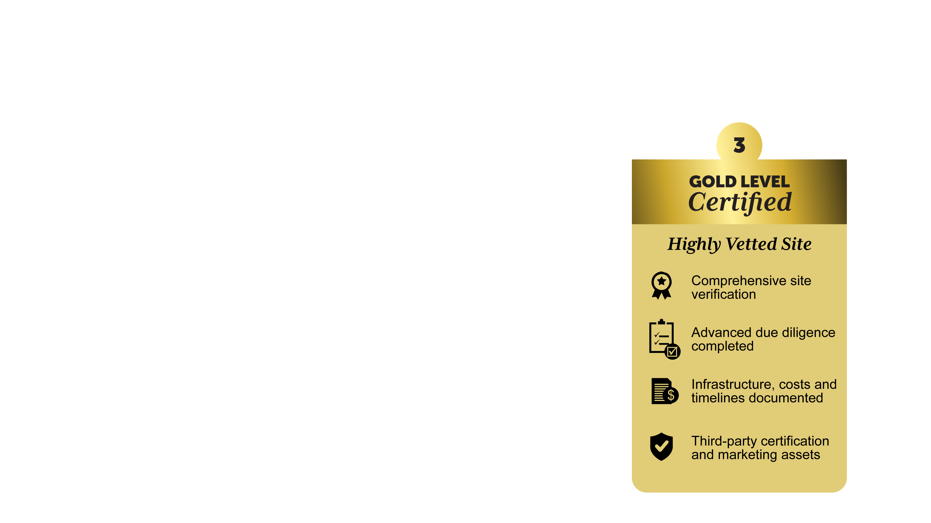
Classifications

Slide 22
General Site Requirements
Must be at least 25 acres.
Should be appropriately zoned or demonstrate ability to be rezoned for industrial use.
Should be served, or capable of being served, by electric, natural gas, water, sewer, and telecom.
Local EDO should acknowledge participation and confirm its support of the property.
Served or capable of being served by roadway that meets DOT standards for industrial traffic.
Should have an established price with an explanation of the terms of a sale or lease.
Important: These requirements are applicable for all levels of the program.

Slide 23
Identified Site – Bronze Level
Build the Pipeline
Purpose: Build a complete LOIS listing with essential site details and visuals.
Best for: Communities beginning their site-readiness journey.
Maintain status: Submit anytime and update the listing annually.

Slide 24
Evaluated Site – Silver Level
Compete for Projects
Purpose: Assess the property’s conditions, infrastructure, development potential, and readiness.
What it delivers: Identify strengths, constraints, and priority improvements to create a clearer path to marketability.
Maintain status: Submit anytime and update the LOIS listing annually.

Slide 25

Certified Site – Gold Level
Win Projects
Certified Site Program remains the same.
Purpose: Position fully vetted sites to win investment projects.
What it delivers: Comprehensive due diligence and recognized standards that strengthen credibility and competitiveness.
Timing: Applications are accepted twice yearly; recertification may be required every three years.

Slide 26

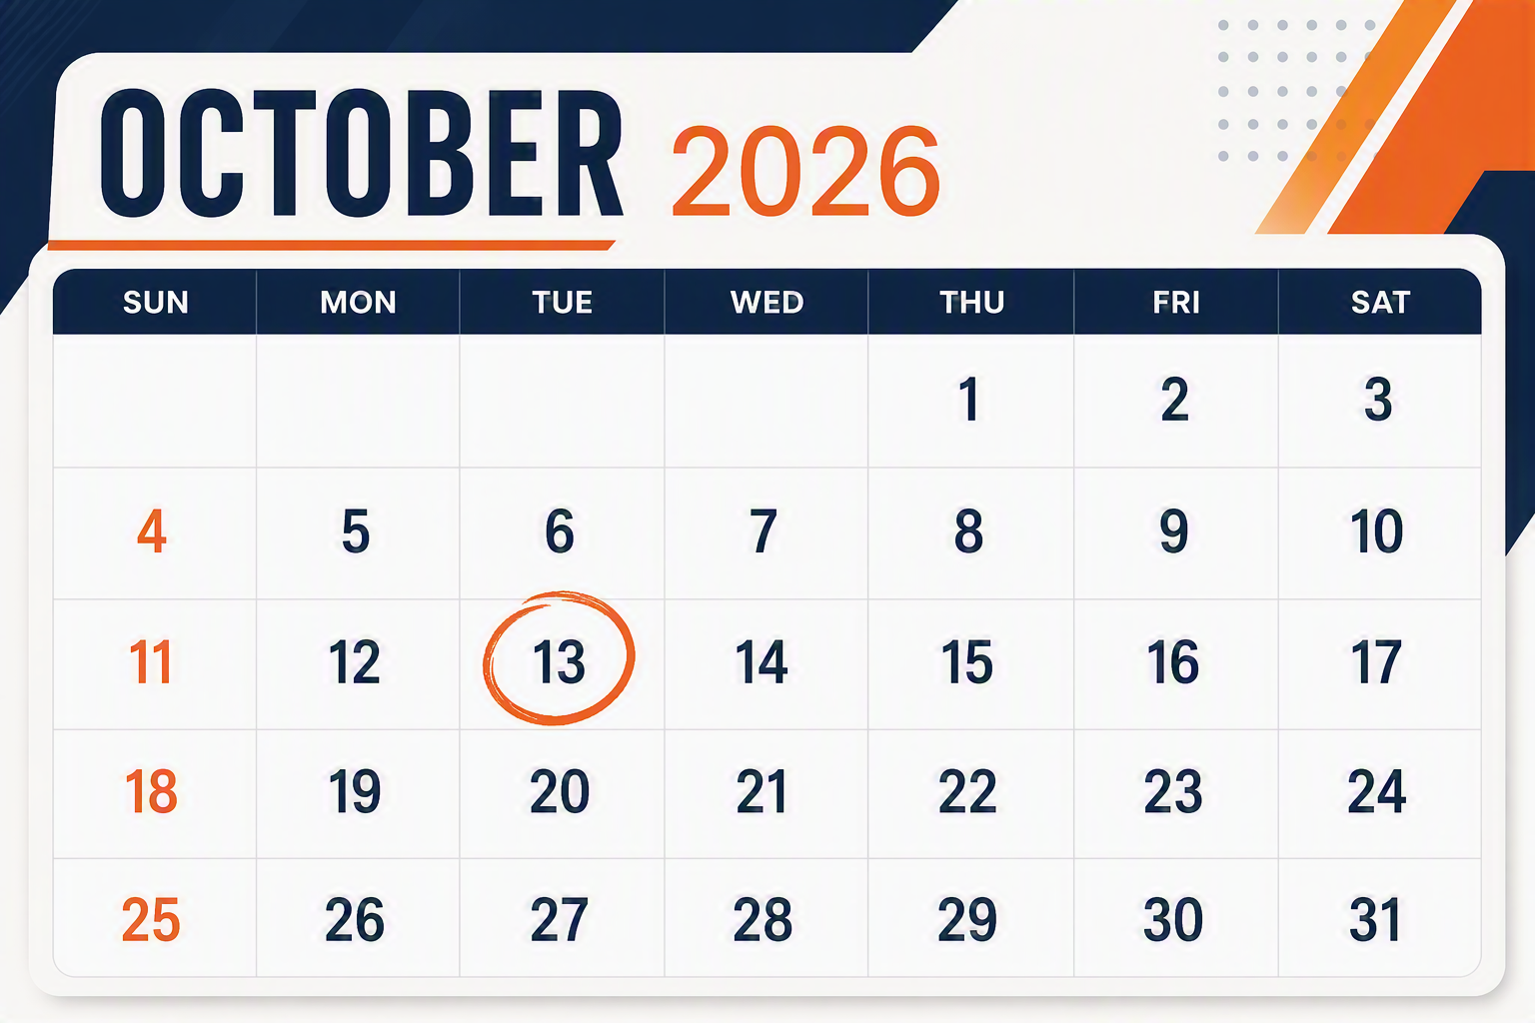
Attend the Program Launch Webinar!
For more information, visit iowaeda.com

Slide 27
Program Launch
Program information
iowaeda.com
COMING SOON
Description of each level and
how to apply
iowaeda.com
Marketing site
businessiowa.com
Program fact sheets
Overview of each level/tier
Kick-off webinar on October 13

Slide 28
Questions?

