Slide 1

America’s SBDC Iowa
PDI – P3 Workshop

Slide 2
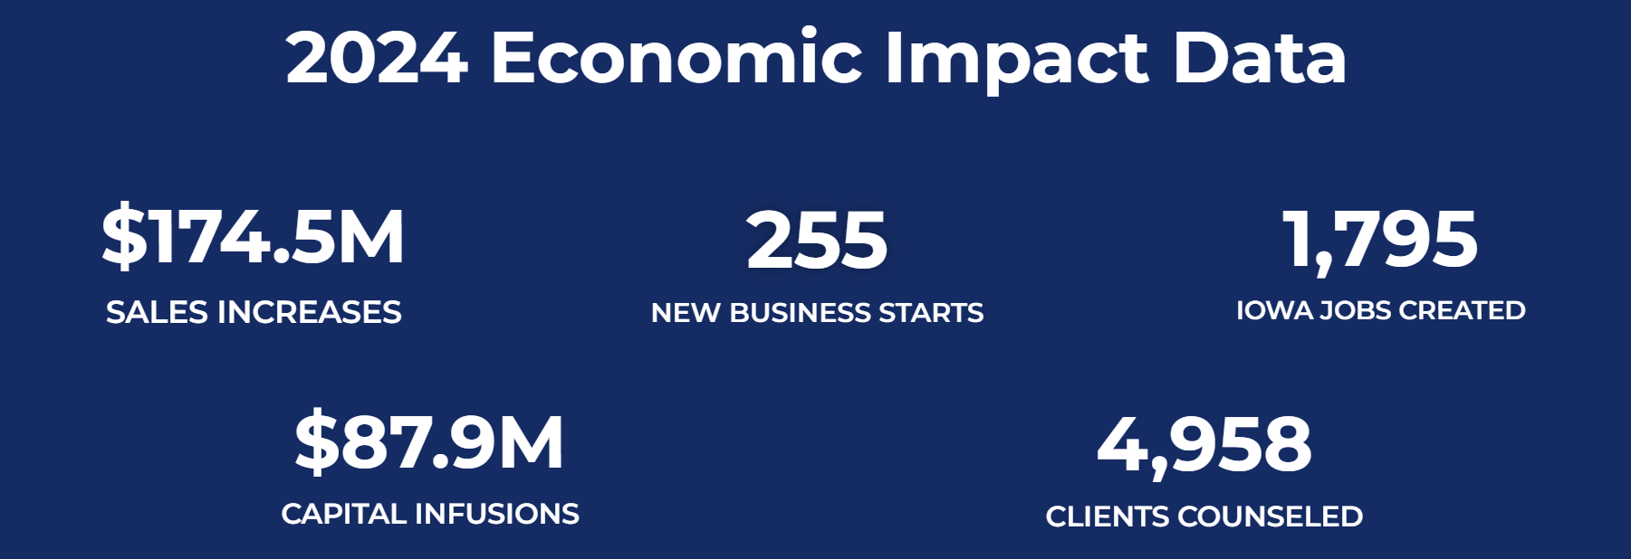
AMERICA’S SBDC IOWA
  America’s Small Business Development Centers
  Nationwide Organization
  No fee, confidential, customized business counseling in all 99 Iowa Counties
2025 Economic Impact Data
Clients Advised
Business Starts
$126.3M
235
1,195
Jobs Created
Capital Infusion
$82.9M
5,465

Slide 3
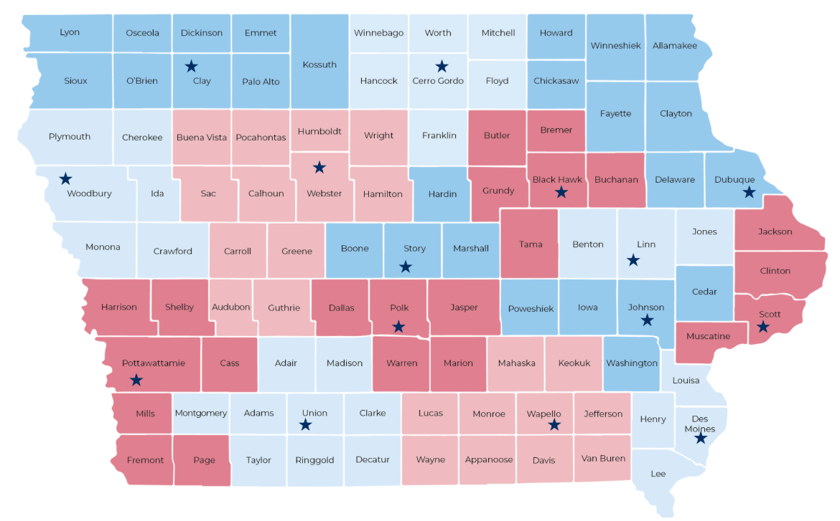
Statewide Offices
  Welcome & Introductions
  The Role of an Executive Summary
  Key Ingredients
  The 7-Point Framework
  Common Mistakes & How to Avoid Them
  Drafting Time
  Peer Feedback & Review
  Refining & Next Steps
  Q&A & Wrap-Up

Slide 4
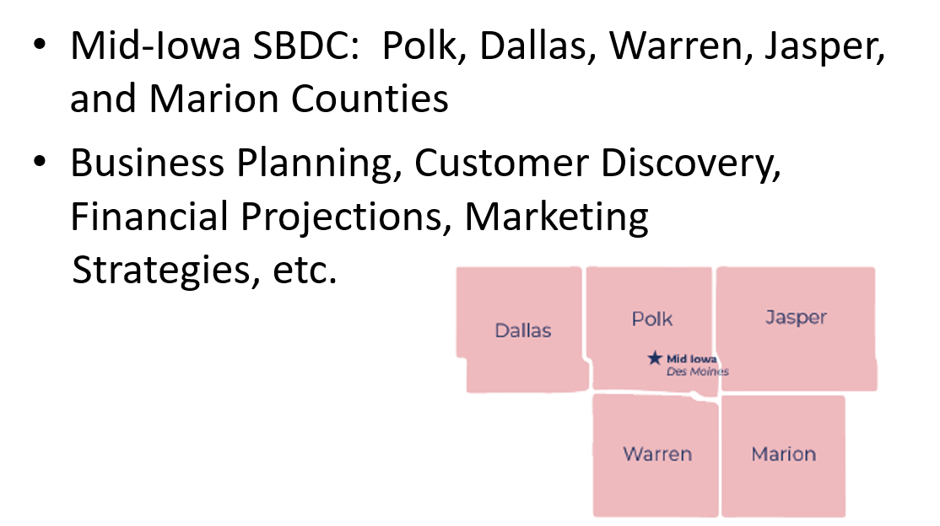
MID-IOWA Regional Center

Slide 5
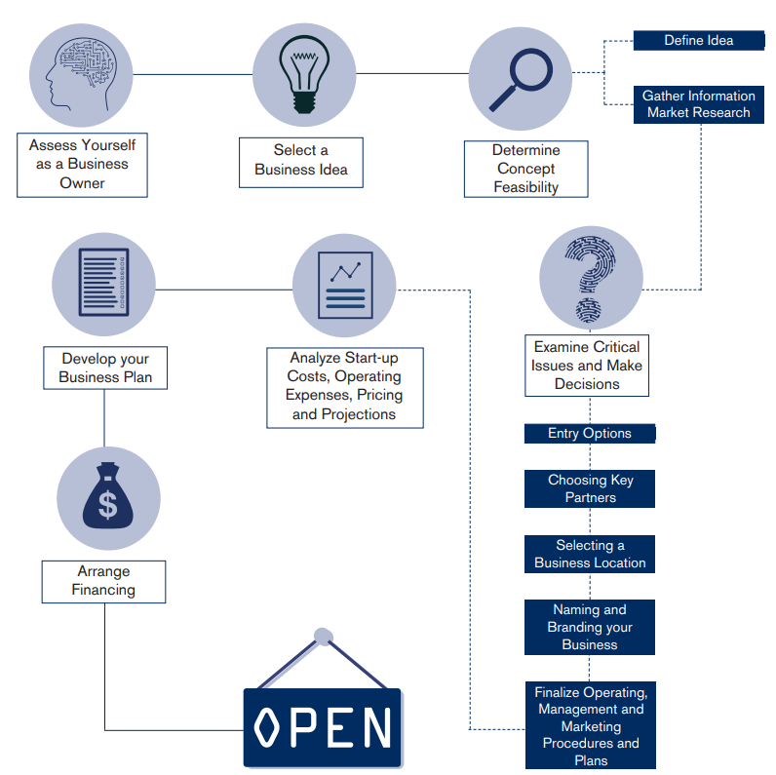
Where we can help

Slide 6
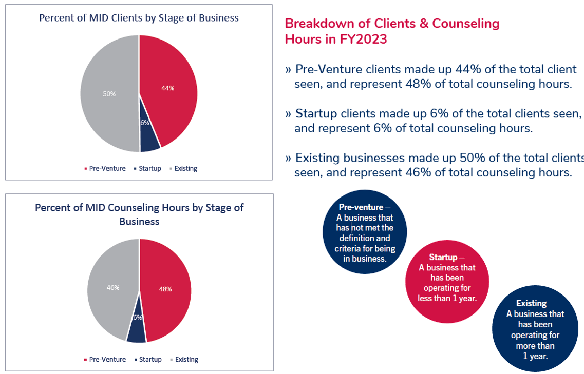
Client Breakdown

Slide 7
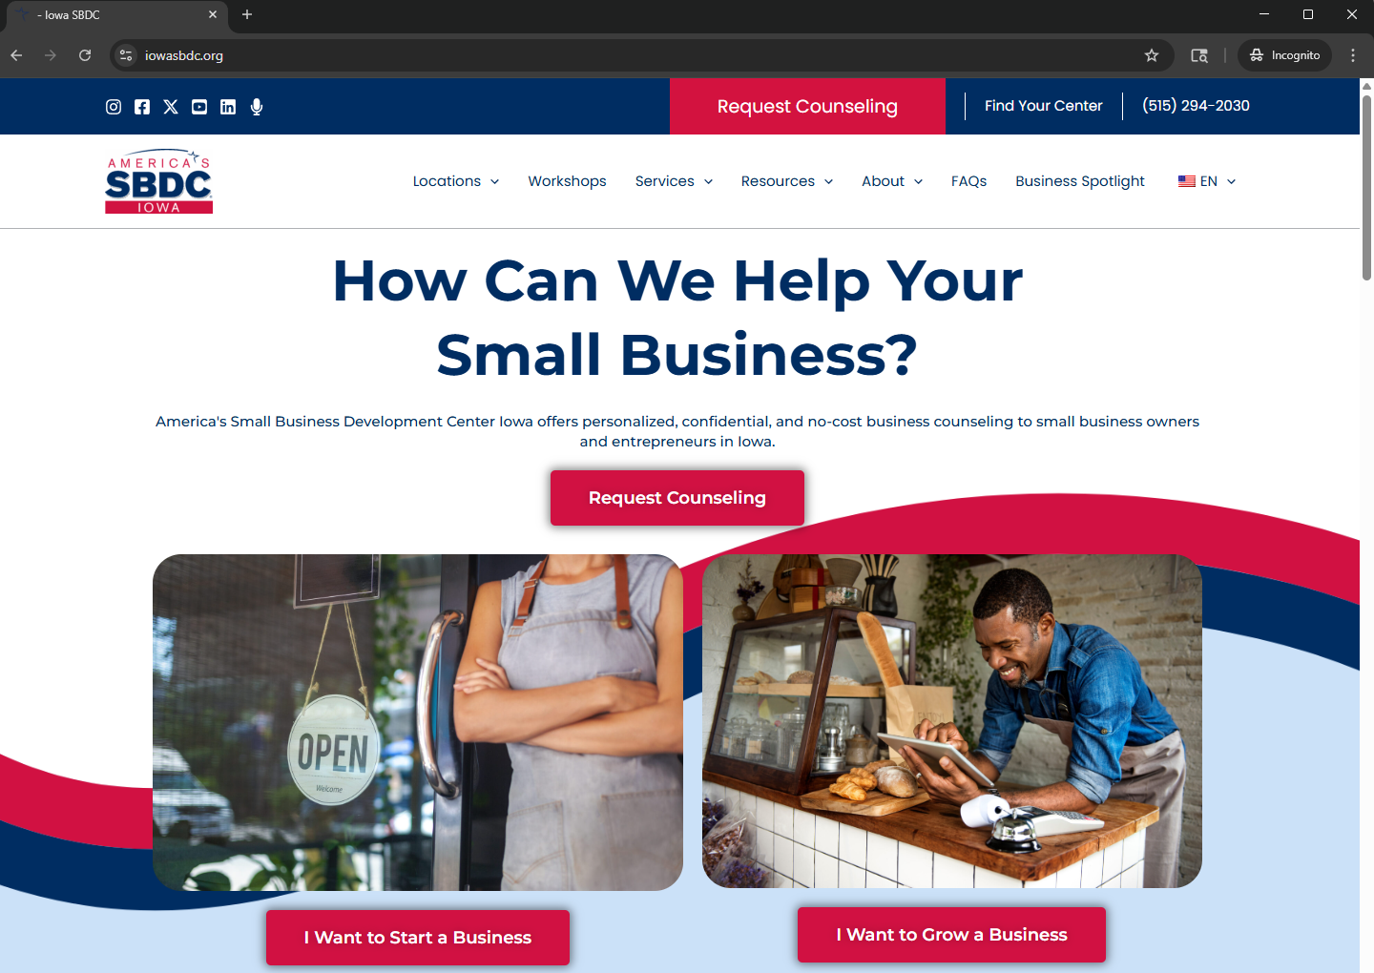
How to connect

Slide 8
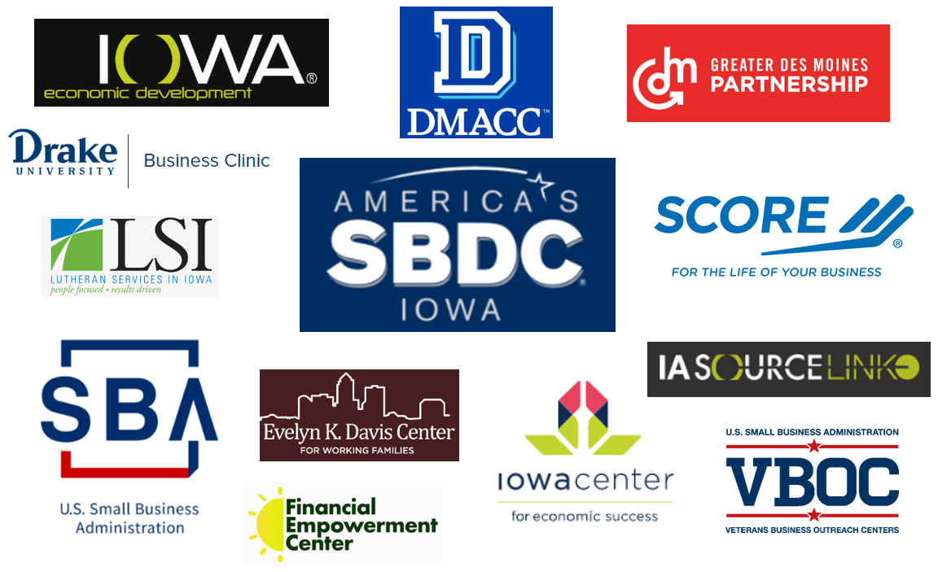
Other Resources

Slide 9
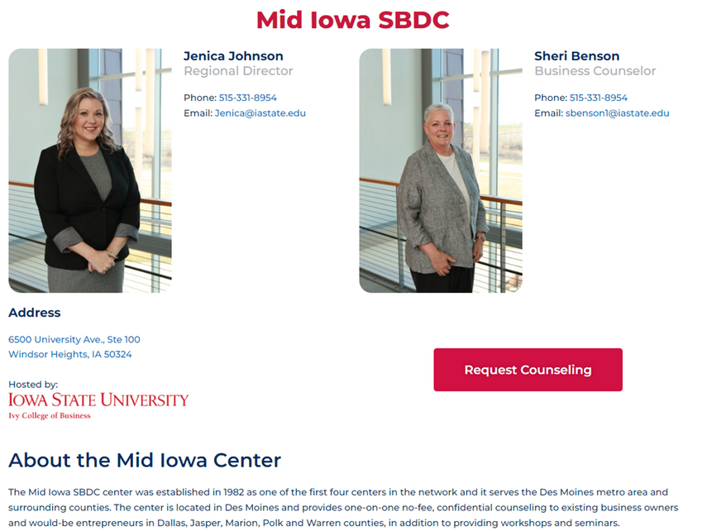
THANK YOU!
www.iowasbdc.org
jenica@iastate.edu
6500 University Ave., Suite 100
Windsor Heights, IA 50324

