Slide 1

STRATEGY & COLLABORATION
P3 Workshop
Amy Lasack
Vice President, Business and Community Solutions
Northeast Iowa Community College
lasacka@nicc.edu

Slide 2
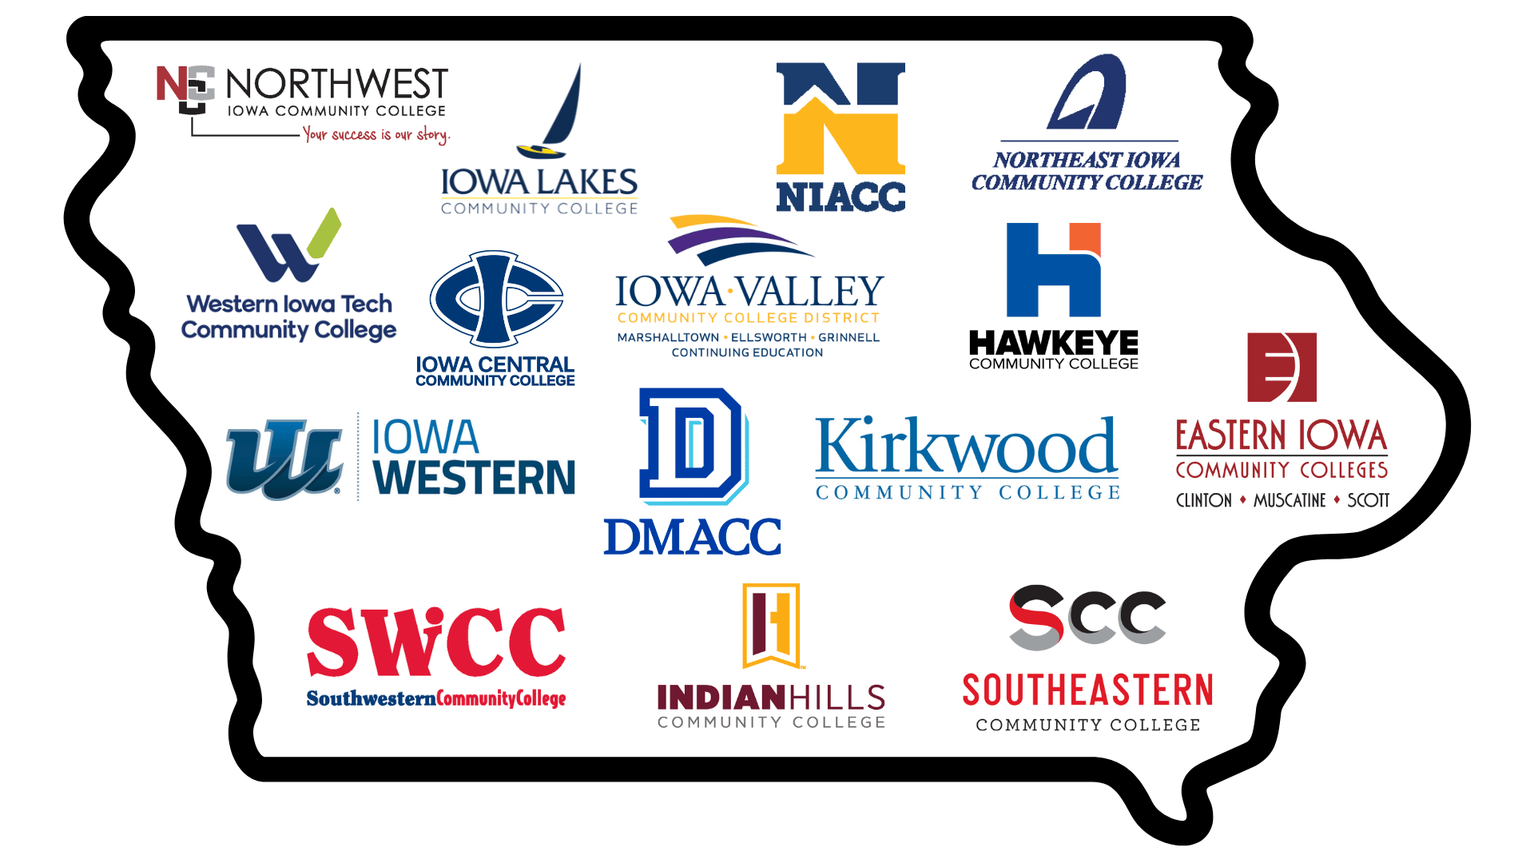
Iowa’s Community College System

Slide 3
A little about Community College Structure
Credit | Non-Credit
Associate Degrees 1 Year Diplomas Certificates Nursing Computer Programming Welding Transfer High School Concurrent | Continuing Education Short Term Certificates Life and Leisure Mandated Contract Training WIOA Adult Basic Education ESL Apprenticeships Workforce Funding
Both Credit and Non-Credit are dependent upon employer feedback and support
Pathways, students can go back and forth depending on needs

Slide 4
The Role of Community Colleges in Workforce
From Department of Education Flyer
“As key partners in statewide industry, workforce, and education initiatives, Iowa's community colleges provide individuals with access to high-quality education and training to ensure employers have a pipeline of skilled workers that meet their specific needs.”
https://www.legis.iowa.gov/docs/publications/SD/918883.pdf
hub
Connectors
Bringing vital stakeholders together:
Business & Industry
K12 Systems
Community Organizations
State Agencies
sync
Flexibility
As the regional and global economy changes, community colleges adapt and flex seamlessly with shifting industry needs.
bolt
Responsive
Quickly delivering customized curriculum, support structures, and targeted pathways directly aligned with employer feedback.

Slide 5
The Role of Community Colleges in Workforce
Workforce Funding
school
260E
Iowa’s New Job Training
trending_up
260F
Incumbent Worker Training
business
WTED Funds
Workforce Training and Economic Development
monetization_on
Grants
Targeted Financial Assistance

Slide 6

The Role of Community Colleges in Workforce
Contract Training
Customized Training for Employers
  Technical
  Computer
  Safety
  ‘Soft’ Skills - Leadership, Communication
  Facilitation
  Executive Coaching
  And more!

Slide 7

The Role of Community Colleges in Workforce
Advisory Boards
Credit Programs
Employer Feedback on Curriculum
This Photo by Unknown Author is licensed under CC BY-SA-NC

Slide 8

The Role of Community Colleges in Workforce
Sector Boards/Sector Partnerships/
Focus Groups
Continuous pulse on industry needs
Employer feedback and support
Provides intel for new products
Connects employers and partners

Slide 9
The Role of Community Colleges in Workforce
Open Enrollment / Pipeline Training
Pipeline & Speed
Pipeline for Hire
Provides a direct, reliable talent pipeline for immediate hiring.
Short Term
Focused, accelerated training designed for rapid workforce entry.
Employer Partners
Critical Involvement
Active employer involvement is essential to project success.
Co-Built Programs
Most successful initiatives are built hand-in-hand with industry partners.
Impact & Funding
Economic Alignment
Directly responds to the real-time needs of the local economy and industry.
Student Funding
Students are often supported financially through dedicated funding pathways.

Slide 10

The Role of Community Colleges in Workforce
Northeast Iowa Community College
Best Practices
Monthly Meetings with Greater Dubuque Development (GDDC)
  Companies Expanding
  Training Needs
  Programmatic Changes
  Grant Applications
Northeast Iowa Business
Network (NIBN)

Slide 11
Questions?
When in doubt, call your local community college

