Slide 1
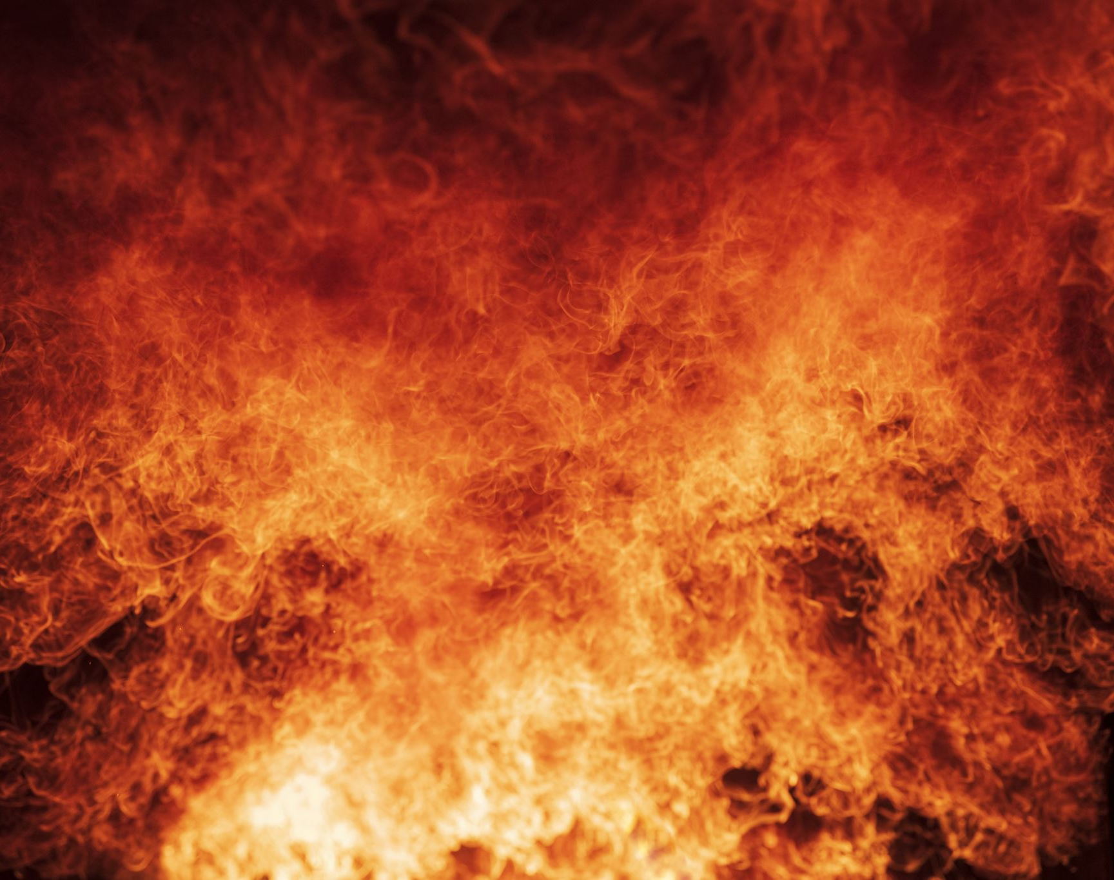

Controlled Burn
An Ecologist’s Guide to Leading Through Disruption
Chris Lee, Organizational Ecologist

Slide 2
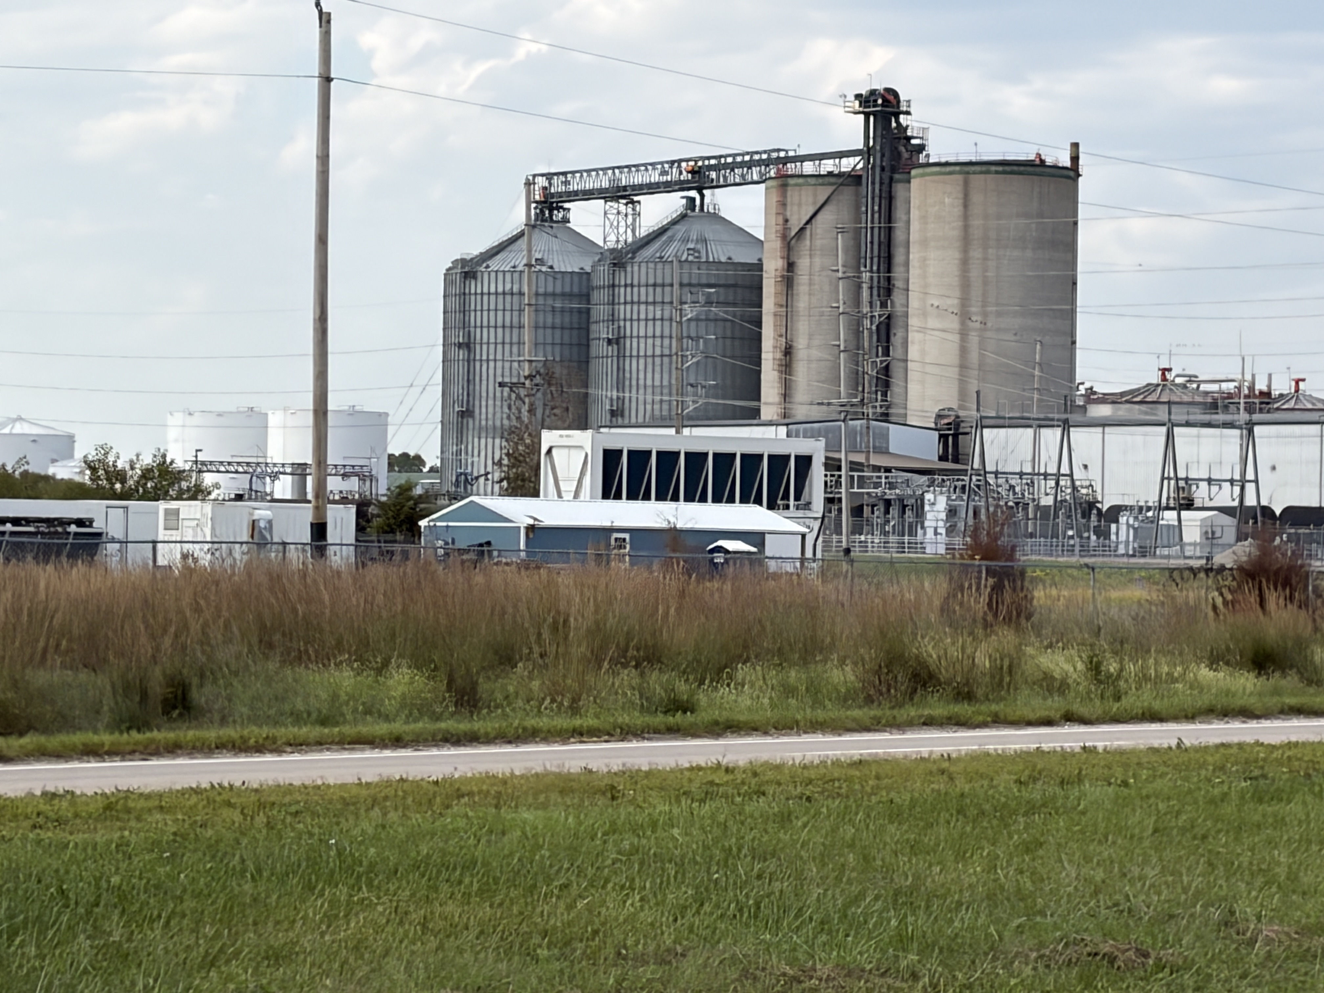

Slide 3
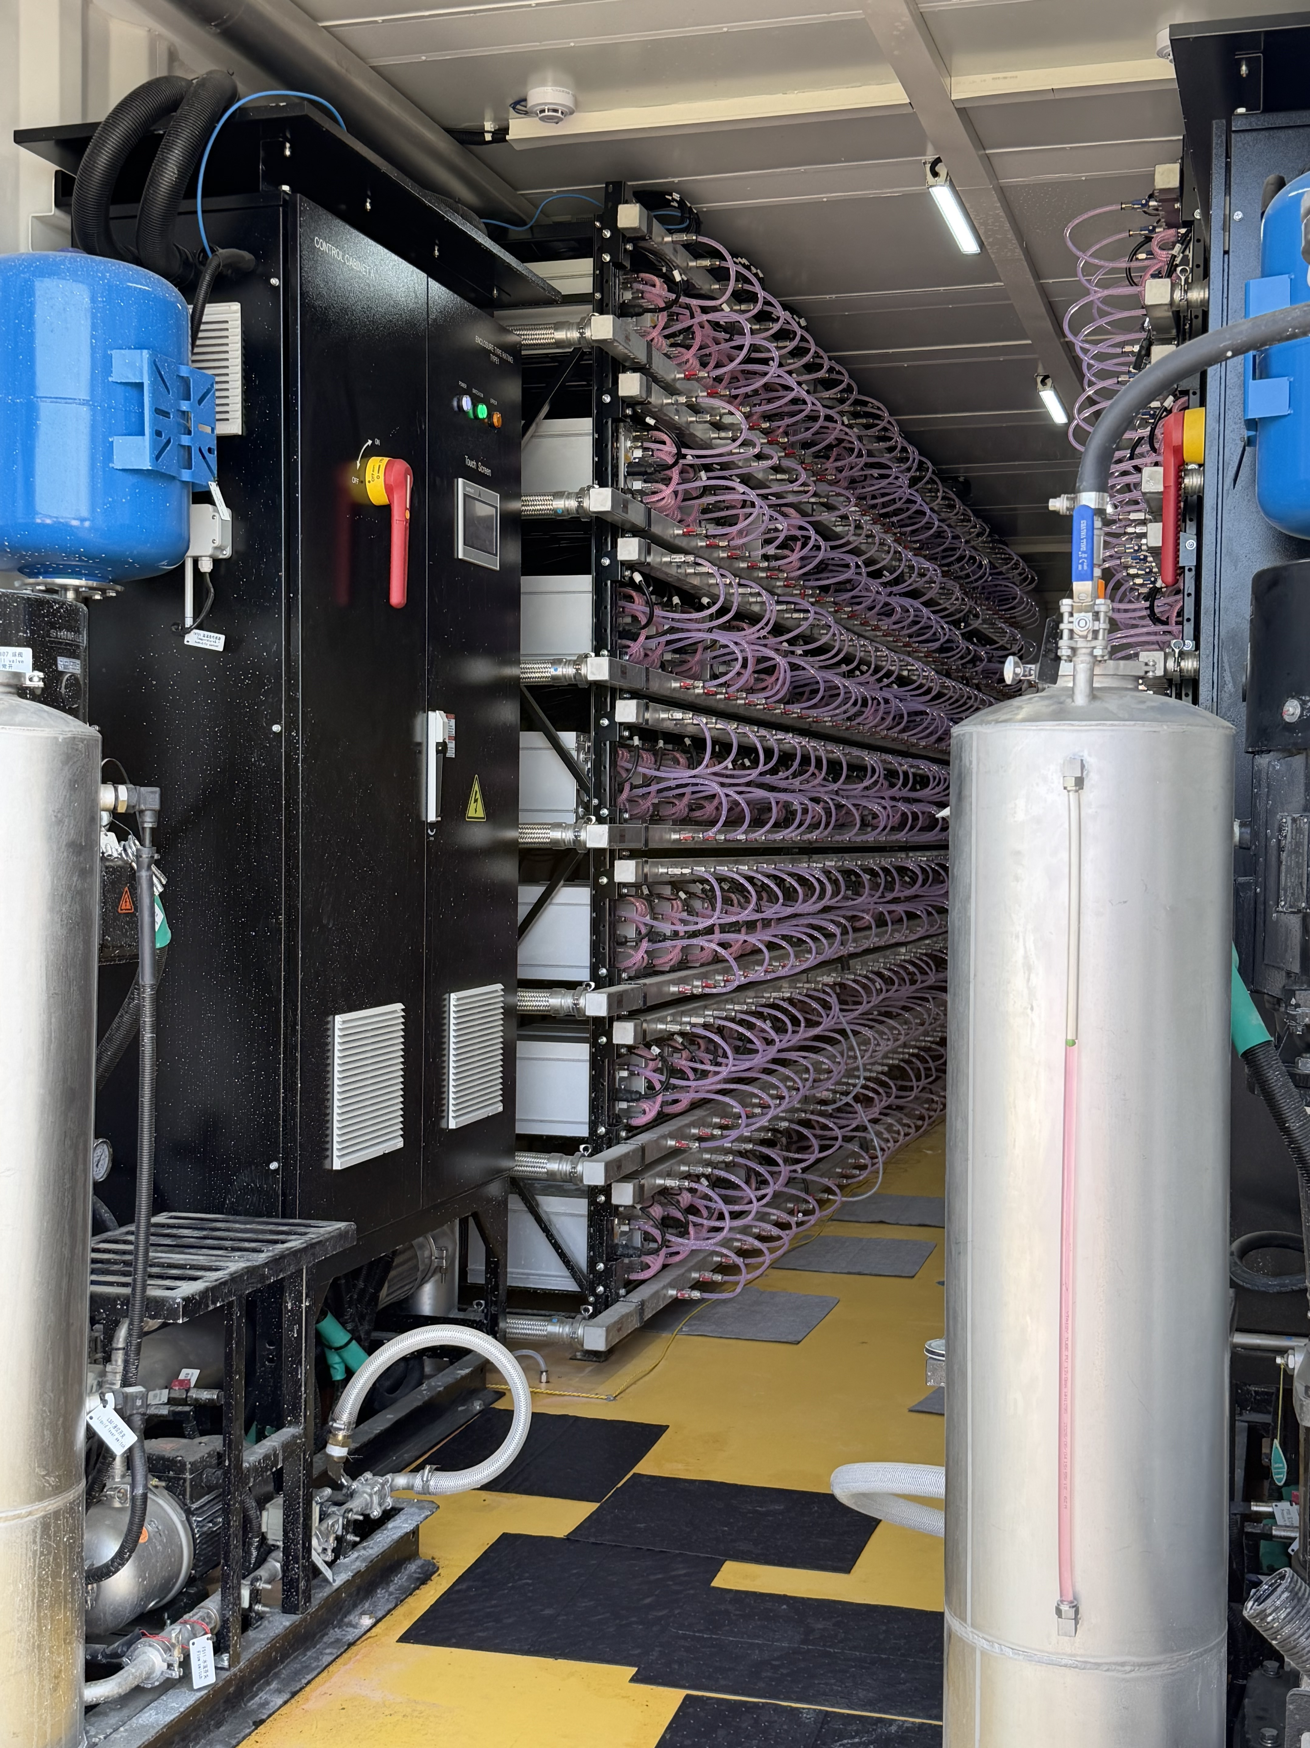
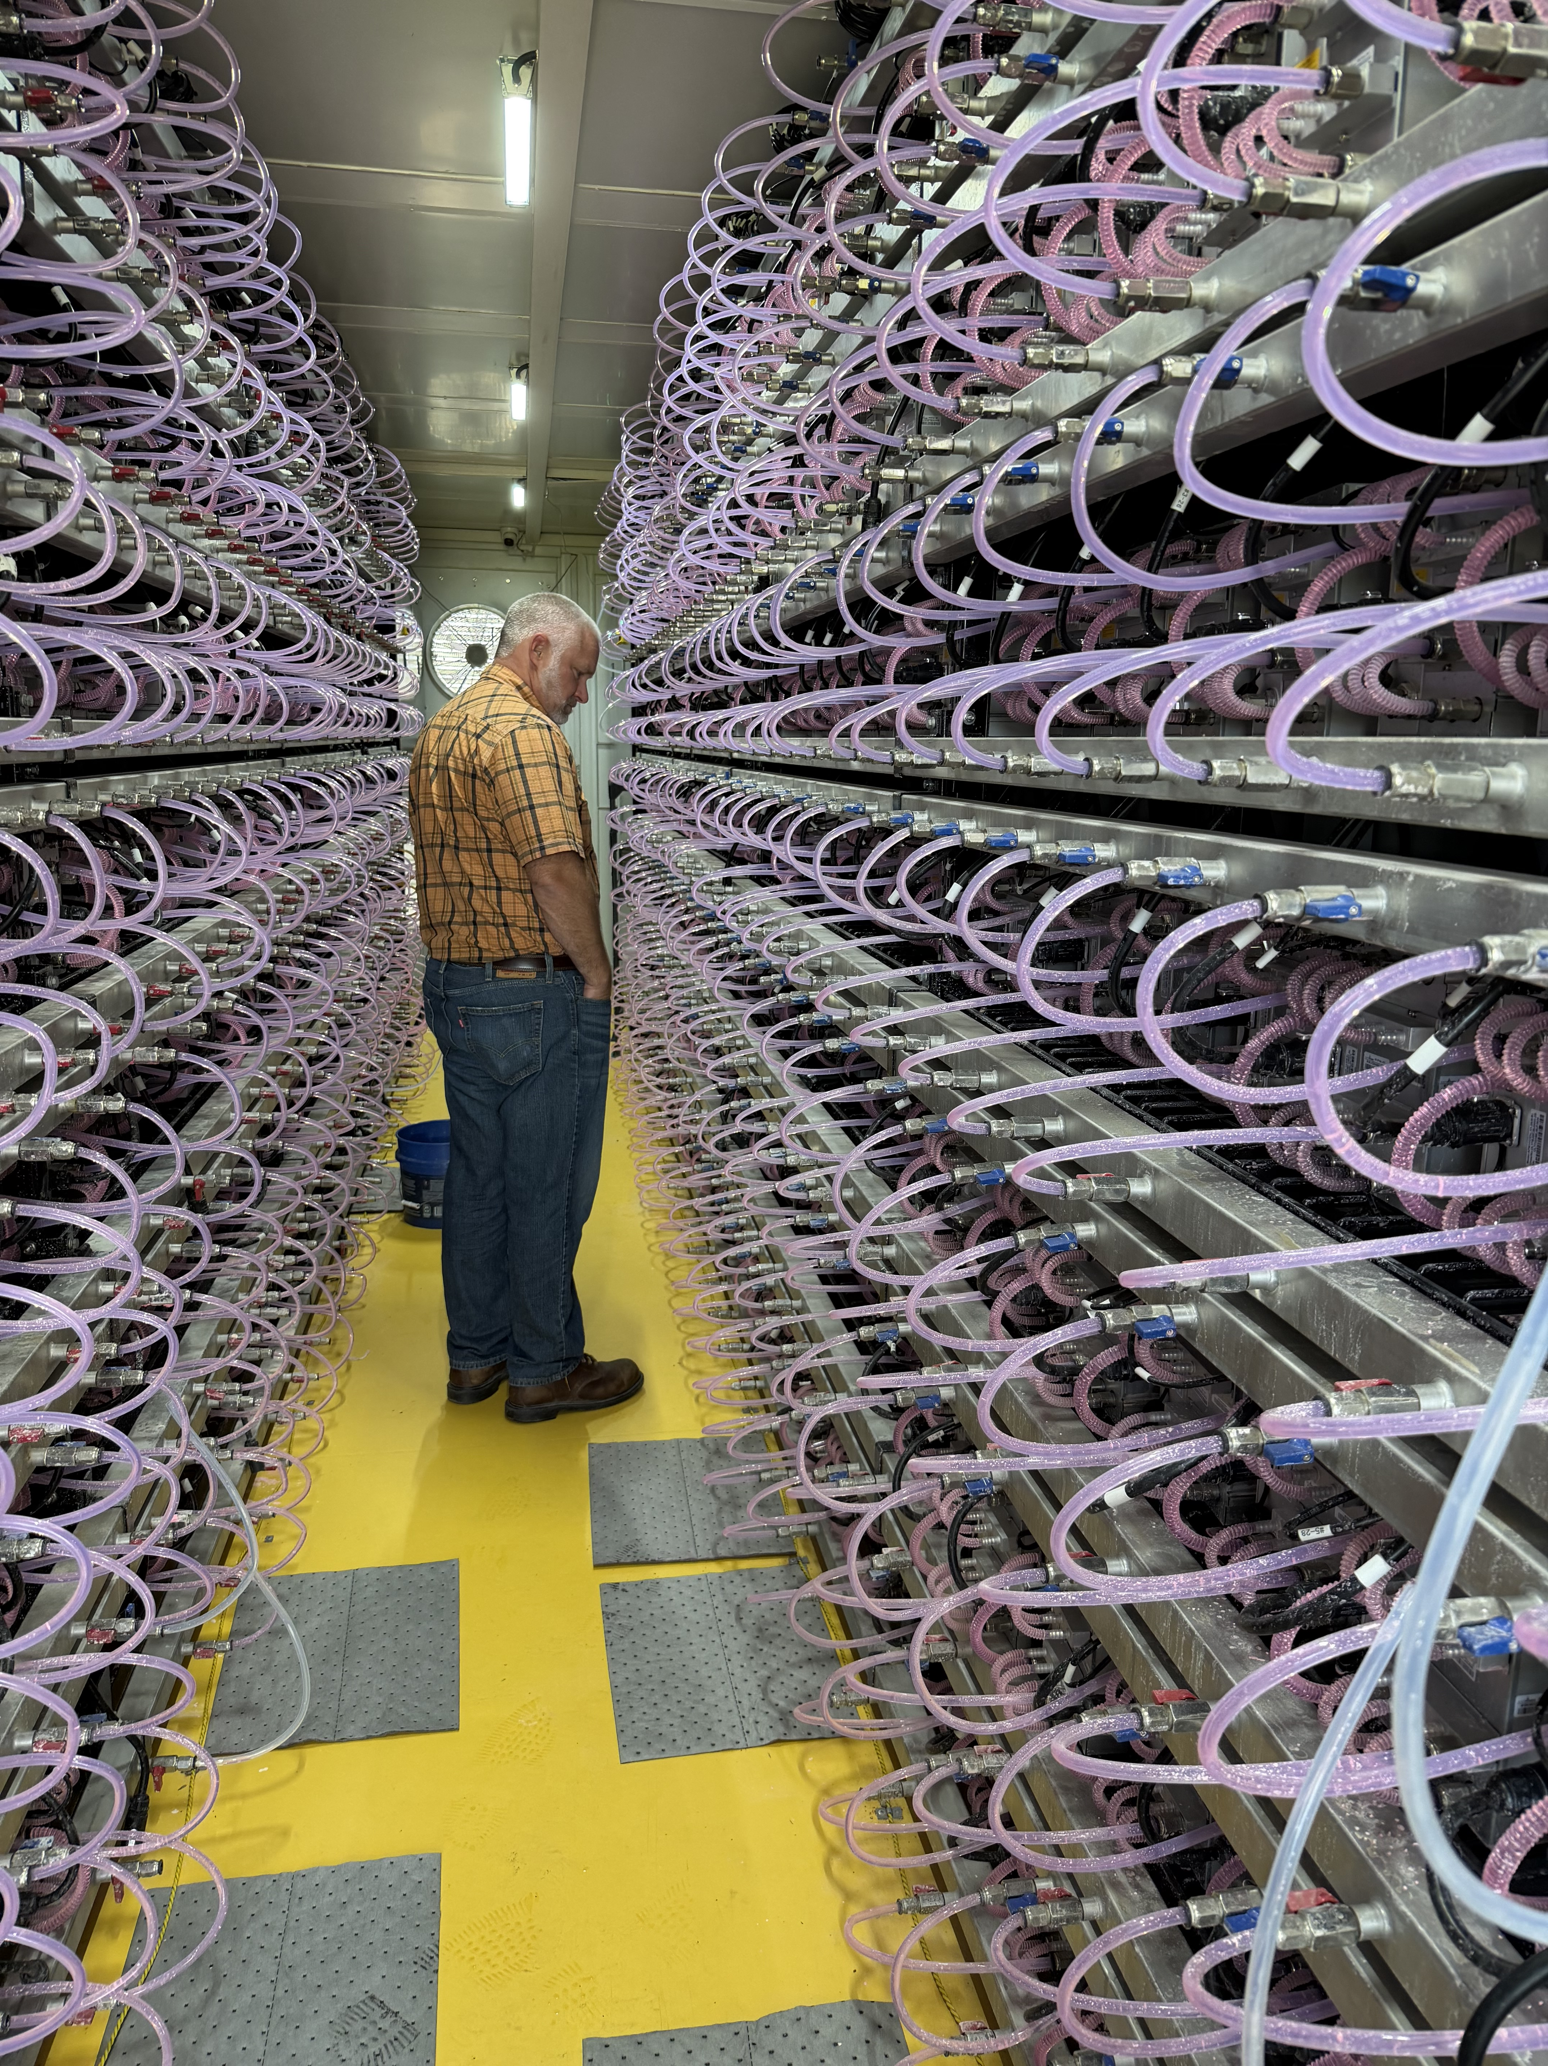

Slide 5
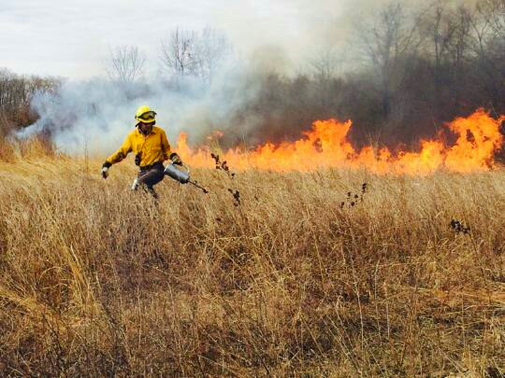

Slide 6
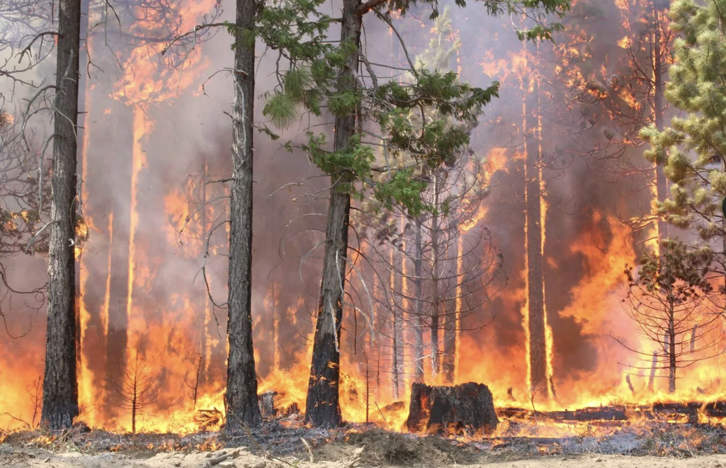

Slide 8
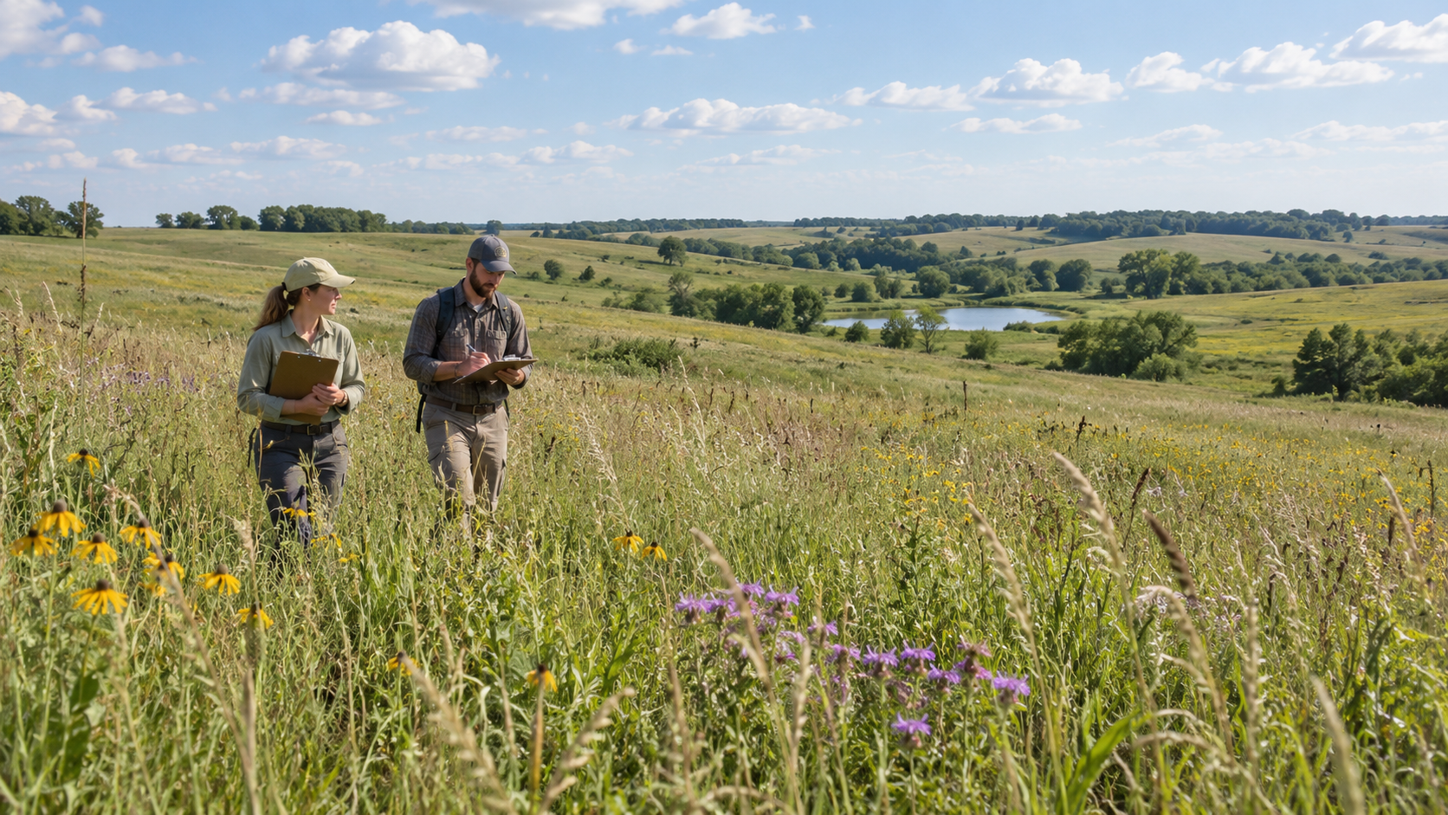

Slide 9


Slide 10
Go / No-Go
Go (what you want)
No-go (what you’ll say no to)

Slide 11
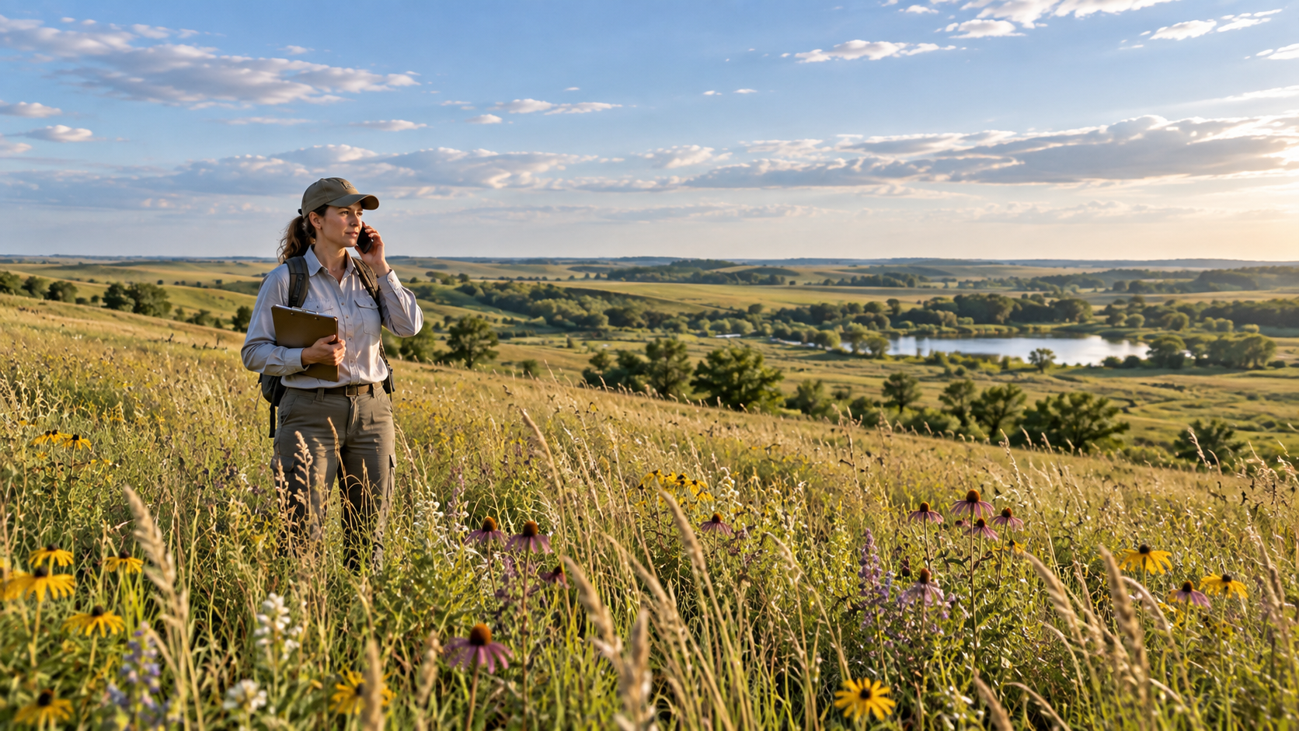

Slide 12
Tell the neighbors
Who in your community should be better informed?
Elected officials
Department heads
Community groups
Service organizations
The public in general – how?

Slide 13
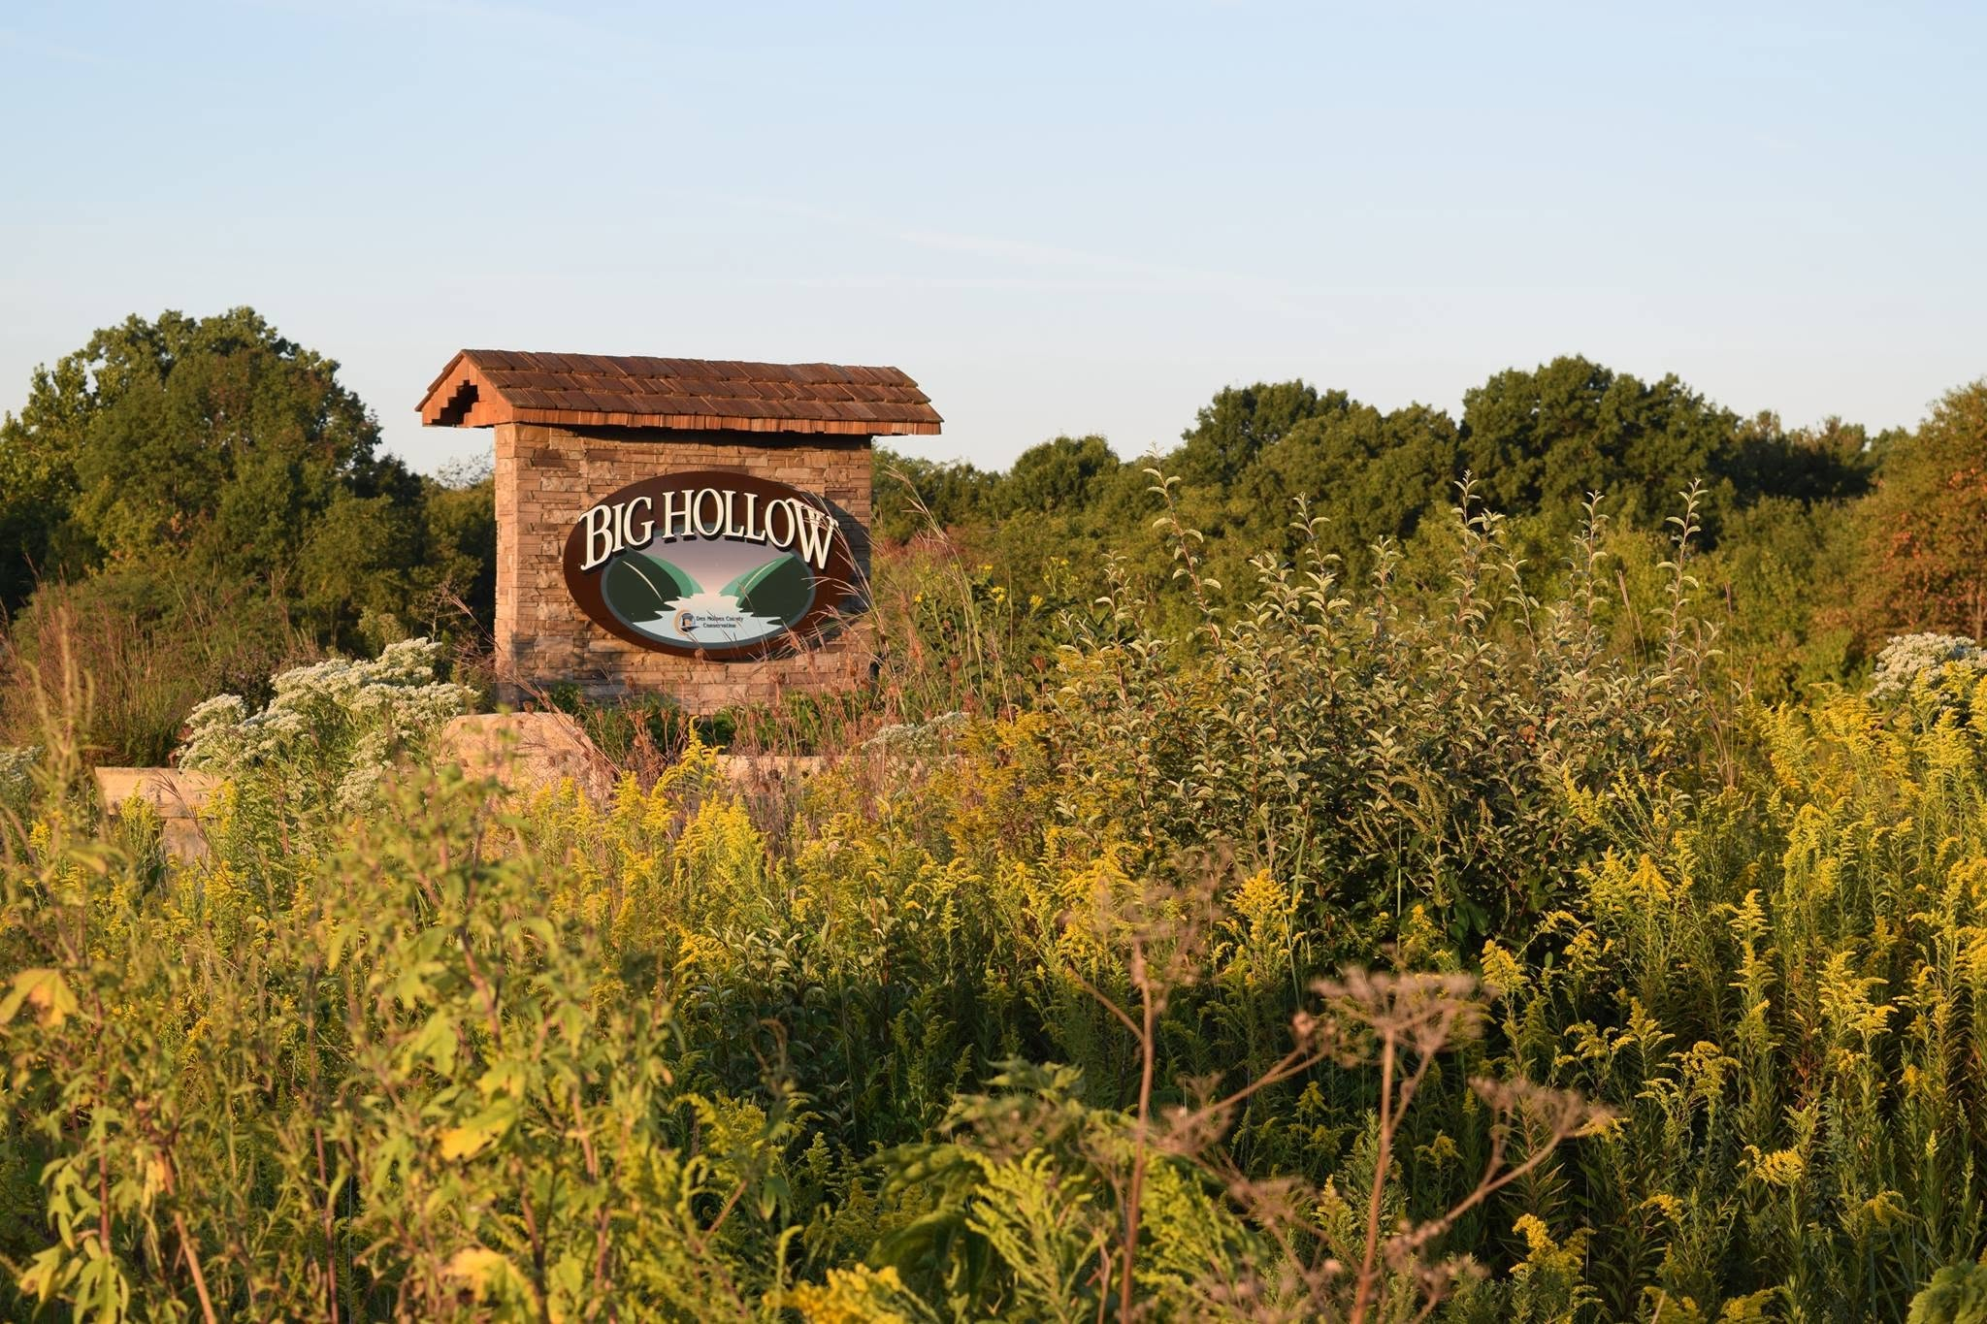

Slide 14
Read the land

Slide 15
Know your No’s

Slide 16
Tell the neighbors

Slide 17
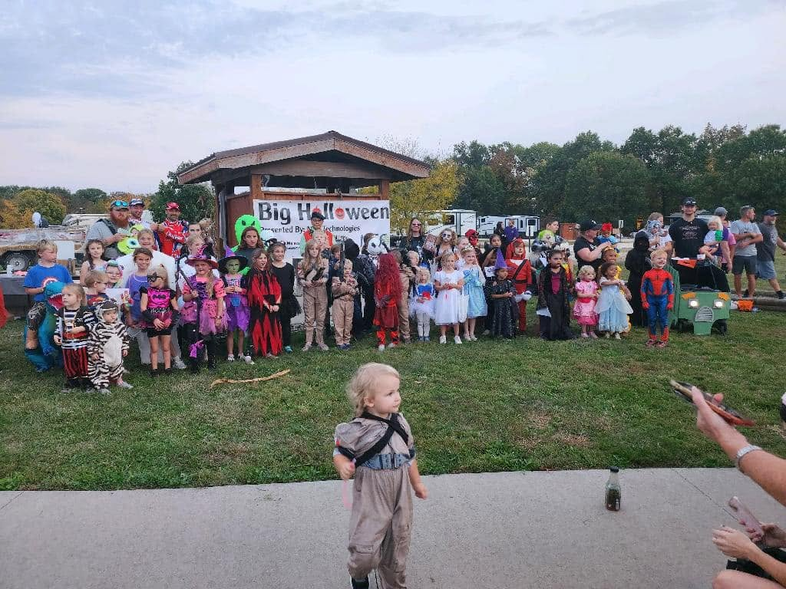

Slide 18
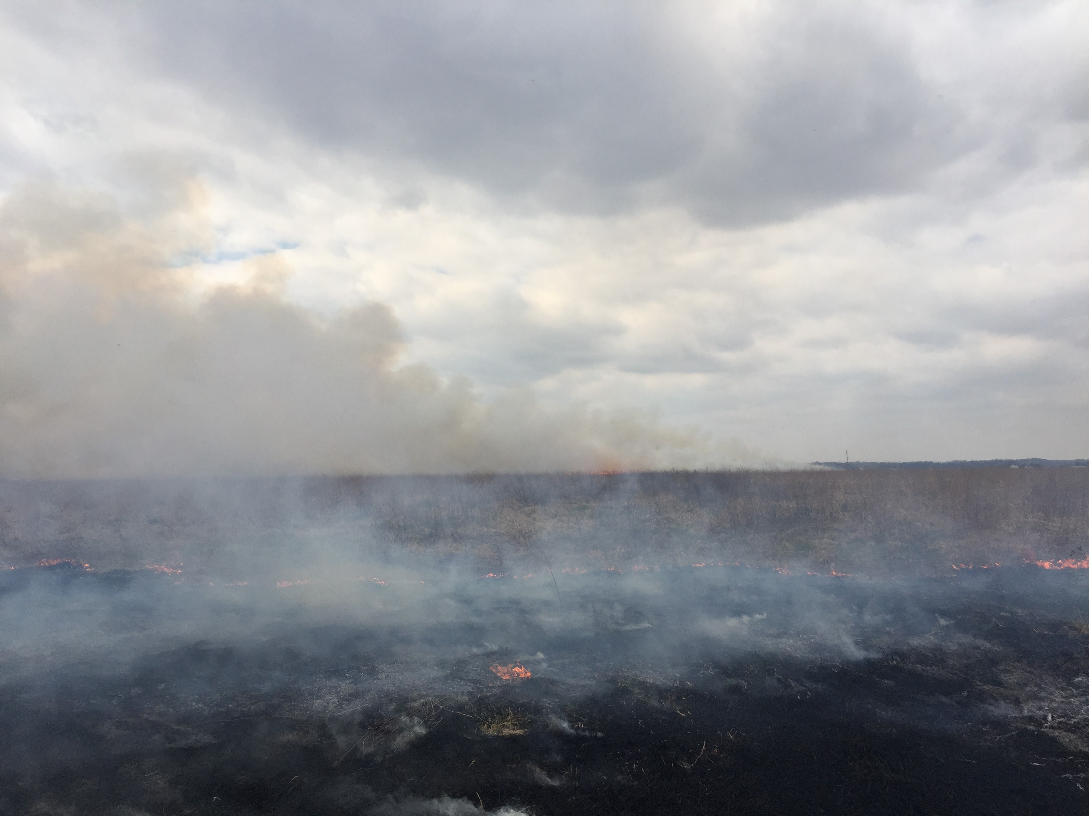

Slide 19
