Slide 1

TIF, Urban Renewal, and Iowa’s Evolving Development
Iowa's Evolving Development Framework
Presented By:
Matthew R. Stoffel, CFA | Chip Schultz
PFM Financial Advisors LLC
September 24, 2026
Notes:
Welcome and introduction. Acknowledge PDI for the opportunity to present. Overview: TIF primer for those newer to the topic, then deep dive on the 2026 Iowa legislative changes and what they mean for cities.

Slide 2
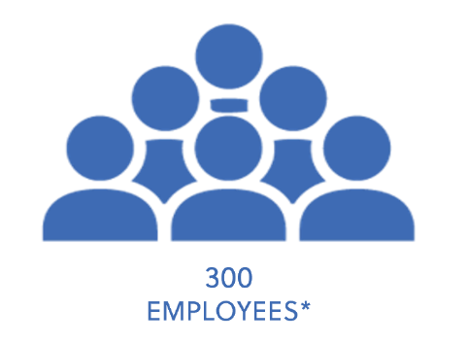
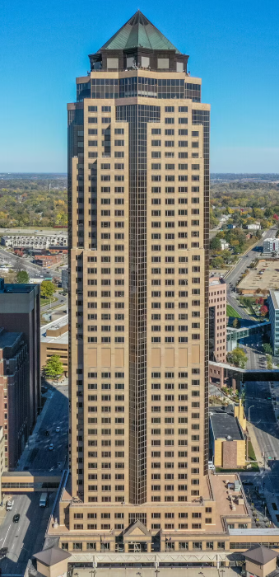

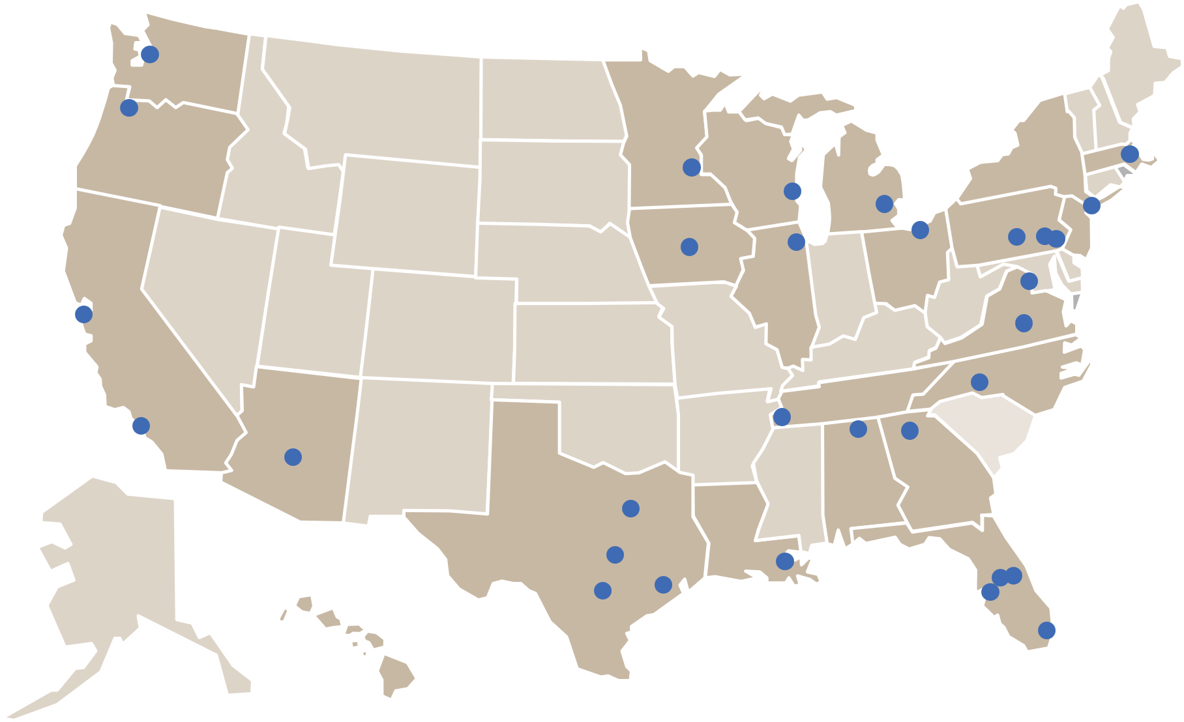
Who is PFM?
National Presence with Local Expertise
PFM currently has approximately 300 employees located in 31 offices and locations across the United States.¹
We leverage our strong market presence, expertise and access to information for the benefit of our clients on every engagement.
PFM has been ranked the #1 financial advisor for the last 31 years² in the public finance industry, maintaining an expansive national presence.
#1
Ranked #1 for 31
consecutive
years
¹Internal data contained herein is according to PFM internal records as of January 09, 2026
² Ranked by Ipreo in terms of par amount as of December 31, 2025
© PFM
PFM Financial Advisors LLC | PDI Fall Conference | September 2026
Notes:
Walk through five sections. 75-minute session — leave 10 minutes for Q&A at the close.

Slide 3
Today's Agenda
01
02
03
04
05
TIF Fundamentals
The 2026 Legislative Changes
Rethinking TIF
Case Studies
Takeaways & Q&A
A primer on how TIF works in Iowa
Senate File 2472 — what changed and when
Financial planning, debt structuring, and strategy
Three scenarios Iowa cities are navigating now
What cities should do now
© PFM
PFM Financial Advisors LLC | PDI Fall Conference | September 2026
Notes:
Walk through five sections. 75-minute session — leave 10 minutes for Q&A at the close.

Slide 4
What Is Tax Increment Financing (TIF)?
Section 01 — TIF Fundamentals
The Basic Concept
TAX INCREMENT
→ TIF Fund (City Uses)
Iowa cities designate an Urban Renewal Area by city council resolution (Iowa Code Chapter 403)
The assessed value of property is "frozen" at the time of designation — this is the base value
As new development occurs, property values rise above the base — the difference is the tax increment
Property taxes on the increment are diverted to the city's TIF fund instead of flowing to overlapping taxing bodies
TIF is self-financing: the development that benefits from the incentive generates the revenue that pays for it
BASE VALUE
(Frozen at
Designation)
→ Taxing Bodies
(County, Schools,
City General)
Property Value After Development
© PFM
PFM Financial Advisors LLC | PDI Fall Conference | September 2026
Notes:
Take time here for anyone new to TIF. The key insight is self-financing: no new taxes are levied; the increment is redirected from overlapping taxing bodies during the TIF period. Once TIF terminates, full tax revenues flow to all taxing bodies on the higher assessed value.

Slide 5
How Iowa Cities Use TIF
Section 01 — TIF Fundamentals
Infrastructure & Public Improvements
Developer Incentives
Debt Financing
Roads, utilities, and streetscaping within the urban renewal area
Property tax rebates — rebating a portion of increment to the developer
General obligation bonds with TIF pledge
Public parking and stormwater improvements
Forgivable loans or grants for eligible project costs
Revenue bonds secured by TIF increment
Park and trail improvements adjacent to development
Gap financing for projects that would not otherwise be feasible
Internal city loans repaid with TIF revenue
Utility extensions to serve new development
Local match for IEDA programs (WHTC, CDBG, CACF)
Notes payable to developers or financial institutions
Key Principle: TIF does not raise taxes — it redirects new increment generated by development to fund the improvements that made it possible.
© PFM
PFM Financial Advisors LLC | PDI Fall Conference | September 2026
Notes:
Emphasize the breadth of TIF uses. In practice cities often use a combination — infrastructure first, then developer incentives. TIF-backed bond issuance is where PFM's financial advisory work is most directly applicable.

Slide 6

02
The 2026
Legislative Changes
Senate File 2472 — Signed May 18, 2026
Notes:
Transition slide. Governor Reynolds signed SF 2472 on May 18, 2026 — the most significant change to Iowa TIF law in many years. Most provisions took effect immediately.

Slide 7
Senate File 2472 — Six Changes to Iowa TIF Law
Section 02 — The 2026 Legislative Changes
Governor Reynolds signed SF 2472 on May 18, 2026. Most provisions took effect immediately upon signing.
1
New 23-year TIF sunset on all new ordinances adopted after May 18, 2026
2
60% TIF collection cap on existing ordinances that previously had no sunset limitation
3
Workforce housing expressly recognized as "economic development" — cities can use public funds to support it
4
Repeal of Iowa Code §403.22 — removes shortened TIF sunsets and LMI set-aside requirements for market-rate residential
5
School foundation tax levies excluded from TIF under certain circumstances
6
School district tax levies excluded from TIF for residential projects receiving Urban Revitalization Act exemptions
Source: Ahlers & Cooney, P.C. Client Alert, May 26, 2026 (legislative slides)
© PFM
PFM Financial Advisors LLC | PDI Fall Conference | September 2026
Notes:
Source: Ahlers & Cooney, P.C. Client Alert, May 26, 2026. Also note SF 2496 (signed May 2, 2026) separately excludes EMS levies from TIF starting FY2027 — covered on the school levy slide.

Slide 8
Change #1: New 23-Year TIF Sunset
Section 02 — The 2026 Legislative Changes
Applies to all new TIF ordinances adopted after May 18, 2026
All TIF ordinances adopted after the Effective Date are limited to 23 years
Clock starts the calendar year after the municipality first certifies indebtedness to the county auditor
Applies regardless of urban renewal area type:
  Slum or blighted area
  Economic development area
  Market-rate housing urban renewal area
TIF ordinance automatically terminates at the end of the 23-year period
Illustrative Timeline
23-Year TIF Window
Ordinance
adopted
2027
First debt
certified
2027
Year 1 of
clock
2028
Auto-
termination
2051
What This Means for Cities
New TIF-backed debt must amortize within the 23-year window
Revenue projections must model increment growth against a defined endpoint
Development delays compress the effective collection window — conservative sizing is essential
Source: Ahlers & Cooney, P.C. Client Alert, May 26, 2026 (legislative slides)
© PFM
PFM Financial Advisors LLC | PDI Fall Conference | September 2026
Notes:
Source: Ahlers & Cooney, P.C. Client Alert, May 26, 2026. Previously many Iowa TIF districts had no defined sunset. This is a fundamental structural change. Every new TIF debt engagement must now be modeled within the 23-year box.

Slide 9
Change #2: 60% Cap on Extended TIF Ordinances
Section 02 — The 2026 Legislative Changes
"Extended TIF Ordinances" = existing ordinances adopted without a prior sunset limitation
Phase 1
Status Quo Period
Phase 2
60% Collection Cap
Exception
20 years from May 18, 2026
—OR—
20 years from first debt certification
(whichever is LATER)
After status quo period ends:
city limited to 60% of otherwise-available TIF increment
School foundation levy also excluded
May exceed 60% cap to pay off debt incurred before May 18, 2026
Cannot incur NEW debt while exceeding the cap
No changes — TIF continues as-is
School foundation levy excluded
Pre-existing debt is protected
What Cities Should Do Now:
Identify which existing TIF ordinances have no prior sunset — these are your "Extended TIF Ordinances"
Calculate when the 20-year status quo period ends for each district — cities closer to expiration need to act sooner
Model outstanding debt maturities against the status quo window and plan accordingly
Source: Ahlers & Cooney, P.C. Client Alert, May 26, 2026 (legislative slides)
© PFM
PFM Financial Advisors LLC | PDI Fall Conference | September 2026
Notes:
Source: Ahlers & Cooney, P.C. Client Alert, May 26, 2026. The key nuance: the status quo period ends on the LATER of two triggers. A city that first certified debt recently may have a much longer status quo window than one that established its TIF 20+ years ago. Every district is different — this requires a district-by-district calculation.

Slide 10
Change #3: School Levy Exclusions & Rate Reductions
Section 02 — The 2026 Legislative Changes
School Foundation Levy Exclusions
School Foundation Levy Rate Reductions
New ordinances adopted January 1, 2027 or later in incorporated areas: school foundation levy excluded from TIF
School Board Opt-In: by resolution, school board may voluntarily contribute its foundation levy for one or more fiscal years (FY2028 onward) — not automatic; requires board action annually
Extended TIF Ordinances: school foundation levy excluded once the 60% cap applies
EMS levies excluded from all TIF starting FY2027 (Senate File 2496, signed May 2, 2026)
Current Rate
$5.40 / $1,000 AV
Baseline
FY 2029
$5.10 / $1,000 AV
↓ $0.30
FY 2030+
$4.90 / $1,000 AV
↓ $0.50 from current
Applies to TIF districts not fully insulated by existing protections
The Bottom Line: TIF revenue is shrinking from multiple directions simultaneously — levy exclusions, rate reductions, and collection caps. All active TIF financial models need to be updated to reflect these compounding changes.
Source: Ahlers & Cooney, P.C. Client Alert, May 26, 2026 (legislative slides)
© PFM
PFM Financial Advisors LLC | PDI Fall Conference | September 2026
Notes:
Source: Ahlers & Cooney (SF 2472) and SF 2496 for EMS levy. Critical nuance on school opt-in: year-by-year at school board discretion — not a committed revenue source. Cities should not budget for it without a formal board resolution in hand.

Slide 11
Change #4: Workforce Housing & Repeal of §403.22
Section 02 — The 2026 Legislative Changes
NEW: Workforce Housing as Economic Development
REMOVED: Iowa Code §403.22 Limitations
"Low and moderate income family housing" now expressly includes workforce housing (Iowa Code §15.353)
Workforce housing explicitly recognized as "economic development" under Iowa Code Ch. 15A
Cities can use public funds — including TIF — to directly support workforce housing development
Opens TIF as a complement to IEDA Workforce Housing Tax Credits (WHTC)
New housing TIF ordinances still subject to 23-year sunset and school levy exclusions
§403.22 previously imposed shortened TIF sunsets on market-rate residential projects
Also required LMI housing set-asides — a major friction point for developers and cities
§403.22 is repealed effective May 18, 2026
Existing market-rate residential TIF ordinances formerly under §403.22 now treated as standard economic development ordinances (20-year status quo / 60% cap)
New market-rate residential TIF ordinances subject to standard 23-year sunset
Opportunity: The §403.22 repeal and workforce housing recognition significantly expand the TIF toolkit for housing. Cities that previously avoided residential TIF due to §403.22 constraints should revisit those decisions.
Source: Ahlers & Cooney, P.C. Client Alert, May 26, 2026 (legislative slides)
© PFM
PFM Financial Advisors LLC | PDI Fall Conference | September 2026
Notes:
Source: Ahlers & Cooney, P.C. Client Alert, May 26, 2026. This is arguably the most positive change in SF 2472 from a city perspective. The §403.22 repeal removes a long-standing barrier that made residential TIF projects administratively burdensome. Combined with workforce housing recognition, this opens meaningful new uses of TIF that align with state housing priorities.

Slide 12
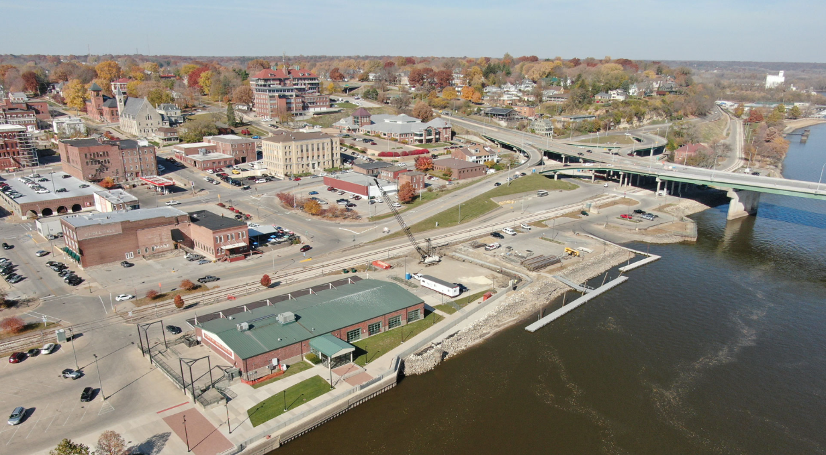
03
Rethinking TIF —
Implications for Cities
Financial planning, debt structuring, and strategy shifts
Notes:
Transition. This section moves from "what the law says" to "what cities should actually do differently." Financial advisory perspective — audit, model, plan, engage.

Slide 13
Step 1: Audit Your TIF Portfolio
Section 03 — Rethinking TIF
Every city should immediately inventory its urban renewal areas and TIF ordinances.
Adoption Date
Outstanding Debt
Was the ordinance adopted before or after May 18, 2026? This determines which framework applies.
What debt is currently pledged to TIF revenue? What are the maturity dates? Is existing debt at risk from the cap?
Sunset Status
Urban Renewal Area Type
Did the existing ordinance have a prior sunset? If not, it is an Extended TIF Ordinance subject to the 60% cap.
Slum/blight, economic development, or residential? Area type affects applicable rules under the new law.
First Debt Certification
Planned Indebtedness
When did the city first certify indebtedness to the county auditor? This triggers the 20-year status quo clock.
Are new bond issuances or developer agreements planned? These must fit within the 23-year window for new ordinances.
© PFM
PFM Financial Advisors LLC | PDI Fall Conference | September 2026
Notes:
The audit is the foundation of everything that follows. Without knowing which rules apply to each district, cities cannot make informed decisions about debt structuring, project timing, or developer negotiations. Typically a joint exercise between the city finance director, city attorney, and financial advisor.

Slide 14
Step 2: Update Your Financial Models
Section 03 — Rethinking TIF
TIF revenue projections built before 2026 are no longer accurate. Every active TIF model needs to be refreshed.
New TIF Districts (Post-May 18, 2026)
Existing TIF Districts (Extended Ordinances)
Model increment growth trajectory against the 23-year window — when does the district generate enough revenue to support proposed debt?
Size debt conservatively — factor in slower-than-projected development timelines
Exclude school foundation levy for ordinances adopted after January 1, 2027
Exclude EMS levy from all projections (FY2027 onward)
Run scenario analysis: base case, conservative, and stress case
Evaluate debt coverage ratios with and without school board opt-in revenue
Calculate when the 20-year status quo period ends — model revenue at 60% of increment after that date
Model school foundation levy rate reductions ($5.40 → $5.10 in FY29; → $4.90 in FY30)
Assess whether outstanding pre-2026 debt can be retired before the 60% cap applies
Evaluate refunding or restructuring existing debt to reduce cap exposure
Identify projects that should be advanced while full increment is available
Model EMS levy exclusion impact starting FY2027
© PFM
PFM Financial Advisors LLC | PDI Fall Conference | September 2026
Notes:
This is where PFM's financial modeling expertise adds the most value. Cities that don't update their TIF projections risk being caught flat-footed — mispriced developer agreements, insufficient debt coverage, or unexpected revenue shortfalls.

Slide 15
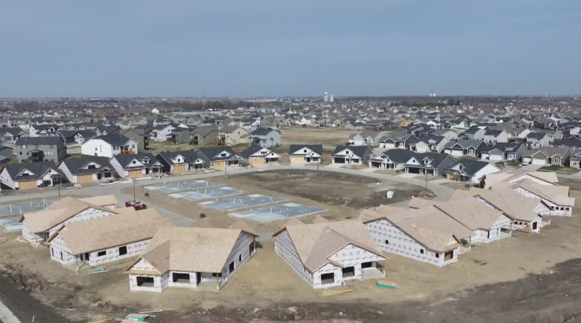
04
Case Studies
Three scenarios Iowa cities are navigating right now
Project specifics are illustrative and generic
Notes:
Transition to case studies. Scenarios are illustrative — not tied to any specific named client or project. Drawn from common situations Iowa cities face.

Slide 16
Case Study 1: The Long-Running TIF District
Section 04 — Case Studies
Scenario:
A mid-size Iowa city established an economic development TIF district in the early 2000s with no sunset. The district has supported multiple projects over 20+ years. Outstanding TIF-backed debt matures in 2032. The city is now planning a new phase of development in the same district.
Key Questions Under SF 2472
Strategic Considerations
When was indebtedness first certified? → Determines when the 20-year status quo clock started
Will the 2032 debt maturity occur before the status quo period ends? → If yes, city may avoid the 60% cap on that obligation
Can new indebtedness for the next phase be structured within the remaining status quo window?
What does the TIF revenue projection look like after the 60% cap applies?
Accelerate planned projects or debt issuances to execute before the 60% cap applies
Evaluate early retirement or refunding of 2032 debt to reduce cap exposure
Model the impact of school foundation levy rate reductions on debt coverage
Consider whether a new TIF ordinance (23-year sunset) is more appropriate for the next phase than continuing under the Extended TIF Ordinance
Brief city council proactively — frame as a planning exercise, not a crisis
© PFM
PFM Financial Advisors LLC | PDI Fall Conference | September 2026
Notes:
Illustrative scenario — not based on any specific named client. Key message: the status quo end date differs city by city. Some cities may have decades remaining; others may be facing the cap relatively soon. Every district requires a detailed calculation.

Slide 17
Case Study 2: Structuring a New TIF District
Section 04 — Case Studies
Scenario:
A growing Iowa city plans to establish a new economic development TIF district for commercial and light industrial development. The developer requests a 15-year property tax rebate. City anticipates adopting the ordinance and certifying debt in 2027.
Illustrative Key Variables
Structuring Considerations
Ordinance adoption / first debt certification
2027
15-year rebate fits within window — but leaves little margin for development delays
Slow absorption compresses available revenue — conservative increment growth assumptions are critical
Engage school board about opt-in resolution — could meaningfully improve revenue coverage
Structure rebate as % of increment, not a fixed dollar amount — protects city if development underperforms
Year 1 of 23-year clock
2028
Automatic TIF termination
2051
Effective collection window
23 years
Maximum debt maturity
2051 or earlier
School foundation levy included?
No (post-Jan 1, 2027)
EMS levy included?
No (FY2027 onward)
© PFM
PFM Financial Advisors LLC | PDI Fall Conference | September 2026
Notes:
Illustrative scenario. Key message: exclusion of the school foundation levy for post-January 2027 ordinances meaningfully reduces the TIF revenue pool. For a typical commercial district the school levy can represent 20-25% of the total increment. Cities and developers need updated projections — pre-2026 estimates are no longer valid.

Slide 18
Case Study 3: Workforce Housing TIF
Section 04 — Case Studies
Scenario:
A smaller Iowa city faces a housing shortage constraining its ability to attract and retain employers. A developer proposes a 60-unit workforce housing development but cannot make the project work without public assistance. The city previously avoided residential TIF due to §403.22 complications.
TIF Tools Now Available
IEDA Program Layering
Structuring Considerations
Establish urban renewal area — workforce housing is now a qualifying "economic development" objective
Iowa Workforce Housing Tax Credit (WHTC) — TIF can serve as the local match
New ordinance subject to 23-year sunset — sufficient for typical housing project
Developer rebate: rebate a portion of TIF increment over the project term
Combine TIF rebate with WHTC to bridge the project gap
School foundation levy excluded (post-Jan 1, 2027) — reduces increment pool
City infrastructure improvements funded with TIF
CACF for mixed-use components
Engage school board about opt-in resolution
§403.22 repeal removes the LMI set-aside and shortened sunset
CDBG for infrastructure if income-qualifying units included
Structure rebate as % of increment — limits city exposure if values underperform
© PFM
PFM Financial Advisors LLC | PDI Fall Conference | September 2026
Notes:
Illustrative scenario. Key message: SF 2472 changes the calculus for residential TIF significantly. Cities that avoided housing TIF due to §403.22 should re-evaluate. Workforce housing recognition also creates a new way to frame TIF support to city councils — it is economic development, not a subsidy. WHTC/TIF combination is a powerful layering tool.

Slide 19

05
Key Takeaways
& Q&A
What cities should do now
Notes:
Transition to takeaways and Q&A. Keep tight — allow 10-12 minutes for audience questions.

Slide 20
Key Takeaways — What Cities Should Do Now
Section 05 — Key Takeaways
①
Inventory every urban renewal area and TIF ordinance. Classify each — adoption date, sunset status, first debt certification date, and outstanding obligations.
Audit
②
Update financial projections for every active TIF district. Account for the 23-year sunset, the 60% cap timeline, levy exclusions, and the FY29/FY30 rate reductions.
Model
③
Identify projects or debt issuances that should be advanced while full increment is still available. Evaluate refunding or restructuring to reduce 60% cap exposure.
Plan
④
Brief city councils, school boards, and developers proactively. Pre-2026 project pro formas and development agreements need to be revisited.
Engage
⑤
Repeal of §403.22 and workforce housing recognition open new doors. Cities with stalled or previously infeasible housing projects should re-evaluate TIF — and explore WHTC/TIF combinations.
Capitalize
© PFM
PFM Financial Advisors LLC | PDI Fall Conference | September 2026
Notes:
Summarize briskly. The changes require action, not just awareness. Cities that wait risk being caught unprepared when the 60% cap applies or when a new project requires debt structured within the 23-year window.

Slide 21


Questions?
Matthew R. Stoffel, CFA
Chip Schultz
Director | PFM Financial Advisors LLC
Director | PFM Financial Advisors LLC
515-724-5737
(515) 724-5725
stoffelm@pfm.com
schultzc@pfm.com
Important Disclosures
Legislative information in this presentation is sourced from Ahlers & Cooney, P.C. Client Alert, "Changes to Iowa's Urban Renewal Act and Urban Revitalization Act Under the 2026 Property Tax Bill," dated May 26, 2026, authored by Nathan Overberg and Jenna Sabroske. This presentation is for informational and educational purposes only and does not constitute legal or financial advice. Consult qualified legal counsel regarding the application of Senate File 2472 to any specific urban renewal area or TIF ordinance. Case studies are illustrative and do not reference any specific client or project. PFM Financial Advisors LLC is a registered municipal advisor with the SEC and MSRB.
© PFM
Notes:
Open Q&A. Offer to follow up individually with cities that want a TIF portfolio audit or updated financial modeling.

