Slide 1

Business Engagement Division
Iowa’s One-Stop Shop for Employers

Slide 2
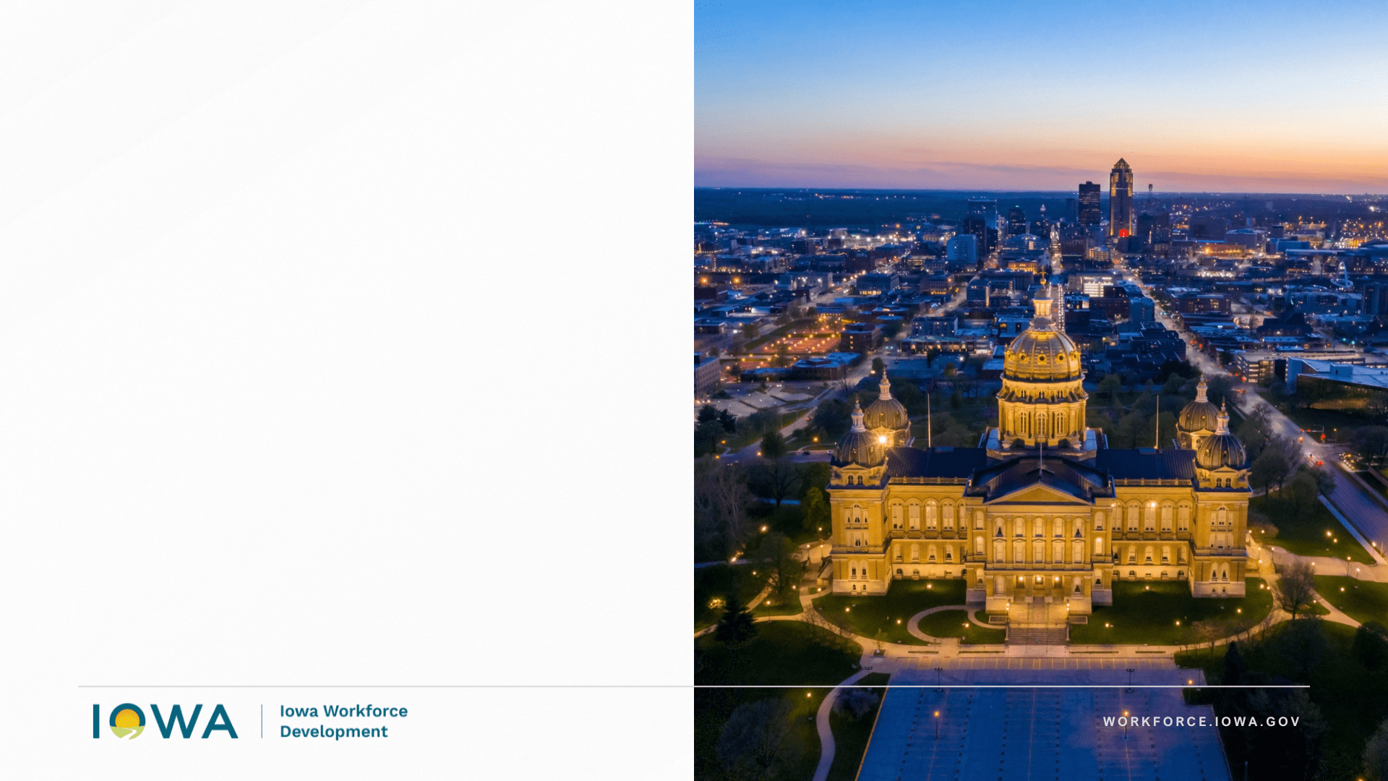
History
Established in fall of 2022 under direction of Governor Kim Reynolds and IWD Director Beth Townsend
Centralized “One Stop Shop” for Iowa employers
Goals:
Let employers know we are here to help with workforce, regardless of where they are in their business cycle
Be a trusted and first point of contact for employers, helping to navigate the various resources across federal government programs, multiple agencies, local workforce boards, community partners and non-profits
Connect them to talent, programs, resources and grants

Slide 3

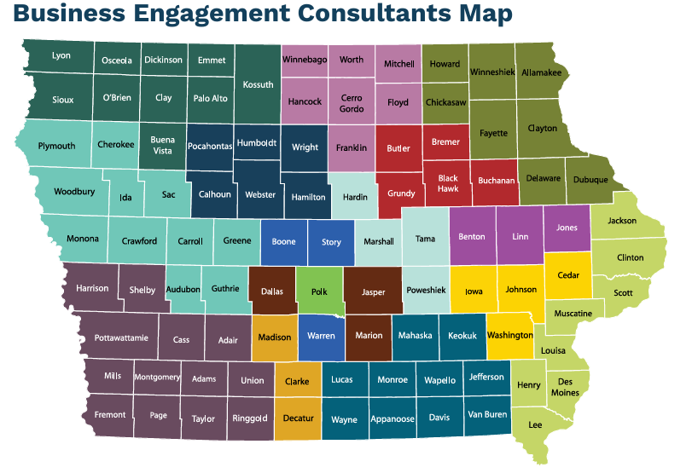
COVERING IOWA
Notes:
As you can see, our business services team covers the entire state of Iowa.

Slide 4


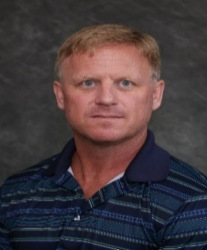


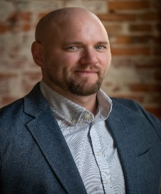
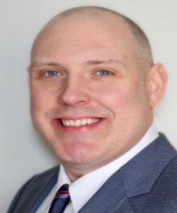
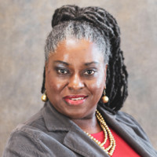
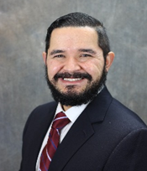
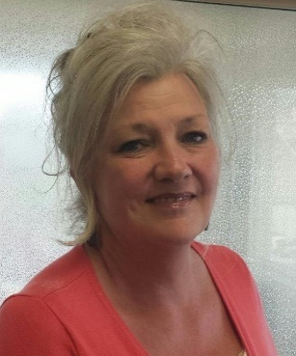


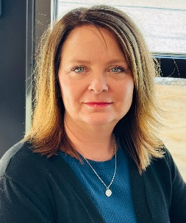



Meet the Business Engagement
Consultant Team
Brandi Haight
Burlington/Davenport
Mace Huffman
CR/IC
Shelby Hollett
CR/IC
Jeff Veit
Council Bluffs
Drew Emerson
Des Moines
Chad Pierce
Des Moines
Vonnie Stewart-Kai
Des Moines
c
Victor Ochoa
Dubuque
Theresa Bullock
Ft. Dodge
Michelle
Roseburrough
Marshalltown
Sara Cook
Mason City
Brenda Noe
Ottumwa
Chad Hauswirth
Sioux City
Aaron Merry
Spencer
Niki Litzel
Waterloo
Notes:
Meet the team who has a variety of backgrounds and experiences working in their communities with business partners.

Slide 5
Advanced Manufacturing Pathways Development (AMP’D)
Federally funded program with $4.3 million available
Purpose:
Align worker training with the technological needs of tomorrow.
Build a pipeline of new skilled workers, including current employees who can be quickly upskilled.
Offset the high cost of training and improve overall worker retention.
More detail:
Reimburse training costs of employers in the advanced manufacturing industry
Employers are eligible to receive up to 80% of the eligible training expense on a reimbursement basis.
The maximum reimbursement ceiling for each employer is $250,000 regardless of the number of training programs.
The maximum reimbursement ceiling per eligible employee is $4,000.
Completion of the training and six (6) month’s job retention.
Application Window: Ongoing application window open June 29, 2026, reviewed on a first-come, first-served basis
Iowa State University’s Center for Industrial Research and Service (CIRAS) will serve as a technical partner to interested employers.
Informational grant webinar available at: workforce.iowa.gov/opportunities/grants/ampd
Notes:
Meet the team who has a variety of backgrounds and experiences working in their communities with business partners.

Slide 6
Career Training Physical Infrastructure Program
Created in SF2168, signed by Governor June 2, 2026
$3.5M Infrastructure Grant to Grow Apprenticeships
Purpose:
Provide financial assistance for construction of new facilities/procurement of capital
Expand capacity for apprenticeship programs at community colleges, union facilities and non-union facilities
Applicants will demonstrate:
Expansion of infrastructure will directly increase number of workers for in-demand fields
Demonstrate employer-demand for the infrastructure project/equipment
Priority will be given to applications that demonstrate that training provided is not duplicative of other training programs provided.
Updates on the grant will be provided at www.workforce.iowa.gov.
Notes:
Meet the team who has a variety of backgrounds and experiences working in their communities with business partners.

Slide 7
Labor Market Information
Division
Iowa’s One-Stop Shop for Employers

Slide 8
What is Labor Market Information (LMI)?
The LMI Division of Iowa Workforce Development is responsible for collecting, analyzing, and reporting data related to Iowa's workforce and the economy.
Purpose:
The mission of LMI is to provide timely, accurate, and objective economic and workforce data so that customers can make informed plans, decisions, and policies: career exploration, education & workforce training, hiring, business recruitment and retention, and public policy .
Customers & Data Users:
Students
Job Seekers
Employers-Businesses
Economic Development
Workforce Development
Educators
State & Local Elected Officials & Policymakers
Researchers

Slide 9
Available Labor Market Information
Local Area Unemployment Statistics > Unemployment Rate, Unemployed, Labor Force
Current Employment Statistics > Number of Employer Jobs
Occupational Employment & Wage > Wages & Salaries paid to specific jobs
Industry & Occupational Forecasts > Future employment projection of industry and job demand
Career Exploration Data > STEM, Hot Jobs, Iowa’s Career Explorer
Quarterly Census of Employment & Wages > Detailed industry employment and gross wages
Job Openings > Current online job openings
Labor Force Demographics > Census data on demographic characteristics of the labor force
Laborshed Studies > Study of where communities attract their workers, identify available workers, and the characteristics of the workforce.

Slide 10
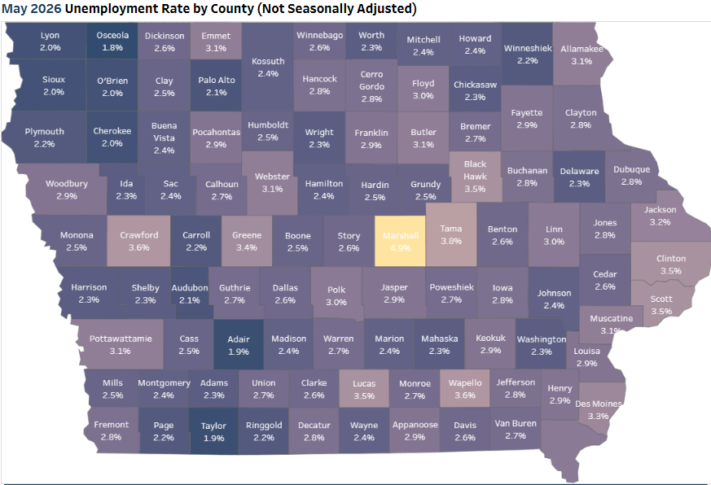
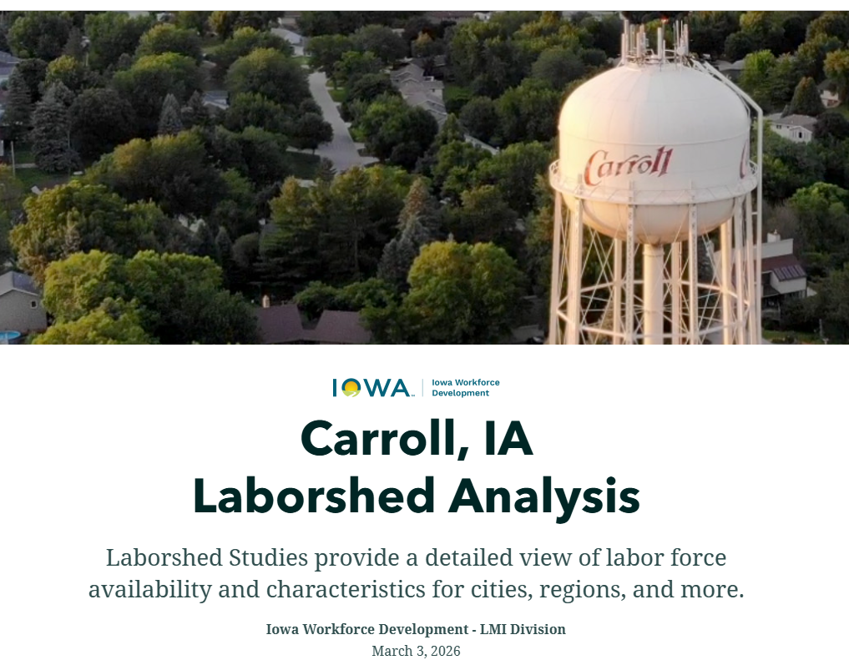
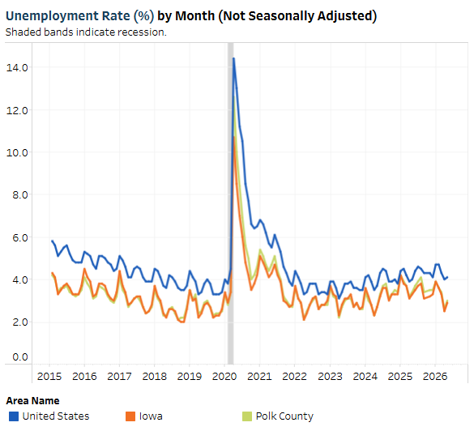
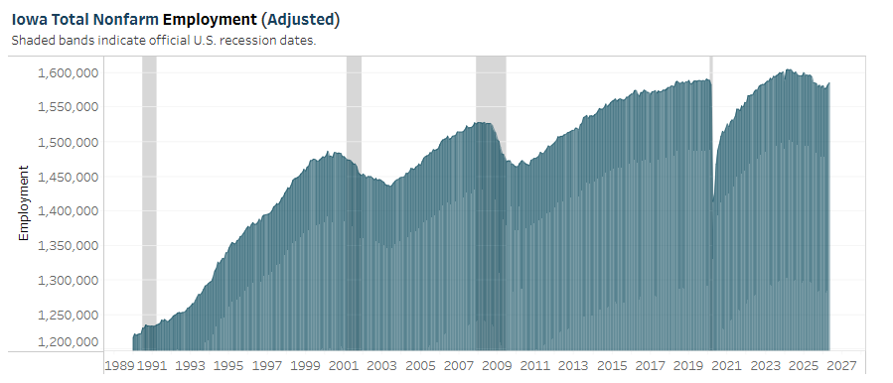
IowaLMI.gov

Slide 11
Iowa Workforce Development Contacts
Business Engagement Division
  Email: iaworks@iwd.iowa.gov
  Phone: 888-848-7422 (Option #1 followed by Option #7)
  Home page: https://workforce.iowa.gov/working-business-engagement
  Find your local Business Engagement Consultant: https://workforce.iowa.gov/employers/iwd-business/bec
Labor Market Information Division
  Email: iwd.lmi@iwd.iowa.gov
  Phone: 515-249-4765 (Ryan’s number}
  Home page: iowalmi.gov
  Labor Market Information Resources page: https://workforce.iowa.gov/labor-market-information/resources

