Slide 1
Business Incentives for Growth (BIG) Program
Maicie Pohlman | Program Manager
Iowa Economic Development Authority

Slide 2
BIG Program Purpose
Helps qualifying businesses offset some of the costs of locating, expanding or modernizing a facility in Iowa. Offered by the Iowa Economic Development Authority (IEDA), BIG supports growth in key industries:
Advanced manufacturing
Bioscience
Insurance and Finance
Technology

Slide 3
Not eligible for BIG
Retail businesses
Service providers
Data centers
Businesses not engaged advanced manufacturing, bioscience, insurance/finance, or technology as their primary business
Routine projects such as deferred maintenance, repairs or basic equipment replacement

Slide 4
Tax Incentives
Only projects that demonstrate extensive economic impact will be awarded the maximum amount of tax incentives
Maximum 5% of Qualified Investment - County population > 20,000
Maximum 7.5% of Qualified Investment - County population < 20,000
Type of Tax Incentives
  Investment tax credit — performance-based, earned when qualifying assets are placed in service, and spread over five years. If the credit exceeds Iowa income taxes owed, the difference is refunded.
  Refund of sales tax paid on construction materials.
  Local property tax exemption, if approved by the city or county

Slide 5
Qualifying Investment
Capital investment in real property
Purchase of land and buildings
Site preparation
Building construction
Major renovation
Long-term lease costs
  10-year term

Slide 6
Qualified Jobs
Created at least 100% of the local laborshed wage
Retained jobs at least 120% of the local laborshed wage
  Wage established at the time of the application approval
Wage requirements can be searched by city or zip code on the IEDA website.

Slide 7
Additional Economic Impact Factors
Having a high proportion of, or growing, number of in-state suppliers
Diversifying the state’s economy
Has few in-state competitors
Increasing skills and wages for existing workers
Increasing capacity, productivity, efficiency, and competitiveness through adoption and integration of smart technologies.
Increasing the state’s GDP

Slide 8
City or County participation
Municipality (city or county) sponsor by resolution
Local match not prescribed or required
BIG statute authorizes local exemption
  At the discretion of municipality
  Up to 100% over 10 years

Slide 9
Additional BIG Provisions
Sufficient benefits package to all full-time employees
Projects initiation prohibited (includes starting construction, acquiring a building, executing a lease agreement, or installing equipment)
Relocating or reducing operations in one part of the state, cannot simultaneously seek incentives
A pattern or record of violations of the law or of rules, including but not limited to antitrust, environmental, trade, or worker safety may be ineligible.
Additionally confidential payroll and financial documentation will be required with applications and throughout the contract compliance.

Slide 10
Water Conservation and Waste Reduction Plan
Projects that that will result in elevated water consumption by the business, the BIG application shall be accompanied by a water conservation plan
Elevated water consumption will be assessed using the following factors:
  The total anticipated water consumption and wastewater discharge
  The capacity of the water provider facilities that will serve the project
  Information provided by the water provider about the ability or inability to accommodate the anticipated water consumption
  Information provided by the Iowa Department of Natural Resources

Slide 11
Application fee for BIG applications
0.5% of the total tax incentives awarded, up to $10,000
Due at application approval
  Contract will be issued after fee is paid

Slide 12
BIG Contract
Terms of the agreement will be based on the incentives awarded.
  The contract will be in place for as long as the company is claiming credits.
Flexibility on time to make investment and create jobs.
  Three-year assumption for investment completion
  If the company completes the investment prior to that date, they can proceed with documenting the investment and claiming credits.
Annual Reports will be required for all open contracts
  Confirm that the business is at or above base employment
  Employee benefits meet the sufficient benefit requirement
  Status of project
The job verification will be done following the contract end date, at close out.
  The base employment established at the application must be maintained throughout the contract period.

Slide 13
Application Process
Submit a pre-application — a confidential check of eligibility and estimate incentives.
Complete the application (if invited). Substantial completion by the 15th of the month and must be signed by month’s end for review at the next month’s IEDA Board meeting.
IEDA Board review. The board meets monthly on the third Friday. Awards and application details are public, though payroll and financial records remain confidential under Iowa law.
Submit through the online portal. Both pre-applications and applications are managed online.

Slide 14
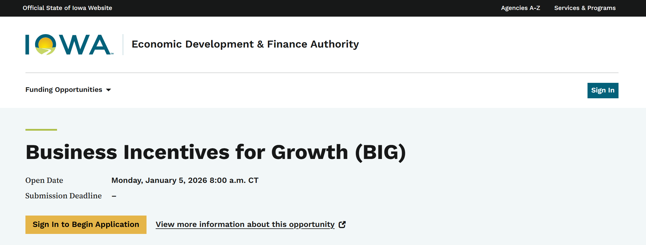
Opportunity Iowa
Portal
Company contact – sign in
Create Organization profile
Navigate to Funding Opportunities
Start BIG pre-application
If applicable, invite consultant (step 2)

Slide 15
THANK YOU

