Slide 1
Ready, Set…Collaborate
Jason Hutcheson
Dennis Fraise

Slide 2
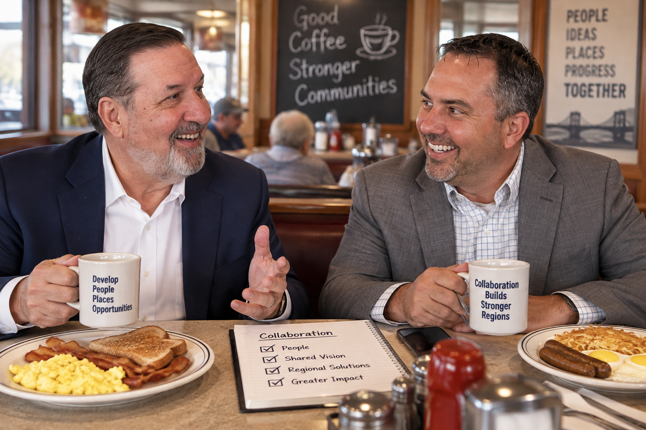

Slide 3
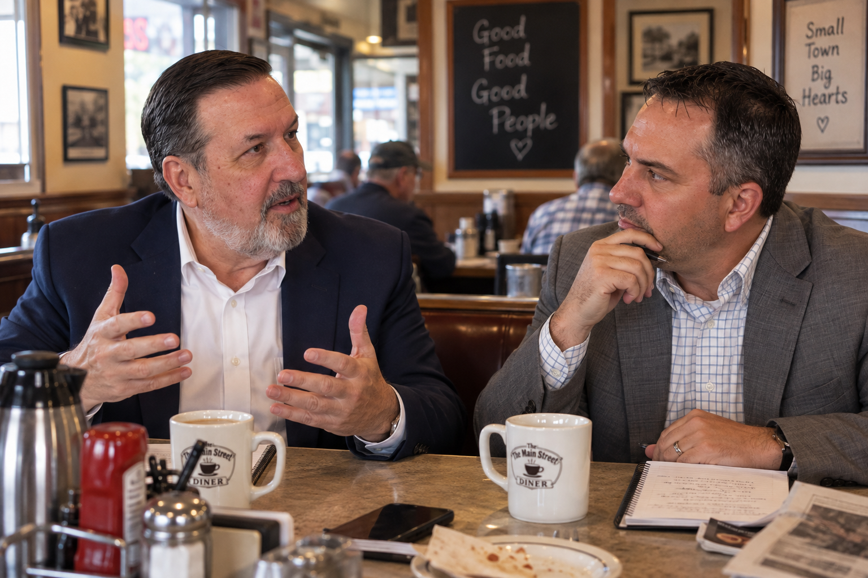

Slide 4
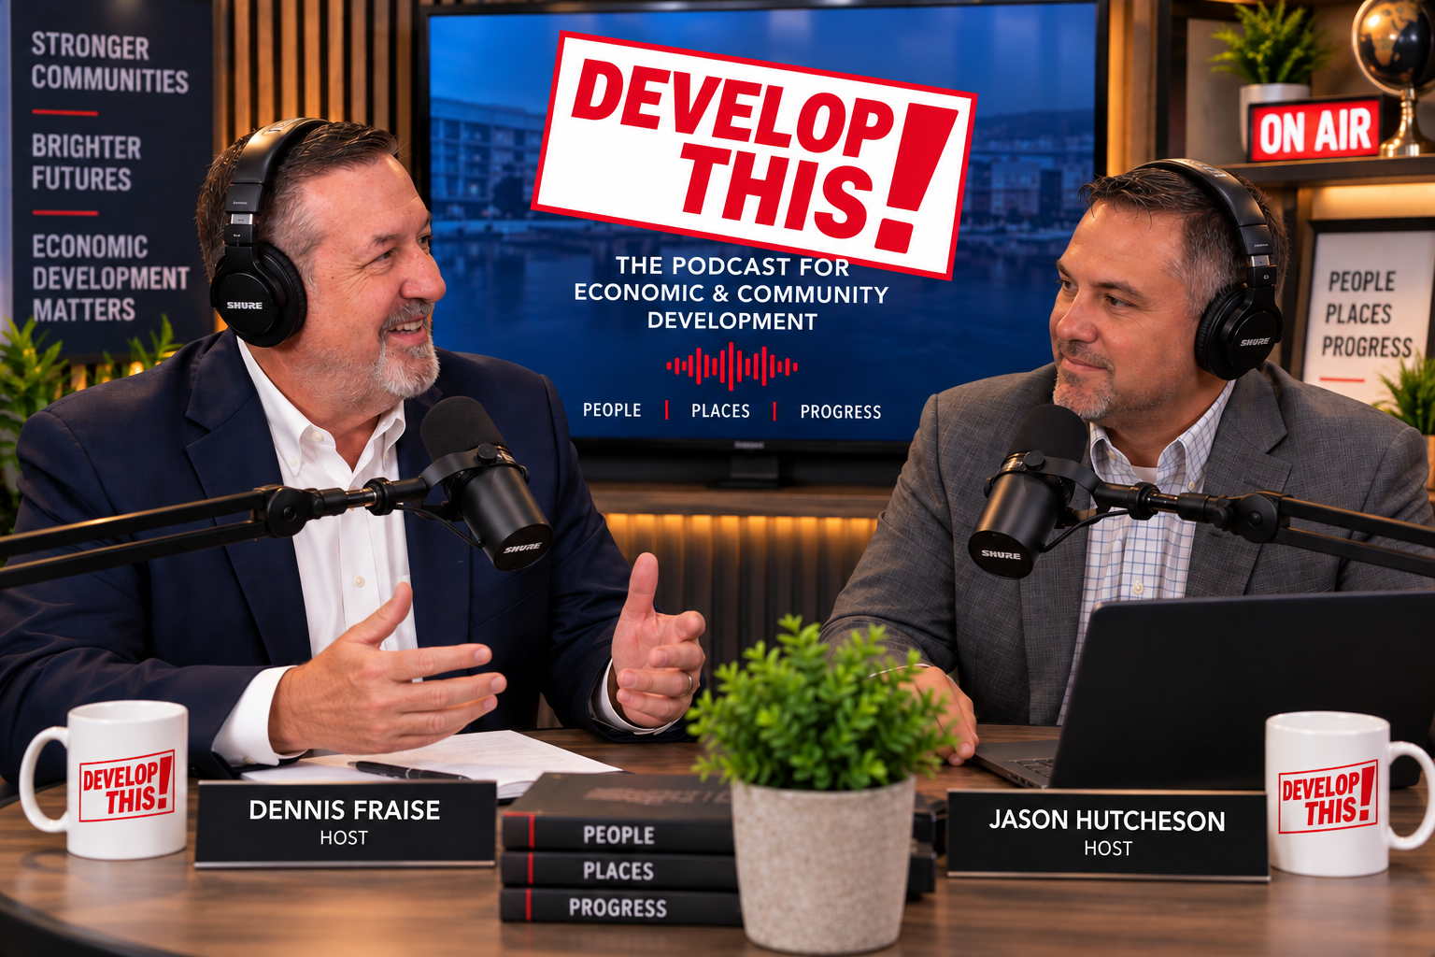

Slide 5
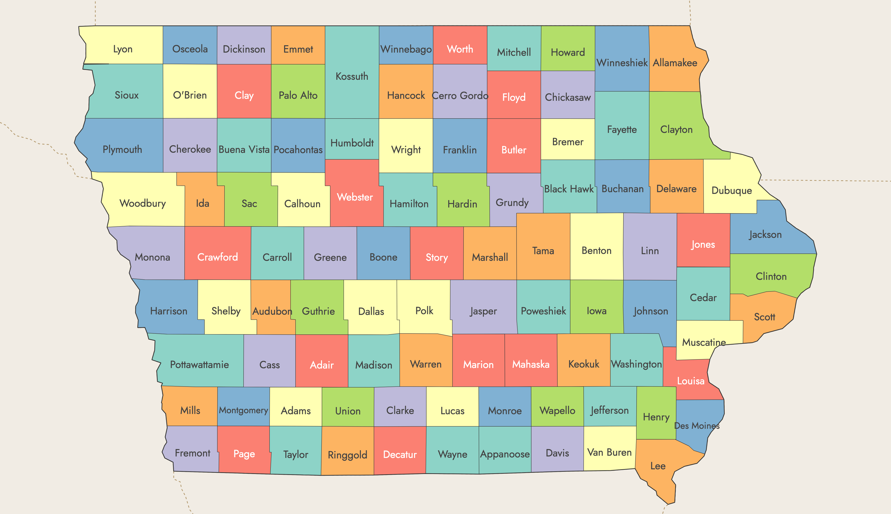

Slide 6


Slide 7
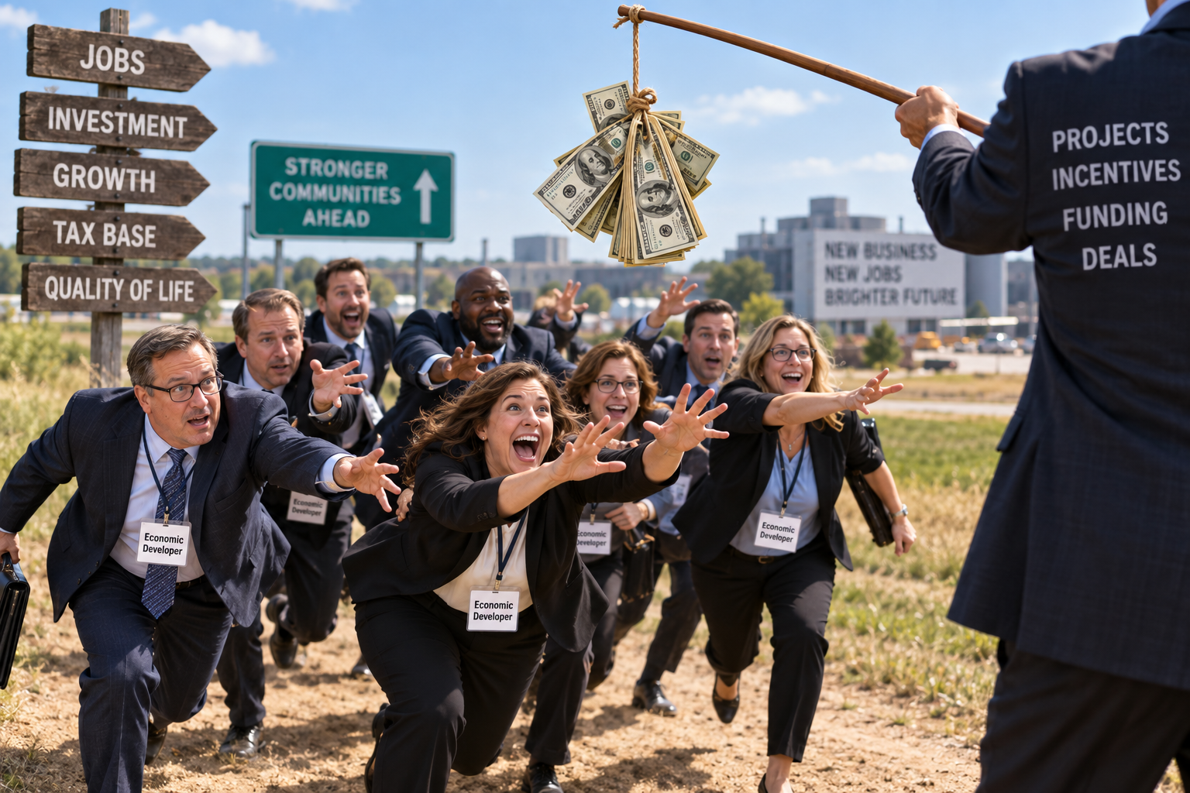

Slide 8
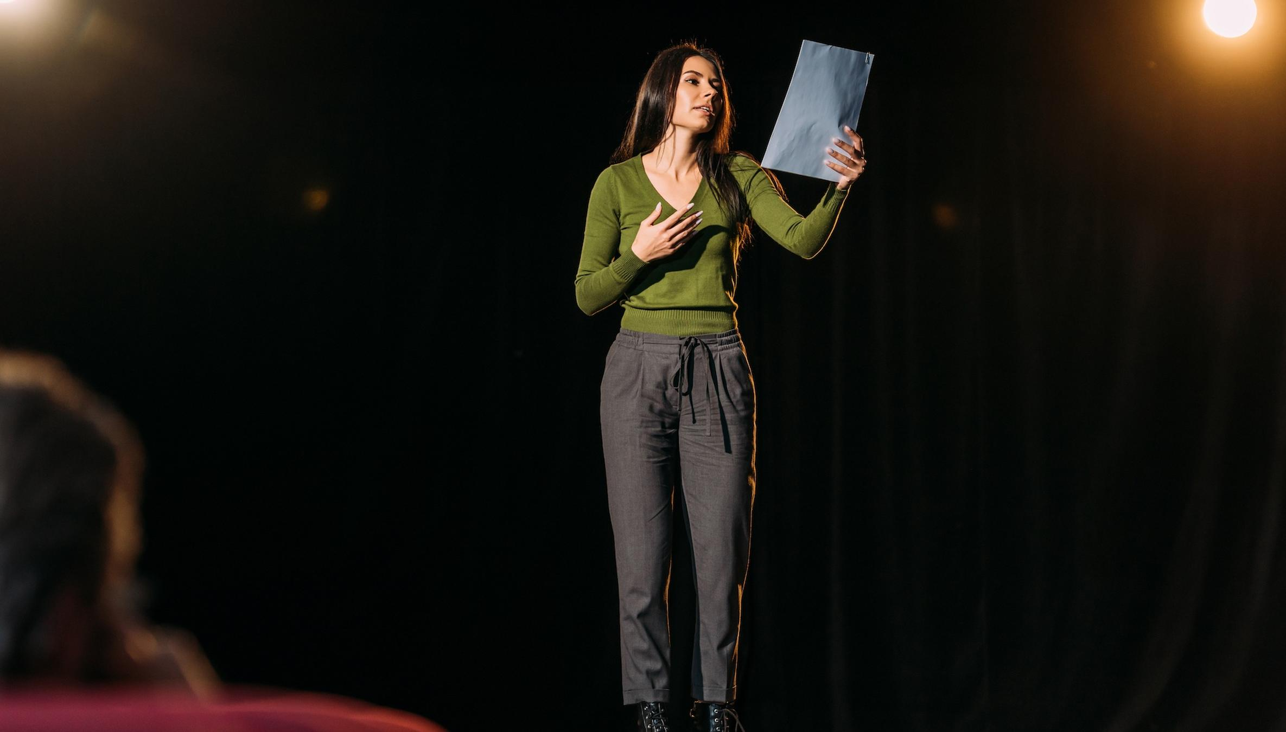

Slide 9
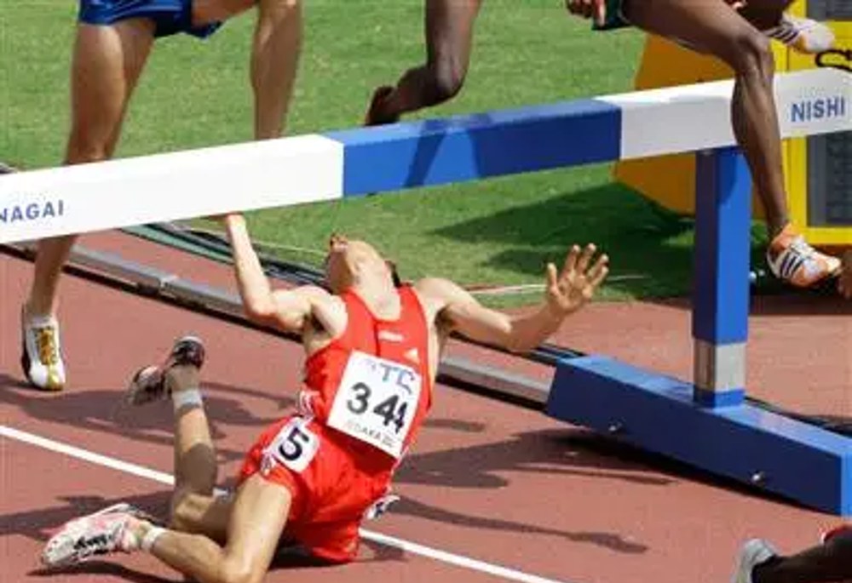

Slide 10


Slide 11


Slide 12
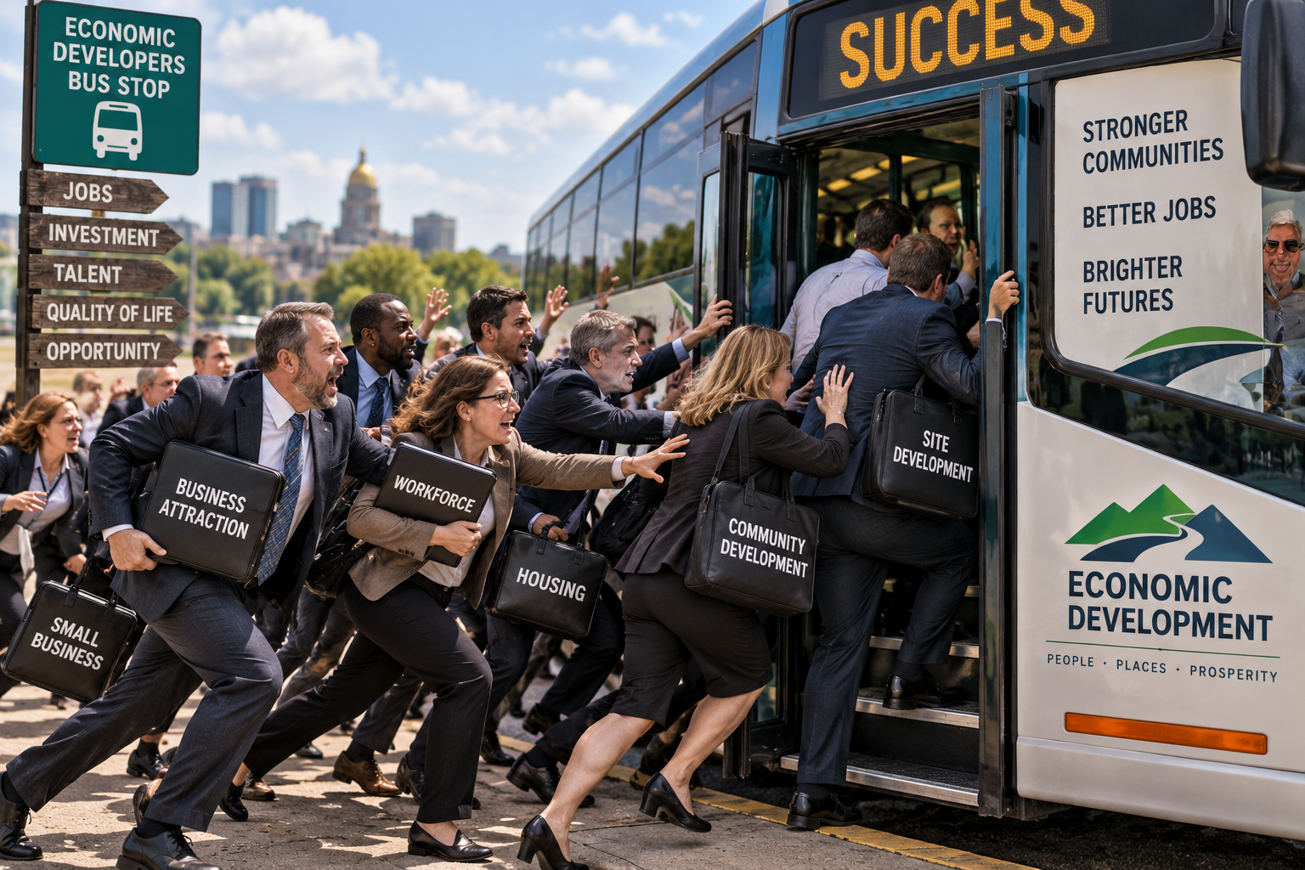

Slide 13


Slide 14
Never Ask A Question You Don’t Already Know The Answer To.

Slide 15


Slide 16

Thank You!

