Slide 1
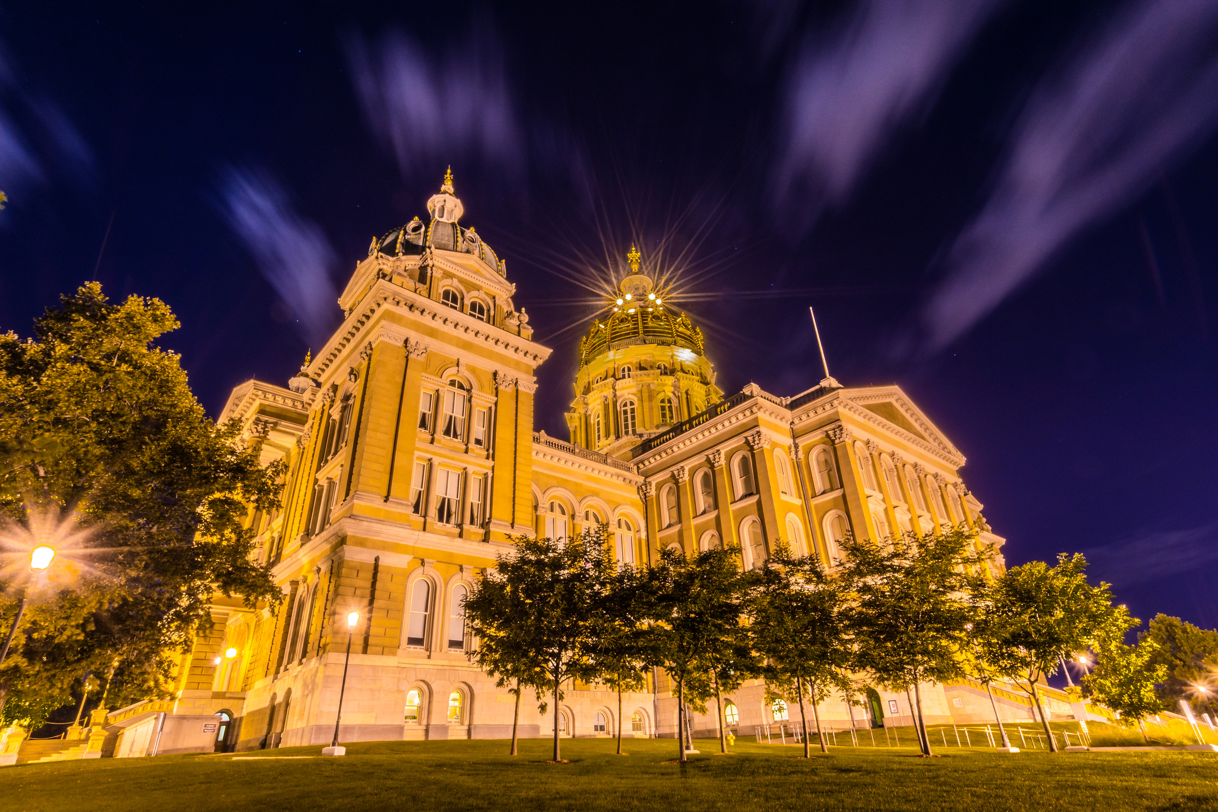

2026
P3 Workshop
Legislative overview

Slide 2
LEGISLATIVE COMMITTEE CO-CHAIRS
FOR MORE INFORMATION CONTACT:
Josh Laraby
PDI LOBBYIST
jlaraby@cityofjohnston.com and (319) 344-8611
Craig Patterson
craig@ialobby.com
(515) 554-7920
Nicolas Hockenberry
nicolas@greaterdubuque.org and (563) 557-9049
Dave Miller
David.Miller@homesforia.com and (712) 830-1445
EXECUTIVE DIRECTOR
Lane Till
Jolly Omar
director@pdIowa.com
(515) 750-2310 Ext. 8
Jolly.omar@stuartia.gov and (515) 363-8002

Slide 3
2027 STATE LEGISLATIVE PRIORITIES
  Professional Developers of Iowa is the state association of economic development professionals united to strengthen communities and drive long-term growth for Iowa.
  PDI’s more than 300 members come from disciplines including community, county and regional economic developers, utilities, legal and financial firms, universities, community colleges, engineering and construction firms, and rail transportation companies.
  PDI’s 2025 legislative priorities represent the collective interests of economic development leaders across Iowa’s 99 counties.

Slide 4
TOPICS / AGENDA
  Purpose of Legislative Committee
  Why advocacy matters
  How to contact your representative
  PDI State Legislative priorities
  Legislative schedule
  2026 Legislative Session in review & 2027 thoughts
  Q&A

Slide 5
2026
Election Year
Change is coming (IGOV/Cabinet, IA House, ½ Senate)
Leadership Changes. Agency Direcotrs, Dept. Leadership
Find candidates local events & attend!
Offer tours, meetings with business & leadership

Slide 6
2026
LEGISLATIVE ROUNDTABLES
Partnering with League of Cities and others!
Stay tuned for locations!
Creston: Tuesday, Sept. 29 @ 10am
Council Bluffs: Wednesday, Sept. 30 at 3pm
Spencer: Thursday, October 1 @ TBD

Slide 7
2026 LEGISLATIVE SESSION
WHAT ACTUALLY HAPPENED:
WINS:
  Workforce Housing Increase
  Business Incentives for Growth (BIG)
  Continued Economic Development Funding

Slide 8
2027 LEGISLATIVE SESSION
WHAT TO KEEP AN EYE ON:
ONGOING ISSUES:
  Property Tax
  Tax Increment Financing (TIF)
  Housing
  Infrastructure
  Workforce Development (260E/F)

Slide 9
WHAT SHOULD YOU BE DOING RIGHT NOW?
  Know your legislators
  Invite them to projects (Public & Private)
  Share successes & failures (why!)
  Measure outcomes / Use Data
  Build partnerships – Think regionally
  Stay engaged with PDI Team
  Q&A

Slide 10
LEGISLATIVE AGENDA
discussion

Slide 11
ADDRESS
CONTACT INFORMATION
400 East Court Ave., Suite 126 Des Moines, Iowa 50309
PROFESSIONAL DEVELOPERS OF IOWA
EMAIL ADDRESS
WWW.PDIOWA.COM
director@pdIowa.com
PHONE NUMBER
(515) 750-2310 Ext. 8

