Slide 1
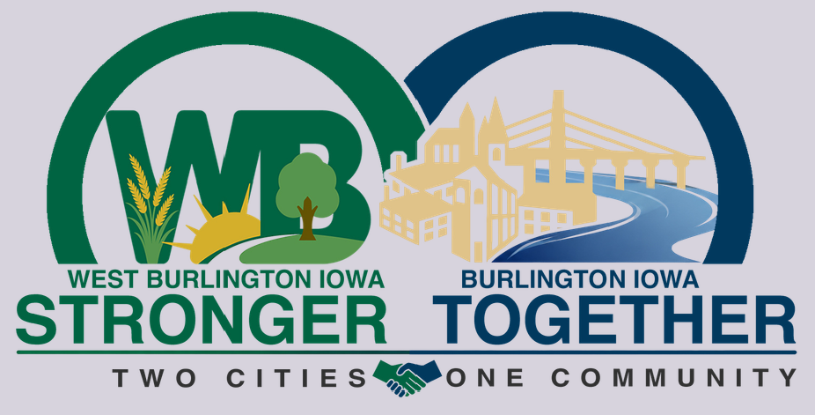
Building Stronger Communities through Collaboration
Burlington & West Burlington
Two Cities. One Community.
Different Identities. Shared Opportunities.
Chad Bird, Burlington
Gregg Mandsager, West Burlington
Notes:
The Burlington–West Burlington effort is not really a story about consolidation. It is a story about figuring out where jurisdictional boundaries matter—and where they really shouldn’t.
As my colleague to the West says, sometimes sharing and collaboration work and sometimes they don’t – but we should always discuss.
Collaboration doesn't require consolidation. It requires trust, communication, and the willingness to ask, "Why are we doing this twice?"

Slide 2

… or how diving with sharks requires teamwork and cooperation.

Slide 3
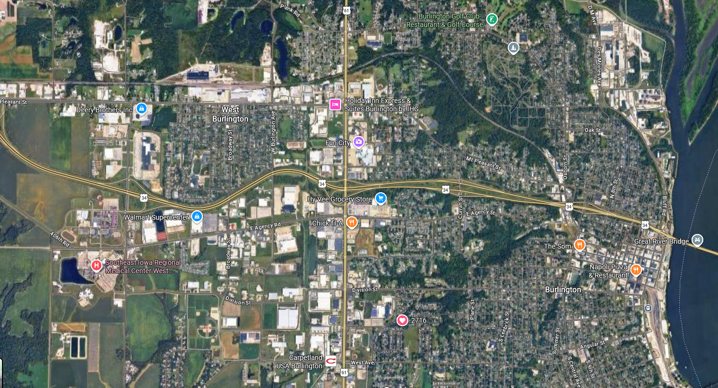
Notes:
“If I erased the municipal boundary from this map, could you tell me where Burlington ends and West Burlington begins?”
Burlington is roughly 23,600 people and West Burlington roughly 3,200, but economically and socially the communities function in many respects as one area. The University of Iowa study even captured the sentiment that the communities are essentially one community separated by a governmental boundary.
We aren't trying to erase that boundary. We're asking when it should matter.
For residents, employers, developers and visitors:
They don't particularly care which jurisdiction plows which road.
They don't care whose fuel tank a city truck uses.
They don't care which city owns the swimming pool.
They don't care whose name is on a regional plan.
They care whether the community works.

Slide 4
University of Iowa Study
Iowa Initiative for Sustainable Communities
West Burlington (pop. 3,197) and Burlington (pop. 24,018) requested a study (’24/’25) exploring opportunities to share/merge some local government department-level services.
Rather than each community providing essential services individually, strategic collaboration may result in significant cost savings and enhanced quality of services to residents. One community partner stated that “Burlington and West Burlington are essentially one community except for a boundary that separates the two.”

Slide 5
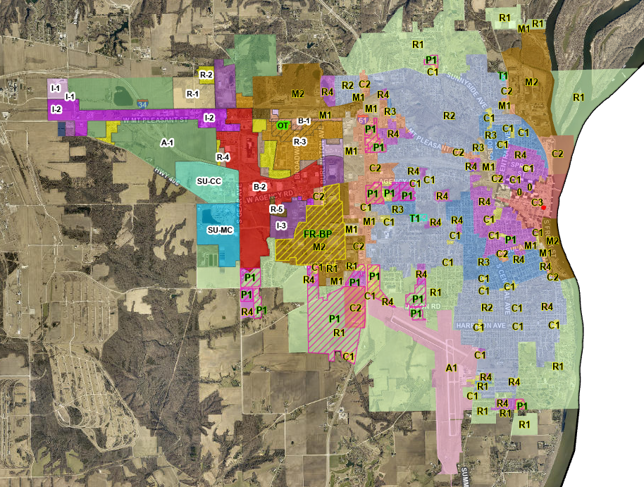
A developer sees:
  Workforce → Infrastructure →
  Land →
  Utilities → Transportation → Housing →
  Amenities →
  Permitting →
  Incentives
Notes:
Developers don't see municipal boundaries the way governments do.
A developer sees:
Workforce → Infrastructure → Land → Utilities → Transportation → Housing → Amenities → Permitting → Incentives
Government tends to see:
Burlington | West Burlington | County | School District | Utility | State
Your point:
“Our challenge as local government officials is to make the second system work more like the first.”
That's a strong economic-development message.
Discuss how unnecessary jurisdictional fragmentation can mean different processes, duplicated infrastructure, competing capital priorities, inconsistent communication, and sometimes communities competing against themselves.
Similar zoning, same codes, especially building and rental.

Slide 6
  So, where do we start?
“Start with the boring stuff”
Lesson #1: Don't start with police and fire. Start with the fuel tank.
The Iowa shared-services study found exactly the sort of thing we encountered in practice:
equipment purchases, training and seasonal staffing can offer relatively straightforward opportunities, while police and fire raise much more complicated questions involving service models and community identity.
Why was the fuel farm was such a useful first project.
Low political risk.
Easy to understand.
Measurable savings.
No loss of community identity.
Nobody wakes up saying:
“I'm furious that my city's dump truck bought diesel three miles east.”
Successful small collaborations build the trust needed for larger collaborations.
Notes:
There has been a history of practical cooperation.
Water. West Burlington purchases water from Burlington for resale through its municipal distribution system.
Fuel Farm. In 2024, West Burlington began using Burlington's fuel farm. Burlington gains purchasing volume; West Burlington avoids duplicating infrastructure and gains efficiency.
Aquatics. When Burlington did not open Dankwardt Pool in 2025, the communities worked together so Burlington residents could retain access to West Burlington's aquatic facility.
University of Iowa partnership. Nearly 90 students and faculty worked on 15 projects spanning both communities—including shared services, transportation, arts and culture, engineering and planning.
Joint Councils. The two councils have moved beyond staff-level cooperation to regular elected-official conversations. The May 2026 joint work session specifically included cooperation, accomplishments, ongoing discussions and next steps.
Collaboration is a ladder
Help each other → Share equipment → Share facilities → Coordinate planning → Share services → Joint investment
And importantly:
You don't have to climb every rung.

Slide 7

Notes:
What teamwork and collaboration do we see here?
Again, Successful small collaborations build the trust needed for larger collaborations.

Slide 8
Now, you decide.
  Share / Maybe / Keep Separate
Street Sweeper | Share | Maybe | Keep Separate
Building Inspector (staff)
IT / Cybersecurity (staff or other)
Fire Department
Communications (other staff?)
Expensive, specialized equipment only used 30 days a year
Notes:
OK – you’re a city council member
Then ask two tables to explain one answer.
Your reveal:
There isn't necessarily a right answer.
Instead ask:
What made you uncomfortable?
Cost?
Control?
Response time?
Accountability?
Community identity?
Politics?
Those are exactly the issues Burlington and West Burlington have been confronting.

Slide 9
The Five Questions
1. Are we both buying the same thing?
Capital
2. Are we both struggling to find the same people?
Staffing
3. Could one operation serve both communities better?
Efficiency
4. Would residents notice a decline—or an improvement?
Service
5. Does local identity/control genuinely matter here?
Community
Notes:
The Burlington/West Burlington decision test
The University of Iowa team developed a decision framework around issues including capital purchases, staffing, service quality, cost efficiency and community identity/political feasibility.
Both cities perform pavement marking. The cities have explored jointly purchasing a larger painting vehicle and allocating cost based on lane miles. West Burlington's analysis indicated its investment could potentially be recovered in about three years.
That's almost the perfect shared-service case study.
Expensive equipment + low utilization + easy scheduling + measurable allocation = good candidate.

Slide 10

Notes:
Most collaborative arrangements eventually encounter:
“Who decides?”
“Who pays?”
“Whose employee is it?”
“Who gets priority?”
“What happens when both cities need it?”
“What if one council changes direction?”
“What happens when someone complains?”
“What if one community thinks the other is getting the better deal?”
The UI study found these exact concerns, including communication between managers, priority setting, complaints, and preservation of community identity.
Your lesson:
You can solve the financial equation on a spreadsheet. The governance equation is harder.

Slide 11
The $1 million Decision.
Your neighboring city calls.
Both communities need a specialized public works facility/equipment package.
City A: Population 25,000
City B: Population 4,000
Separate facilities/equipment:
$1 million each.
Joint facility/equipment:
$1.35 million total.
But...
City A expects 75% of the use.
City B wants equal governance.
The facility would physically be located in City B.
Both cities occasionally need it simultaneously.
Notes:
You have three minutes. Structure the deal.
They have to decide:
Who owns it?
How are capital costs divided?
How are operating costs divided?
Who gets scheduling priority?
Who replaces it?
How does either city get out?
“Congratulations. You are now city managers.”

Slide 12
One Community ≠ One Government
Collaboration ≠ Consolidation
Burlington and West Burlington have explicitly emphasized preserving their separate identities while exploring shared services and reducing duplication.
“Sometimes when you start talking about shared services, people immediately jump to merger or consolidation. That's not what we're talking about. We're talking about two communities retaining their identity while being mature enough to recognize that identity doesn't require duplication.”
- Someone Wise

Slide 13
The Headlines
Greater Burlington is not alone
Headline #1: Fiscal pressure is forcing collaboration
Property-tax and revenue constraints are making cities reconsider whether every jurisdiction needs to independently own every asset and provide every service. The Burlington-West Burlington study specifically identified Iowa's changing municipal revenue environment as part of the impetus for examining shared services.
Headline #2: Economic development is increasingly regional
Labor sheds, housing markets, transportation systems, retail markets and utility systems don't respect city limits.
Headline #3: Collaboration is spreading beyond governments
Jackson County recently used a similar University of Iowa process to examine overlap and coordination among economic development organizations, chambers and tourism entities.
Notes:
I go back to earlier comments; citizens deserve the best in public service, and they don’t really care who delivers the basic needs.

Slide 14
What can we take home?
Start with relationships, not agreements.
Start small and bank some wins.
Share things before you share people.
Don't collaborate simply for the sake of collaboration.
Measure savings and service—not just savings.
Respect community identity.
Ask “Why not?” instead of automatically saying “That's how we've always done it.”
Then finish with:
The boundary can define our governments without defining our community.
Notes:
Check the egos and the arm patches at the door.

Slide 15
