Slide 1



Winter Winners
Myths. legends and made up monsters

Slide 2
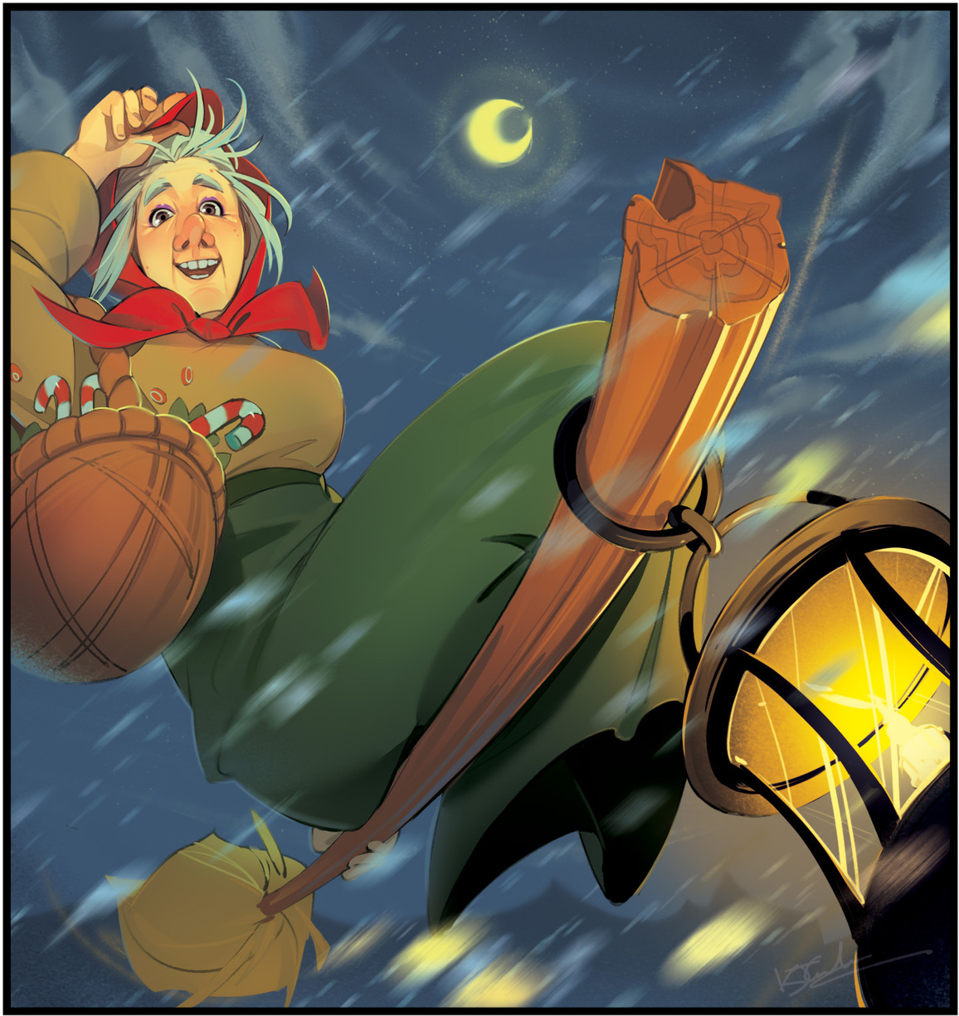
BEFANA
In Italy, it’s this friendly winter witch who delivers all the presents.
No need for reindeer when you have a broomstick.
What sorts of adventures would she have in flight?

Slide 3
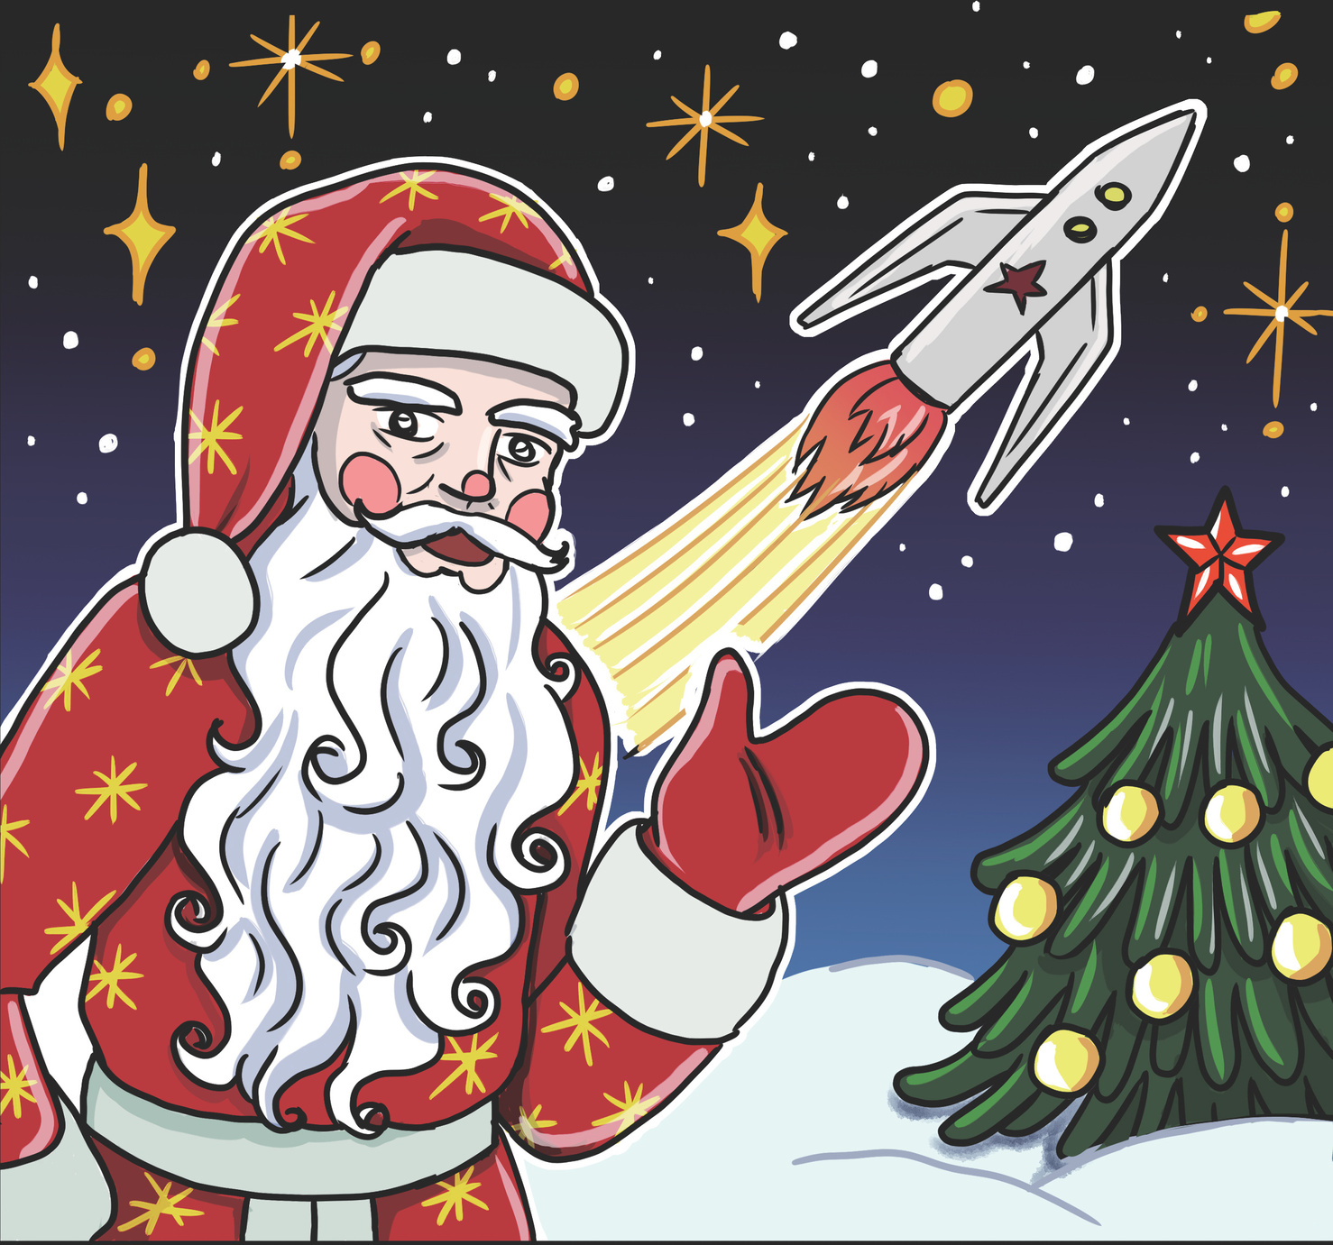
DED MOROZ
This Russian Santa started flying spaceships in the 1950s.
He’s also sometimes known as
Grandfather Frost.
Where would this Space Santa travel to? Who might he meet?

Slide 4
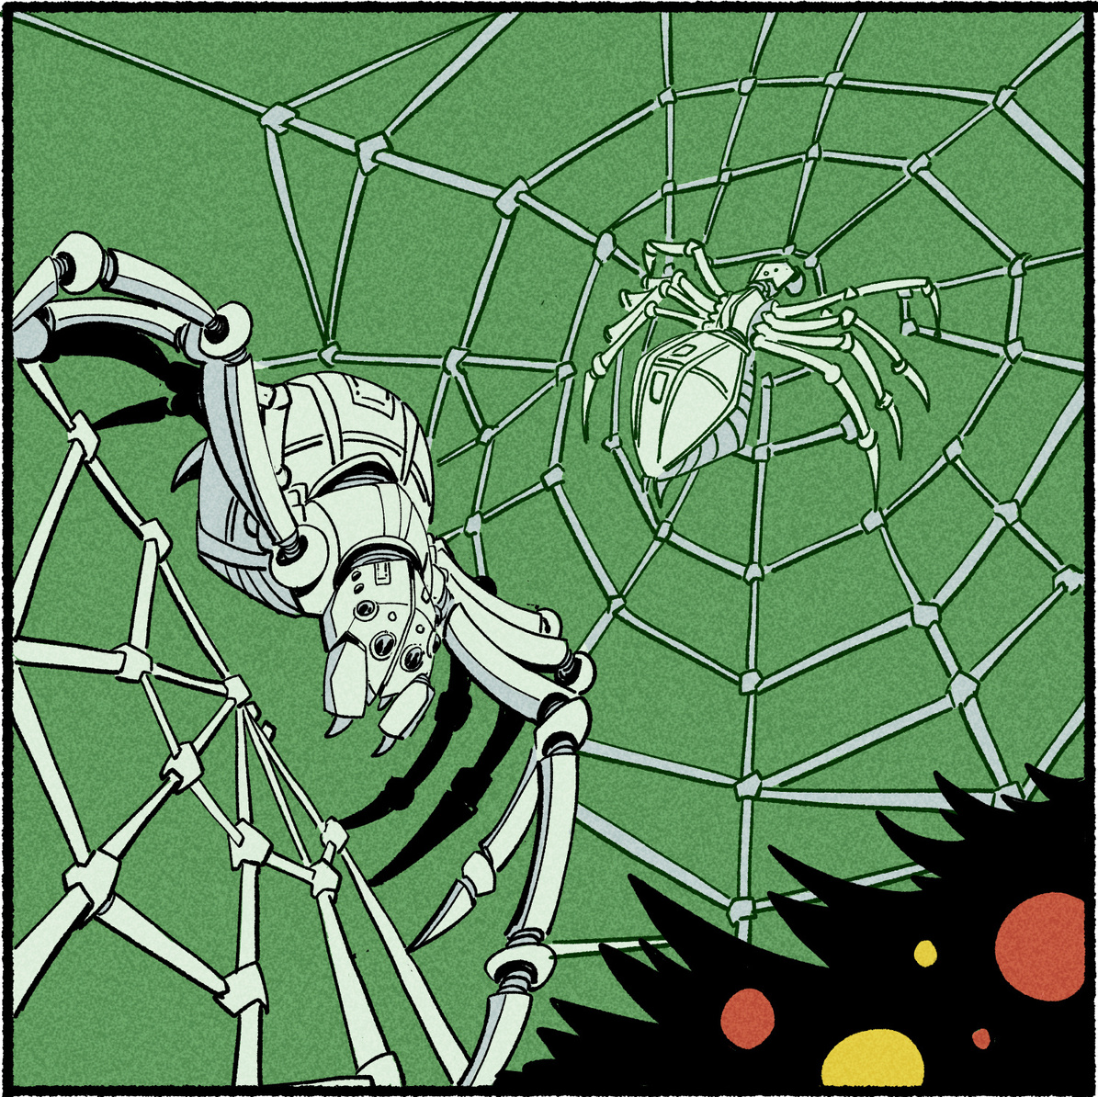
CHRISTMAS SPIDERS
In Ukraine, there’s a tale of friendly Christmas spiders, who decorated a family’s tree with their sparkling icy webs.
What decorations would other insects make?

Slide 5
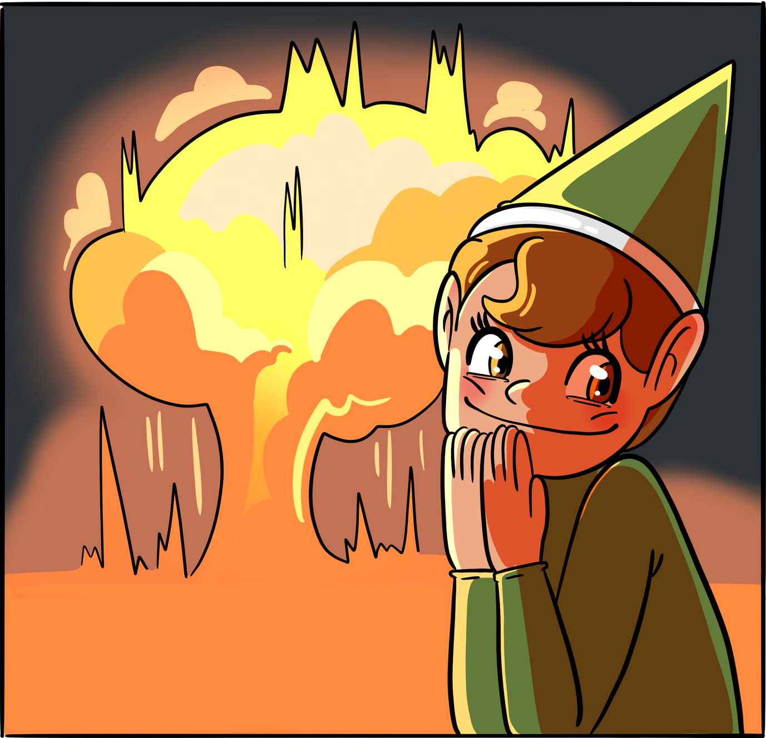
STEALTH ELF
Cheeky house elf or dangerous spy on a mission?
What sorts of special spy equipment do they use?
What traps might they set?

Slide 6
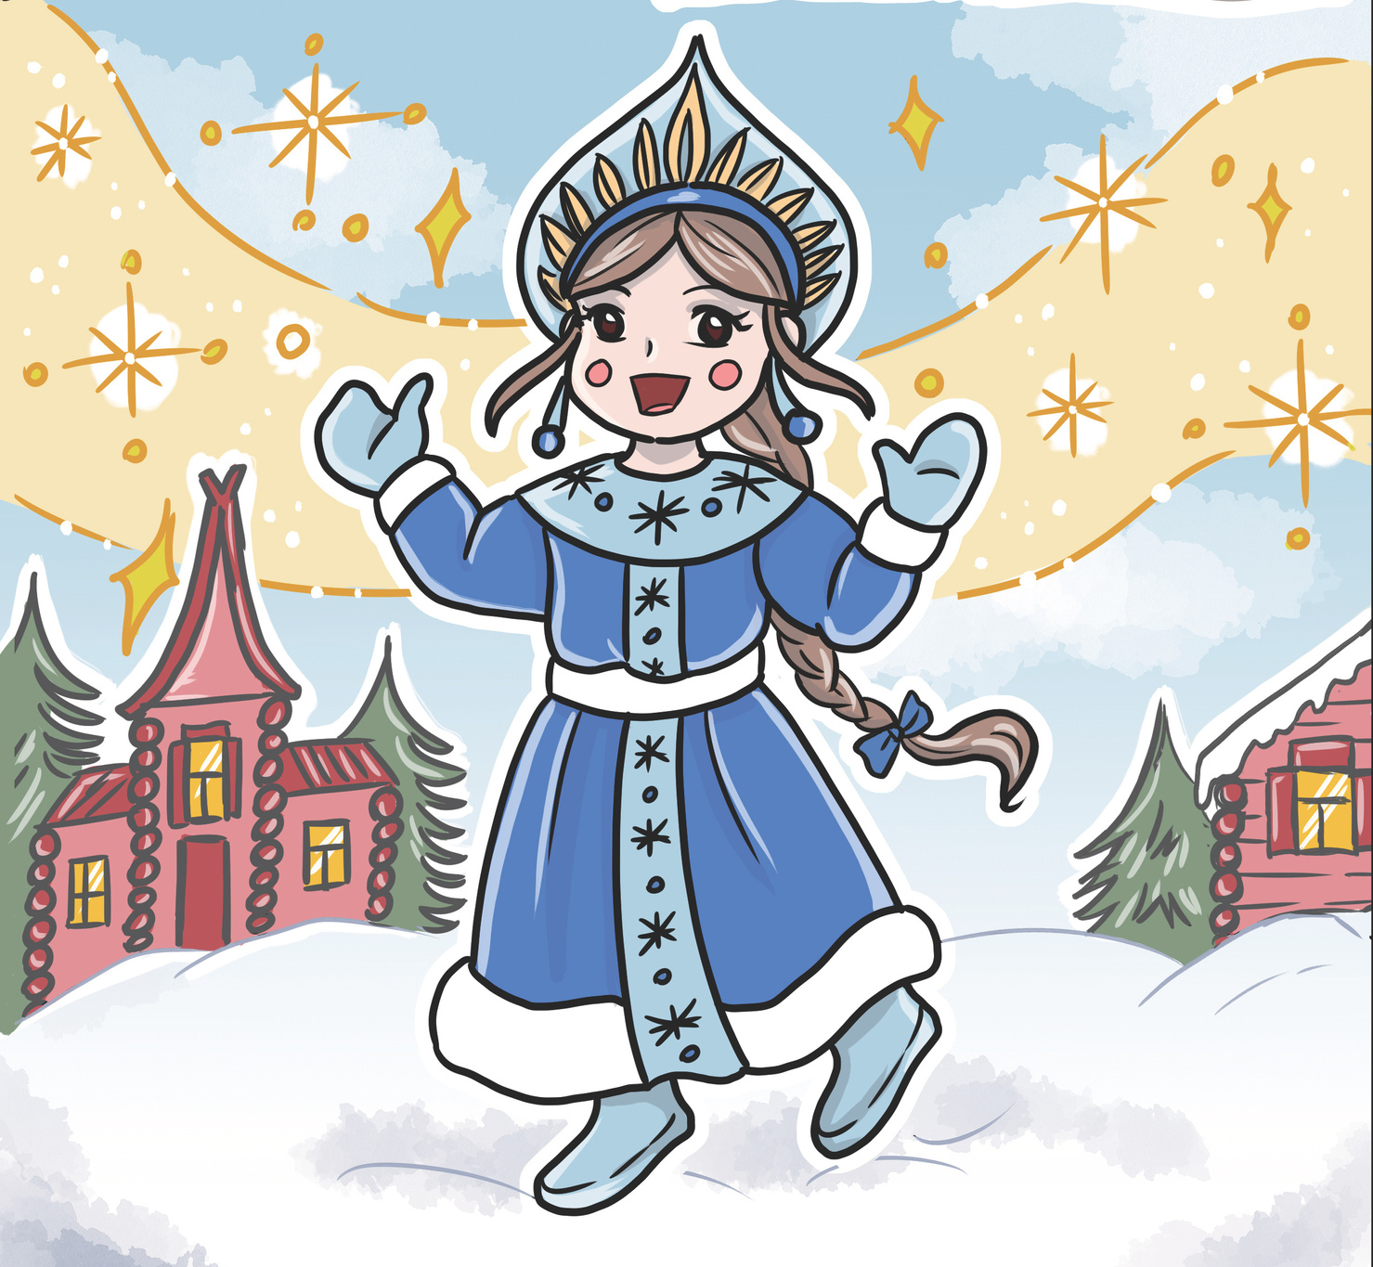
The magical Russian snow maiden, made of snow and ice, but with a warm heart.
What’s your favourite type of warm drink in winter?
SNEGUROCHKA
The magical Russian snow maiden, made of snow and ice, but with a warm heart.
What’s your favourite type of warm drink in winter?

Slide 7
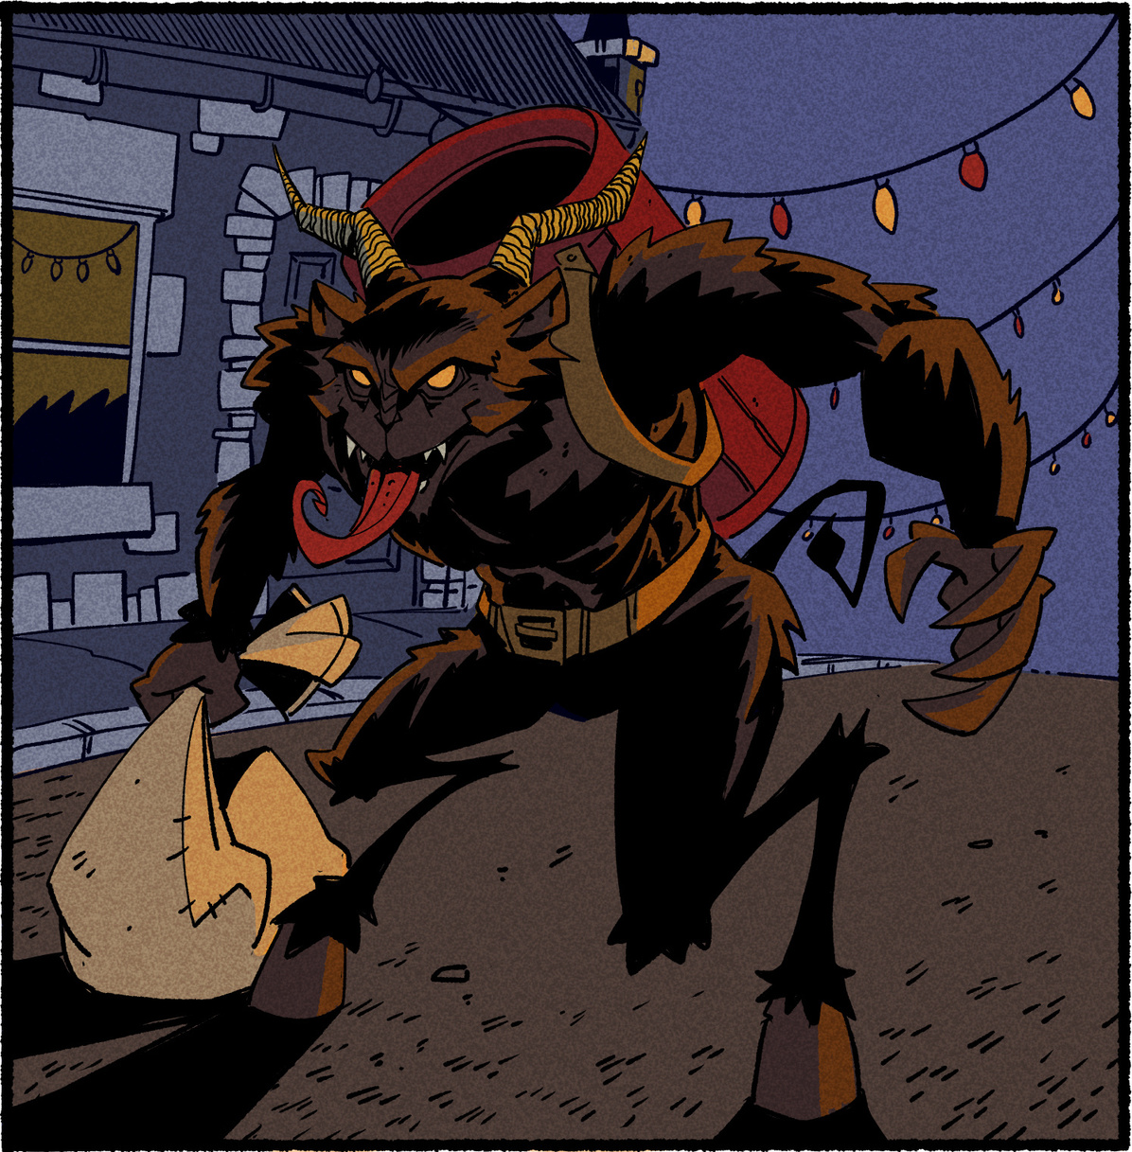
KRAMPUS
In some countries, the ‘Devil of Christmas’ pays a visit to anyone on the naughty list.
‘Krampusnacht’ or Krampus Night is usually celebrated on 5th December.
What’s the most helpful thing you have done all year?

Slide 8
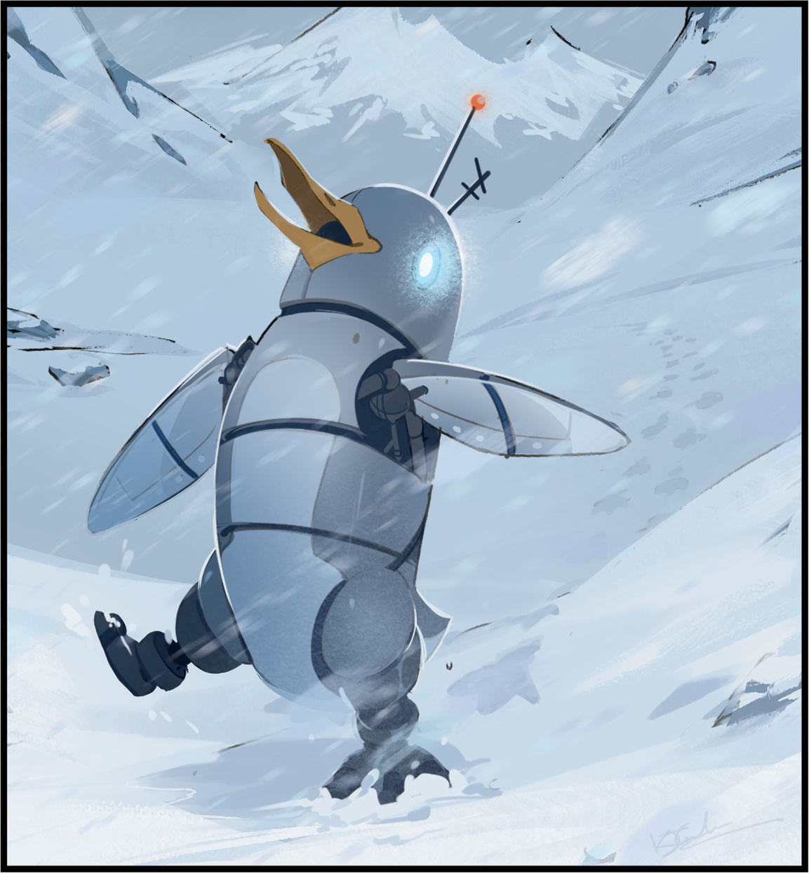
PENGBORG
A Cyborg Penguin, protecting the Antarctic from alien spacecraft.
What sorts of strange things might he encounter on his patrols?

Slide 9
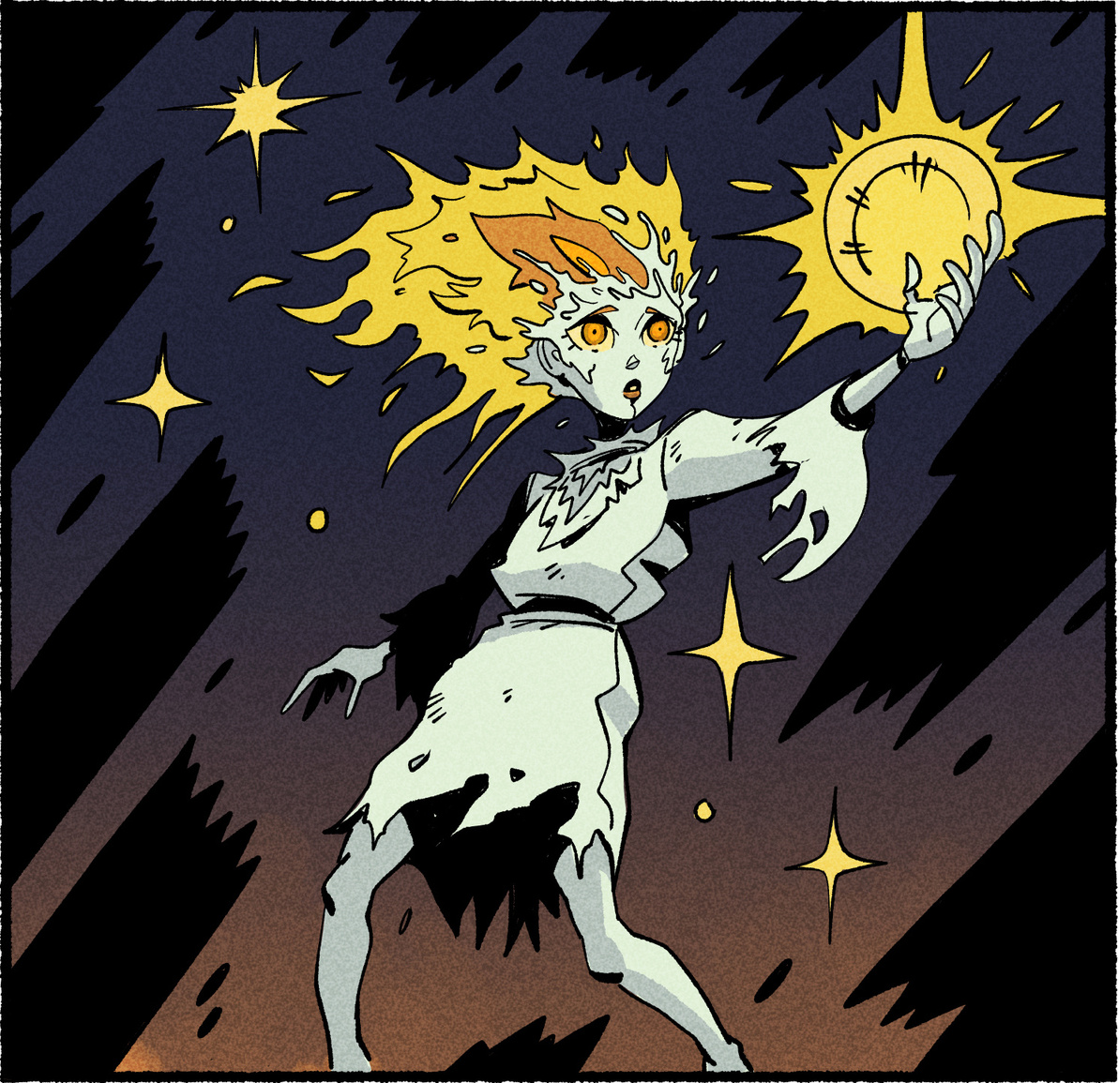
GHOST OF
CHRISTMAS PAST
One of the Ghosts who visits Scrooge in Charles Dickens ‘A Christmas Carol’.
She’ll show you all the yesterdays that matter…
Can you remember your favourite ever day?
What made it special?

Slide 10
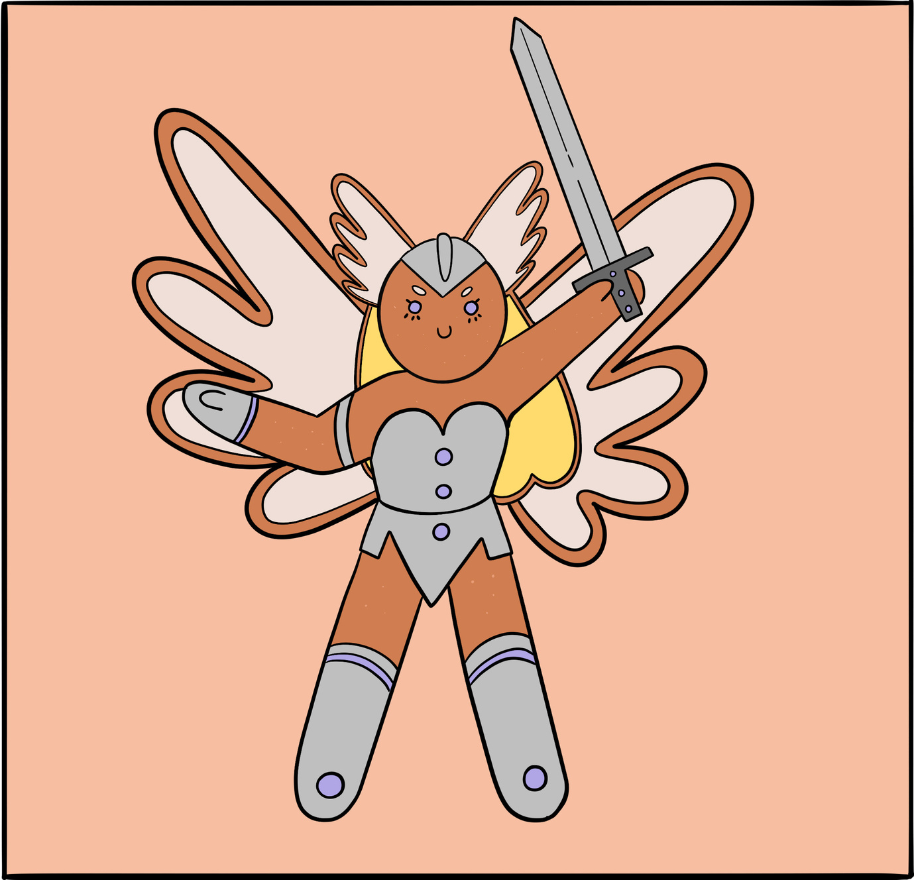
GINGERBREAD
VALKYRIE
From ancient Viking myth and legend comes a crunchy hero.
She’s not as sweet as she looks.
What other Gingerbread Characters are in the Valkyrie’s Gingerbread Army?

Slide 11
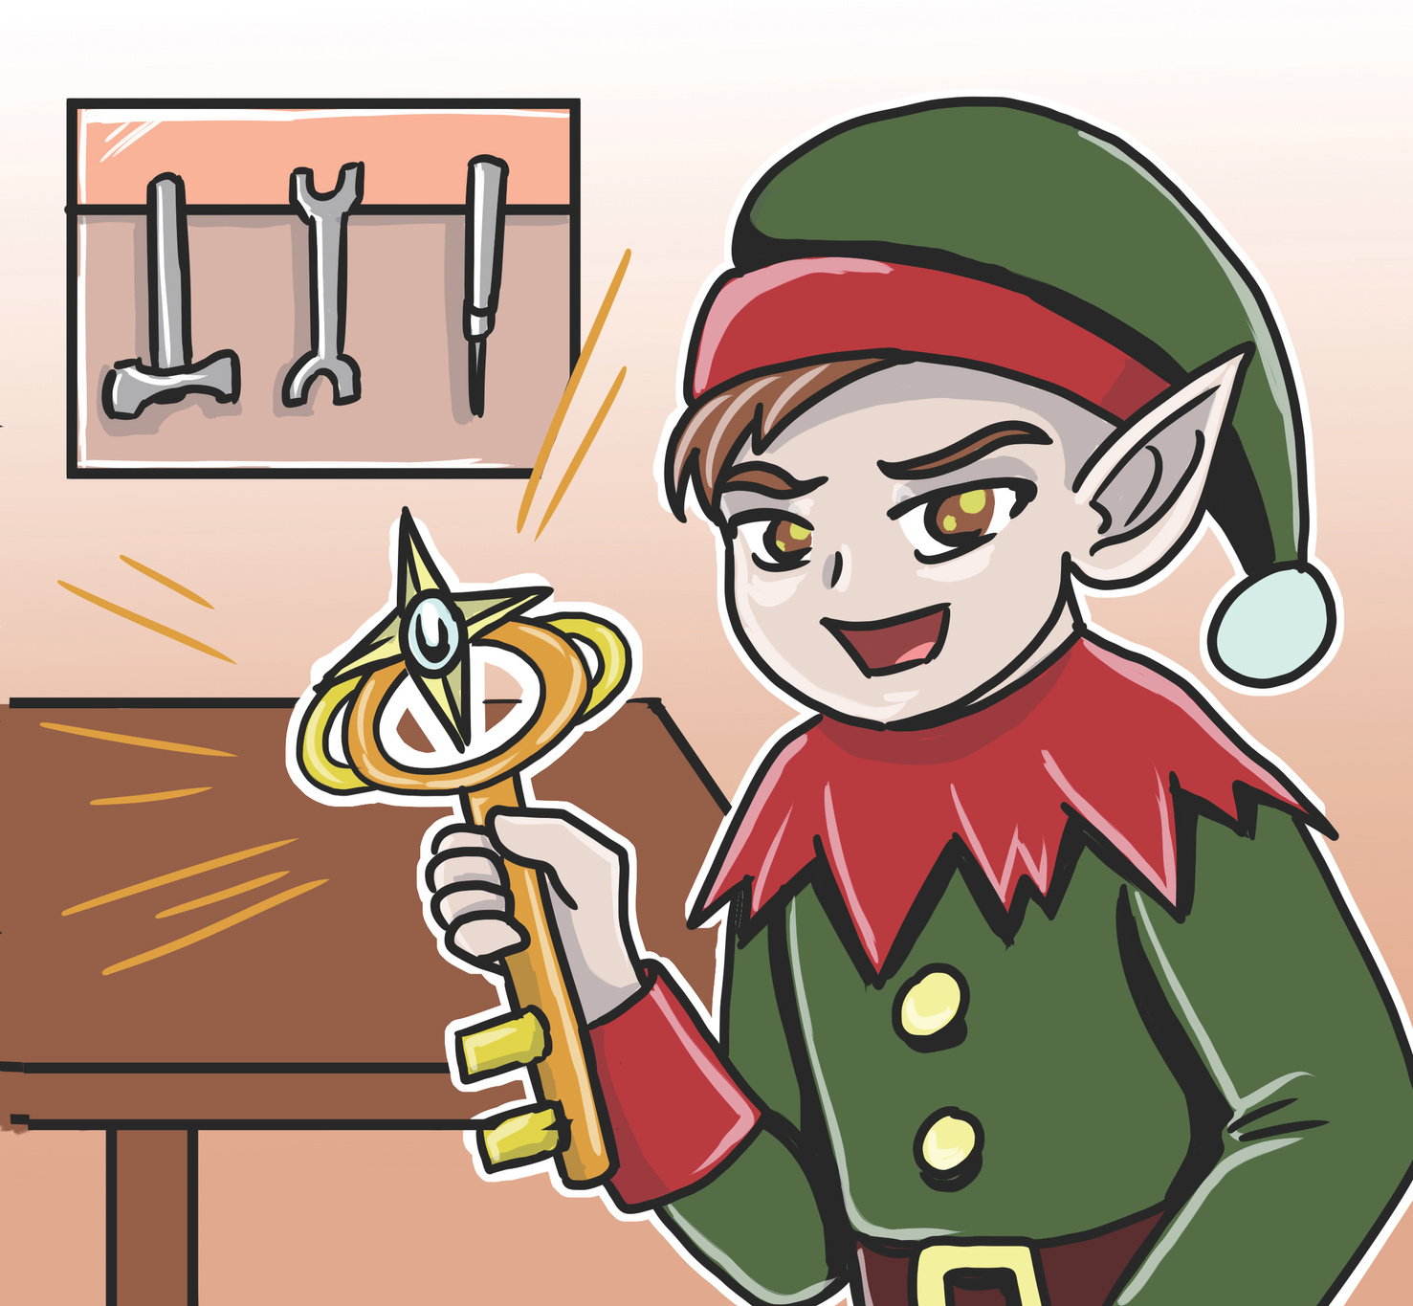
ELVEN KEYSMITH
When he’s not making Santa’s magic keys, this friendly elf
robs banks.
What other sorts of places could this magical elf break into to have adventures?

Slide 12
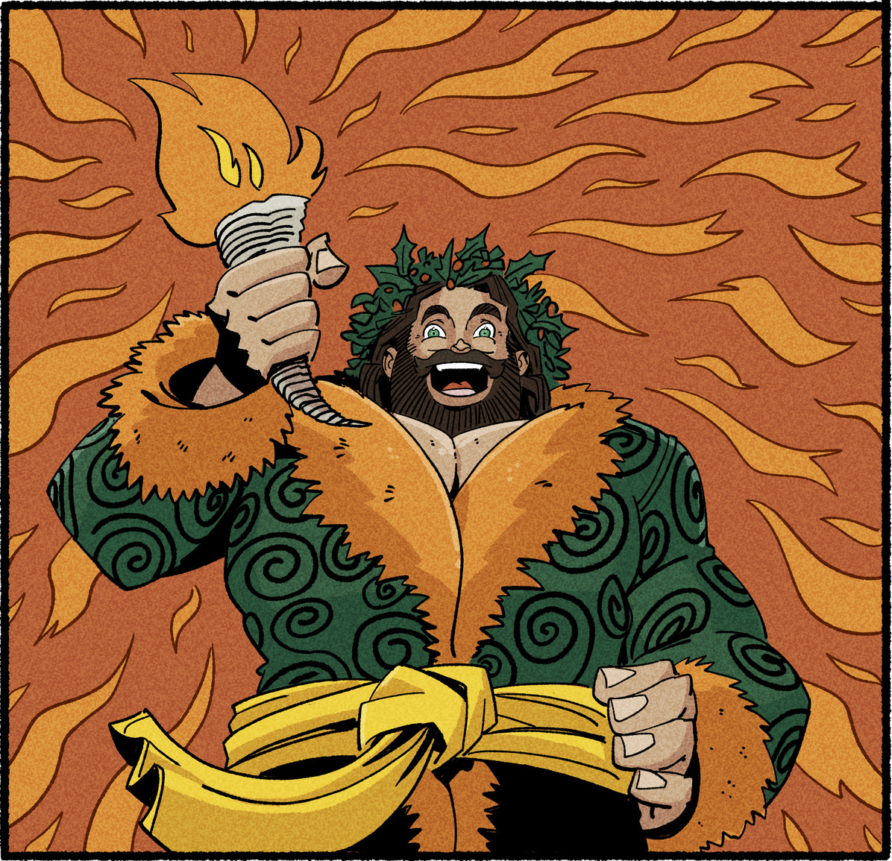
GHOST OF
CHRISTMAS PRESENT
One of the Ghosts who visits Scrooge in Charles Dickens ‘A Christmas Carol’.
He will remind you to live in the moment, surrounded
by loved ones…
Where would you go to
have a big party?
Who would you invite?

Slide 13
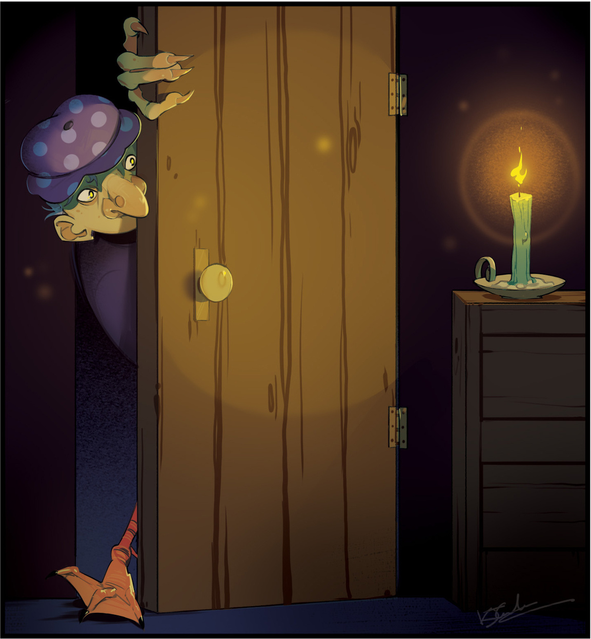
FRAU PERCHTA
A mountain spirit and wise woman, leading the wild hunt across the sky.
Some believe she can shapeshift - what animal might she change into and where would she go?

Slide 14
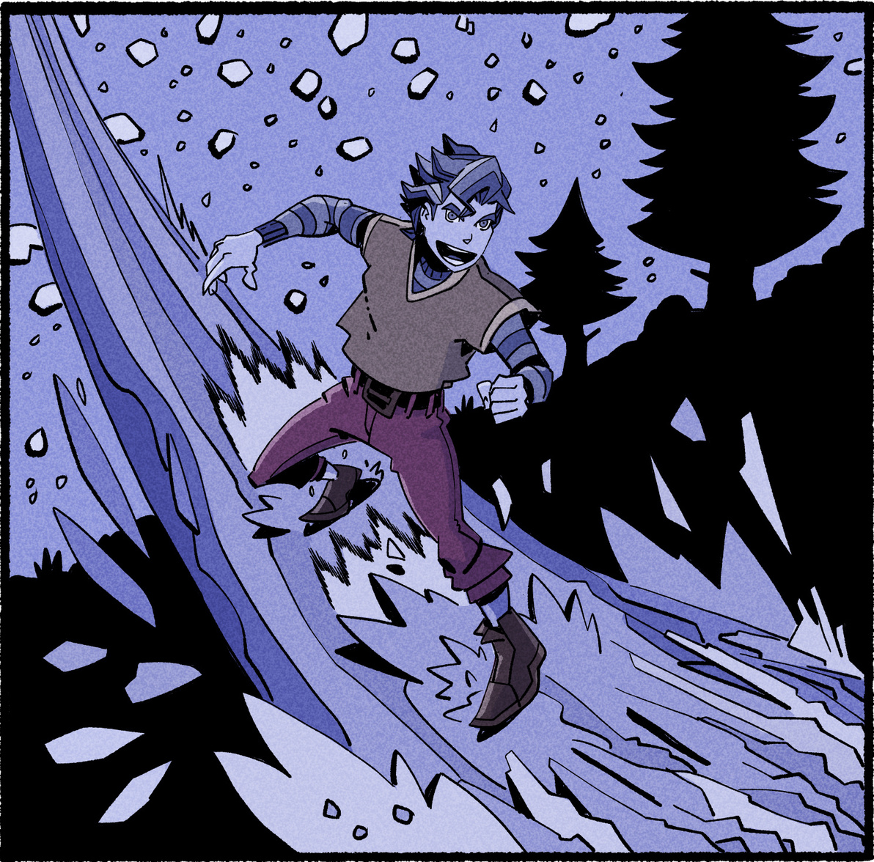
JACK FROST
Chill out!
This cool character always
stays frosty.
What’s the coolest thing you’ve ever done?

Slide 15
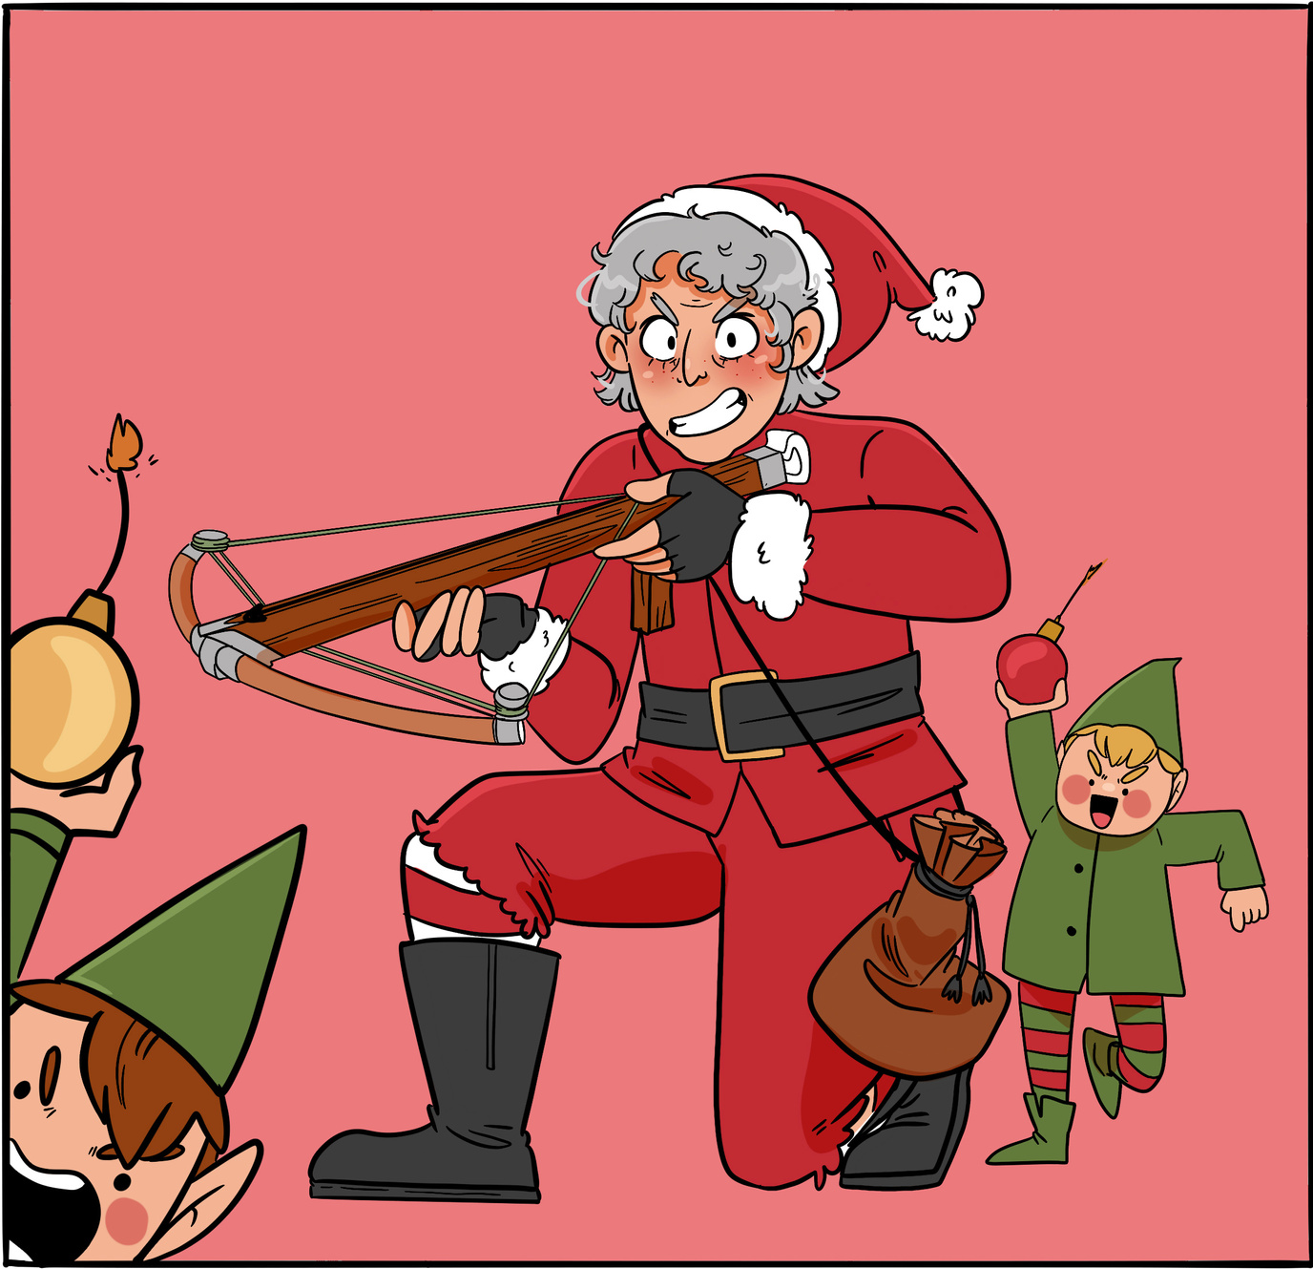
MRS CLAUS
This fearless defender of the North Pole has no time
for your nonsense.
What sorts of hobbies does
Mrs Claus have?
Mrs Claus is always inventing new toys - what sort of new toy would you create?

Slide 16
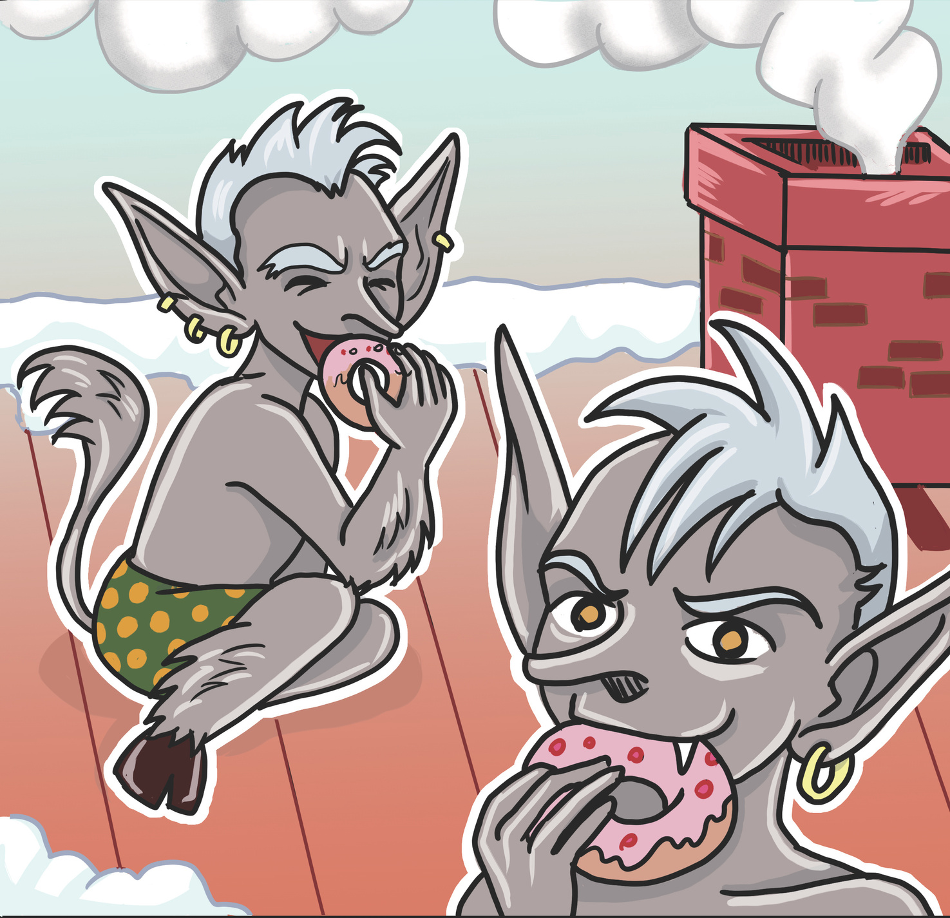
KALIKANTZORII
These messy winter goblins are only allowed above ground on the darkest night of the year and they make the most of it.
When was the last time you tidied your room?
What is your favourite
messy food?

Slide 17
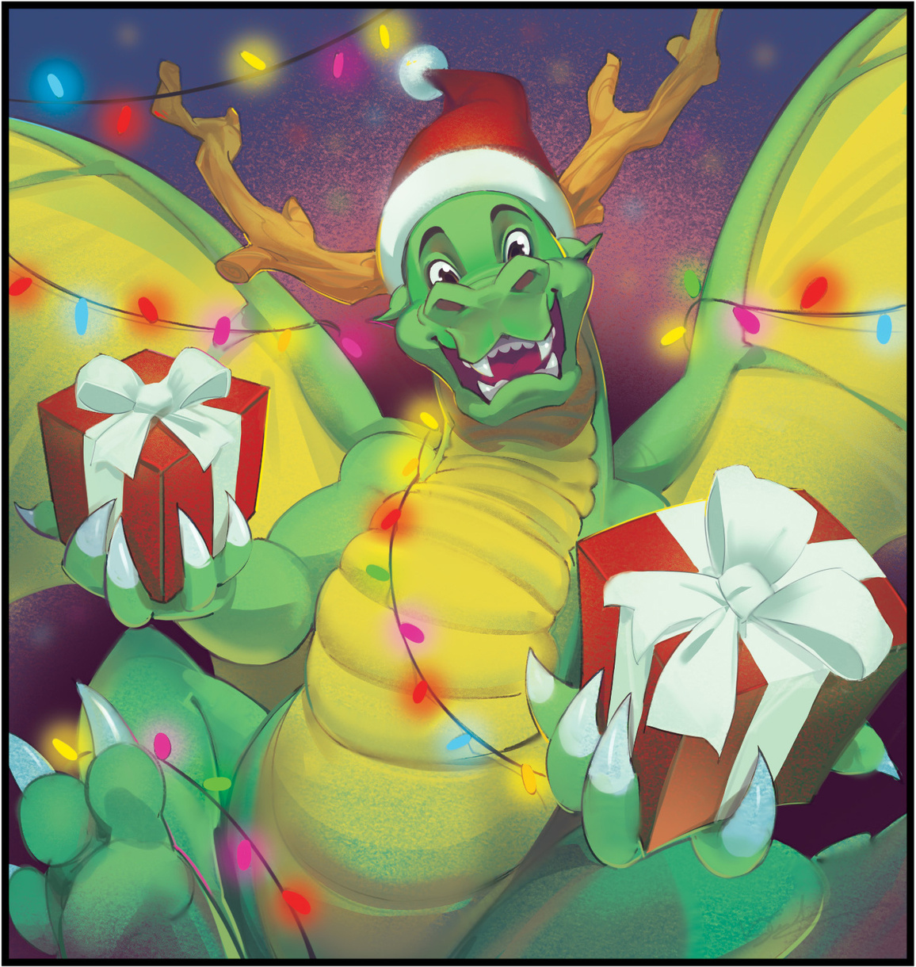
CHRISTMAS DRAGON
There’s an old Christmas tradition of performing the story of St George & the Dragon in winter time.
Saint George won’t want to defeat this Dragon – she’s far too jolly and sharing all her gold!
What treasure would you want to find in a Dragon’s Cave?

Slide 18
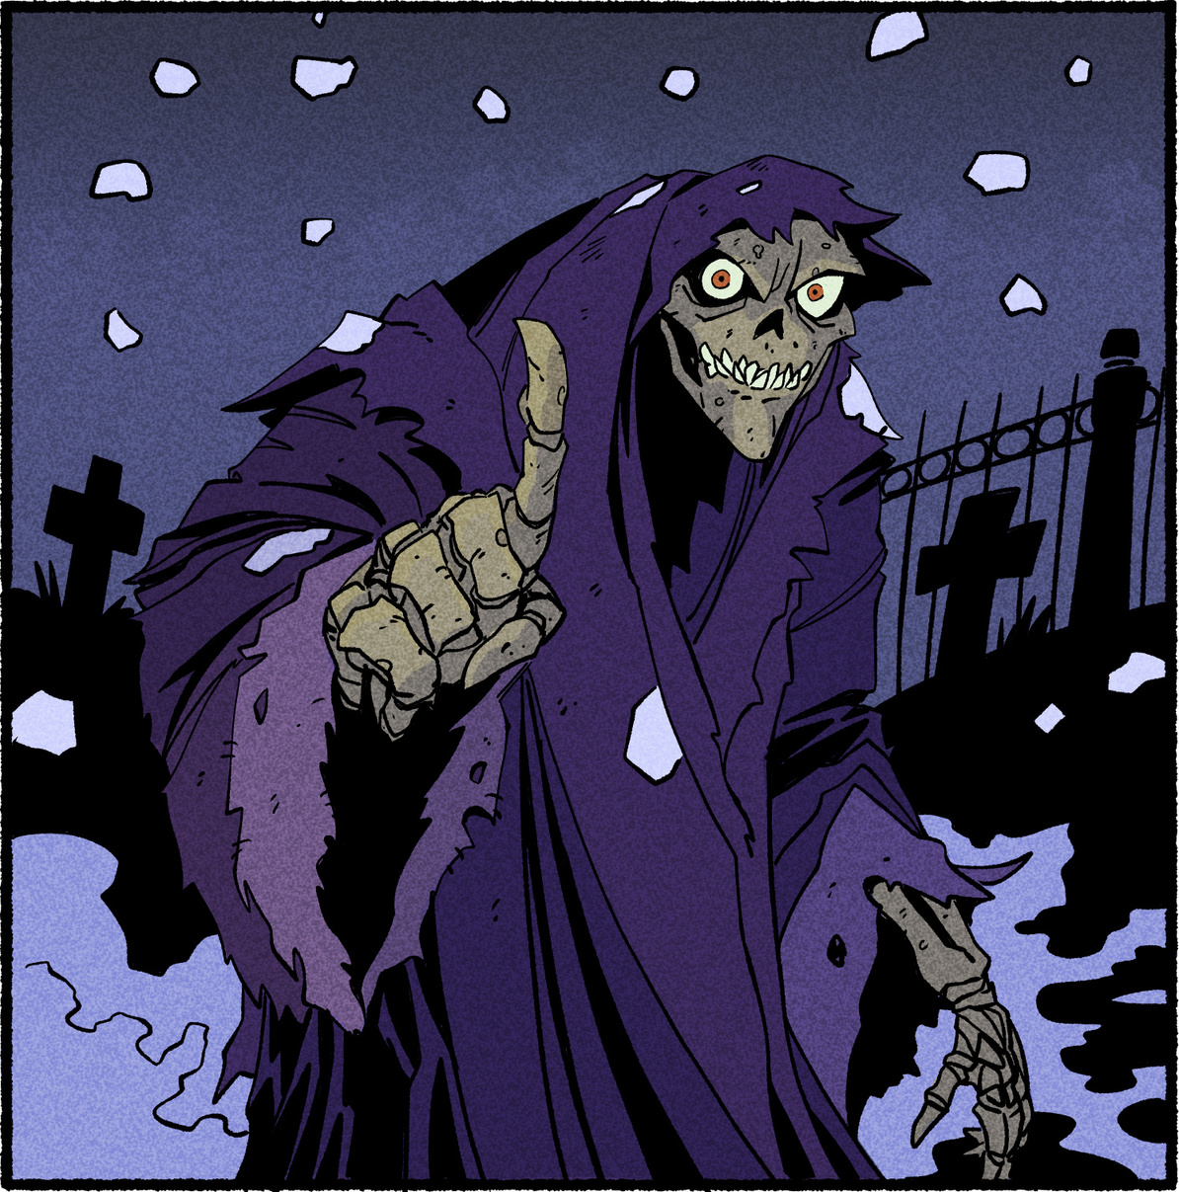
GHOST OF
CHRISTMAS FUTURE
One of the Ghosts who visits Scrooge in Charles Dickens ‘A Christmas Carol’.
They will show you where the wrong roads might lead…
What do you see in your future?

Slide 19
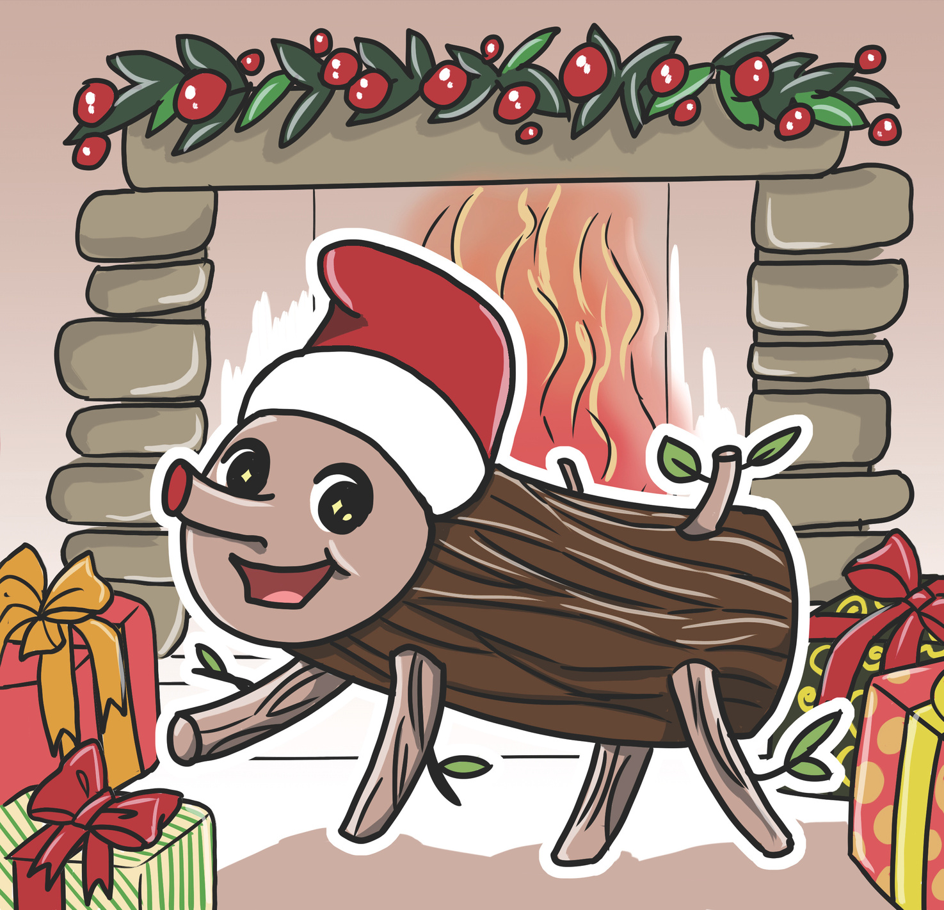
POOP LOG
In Spain there’s a lucky Christmas log that poops sweeties every year.
True story.
Would you eat sweets from the Poop Log?

Slide 20
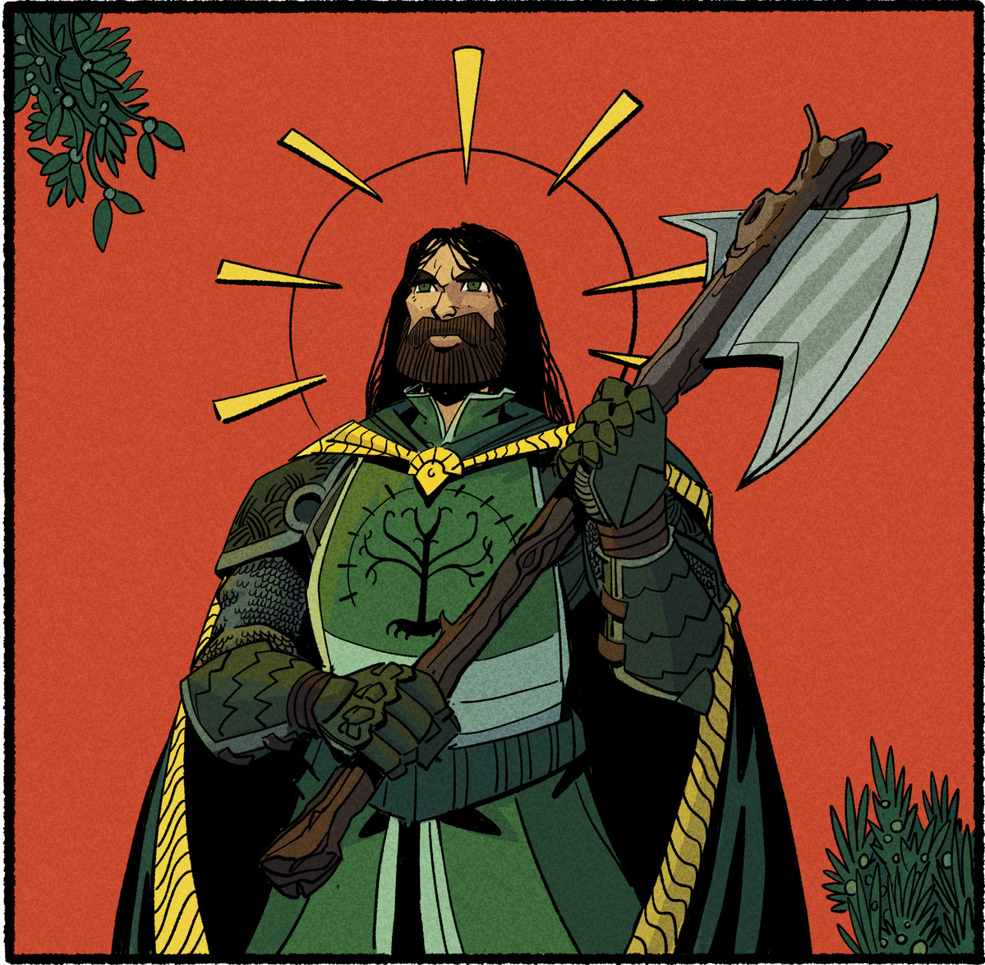
SIR GAWAIN
A Knight of the Round Table on a quest to keep his honour.
He will not falter or fear.
What mysterious creatures and puzzles will Gawain find on his quest to find the Green Knight?

Slide 21
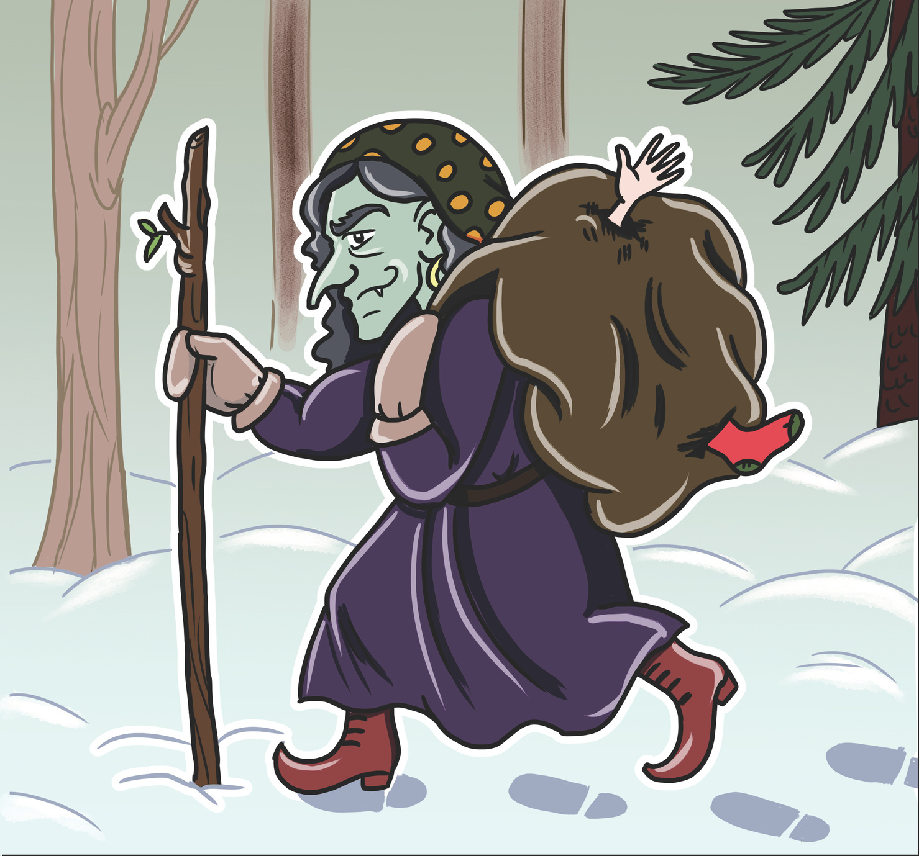
GRYLA
Iceland’s winter witch isn’t as friendly as Befana.
She’s always looking for new ingredients for her stew…
How would you escape
from Gryla?

Slide 22
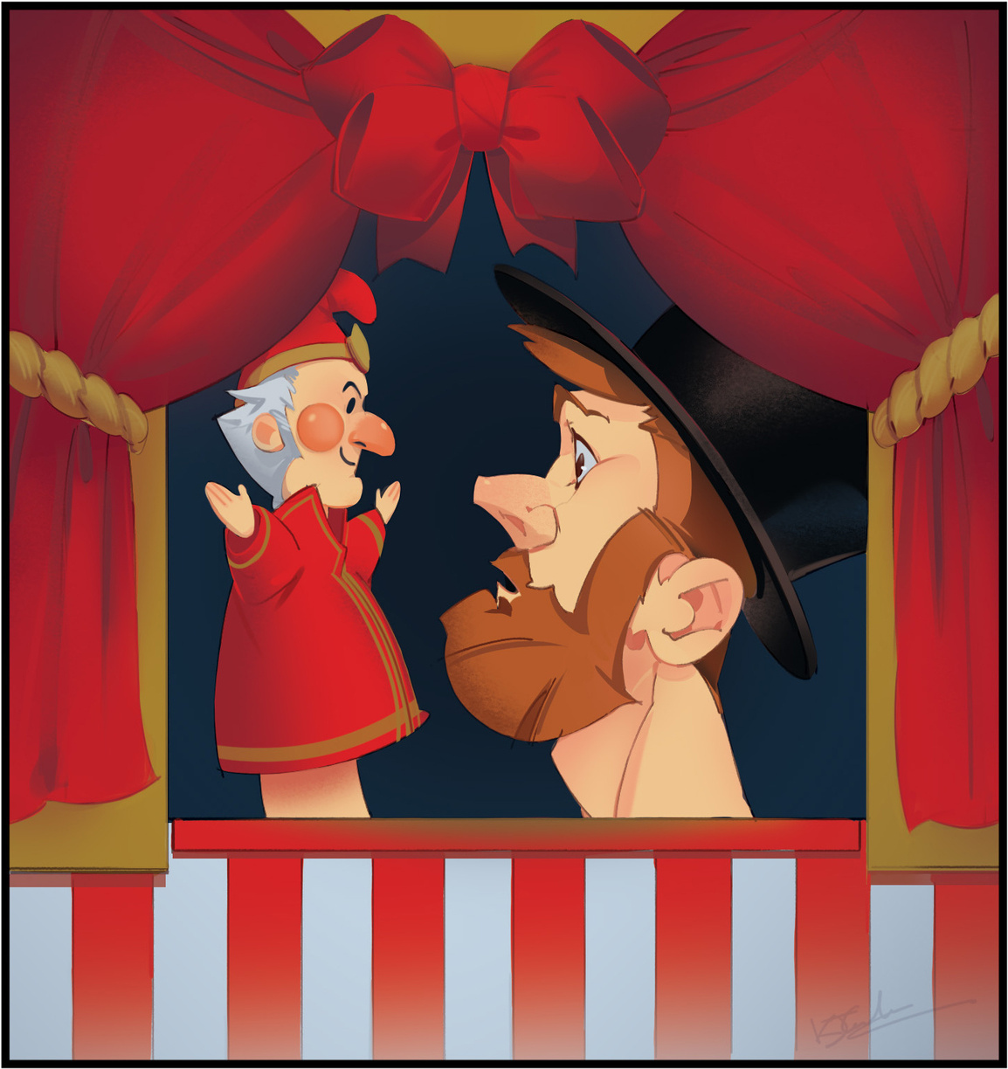
THE PUNCH & JUDY MAN
This puppeteer can cast a spell when he tells a story.
He appears in the book ‘The Box of Delights’ by John Masefield, performing a traditional
Punch & Judy show.
Have you ever performed a puppet show?

Slide 23
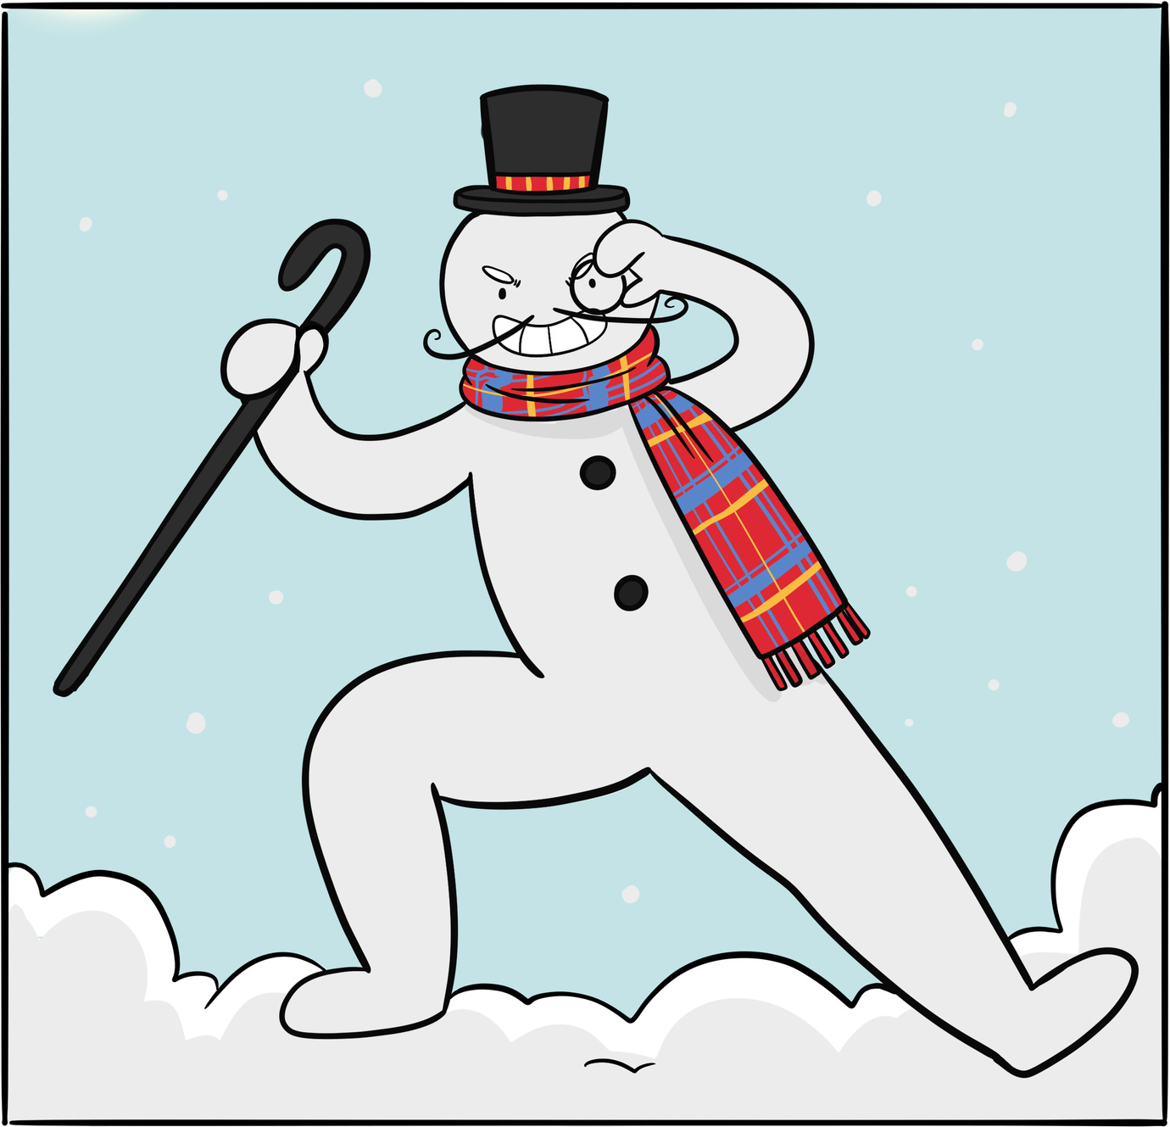
EVIL SNOWMAN
Who says only good snowmen come to life?
What kind of nasty nonsense could this sinister snowman get up to in your town?
How could he be stopped?

Slide 24
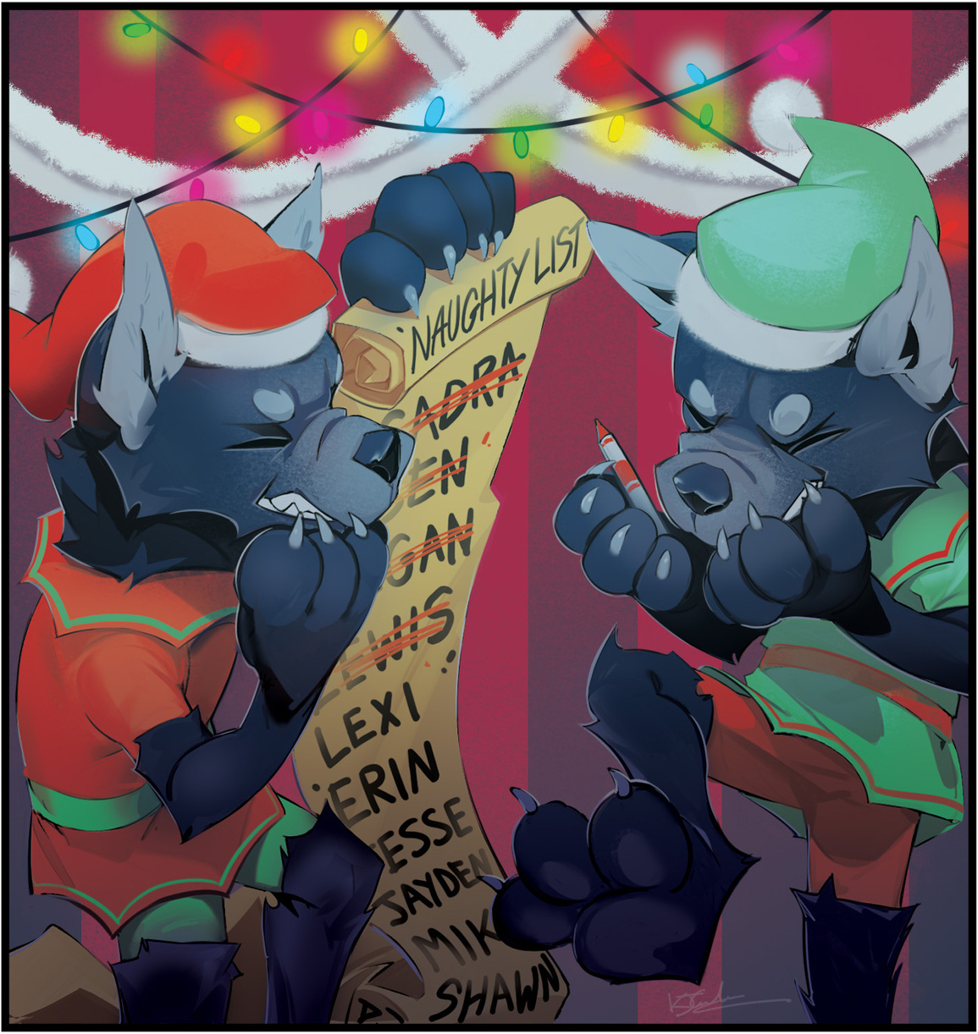
SANTA’S LITTLE
WEREWOLVES
These unlucky elves got bitten on the bottom by a werewolf, but have found a way to help Santa out at Christmas…
Are there other helpful Christmas Monsters?

Slide 25
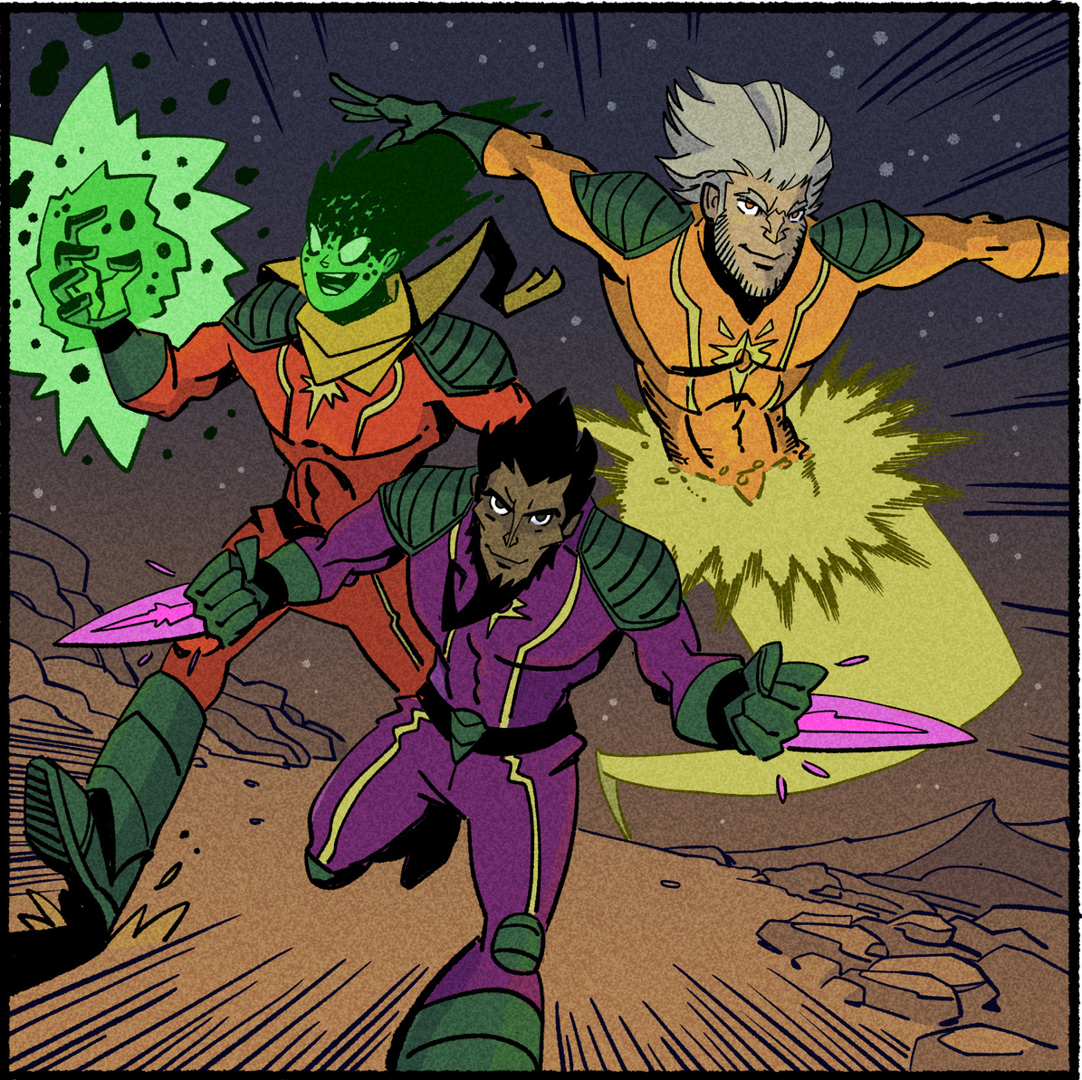
THE MAGI
Three mysterious Wizard Kings, each with a unique gift to help save Christmas.
What would your
superpower be?
How could it help people?

Slide 26
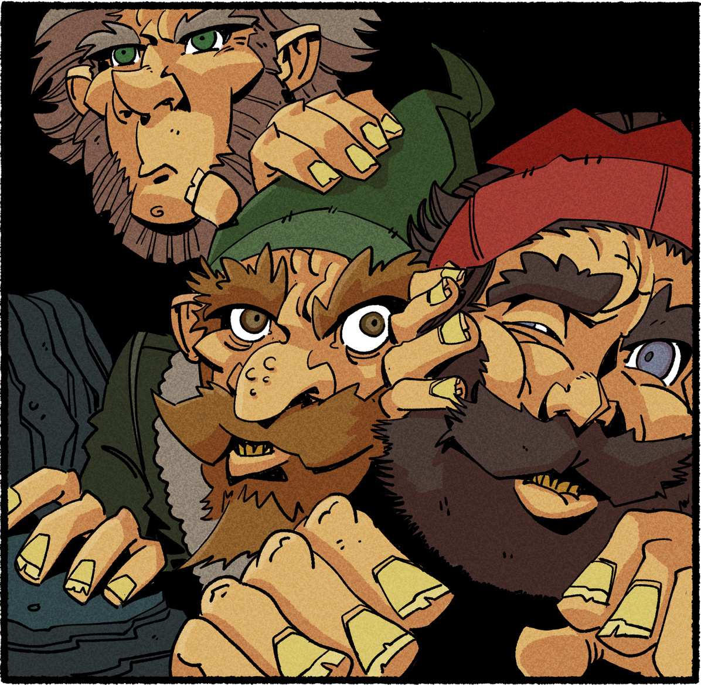
JOLASVEINAR
Grylas’s children, twelve strange visitors wait in their
mountain cave, one for
every day of Christmas, and they visit houses in the towns and villages below to cause trouble...
Does your house have any Christmas traditions?

Slide 27
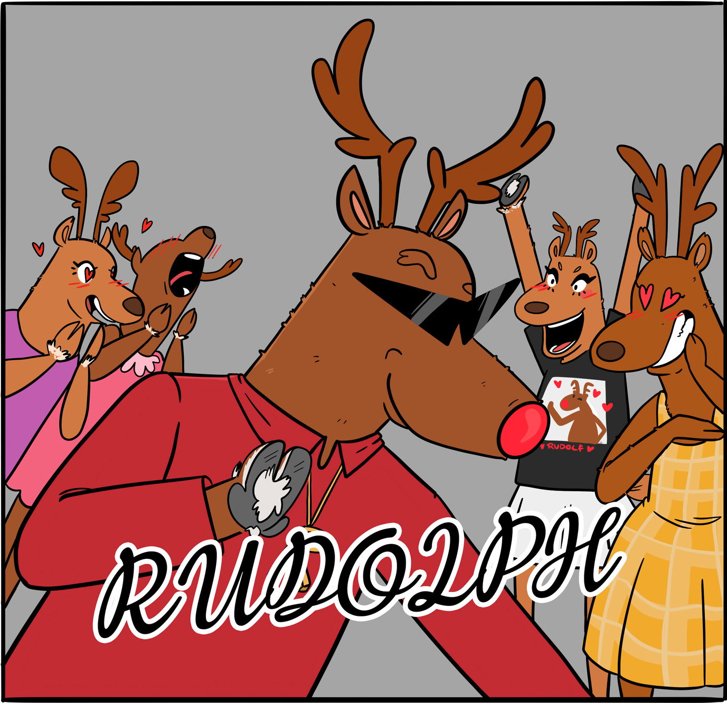
RUDOLPH
This shining superstar is
always making history.
We’re always hearing about Rudolph...I wonder what
sorts of adventures all the
other reindeer have...

Slide 28
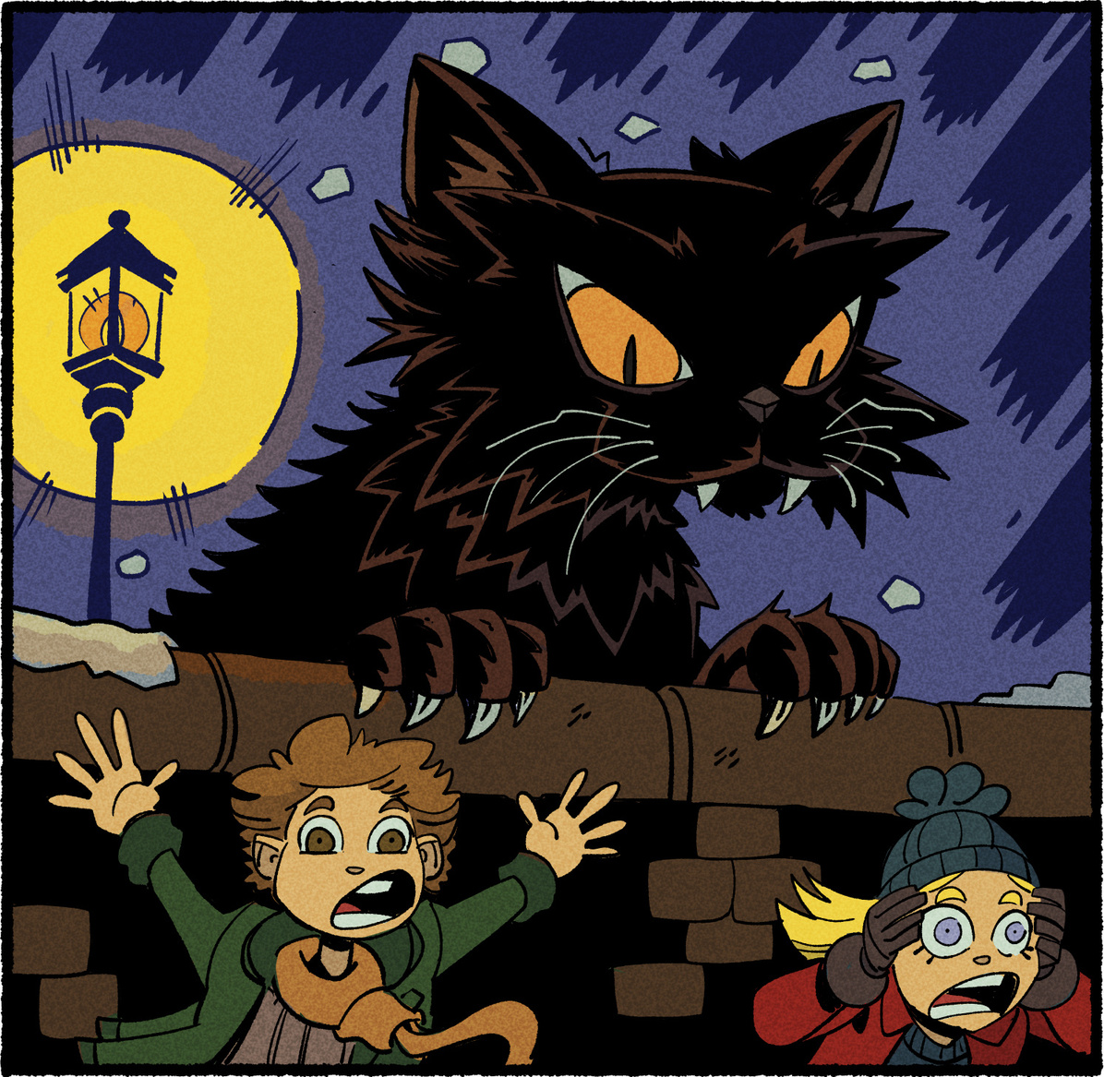
YULE CAT
Gryla’s enormous cat is hungry and it’s favourite food is rosy cheeked children.
If you could have any pet,
what would it be?

Slide 29
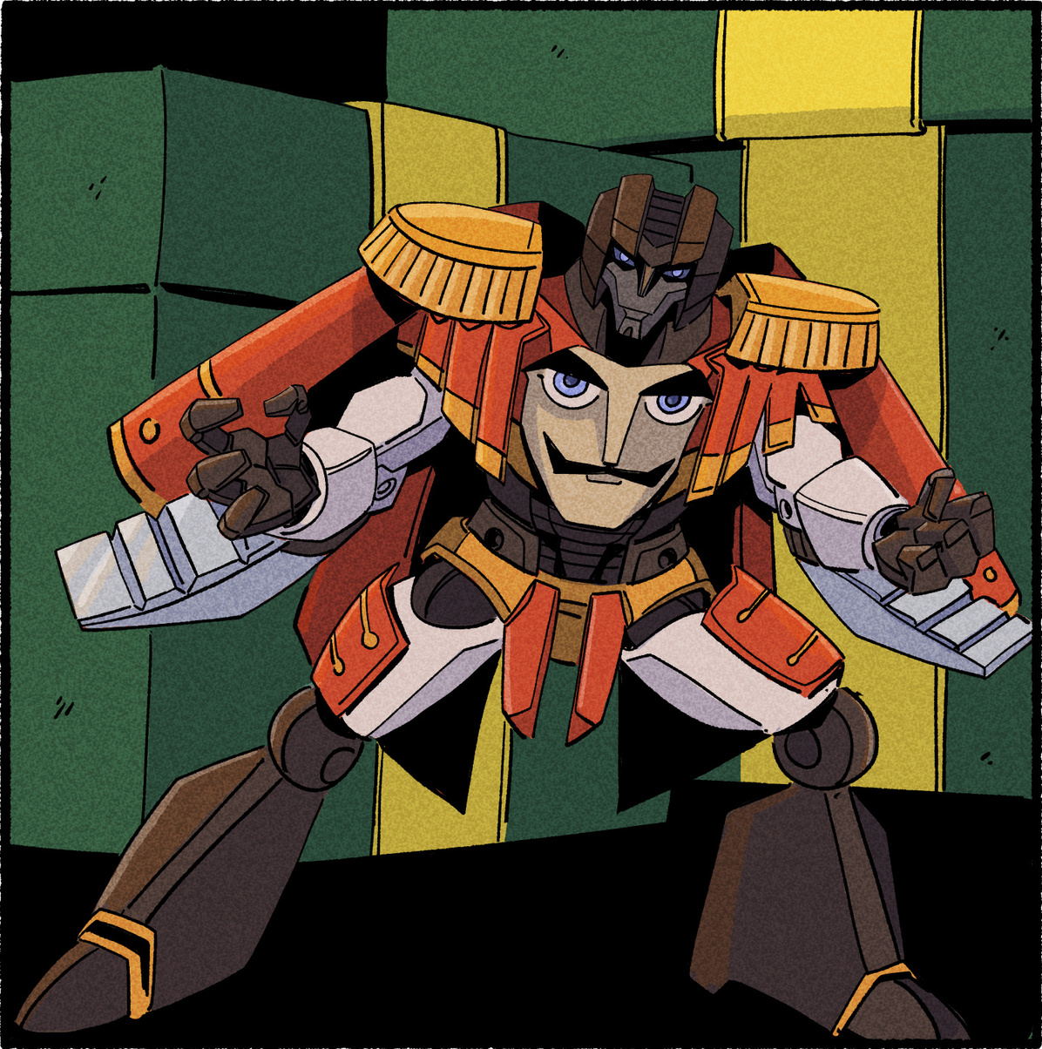
NUTCRACKER
A robotic soldier from an interstellar war,
this transforming hero
has taken the form of a Christmas Nutcracker, as featured in the famous
festive ballet.
What other Christmas Robots
cab you imagine?

Slide 30
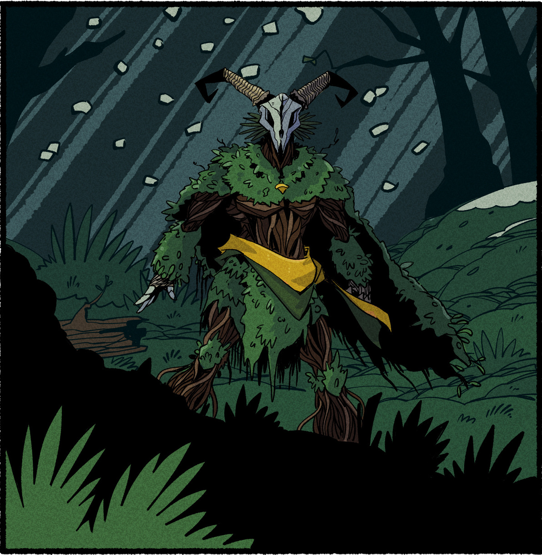
THE GREEN KNIGHT
Sir Gawain finally tracks down the mysterious Green Knight between Christmas and
New Year.
Dare you play the Green Knight’s game?
Don’t lose your head!
What’s your favourite riddle?

Slide 31
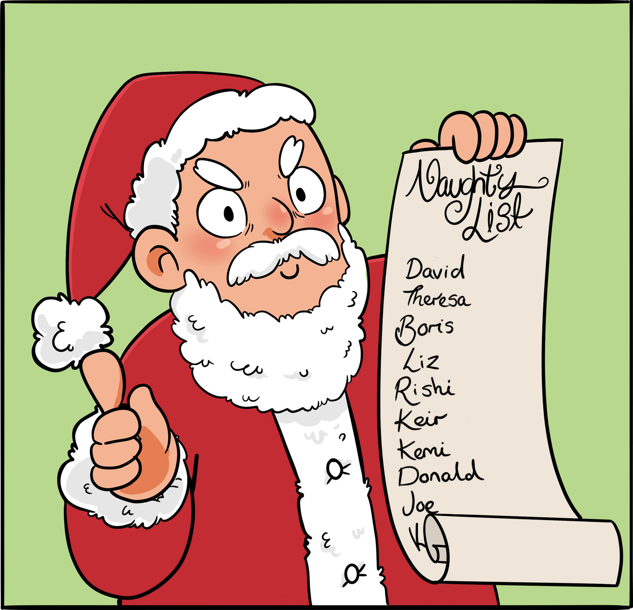
SANTA CLAUS
Don’t end up on his hit list or you better believe its coal for Christmas.
Who do you think should be on the nice list this year?

Slide 32


Scan the QR to download a free print and play version of
Winter Winners

