Slide 1


Winter Wonderland
An advent calendar comic journey
through some unusual Christmas and winter traditions from around the world
Winter Wonderland created by Magic Torch Comics CIC, artwork by Katherine Hemmings

Slide 2
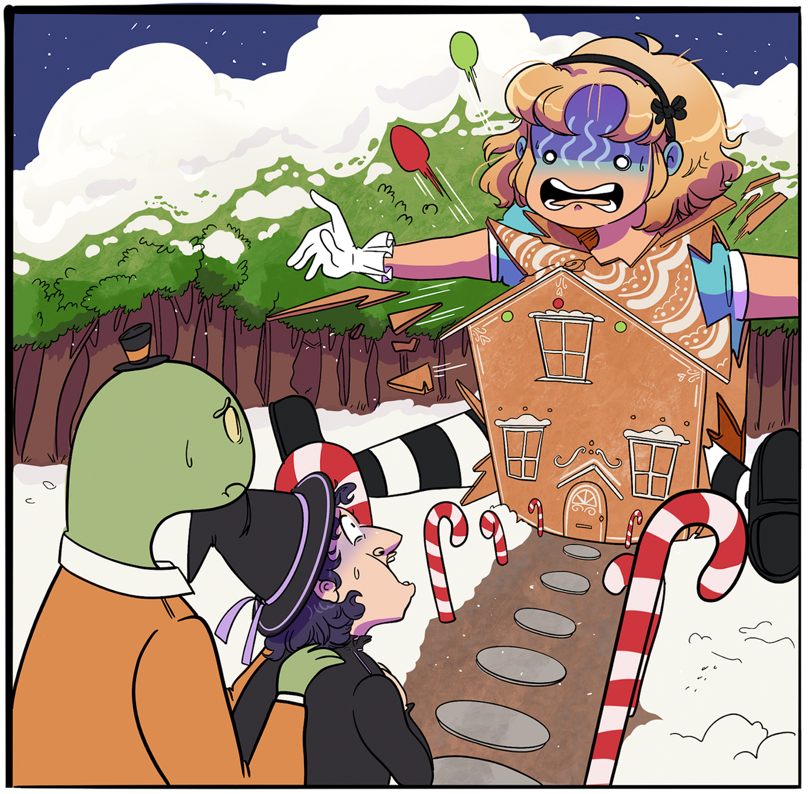
Winter Wonderland
Day 1 - Gingerbread House
Decorated gingerbread houses became popular in Germany in the 1800s, after appearing in the Brothers Grimm folktale ‘Hansel & Gretel’. Soon after, they became a Christmas tradition around the world.
Draw a gingerbread house covered with your favourite sweets (maybe there’s a witch inside hiding)
Winter Wonderland created by Magic Torch Comics CIC, artwork by Katherine Hemmings

Slide 3
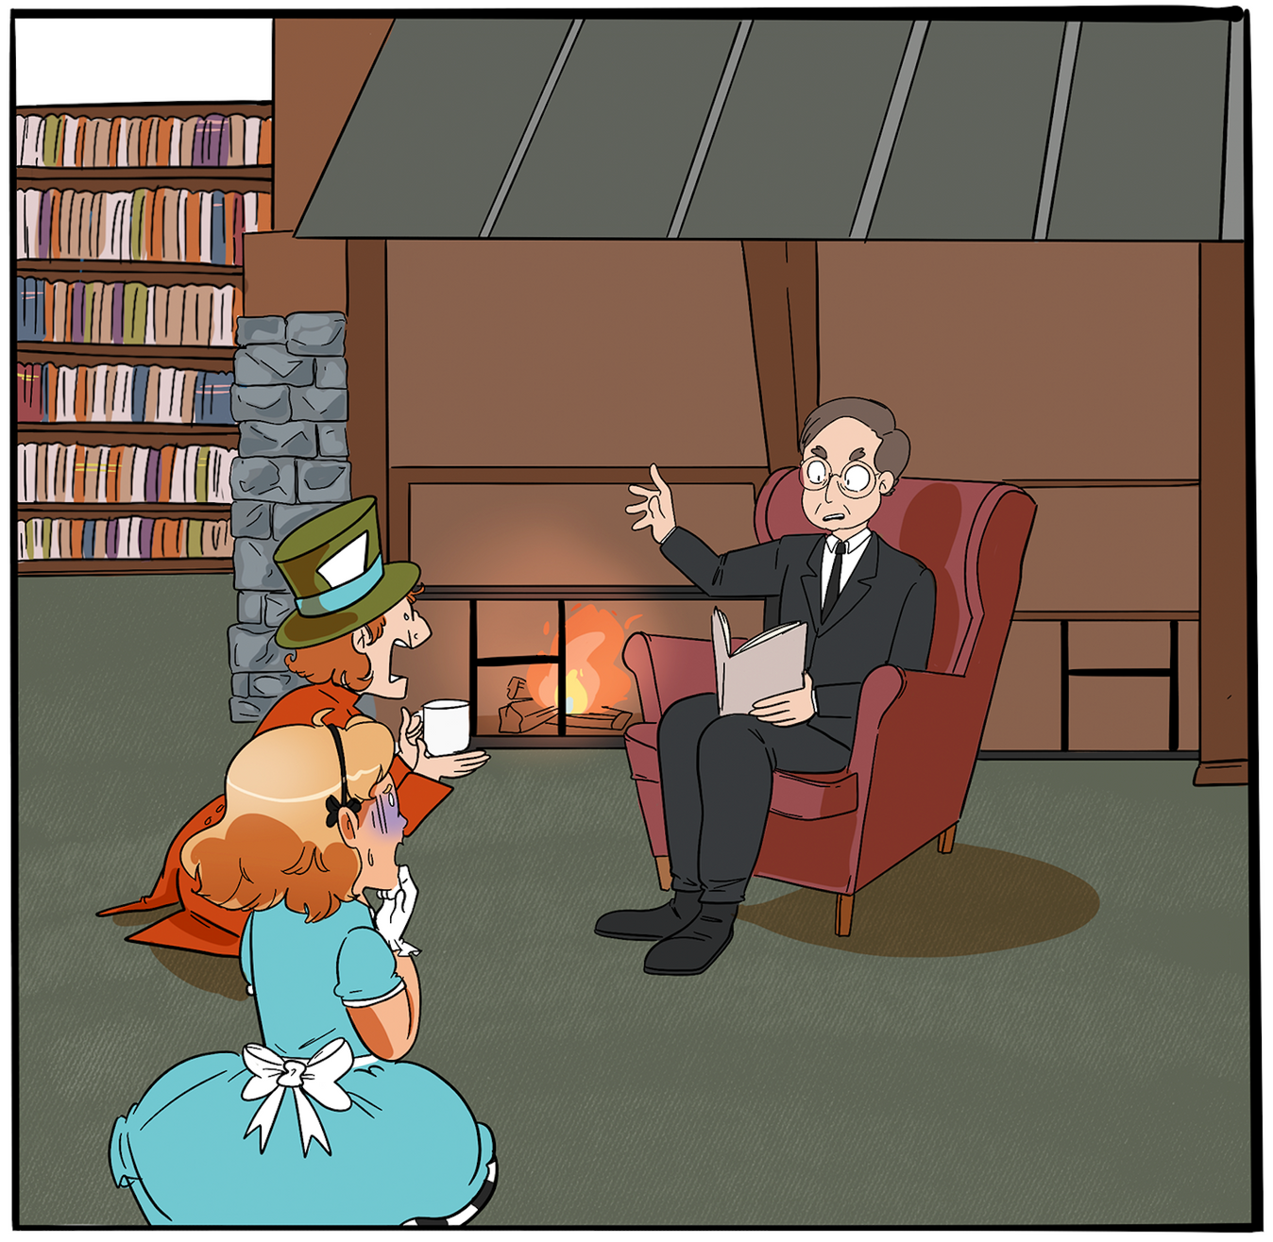
Winter Wonderland
Day 2 - Ghost Story Season
The dark winter nights have always been a popular time to share spooky stories, but it was the Victorians who made Christmas Ghost Stories a tradition. The industrial revolution meant it was now cheaper to print books and magazines, and so writers such as Charles Dickens would prepare stories ready for sale at the Christmas season.
Draw an adventure with a friendly Christmas ghost.
Winter Wonderland created by Magic Torch Comics CIC, artwork by Katherine Hemmings

Slide 4
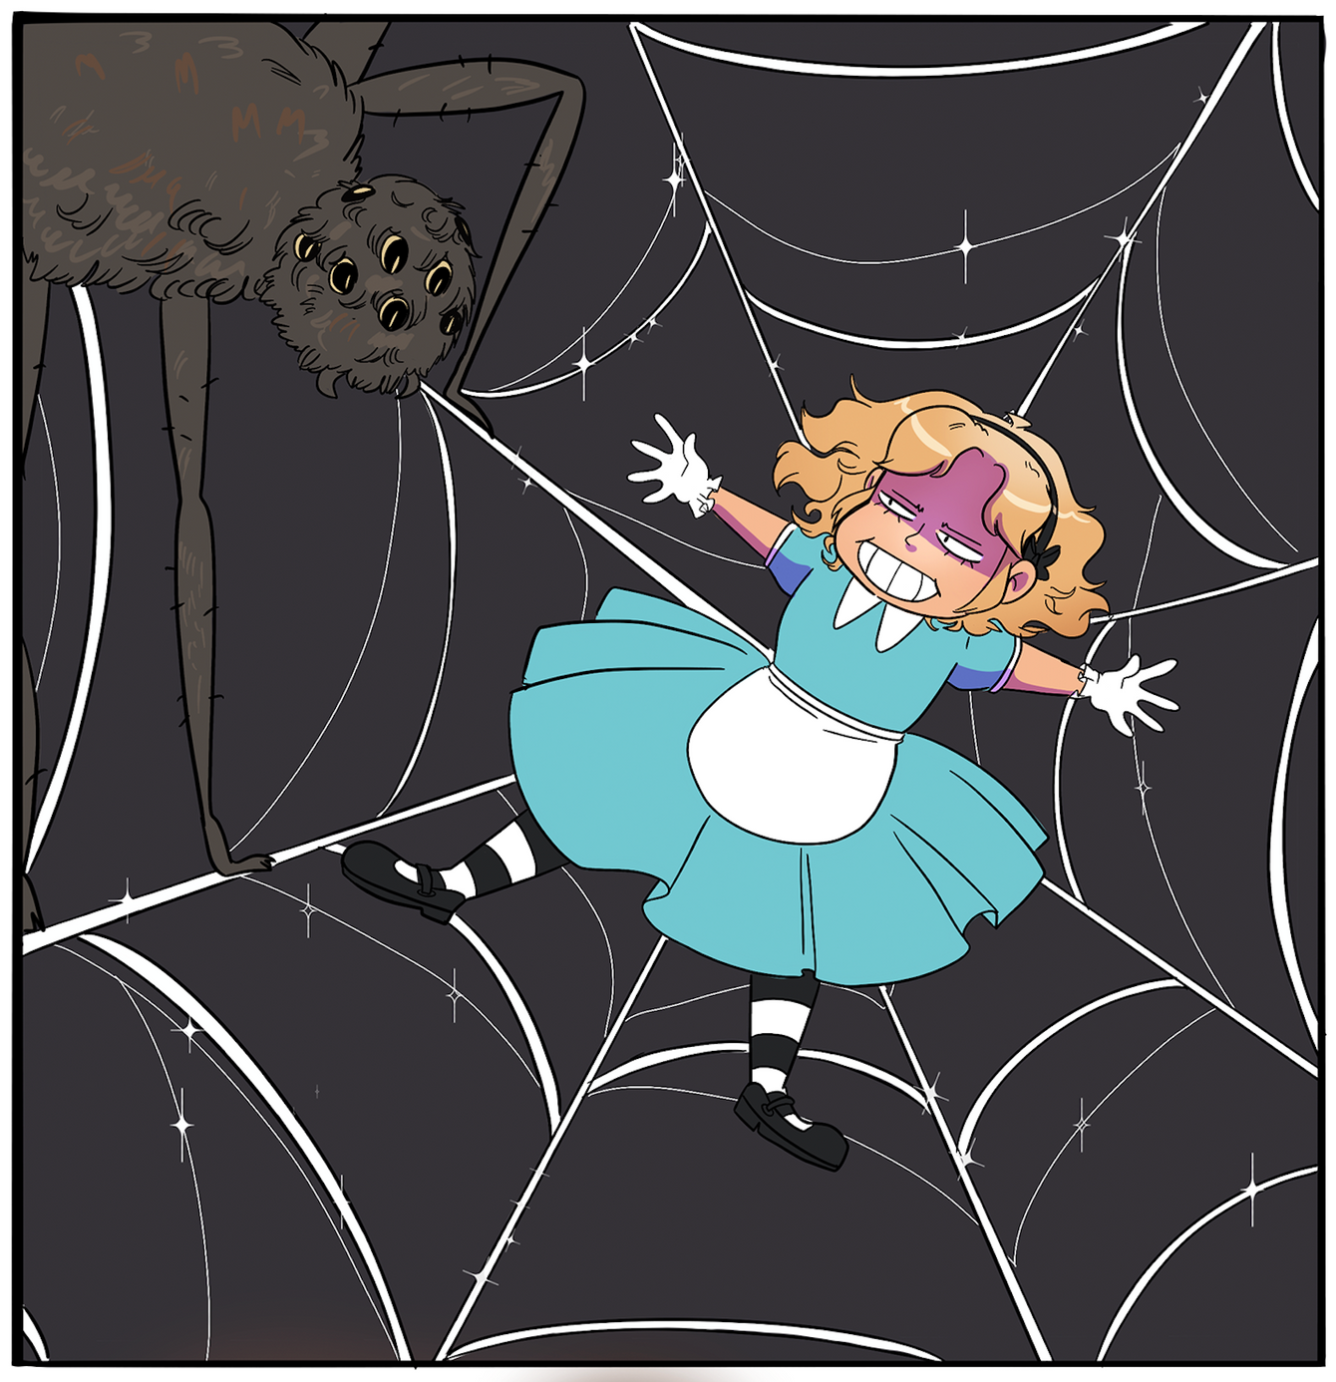
Winter Wonderland
Day 3 - Visiting
Christmas Spiders
A folktale from Ukraine tells of the some kind spiders, who brought joy to a poor widow and her children by decorating their tree in sparkling webs on Christmas Eve. Jewelled spiders and glittering webs are now often found as tree decorations.
Draw some merry Christmas spiders in their sparkling webs.
Winter Wonderland created by Magic Torch Comics CIC, artwork by Katherine Hemmings

Slide 5
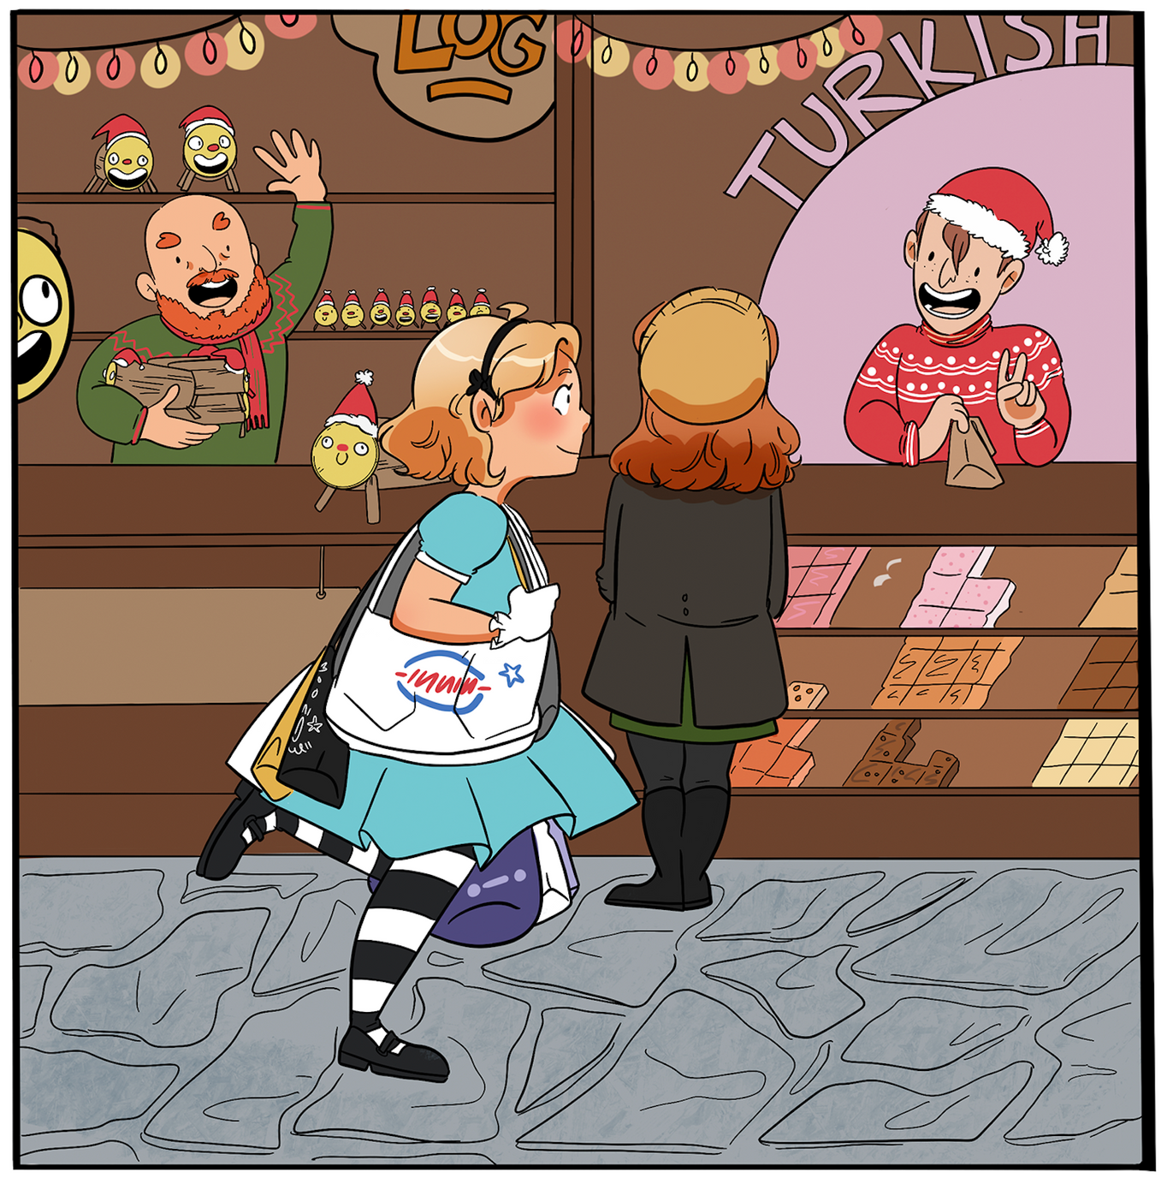
Winter Wonderland
Day 4 - Midwinter Markets
Christmas Markets are popular all over the world, and can be a nice place to find unusual gifts based on the traditions of other countries. In this market, someone is selling the rather cheeky ‘Poop Log’, a traditional Christmas character from Catalan in Spain, who poops nougat on Christmas Eve.
What would be on your Christmas market shopping list?
Or what would you sell at YOUR stall?
Winter Wonderland created by Magic Torch Comics CIC, artwork by Katherine Hemmings

Slide 6
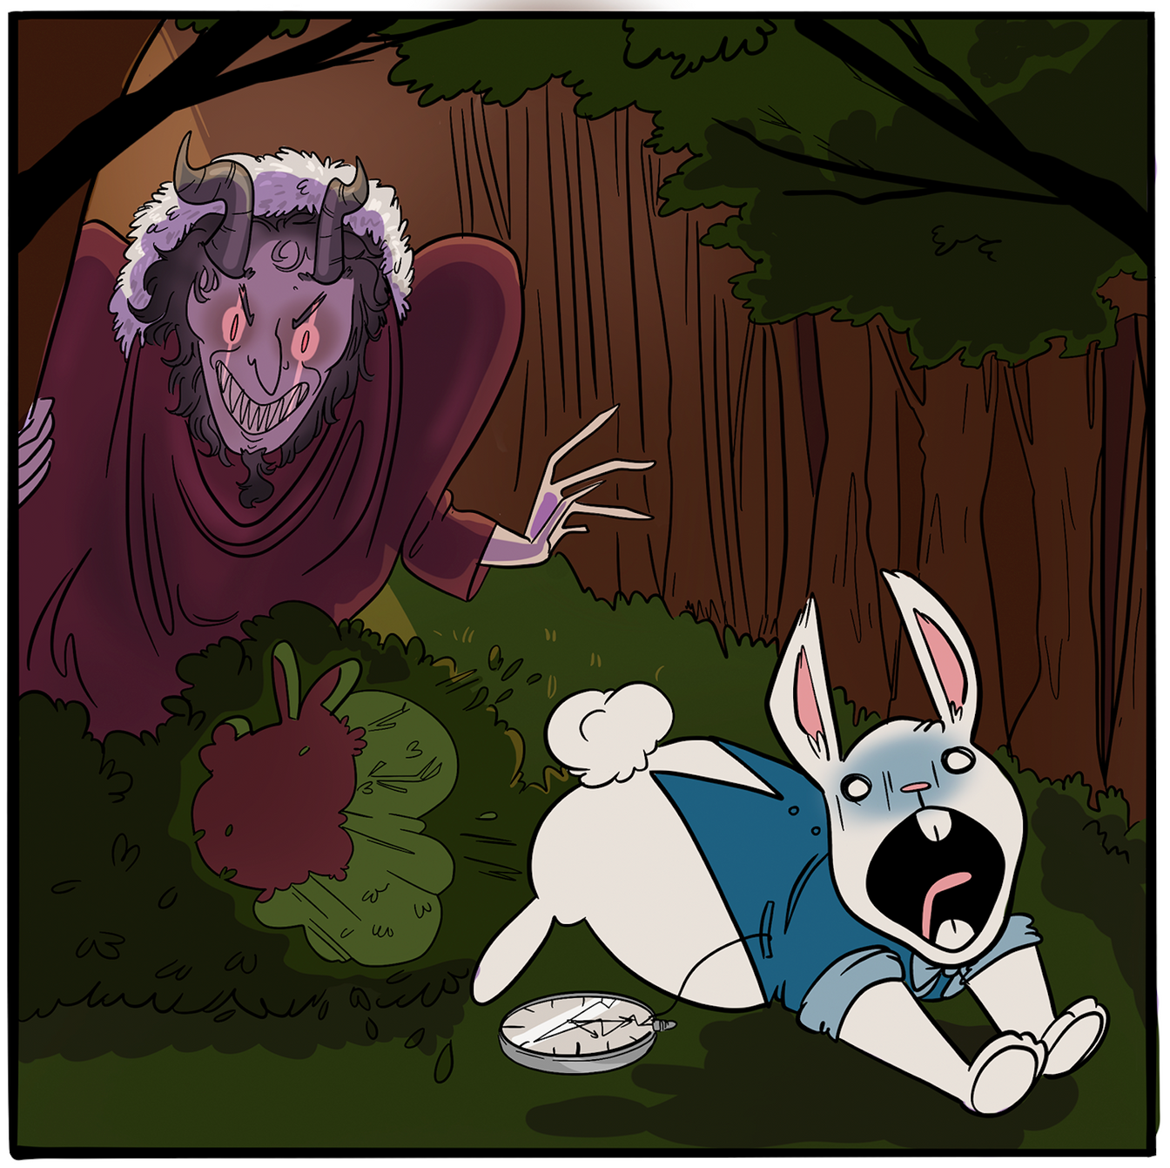
Winter Wonderland
Day 5 - Don‘t be late
for Krampus
Krampus is a friend of St Nicholas, who arrives on December 5th in Germany and Austria. The monster throws any naughty people in his sack and steals them away. Krampusnacht is now often celebrated with people dressing up as the monster to chase one another through the town.
Draw yourself doing a good deed to show Krampus how kind you have been this year.
Winter Wonderland created by Magic Torch Comics CIC, artwork by Katherine Hemmings

Slide 7
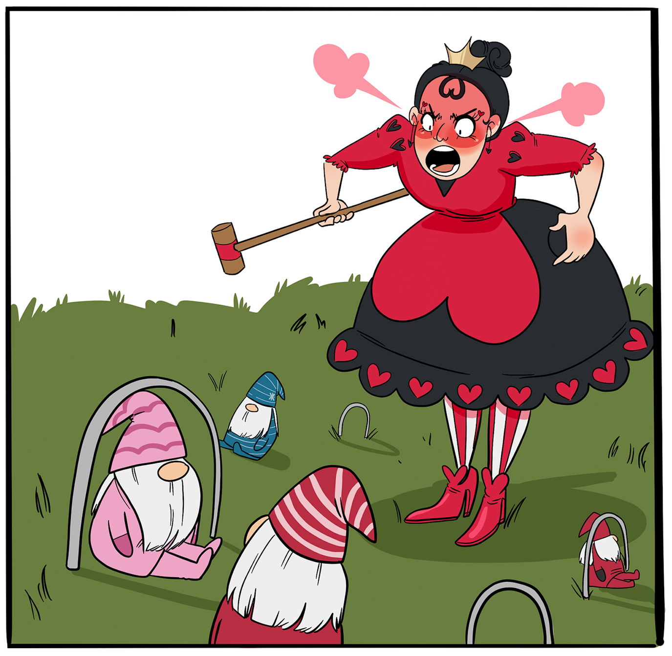
Winter Wonderland
Day 6 - Tomte Trouble
The Tomte from Sweden are mischievous gnomes, who will usually help to look after homes, animals and children during the winter months. However, if you are rude, or annoy the Tomte, you might find things starting to go wrong around your house.
Imagine Tomte are all over the school causing trouble, draw what they are up to.
Winter Wonderland created by Magic Torch Comics CIC, artwork by Katherine Hemmings

Slide 8
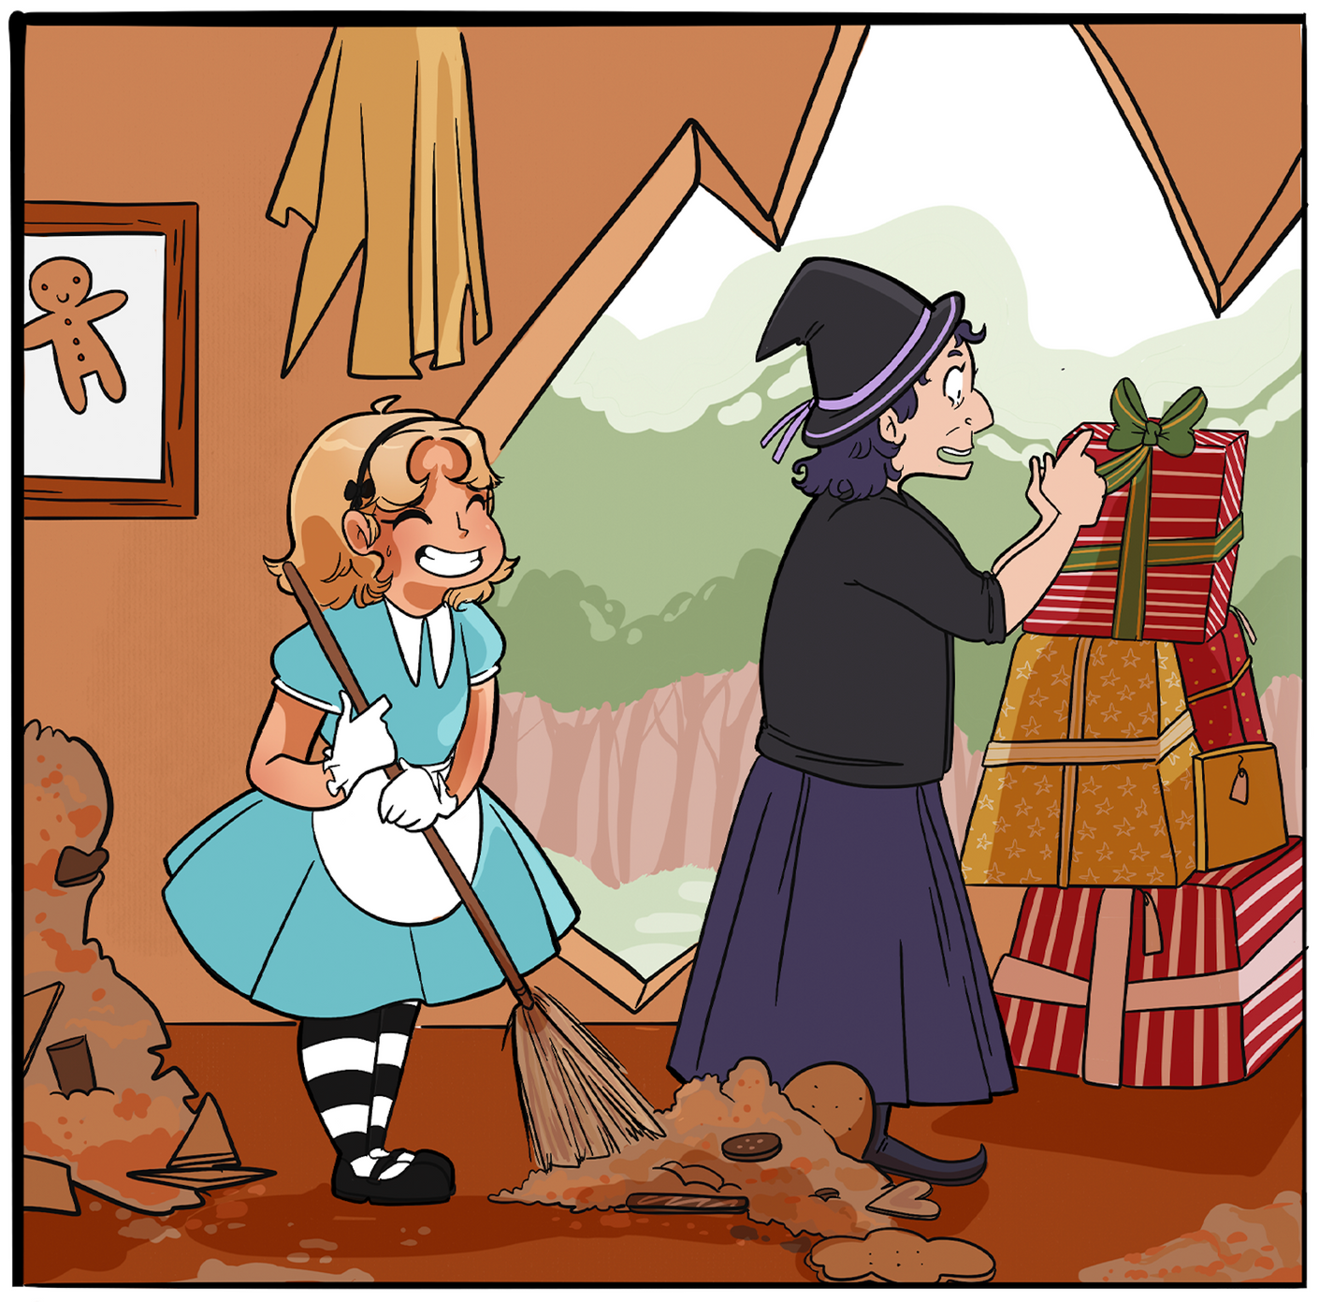
Winter Wonderland
Day 7 - Winter Witches
In the Nordic countries, many believe witches roam the land during the darkest months, so its important to hide your broom so a witch can’t steal it. However, its also important to keep your house clean and tidy for new year visitors, so don’t hide it too well. Not all witches are wicked - in Italy, it is Befana the Winter Witch who delivers presents.
Draw your own version of a winter witch or wizard.
Winter Wonderland created by Magic Torch Comics CIC, artwork by Katherine Hemmings

Slide 9
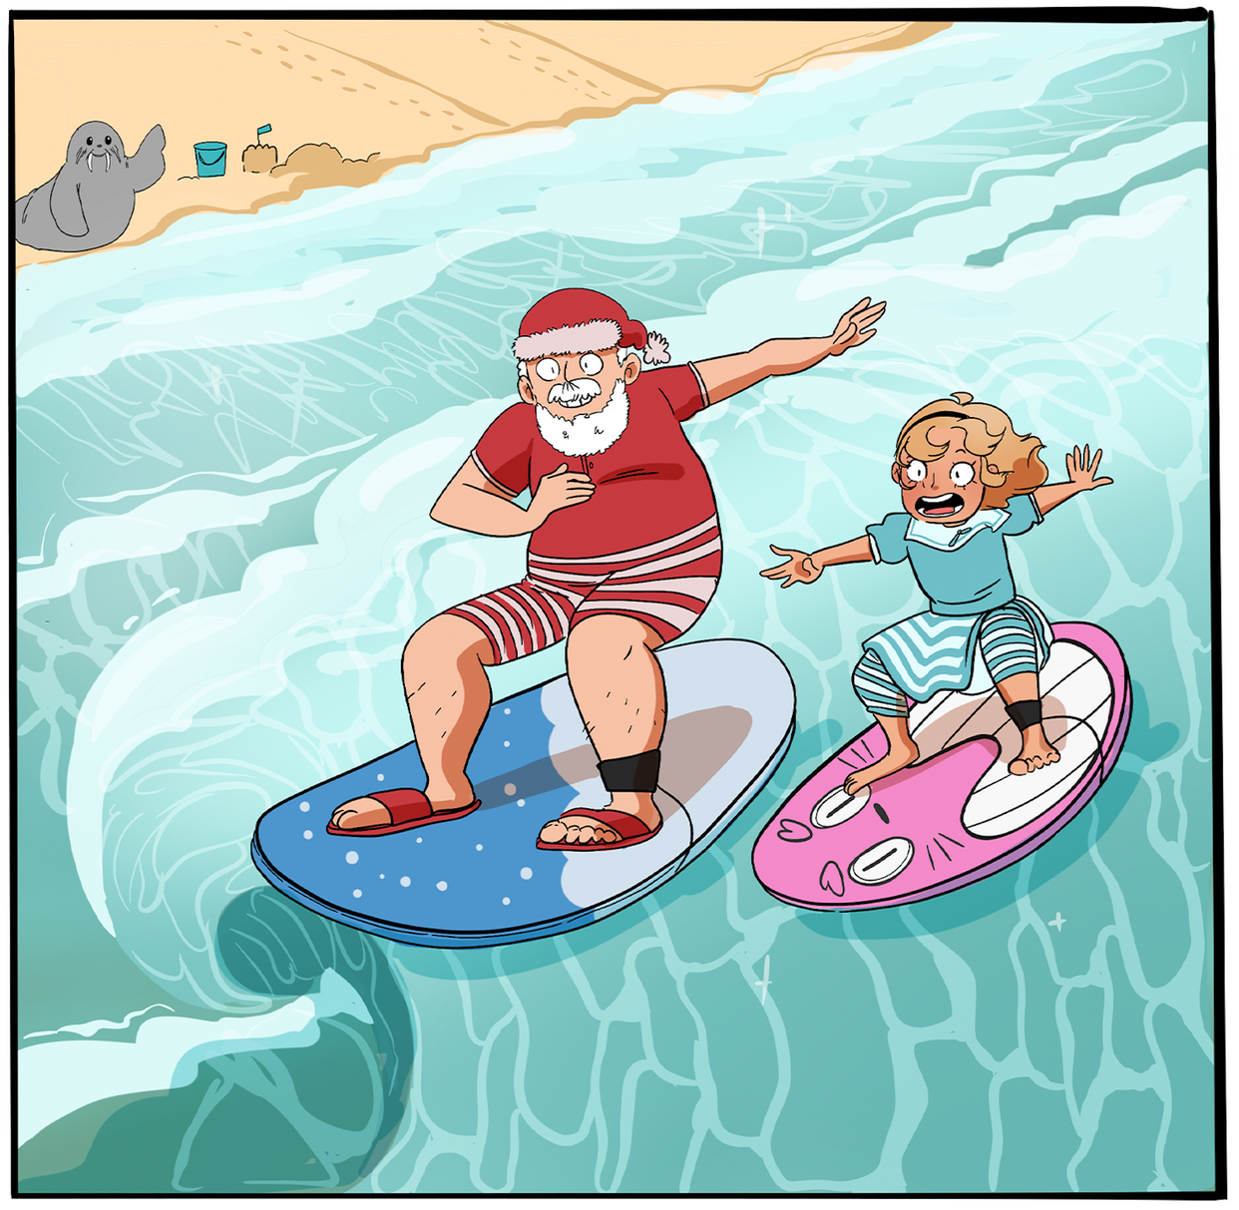
Winter Wonderland
Day 8 - Aloha Santa! Hang ten!
Surfing Santas can be found on Cocoa Beach Florida every Christmas Eve, where thousands of people come to watch the spectacle. You might also find Surfing Santas in Australia, where Christmas arrives in the middle of summer.
Surfers decorate their surfboards – what colours and patterns would be on yours?
Winter Wonderland created by Magic Torch Comics CIC, artwork by Katherine Hemmings

Slide 10
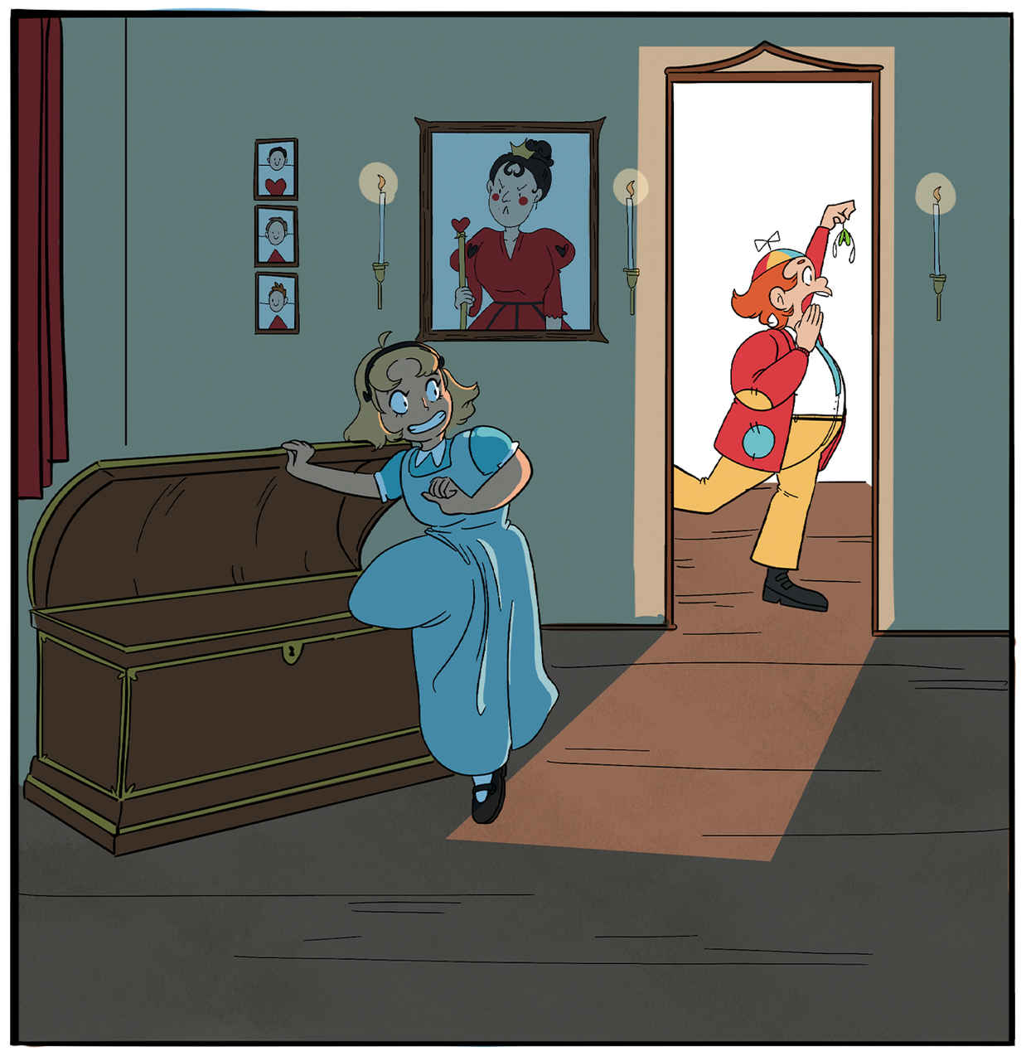
Winter Wonderland
Day 9 - Party Games
Victorians enjoyed all sorts of traditional party games at Christmas, including ‘Hunt the Thimble’, ‘Charades’ and ‘Squeak Piggy Squeak’
Whats your favourite party game? Is there something the whole class can play?
Winter Wonderland created by Magic Torch Comics CIC, artwork by Katherine Hemmings

Slide 11
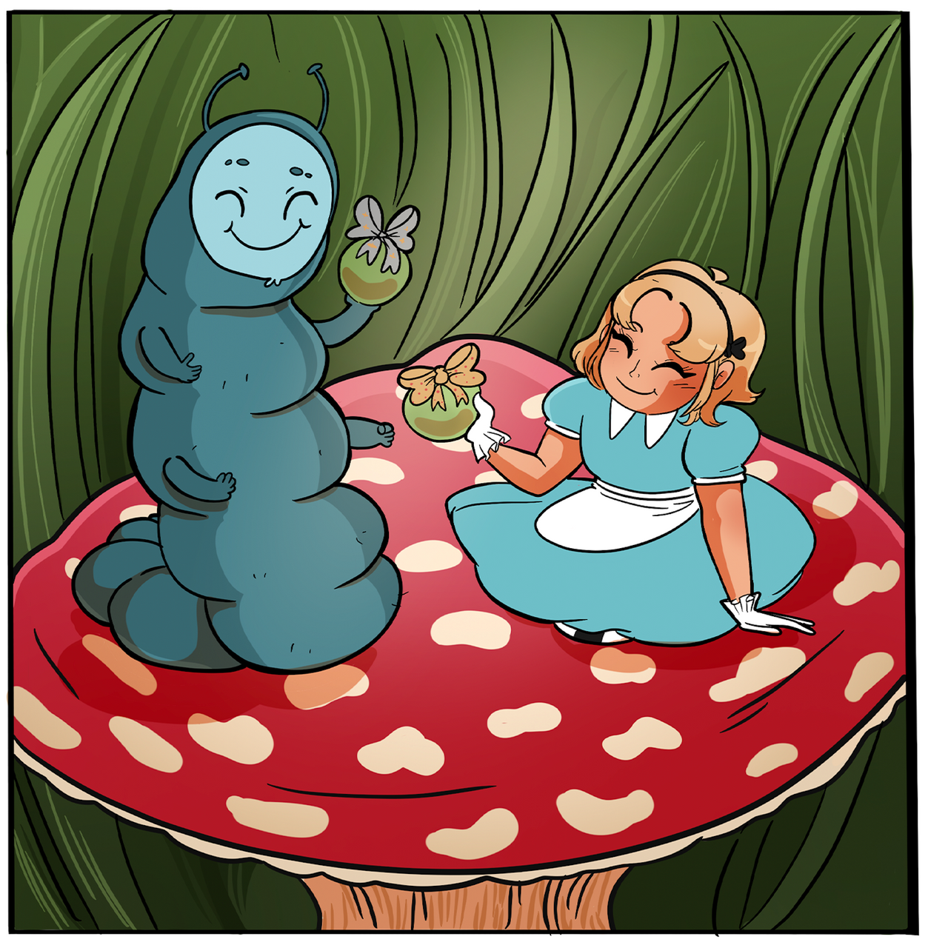
Winter Wonderland
Day 10 - Peace Apples
A new tradition has emerged in China, of exchanging ‘Peace Apples’ at Christmas. The apples are often wrapped in fancy paper, or painted or carved with special messages and are intended to show how much you care for someone.
Draw the words and patterns on your peace apple.
Winter Wonderland created by Magic Torch Comics CIC, artwork by Katherine Hemmings

Slide 12
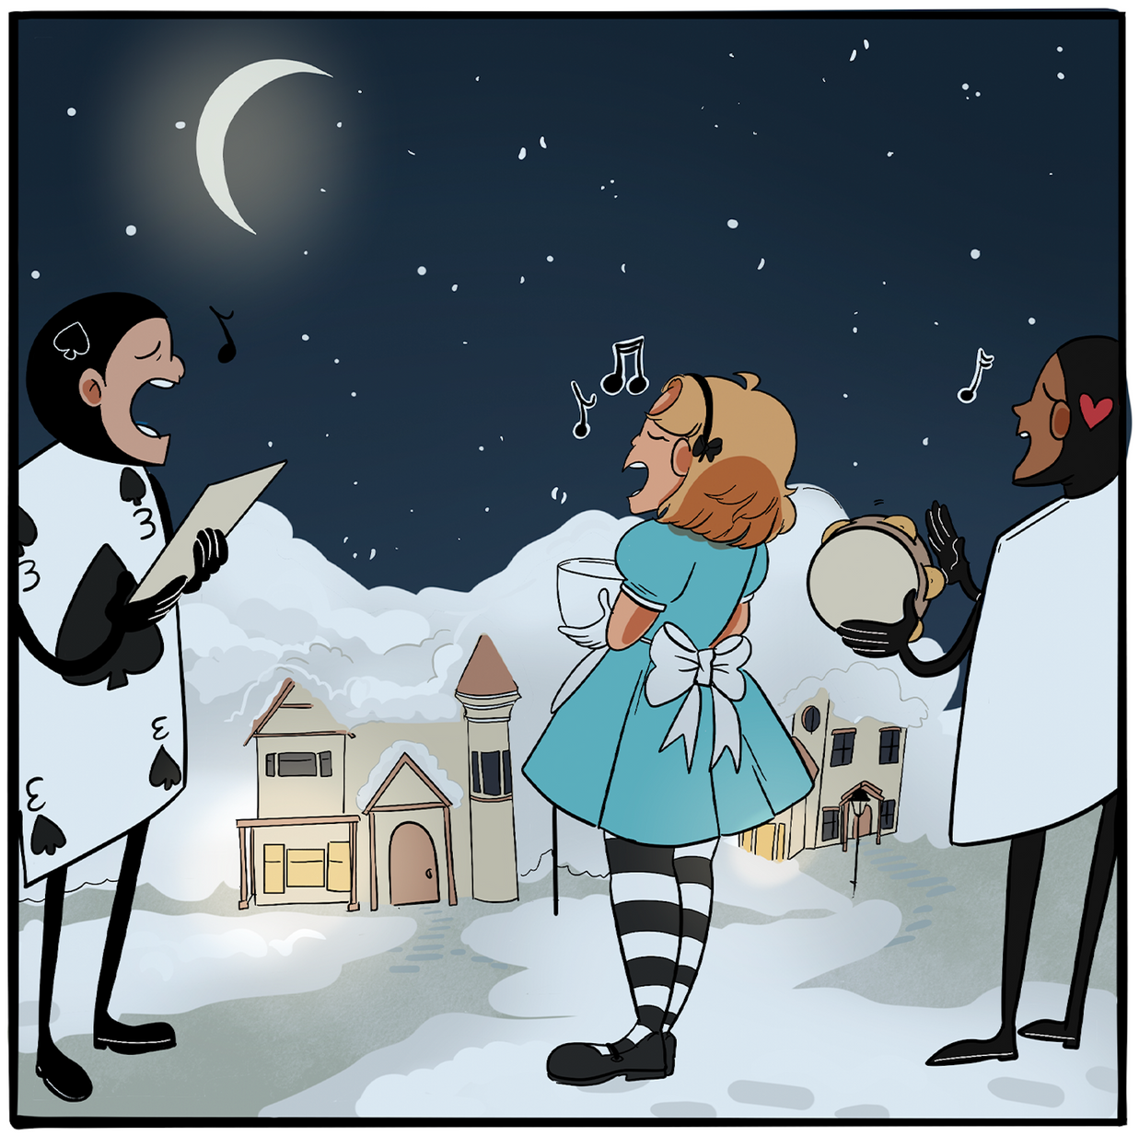
Winter Wonderland
Day 11 - Here we come
a wassaling!
Wassailing is a little like Christmas carolling. People go from door to door, singing songs and spreading good cheer, collecting donations in their wooden wassailing bowl. Another type of wassailing involves going to orchards and places where fruit grows, and singing and dancing around the trees in the hope of a good harvest next year. Either way, everyone is wishing good health to others.
Class vote on your favourite Christmas song –
then sing it all together.
Winter Wonderland created by Magic Torch Comics CIC, artwork by Katherine Hemmings

Slide 13
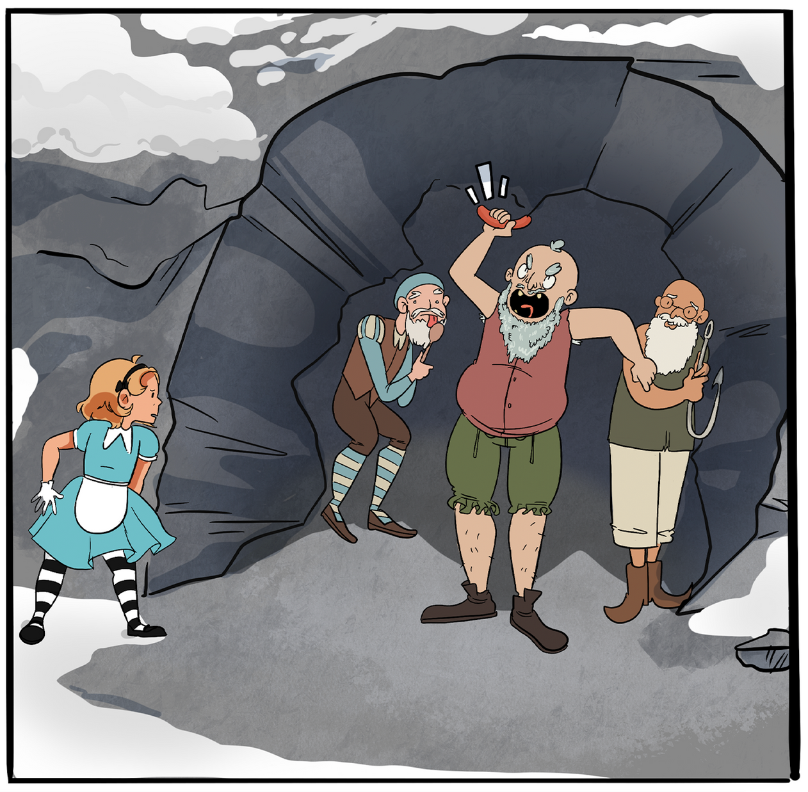
Winter Wonderland
Day 12 - The Yule Lads
In Iceland, the Yule Lads, come down from the mountains to cause mischief, starting on December 12th. A different lad arrives each night until December 24th, each one causing a particular type of trouble in the house – from slamming doors and licking spoons to snatching sausages and stealing candles.
Yule Lads are a bit like the elf on a shelf – causing trouble in your house. What sorts of trouble would happen in your house?
Winter Wonderland created by Magic Torch Comics CIC, artwork by Katherine Hemmings

Slide 14
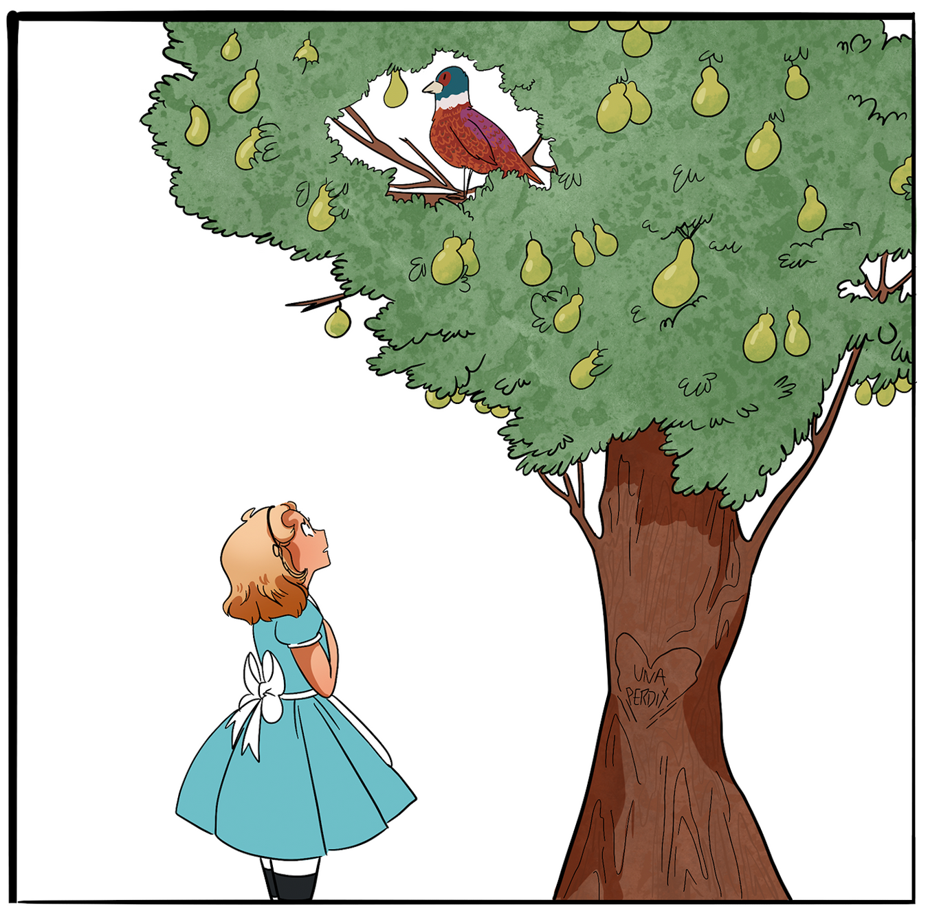
Winter Wonderland
Day 13 - A Partridge in
a Pear Tree?
There are many different versions of ‘The Twelve Days of Christmas’, and all the gifts have a different meaning. It has been suggested that the first gift, the partridge, wasn’t meant to be in a pear tree at all – someone just misunderstood the French for ‘one partridge’ – Un Perdix.
Think of the song The Twelve Days of Christmas…now, add up all the presents that your true love gave you. How many presents is that?
Winter Wonderland created by Magic Torch Comics CIC, artwork by Katherine Hemmings

Slide 15
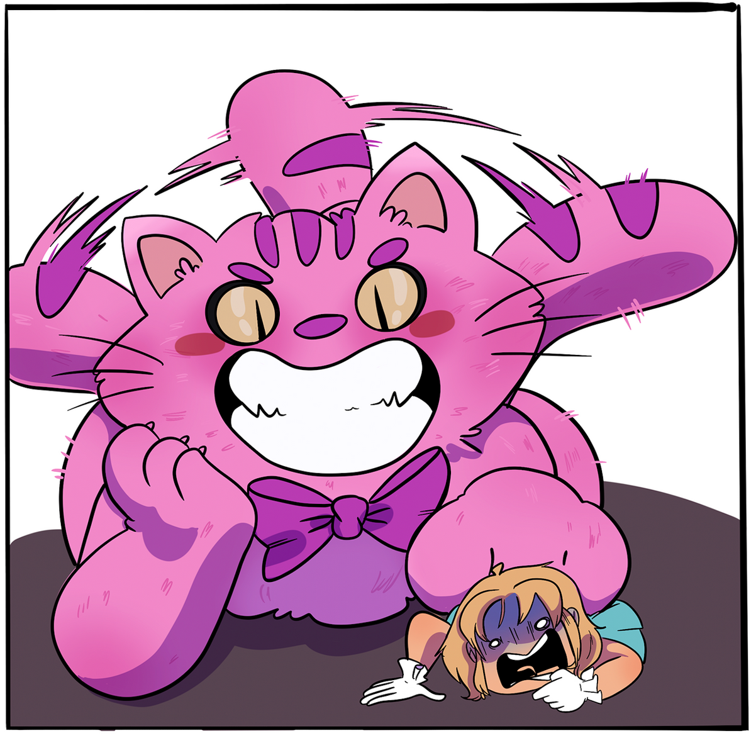
Winter Wonderland
Day 14 - The Yule Cat
Iceland’s Yule Lads come from a spooky family, who also have an enormous cat – the Yule Cat. The cat prowls around looking for anyone who isn’t wearing new Christmas clothes, and gobbles them up. Rude.
You must distract the Yule Cat! Draw a picture of what you do to stop it pouncing – what would a ginormous cat like?
Winter Wonderland created by Magic Torch Comics CIC, artwork by Katherine Hemmings

Slide 16
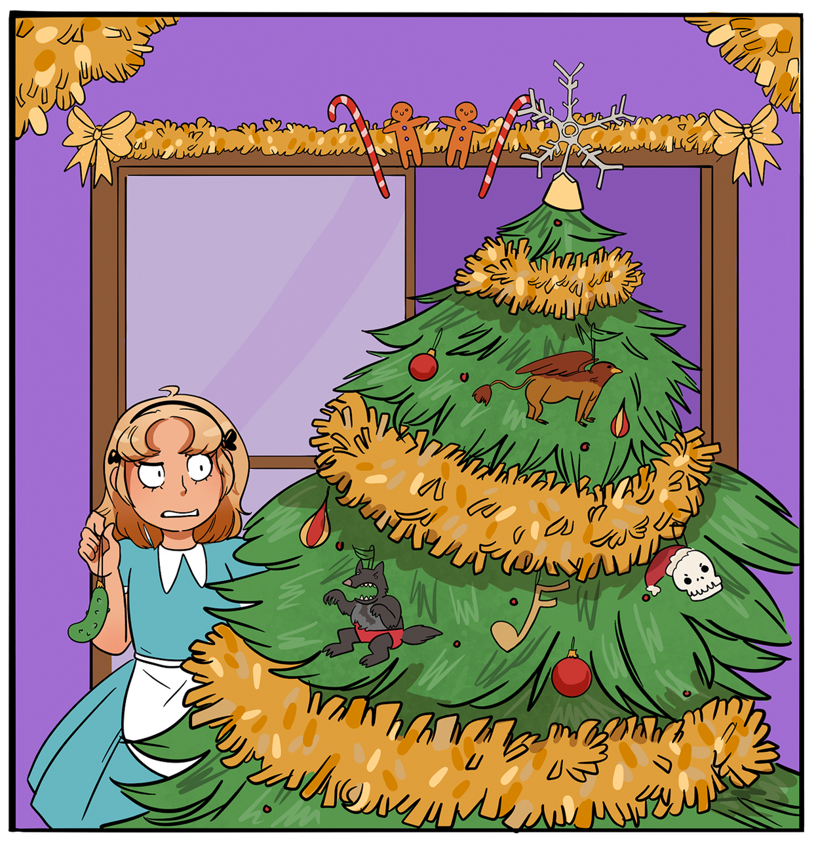
Winter Wonderland
Day 15 - Find The Pickle
In the 1880s, the American store ‘Woolworths’ starting selling glass ornaments for trees, and these included fruits and the traditional German Christmas Pickle. People were invited to hide the ornament in their tree as a game. The only thing was, there was no such thing as a traditional German Christmas Pickle, it was totally made up – perhaps because the shop had ordered too many weird pickle ornaments. It turned into a tradition anyway.
Design a Christmas ornament as silly as the Christmas pickle.
Winter Wonderland created by Magic Torch Comics CIC, artwork by Katherine Hemmings

Slide 17
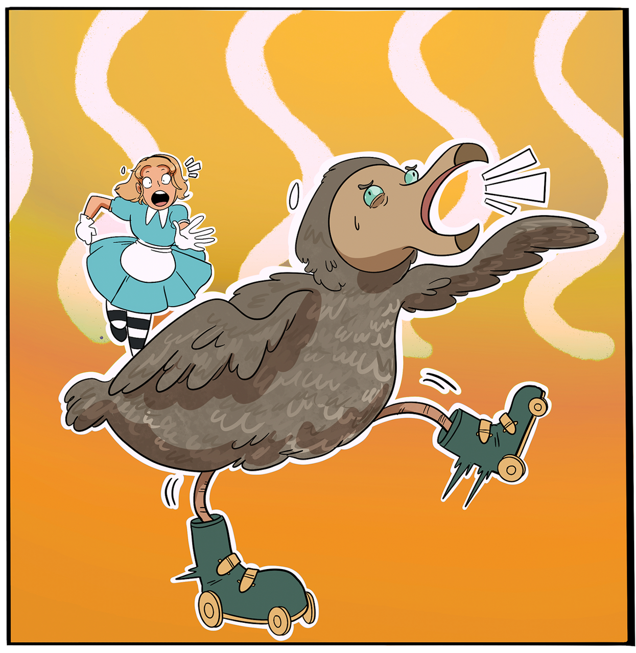
Winter Wonderland
Day 16 - Holy rollers
In Venezuela, people roller skate to church on Christmas day, with the streets closed so families can skate together safely. As they skate, the sound of fireworks and firecrackers fills the air along with the church bells. Perhaps the skating is a way of enjoying the winter fun of sledging or ice-skating in a hot country, or maybe everyone just loves roller skates.
What unusual way would you like to travel on Christmas day?
Winter Wonderland created by Magic Torch Comics CIC, artwork by Katherine Hemmings

Slide 18
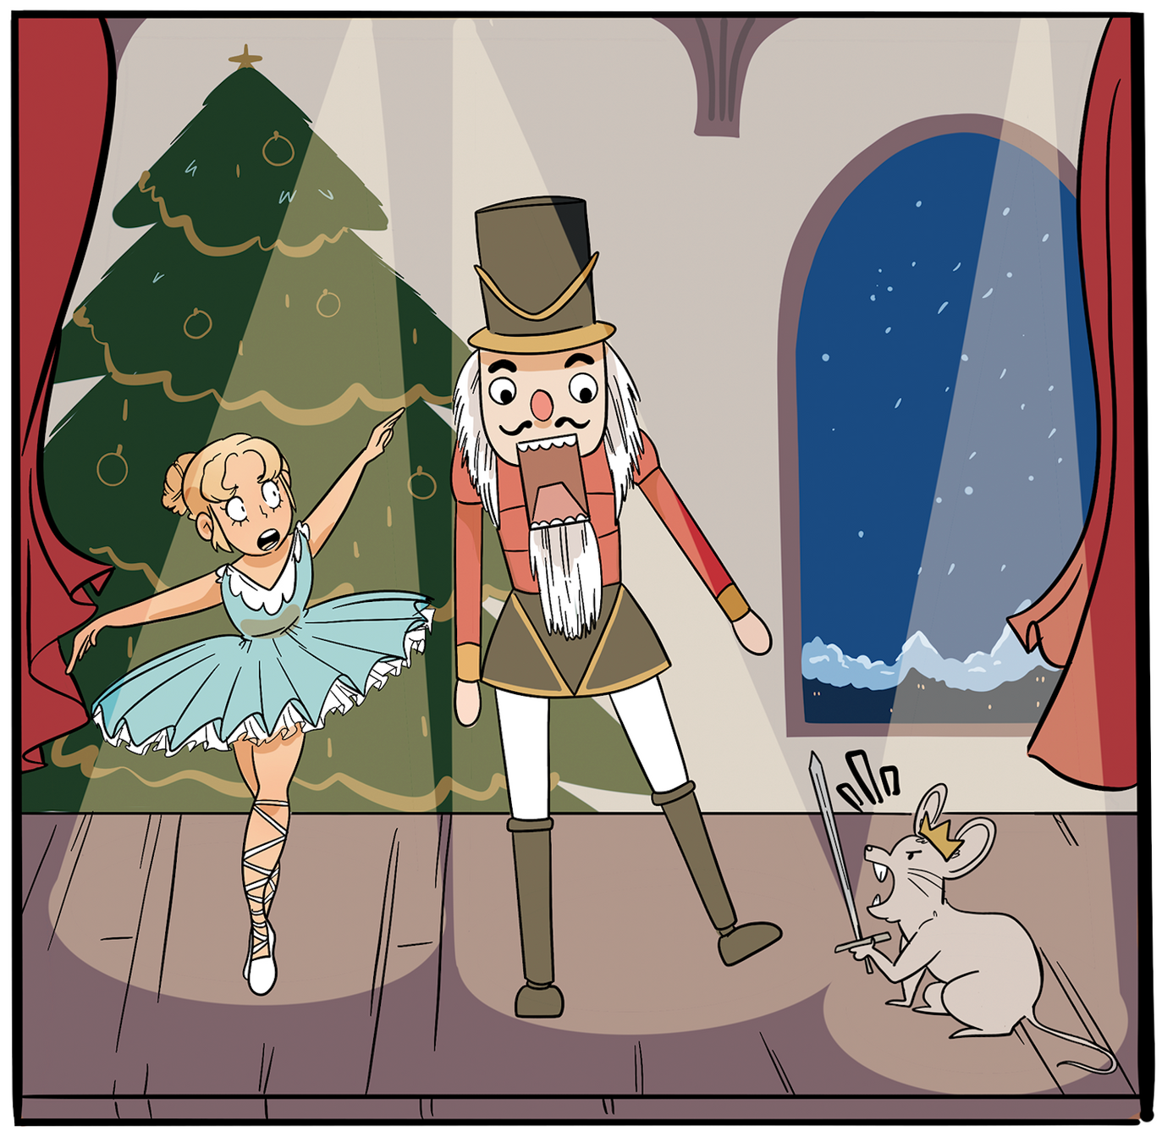
Winter Wonderland
Day 17 - Ballet Battle
The Nutcracker Ballet by Tchaikovsky was first performed on December 17th 1892. It was a massive flop and no one liked it. The story is about a nutcracker that comes to life on Christmas Eve to help a girl battle the evil mouse king. The ballet grew more popular as it toured the world, eventually becoming a Christmas tradition, which just shows that not everything is an overnight success.
Imagine one of your toys came to life on Christmas Eve…which one would it be and what would you do?
Winter Wonderland created by Magic Torch Comics CIC, artwork by Katherine Hemmings

Slide 19
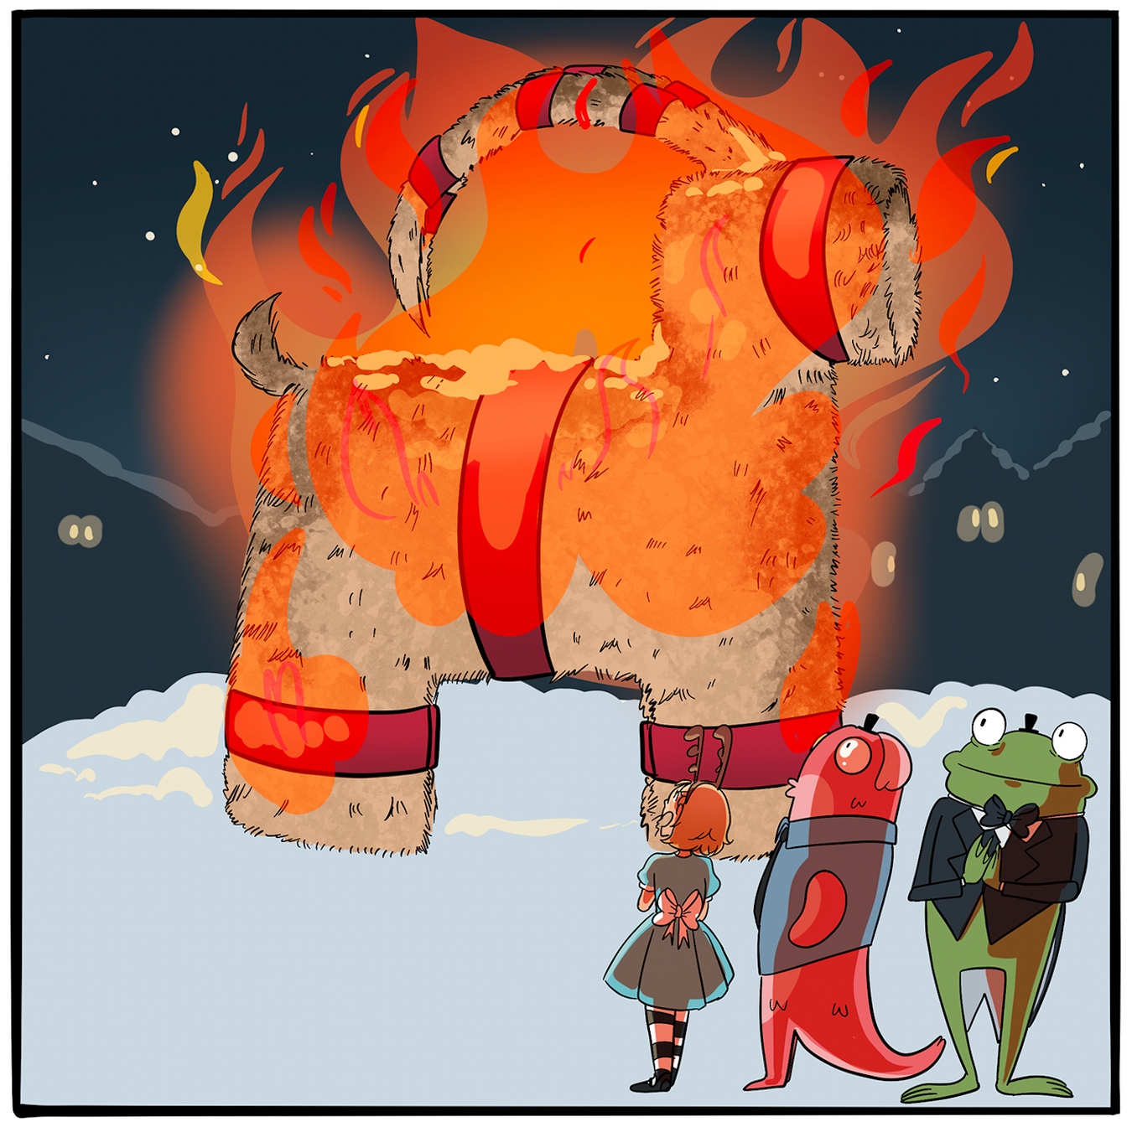
Winter Wonderland
Day 18 - The Yule Goat
Every year, cities and towns throughout Sweden build huge straw Yule Goats to stand throughout the winter celebrations. And every year, cheeky pranksters find a way to set the goat on fire instead.
You must protect the Yule Goat! How will you keep the fire starters away?
Winter Wonderland created by Magic Torch Comics CIC, artwork by Katherine Hemmings

Slide 20
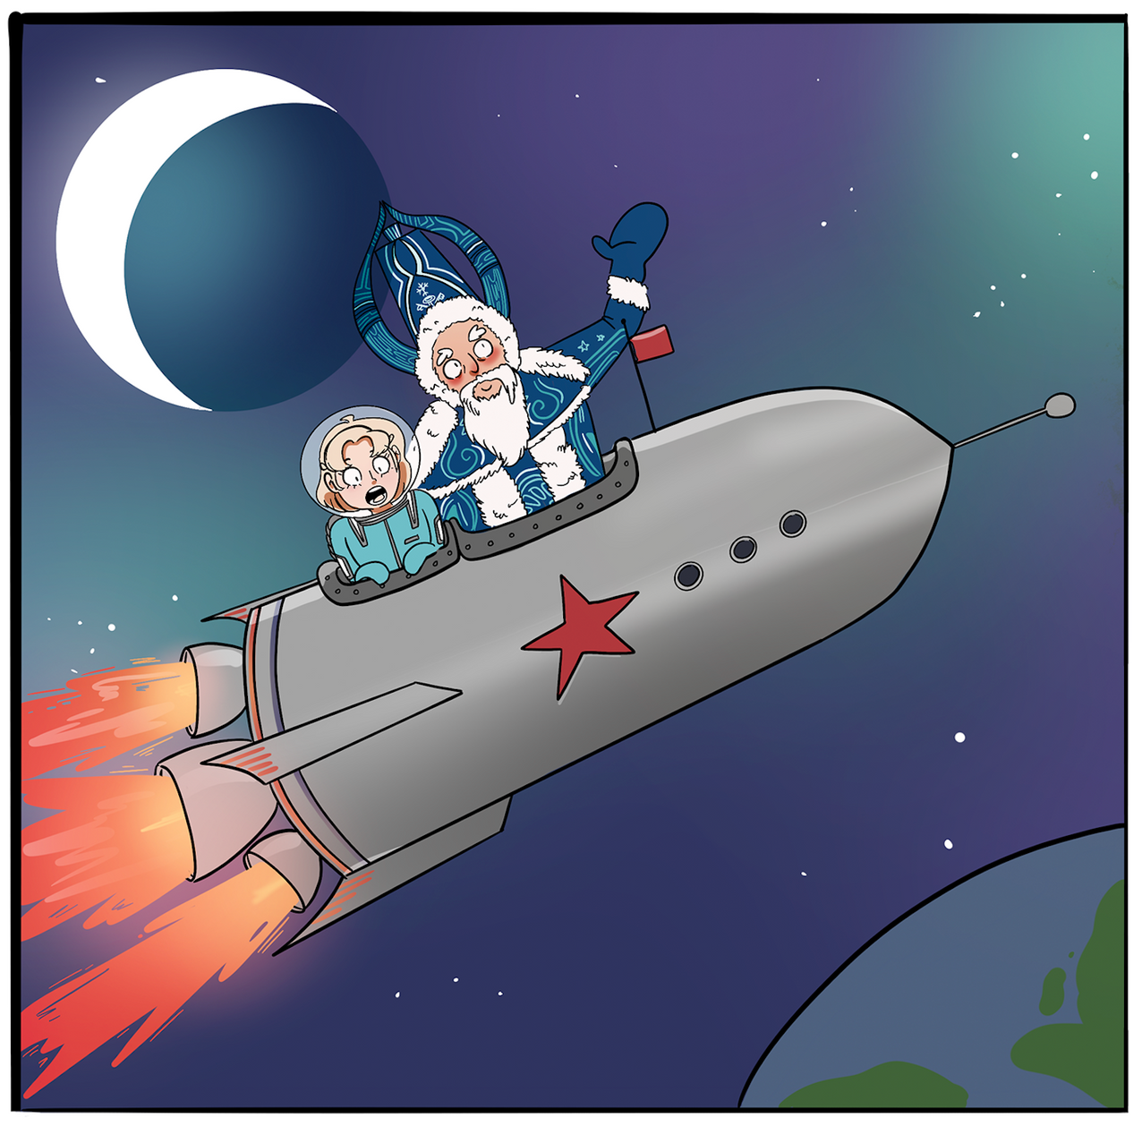
Winter Wonderland
Day 19 - Space Santa
In parts of Russia, Santa is known as Grandfather Frost or Ded Moroz. In the 1950s when Russia and America were racing to be the first into space, Ded Moroz could often be found on Christmas cards and posters, flying rockets and spaceships, which you have to admit
is cooler than the Coca Cola truck.
Draw us some more of Santa’s space adventures. Where does he go? Who does he meet?
Winter Wonderland created by Magic Torch Comics CIC, artwork by Katherine Hemmings

Slide 21
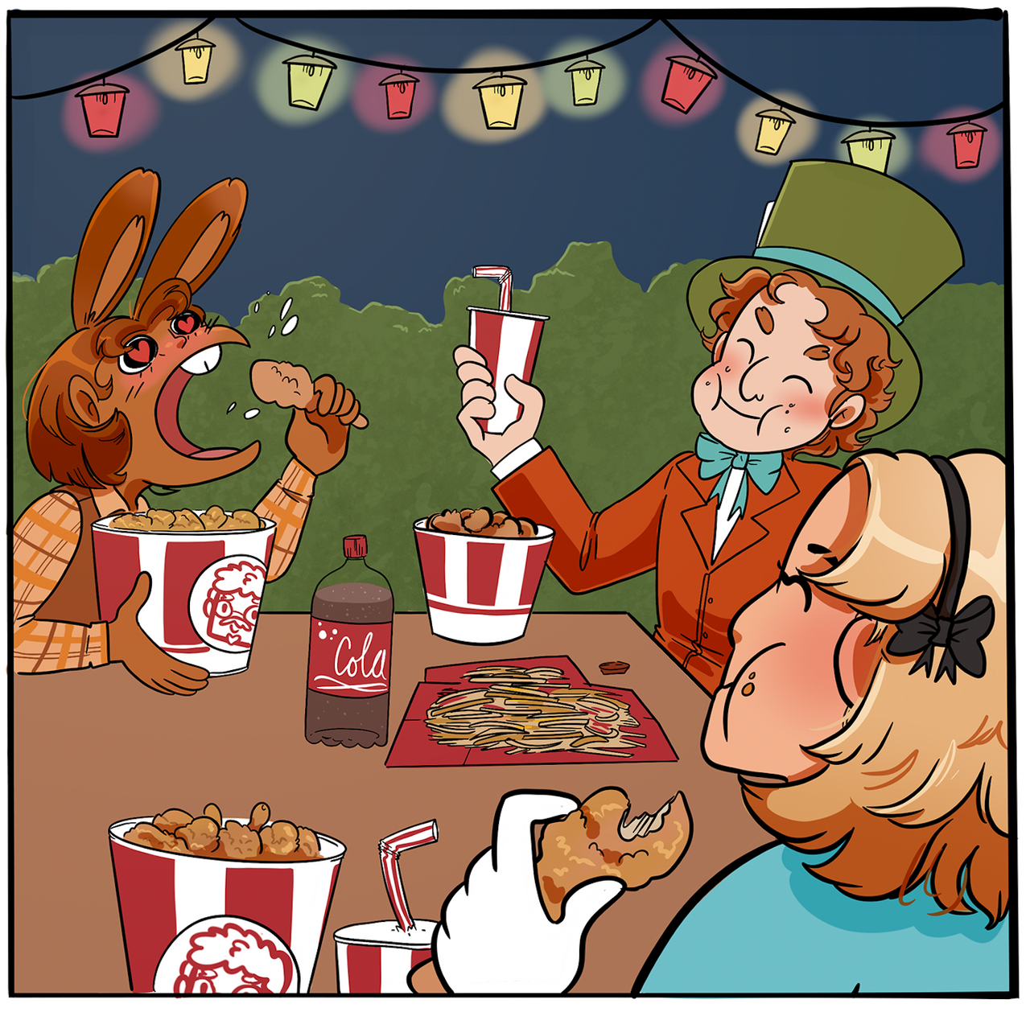
Winter Wonderland
Day 20 - Kentucky Fried Christmas
Since the 1980s, it has been a Japanese custom for families to share a KFC party bucket together on Christmas Eve. It’s the busiest time of year for KFC, with queues out the door, and ten times as many customers as usual. Personally I prefer a chippy…
What would your ideal Christmas dinner be?
Winter Wonderland created by Magic Torch Comics CIC, artwork by Katherine Hemmings

Slide 22
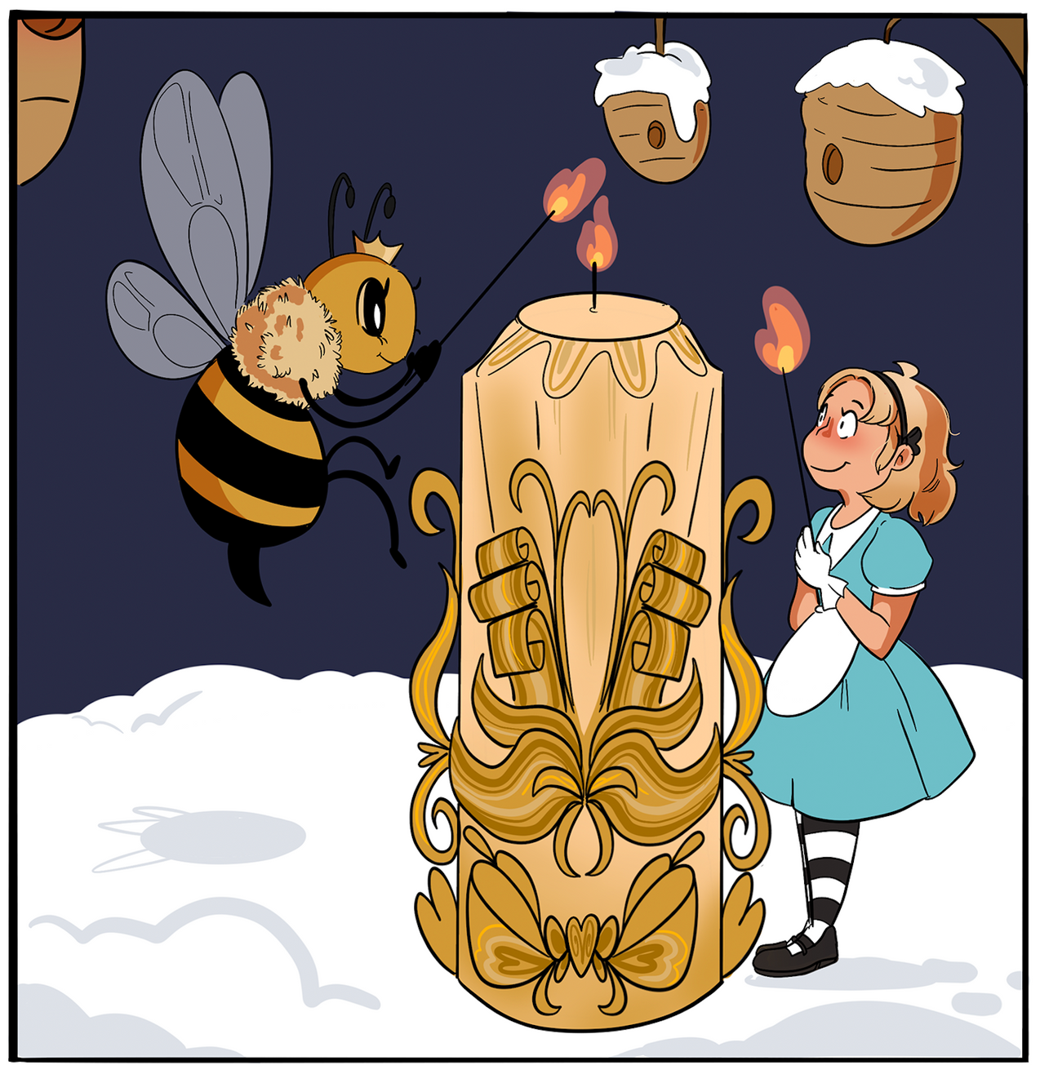
Winter Wonderland
Day 21 - Snow Bees
Hans Christian Andersen’s ‘The Snow Queen’ is queen of all the snow bees. The power of the sunlight harvested by the bees in summer, helps the solstice candle burn brighter on December 21st - midwinter, the longest night of the year.
Candles all have nice smells now, what would be the ingredients of YOUR candle?
Winter Wonderland created by Magic Torch Comics CIC, artwork by Katherine Hemmings

Slide 23
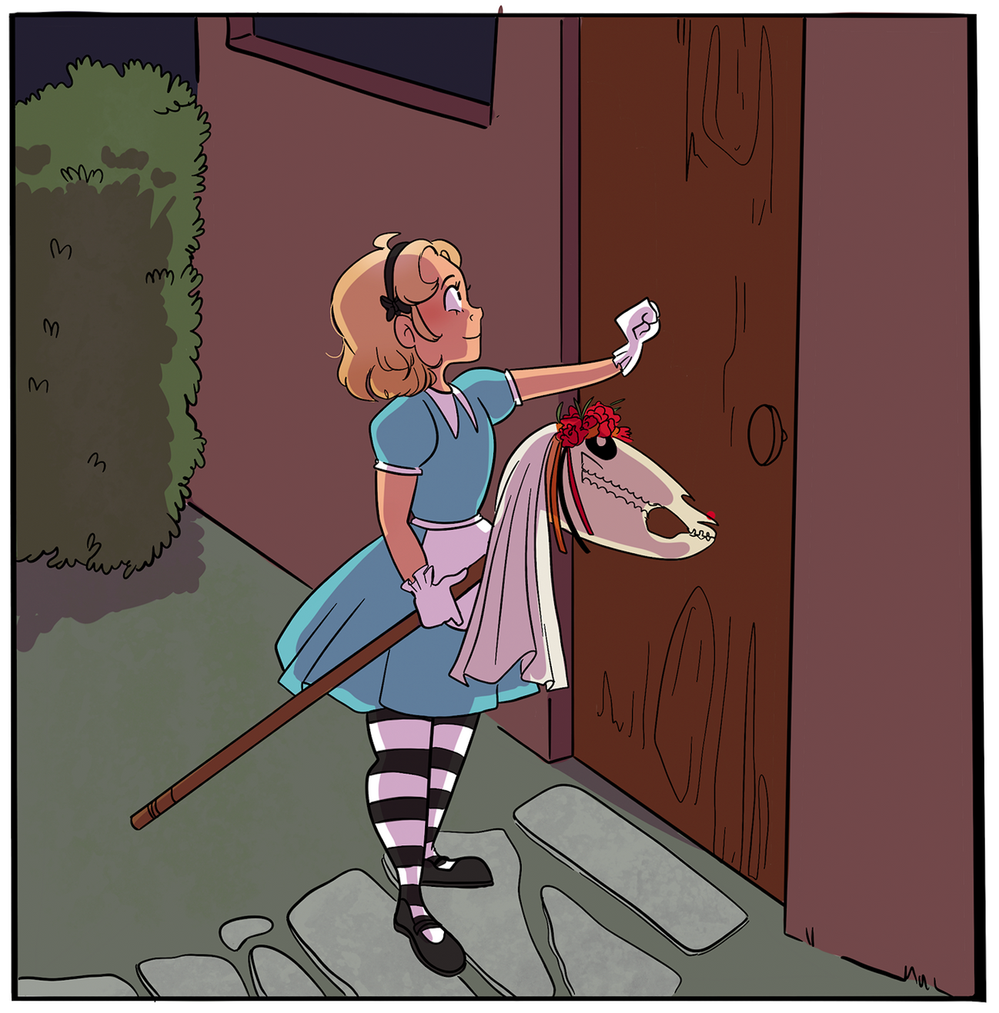
Winter Wonderland
Day 22 - Mari Lwyd
In Wales, the Mari Lwyd is another wassailing type tradition. A group of visitors with their wooden hobby horse would sing a song at each door and ask to be let in for food and drink. The people inside sing a song back and pretend not to let them in. And so it goes back and forth until eventually the group are allowed in (or someone runs out of songs).
Split the class and have a song battle where you each sing lines of songs until one team runs out.
Winter Wonderland created by Magic Torch Comics CIC, artwork by Katherine Hemmings

Slide 24
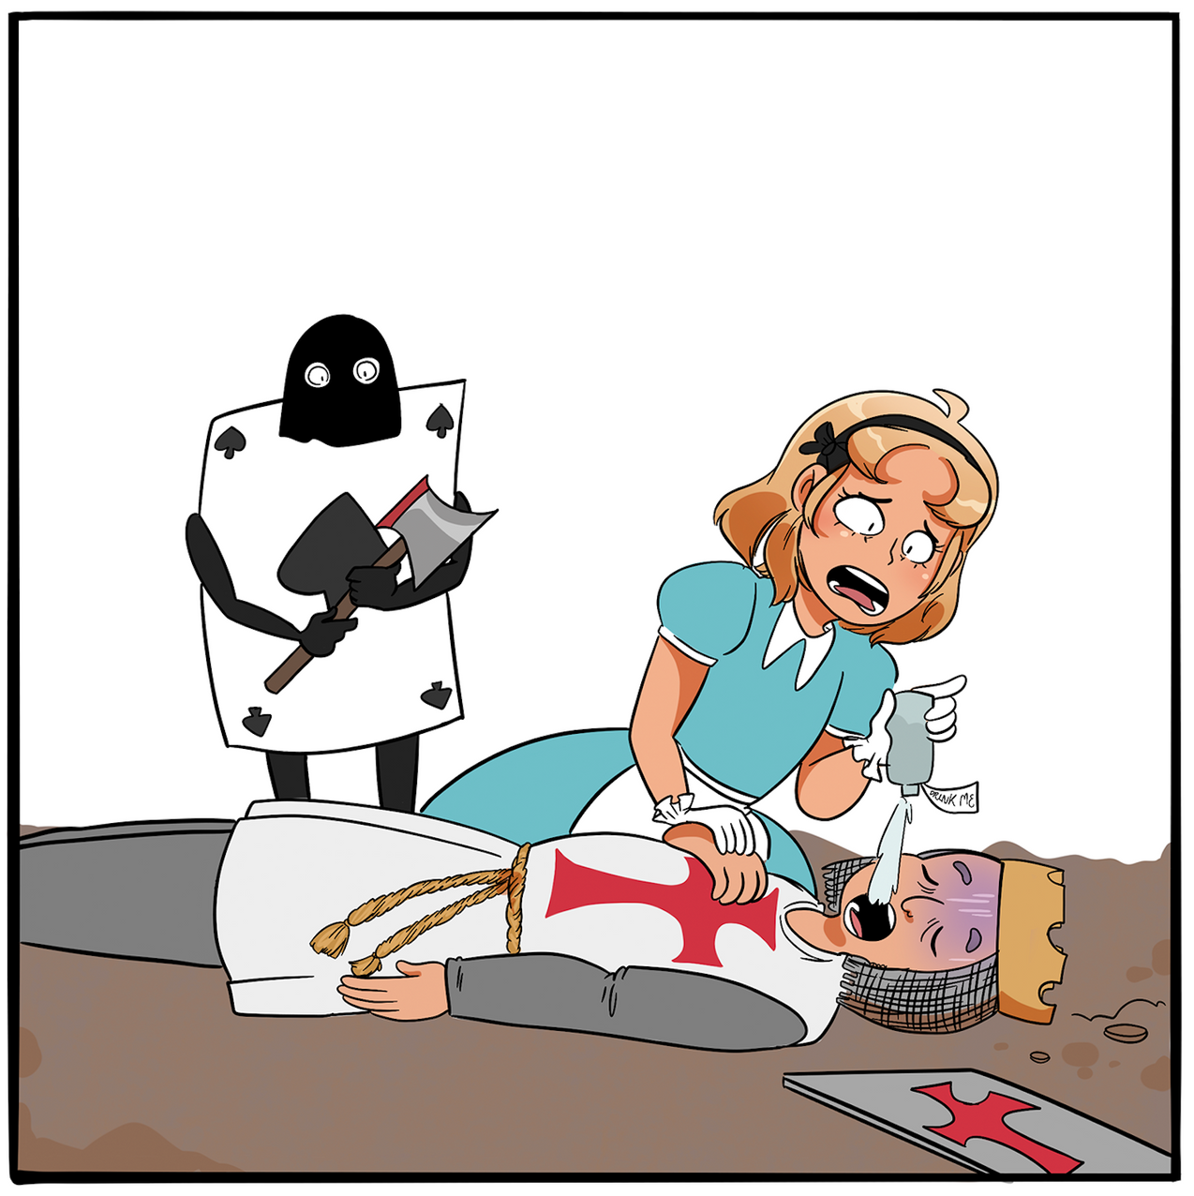
Winter Wonderland
Day 23 - Rise sir!
And fight again!
Another household visiting tradition is the mumming play, a retelling of St George and the Dragon, in which a heroic knight is killed in battle and brought back to life with a magic potion. When performed in winter, the story symbolises the end of one year and the starting of the next.
If a magic potion could give you any magical power, what would it be?
Winter Wonderland created by Magic Torch Comics CIC, artwork by Katherine Hemmings

Slide 25
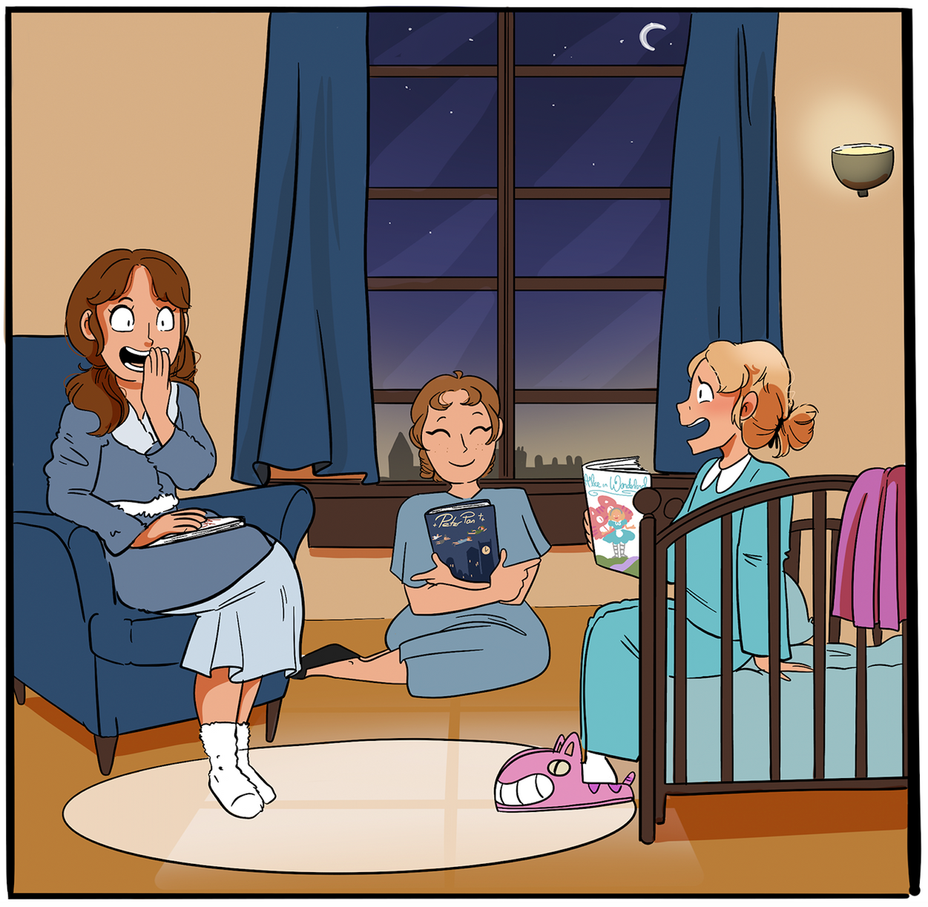
Winter Wonderland
Day 24 - Jolabokaflod!
In Iceland, people give one another books on Christmas Eve. The tradition dates from around World War 2, as paper was one of the few things not rationed in Iceland, so meant it was able to be used for festive gifts. Iceland publishes thousands of books during the winter months as part of this ‘Christmas Book Flood’.
Write a Christmas poem or story to give to someone as a present on Christmas Eve.
Winter Wonderland created by Magic Torch Comics CIC, artwork by Katherine Hemmings

