Slide 1
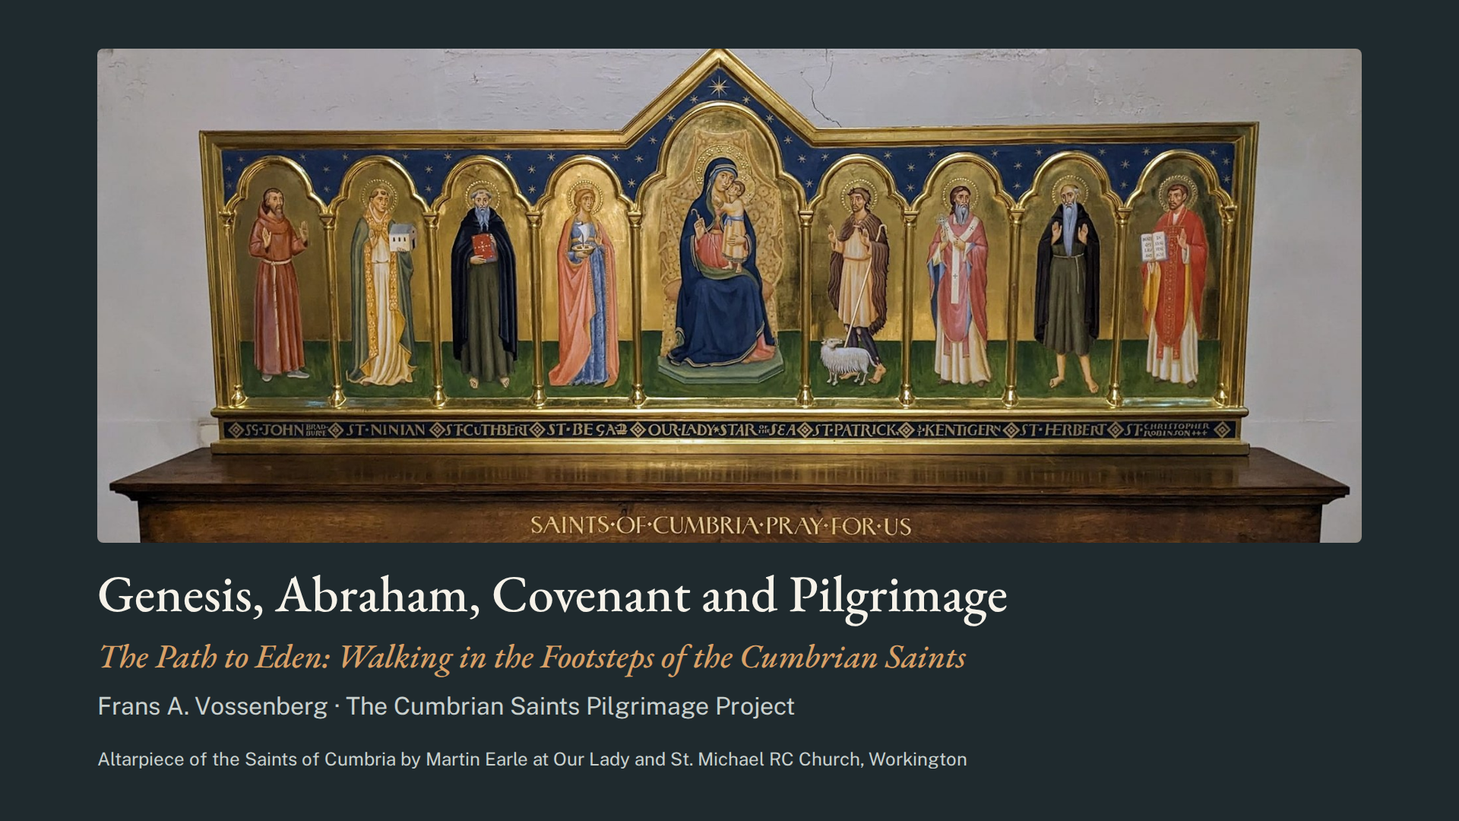
Notes:
Good morning, walkers, and welcome to “The Path to Eden: Walking in the Footsteps of the Cumbrian Saints”. We stand before the altar of the eight saints of Cumbria in the Church of Our Lady Star of the Sea and St Michael in Workington, Northwest England. Several of you are new to pilgrimage, so let us begin with its biblical roots: the story of Abraham and his covenant with God.

Slide 2
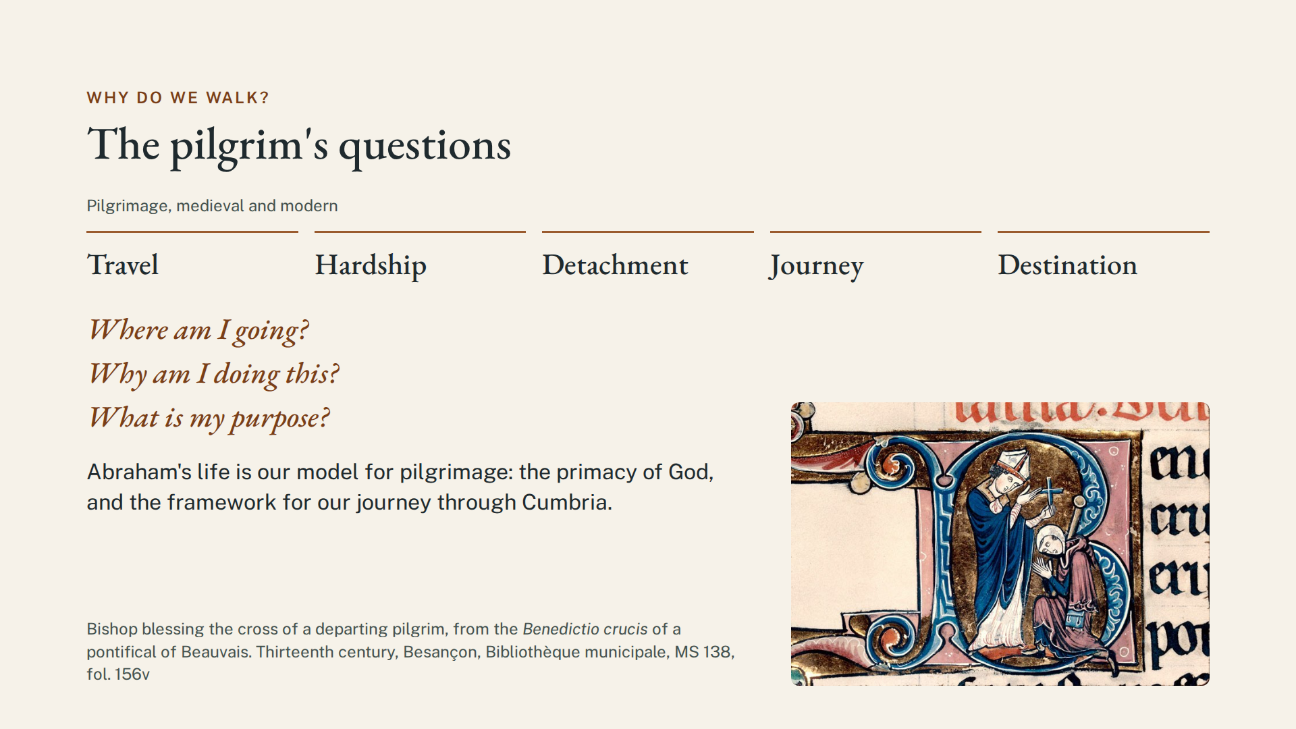
Notes:
Firstly, Why Do We Walk on Pilgrimage?
Medieval pilgrimage involved travel, hardship, detachment, a journey, and a destination. As the body grows weary, the mind turns to meaning. Where am I going? Why am I doing this? What is my purpose? My goal in this talk is to offer Abraham’s life as the model for modern pilgrimage. We will see how his example emphasizes the primacy of God in our lives and provides the framework for our personal journey through Cumbria.

Slide 3
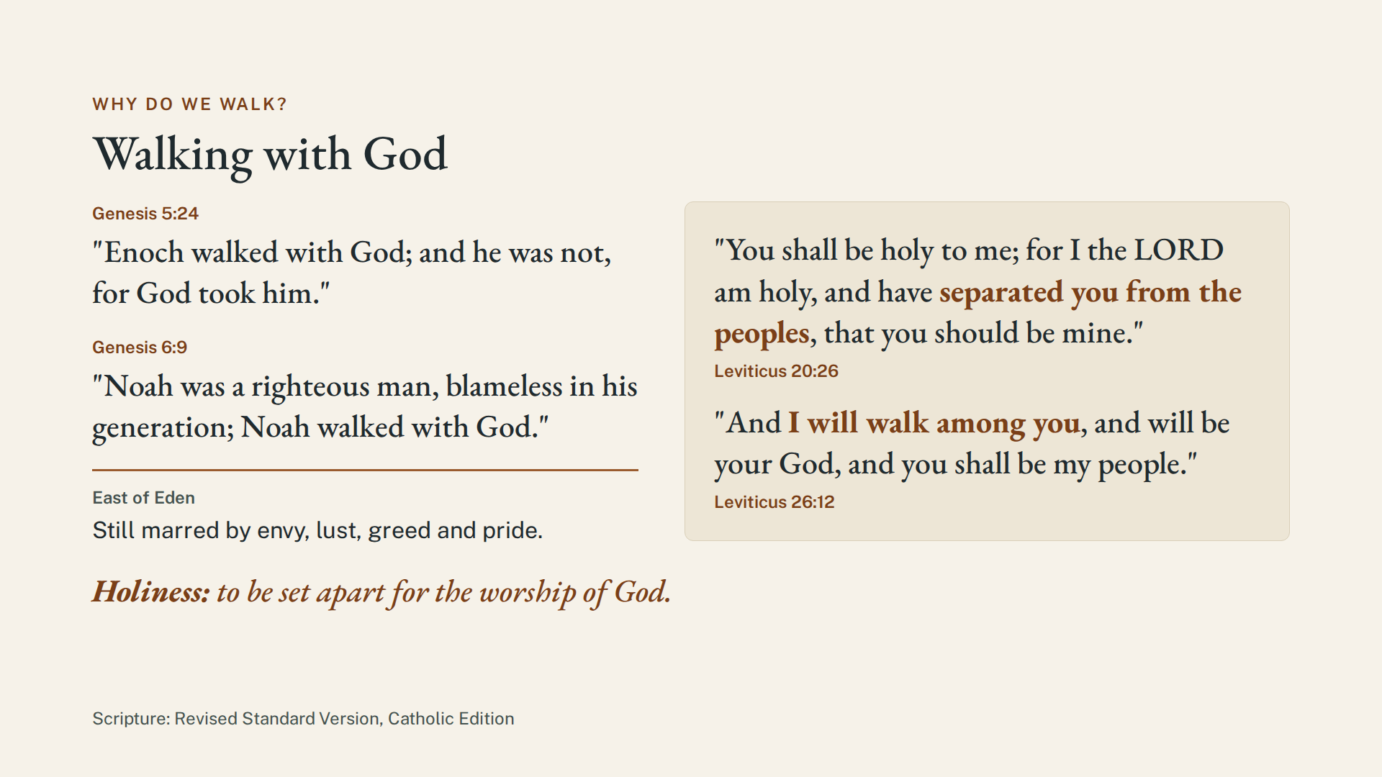
Notes:
In the early chapters of Genesis, Enoch and Noah are said to ‘walk with God’. But everywhere East of Eden is still marred by envy, lust, greed and pride. Genesis 12 reveals that the call to holiness, that is, to be set apart for the worship of God, was a gift, freely bestowed on Abraham. God calls us to detachment as a spiritual discipline and responds to those who seek him by inviting us out of sin and into a family relationship. Hear his words to Israel in Leviticus:
You shall be holy to me; for I the Lord am holy, and have separated you from the peoples, that you should be mine. (Leviticus 20:26)
And I will walk among you, and will be your God, and you shall be my people. (Leviticus 26:12)

Slide 4
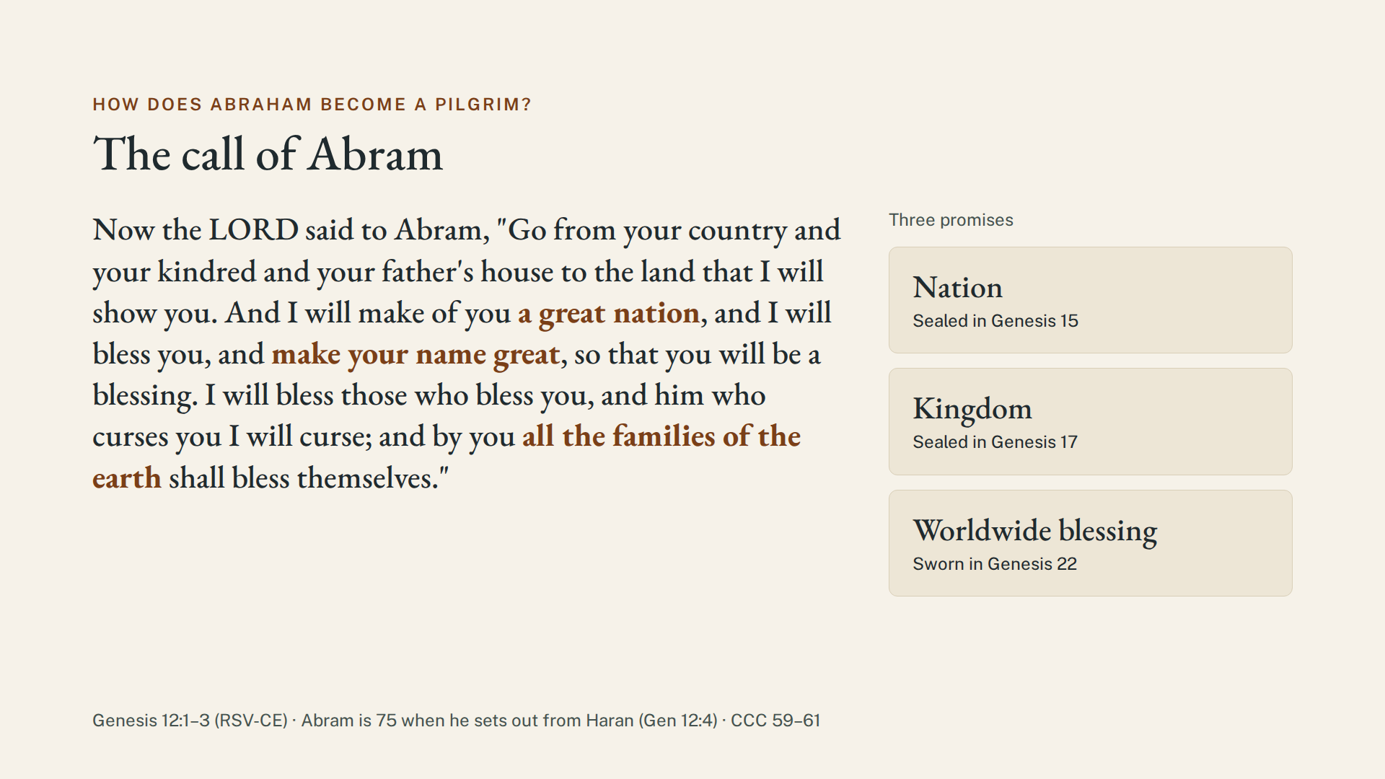
Notes:
How Does Abraham Become a Pilgrim and Form a Covenant with God?
In Genesis 12, God singles out Abram, not for anything he has earned, but as a free and unmerited gift, and promises him nationhood, kingdom, and worldwide blessing.
Genesis 12:1-3 Now the Lord said to Abram, “Go from your country and your kindred and your father’s house to the land that I will show you. And I will make of you a great nation, and I will bless you, and make your name great, so that you will be a blessing. I will bless those who bless you, and him who curses you I will curse; and by you all the families of the earth shall bless themselves.”
So, at the age of 75, Abram sets out from Haran and becomes the first pilgrim. Over the following decades, God establishes his three promises as covenants.

Slide 5
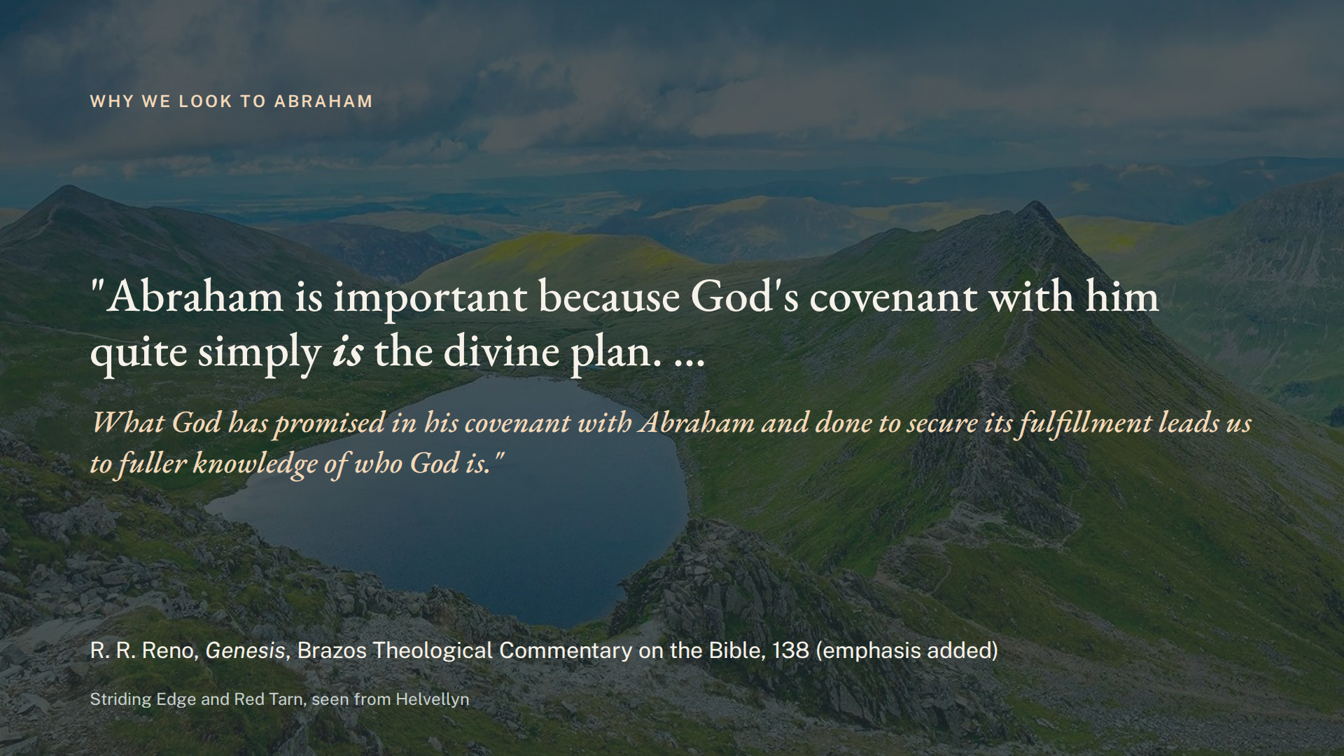
Notes:
God’s covenant of Nation, Kingdom and Blessing, as R. R. Reno writes, “quite simply is the divine plan.”

Slide 6
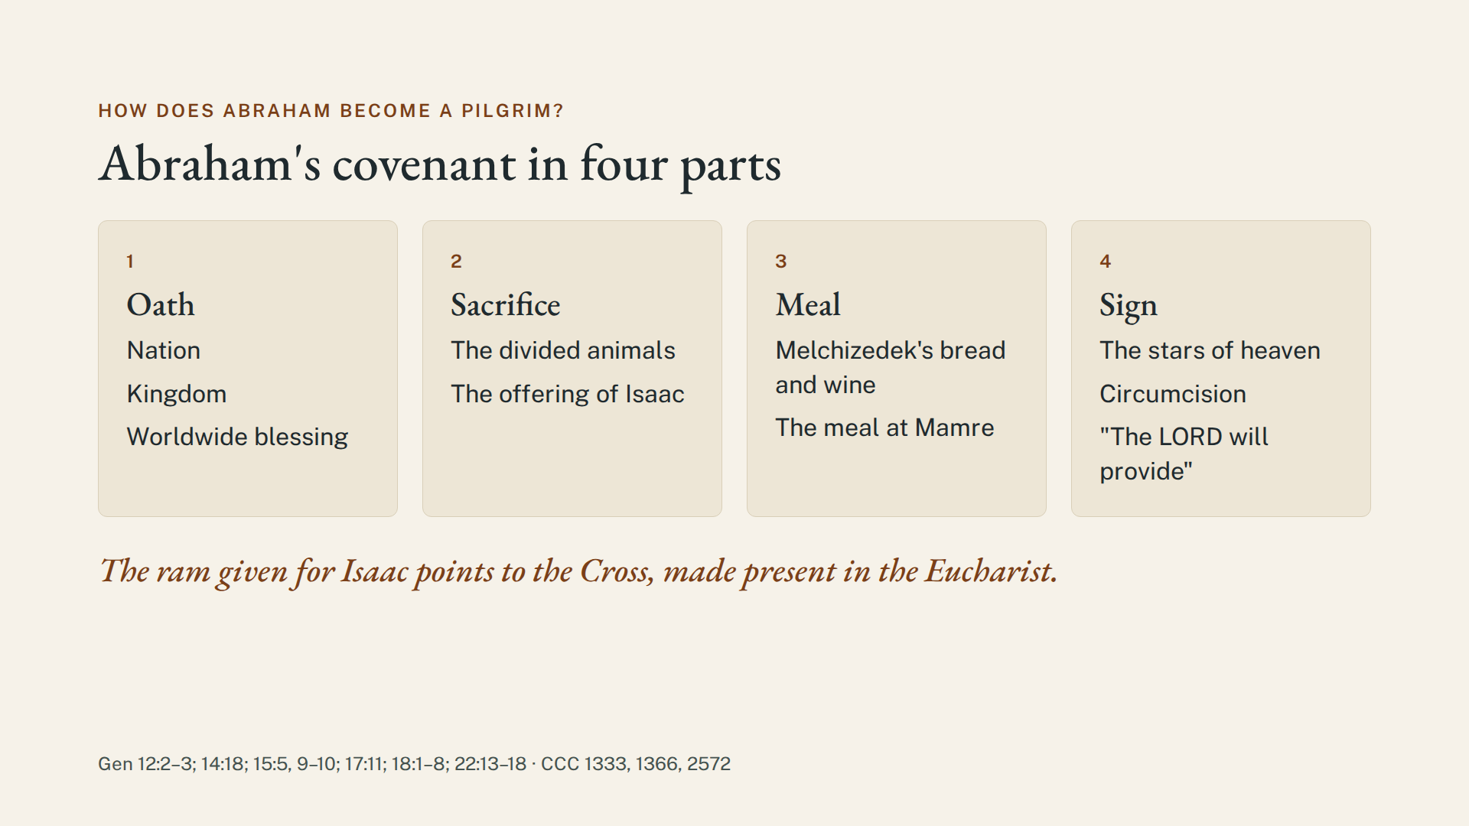
Notes:
Biblical covenants typically included four parts: an Oath, a Sacrifice, a Meal and a Sign. Abraham’s sacrifices were intrinsic to God’s covenants, progressively intensifying from the divided animals to the offering of Isaac. The signs were the stars of heaven, the scar of circumcision, and the mountain named “The Lord will provide”, which Jewish tradition joins with Melchizedek’s Salem in the name ‘Jerusalem’, which translates as “The Lord will provide peace”. The meals were the bread and wine offered by Melchizedek and the dinner prepared for the three visitors at Mamre. The ram slain in Isaac’s place on Mt. Moriah points to Christ’s sacrifice on the Cross, made present in the Eucharist.

Slide 7
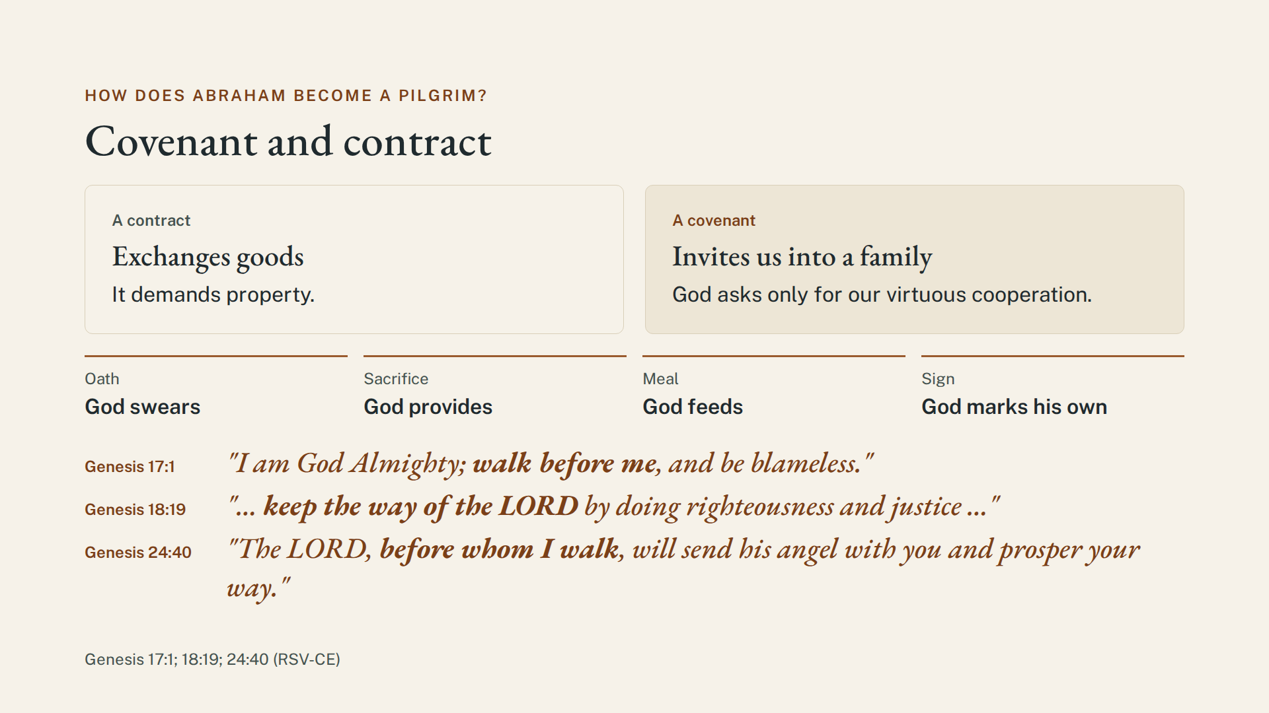
Notes:
Notice that a covenant is much more than a contract. A contract demands property, whereas a covenant invites a familial relationship. Covenant is a reception, not a taking: God swears an oath, provides the sacrifice, feeds us, and marks us as His own. He asks only for our virtuous cooperation, as in Genesis 17:1:
“I am God Almighty; walk before me, and be blameless.”
God says of Abraham in Genesis 18:19:
“… keep the way of the Lord by doing righteousness and justice …”
And later, the patriarch Abraham can say, in Genesis 24:40:
“The Lord, before whom I walk, will send his angel with you and prosper your way.”

Slide 8
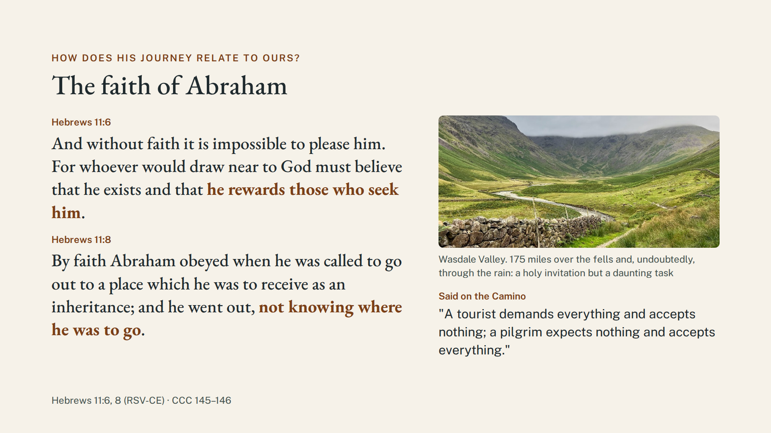
Notes:
How Does Abraham’s Journey Relate to Our Pilgrimage?
A 175-mile hike over the fells and undoubtedly through the rain of Cumbria is a holy invitation but a daunting task. On the Camino, it is said that “A tourist demands everything and accepts nothing; a pilgrim expects nothing and accepts everything.” Like Abraham, we must trust in God:
Hebrews 11:6,8
And without faith it is impossible to please him. For whoever would draw near to God must believe that he exists and that he rewards those who seek him.
By faith Abraham obeyed when he was called to go out to a place which he was to receive as an inheritance; and he went out, not knowing where he was to go.

Slide 9
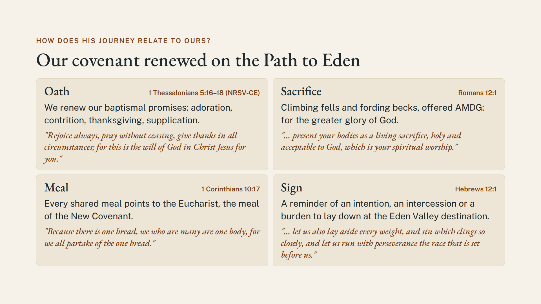
Notes:
As we walk by faith on our personal pilgrimage, we renew our Christian covenant with:
An Oath: Which is, for us, a renewal of our baptismal promises followed by prayerful walking with intentions of adoration, contrition, thanksgiving, and supplication.
We aim to follow the advice of St. Paul: Rejoice always, pray without ceasing, give thanks in all circumstances; for this is the will of God in Christ Jesus for you. (1 Thessalonians 5:16-18)
Sacrifice: Climbing fells and fording becks is offered AMDG, like the "living sacrifice" of Romans 12:1: “I appeal to you therefore, brethren, by the mercies of God, to present your bodies as a living sacrifice, holy and acceptable to God, which is your spiritual worship.”
Meal: Every shared meal with your fellow pilgrims points to the Eucharist, the meal of the New Covenant, as Paul writes: “Because there is one bread, we who are many are one body, for we all partake of the one bread.” (1 Corinthians 10:17)
Sign: Each pilgrim will choose a stone from Fleswick Beach to carry as an intention, an intercession, or a burden to lay down at the Eden Valley destination, as it is written in Hebrews: “let us also lay aside every weight, and sin which clings so closely, and let us run with perseverance the race that is set before us.” (Hebrews 12:1)

Slide 10
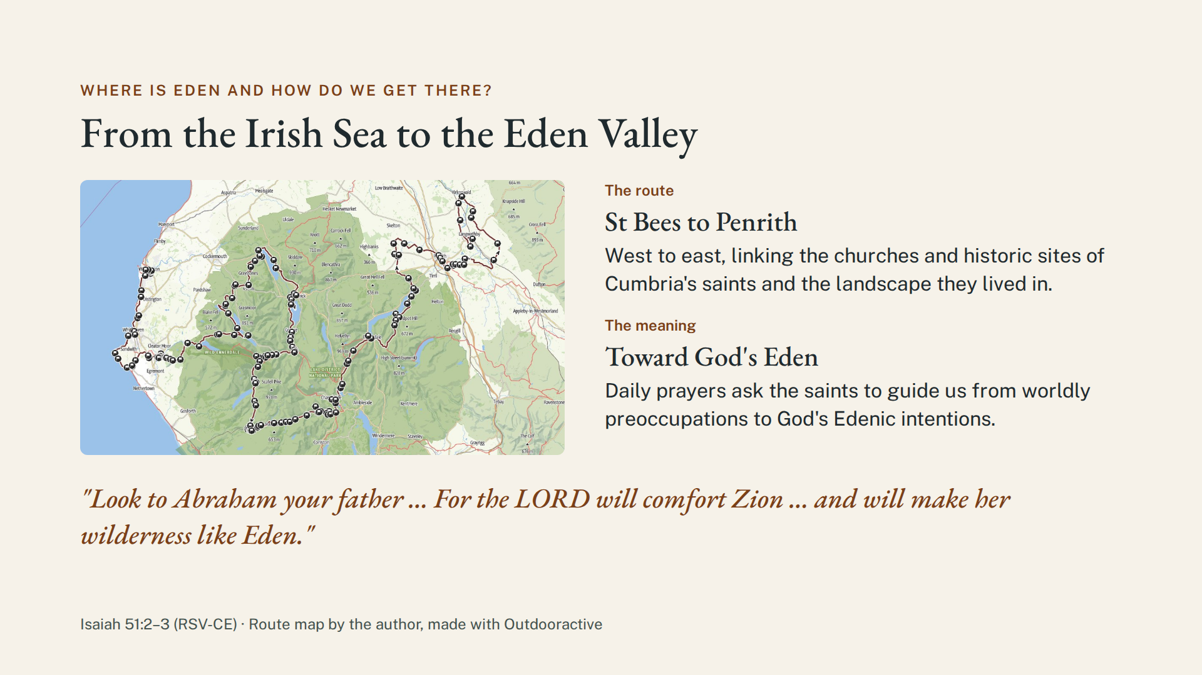
Notes:
Where Is Eden and How Do We Get There?
“The Path to Eden” is both literal and allegorical. The Footsteps of the Cumbrian Saints extend from west to east, leading the pilgrim from the Irish Sea area of St Bees to the Eden Valley region of Penrith. This West Cumbrian and Lake District pilgrimage route links historic sites and churches associated with Cumbria's saints to the dramatic landscape in which they lived. Daily prayers and reflections ask these holy men and women to guide us from our worldly preoccupations to God’s Edenic intentions. Isaiah 51:2-3 ties Abraham to this hope: “Look to Abraham your father … For the Lord will comfort Zion … and will make her wilderness like Eden.”

Slide 11
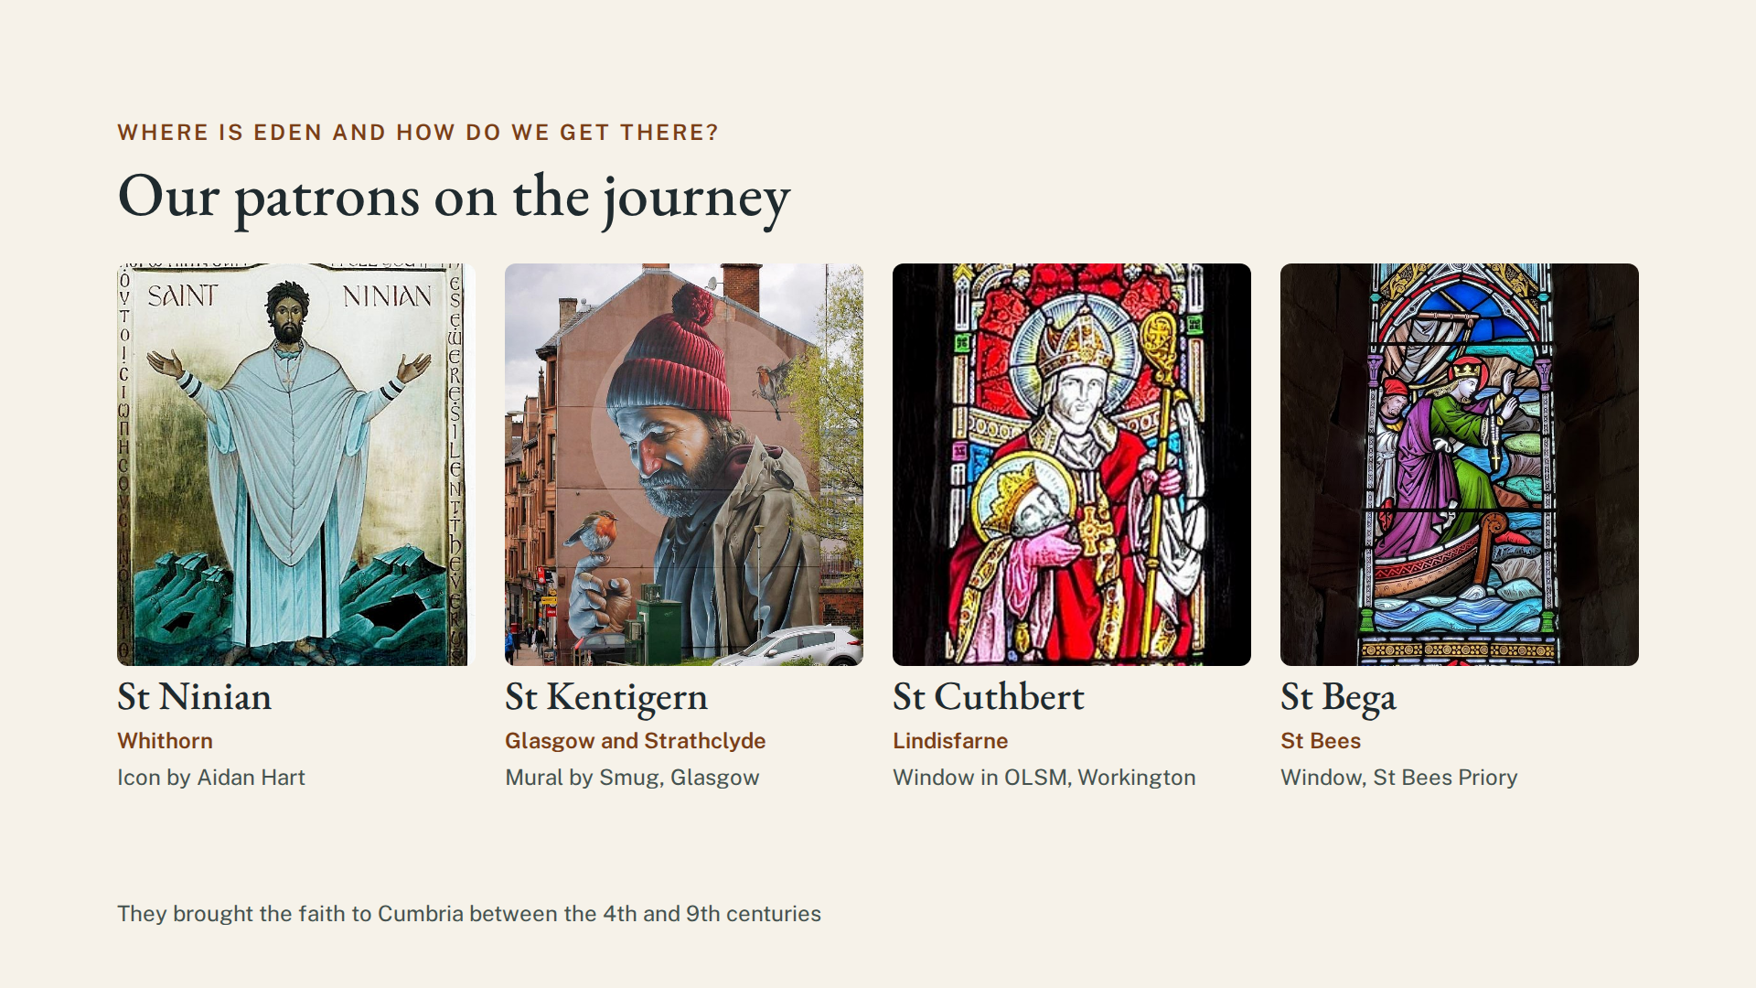
Notes:
Our patrons on this journey include Saints Ninian, Kentigern, Cuthbert and Bega, who brought the faith to Cumbria between the 4th and 9th centuries.

Slide 12
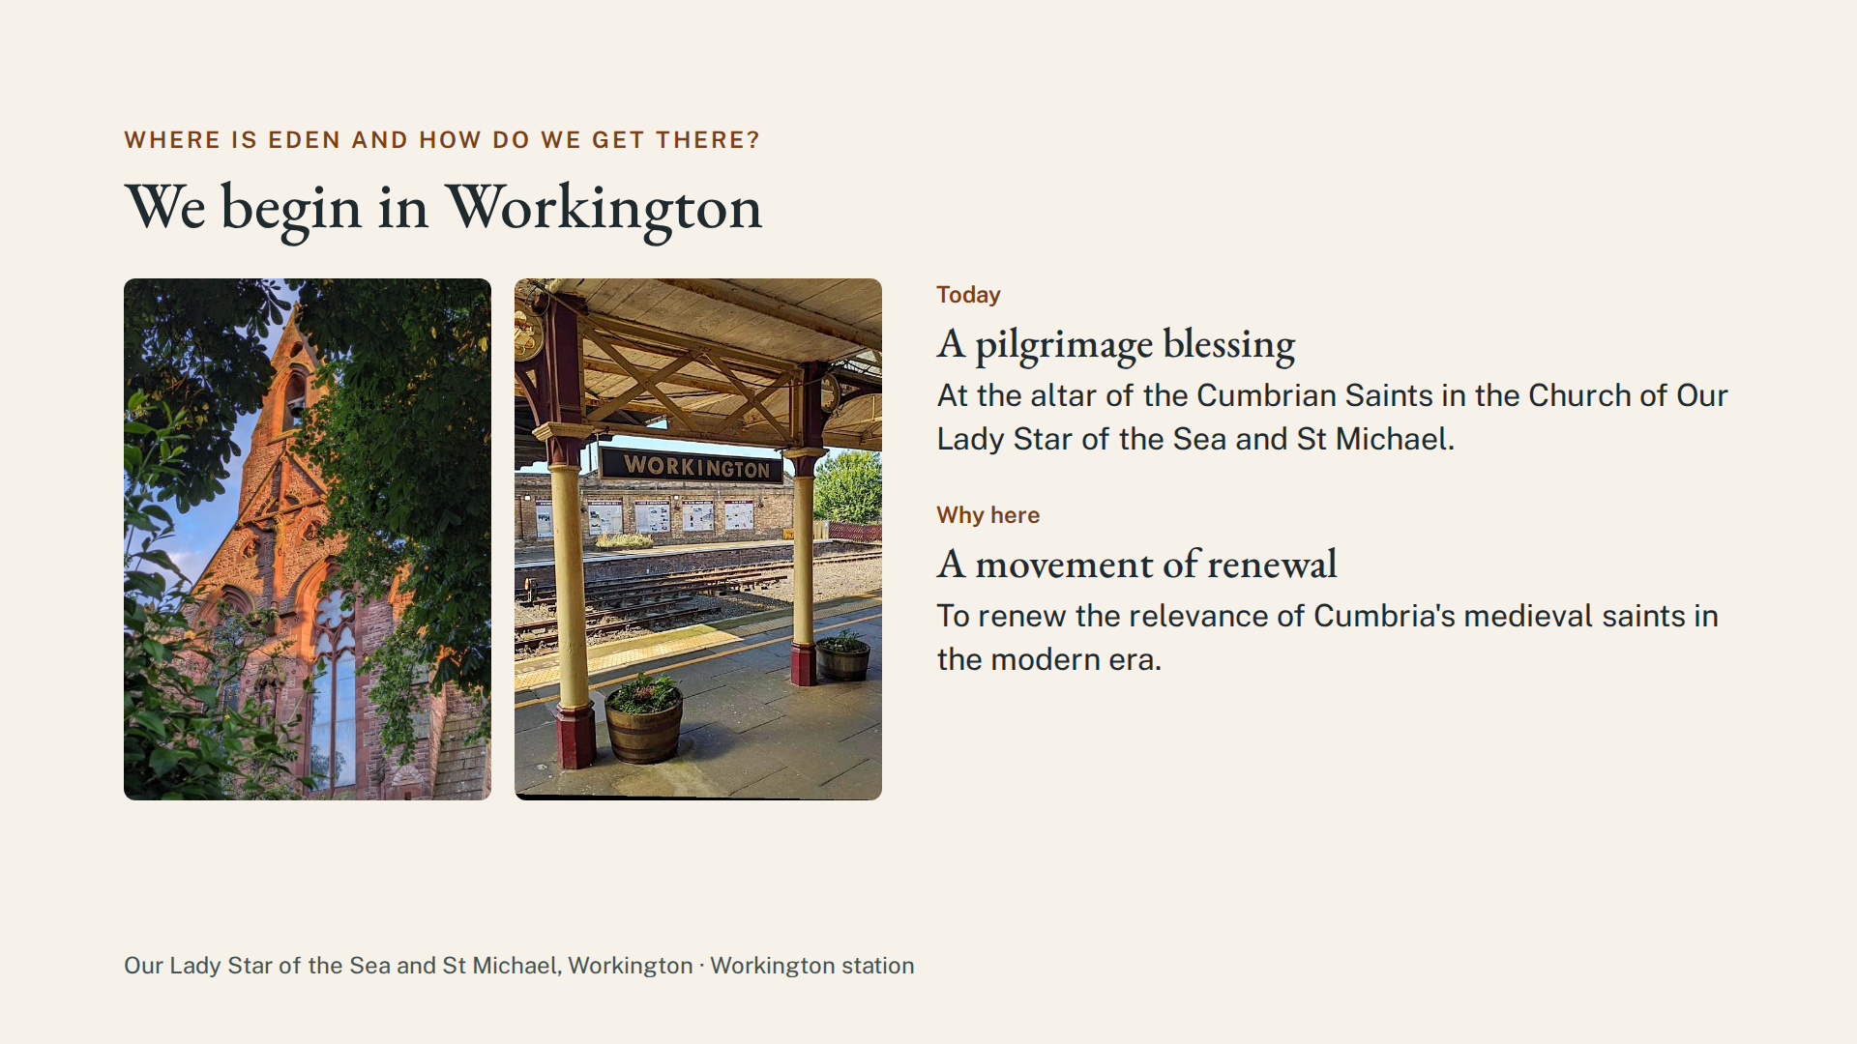
Notes:
Our start today at this church in Workington reflects a movement to renew the relevance of Cumbria's medieval saints in the modern era. Our walk begins with a pilgrimage blessing at the altar of the Cumbrian Saints, extends down the Irish Sea coast and then eastward through the Lake District.

Slide 13
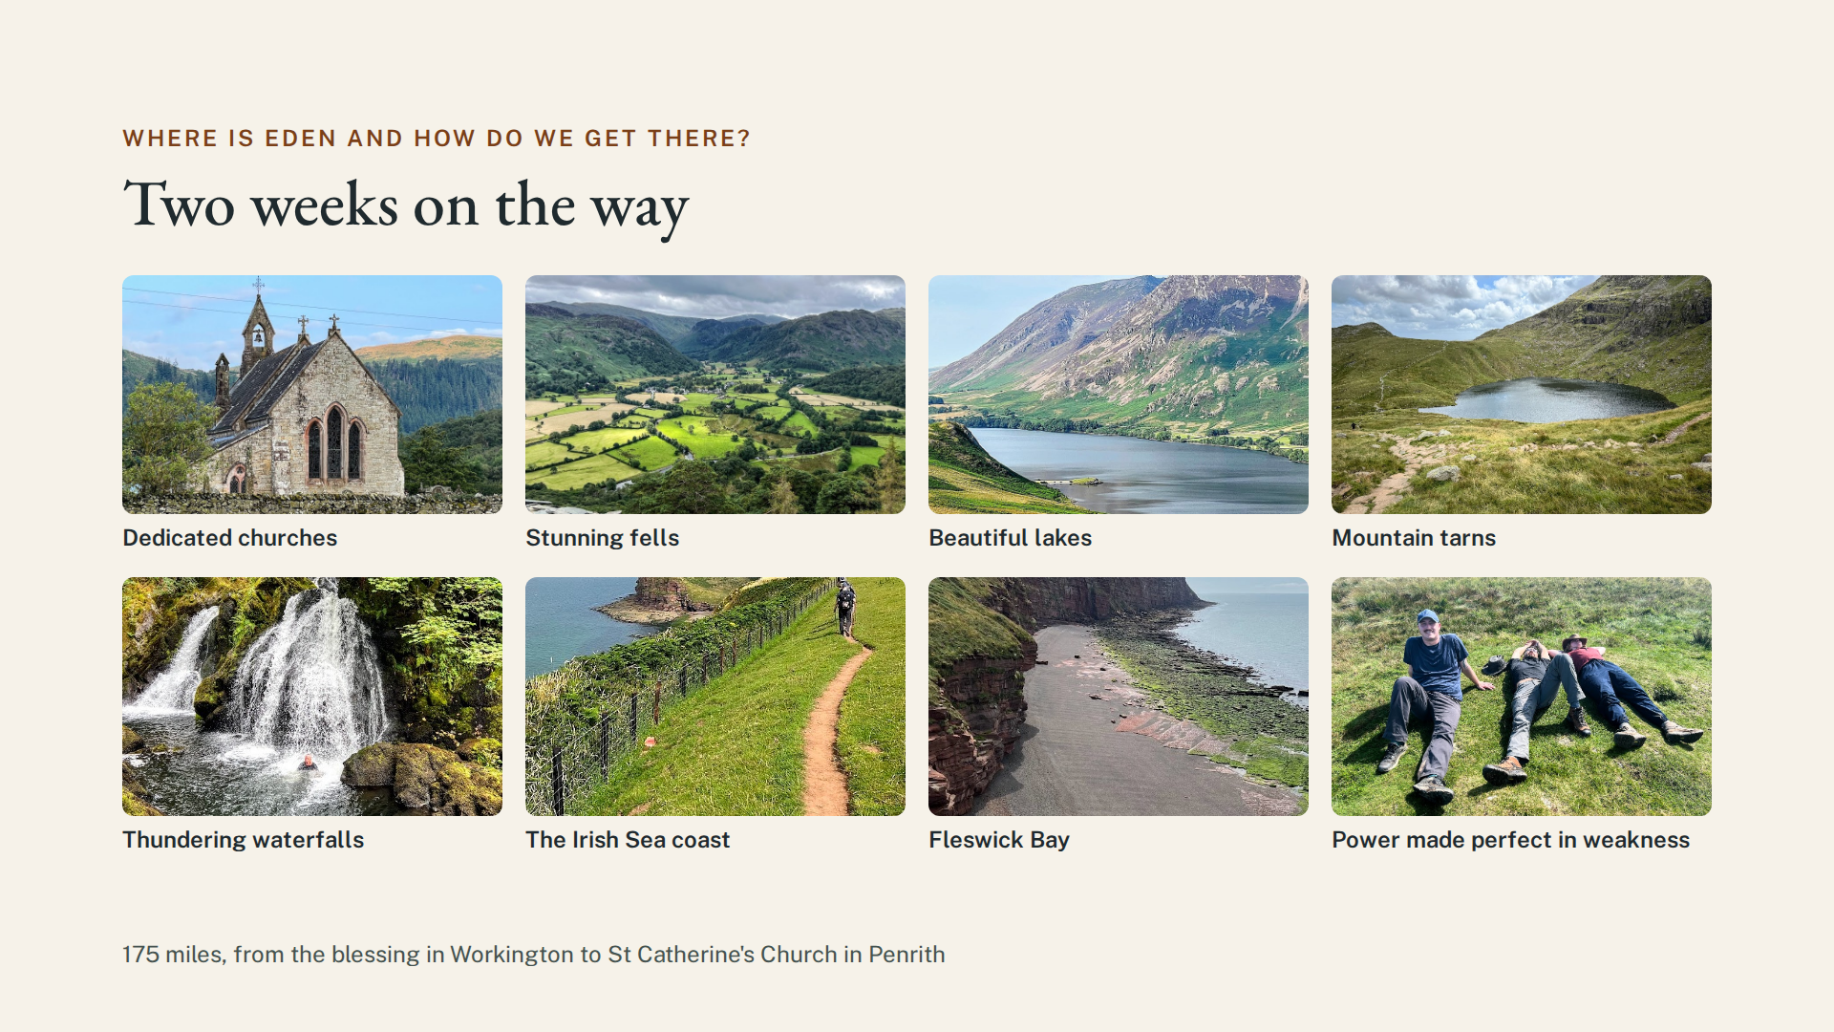
Notes:
Over two weeks, our hike visits many of the dedicated churches, historic ruins, holy wells, ancient crosses, lonely islands, stunning fells, beautiful lakes, and thundering waterfalls vital to our engagement with the heritage of the Cumbrian Saints. The pilgrimage ends 175 miles later at St Catherine’s Church in Penrith. Our goal is to restore our faith and apply the lessons of Cumbria's saints to our own lives.

Slide 14
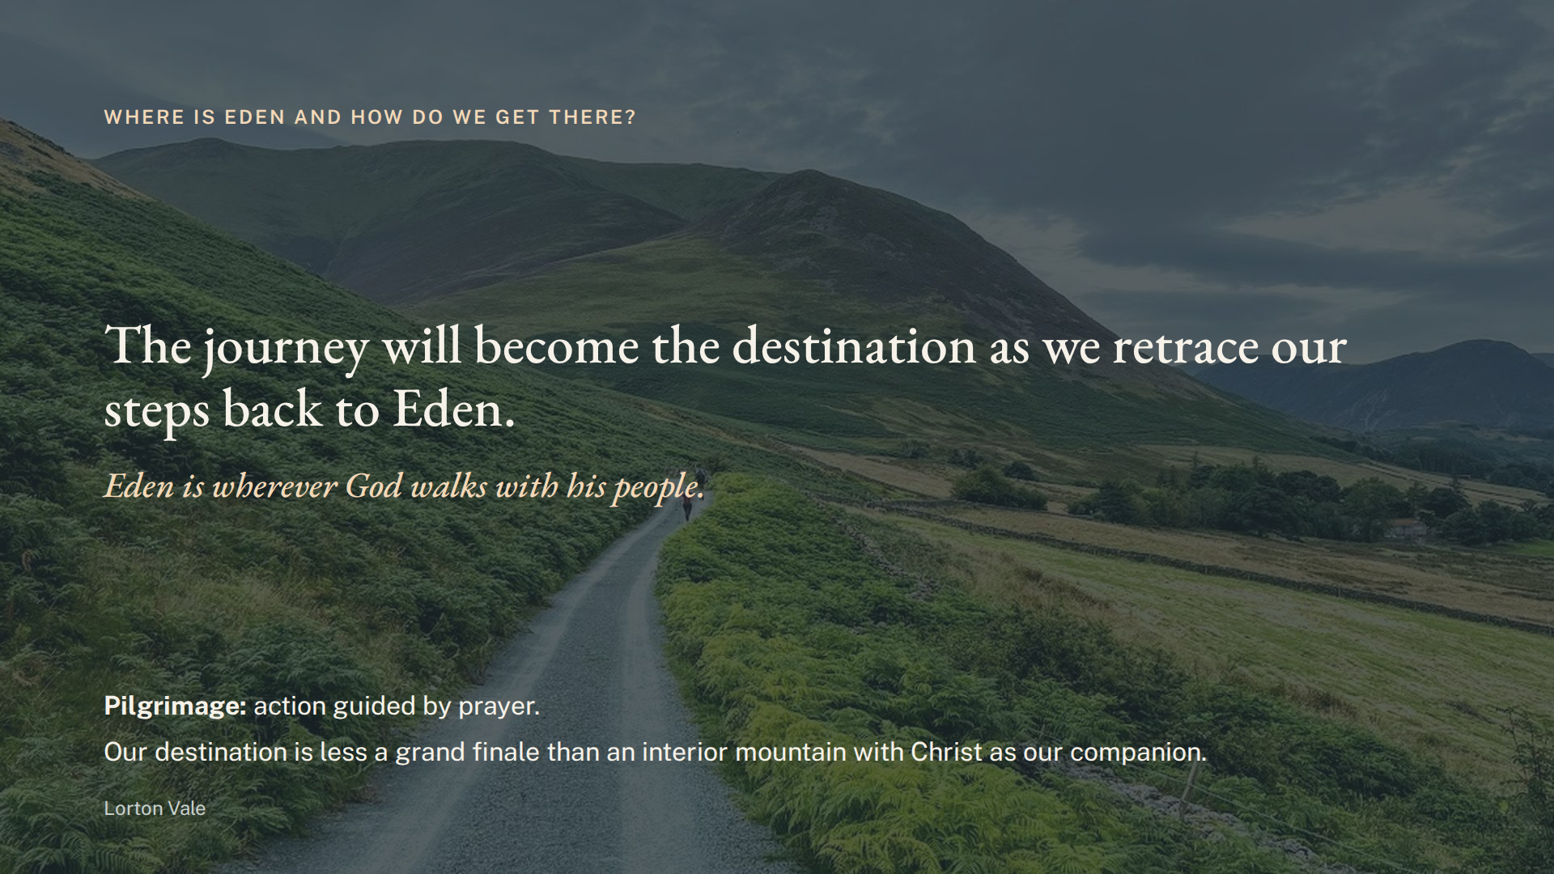
Notes:
Your trek through Cumbria will be a pilgrimage of offering as you seek holiness. Although your route may feel like wandering, you will not be lost, because pilgrimage is action guided by prayer. Walking in the footsteps of the Cumbrian saints requires only faith that our path will lead our hungry souls, like the rays of a scallop shell, to the Savior who has been seeking us. Our destination is less a grand finale than an interior mountain with Christ as our companion. The journey will become the destination as we retrace our steps back to Eden, because Eden is wherever God walks with his people.

Slide 15
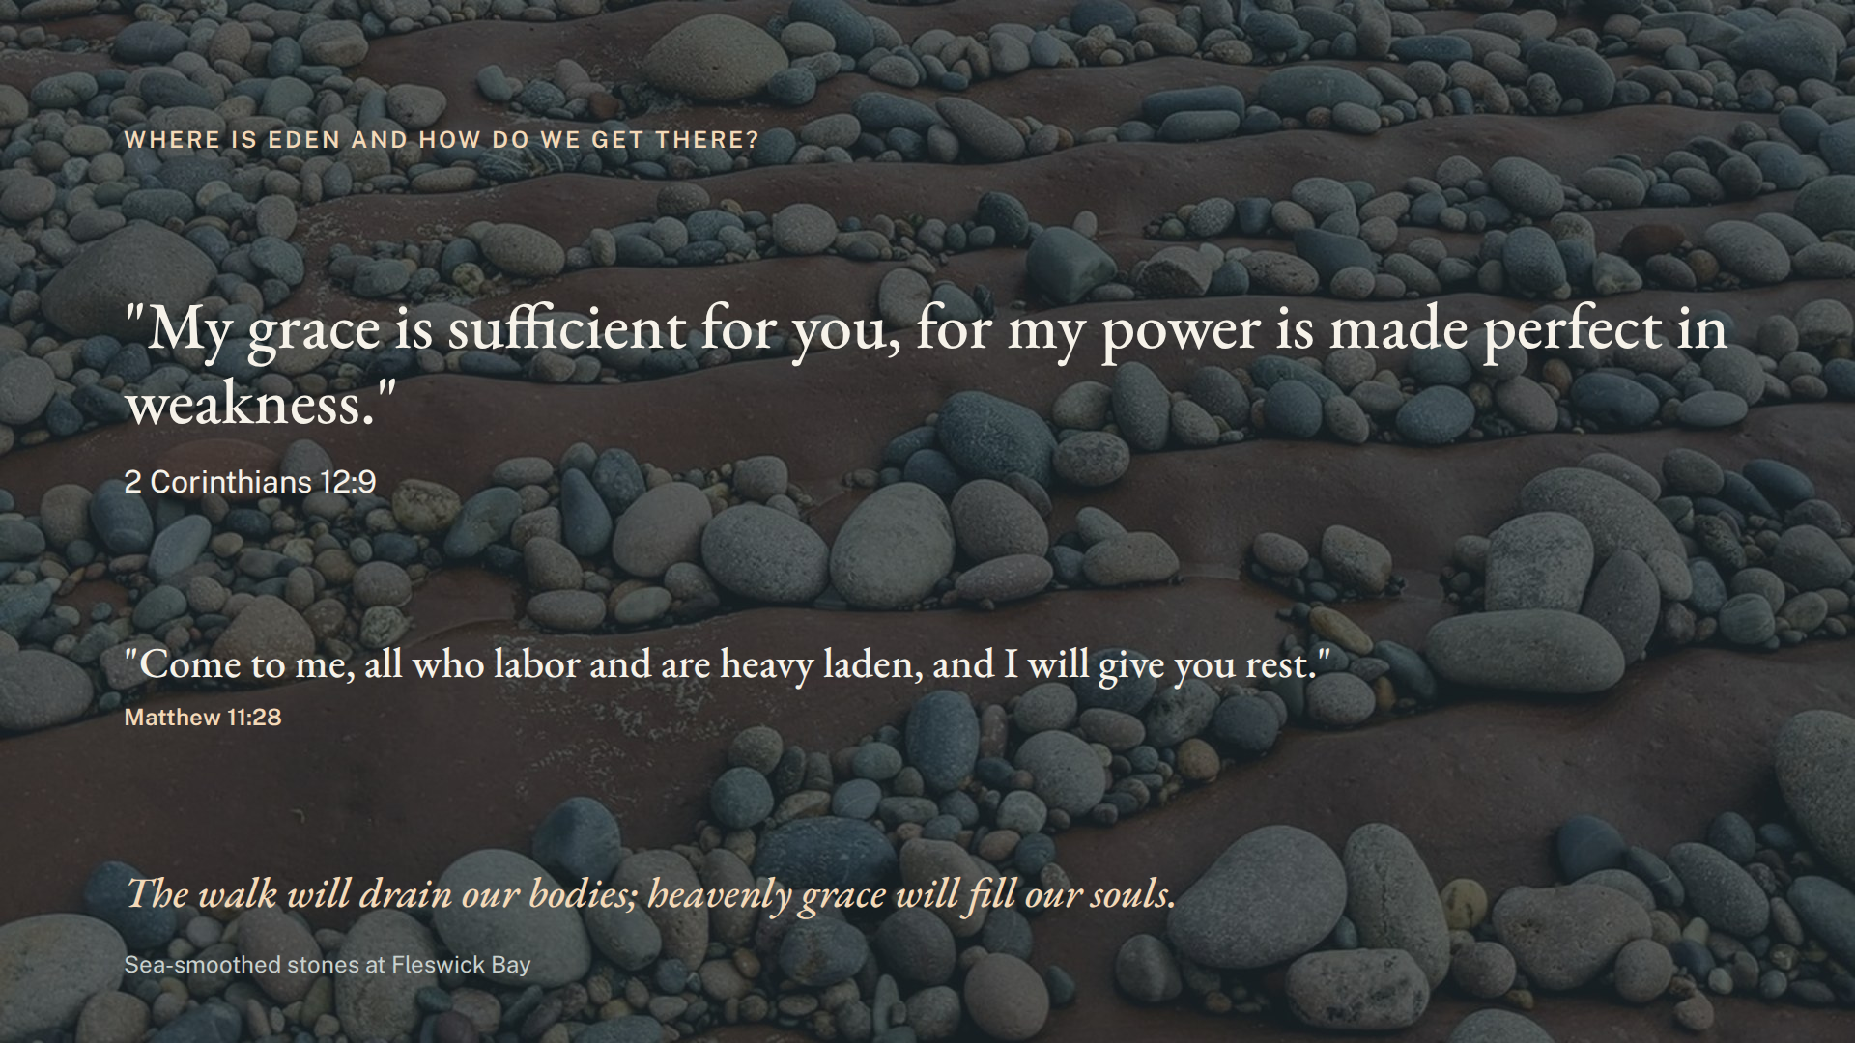
Notes:
We expect the physical stress of our walk will drain our bodies, but we trust that heavenly grace will fill our souls, as the Lord said to St. Paul:
“My grace is sufficient for you, for my power is made perfect in weakness.”
(2 Corinthians 12:9)
And Christ himself says: “Come to me, all who labor and are heavy laden, and I will give you rest.” (Matthew 11:28)

Slide 16
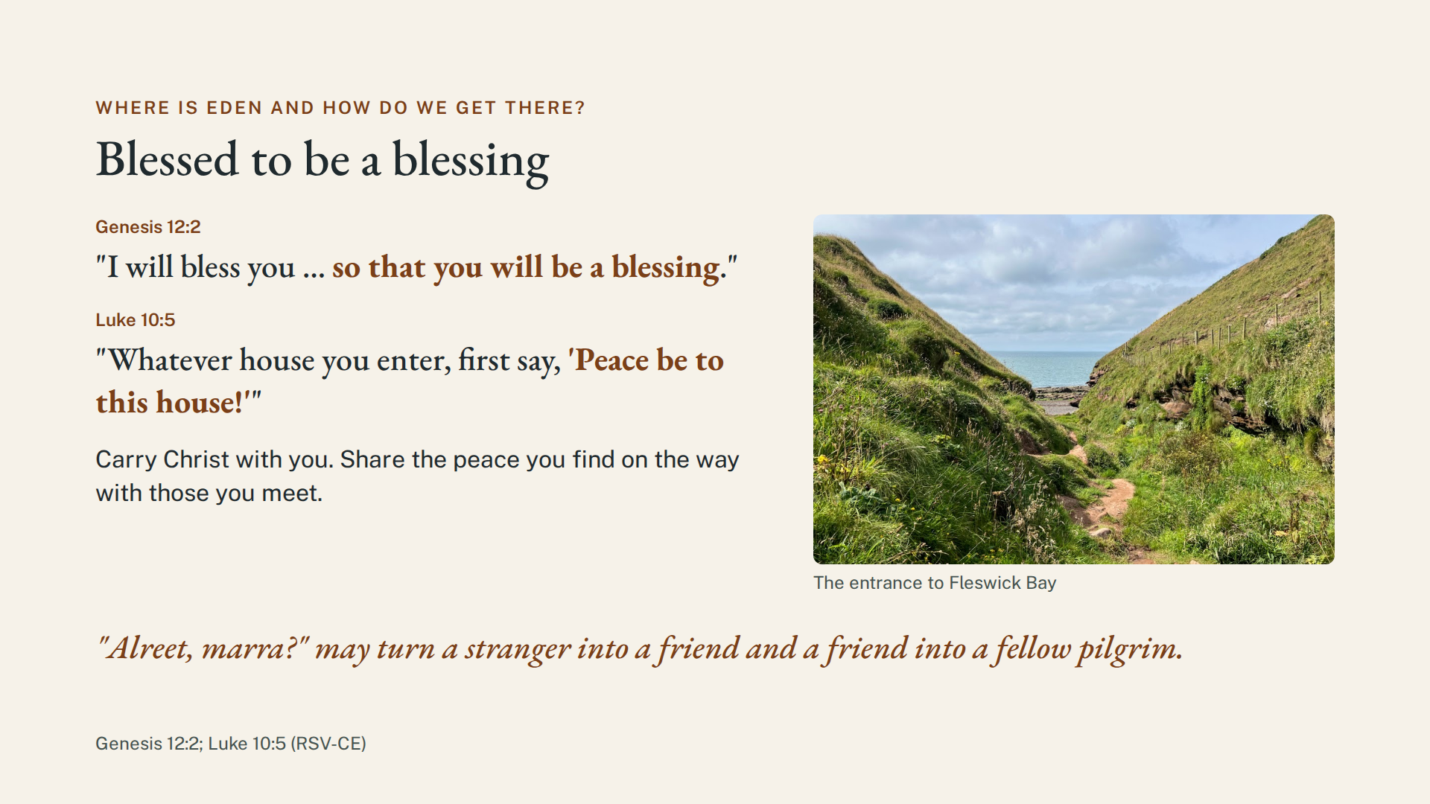
Notes:
On this pilgrimage, carry Christ with you so that, like Abraham, “you will be a blessing.” It is our duty and our privilege. In the Footsteps of the Cumbrian Saints, take time to share the peace you find on the way with those you meet. As Jesus tells the seventy in Luke 10:5, “Whatever house you enter, first say, ‘Peace be to this house!’” A simple “Alreet, marra?” may turn a stranger into a friend and a friend into a fellow pilgrim.

Slide 17
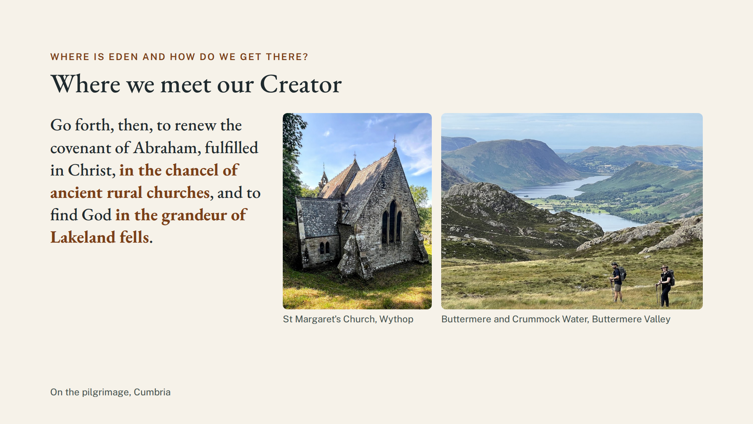
Notes:
Go forth, then, to renew the covenant of Abraham, fulfilled in Christ, in the chancel of ancient rural churches, and to find God in the grandeur of Lakeland fells.

Slide 18
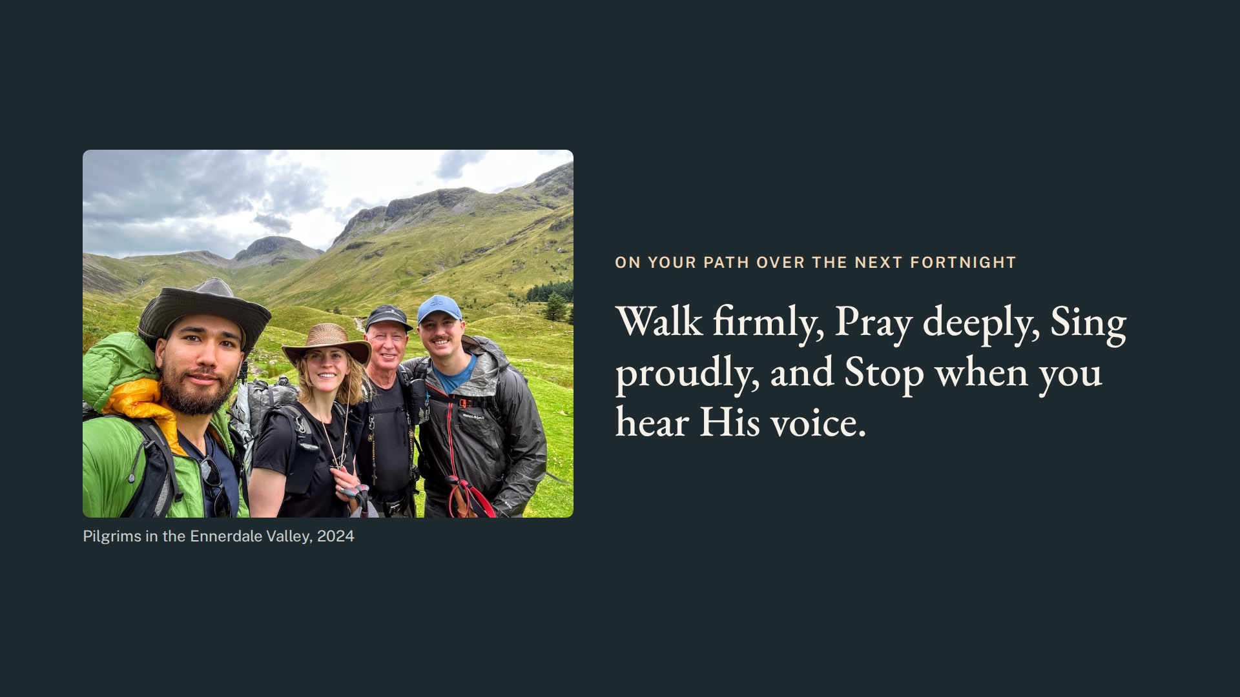
Notes:
So, on your path over the next fortnight, “Walk firmly, Pray deeply, Sing proudly, and Stop when you hear His voice.”

Slide 19
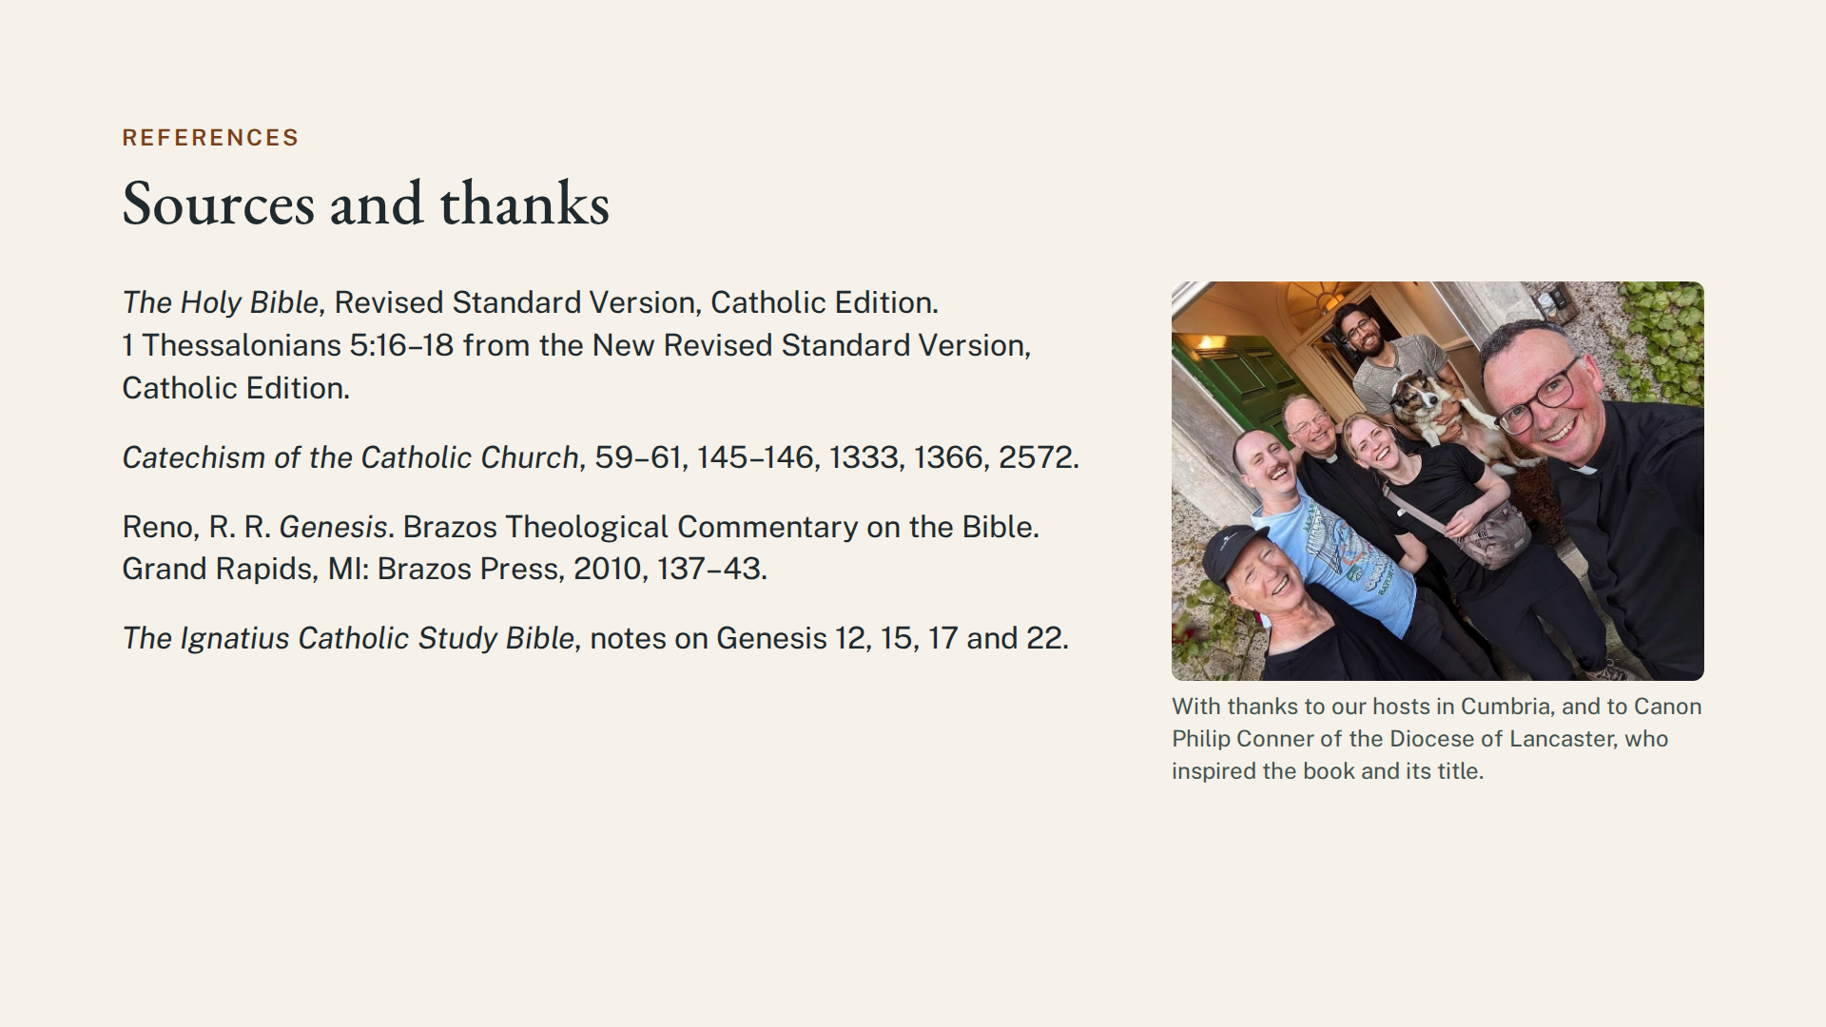
Notes:
(No narration: sources and thanks.)

