Slide 1

Cost Segregation & Variable statistical sampling Presented by Frank Udiskey IRS Statistical Sampling Coordinator (Retired)

Slide 2

AGENDA
Sampling Basics
Variable Statistical Sampling Overview
Is Sampling the Right Technique?
Estimation Process
Sampling Preparation Steps
Stakeholder Roles
IRS Review & Audit Preparation
Key Points

Slide 3
Disclaimer
The information provided in this presentation is for general informational purposes only and does not constitute professional tax advice. While efforts have been made to ensure accuracy, the content may not reflect the most current tax laws or regulations. Attendees are encouraged to consult their own tax advisors or professionals regarding their specific situations before taking any action based on the information presented. Neither the speaker nor any affiliated organization accepts any responsibility or liability for outcomes resulting from actions taken in reliance on this content. The opinions expressed here are solely those of the presenter and should not be taken as the official position of the Internal Revenue Service.

Slide 4
Bio – Education & WORK EXPERIENCE
Education:
B.S. Accounting - Central Connecticut State University
CPA - State Of Connecticut (1983, non-practicing)
Work Experience:
2-Years - Public Accounting
5- Years - Internal Auditor for large international advertising agency
2- Years - Controller of Marketing Company
34- Years - US Treasury (IRS)

Slide 5
IRS Statistical Sampling Program
Established by Dr Roberts who wrote the landmark book in 1978, Statistical Auditing, which became a classic text for compliance applications in financial auditing.
Computer Audit Specialists receive specialized training in sampling
The Statistical Sampling Coordinator Group oversees the sampling program in the LB&I Division of the IRS

Slide 6
Responsibilities Of statical sampling coordinator
Advise various audit teams across the country in designing & executing IRS generated samples.
Review & evaluate taxpayer samples to determine if they are following safe harbor provisions of Revenue Procedure 2011-42
Train new Computer Audit Specialists ( 2-week course ) in sampling
Conduct workshops for new IRS engineers & employment tax agents

Slide 7
TYPICAL TAX Issues For which Taxpayers use Sampling
IRC 41 Research & Development (Calculating Qualifying Research Expenditures)
Cost Segregation & other asset-based studies such as Capital to Repair, Depreciation & Bonus Depreciation studies

Slide 8
Sampling Basics
Sampling is the process of selecting a subset (sample) of individual items from a larger population to analyze and make inference about the entire population
More efficient, cost-effective and practical than studying an entire population, especially if it is large or inaccessible
When is sampling NOT appropriate?
When the population can be examined in its entirety or a more accurate source is available

Slide 9
Sampling Basics - Two Types
Judgment
Pros: Selection is simple & easily executed
Cons: Sample selection introduces bias; does not calculate the accuracy or margin of error; results are generally not accepted by taxing authorities such as the IRS.
Statistical
Pros: Randomly selected, (unbiased); can calculate margin of error (within a degree of confidence); Generally allowed by taxing authorities in most situations & applications
Cons: Need to follow certain procedures; more time consuming

Slide 10
Sample Basics - Two Common Statistical Samples
Design
Pros: simple to use, which uses the 4 estimators (Mean, Difference, Ratio & Regression (however the last two require 100 sample units & 30 per stratum)
Con: May not be the most efficient (You may have higher sampling error)
Model
Pros: When there is high correlation in the population (very similar) it can reduce the sampling error; use the ratio & regression estimators without the sample size requirement
( Per Rev-Proc 2011-42)
Con: Works best when the population is highly correlated and there are no zeros for the actual amount

Slide 11
Variable Statistical Sampling Overview
Overview : Variable statistical sampling is a rigorous, IRS-recognized technique for conducting cost segregation studies across large property portfolios, designed to deliver the benefits of accelerated depreciation and substantial tax savings efficiently and defensibly—especially when individually evaluating each property is impractical or cost-prohibitive

Slide 12
Variable Statistical Sampling Overview
The sampling or modeling approach uses a created model (or template) to analyze multiple facilities that are nearly identical in construction, appearance, and use (e.g., fast food chains and retail outlets). The use of sampling minimizes resources and costs compared to conducting studies on all properties.

Slide 13
Variable Statistical Sampling Overview
Typical steps are: (Per Cost Segregation Audit Technique Guide)
• Stratify properties by facility type (e.g., free-standing facility, mall location, leased or owned property, etc.)
• Perform a cost segregation study by sampling properties within each stratum.
• Based on the results in the prior step, develop a standard model for each type of facility
• Apply the costs derived from the model(s) to the population on a percentage basis. For example, the model may indicate that 10% of the project costs are allocable to 5-year property. This same percentage is then applied to each facility within the same stratum.
Notes:
(

Slide 14
Variable Statistical Sampling Overview
Purpose: Variable statistical sampling uses mathematical principles to select a representative subset of properties (or components) within a portfolio and analyzes these to estimate the characteristics of the entire group. This allows taxpayers to reclassify building costs for accelerated depreciation and significant tax benefits.
When Ideal: Best suited for portfolios with 100+ properties or where each has a low depreciable basis , making full studies on every property unfeasible.
Benefit: Delivers substantial efficiency and cost savings while maintaining statistical rigor, compared to “rule of thumb” or judgmental approaches, which the IRS does not recognize as valid under audit.

Slide 15
Is Sampling the Right Technique
Sampling vs. Full Study:
Best Use Case: Large, relatively homogenous property portfolios.
Alternatives: For small portfolios, or where properties are highly dissimilar, individual studies may provide more accurate results.
Limitations: Statistical sampling might become less reliable for portfolios under 50 properties or highly heterogeneous populations.
Notes:
Main point

Slide 16
Estimation Process
Primary Estimation : Two Steps
Step 1
The primary calculation determines the amount that qualifies for accelerated deduction from the population of 27.5- or 39-years costs.
Step 2
The secondary allocation / calculation allocates the total accelerated amount from Step 1 into the various asset categories such as current deduction , 5, 7 & 15-year property or other such as QIP

Slide 17
Estimation Process
How is it measured ?
The reported amount is the amount classified as 27.5 (39)year property, at either the cost or net asset value, which is then compared to the non--27.5 (39)-year property for each sample unit .
The non--27.5 (39)-year property for each sample unit is then allocated to the proper category such as current deduction, 5,7 15 year or other.

Slide 18
Sample Preparation Steps
Determine your sample objective
Determine Sample Objective : What do you want to measure ?
Data Analysis /Portfolio Stratification/Sample design:
Group properties by key characteristics (type, location, ownership, etc.).
Determine to stratify or not ( by type or amount)
Refining the population ( remove any unusual items or items that you want to review due to nature or amount , these hand selected items will be part of the results, but not projected ( certainty stratums )
Determining sample size & stratum boundaries ( based on population )

Slide 19
Sample Preparation Steps
Documentation: Prepare a sample plan that documents the steps & methodologies undertaken. The actual sections are included in Appendix A&B of Revenue Procedure 2011-42. They include such items as the Sample objective, audit trail from the sample frame to the sample population, Sample design & other methodologies (the sample items & results are often attached)

Slide 20
Sample Preparation Steps
Determine your samp
Sample Selection
Serialize the sample population & select the sample such as simple stratified random sample by using an acceptable random number generator.
Sample Evaluation / Projecting Results
Gather cost and construction data, conduct physical inspections, and analyze sampled assets in detail.
Calculate the accelerated amount and then either allocate or calculate that amount to the appropriate buckets

Slide 21
Sample Preparation Steps
Sample Design Considerations
Facts - Client has 150 retail locations, of which one is the Flagship in NYC & two are warehouses.
Design 1:
Remove Flagship location & warehouse and place in separate strata
Design 2:
Separate & group strip mall locations from stand alone locations

Slide 22
Sample Preparation Steps – Example of Sample Plan
I. Objective The objective is to determine the portion of property costs appropriately allocable to a recoverable period shorter than 27.5 or 39 years using statistical sampling. The estimate will be derived from an unbiased evaluation of the company’s assets at the property level.
II. Population and Sampling Frame Population: All property costs placed in service by Taxpayer Corp. during the tax year ending December 31, 2024, that have been classified as 27.5‑year or 39‑year property. Reconciliation: The population will be reconciled to the general ledger and trial balance. Taxpayer Corp. will provide the IRS with a complete listing of all property assets and associated expenditures.
Sampling Frame: The sampling frame will consist of all identified properties acquired between 2020 and 2024, serialized for random number selection.

Slide 23
Sample Preparation Steps – Example of Sample Plan
III. Sampling Unit The sampling unit will be each individual property as defined by Taxpayer Corp.’s accounting system. Each property record will include a unique identification number linked to its costs, activities, and documentation
IV. Stratification To enhance precision, the population will be divided into strata based on the total qualified cost per project
Stratum 1 (Large Retail Properties): Retail locations with costs greater than $1,000,000. All units in this stratum will be reviewed 100%.
Stratum 2 (Headquarters and Warehouses): The two warehouse and corporate headquarters facilities will also be reviewed 100%.
Stratum 3 (Medium Retail Locations): Retail locations with costs between $200,001 and $1,000,000. A sample of 35 will be selected from this stratum.
Stratum 4 (Small Projects): Retail locations with costs of $200,000 or less. This stratum will be excluded from sampling.

Slide 24
Sample Preparation Steps – Example of Sample Plan
V. Sample Size Sample size for each stratum will be determined independently to achieve a target relative precision of 10% or better at the 95% confidence level. A qualified statistician will perform and document the sample size calculations, including all formulas and input parameters used.
VI. Sample Selection Methodology: Stratified random sampling will be applied to ensure that each project has a known, nonzero probability of selection. Random Numbers: Random numbers will be generated using a standard statistical software package (e.g. SAS random module). The random number generator “seed” will be documented to ensure reproducibility. Association: The property list will be sorted by a unique identifier (e.g. location ID). Random numbers will then be paired with the serialized list to select the sample units. Control: Serialization of the property list and random number generation will be performed independently to ensure objectivity and prevent selection bias.

Slide 25
Sample Preparation Steps – Example of Sample Plan
VII. Evaluation of Sample Units Taxpayer Corp. will provide all supporting documentation for each sampled project, including invoices, project records, and related payroll data. Each sampled project will be analyzed to determine whether costs qualify for a shorter recovery period under applicable tax provisions. If records for a sampled unit are unavailable, the project will be treated as non‑qualifying. Substitution of samples is not permitted.
VIII. Projection and Final Estimate Projection will be performed in accordance with Revenue Procedure 2011‑42. The qualified accelerated costs identified in the sample will be projected to the population using the weighted results for each stratum. The resulting estimates will be allocated across property categories based on the proportionate qualified costs identified in the sample.

Slide 26
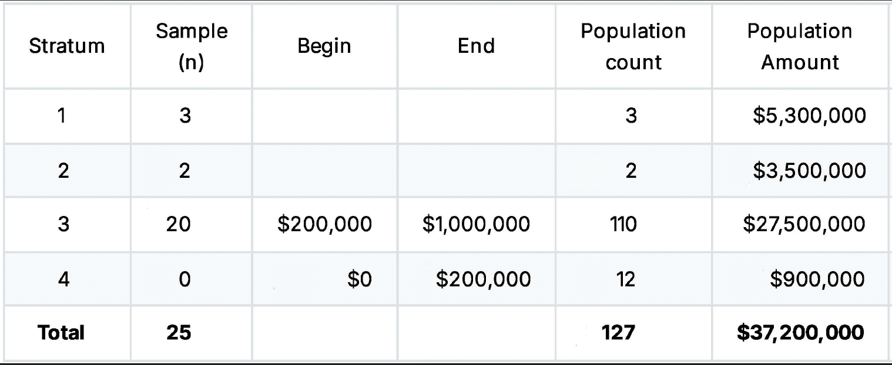
Sample Preparation Steps – Sample Design

Slide 27
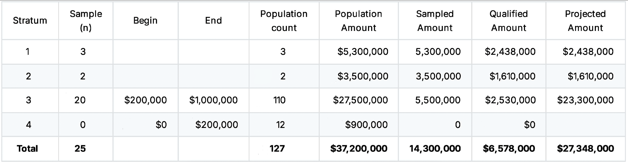
Sample Preparation Steps – Sample RESULTS

Slide 28
Allocation of qualified amount
Sample Results
Sample Frame | $37,200,000
Amount Sampled | $14,300,000
Sample Amount Qualified | $6,578,000
Projected Amount Qualified | $27,348,000
Allocation
7 Year Property | $7,806,600
15 Year property | $9,541,400
Land Improvements | $10,000,000
Total Amount Qualified | $27,348,000
Amount to remain 27.5 Year | ($37,200,000 -$27,348,000) | $9,852,000

Slide 29
Stakeholder roles
Client: Provides access to property data and records, facilitates communication, and supports site visits.
Accountant: Assists with tax planning strategy, reviews study methodology and results for financial statement impact.
Engineer: Conducts technical analysis of buildings and identifies asset classifications per cost segregation standards.
Sampling Expert: Designs and executes the statistical sampling plan, ensuring compliance with IRS standards and statistical integrity.

Slide 30
irs review & preparation – Revenue Procedure 2011-42
IRS Revenue Procedure 2011-42 is a safe harbor provision that allows the use of sampling and estimates.
A safe harbor means that if specific IRS rules and procedures are followed, the use of sampling and estimates will be accepted as long it meets the criteria of the Revenue Procedure .
Revenue Procedure is not for one specific issue but must be appropriate for the situation.
It should only be used when you cannot obtain information from a more reliable source, like your financial system’s general ledger.
In summary, this Revenue Procedure is a combination of statistical sampling principles & administrative rules.

Slide 31
irs review & preparation
IRS Guidelines:
IRS Revenue Procedure 2011-42 and the Cost Segregation Audit Techniques Guide specify that statistical samples must be:
Scientifically valid (random/stratified random sampling)
Estimate is calculated at the 95% confidence level
Relative precision not exceeding 10%, otherwise the estimate needs to be reduced by the appropriate sampling error.
Well-documented & meet the specific criteria in Appendix A&B of Revenue Procedure 2011-42.
IRS Audit Expectations:
IRS examiners expect detailed documentation, clear explanations of methods, and the selection criteria used for sampling.
IRS will expect a Sampling Plan, Population File, Details of the sample design and results of the sample items as well as how the estimation was calculated .
Preparation for Audit:
Maintain comprehensive records of assumptions, sample selection, stratification rationale, and all asset documentation.
Engage professionals with proven experience in statistical sampling and cost segregation defense.

Slide 32
KEY POINTS
Only true statistical variable sampling (not judgmental sampling or rule-of-thumb approaches) is accepted by the IRS.
Must comply with Revenue Procedure 2011-42
Rigorous documentation and adherence to established guidelines significantly strengthen audit defensibility.
Each stakeholder plays a vital, distinct role; effective collaboration ensures reliability and compliance.
* The sources of the information contained in this presentation include IRS Cost Segregation Audit Techniques Guide, Revenue Procedure 11-42 and professional best practices.

Slide 33

THANK YOU!
Frank Udiskey
Fudiskey@Icloud.com
203-952-6425

