Slide 1
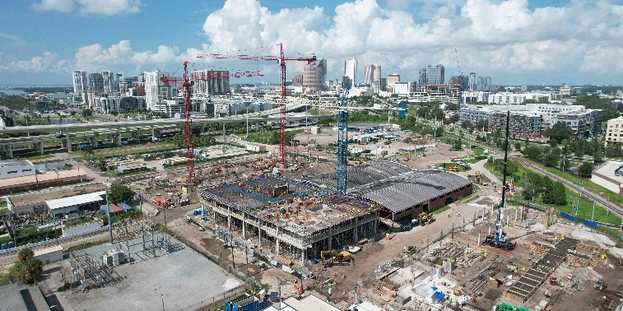
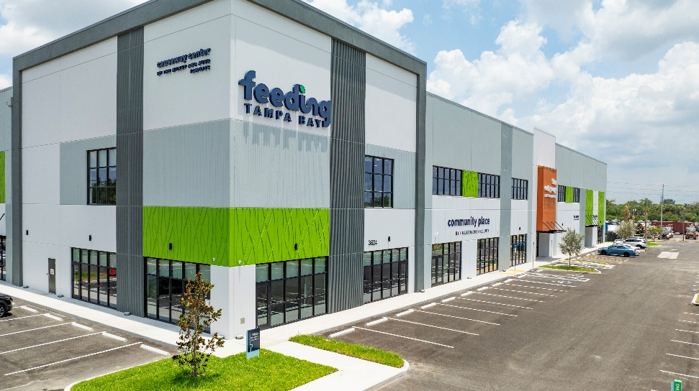
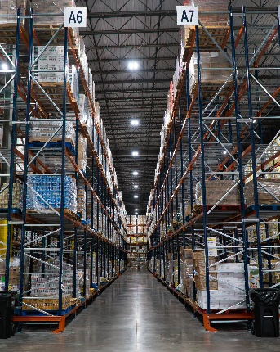
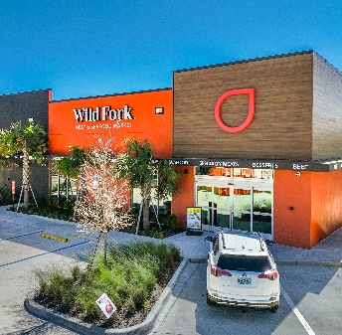

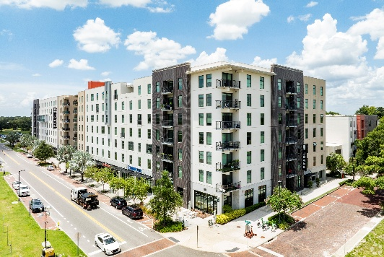
U.S CRE Market
Update
November 2026
Prepared by Michelle Rumore
Senior Director, Market Analytics

Slide 2
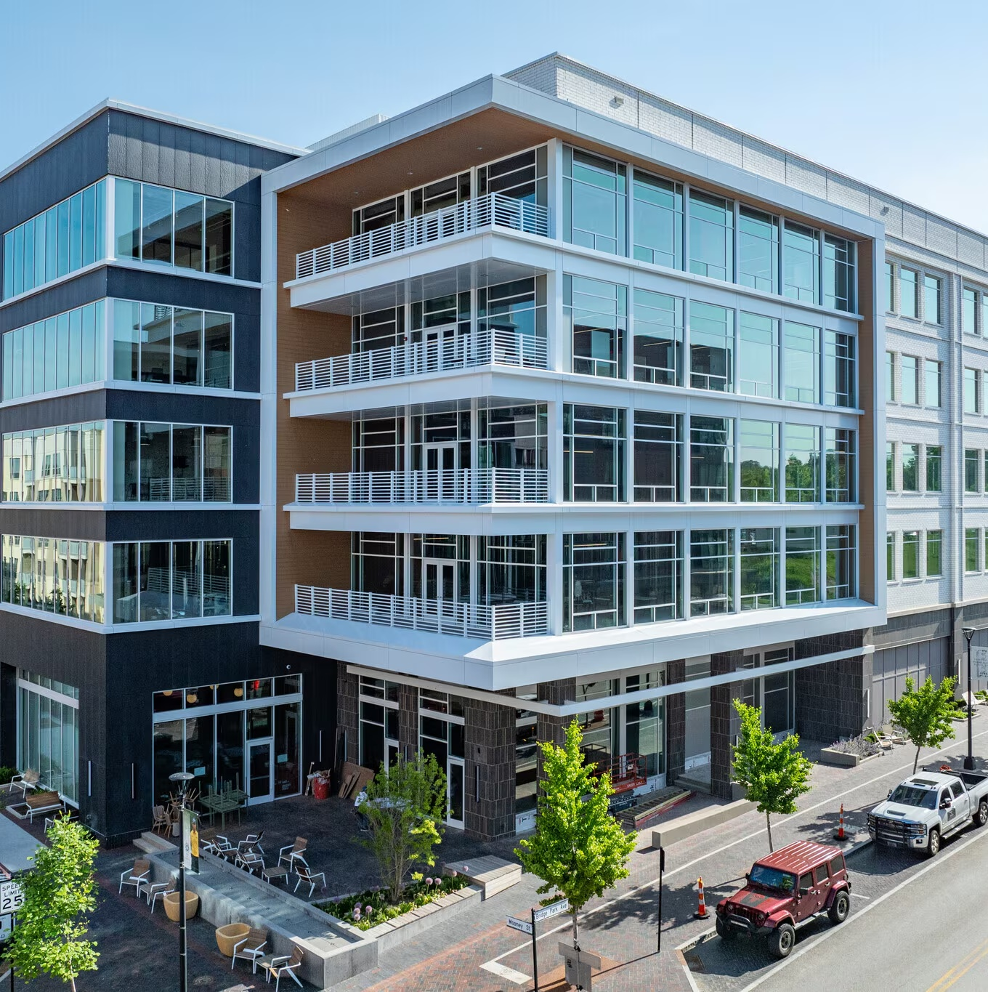
Office

Slide 3
US office recovery well into its second year
FORECAST
Source: CoStar

Slide 4
But, demand heavily skewed towards a few markets
Source: CoStar

Slide 5
Most markets are still seeing below pre-pandemic levels of leasing activity
Source: CoStar

Slide 6
The gap between winners and losers is widening
Source: CoStar

Slide 7
Construction pipeline near a 15-year low
Source: CoStar

Slide 8
Office demolitions exceed deliveries while starts languish
Source: CoStar

Slide 9
Rents have risen despite elevated vacancy
FORECAST
Source: CoStar

Slide 10
Office sales volume remains subdued

Slide 11
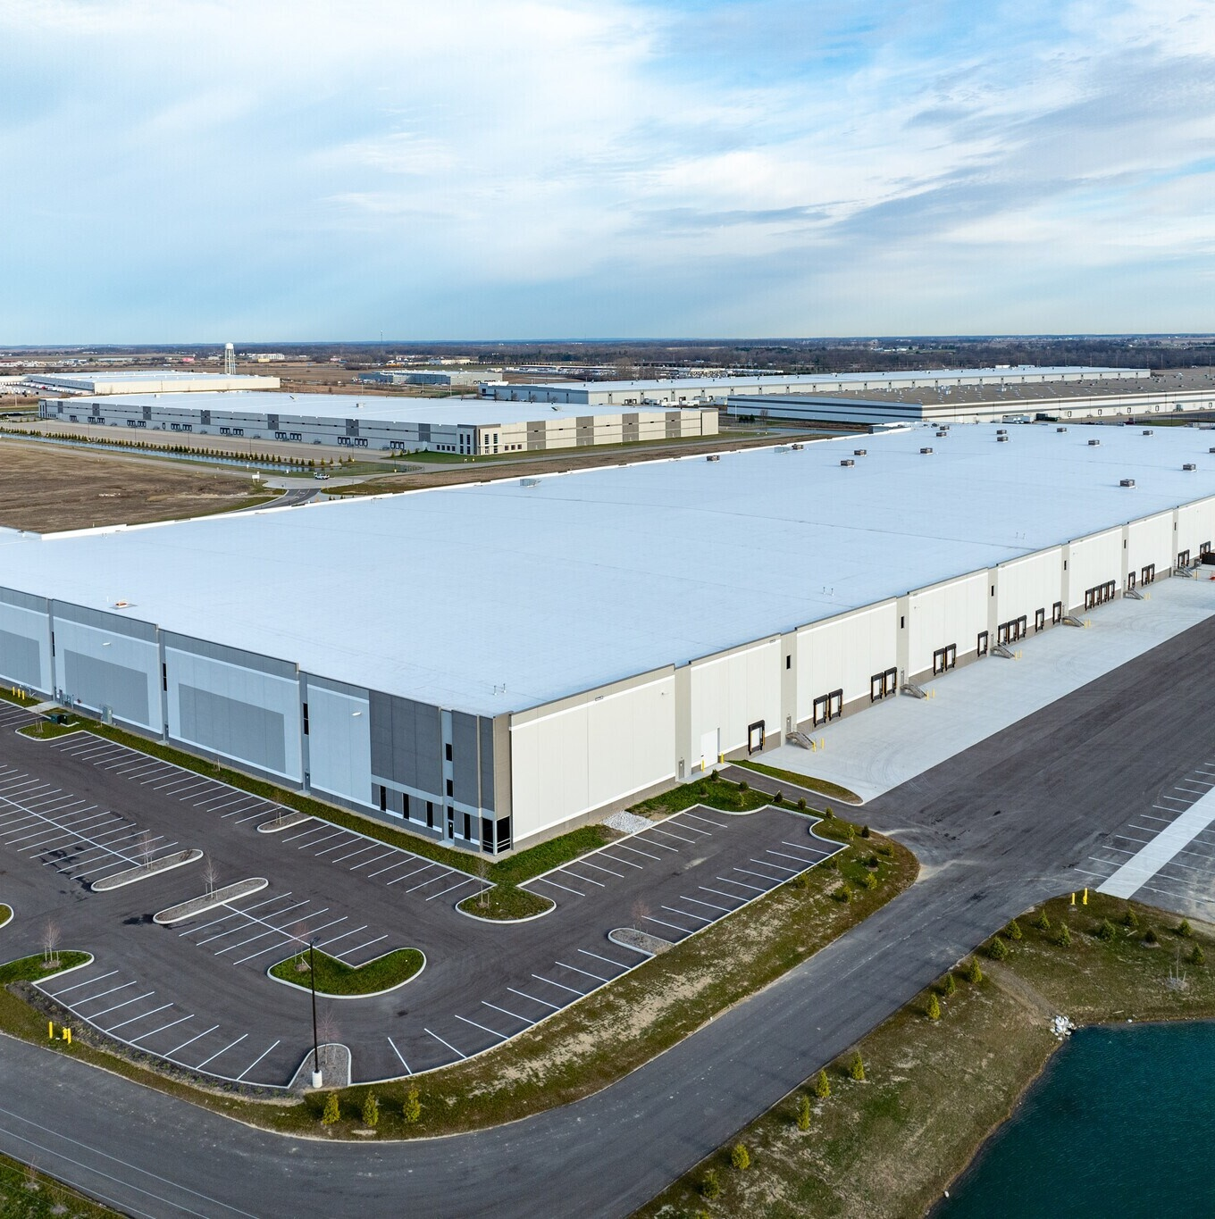
Industrial

Slide 12
Industrial vacancy expected to remain flat as supply and demand become more balanced
Source: CoStar

Slide 13
500k+ availability by market
Property age:
Note: Analysis is limited to logistics properties
Source: CoStar

Slide 14
Tenants continue to prefer the newest builds
Property age:
Note: Analysis is limited to logistics properties
Source: CoStar

Slide 15
Only new, large properties have seen a significant vacancy contraction
Property age
and size:
Note: Analysis is limited to logistics properties
Source: CoStar

Slide 16
Sub 9% availability has triggered healthy rent gains in the past
Sub 9% period
Note: Analysis is limited to logistics properties
Source: CoStar

Slide 17
Industrial pipeline picking back up again
Source: CoStar

Slide 18
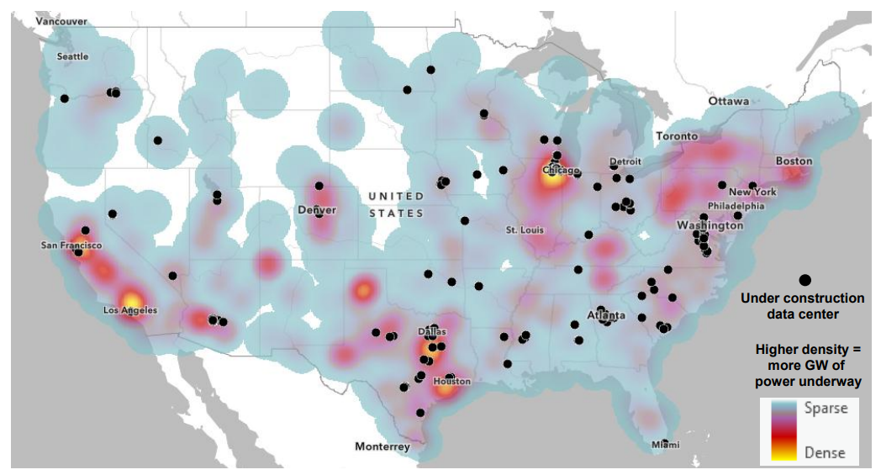
New power & data centers underway
Note: Based on expected power additions over the next three years
Source: EIA, CoStar

Slide 19
Industrial pricing continues to rise

Slide 20
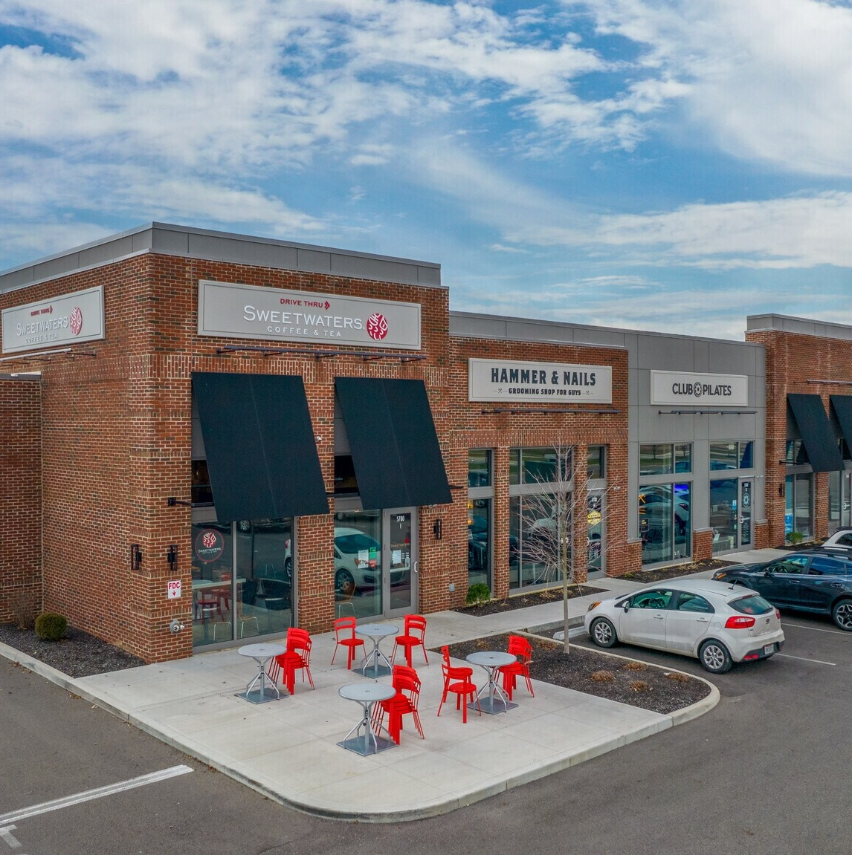
Retail

Slide 21
Announced store openings outpacing closings
Source: Daily on Retail, October 5, 2026

Slide 22
Dozens of retailers are planning 25+ store openings
Source: Daily on Retail, October 5, 2026

Slide 23
Closures remain concentrated in a handful of retailers
Source: Daily on Retail, October 5, 2026

Slide 24
Retail demand holding stead
FORECAST
Source: CoStar

Slide 25
Sun Belt markets lead occupancy gains
Trailing 12-month net absorption as a share of inventory, 26Q3
Note: Includes markets with at least 100 million SF of retail inventory
Source: CoStar, October 2026

Slide 26
Malls and power centers continue to tighten
Property Segment | Direction | Basis Point Change
Mall | ↓ | -50
Power Center | ↓ | -30
Neighborhood Center | ↓ | -6
Strip Center | ↑ | +35
General Retail | ↑ | +4
Source: CoStar

Slide 27
Impact on fundamentals from new development will remain limited
Source: CoStar

Slide 28
Retail rent growth has slowed to its lowest level in over a decade
Source: CoStar

Slide 29
Retail has been one of the most consistent of the CRE sectors
Source: CoStar

Slide 30
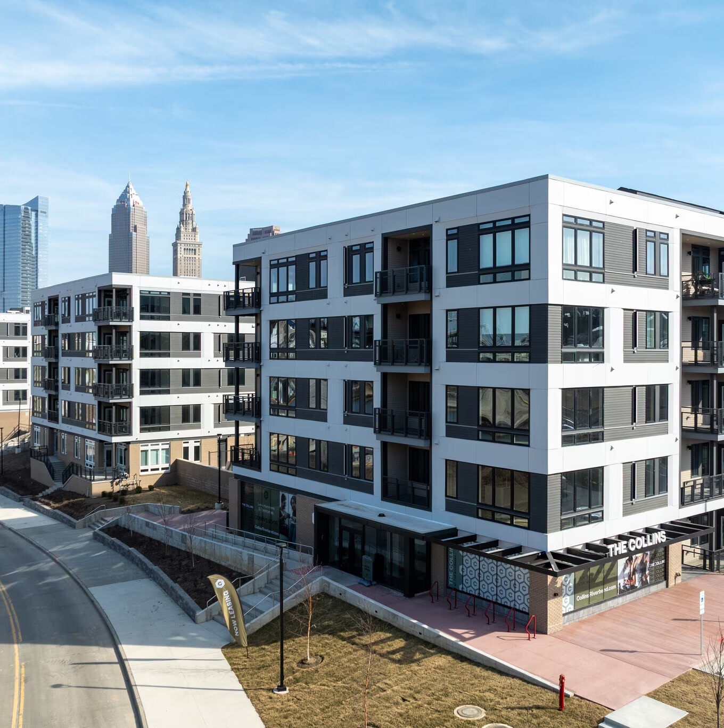
Multifamily

Slide 31
Multifamily vacancy expected to fall
Source: CoStar

Slide 32
Vacancy remains elevated in the South
Source: CoStar

Slide 33
Under construction by market
Source: CoStar

Slide 34
Construction pipeline to a 10-year low
- 53%
Source: CoStar

Slide 35
Lease-up periods have lengthened over the past three years
Source: CoStar

Slide 36
Rent growth has strengthened, but is expected to remain subdued
FORECAST
Source: CoStar

Slide 37
Low vacancy markets seeing the most rent growth
Source: CoStar

Slide 38
Multifamily has seen the steepest drop off in sales activity this year vs. last
Source: CoStar

Slide 39
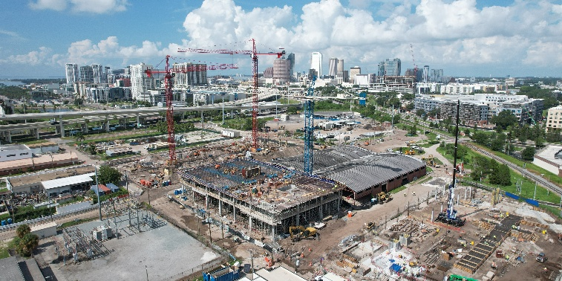
Thank you!

