Slide 1

ASCSP Conference Las Vegas, NV November 13, 2025
Notes:
Shutterstock image 1975805468

Slide 2
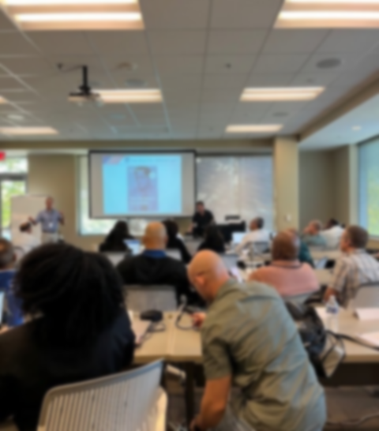
IRS ENG Training Cost Seg, Section 179D also Summary of: AmeriSouth v Comm
Notes:
JCPeacock Photo, Franklin TN

Slide 3

Brought to you by:
Notes:
J Peacock Logo and Title with presenter name and email address

Slide 4

In Case the IRS Is Listening…
Disclaimer
The information in this presentation represents the personal observations and opinions of the presenter, who is not an employee of the Internal Revenue Service and is not providing legal or tax advice. The presenter is not an attorney, and this material is intended solely for general informational and educational purposes.
Attendees and readers should consult with qualified tax professionals or legal advisors before taking any action based on this content.
No responsibility or liability for tax positions, interpretations, or outcomes is assumed by the presenter.
Notes:
MS PowerPoint Stock Image

Slide 5
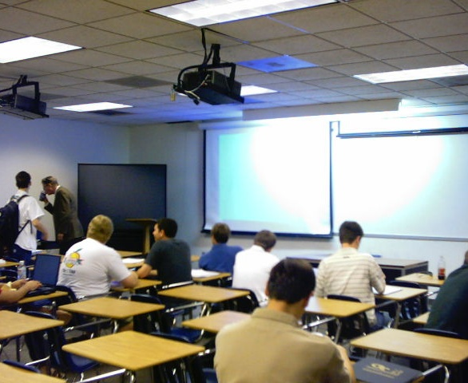
IRS Engineers Training Overview
IRS Engineer Training (2022–2025)
Comprehensive multi-week program
Initial sessions – On-Line:
Federal Income Tax fundamentals
Tax accounting and law - IRC & Court Cases
Intro to Real Estate Appraising (in Person)
Intermediate sessions – In Person:
Cost Segregation
Section 179D
Casualty losses, R&E credits, and other business credits
Final sessions – In Person:
Business valuation of closely held companies and additional complex issues
Notes:
Picture from MS Powerpoint stock
This is a sample summary, they did change phase to phase depending on scheduling.
Comprehensive multi-week program covering multiple engineering and tax disciplines.
We started at least Seven phases of new-hire training since late 2022 due to the IRA of 2022. For close to 200 new-hire engineers. Training was delivered by a rotating team of instructors over several-weeks sessions. Session last typically two weeks at a time.
Initial sessions: Some were ONLINE courses
Federal Income Tax fundamentals
Basic tax accounting and tax law (IRC sections)
Introduction to real estate appraising
Intermediate sessions:
Cost Segregation
Section 179D
Casualty losses, R&E credits, and other business credits
Final sessions:
Business valuation of closely held companies
Additional complex issues were added is needed.

Slide 6

IRS ENGINEER TRAINING - COST SEGREGATION
Notes:
Shutterstock Image 2201839353

Slide 7
IRS Engineers Cost Seg Training - Con’t
IRS Cost Segregation Training Covers fundamentals, the Cost Segregation Audit Techniques Guide (IRS Pub. 5653), and related exercises.
Focus areas include:
Key chapters of the Cost Seg ATG
TP’s depreciation schedules, and fixed asset systems (work with RA)
Ensure depreciation schedules MATCH the tax return
Review complete Cost Segregation Studies
Evaluating how study findings affect the taxpayer’s income tax return
Notes:
IRS Cost Segregation Training Covers fundamentals, the Cost Segregation Audit Techniques Guide (IRS Pub. 5653), and related exercises.
Focus areas include:
Reading and reviewing key chapters of the Cost Seg ATG
Working with Revenue Agents and understanding the taxpayer’s depreciation schedules and fixed asset systems
Ensuring depreciation schedules match the tax return
Requesting and reviewing complete Cost Segregation Studies
Evaluating how study findings affect the taxpayer’s income tax return
Confirming the return reflects the Cost Seg Study results
Preparing and submitting Information Document Requests (IDRs) for additional information

Slide 8
IRS Cost Seg Training -Primary Areas of Concentration – Con’t
Focus areas include:
Confirm the return reflects the Cost Seg Study results
Prepare and submit Information Document Requests (IDRs)
Request access to building documents, including:
New Construction or Recent Renovation:
Plans (Drawings) and Specifications,
Final Contractor's Applications for payment, AIA G702/703
Relevant: Requests for Information (RFIs), Change Orders (CO’s), Construction Change Directives (CCD’s), Unit Pricing schedule, etc.
Construction Contract, General Conditions of the Contract, Scope of the Work, other documented information.
Notes:
Focus areas include:
Request access to building documents, including:
New Construction or Recent Renovation:
Plans (Drawings) and Specifications,
Final Contractor's Applications for payment, AIA G702/703
Relevant: Requests for Information (RFIs), Change Orders (CO’s), Construction Change Directives (CCD’s), Unit Pricing schedule, etc.
If necessary, request - the Construction Contract, General Conditions of the Contract, Scope of the Work, other documented information.
Plans created by the Architect and Engineers, A/Es designing the project.
Typically, the last Application for payment that shows all the amounts included in the final price of the construction.
Any communication or documentation between the A/Es and contractor concerning the relevant parts of the building subject to the cost seg study
On occasion the construction contract, general conditions of the construction contract, and even the scope of work or unit pricing schedule may be necessary to clear up any discrepancies in the information.

Slide 9
IRS Cost Seg Training -Primary Areas of Concentration – Con’t
Request access to building documents, including - Con’t:
Existing or purchased Building:
Purchase Agreement
Appraisals of existing building and improvements
Land Appraisals
Due diligence records performed by taxpayer for the purchase of the building
Databook information used in any estimates by CS Professional
Factors for time, location, deterioration and obsolescence for RCNLD
Notes:
For an existing building that is being subject to a cost seg study, all the relevant purchase documents should be readily available. INCLUDING an APPRAISAL of the acquired land.
The historical construction documents, such as the as-build drawings are typically not available (at least that is what is told to the IRS).
The Databook used to estimate the costs of the 1245 and 1250 property should be made available, I.e. Gordian RS Means Building Construction Costs Databook, 2023, including references to the 12 digit division numbers for each unit estimate as well as the location factor and time factor included in the RCN.
Existing or purchased Building:
Purchase Agreement
Appraisals of existing building and improvements
Appraisals of underlying land
Due diligence records performed by taxpayer for the purchase of the building
Databook information used in any estimates by CS Professional
Factors for time, location, deterioration and obsolescence for RCNLD

Slide 10
IRS Cost Seg Training -Primary Areas of Concentration – Con’t
For each Cost Seg project - New and Existing:
As-build drawings used by Cost Seg Professional
Tour the Building, include with the on-site building engineer
Take many pictures, ask questions, and keep good notes
Compare CS Study with information from tour.
Submit additional IDRs for questions on items not clear or needing more information
Compile engineering conclusions and draft report including possible proposed adjustments
Meet with Taxpayers to discuss engineering conclusions
Notes:
Consider any additional information presented by taxpayer
Write Report and submit with proposed Adjustments
For each building New and Existing:
As build drawings used by Cost Seg Professional to replicate construction of the building and estimate its various costs.
Request a tour of the building with the on-site building engineer present, also TP reps and CS provider.
Take many pictures, ask questions, and keep good notes. (typically, two or more IRS persons on a building tour).
Compare SC Study with information from tour.
Submit additional IDRs for questions on items not clear or needing more information
Compile engineering conclusions and draft report including possible proposed adjustments
Meet with Taxpayers to discuss engineering conclusions

Slide 11
IRS Cost Seg Training -Primary Areas of Concentration – Con’t
CAUTION! IRS Engineers are trained for:
“LUQs” - Large, Unusual, and Questionable Items
Disproportionate amount of 1245 property, no land value on purchased property
Oddly descriptive words
I.e. “decorative” windows or doors, “removable” walls or ceiling tiles, etc.
Excessive factoring of estimated amounts - to match purchase price or construction cost of building
Factors of 2x up to past 10x are commonly seen by IRS Exam.
Vague citations or incomplete reference to which costing data is used
RS Means uses 12 characters to identify a unique location in the Databook
Replication of some items in the CS study for accuracy check
Notes:
CAUTION!
IRS Engineers are trained to look out for:
LUQs, as are all IRS examiners, Specific to the Cost Seg items - 1245 property too high, no land, etc.
Oddly descriptive words intended to make a typical building component sound unique or special,
i.e. “decorative” windows or doors, “removable” walls or ceiling tiles, etc.
Excessive factoring of estimated amounts to match purchase price or construction cost of building
Factors of 2x up to past 10x amount of estimate are commonly seen by Exam.
The higher the factor, the worse the estimate
Construction industry estimate to within a few % points
Budgeting within 5 or 10 %
IRS merely asking for something reasonable, doubling you estimate just tells the IRS that your estimate is way off.
Vague citations or incomplete reference to which costing data is used
RS Means uses 12 characters to identify a unique location in the Databook
Replication of some items in the CS study is recommended to check for accuracy

Slide 12
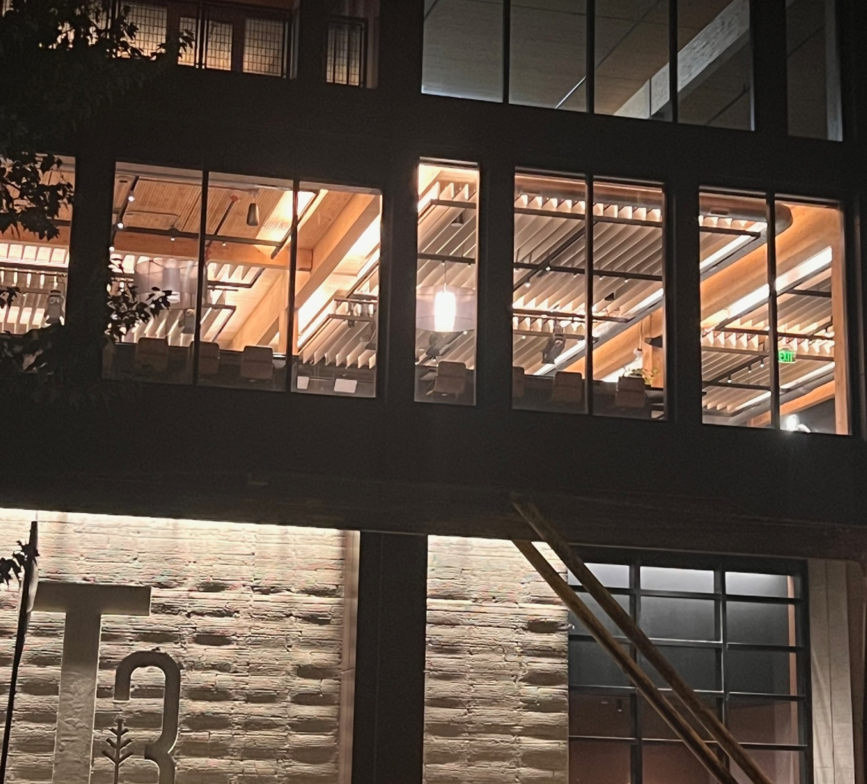
Section 179D – Energy Efficient Commercial Buildings Deduction
Notes:
Picture by JCPeacock - Best example I could find that shows all three 179D qualifying building systems in one photo.
Taken by me in Nashville, TN.

Slide 13
Section 179D - Quick Background
Purpose and History of Section 179D
Encourage energy efficiency in commercial buildings
Enacted under the Energy Policy Act of 2005
Provides a federal tax deduction for energy-efficient commercial building property (EECBP) improvements to:
Interior lighting systems
HVAC and hot water systems
Building envelope
15 Years passed with no IRS Regulations, Notices only - some Guidance
Made Permanent in 2020 but “terminated” June 2026
Notes:
Purpose of Section 179D
Encourage energy efficiency in commercial building design and construction.
Enacted under the Energy Policy Act of 2005.
Provides a federal tax deduction for energy-efficient commercial building property (EECBP) improvements to:
Interior lighting systems
HVAC and hot water systems
Building envelope
15 year with NO Regs! Notices 2006-52, 2008-40, and 2012-26 were the only guidance in the early years of the deduction. Some Office of Chief Counsel Memos were published, the “GLAM” or AA2018-50
See Pages 2 and 3 of the Practice Unit
Made permanent in 2020 - Enacted as part of the Consolidated Appropriations Act, 2021 (Pub. L. 116-260), specifically Title II of Division EE, the Taxpayer Certainty and Disaster Tax Relief Act of 2020.
Terminated by the OBBBA 2025 for buildings placed in service after June 30, 2025
This is NOT A CREDIT; however, it is typically lumped in with the tax credits for installing energy efficient equipment into buildings.

Slide 14
Section 179D - Quick Background- Con’t
IRA 2022 and 2025 Deduction – inflation adjusted amounts started 2023
Sliding scale of Dollars per percentage savings increase up to a set dollar maximum
Base deduction: $0.58 per sq. ft. if 25% energy savings met
Up to a $ maximum per % savings of $1.16/SF
Bonus rate: Base $2.90 up to $5.81 per sq. ft. if prevailing wage and apprenticeship (PWA) requirements are met
Deduction applies to new construction or retrofits that meet energy savings thresholds
Added Energy Efficient Building Retrofit Property EEBRP via Sect 179D(f)
Notes:
Stature statement on Dollar value: 179D(b)(2)
(2) Applicable dollar value
For purposes of paragraph (1)(A)(i), the applicable dollar value shall be an amount equal to $0.50 increased (but not above $1.00) by $0.02 for each percentage point by which the total annual energy and power costs for the building are certified to be reduced by a percentage greater than 25 percent.
The previous law’s maximum was 50% so many assumed the top dollar amount was for 50%, however the subsequent adjustments for inflation shifted the percentage slightly.
2025 Deduction
(inflation-adjusted; started 2023)
Base deduction: $0.58 per sq. ft. of 25% energy savings met
Sliding scale up to a $ maximum per % savings of Up to $1.16/SF
Statute of 179D stated a dollar maximum for IRA 2022 – NOT to 50% as the previous allowed maximum
Bonus rate: Up to $5.81 per sq. ft. if prevailing wage and apprenticeship (PWA) requirements are met.
Deduction applies to new construction or retrofits that meet energy savings thresholds.

Slide 15
Section 179D - Quick Background- Con’t
Energy Standards, Certification and Maximum Deduction
Must meet or exceed ASHRAE Standard 90.1 – 2007 (Through 2026)
Qualified Individual (QI) must certify energy savings using DOE approved modeling software.
PRE IRA 2022 Exceed 50% energy and cost savings for full $1.80/sf
Each system garnered $0.60/sf with lower threshold. See Notice 2012-26
IRS 2022 - Minimum 25% energy cost reduction (after 2023) to qualify
Notes:
Energy Standards and Certification
Must meet or exceed ASHRAE Standard 90.1 – 2007 (Through 2026)
Std in effect 4 years before placed-in-service date.
Independent NOT RELATED TO TP - Qualified Individual (QI) must certify energy savings using DOE approved modeling software.
Minimum 25% energy reduction (after 2023) to qualify slideing scale $/% (Dollars per percentage saving increase) up to a set dollar maximum.
Sliding Scale of $ per %

Slide 16
Section 179D - Quick Background- Con’t
Who can Claim Sect 179D deduction?
Commercial building owners for qualified energy-efficient property.
Designers (architects, engineers, designers of record) of government-owned buildings can be allocated the deduction.
Expanded to Tax-exempt and Tribal entities (per IRA 2022 updates)
Notes:
Who can Claim Sect 179D deduction?
Commercial building owners for qualified energy-efficient property.
Designers (architects, engineers, designers of record) of government-owned buildings can be allocated the deduction.
Most of the 179D cases the IRS saw was designer related. Many promoters in the early years, did not understand the IRS’ guidance on how to follow the issue. MANY sub contractors who installed but not designed the EECBP claimed the deduction.
Tax-exempt and Tribal entities can now allocate deductions (per IRA 2022 updates).
Slide 17 Content:
Feb 2025 Updated 179D Practice Unit (Basically the ATG for 179D)
IRS Practice Unit emphasizes verification of taxpayer eligibility and proper substantiation.
Examiners must distinguish between building owners and designers and evaluate certification and modeling documentation.
IRS Engineers are trained on what a Shop Drawing is, and what constitutes documented proof of being the EECBP designer

Slide 17
IRS Engineers Section 179D Training
IRS ENGs are trained on:
Form 7205
TP building owner or EECBP/EEBRP designer?
Correct identification affects eligibility, documentation, and allocation review
Designers: allocated deduction from a governmental or tax-exempt owner
Documentation proving designers identified
Building Owners: Deduction for property they own and placed in service
Difference between Shop Drawings, RFIs, and other trade or subcontractor generated documents
Notes:
IRS ENGs are trained on:
Form 7205 released for 2022 tax year, mandatory in 2023
Is the taxpayer a building owner or a designer?
Building Owners: Deduction for property they own and placed in service.
Designers: May claim only if allocated deduction from a governmental or tax-exempt owner.
Correct identification affects eligibility, documentation, and allocation review.

Slide 18
IRS Engineers Section 179D Training - Con’t
Core Information to Verify from the Form 7205:
For both Building Owners and Designers:
Building address and square footage
Tax year deduction claimed
Claimed dollar amount and computation method
Documentation of Prevailing Wage and Apprenticeship (PWA) compliance (for bonus rate)
Notes:
Core Information to Verify from the Form 7205:
For both Building Owners and Designers:
Building address and square footage
Tax year deduction claimed
Claimed dollar amount and computation method
Documentation of Prevailing Wage and Apprenticeship (PWA) compliance (for bonus rate)
None of this information is beyond what is required to properly fill out the Form 7205
Dept of Labor Page: https://www.dol.gov/agencies/whd/IRA
IRS publish Reg: June 18, 2024 https://www.federalregister.gov/documents/2024/06/25/2024-13331/increased-amounts-of-credit-or-deduction-for-satisfying-certain-prevailing-wage-and-registered
IRS Page addressing PWA: https://www.irs.gov/credits-deductions/prevailing-wage-and-apprenticeship-requirements
IRS FAQs on PWA: https://www.irs.gov/credits-deductions/frequently-asked-questions-about-the-prevailing-wage-and-apprenticeship-under-the-inflation-reduction-act

Slide 19
IRS Engineers Section 179D Training - Con’t
Certification Requirements
Certification must be by a Qualified Individual using DOE-approved software.
Verify certifier credentials, date of certification, and energy savings model files and report.
Confirm certification corresponds to the actual building placed in service.
Notes:
Certification Requirements
Certification must be by a Qualified Individual using DOE-approved software.
Verify certifier credentials, date of certification, and energy savings model files and report.
Confirm certification corresponds to the actual building placed in service.

Slide 20
IRS Engineers Section 179D Training - Con’t
Energy Modeling Review
In-house or by a third-party contractor? (Outsourced to India?)
Baseline/Reference Model: Follows Appendix G of ASHRAE Standard 90.1 (correct edition) with documented inputs.
Proposed Model: Equipment, materials, and lighting match plans and specifications:
Mechanical schedules
Interior lighting schedules
Exterior - Windows, doors, and wall assemblies
Notes:
Energy Modeling Review
This is what I concentrated on the last few years working for the Service. IRS was not an engineering organization like the DOE, we could only stay within the bounds of the TAX LAW and published IRS guidance on the subject. It took years to break through to let us apply engineering practices to the guidance. Published as the Practice Unit, supervised by NO Counsel but not produced by NO counsel. So not a Rev Ruling, Rec Proc, CCA etc. It holds no real authority and should not be cited as precedent, but like the Cost Seg ATG the longer it hangs around, the more authoritative it becomes.
Was modeling done in-house or by a third-party contractor?
Baseline/Reference Model: Follows Appendix G of ASHRAE Standard 90.1 (correct edition) with documented inputs.
Proposed Model: Equipment, materials, and lighting match plans and specifications:
Mechanical schedules
Interior lighting schedules
Exterior - Windows, doors, and wall assemblies

Slide 21
IRS Engineers Section 179D Training - Con’t
Model Integrity and Compliance
Verify neither the reference nor proposed model includes or omits items inconsistent with Notice 2006-52 or ASHRAE 90.1, Appendix G.
Ensure energy savings percentage (ESP) is calculated correctly.
IRS finds many 50.01%+ qualifiers for the full deduction
Confirm percentage of energy savings is based on qualified energy-efficient property only.
IRS finds some items on plans are not reflected in models, and visa versa
Notes:
Model Integrity and Compliance
Verify neither the reference nor proposed model includes or omits items inconsistent with Notice 2006-52 or ASHRAE 90.1, Appendix G.
Ensure energy savings percentage is calculated correctly.
IRS finds many 50.01% qualifiers for the full deduction
Confirm percentage of energy savings is based on qualified energy-efficient property only.
IRS finds some items on plans are not reflected in models, and visa versa

Slide 22
IRS Engineers Section 179D Training - Con’t
Designer Examinations
Evidence they are actual designers of record:
Contract statements and scope of work
Name appears on plans/specifications
Identified as architect/engineer on project documents
Allocation letter:
Issued by a knowledgeable representative of the building owner
Date (before or after completion?)
Deduction amount clearly stated—not just a percentage
Notes:
Designer Examinations
Evidence they are actual designers of record:
Contract statements and scope of work
Name appears on plans/specifications
Identified as architect/engineer on project documents
Allocation letter:
Issued by a knowledgeable representative of the building owner
Date (before or after completion?)
Deduction amount clearly stated—not just a percentage

Slide 23
IRS Engineers Section 179D Training - Con’t
Sect 179D Best Practices Summary
Clearly establish taxpayer role (owner vs. designer)
Review certification, modeling, and allocation thoroughly
Confirm ASHRAE compliance
Confirm PWA compliance and documentation
Proper review ensures the deduction meets statutory intent and withstands IRS examination
Notes:
Sect 179D Best Practices Summary
Clearly establish taxpayer role (owner vs. designer).
Review certification, modeling, and allocation thoroughly.
Confirm ASHRAE compliance
Confirm PWA compliance and documentation.
Proper review ensures the deduction meets statutory intent and withstands IRS examination.

Slide 24

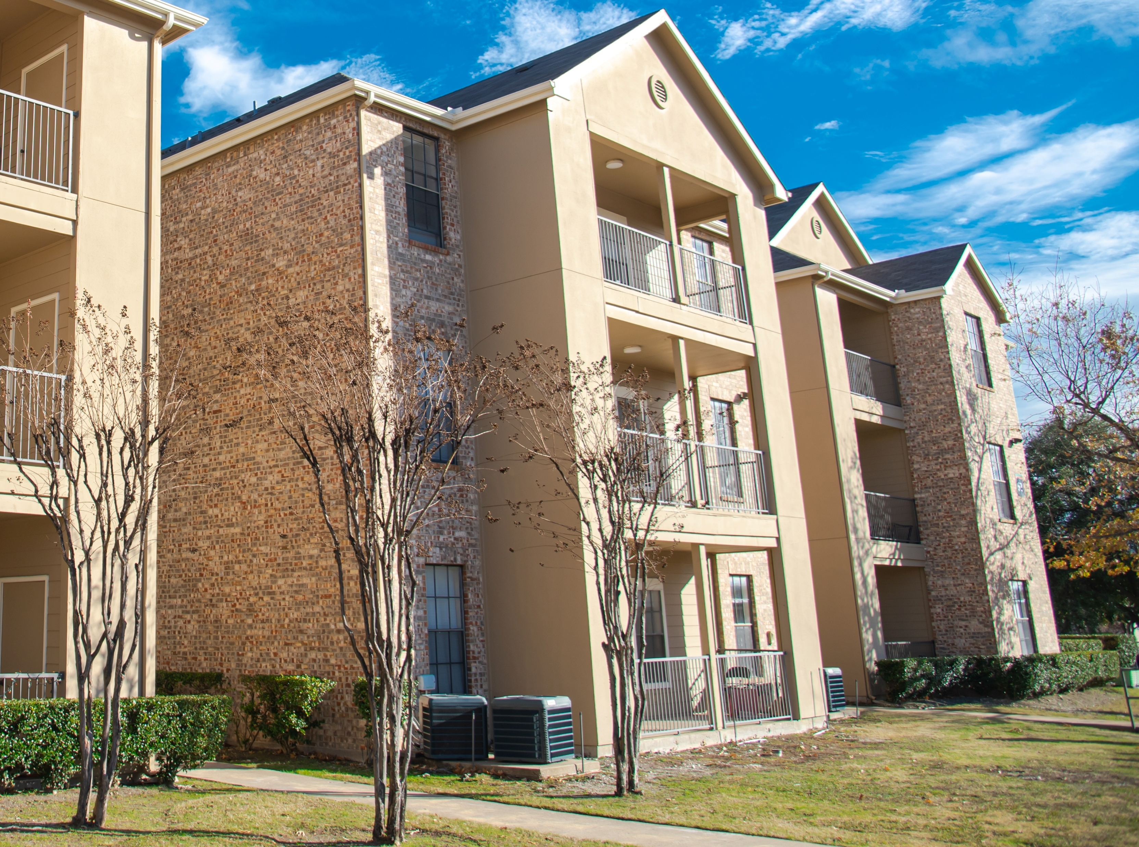
AmeriSouth XXXII, LTD v Comm. - T.C: Memo. 2012-67
Not Actual AmeriSouth Property
Notes:
Both images used are from Shutter stock
Left image is a cropped Shutterstock_2585625783,
Right Image is Shutterstock_2366231887

Slide 25
AmeriSouth XXXII, LTD v Comm. - T.C: Memo. 2012-67
Premiere Cost Seg Case addressing residential rental property (RRP),
all other cases have been on non-residential rental property NRRP
No case is perfect; they all have their good points and their quirks
AmeriSouth is no different
The taxpayer abandoned the court after the trial. However, the judge had cause to render a decision since most of the briefs had already been filed - except Final Brief
Many cases have gone against the IRS when they thought the Government had given a stronger argument than the petitioner. See Morrison Cafeterias, HCA, etc.
In the books now, AmeriSouth decided in 2012
overturning or overruling the outcome must come from other courts, not merely disagreement of the IRS or practitioners
No court case nor act of Congress has changed that since the decision
Notes:
Premiere Cost Seg Case addressing residential rental property RRP,
all other cases have been about non-residential rental property NRRP
No case is perfect; they all have their good points and their quirks.
AmeriSouth is no different.
The taxpayer basically abandoned the court during the trial. However, the judge had cause to render a decision since all or most of the briefs had already been filed.
Many cases have gone against the IRS when they thought the Government had given a stronger argument than the petitioner. See Morrison Cafeterias, HCA, etc.
Each case is in the books now, AmeriSouth decided in 2012
overturning or overruling the outcome must come from other courts, not merely disagreement of the IRS or practitioners.
No court case nor act of congress has changed that since these came out.
Actions On Decision by IRS Commissioner on HCA, Scott Paper, etc.

Slide 26
AmeriSouth XXXII, LTD v Comm. - Con’t
Of the 12 asset types subject of the case, the Court sided with AmeriSouth on these 3 assets:
Special HVAC – dryer vents (§ 1245) split kitchen vents (§ 1250)
Special plumbing – dryer gas lines (§ 1245) split some (§ 1250)
Special electric - (§ 1245/§ 1250)
Commissioner Conceded:
Gate Components as 15-year land improvement
Gate Component Electrical duplex outlet as 15-year land improvements
Timer relating to the watering of the grounds.
The parties agreed are tangible personal property
Surveillance components--consisting of a camera and TV
Sign flood light and accompanying timer,
Notes:
Cost Seg ATG, D.3 table 1, page 94. Table 1: Case Law by Case Name (Reverse Chronological Order)
Page 7 and 8 of AmeriSouth Decision:
1. site preparation and earthwork; Non Depr
2 . water-distribution system; 1250
3. sanitary-sewer system; 1250
4. gas line; utility 1250
5. site electric; utility 1250
6. special HVAC; split Kit Vents 1250, dryer vents 1245
7. special plumbing; 3 – laundry drain and waste 1250, sinks & disposal 1250 dryer gas 1245
8. special electric;
9. finish carpentry; 1250 – needed more support
10. millwork; 1250 needed more support
11. interior windows and mirrors; 1250
12. special painting. Took on class of asset painted, so all 1250.
Of the 12 asset types subject of the case, the Court sided with AmeriSouth on these 3 assets:
Special HVAC – dryer vents (§ 1245) split kitchen vents (§ 1250)
Special plumbing – dryer gas lines (§ 1245) split some (§ 1250)
Special electric - (§ 1245/§ 1250)
Commissioner Conceded:
Gate Components as 15-year land improvement
Gate Component Electrical duplex outlet as 15-year land improvements
Timer relating to the watering of the grounds.
The parties agreed are tangible personal property
Surveillance components--consisting of a camera and TV
Sign flood light and accompanying timer,

Slide 27
AmeriSouth XXXII, LTD v Comm. - Con’t
Assets that are Points of Contention by practitioners:
IRS sees these assets claimed as 1245 property on a regular basis with RRP cost segs:
Kitchen Cabinets
Kitchen Counter Tops
Kitchen Sinks and disposals
Various non-specific electrical outlets
Tax Court cited TP lack of support for most of these items,
TP required to properly support their argument for the Court to consider
All but final briefs were filed - as documented on USTAXCOURT.gov
TP abandoned the case and TP attorneys withdrew after trial
Considered “Bad Law” by many practitioners
The Tax Court missed an opportunity in the decision of this case!
Notes:
Assets that are Points of Contention by practitioners:
The IRS sees on a regular basis with residential property cost segs:
Kitchen Cabinets
Kitchen Counter Tops
Kitchen Sinks and disposals
Various non-specific electrical outlets
Tax Court cited TP lack of support for most of these items,
All the TP needed to do was properly support their argument for the Court to consider
All but final briefs were filed
TP abandoned the case and TP attorneys withdrew
Considered “Bad Law” by many practitioners
The Tax Court missed an opportunity in the decision of this case!

Slide 28
AmeriSouth XXXII, LTD v Comm. - Con’t
AmeriSouth Court Missed Opportunity –
Judge considered:
TP’s argument - comparison to what makes a shell of a “Generic Building”, all other assets should be Section 1245 property
Decided that it should be compared to or the shell of an APARTMENT building
The statute definition of 168(e)(2) was not fully examined.
Case decision cites Sec 168 23 times,
Zero citing of Sec 168(e)(2).
Notes:
Judge Cites Rev Proc 87-56 and predecessor guidance that used a Shell of a building,
FootNote 25 page 36 - We note that several of Rev. Proc. 87-56's predecessors used the word
"shell" to describe a building, see Rev. Proc. 72-10, 1972-1 C.B. 721, 730; Rev.
Proc. 62-21, 1962-2 C.B. 418, 419, but even assuming that modifier sheds light on
the area, it still begs the question whether we look at the shell of a generic
building or the shell of an apartment building.
While I see this as consistent with the statute, it falls short of applying the statute to the facts of this case.
AmeriSouth Court Missed Opportunity –
Judge considered:
TP’s argument - comparison to what makes a shell of a “Generic Building”, all other assets should be Section 1245 property
Decided that it should be compared to or the shell of an apartment building
The statute definition of 168(e)(2) was not fully examined.
Case decision cites Sec 168 23 times,
Zero citing of Sec 168(e)(2).

Slide 29
AmeriSouth XXXII, LTD v Comm. - Con’t
Definition of Residential Rental Property, IRC 168(e)(2)(A):
The term "residential rental property" means any building or structure if 80 percent or more of the gross rental income from such building or structure for the taxable year is rental income from dwelling units.
(I) the term "dwelling unit" means a house or apartment used to provide living accommodations in a building or structure, but does not include a unit in a hotel, motel, or other establishment more than one-half of the units in which are used on a transient basis, and
(II) if any portion of the building or structure is occupied by the taxpayer, the gross rental income from such building or structure shall include the rental value of the portion so occupied.
Notes:
Definition of Residential Rental Property, IRC 168(e)(2)(A):
The term "residential rental property" means any building or structure if 80 percent or more of the gross rental income from such building or structure for the taxable year is rental income from dwelling units.
(I) the term "dwelling unit" means a house or apartment used to provide living accommodations in a building or structure, but does not include a unit in a hotel, motel, or other establishment more than one-half of the units in which are used on a transient basis, and
(II) if any portion of the building or structure is occupied by the taxpayer, the gross rental income from such building or structure shall include the rental value of the portion so occupied.
Section 2 may not be the focus for this instance, but it is for self-occupied taxpayers.
It was important that to distinguish a RRP from a commercial building NRRP, is must contain dwelling unit(s) and provide accommodations for long term living. – Living Accommodations

Slide 30
AmeriSouth XXXII, LTD v Comm. - Con’t
What is a Dwelling Unit and Living Accommodations? Reg §1.280A-1(c)(1):
Dwelling unit includes a house, apartment, condominium, mobile home, boat, or similar property, which provides basic living accommodations such as sleeping space, toilet, and cooking facilities. A single structure may contain more than one dwelling unit. For example, each apartment in an apartment building is a separate dwelling unit. Similarly, if the basement of a house contains basic living accommodations, the basement constitutes a separate dwelling unit. …
TAX COURT NOTE:
Storage was noted by Judge Holmes to be a necessity in an apartment building and also may be interpreted as living accommodations (Page 57 of Decision)
Notes:
§1.280A-1. Limitations on deductions with respect to a dwelling unit which is used by the taxpayer during the taxable year as a residence
(c) Dwelling unit
(1) In general
For purposes of this section and §§1.280A-2 and 1.280A-3, the term "dwelling unit" includes a house, apartment, condominium, mobile home, boat, or similar property, which provides basic living accommodations such as sleeping space, toilet, and cooking facilities. A single structure may contain more than one dwelling unit. For example, each apartment in an apartment building is a separate dwelling unit. Similarly, if the basement of a house contains basic living accommodations, the basement constitutes a separate dwelling unit. All structures and other property appurtenant to a dwelling unit which do not themselves constitute dwelling units are considered part of the unit. For example, an individual who rents to another person space in a garage which is appurtenant to a house which the individual owns and occupies may claim deductions with respect to that rental activity only to the extent allowed under section 280A, paragraph (b) of this section, and §1.280A-3.
Amerisouth Decision page 56 and 57: The design of the buildings, particularly the wall recesses in the living rooms, accommodates permanent shelving; the shelves allow for storage, a necessity in an apartment building; …

Slide 31
AmeriSouth XXXII, LTD v Comm. - Con’t
What does this mean for Residential Cost Seg cases being examined by the IRS?
Look to IRC 168(e)(2) for definition of RRP, not merely a comparison with a shell of a generic building or shell of apartment building
Living accommodations are essential to a dwelling unit:
Sleeping space
Toilet - and personal washing area
Cooking facilities - including food preparation, clean up and storage
Cleaning spaces - for personal, clothing and meals
Storage Space – per Judge in AmeriSouth
Notes:
What does this mean for Residential Cost Seg cases being examined by the IRS?
Look to IRC 168(e)(2) for definition of RRP, not merely a comparison with a shell of a generic building or shell of apartment building
Living accommodations are essential to making a dwelling unit
Sleeping space
Toilet
Cooking facilities Kitchen cabinets,
countertops, including Kitchen sinks
Cleaning spaces - for personal, clothing and meals
Storage Space – per Judge in AmeriSouth
Page 56/57 of TC Case Document from US Tax Court records:
The Commissioner does not dispute that these items are movable, but tells us
to focus on other signs of their permanence: The design of the buildings,
particularly the wall recesses in the living rooms, accommodates permanent
shelving; the shelves allow for storage, a necessity in an apartment building; and the
paneling, molding, and chair rails protect other parts of the buildings, such as the
floors, walls, and ceilings, from damage.

Slide 32
AmeriSouth XXXII, LTD v Comm. - Con’t
What does this mean for Residential Cost Seg cases being examined by the IRS?
Kitchen cabinets, countertops, including Kitchen sinks interpreted as lucrative §1245 assets of a dwelling unit (house, apartment, etc.) for Cost Seg preparers
IRS does not see it that way.
IRS has AmeriSouth and IRC § 168(e)(2) to argue against these § 1245 claims
Documented facts could support § 1245 claim such as:
history and records of removal of assets more frequent than building life or
proof of storage and reinstalling of assets like cabinets and sinks.
Notes:
What does this mean for Residential Cost Seg cases being examined by the IRS?
Kitchen cabinets, countertops, including Kitchen sinks are interpreted as lucrative §1245 assets of an apartments building for a cost segregation study.
IRS does not see it that way.
IRS has AmeriSouth and IRC § 168(e)(2) to argue against these § 1245 claims
Other documented facts could support § 1245 claim such as:
history and records of removal of assets more frequent than building life or
proof of storage and reinstalling of assets like cabinets and sinks.

Slide 33
AmeriSouth XXXII, LTD v Comm. - Con’t
Conclusion
AmeriSouth illustrated importance of fully documenting and presenting support for any position on any building asset claimed as §1245 property.
IRC §168(e)(2) (The Statute) provides the definition of RRP which distinguishes it from NRRP
Claiming Kitchen cabinets, countertops and sinks as §1245 property will be challenged by the IRS
If taxpayer has a history of frequent removal and replacing certain assets and or has a system of removal, storing and reinstalling certain assets, this must be documented and presented upon audit if claimed as § 1245 property.
Notes:
§1.280A-1. Limitations on deductions with respect to a dwelling unit which is used by the taxpayer during the taxable year as a residence
(c) Dwelling unit
(1) In general
For purposes of this section and §§1.280A-2 and 1.280A-3, the term "dwelling unit" includes a house, apartment, condominium, mobile home, boat, or similar property, which provides basic living accommodations such as sleeping space, toilet, and cooking facilities. A single structure may contain more than one dwelling unit. For example, each apartment in an apartment building is a separate dwelling unit. Similarly, if the basement of a house contains basic living accommodations, the basement constitutes a separate dwelling unit. All structures and other property appurtenant to a dwelling unit which do not themselves constitute dwelling units are considered part of the unit. For example, an individual who rents to another person space in a garage which is appurtenant to a house which the individual owns and occupies may claim deductions with respect to that rental activity only to the extent allowed under section 280A, paragraph (b) of this section, and §1.280A-3.
Amerisouth Decision page 56 and 57: The design of the buildings, particularly the wall recesses in the living rooms, accommodates permanent shelving; the shelves allow for storage, a necessity in an apartment building; …
If taxpayer has a history of frequent removal and replacing certain assets like carpeting, tiling, wall covering, and or
has a system of removal, storing and reinstalling certain assets, this must be documented and presented upon audit if claimed as § 1245 property.

Slide 34

It’s the SUPPORT – Not the REPORT!
Mark Ramos, IRS Engineer
Esteemed Colleague from the IRS Engineering Program
Notes:
Picture of M Ramos per S Varga 2025

