Slide 1



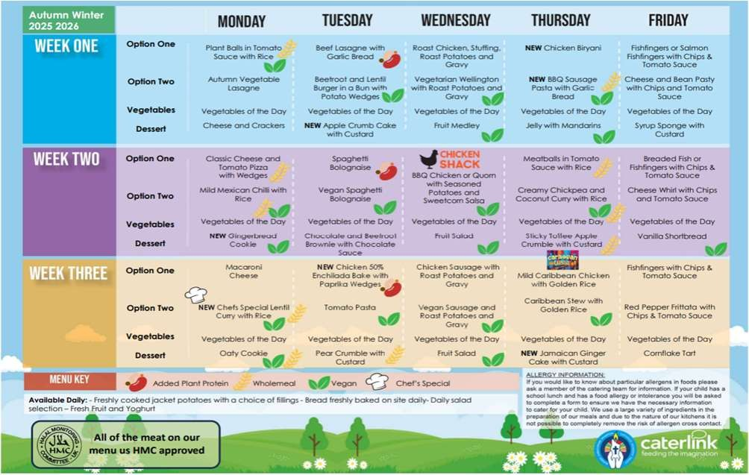


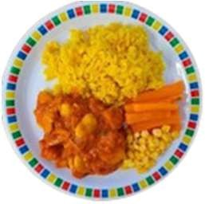
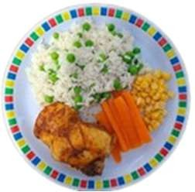




Newsletter September 2025
Your New Autumn/Winter Menu is here!
We are very excited to share with you, the new menu for Autum / Winter 25 - 26.
Our menus change twice yearly October to April (Autumn/Winter) April to October (Spring/Summer)
This new menu will run from November 2025, running through to Easter half-term 2026 at the new price of £3.00 per meal
This new menu is packed with old favorites and new dishes, plus our new concept Caribbean Carnival, more if on this below.
Food for Life ,which was created by the Soil Association, started in 2003 with the aims of making healthy, tasty and sustainable meals the norm for all to enjoy, reconnecting people with where their food comes from, teaching them how food is grown and cooked, and championing the importance of well-sourced ingredients.
The Food For Life Served Here award ensures:
Food served is fresh • Healthy eating is made easy
The food we buy is sustainable and ethical
Local farmers & food producers are supported
Everyone eating a Caterlink primary school lunch can be sure that they are eating from a menu that meets at least the Food For Life Served Here
What is Caribbean Carnival?
Caribbean food is full of bold, rich flavours, using a combination of spices and fresh ingredients, culminating in dishes that are both vibrant in flavour and colour. We have worked hard to create these dishes full of Caribbean flavours in mind, but
without All of the spice, so everyone can enjoy and experience the Caribbean food whatever their spice
tolerance. The concept and dishes have been tried, tested and adapted in several Primary schools and the feedback from the children, school staff and
parents has all been very positive.
Mild Caribbean Chicken with Rice and Peas
Caribbean Butterbean Stew with Rice

Slide 2






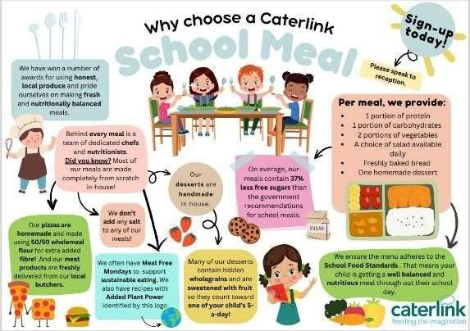

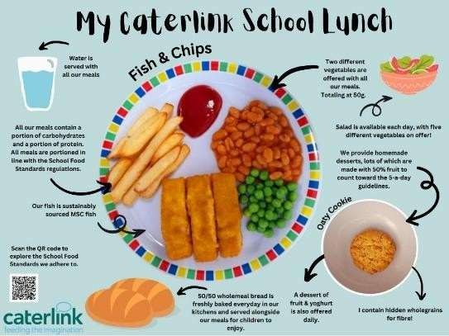


Information
Menu feedback and changes
When putting together any menu we always ask for feedback from the children, the cooks in the kitchen, Brighter Futures for Children and schools with any changes or feedback they would like before the menu go live.
On this new menu two items kept coming up, so we put this to a vote to all schools (majority wins). The results of this vote and subsequent changes to the menu are outlined below:
Change Jacket Potato as third option everyday: A lot of feedback that came back was to offer a pasta dish as the
third option on some days.
Vote results: Jacket Potato will be changed to Pasta with a Tomato Sauce on a Tuesday and Thursday each week to offer more variety on the menu.
Why “Peas s Beans” and not ‘Peas OR Beans’ or ‘Peas/Beans s a different vegetable’? The Government Food Standards Regulations, states that we must provide two different vegetables each day. We put several options to schools including ‘Peas C Sweetcorn’ / ’Beans C Carrots’ / ‘Peas C Carrots’ with majority of schools saying….
Vote Results: Majority of schools voted to keep Peas and Beans. So, Peas C Beans have remained on the menu
Portion size
We often get asked by parents about the portion sizes that we give as a
company. As a company, we adhere to the portion sizes outlined in the Government’s School Food Standards, to ensure that children receive adequate quantities of food for their requirements. This details how much protein, carbohydrates and vegetables should be on a main meal, and what the portion size of desserts should be. I have included a link for you here… School-Food-Standards-Guidance-FINAL-V3.pdf (schoolfoodplan.com)
Whilst we follow the School Food Standards, we also offer unlimited vegetables, salads and freshly baked breads so if your child has more of an appetite on a given day, they can take more additional items.
To ensure our teams are giving the correct portions, we have several training resources, including comprehensive recipes and a pictorial portion size chart for our sites which assists in the whole plate approach, identifying requirements for KS1, KS2 and KS3.
We would like to welcome all the new children and families who joined in September and share with you a little bit more information about Caterlink, school meals and our offer. See attached full size posters.

