Slide 1

HIV and Contraceptive Assessment:
New Roles for Pharmacists
March 5, 2025

Slide 2


WELCOME
TODAY’S PRESENTERS
Jill Hayden
President & CEO
IAMHP
Tony Kolbeck
Bureau Chief, Provider Enrollment Services
IL Department of Healthcare and Family Services
Lindsey Artola
President
Sage Health Strategy
Amy Moffat
Section Manager
Non-Institutional Provider Services (NIPS) Billing Unit
IL Department of Healthcare and Family Services

Slide 3
IAMHP Health Plans in 2024
HealthChoice Illinois
Aetna Better Health
Blue Cross Blue Shield Community Health Plans
CountyCare
Meridian
Molina
MMAI
Aetna Better Health
Blue Cross Blue Shield Community Health Plans
Humana
Meridian MMAI
Molina
YouthCare
Meridian (Name displays as YouthCare)

Slide 4
AGENDA
Background and Overview of Changes to Pharmacy Practice Act
Participation Requirements:
  For HealthChoice Illinois
  For HIV/Contraceptive Services
Contracting with HealthChoice Illinois Managed Care Organizations (MCOs)
Submitting Claims for Services
Wrap-up and Q&A

Slide 5
Background and Overview:
The Evolving Role of the Pharmacist

Slide 6
New Statutes Broaden the Role of the Pharmacist
Legislative changes enacted in 2022:
  Contraceptive Assessment and Consultation Services: Public act: 102-0103
    HFS Provider Notice issued October 31, 2022, and August 9, 2023
  HIV Pre/Post Exposure Prophylaxis Assessment and Consultation: Public Act 102-1051
    HFS Provider Notice issued August 9, 2023
These statutory changes broadened the scope of practice for pharmacists to include:
  Assessment and consultation of patients and the dispensing of hormonal contraceptives
  the initiation, dispensing, or administration of drugs, laboratory tests, assessments, referrals, and consultations for HIV pre- and post-exposure prophylaxis
With these changes, the traditional role of the physician (assess, consult, prescribe) is delegated to the pharmacist
These new services have specific IMPACT registration requirements and are provided and billed outside of the PBM and POS systems that pharmacists traditionally use for billing.
  They are billed on a professional claim (CMS-1500 or 837P), NOT an NCPDP claim, and are submitted directly to the MCO or HFS.

Slide 7
IMPACT Registration and Program-Specific Credentialing Requirements

Slide 8

General Requirements
IMPACT is the HFS Medicaid provider credentialling system and is accepted/used by all MCOs for provider credentialling.
All pharmacies (organizations) must be enrolled in IMPACT as a credentialed Medicaid provider (as a Facility, Agency or Organization) in order to dispense Rx to Medicaid members and submit claims.
Individual pharmacists do not need to be enrolled in IMPACT if they are only dispensing Rx to Medicaid members as an employee/contractor of an enrolled pharmacy.
However, to provide the new HIV/Contraceptive assessment and prescribing services, individual pharmacists must be enrolled in IMPACT as individual practitioners and be associated with an enrolled pharmacy.
  The prescribing pharmacist must also complete Illinois-specific training before enrolling in IMPACT, as there is an enrollment step that requires them to attest they have completed the training and the date it was completed.
  They must also have standing order from a physician:
    HIV services: an affiliated and IMPACT-enrolled physician
    Contraceptive services: IDPH Standing Order is in place

Slide 9

ILLINOIS PROVIDER ENROLLMENT
Creating an ILogin Account
for New External IMPACT Users
Notes:
.

Slide 10
Table of Contents
Glossary of Terms 3
Introduction to ILogin 4
Creating a New Account in ILogin 5
Activating the ILogin Account 8
Applying Multifactor Authentication Methods 11
IMPACT Identity Proofing 12
Accessing IMPACT Application 15
Starting IMPACT Enrollment 16
Contact Information 17

Slide 11
Glossary
Glossary of Terms
Chiclet – ILogin term for IMPACT component.
External User – A user whose ILogin User ID does not end with “@illinois.gov”.
HFS – Illinois Department of Healthcare and Family Services.
IMPACT – Illinois Medicaid Program Advanced Cloud Technology is a multi-agency effort to replace Illinois’ 30-year-old Medicaid Management Information System (MMIS).
MFA – Multifactor Authentication. Adds a layer of protection to the sign-in process. Users provide additional identity verification.
New Enrollment – A new provider who needs to enroll in IMPACT.

Slide 12
Introduction to ILogin
IMPACT Single Sign-On Migrates to new ILogin/IMPACT System
The Department of Healthcare and Family Services (HFS) is replacing the authentication and authorization tool used to establish the Single Sign-On account of the Illinois Medicaid Program Advanced Cloud Technology (IMPACT) System with ILogin.
ILogin adds additional layer of security and requires a Multi Factor Authentication (MFA) to access the IMPACT Account.
As a new external user to IMPACT, follow the step-by-step instructions to create a new account in ILogin, set-up Password Recovery options, establish Multifactor Authentication methods, complete IMPACT Identity Proofing and begin a new IMPACT enrollment.

Slide 13
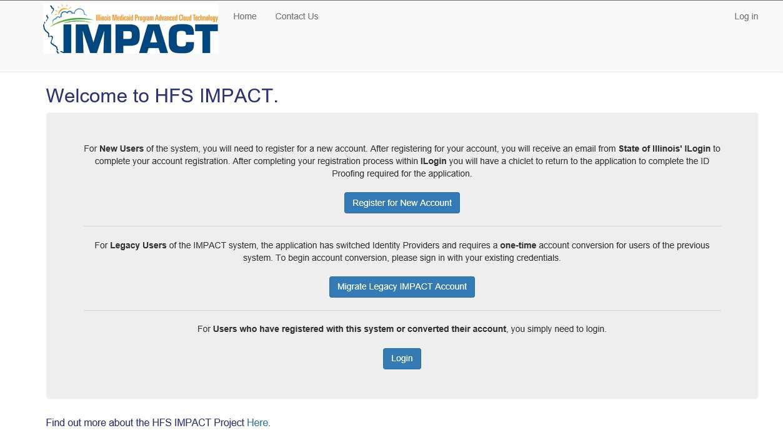
Step 1: Creating A New Account In ILogin
To start creating a new account, go to https://impact.illinois.gov.
Select the “Register for New Account” button.

Slide 14
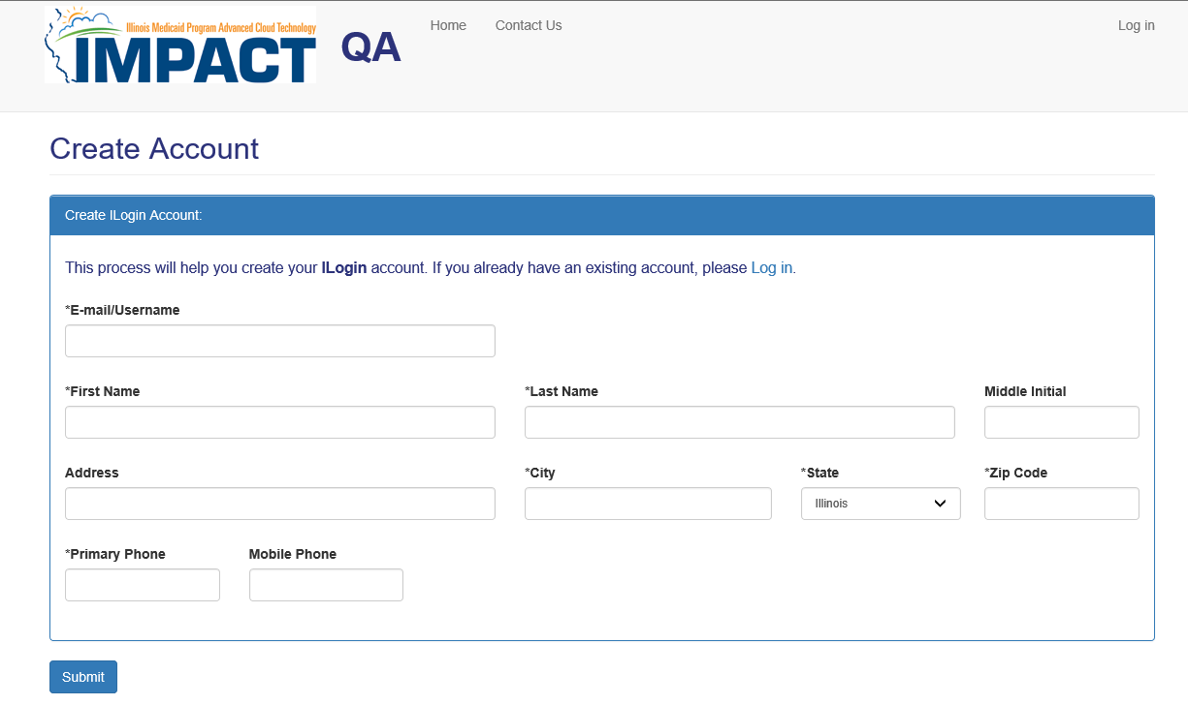

Step 1: Creating A New Account In ILogin
Complete the registration information and click on “Submit”.
The email/username will need to be unique within ILogin.

Slide 15
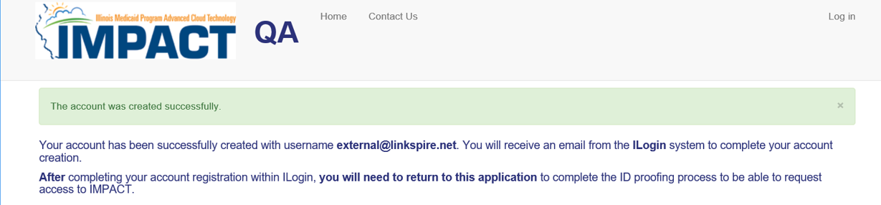
Step 1: Creating A New Account In ILogin
Once you have submitted your registration, you will see the following information indicating “The account was created successfully.”
You will also receive an activation email.

Slide 16
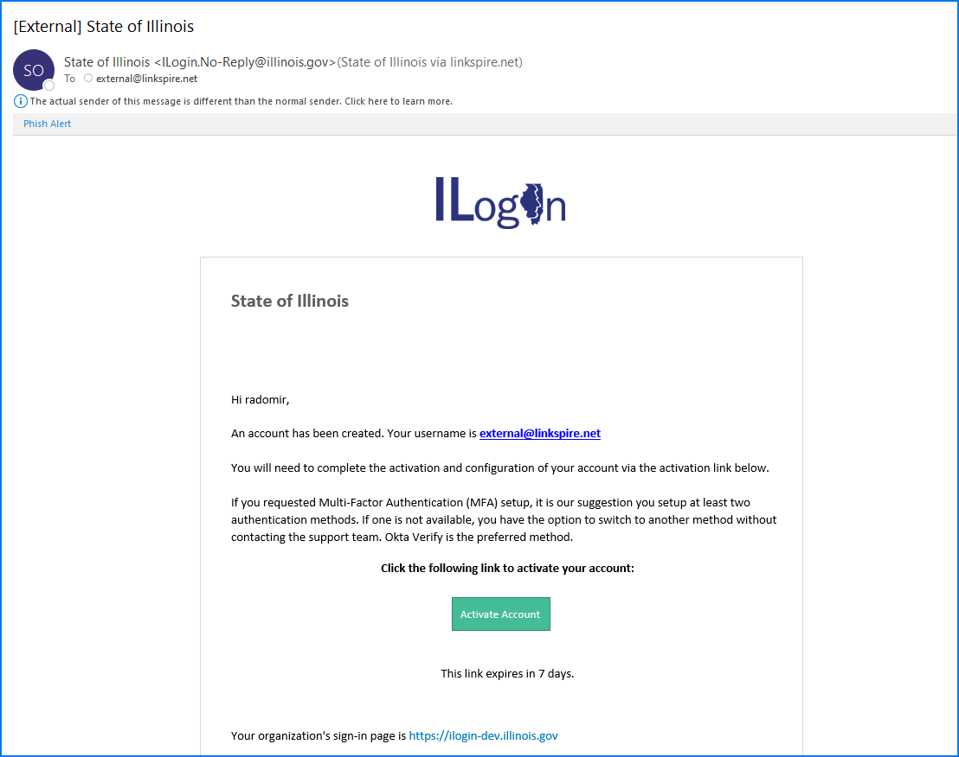
Step 2: Activating the ILogin Account
Once you receive the ILogin activation email, click on the Activate Account button. You will be directed to set up a password, security questions and options for password recovery.
Please Note: This link expires 7 days after you receive the email. Be sure to activate your account as soon as possible.

Slide 17
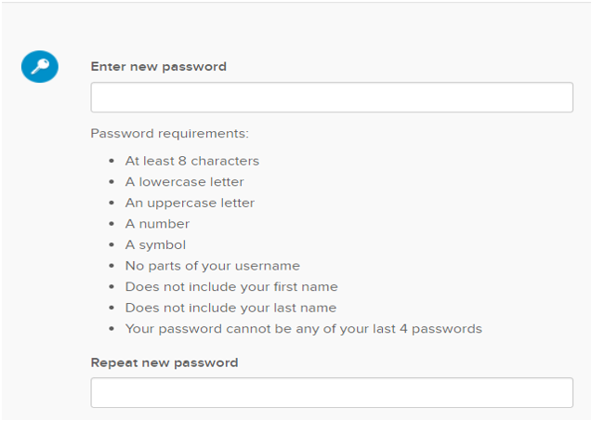
Step 2: Activating the ILogin Account
Create your password. Be sure to follow the password requirements listed below:

Slide 18
Step 2: Activating the ILogin Account
Password Recovery Options
Only presented when logging in to ILogin for the first time.
Complete at least ONE (1) Password Recovery Options.
Click on “Create My Account” to complete account activation.
To make a change to your Password Recovery Options, you can click on the ILogin “Settings” after creating your account.

Slide 19
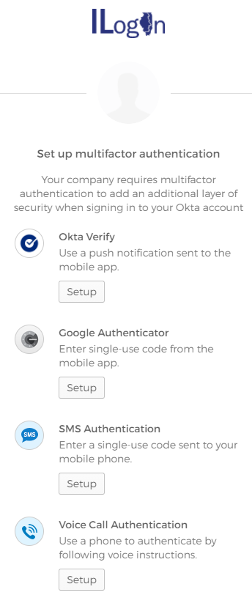
Step 3: Applying Multifactor Authentication Methods
Multifactor Authentication (MFA) Set Up
Only presented when logging in to ILogin for the first time.
You must complete at least ONE (1) Multifactor Authentication Methods.
It is recommended to setup multiple methods, so you have a back-up option if one method is not available to you.
Once MFA Methods is set up, click on the “Finish” button.

Slide 20
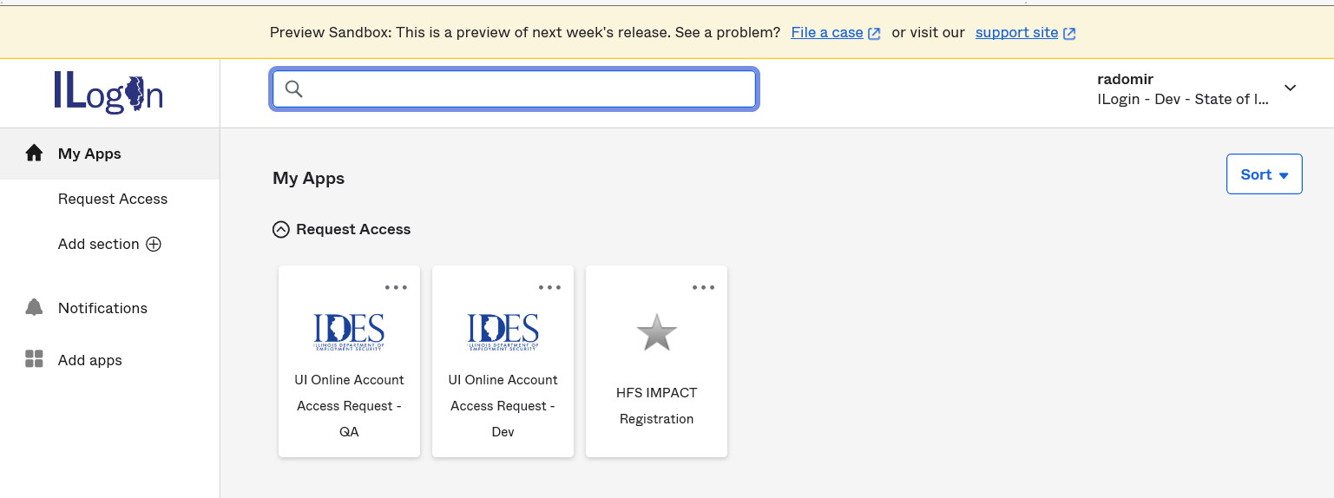

Step 4: IMPACT Identity Proofing
Welcome to the ILogin Dashboard. All the application chiclets that you are authorized to use will appear here. Click on the “HFS IMPACT Registration” chiclet to begin the Identity
Proofing process.

Slide 21
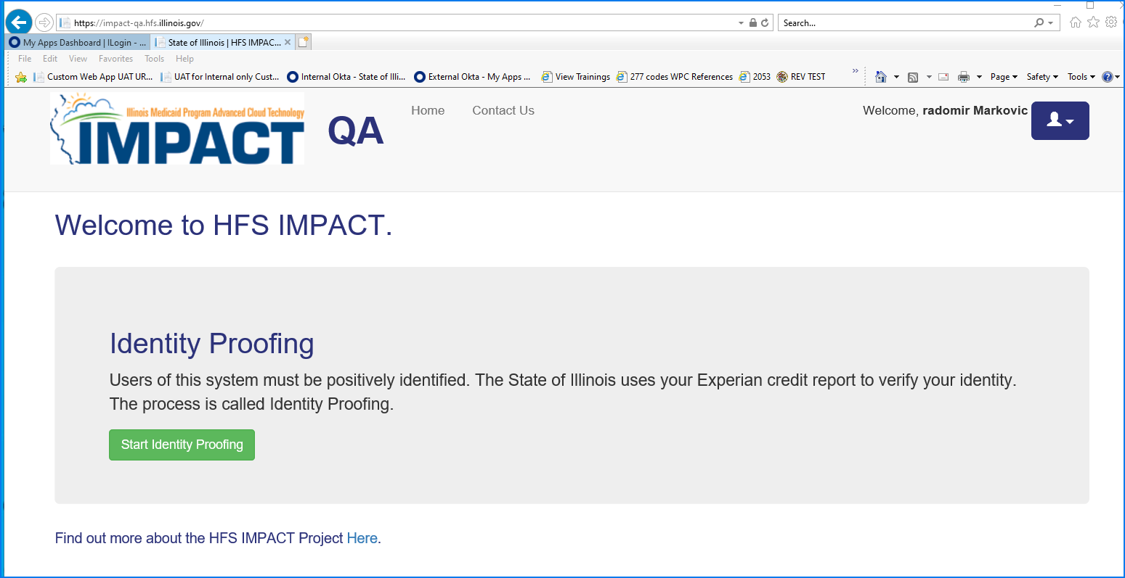
Step 4: IMPACT Identity Proofing
Click on “Start Identity Proofing” button.

Slide 22
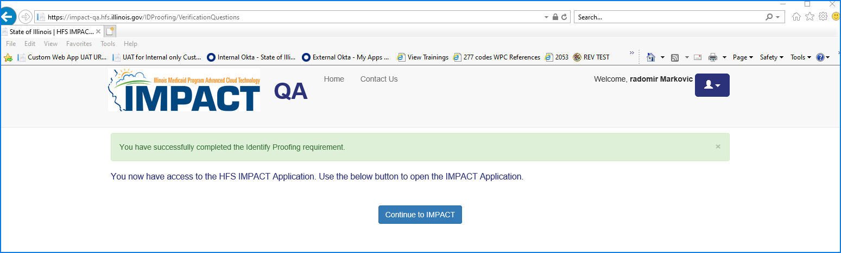
Step 4: IMPACT Identity Proofing
You have successfully completed the IMPACT Identity Proofing step. Click on the “Continue to IMPACT” button.

Slide 23
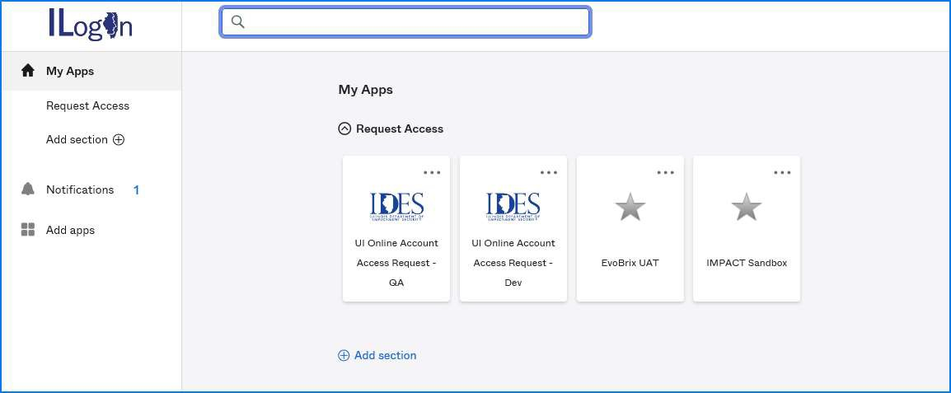

Step 5: Accessing IMPACT Application
Click on the IMPACT chiclet to launch application.

Slide 24
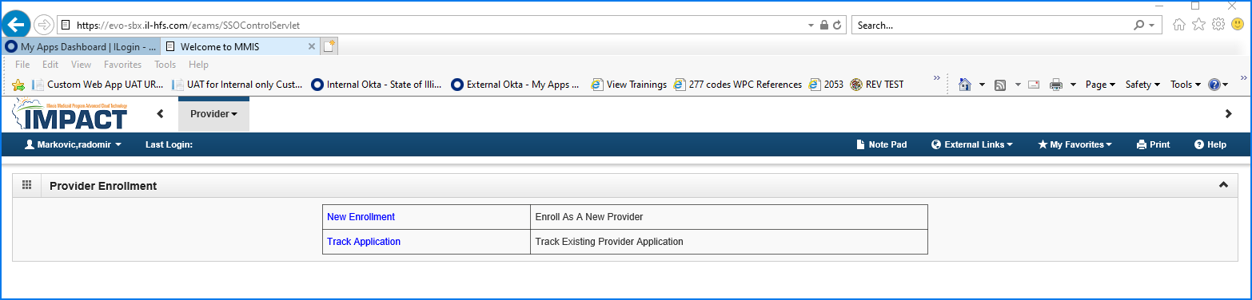
Step 6: Starting IMPACT Enrollment
As a new IMPACT user, you can click on New Enrollment to enroll as a new provider.

Slide 25
Contact Information
Contact Information
Issues with logging in (Locked account or other related issues)
IMPACT Login Helpdesk
1-888-618-8078
IMPACT.Login@Illinois.gov
Issues with ILogin User accounts
DoIT.Okta.Support@illinois.gov
Issues with IMPACT Provider Enrollment – Provider Enrollment Helpdesk
1-877-782-5565
IMPACT.Help@illinois.gov

Slide 26


Rendering / Servicing Provider

Slide 27

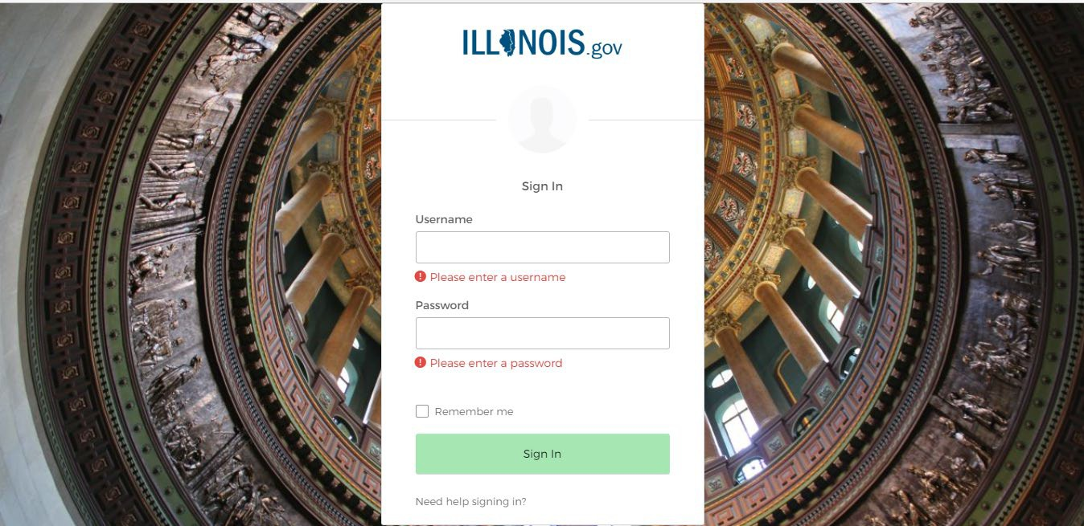

OKTA LOGIN
Input Username and Password created during the creation of the account.

Slide 28

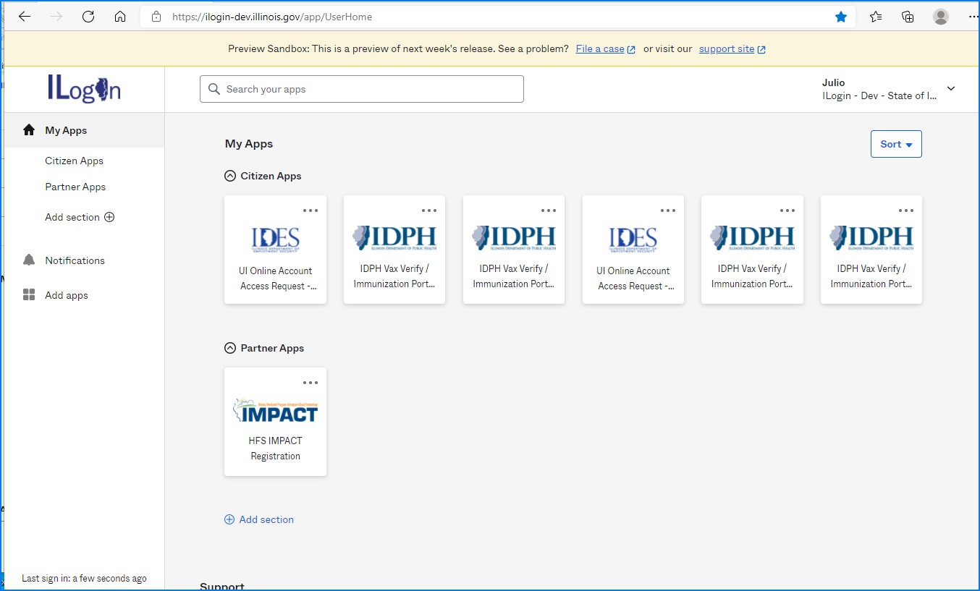

IMPACT CHICKLET
Click on the IMPACT PE Chicklet to access IMPACT

Slide 29

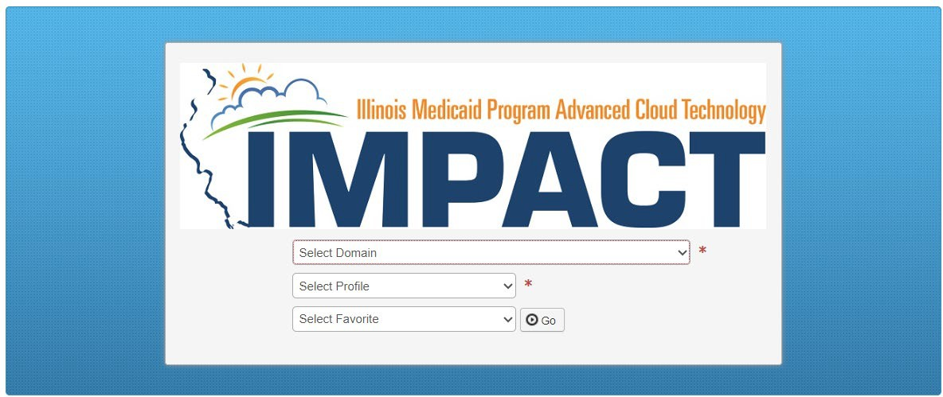
IMPACT DASHBOARD
Select the Domain and Profile from the drop-down menus.
Click on GO
12/19/2023
4

Slide 30
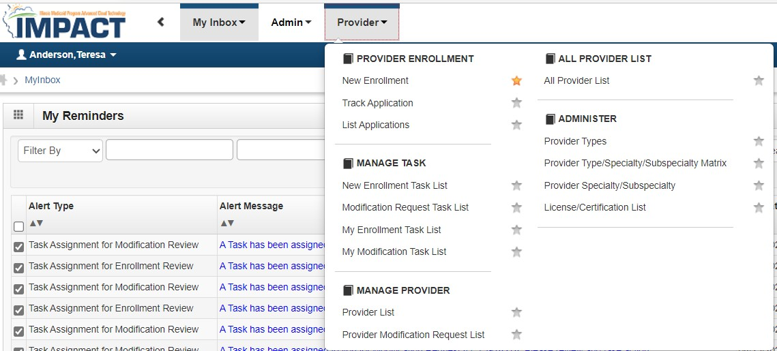
Application Process
Regarding completing an application, there are two options: New Enrollment or Resuming an application.
If starting a new application, go to slide 7 for step-by-step instructions.
If resuming an application previously started go to slide 6 for step-by-step instructions.

Slide 31
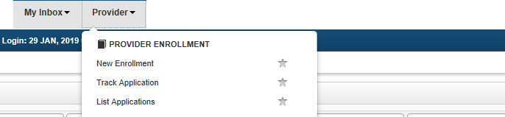
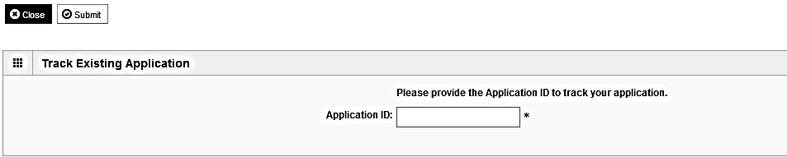
Resuming an Application
To resume an application, click on Track Application.
Enter the Application ID for the application you want to access.
After entering the ID number, click Submit.
This process will then go directly to the Business Process Wizard (BPW).

Slide 32
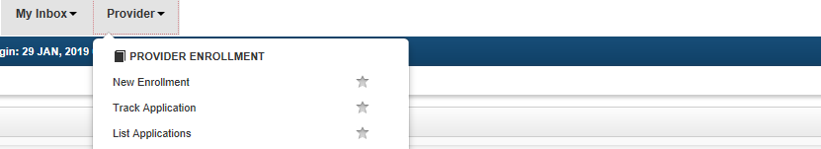
Starting a New Application
If completing a new application, click on New Enrollment.

Slide 33

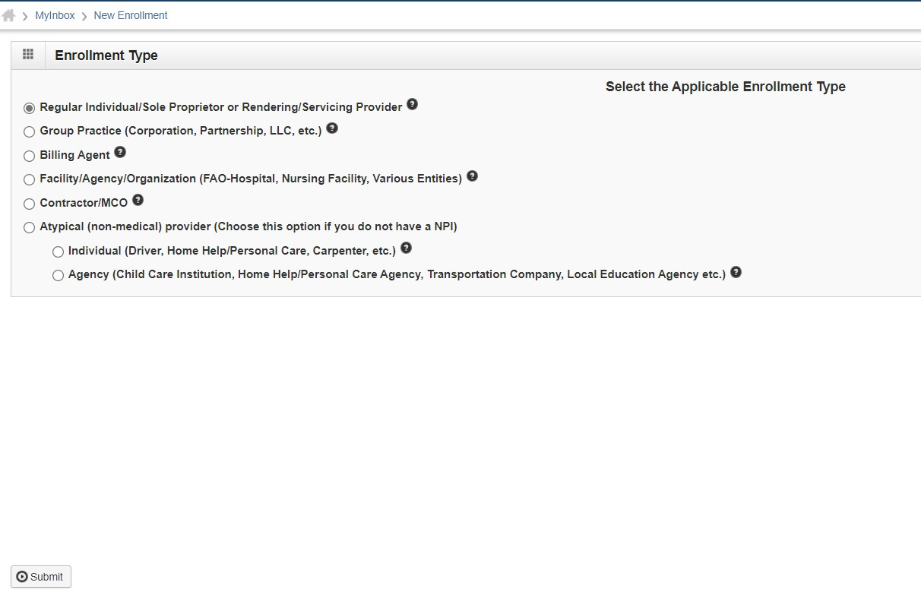
Starting a New Application
Use the radio buttons to select your enrollment type, then click on Submit in the lower left corner.

Slide 34
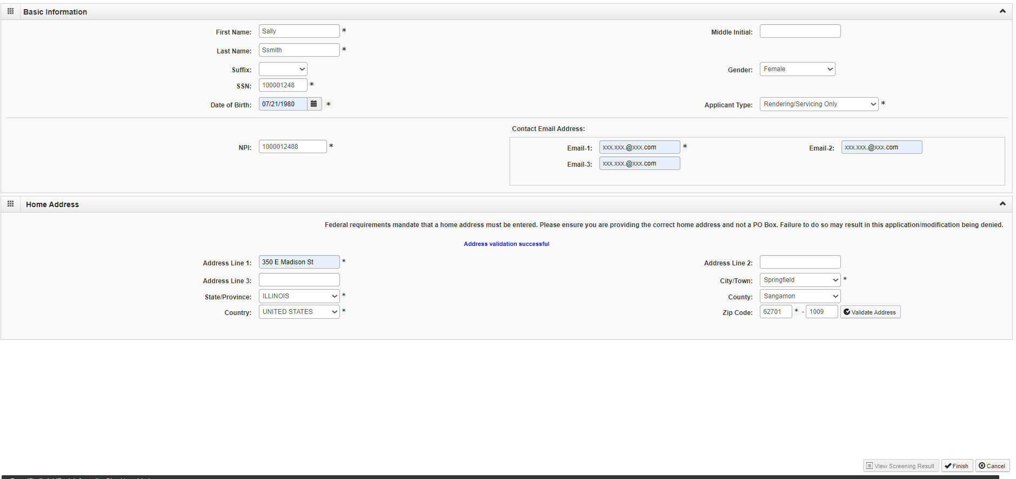
Starting a New Application
(Step 1: Basic Provider Information)
Please complete all fields. At a minimum, all fields with an * are required.
Click on Applicant Type and scroll down to Rendering Servicing Only.
Click Validate Address after street address and zip code have been entered.
After₁₂a/l₁l₉t/h₂₀e₂₃information has been entered click Finish.
9

Slide 35
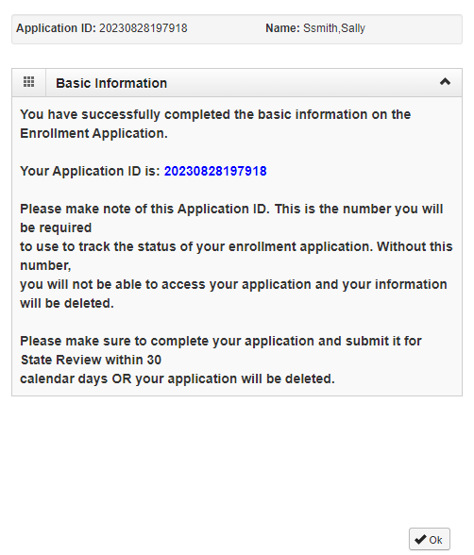
Starting a New Application
(Step 1: Basic Provider Information)
Application ID: systematically generated.
Name: should reflect name from Basic Information.
The system will generate an application ID after the successful completion of the Basic Information screen; the application number is a 14-digit number that has the following components:
  The system date in yyyymmdd format
  A 6-digit system generated random number
  Example: 2023082819718
Application IDs are valid for 30 calendar days; applications must be completed and submitted to the state for review during this 30-day period or the application will be DELETED.
The application ID will be used to access the application before submission to the state for review and will be used to track the status of your submitted application until it is mark approved.
After documenting the ID number click OK.

Slide 36
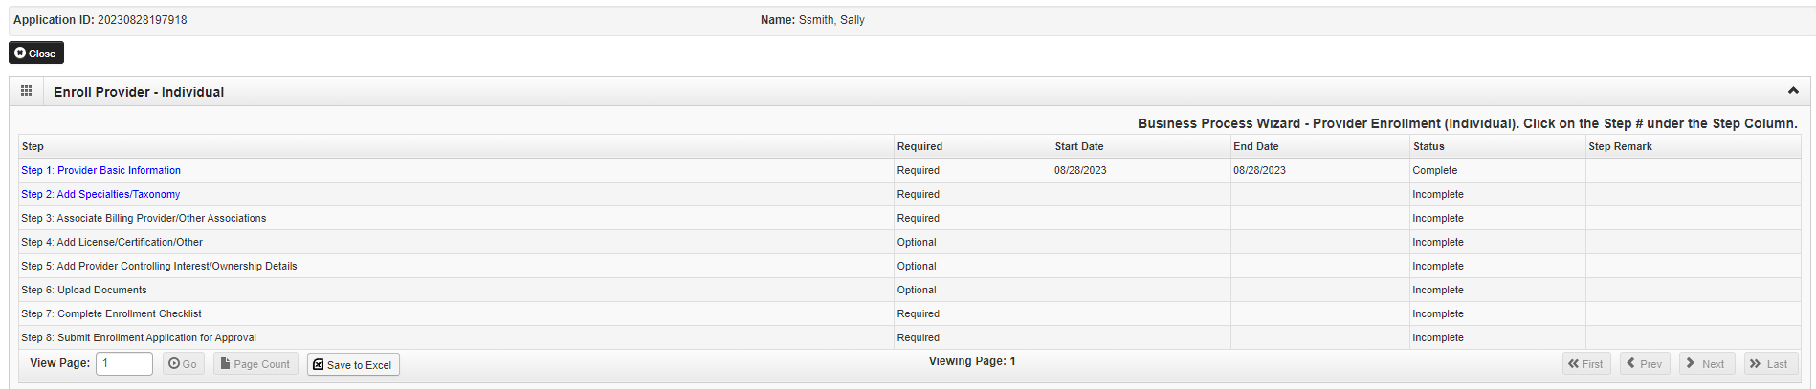
The Business Process Wizard (BPW)
The BPW serves as the “Control Center” of the application.
Required: Steps listed as Optional may change to Required based upon previous steps.
Dates: Entered by the system; Start Date is the date each step is opened; the End Date is the date each step is completed.
Status: When a step is completed the Status will be updated to Complete; answering some checklist questions may change a prior step’s status back to Incomplete.
Remarks: Remarks are systematically generated throughout the enrollment process.

Slide 37
Completing the Application Using BPW
Once you have documented your Application ID, you have completed Step 1: Provider Basic Information. The system will place the current date in the End Date field and will place Complete in the corresponding Status field.
Steps 1 and 2 must be completed before attempting any of the later steps.
Click on Step 2: Add Specialties to continue completing your application.
12

Slide 38
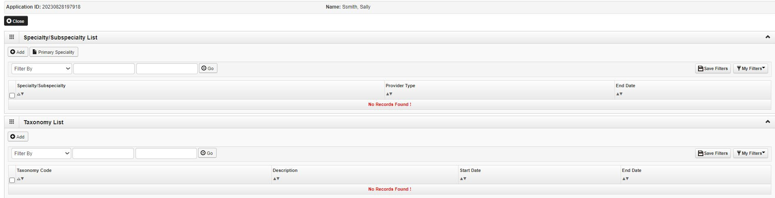
Step 2: Add Specialties/Taxonomy
Click the Add button in the upper left corner.
13

Slide 39

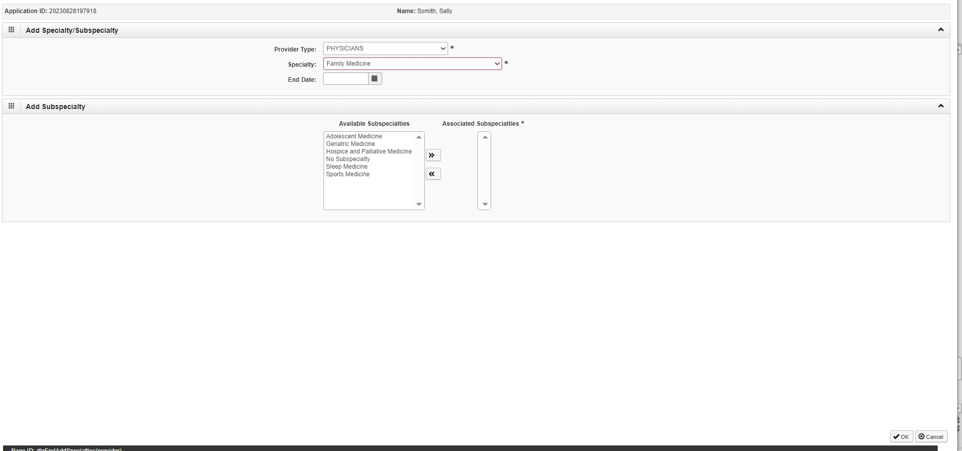
Step 2: Add Specialties/Taxonomy
Select your Provider Type from the drop down.
Select your Specialty from the drop down.
14

Slide 40
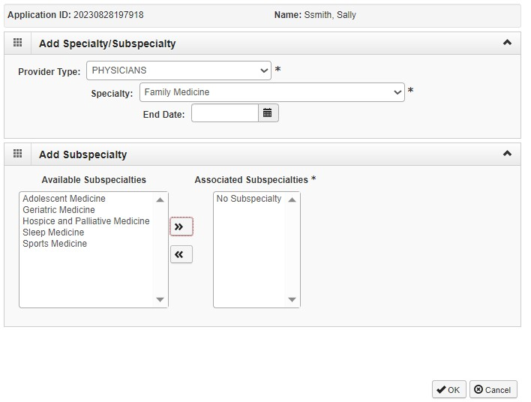
Step 2: Add Specialties/Taxonomy
Once the Provider Type and the Specialty are selected, the Subspecialties will populate at the bottom of the screen in the
Available Subspecialties box.
The Provider must choose at least one Available Subspecialty (or No Subspecialty) if multiple selections are available.
If only one choice is available, the system will preselect that selection.
Once all desired selections are moved to the Associated Subspecialties box, click OK in the bottom right corner
Click on the Subspecialties then click on the double arrows to move the Subspecialties over to the Associated Subspecialties box.

Slide 41
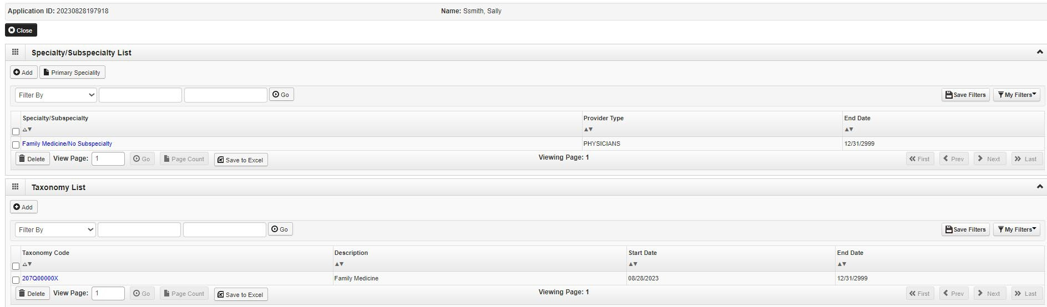
Step 2: Add Specialties/Taxonomy
If you have another Specialty/Subspecialty to enter, click the Add button in the top left corner and repeat the previous steps.
When all the specialties/subspecialties have been entered, click Primary Specialty to designate one of the listed Specialties as Primary.

Slide 42
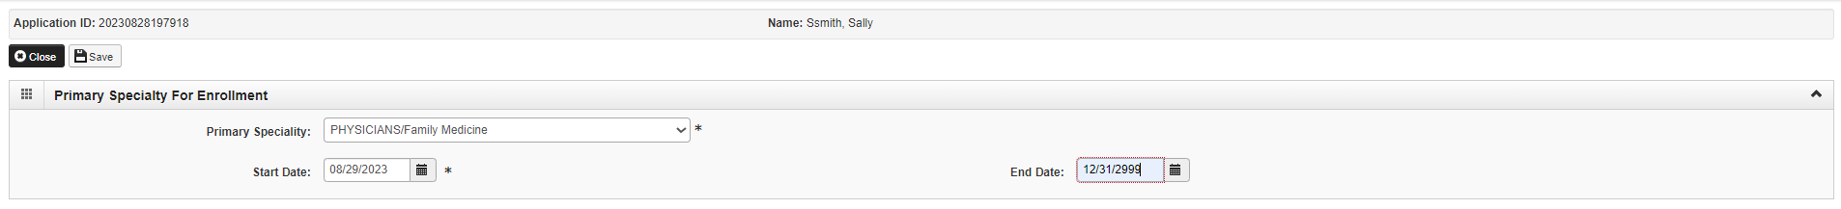
Step 2: Add Specialties/Taxonomy
Choose the Primary Specialty for this enrollment from the drop-down menu.
Complete the Start Date field. Leave End Date blank.
When all information has been entered, click on Save then Close.

Slide 43
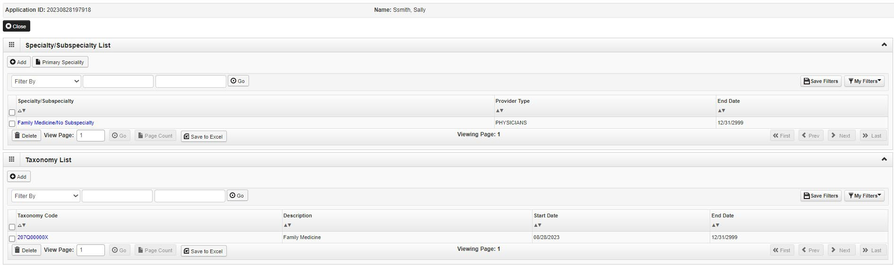
Step 2: Add Specialties/Taxonomy
The Taxonomy Code should automatically populate but if it does not click on the Add tab under Taxonomy List.
At least one of the Taxonomy Codes entered in IMPACT must be the Taxonomy Code registered with the National Plan and Provider Enumeration System (NPPES).
The correct taxonomy is 183500000X (the one associated with your pharmacist NPI).
If the Taxonomy code automatically populates proceed to slide 22.

Slide 44
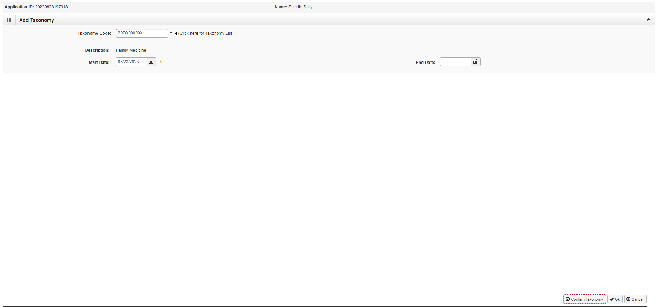
Step 2: Add Specialties/Taxonomy
Enter the Taxonomy Code and the Start Date.
Click on Confirm Taxonomy and verify Description is populated correctly.
Click on OK to finalize the submission.

Slide 45
Step 2: Add Specialties/Taxonomy
Repeat the steps by clicking on the Add button for any additional Taxonomy Codes that need to be entered.
Otherwise, click on the Close button in the upper left corner.

Slide 46
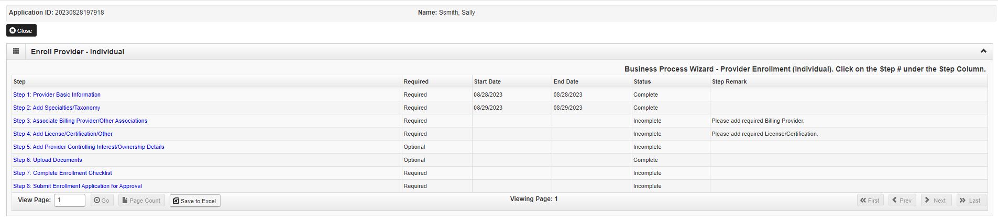
Business Process Wizard (BPW)
You have completed Step 2: Add Specialties/Taxonomy. The system will place the current date in the End Date field and will place Complete in the corresponding Status field.
Click on Step 3: Associate Billing Provider/Other Associations to continue your application.

Slide 47
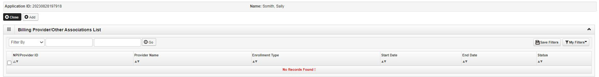
Step 3: Associate Billing Provider/Other Associations
Presenter Notes
2023-12-19 18:02:23
--------------------------------------------
Click Add to associate to a Billing Provider.

Slide 48
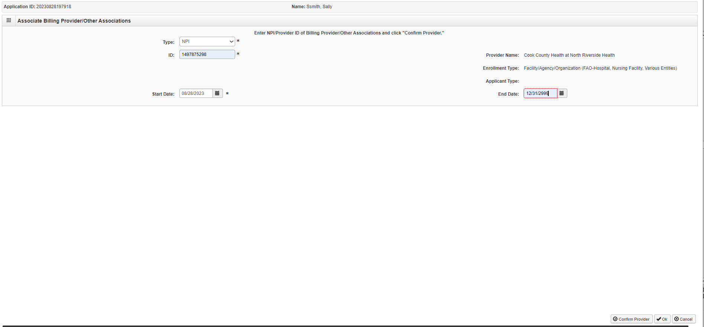
Step 3: Associate Billing Provider/Other Associations
Input the Employer’s NPI not Rendering/Servicing Provider’s NPI
Once all information has been entered, click on Confirm Provider and verify the correct Provider Name is displayed.
Leave the end date blank. The end date will be automatically populated.
Click OK when you are finished.

Slide 49
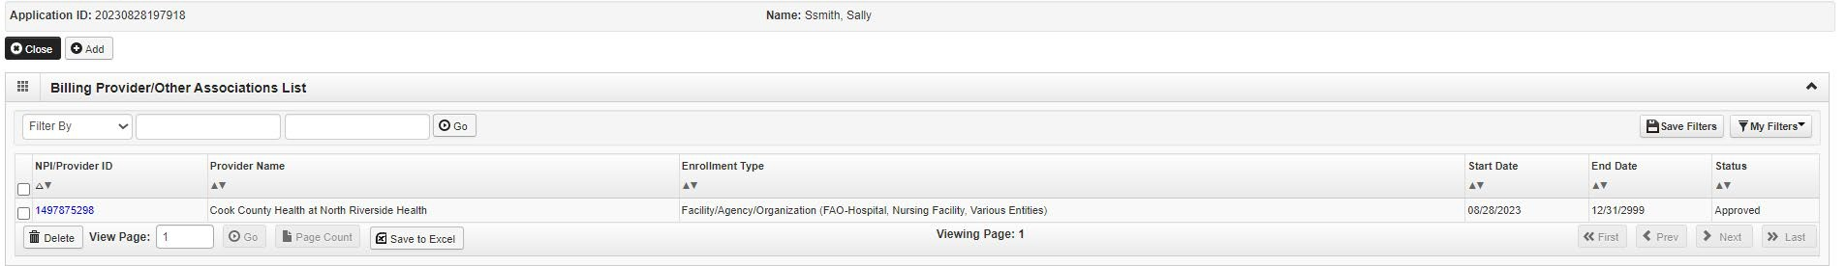
Step 3: Associate Billing Provider/Other Associations
Presenter Notes
2023-12-19 18:02:23
--------------------------------------------
Click Add and repeat the process, as necessary.
If there are no other Billing Providers to add, click on Close to return to the BPW.

Slide 50
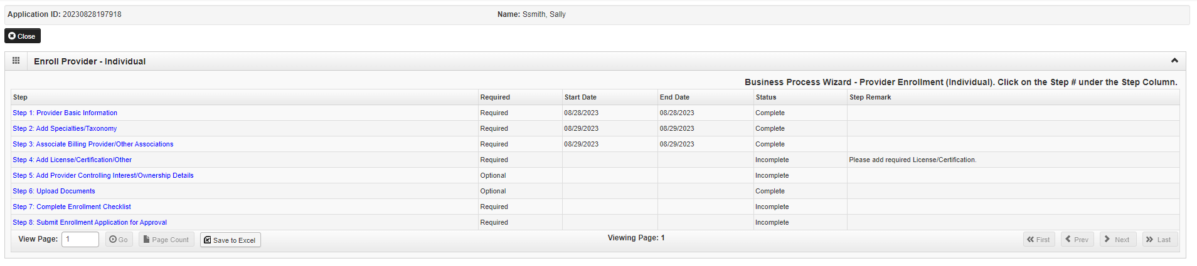
Business Process Wizard (BPW)
You have completed Step 3: Associate Billing Provider/Other Associations. The system will place the current date in the End Date field and will place Complete in the corresponding Status field.
Click on Step 4: Add Licenses and Certification/Other to continue your application.

Slide 51

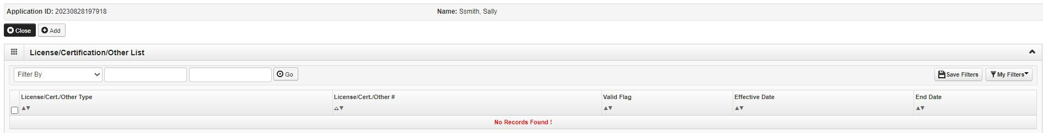
Step 4: Add License/Certification/Other
Click on the Add button to begin adding Licenses and Certifications.

Slide 52
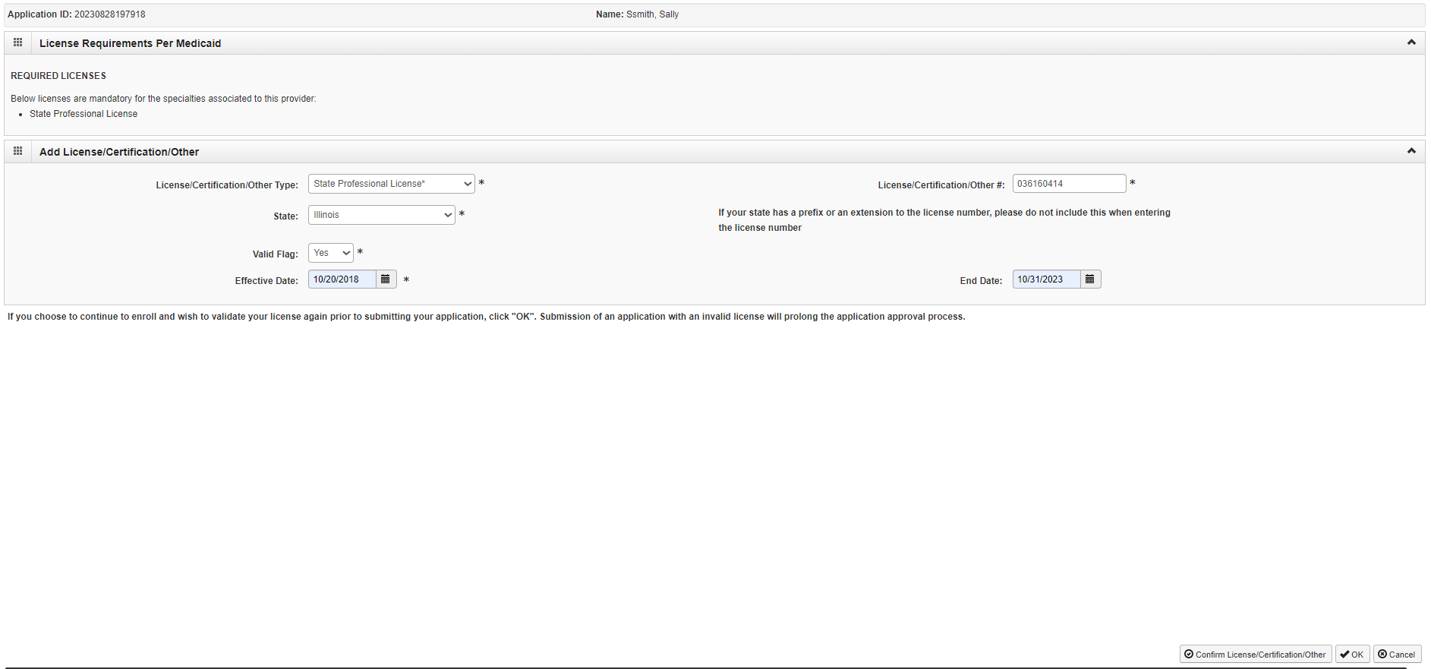
Step 4: Add License/Certification/Other
Click the drop-down menu next to License/Certification Type to select your License/Certification, then enter the
License/Certification Number and Effective Date in the appropriate fields. Leave the End Date field blank.
Click the drop-down menu next to State to select the State from which the license was obtained.
After all information is entered, click on Confirm License/Certification.
Clicking this button will result in the License/Certification being validated and update the Valid Flag to Yes if it is verified to be authentic.
Click Ok.

Slide 53
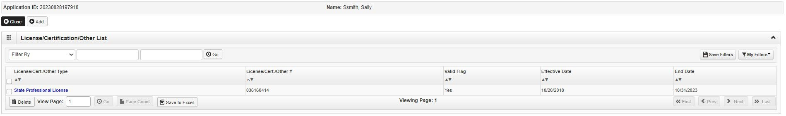
Step 4: Add License/Certification/Other
If any additional Licenses/Certifications, click on the Add button in the top left corner and repeat the steps.
Click Close once all Licenses/Certifications have been entered to return to the BPW.

Slide 54
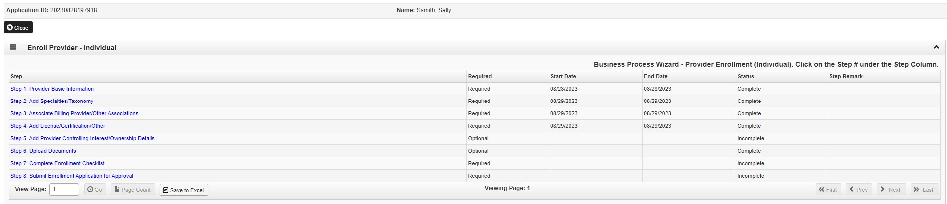
Business Process Wizard (BPW)
You have completed Step 4: Add Licenses and Certifications. The system will place the current date in the End Date field and will place Complete in the corresponding Status field.
Click on Step 5: Add Provider Controlling Interest/Ownership Details to continue your application.

Slide 55

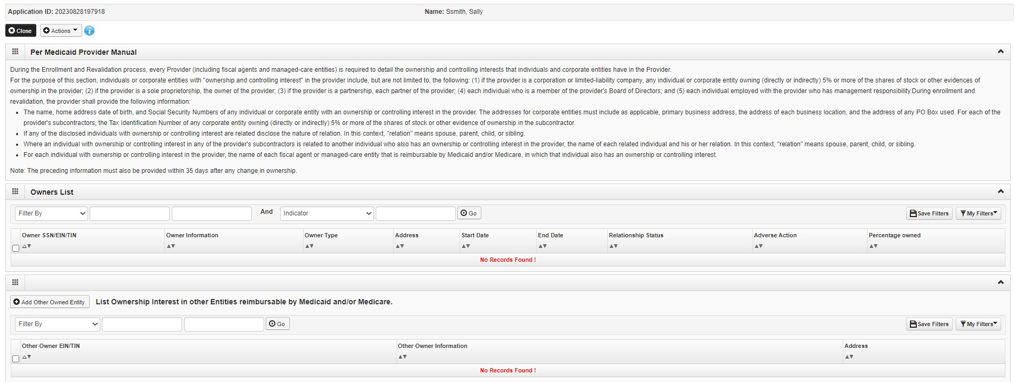
Step 5: Add Provider Controlling Interest/Ownership Details
Note: This Step in not applicable to Rendering Servicing Providers
This step is not applicable to Rendering Servicing provider.
Click Close to move to the next step.

Slide 56
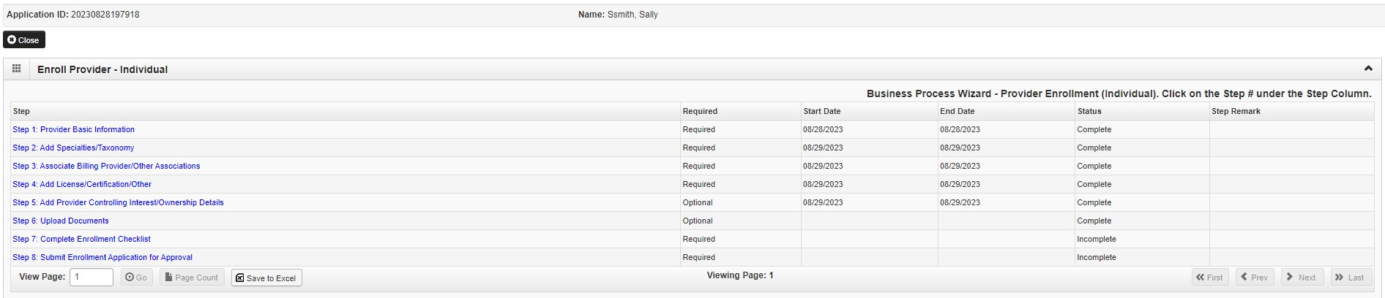
Business Process Wizard (BPW)
You have completed Step 5: Add Provider Controlling Interest/Ownership Details. The system will place the current date in the End Date field and will place Complete in the corresponding Status field.
Click on Step 6: Upload Documents to continue your application.
34

Slide 57
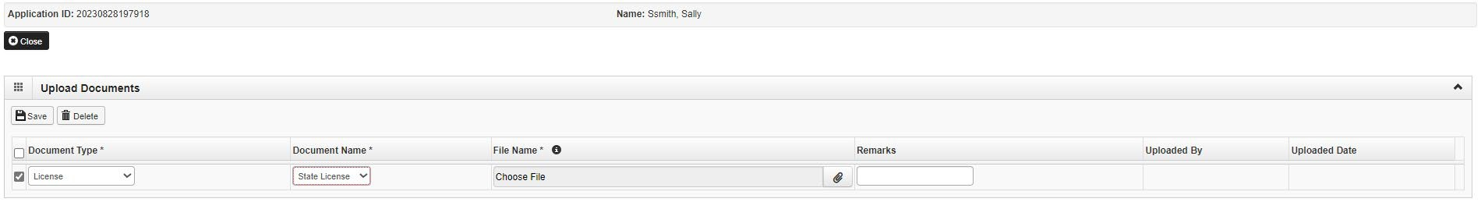
Step 6: Upload Documents
This step is optional except for Transportation, Home Health, and DME provides.
From dropdown box labeled Document Type select the document being uploaded.
From Document Name drop down box select the name of the document being uploaded.
Click on paperclip icon to search for document being uploaded.
Once document is found click Save .

Slide 58
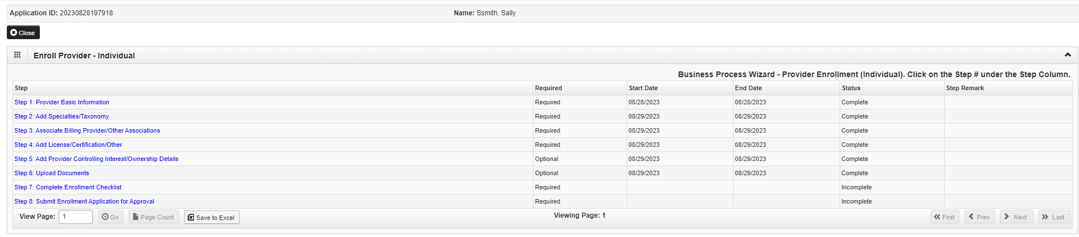
Business Process Wizard (BPW)
You have completed Step 6: Upload Documents. The system will place the current date in the End Date field and will place Complete in the corresponding Status field.
Click on Step 7: Complete Enrollment Checklist to continue your application.

Slide 59
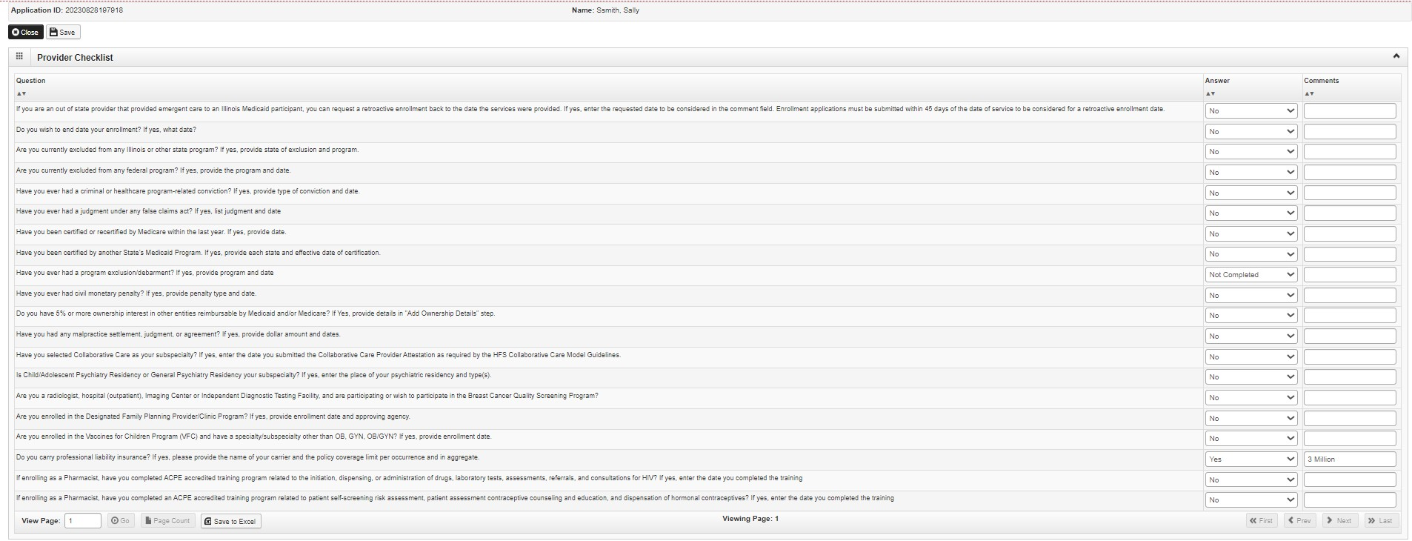
Step 7: Checklist
All questions must be answered either Yes or No and comments made if directed to do so.
If a Checklist item does not apply, select No as the answer.
After all the questions have been answered and Comments made, click on the Save button in the upper left corner followed by clicking on the Close button.

Slide 60

Business Process Wizard (BPW)
You have completed Step 7: Complete Enrollment Checklist. The system will place the current date in the End Date field and will place Complete in the corresponding Status field.
Click on Step 8: Submit Enrollment Application to continue your application.

Slide 61
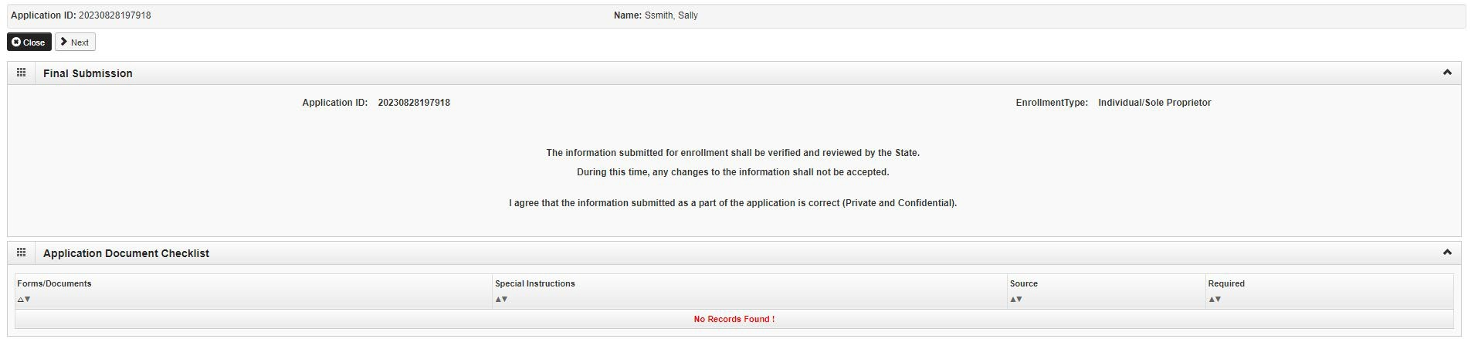
Step 9: Submit Enrollment Application for Approval
Click Next to confirm that all the information that you have submitted as a part of the application is accurate.

Slide 62
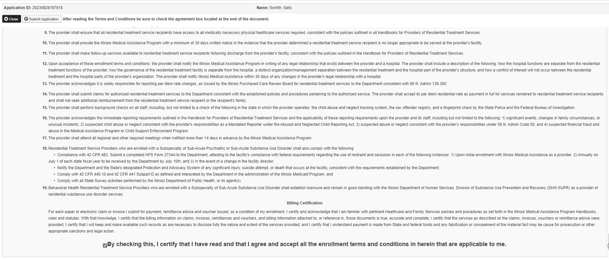
Step 8: Submit Enrollment for Application for Approval
Read through all the terms and conditions.
Check the box certifying that you agree to the Terms and Conditions.
Then select Submit Application.

Slide 63
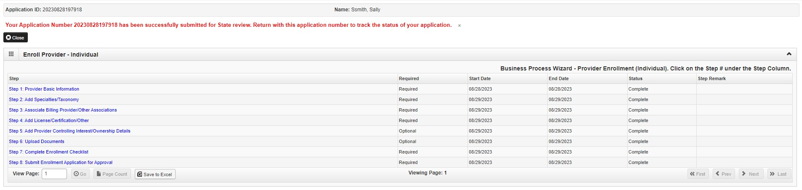
Business Process Wizard (BPW)
The below message will appear advising that the application has been submitted to the state for review. The application number can be used through the track application option after sign-on to check the status of the application.
Click Close to exit the enrollment.
You have completed Step 8: Submit Enrollment Application. The system will place the current date in the End Date field and will place Complete in the corresponding Status field.

Slide 64

Resources
For more information regarding IMPACT, please visit IMPACT Home | HFS (illinois.gov)
Check out the definitions of common terms at Glossary | HFS (illinois.gov)
FAQ’s can be found at Frequently Asked Questions (illinois.gov) to help resolve common questions and problems when submitting applications.
General questions regarding IMPACT can be addressed to:
  Email: IMPACT.Help@Illinois.gov

Slide 65
Completing the MCO Universal Roster

Slide 66

IMPACT vs the Universal Roster
IMPACT is the HFS on-line Medicaid credentialing system for providers. MCOs no longer credential providers for Medicaid.
Once an IMPACT application is approved by HFS, the provider is considered credentialed with the State and all MCOs to provide services (i.e., they have the requisite certifications, licenses, registrations, etc.).
Credentialing on its own does not mean a provider and a health plan will be doing business together. Provider and plans must still enter contractual relationships and satisfy all necessary operational requirements.
Currently, MCOs do not receive everything they need from the IMPACT provider file - hence the Universal Roster. HFS does NOT require submission of the Roster.
The Universal Roster is accepted by ALL HealthChoice MCOs.
The Universal Roster collects three categories of information required for contracting and provider directories:
Information that is required
Information that is required only if applicable to your organization
Information that is preferred, but not required

Slide 67
Basic Do’s and Don’ts
Submit your full Universal Roster to the MCO at the SAME TIME you complete your IMPACT registration to avoid unnecessary delays in your ability to bill. Per statute, MCOs’ liability for claims payment is the later of:
  The execution date of a network participation contract agreement.
  The date the provider submits to the MCO the complete and accurate Universal Roster.
  The provider effective date contained within the Department’s IMPACT system.
After initial submission, Universal Rosters should be submitted according to each plan’s requested cadence
  Please check if plans can accept change files only or need full rosters monthly
  Providers listed/changed on the roster will be loaded by the MCO within 30 days
Universal Roster format
    Providers are asked to use the most updated roster format (found at http://www.iamhp.org/providers)
    Do not delete columns or headers
    Fields that are not applicable should be left blank (i.e., do not state N/A)
    Additional lines can be added to reflect additional locations for the provider.
  Incomplete rosters
    Providers without complete information on the Universal Roster will not be loaded by the MCO.
Notes:
Same time = expedites the process

Slide 68
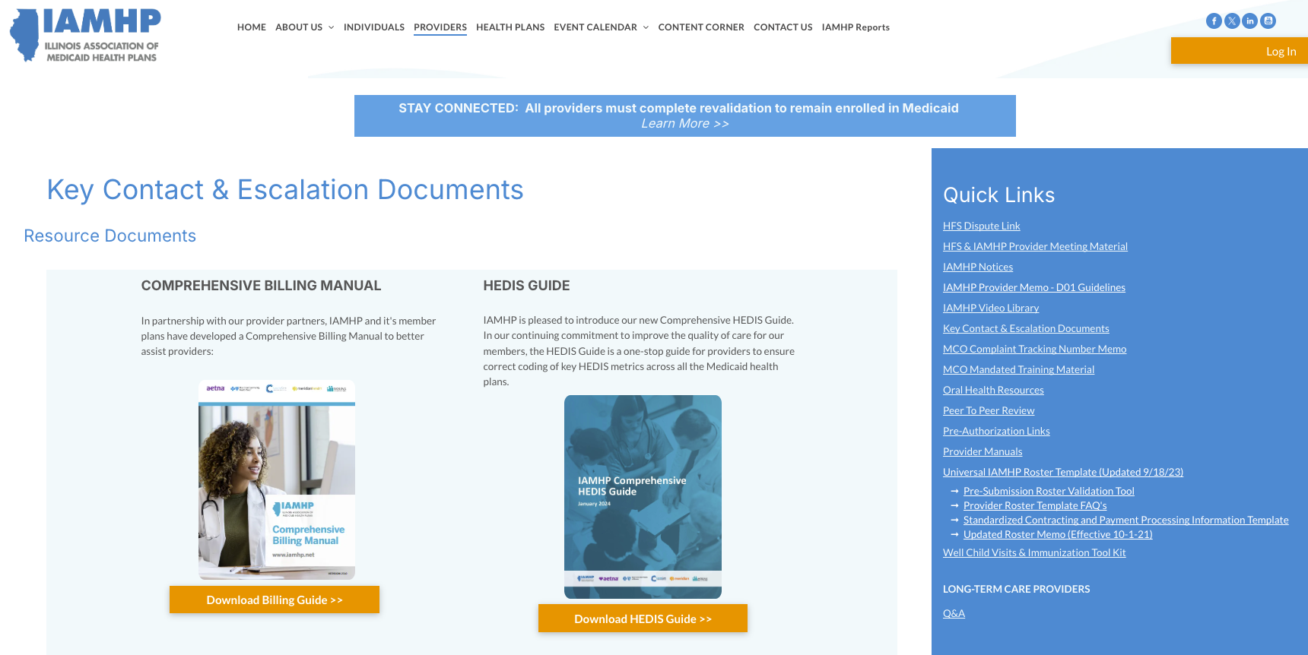

Slide 69
Filling out the Universal Roster
The Universal Roster is a multi-tabbed Excel workbook:
  The First Tab – INSTRUCTIONS – provides definitions and basic outline of how to complete the workbook.
  There are three different sections (tabbed in green): Practitioners, Groups/Locations, and Facilities. You will complete the Group and the Practitioner tabs only.
  Before each green tab, there is a corresponding tab with more detailed instructions on how to complete each field.
  Each sheet has certain fields that are drop-downs (Status, State, Y/N, M/F, etc.) Not all fields contain a drop down, and these are free text. Please utilize the drop down when appropriate and follow the format outlined in the Instructions tab for free text fields (i.e. phone numbers should be in xxx-xxx-xxxx format).

Slide 70
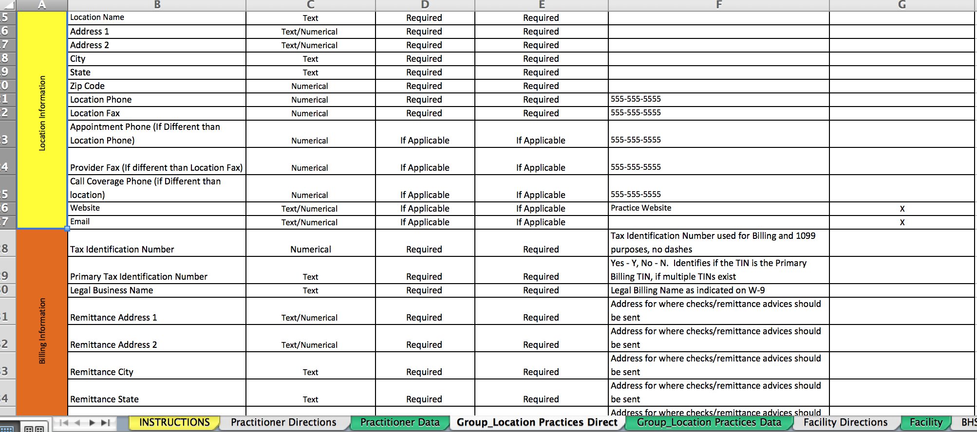
Group/Location Tab Directions: For Pharmacy

Slide 71
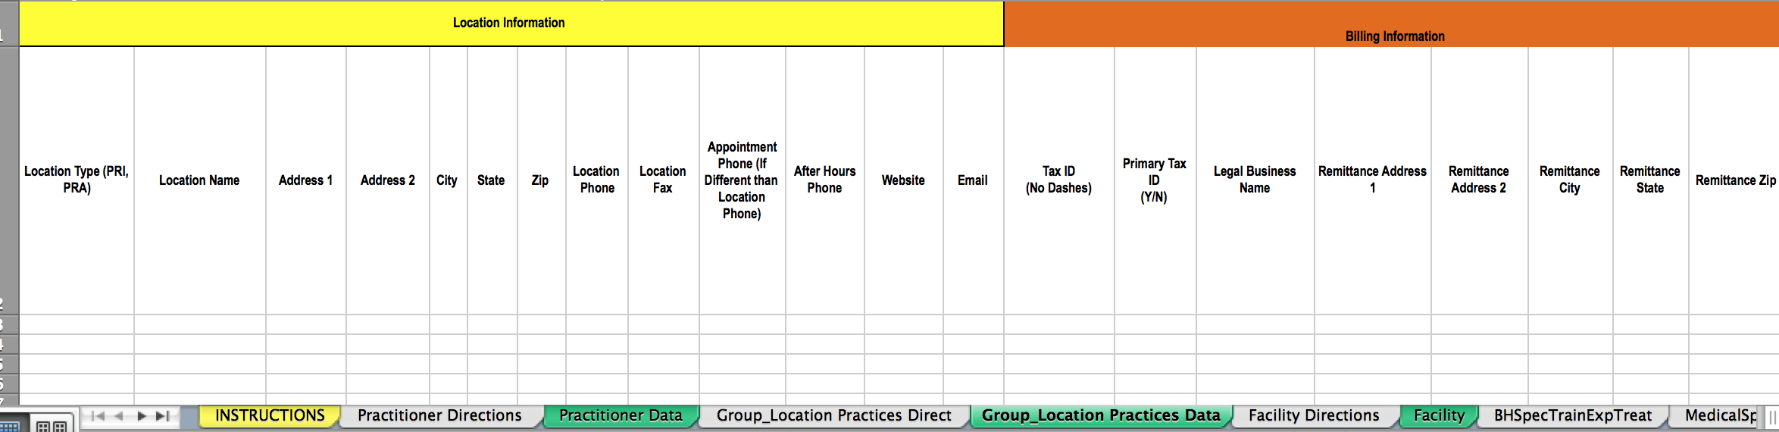
Group/Location Data Input: For Pharmacy

Slide 72
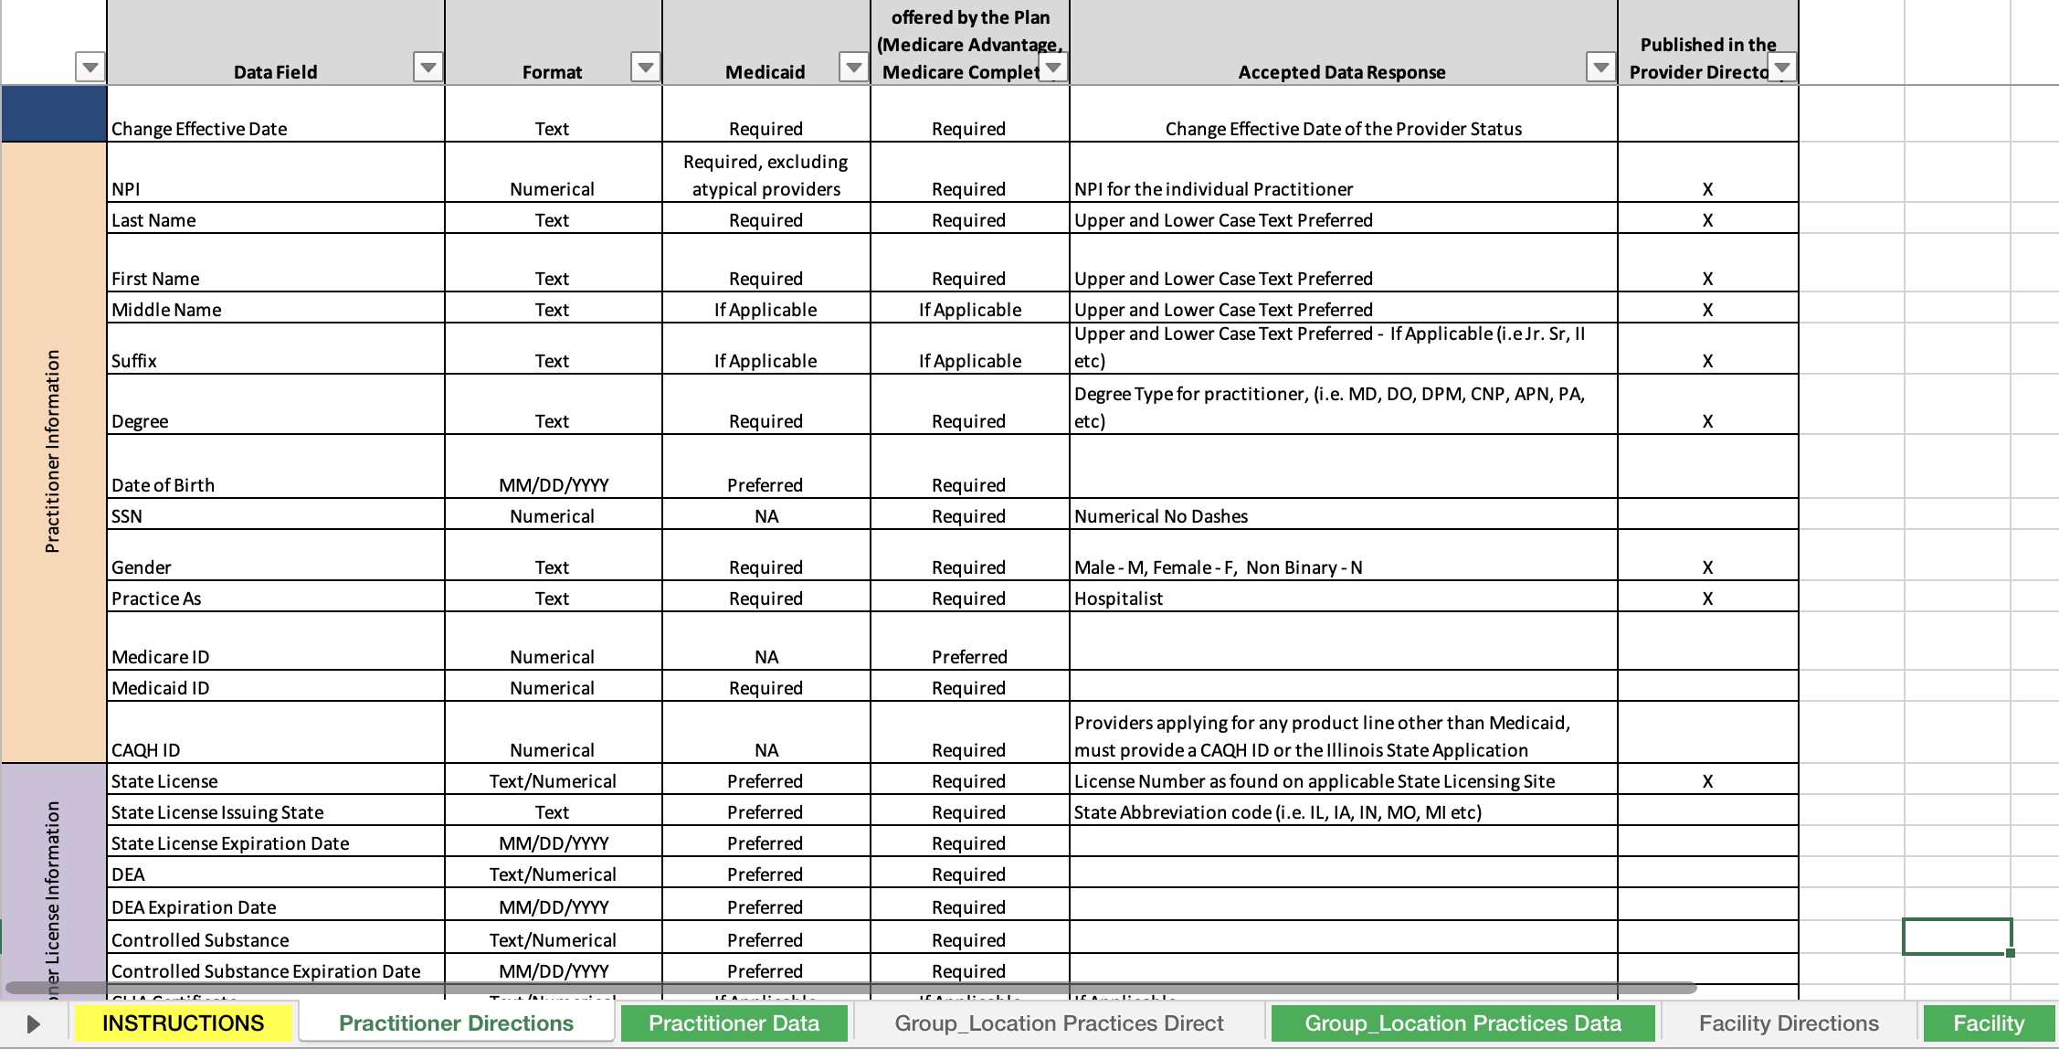
Individual Practitioner Directions: For Pharmacist

Slide 73

Individual Practitioner Data Input: For Pharmacist

Slide 74
MCO Contracting

Slide 75
MCO Contracting
Once a pharmacist has completed training and enrolled in IMPACT, they will show up on the HFS IMPACT provider file that is sent to the MCOs. This tells the MCO that you are credentialled to provide services to Medicaid members.
It is important to remember that HIV/Contraceptive services may not be covered under a pharmacy’s current contract as these new services are medical services that are billed directly to the MCO, not the PBM. You will need a new contract with the MCO directly (i.e., not the PBM).
The following MCO contacts have been specifically assigned to the new HIV/Contraceptive services contracting process:
HEALTH PLAN | CONTACT | EMAIL
Aetna Better Health of Illinois | Janell Closson Miakaye Anderson | Clossonj@aetna.com (contracting) Andersonm1c6b52@aetna.com (billing)
Blue Cross Community Health Plan |  | BCBSIL Join our Network
CountyCare |  | CountyCareContracting@cookcountyhhs.org
Humana (MMAI only)
Meridian and YouthCare | Tanisha White | Tanisha.L.White@mhplan.com
Molina | Tom Rodakowski | Tom.Rodakowski@molinahealthcare.com

Slide 76
Claim Submission

Slide 77


PBM vs MCO claims
PBM CLAIMS
  Services are covered under the Medicaid pharmacy benefit.
  Claims are submitted using an NDCDP claim format to the MCO’s PBM.
  Only the pharmacy needs to be credentialled in IMPACT.
  Claims do not require a Rendering Provider to be listed, as the pharmacy is both the Billing and the Rendering Provider (i.e., no individual pharmacist is on the claim).
HIV/CONTRACEPTIVE SERVICES CLAIMS
  Services are covered under the Medicaid medical benefit.
  Claims are submitted using the CMS1500 or 837P claim format and are submitted directly to the MCO.
  The pharmacy AND the individual pharmacist must be credentialed in IMPACT.
  The claim will require both a Billing Provider (the pharmacy) and a Rendering Provider (the individual pharmacist).

Slide 78
Claim Submission: All Claims Must…
Use the CMS1500 or 837P claim format and be submitted directly to the MCO
Identify the name and TIN number of the pharmacy (Billing Provider), with matching NPI number and taxonomy code based on the IMPACT provider type.
Identify the name and NPI of the pharmacist as the Rendering Provider.
Identify the patient (RIN and/or MCO-specific Plan ID, address and date of birth). Always check the HFS MEDI system to verify patient Medicaid eligibility and assigned MCO before rendering service.
List the date (mm/dd/yyyy) and place of service.
Have valid ICD-10 Diagnosis Code, Procedure, Modifier, and Place of Service Codes
Ensure all other insurance resources have been exhausted before submission. Medicaid is always the payer of last resort.
Be submitted according to timely filing requirements (180 days from date of service).
NOTE: Claims cannot be submitted until the pharmacist receives an updated IMPACT Provider Information Sheet noting the addition of COS 132 (HIV) and/or COS 103 (Contraception).

Slide 79
HFS Fee-for-Service Claims
Claims may be submitted to the Department upon completion of enrollment in IMPACT as instructed in the provider Notices dated August 9, 2023 with the addition of the Category of Service (COS) code 132 for HIV assessment and consultation and/or COS 103 for contraceptive assessment and consultation.
Pharmacies billing on behalf of pharmacists will submit claims in the 837P electronic format.
One of the following Evaluation and Management procedure codes may be billed for the assessment component of the service. Modifier FP must be used for contraceptive assessment, while no modifier should be reported for HIV assessment:
  99202 Office or other outpatient visit for the evaluation and management of a new patient; 15-29 minutes
  99203 ;30-44 minutes
  99211 Office or other outpatient visit for the evaluation and management of an established patient; less than 10 minutes
  99212 ;10-19 minutes
CPT 99401 may be billed for the counseling component of the service. Again, CPT 99401 must be billed with the FP modifier for contraceptive counseling, while no modifier should be reported for HIV counseling.
The pharmacist must have a standing order from an IMPACT-enrolled physician and the physician must be identified as the ordering/prescribing provider.
The pharmacist’s National Provider Identifier (NPI) must be identified as the rendering/servicing provider.
The pharmacy’s NPI must be identified as the billing provider.
The Place of Service code must be “01”.
Drugs and dispensing fees will continue to be billed through the pharmacy billing system.
Pharmacist rates for the above CPT procedure codes are identified in a separate Pharmacist Fee Schedule on the Department’s website.

Slide 80
MCO Claim Submission
How Do I File a Claim?
3 Options:
Paper (CMS-1500)
Electronic Submission through a clearinghouse (837P format)
Submission through MCO Portal (functionality and process will vary by MCO)
Decision on which method to use will vary by organization:
Volume of claims
Revenue cycle systems capabilities
Contract language
Other payor relationships

Slide 81

IAMHP’s Comprehensive Billing Guide
General billing guides for:
General claim submission information
Claim disposition
Hospital Outpatient / Inpatient
Supportive living facility (SLF)
Long-term care/skilled nursing
Find online at iamhp.org/providers
CMHC and SUPR
FQHC/ERCs and Pediatrics
HCBS Waivers
And Many MORE!
Dental
Pharmacy
Transportation

Slide 82
HIV and/or Contraceptive Services Claim Elements
Claim Element |  | CMS1500 Field | 837P Loop
Billing Provider | Pharmacy Name/Address and NPI | 33 and 33a | 2010AA
Rendering Provider | Pharmacist Name and NPI | 24J | 2420A
Referring Provider | Name/NPI of Physician providing Standing Order | 17 and 17b | 2310A
Place of Service | POS 01 | 24B | 2400
Procedure Code* * When providing these codes for contraceptive services, use the modifier FP with each code | 99401 – Preventive Medicine counselling/risk factor reduction (15 mins) | 24D | 2400
 | 99202 – Office/OP visit, E&M of new patient (15 – 29 mins)
 | 99203 - Office/OP visit, E&M of new patient (30-44 mins)
 | 99211 - Office/OP visit, E&M of established patient (15 – 29 mins)
 | 99212- Office/OP visit, E&M of established patient (30-44) mins
NOTE: Any drugs dispensed continue to be billed through the Pharmacy Billing System

Slide 83
Wrap-up and Q&A

Slide 84
End-to-End Process Summary
Pre-Service/Billing Checklist
Start Here
Complete HFS IMPACT Registration
Check MEDI for patient Medicaid eligibility and MCO assignment
Provide assessment service(s) and submit medical claim to MCO (CMS1500 or 837P claim)
Prescribe medication(s) and bill to PBM (NDCDP claim)
Complete required training
(HIV and/or Contraceptive Services)
IMPACT registration complete and Provider Information Sheet received
Signed MCO contract(s)
Roster loaded with MCO(s)
Determine and set up method of claim submission
Initiate MCO contracting process
Complete/submit IAMHP Universal Roster to MCO(s)
(Complete both Group and Practitioner tabs)
Work these in parallel
Deliver Services

Slide 85
Resources

Slide 86






Help!
For enrollment questions please call 877-782-5565 to speak to an IMPACT enrollment specialist.
Pharmacies will be assigned a Provider Representative at each of the MCOs to help with questions related to contracting and/or claims.
For billing and claims inquires, call 877-782-5565 and follow the prompts to reach a physician billing consultant
For more general questions about policy, procedures, or processes, please reach out support@iamhp.org.
Sign up to receive HFS Provider notices and program updates here

Slide 87



Tools for person-centered contraceptive counseling
www.ican4all.org
Strategy 1: Develop a TRUER Care Workforce
Available in 7 languages
Notes:
https://ican4all.org/start-quiz-2/
Created with input from community advisory board and providers who regularly care for patients with low resources.
How does birth control work? Not meant to be a trick question

Slide 88


Simple way to connect your clients to community health centers
Your client will receive text and email reminders on how to schedule their appointment.
All providers offer free or low cost sexual and reproductive health care in the primary are setting.
Many providers offer immediate enrollment support to help with getting coverage.
Clients are invited to share feedback on their experience to improve the quality of care for others (could consider adding pharmacy partners down the road too).

