Slide 1




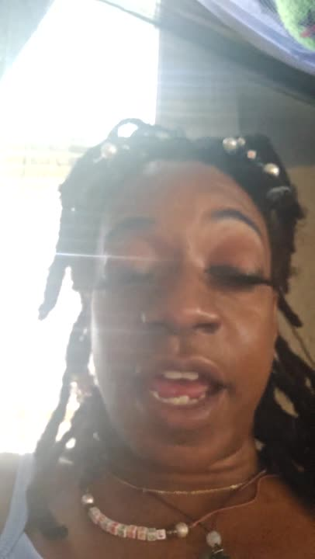
WHAT IS YOUR SHADOW
???
@GODDESSGALLERYLLC

Slide 2


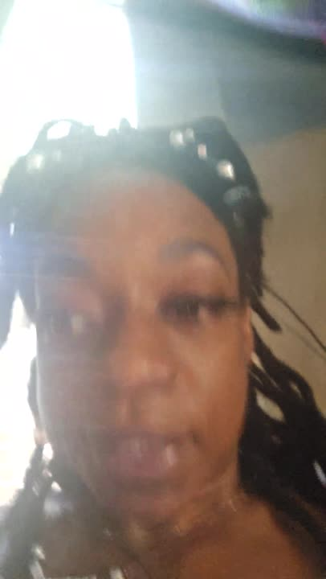
OUTLINE
The Healing Begins
06
What's the Shadow Self
Ways to Journal
01
07
Ego vs Self
Be creative & Make it Fun!
02
08
What is Shadow Work
03
Trauma Types
04
Starting Shadow Work
05

Slide 3

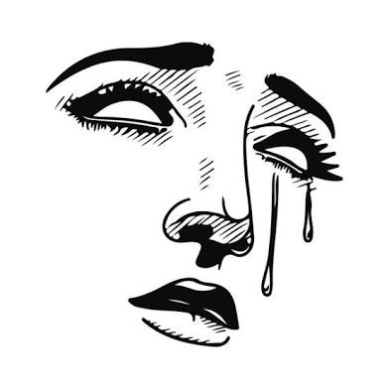
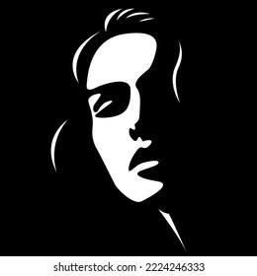
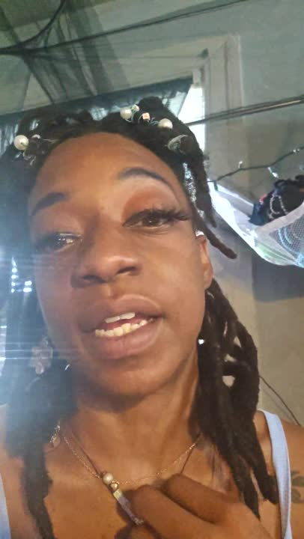
The shadow represents the darker aspect
of a person's psyche.
•Inner Conflicts
•Repressed ideas, desires, weaknesses, and shortcomings
•Doesn't meet society norms
•Envy, greed, hate or aggression
WHAT IS YOUR SHADOW SELF?

Slide 4

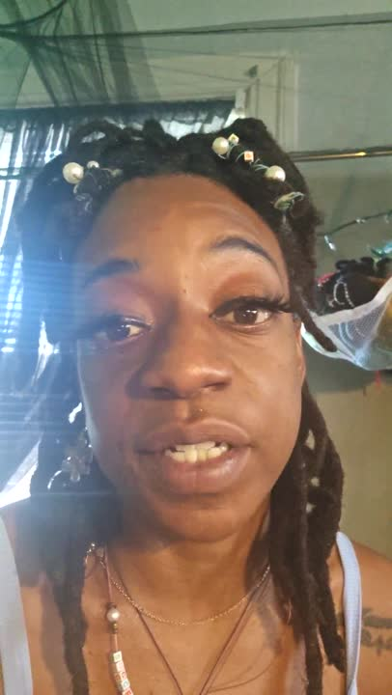
Ego is the parts of ourselves we have conditioned into acting a certain way due to trauma, society or life in general
Self is the parts of us that doesn't have to hide how we feel or mask for the sake of others
EGO VS. SELF

Slide 5
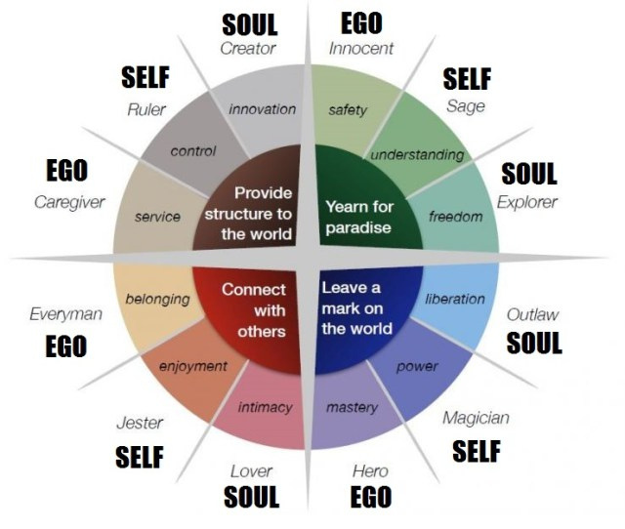
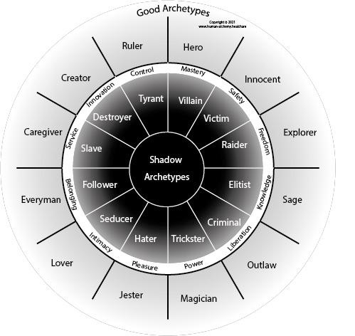
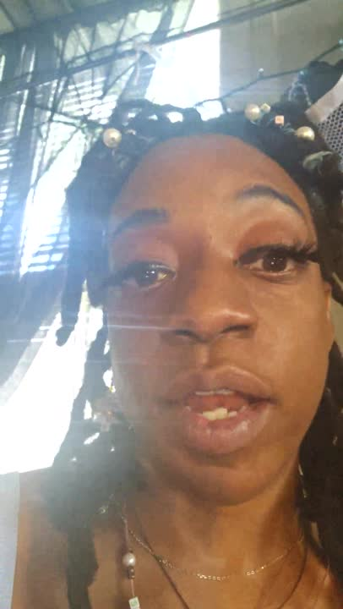

Slide 6

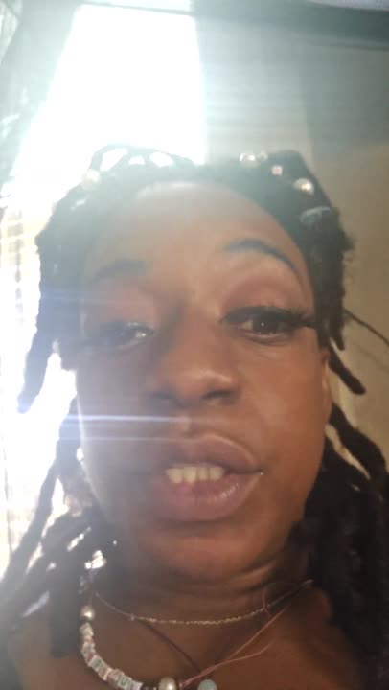
Trauma Types
AD
Adulthood
ADOLESCENT
CHILDHOOD
TRAUMATIC SITUATIONS
SOCIETY
RELATIONSHIPS

Slide 7

NOW LET'S GET SERIOUS
START SMALL....
Let it all out!!!!!
...NOW THE HEALING BEGINS
•character
•decision making
•Processing emotions
•procrastination
30 DAY JOURNAL PROMPTS
STARTING SHADOW WORK

Slide 8

SOCIAL MEDIA
•Blogs, vlogs, streaming,
•ART, POETRY & MUSIC
CRAFTS
•MENTORING OTHERS
WAYS TO JOURNAL
DON'T HOLD ANYTHING BACK!!!

Slide 9
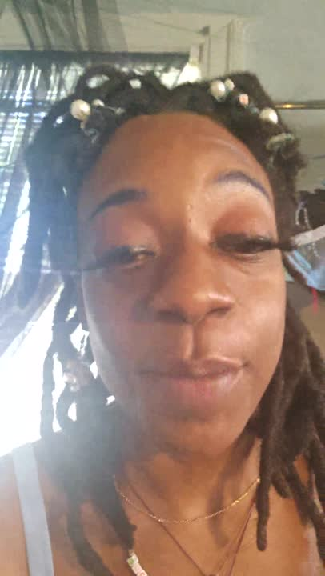




thank you for joining!!!
www.mygoddessgallery.com

