Slide 1
Decentralized Identity/Verifiable Credentials and Implementation Scenarios
Vikas Malhotra, Drummond Reed, Purva Rajkotia, Monica Tsang, Richard Esplin
Sep 1-3 ,2026
Global Digital Collaboration Conference, Geneva

Slide 2
Agenda
What is Decentralized Identity?
  DID – Decentralized Identifiers
  VC – Verifiable Credentials
Scenarios
  Retail
  Telecom
  Check / Credit Card fraud

Slide 3
Decentralized Identity

Slide 4
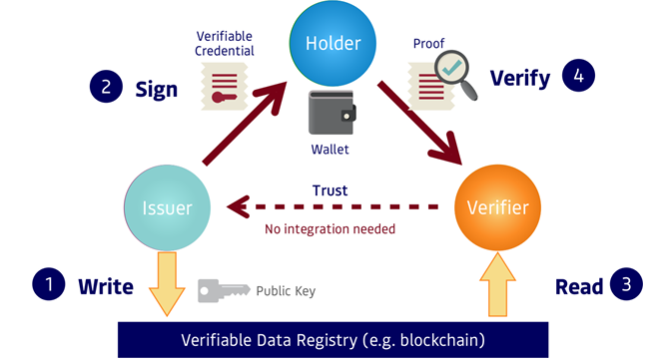
The Verifiable Credential Trust Triangle – shifts locus of control to the holder
The issuer writes a decentralized identifier (DID) together with its public key (and any other cryptographic material needed to verify the issuer’s credentials) to some type of verifiable data registry (for example, a blockchain, a distributed database, or any other sufficiently trusted public utility accessible to verifiers).
The issuer uses its private key to digitally sign a verifiable credential and issues it to a qualified holder to store in his/her/its digital wallet.
A verifier requests a proof of a verifiable credential from a holder, and the holder consents to provide a proof produced by the holder's digital wallet.
The verifier uses the issuer’s public key to verify that the proofs are valid and that the digital credential has not been tampered with.
Data sovereignty
Selective information and context proof [ZKP]
Terms at the point of interaction. [IEEE 7102-2025 / MyTerms]
Verifiable authentic no tampering
Reference: Introduction-to-ToIP-V2.0-2021-11-17.pdf
W3C - Verifiable Credentials Data Model v2.0
W3C - Decentralized Identifiers (DIDs) v1.0

Slide 5
Decentralization and digital trust – LOCUS of CONTROL
Decentralized model
Self-sovereign model
Centralized / federated model
Locus of Control
Locus of Control
Issuer
Prove
Verifier
Issuer
Prove
Entity (A person)
Prove
Verifier
Prove
Entity (A person)
Registry
Power Relationship

Slide 6
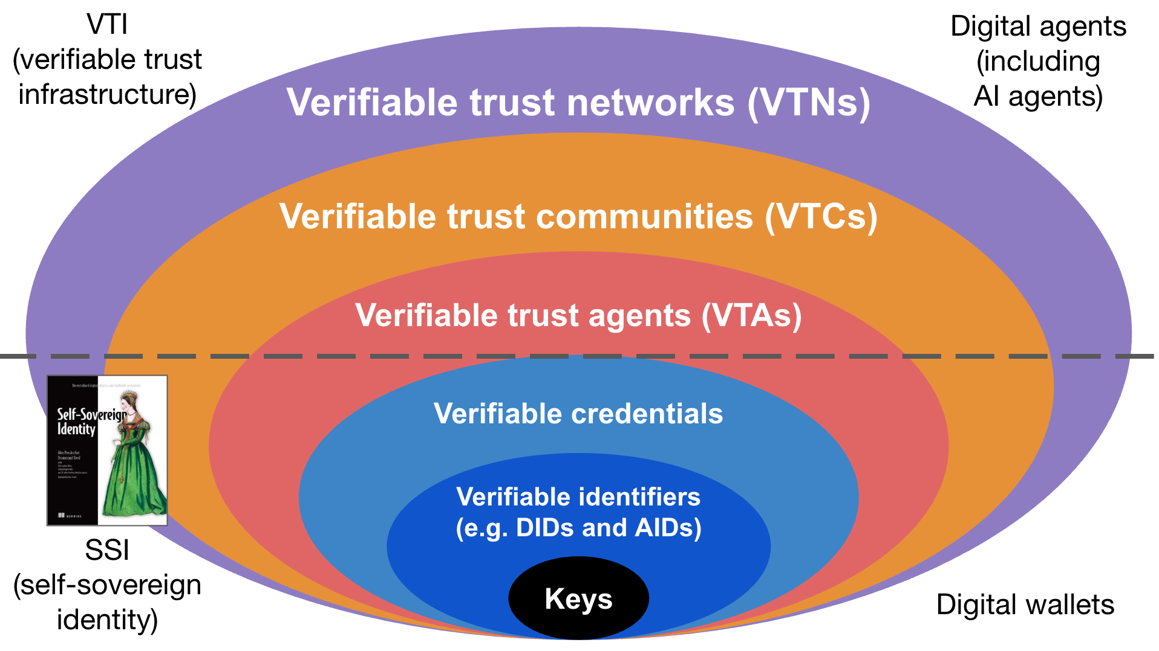

Slide 7
Implementation Scenarios
Retail
Robotic call KYC
Check and Credit card fraud

Slide 8
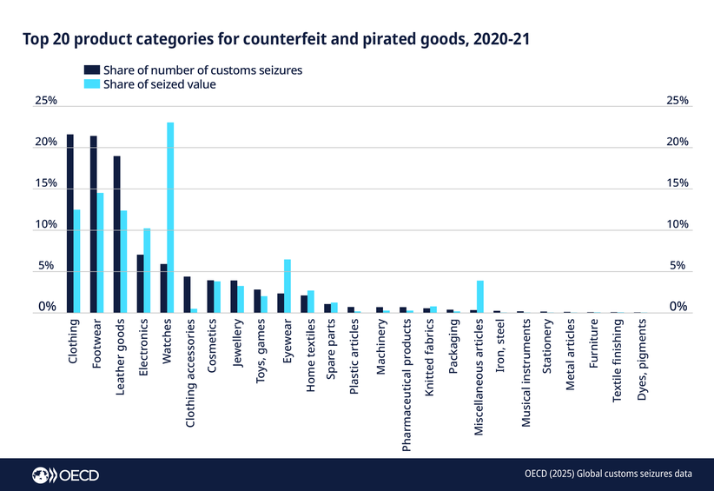
Retail – COMPLIANCE, ANTI - Counterfeit
Global Problem:
Counterfeit items account for $467 B (OECD, 2025)
Hazardous fakes, (ex: automotive parts, medicines, cosmetics, toys and food) are increasingly prevalent, posing serious risks to consumer health and safety.

Slide 9
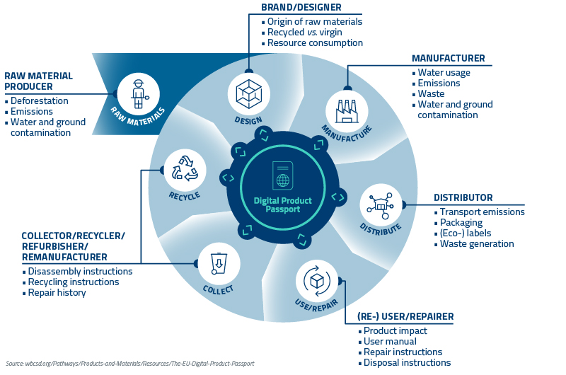
Verifiable Credentials to mitigate counterfeit items
EU Digital Product Passport (DPP):
built upon W3C’s Verifiable Credentials 2.0
QR Code or NFC tag connects item to digital record
Operational on July 20, 2026
Shares supply chain, environmental and compliance data
Under ESPR, rollout timeline:
    2026: Iron, steel, and initial registry framework operationalization.
    2027: Batteries (mandatory enforcement begins)
    2027–2029: Textiles, aluminum, tires, and energy-related items.
    2028: Furniture
    2029: Mattresses and ICT/electronics products

Slide 10

Telecommunication – ELIMINATE UNLAWFUL ROBOCALLS
Elimination of unlawful robocalls
NOTES:
•In 2025, U.S. consumers were attacked by 52.5 billion robocalls (Youmail Robocall Index)
GenAI has exasperated the robocall epidemic
fraudsters continue to exploit gaps in call-signing protocols, deploying multi-pronged attacks that combine voice and text scams targeting customers

Slide 11
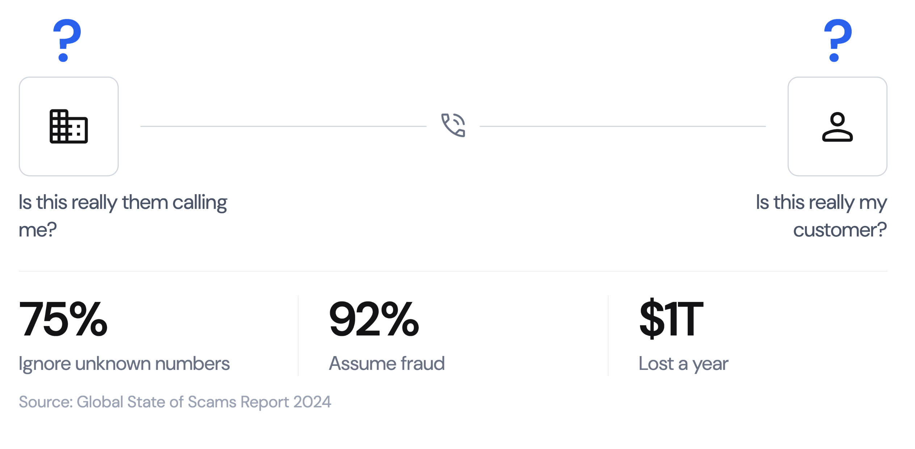
Identity Problems in telecom

Slide 12
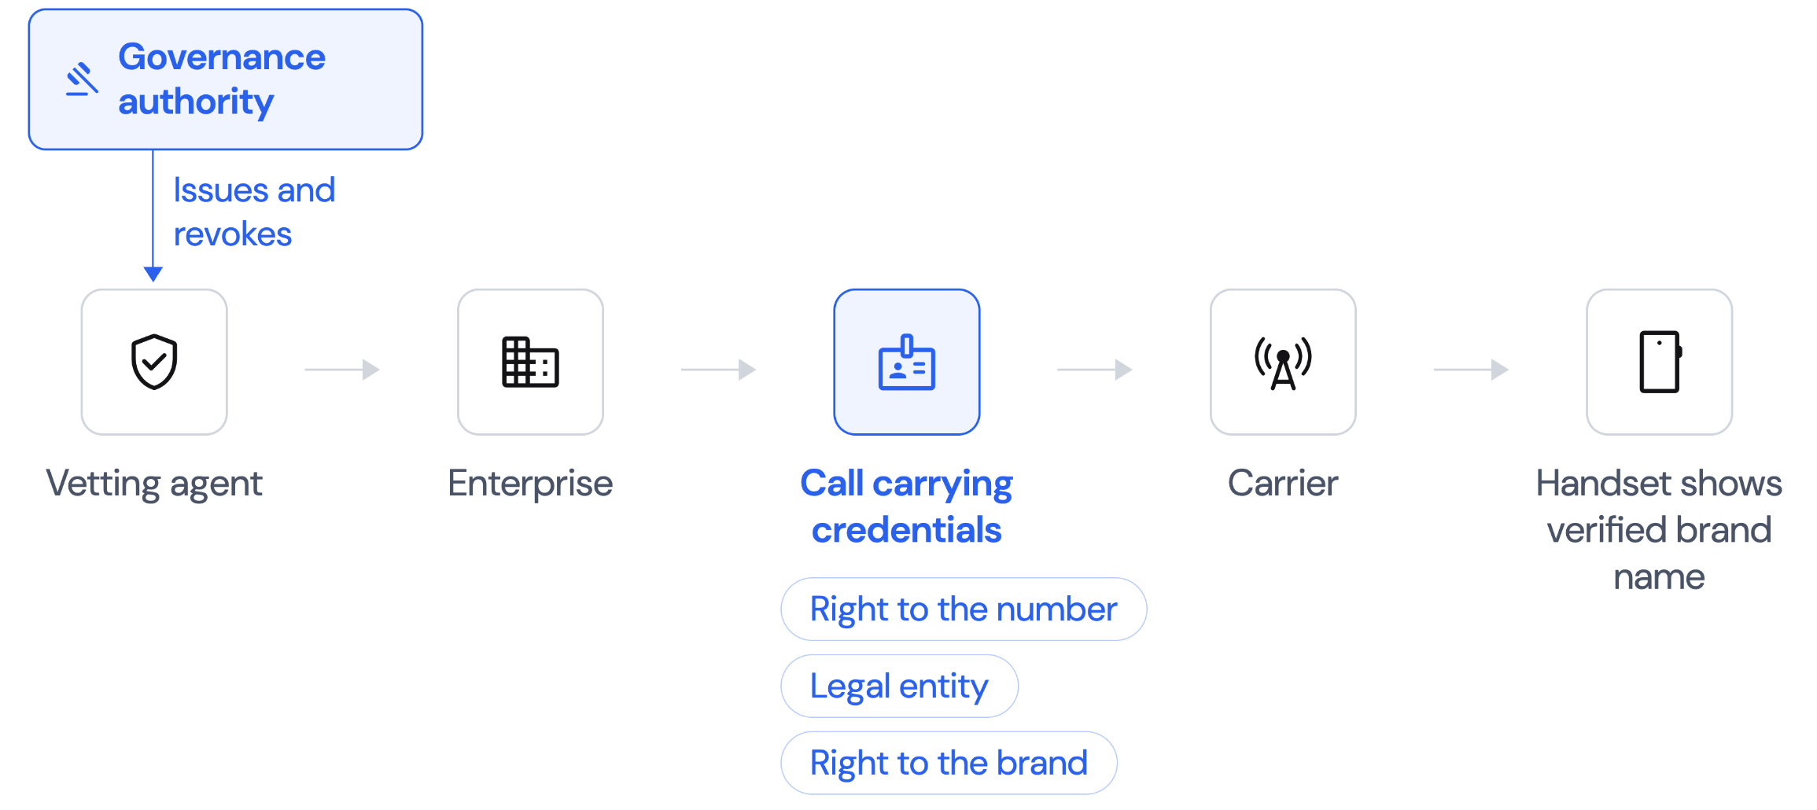
Outbound: the organisation proves itself

Slide 13
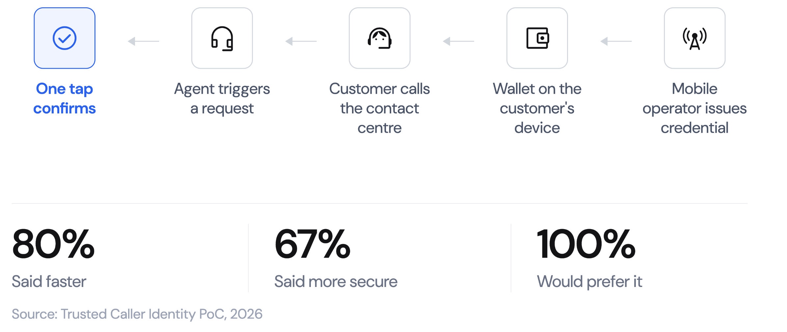
Inbound: the person proves themselves

Slide 14
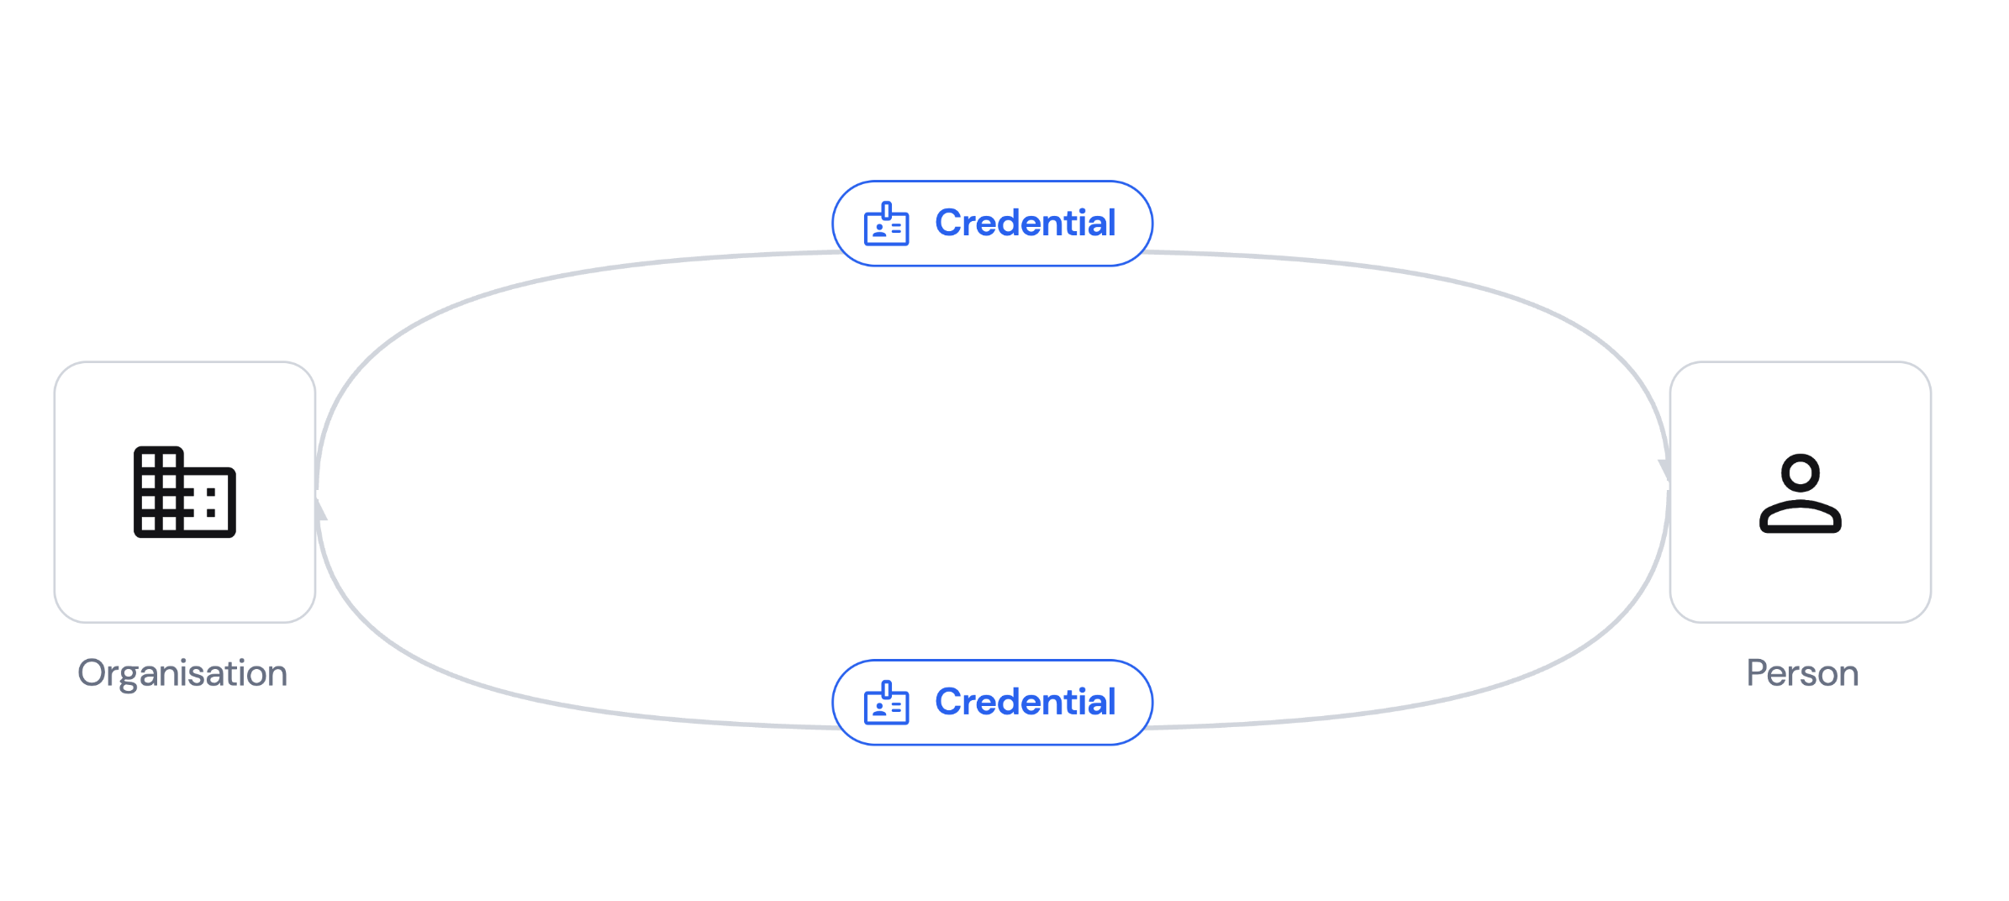
Same primitive, both directions

Slide 15
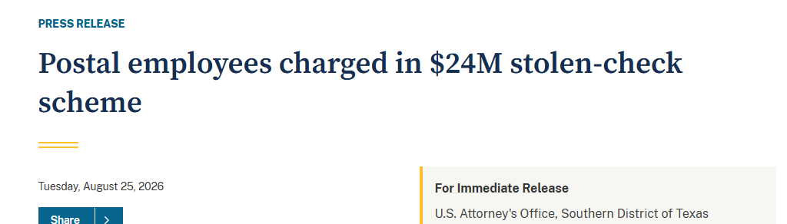
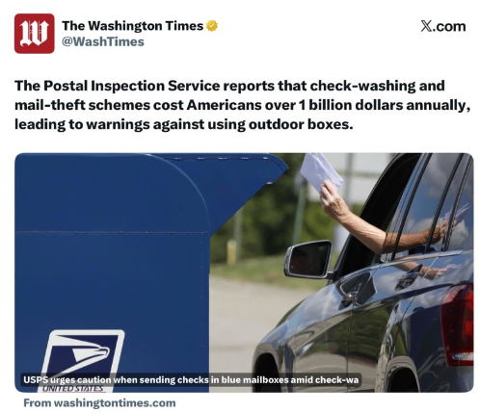
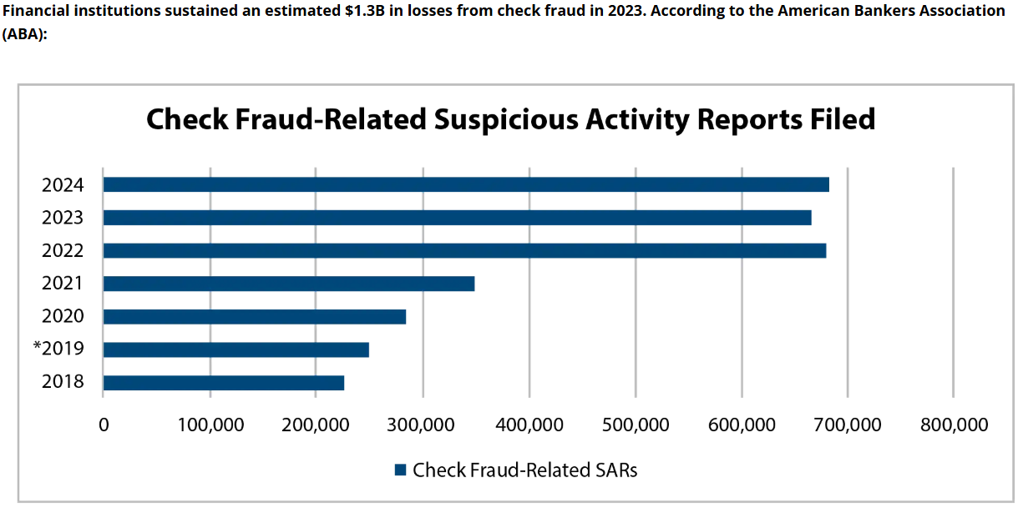
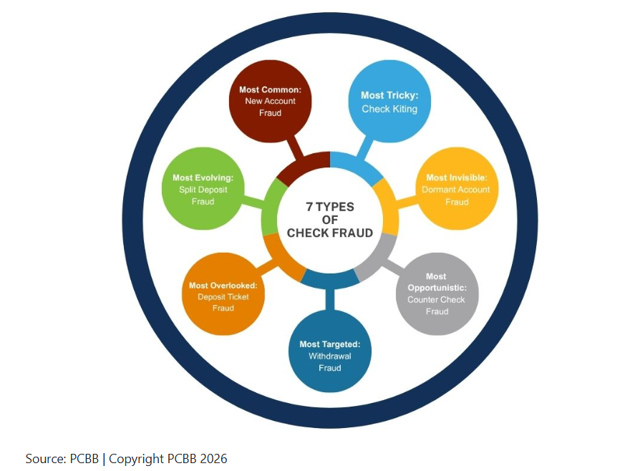
Check Fraud
…Check fraud the number one payment fraud threat facing community financial institutions (CFIs). According to the 2026 AFP Payments Fraud and Control Survey, 58% of organizations said they experienced check fraud in 2025, which was higher than both ACH and wire fraud…
Check Altering
…The Federal Reserve's own data confirms that check fraud accounted for 30% of all fraud losses at financial institutions, second only to debit card fraud…
Counterfeit Checks
Fraudulent Signature

Slide 16
Prevent Check Fraud
Check
Check
Signature
Amount
Payee
Bank 1
Bank 2
Bank 2
Bank 3
A/C Holder
Bank 2
1
3
Prevention: Double Deposit
Prevention: Counterfeit Checks
2
Prevention: Check Altering

Slide 17
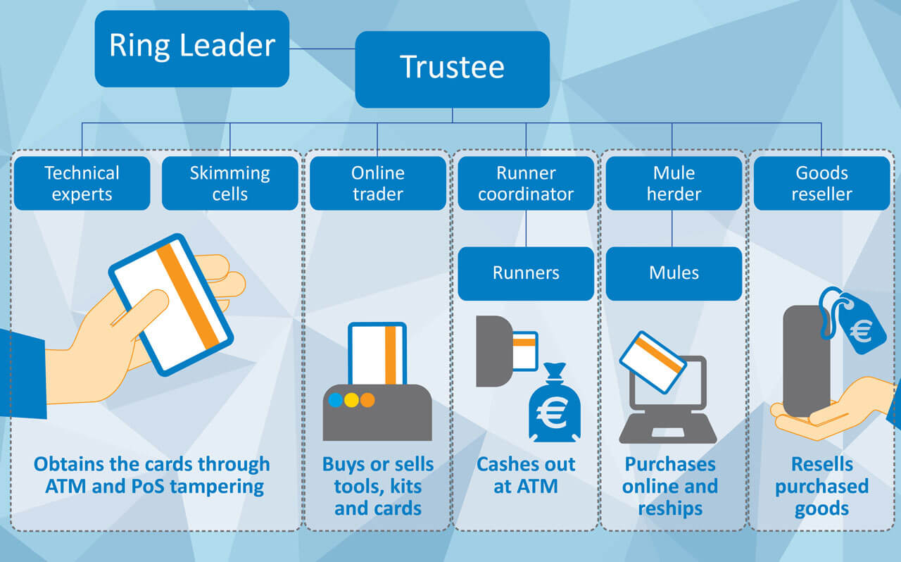
Credit card fraud
Credit card fraud is a form of identity theft involving the unauthorized use of a victim’s credit card or account information to make purchases, withdraw funds, or open new accounts. It is the most prevalent type of identity theft, with an estimated 61.3 million Americans experiencing fraudulent charges in the past year, totaling roughly $6.1 billion in unauthorized purchases.
The fraud primarily manifests in two categories: card-not-present (CNP) fraud, which occurs online or over the phone using stolen digital credentials, and card-present fraud, which involves physical theft, skimming devices at ATMs or gas pumps, or cloned cards. Common methods include account takeover (hijacking existing accounts via phishing), application fraud (opening new accounts with stolen personal data), and skimming (capturing magnetic stripe data).

Slide 18
Prevent Credit Card Fraud
Credit Card
Driver’s License
Passport
Name
Number
Expiration
Name
Bank 1
Processor
DMV
Passport Office
Processor

Slide 19
Thank you

