Slide 1



BUILDING SAFER ENVIRONMENTS WITH HUMAN-CENTRIC ARCHITECTURE: CONTROL, DECENTRALIZATION, AND DISTRIBUTION
VIKAS MALHOTRA, RICHARD ESPLIN, PURVA RAJKOTIA, MONICA TSANG SEP 1-3 2026
GLOBAL DIGITAL COLLABORATION CONFERENCE, GENEVA

Slide 2
AGENDA
Setting the Stage and Speaker Introductions | Karen McCabe
Day in the Life | Vikas Malhotra
Human Centric Architecture | Richard Esplin
Standards Landscape | Purva Rajkotia
Discussion Q&A Moderator: Karen McCabe | Monica Tsang, Vikas Malhotra, Richard Esplin, Purva Rajkotia
Closing Summary | Karen McCabe
2

Slide 3

DAY IN LIFE / PITFALLS

Slide 4
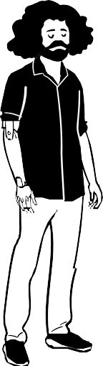

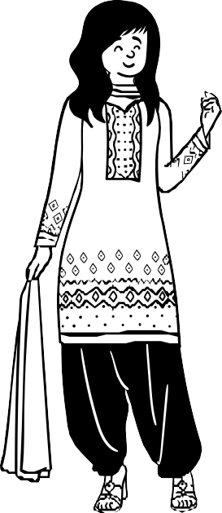

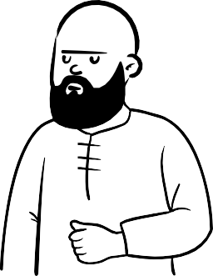

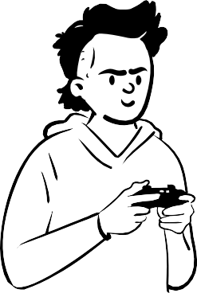
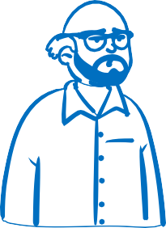
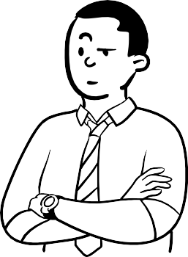



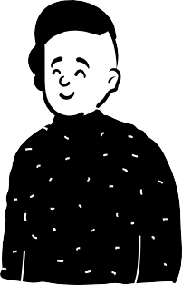
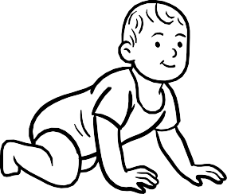
Citizen / human, our institutions, our infrastructure, our communities, our nations, our families.
Burger joint
Car
Pharmacy
Worship
Mr. Picata
Office
Communication, Interactions, Transactions make the world tick
Hospital
6

Slide 5
Mr. Picata’s information is in 100+ places
Name: Joe Picata
DOB: May 25, 1965
Address:
Allergy: Dust mites
Medicines:
Ailments
-------
Name: Joe Picata
DOB: May 25, 1965
Place of birth: Malta, NY
Eye Color: Grey
Speed:
Traffic violations
Name: Joe Picata
DOB: May 25, 1965
Address:
Password
Mother’s maiden name:
-------
Pharmacy
Burger joint
Hospital
Car
Website account
Name: Joe Picata
DOB: May 25, 1965
Place of birth: Malta, NY
Eye Color: Grey
Allergy: Dust mites
Fav color: Blue
Fav Music: ABBA
Fav food
Name: Joe Picata
DOB: May 25, 1965
Place of birth: Malta, NY
Eye Color: Grey
Fav music ABBA
-------
Name: Joe Picata
DOB: May 25, 1965
Address:
Race:
Fav sport:
-------
Music Service
Mr. Picata
Stadium
Name: Joe Picata
DOB: May 25, 1965
Place of birth: Malta, NY
Eye Color: Grey
Fav movie genre: Western
-------
Name: Joe Picata
DOB: May 25, 1965
SSN: xxx-xx-xxxx
Address:
Place of birth: Malta, NY
-------
Video streaming
Customer Service
Credit
Name: Joe Picata
DOB: May 25, 1965
Place of birth: Malta, NY
Eye Color: Grey
Fav movie genre: Western
-------
Name: Joe Picata
DOB: May 25, 1965
Fav movie genre: Western
-------
Hotel
Saliva test
Grocery / shopping

Slide 6
It doesn’t end there, information is shared & sold
Name: Joe Picata
DOB: May 25, 1965
Address:
Allergy: Dust mites
Medicines:
Ailments
-------
Insurance
POS
Name: Joe Picata
DOB: May 25, 1965
Place of birth: Malta, NY
Eye Color: Grey
Speed:
Traffic violations
Name: Joe Picata
DOB: May 25, 1965
Address:
Password
Mother’s maiden name:
-------
Pharmacy
Burger joint
Hospital
Car
Website account
Name: Joe Picata
DOB: May 25, 1965
Place of birth: Malta, NY
Eye Color: Grey
Allergy: Dust mites
Fav color: Blue
Fav Music: ABBA
Fav food
Name: Joe Picata
DOB: May 25, 1965
Place of birth: Malta, NY
Eye Color: Grey
Fav music ABBA
-------
Name: Joe Picata
DOB: May 25, 1965
Address:
Race:
Fav sport:
-------
Music Service
Mr. Picata
Stadium
Name: Joe Picata
DOB: May 25, 1965
Place of birth: Malta, NY
Eye Color: Grey
Fav movie genre: Western
-------
Name: Joe Picata
DOB: May 25, 1965
SSN: xxx-xx-xxxx
Address:
Place of birth: Malta, NY
-------
Video streaming
Customer Service
Credit
Name: Joe Picata
DOB: May 25, 1965
Place of birth: Malta, NY
Eye Color: Grey
Fav movie genre: Western
-------
Name: Joe Picata
DOB: May 25, 1965
Fav movie genre: Western
-------
Hotel
Saliva test
Grocery / shopping

Slide 7
Honeypots of Information – HACKED… millions of records
Name: Joe Picata
DOB: May 25, 1965
Address:
Allergy: Dust mites
Medicines:
Ailments
-------
Insurance
POS
Name: Joe Picata
DOB: May 25, 1965
Place of birth: Malta, NY
Eye Color: Grey
Speed:
Traffic violations
Name: Joe Picata
DOB: May 25, 1965
Address:
Password
Mother’s maiden name:
-------
Pharmacy
Burger joint
Hospital
Car
Website account
Name: Joe Picata
DOB: May 25, 1965
Place of birth: Malta, NY
Eye Color: Grey
Allergy: Dust mites
Fav color: Blue
Fav Music: ABBA
Fav food
Name: Joe Picata
DOB: May 25, 1965
Place of birth: Malta, NY
Eye Color: Grey
Fav music ABBA
-------
Name: Joe Picata
DOB: May 25, 1965
Address:
Race:
Fav sport:
-------
Music Service
Mr. Picata
Stadium
Name: Joe Picata
DOB: May 25, 1965
Place of birth: Malta, NY
Eye Color: Grey
Fav movie genre: Western
-------
Name: Joe Picata
DOB: May 25, 1965
SSN: xxx-xx-xxxx
Address:
Place of birth: Malta, NY
-------
Video streaming
Customer Service
Credit
Name: Joe Picata
DOB: May 25, 1965
Place of birth: Malta, NY
Eye Color: Grey
Fav movie genre: Western
-------
Name: Joe Picata
DOB: May 25, 1965
Fav movie genre: Western
-------
Hotel
Saliva test
Grocery / shopping

Slide 8
Information is then analyzed and used to tickle back Mr. Picata’s senses. Lack of Authenticity verification
Name: Joe Picata
DOB: May 25, 1965
Address:
Allergy: Dust mites
Medicines:
Ailments
-------
Insurance
POS
Name: Joe Picata
DOB: May 25, 1965
Place of birth: Malta, NY
Eye Color: Grey
Speed:
Traffic violations
Name: Joe Picata
DOB: May 25, 1965
Address:
Password
Mother’s maiden name:
-------
Pharmacy
Burger joint
Phishing
Buy me
Hospital
Car
Website account
Name: Joe Picata
DOB: May 25, 1965
Place of birth: Malta, NY
Eye Color: Grey
Allergy: Dust mites
Fav color: Blue
Fav Music: ABBA
Fav food
Name: Joe Picata
DOB: May 25, 1965
Place of birth: Malta, NY
Eye Color: Grey
Fav music ABBA
-------
Password stolen and dating scam
Name: Joe Picata
DOB: May 25, 1965
Address:
Race:
Fav sport:
-------
Fake account opened
Music Service
Mr. Picata
Stadium
Name: Joe Picata
DOB: May 25, 1965
Place of birth: Malta, NY
Eye Color: Grey
Fav movie genre: Western
-------
Mr. Picata’s wife (deep fake) calling to send money
Name: Joe Picata
DOB: May 25, 1965
SSN: xxx-xx-xxxx
Address:
Place of birth: Malta, NY
-------
Video streaming
Customer Service
Credit
Name: Joe Picata
DOB: May 25, 1965
Place of birth: Malta, NY
Eye Color: Grey
Fav movie genre: Western
-------
Name: Joe Picata
DOB: May 25, 1965
Fav movie genre: Western
-------
Hotel
Saliva test
Grocery / shopping

Slide 9

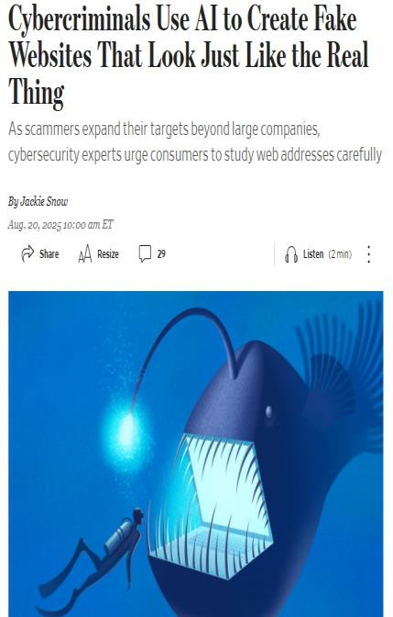
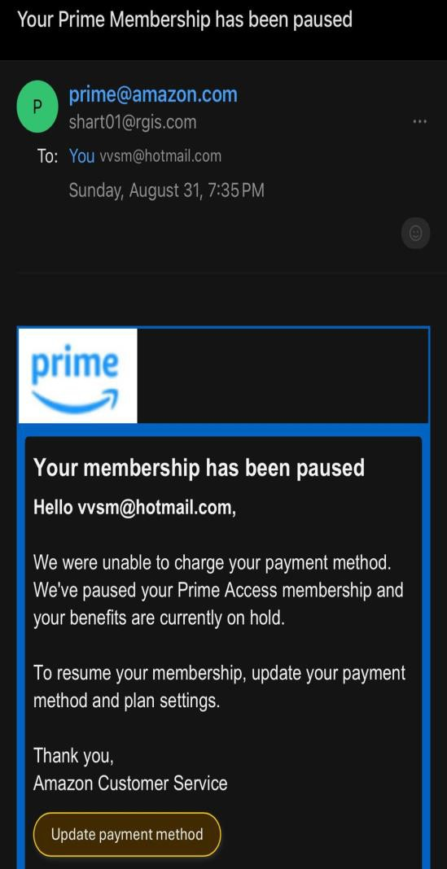
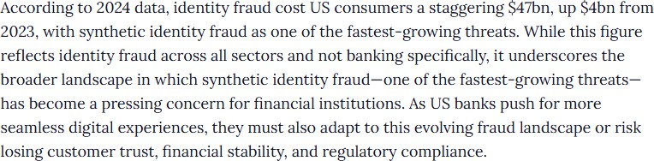
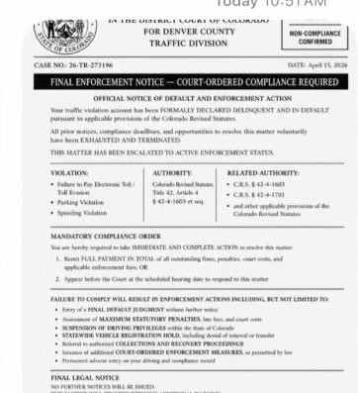
CURRENT DAY IN LIFE - PITFALLS
3
2
1
Identity and then information is stolen.
Person (or entity) has no control.
Current identity systems are centralized or federated at the platform.
Hundreds arrive at Denver courthouse after fake summons texted to Denver-area phones
4
i
5
PBSD victim of
$3.2 million
cybersecurity
incident
By I.C. Murrell·News·April 27, 2026
12

Slide 10
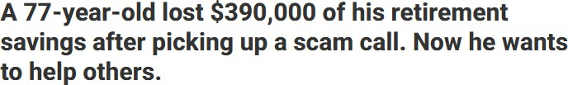
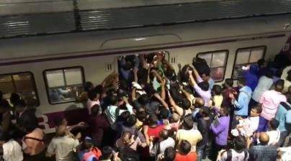
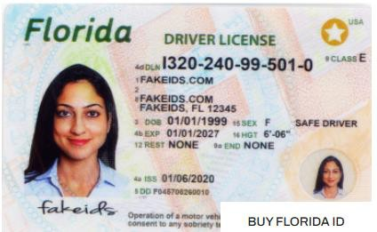
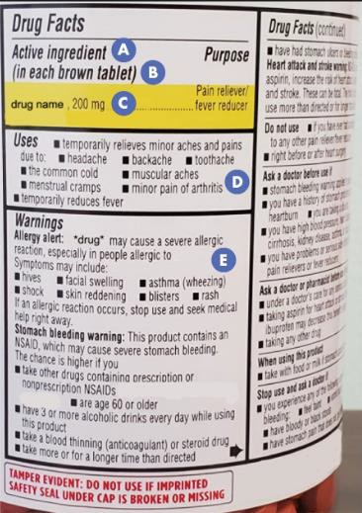
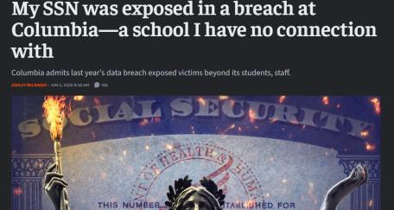
EXAMPLES OF ISSUES MR. PICATA (OR ANY ENTITY) FACES
Lack of control on their information. No sovereignty.
-Mass collection in multiple places in lieu of forms, checks, background verification etc.
-Information is shared and / or sold further
Inability to identify authentically who and what they are dealing with
Financial and stealing crimes by scammers
Inability to mass communicate, interact or transact. Scammers benefit
Fake IDs. Scammers benefit
No compliance checks.
Scammers benefit
Privacy encroaching checks Age verification
13

Slide 11
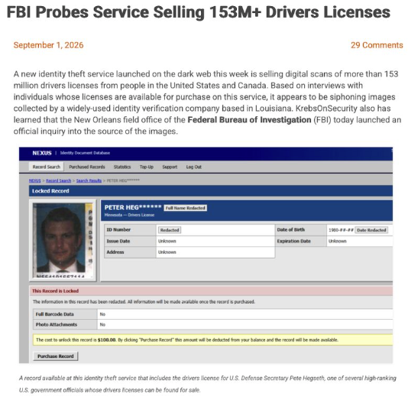
LATEST

Slide 12
HUMAN CENTRIC ARCHITECTURE
WHITE PAPER - CYBERSECURITY FOR NEXT-GENERATION CONNECTIVITY SYSTEMS--RETHINKING DIGITAL ARCHITECTURES TO SAFEGUARD THE NEXT GENERATION FROM CYBERSECURITY BREACHES | IEEE STANDARD | IEEE XPLORE

Slide 13
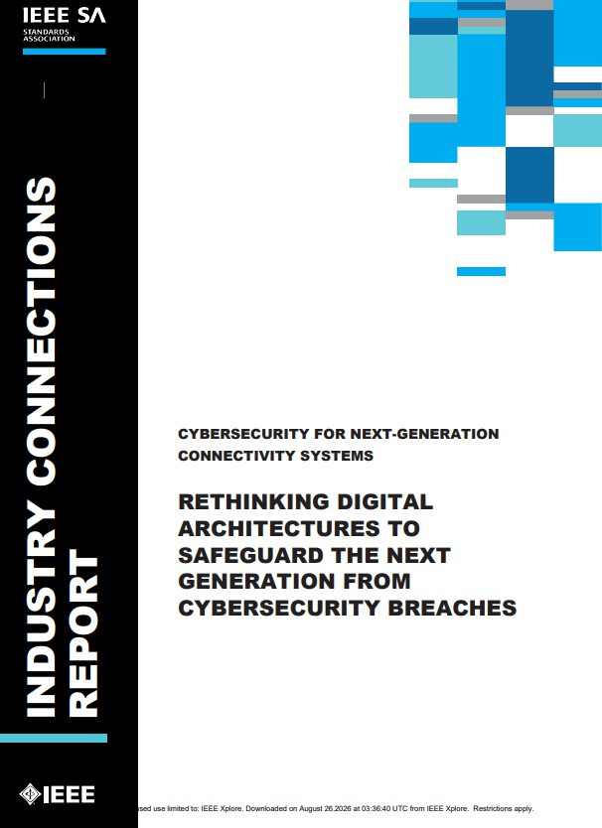
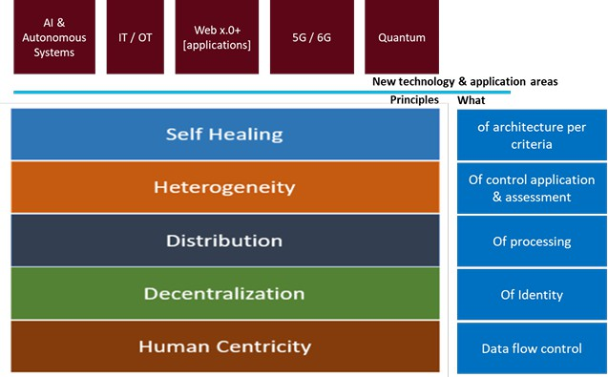
PRINCIPLES
Intelligent
3
2
1

Slide 14





Architecture Framework
Five Pillars of Safer Design
Preserve essential public-service functions despite compromise, outage or component failure
Human Centricity
Decentralized Identity
Distributed Processing
Rights, access and redress as measurable design rules
Verifiable credentials, selective disclosure, no single provider
Edge and local processing without losing federation
Heterogeneous Controls
Self-Healing Systems
No single vulnerability defeats every safeguard
Detect, isolate, degrade safely, recover and learn
Safety comes from architecture that keeps serving people when a component fails.
IEEE SA | GDC-CON 2026 | Geneva
2026

Slide 15
USER CONTROL, DECENTRALIZATION, DISTRIBUTION
Decentralization in Identity
…a decentralized and self-sovereign identity with verifiable credentials, which is applicable to both humans and things (such as IoT) …
Distribution of data / Processing
…With distribution in storage and processing, define methods by which the data and information are not stored or processed in entirety in a single place, but they are spread across various systems in the context of the owner. …
User Control
…With Sovereignty & Control, build better controls for the flow of information from a human standpoint that may lead to less but relevant and compliant data collection. these controls can lead to lowering unabated data collection, which has implications on privacy and security, at personal, organization and national levels…
Benefits: Reduces centralization of information, avoids single points of failures, provides for stronger verifiable authentication, provides for peer–peer communication channels, reduces identity fraud, and single sign-on.
Benefits: Increased resilience, in which failure (security, unavailability etc.) of one part does not lead to failure of the whole system.
Benefits: Prevents unwanted data flow into the system.
Enables privacy and hence
security at the edge.

Slide 16
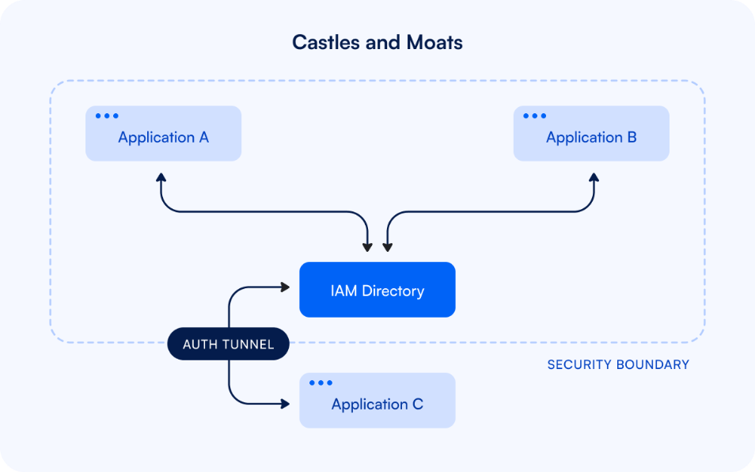
16

Slide 17
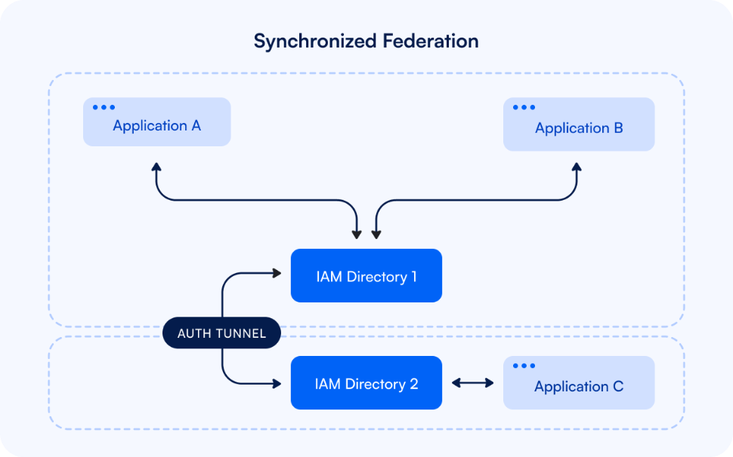
17

Slide 18
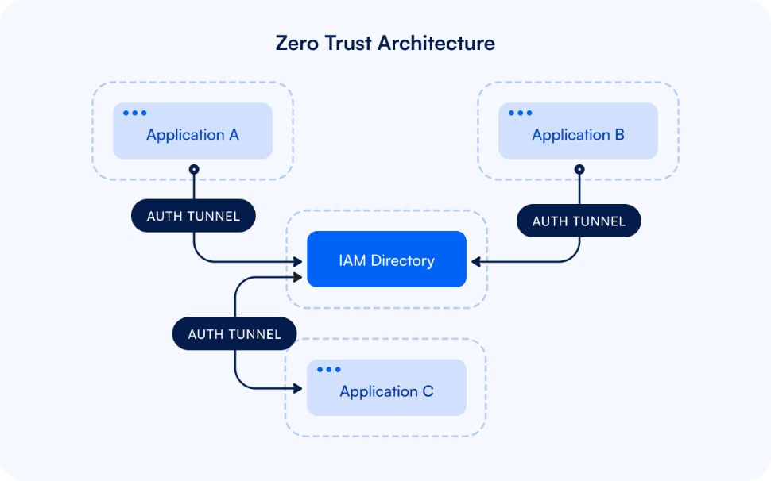
18

Slide 19
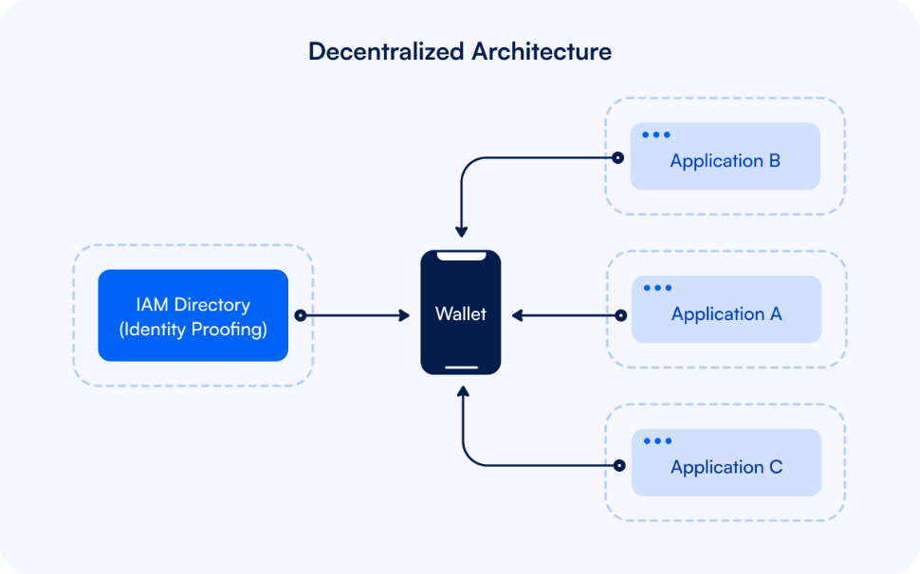
19

Slide 20
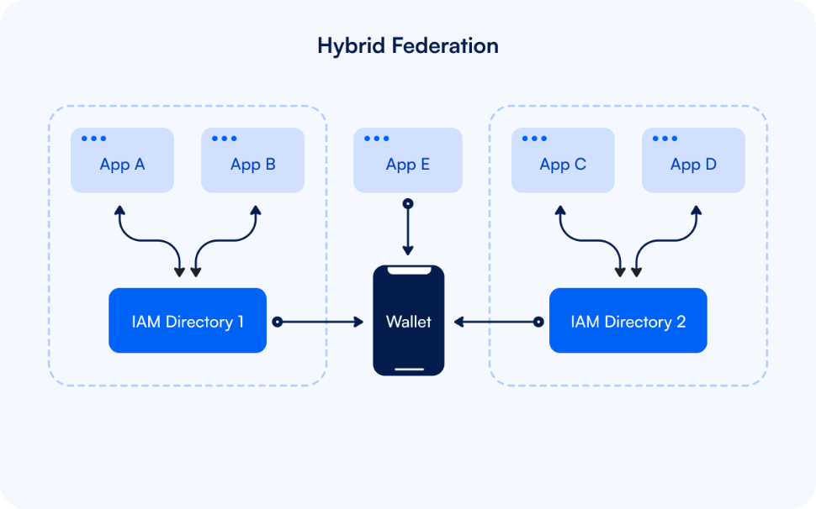
20

Slide 21
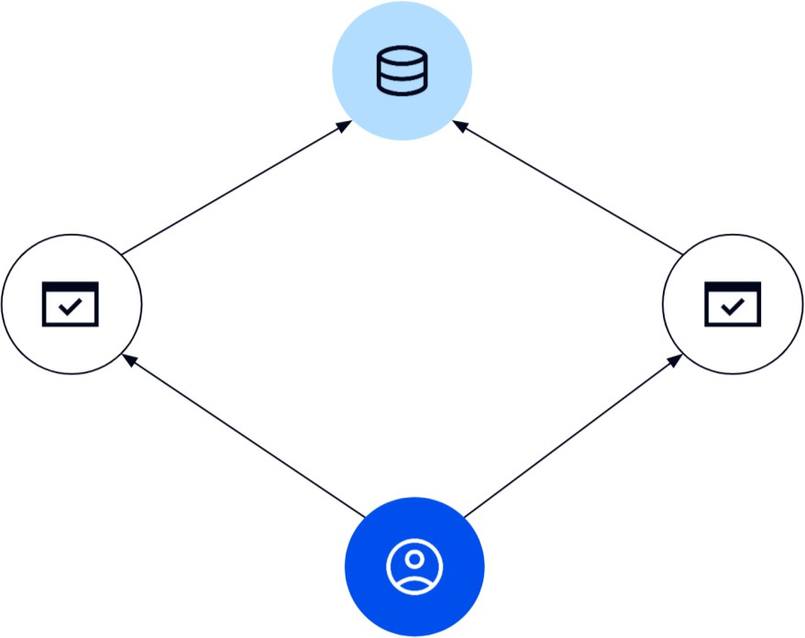
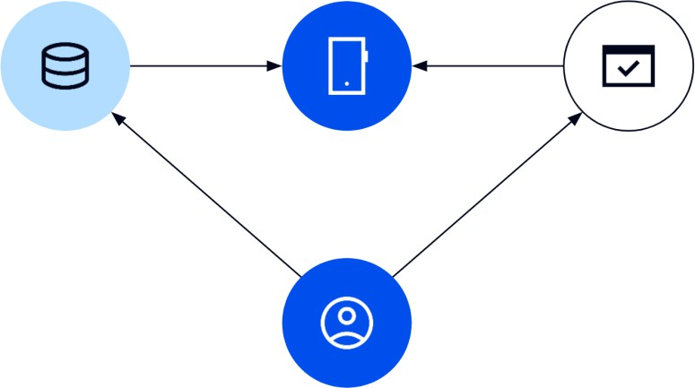
DECENTRALIZATION AND DIGITAL TRUST – LOCUS OF CONTROL
Centralized / Federated Identity Model
Multiple systems act as relying parties, accessing an identity provider database.
User-Centric Identity Model
Identity subject carries their data between organizations

Slide 22
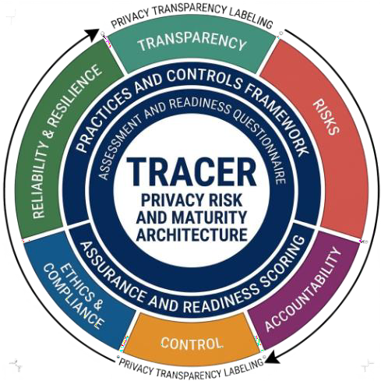


3 TOOLS FOR USER CONTROL
Zero Knowledge Proofs
My Terms (IEEE Standard 7012-2025)
Tracer recommendations from IEEE IC
BBS 2023 is being used at IRTF CFRG and W3C Data Integrity work.
Google's longfellow-zk used by OWF Multipaz.
Most common use
is to prove a statement without revealing underlying data (prove a range): "I'm over 21" (birthdate withheld).
Individuals offer privacy terms to online services in
a machine-readable format.
Terms are chosen from standard-form agreements—like Creative Commons for privacy.
Agreed terms are signed electronically by both sides, with auditable records.
Transparency, Risks, Accountability, Control, Ethics, and Reliability
Soon to be published concept document
23

Slide 23
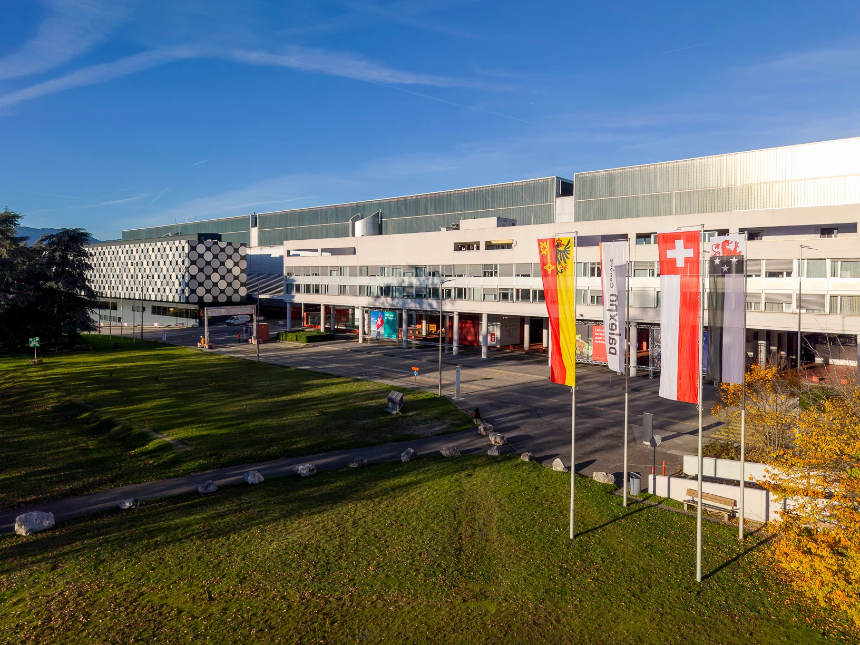
GDC-CON 2026 · Palexpo
Standards & IEEE Activities
for Safer Digital Environments
Human-centric architecture for digital public infrastructure: safety, resilience, interoperability and rights designed in from the start.
Threat Landscape
Five Pillars
Published Standards
In Development
Open Ecosystem
EU Pilots
Call to Action
Geneva, 1-3 September 2026
2026

Slide 24
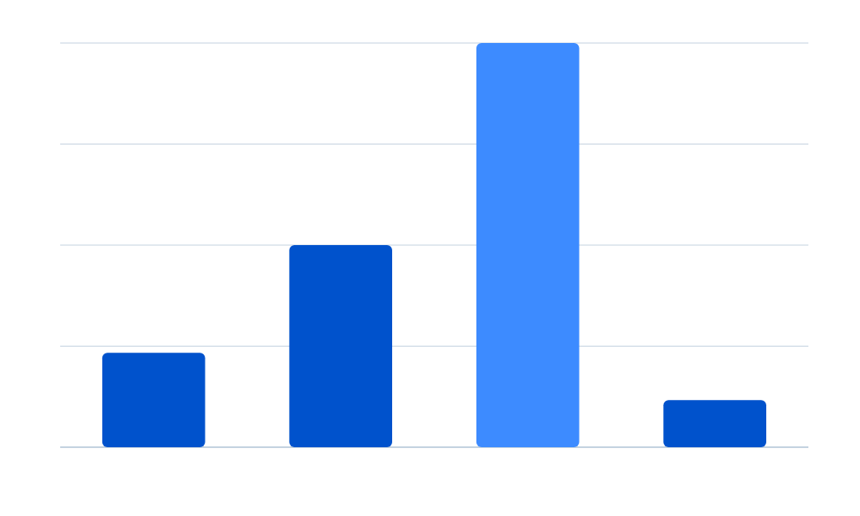
Threat Landscape
Why Standards Matter Now
2024–25 incident data shows intrusion is persistent, not exceptional.
300%
$10M
Average US data-breach cost, 2025
400+
150%
Organizations breached via SharePoint, July 2025
70%
35%
44states
Critical infra share of US attacks
PRC espionage growth
China-targeted sector attacks
Small orgs citing weak resilience
US states reporting cyber incidents in 2025
Architect public services for persistent intrusion, not assumed prevention.
IEEE SA | GDC-CON 2026 | Geneva
2026

Slide 25
Architecture Framework
Five Pillars of Safer Design
Preserve essential public-service functions despite compromise, outage or component failure
Human Centricity
Decentralized Identity
Distributed Processing
Rights, access and redress as measurable design rules
Verifiable credentials, selective disclosure, no single provider
Edge and local processing without losing federation
Heterogeneous Controls
Self-Healing Systems
No single vulnerability defeats every safeguard
Detect, isolate, degrade safely, recover and learn
Safety comes from architecture that keeps serving people when a component fails.
IEEE SA | GDC-CON 2026 | Geneva
2026

Slide 26

Published Standards
Ready to Apply Today
Two IEEE standards are published and usable now: ethical system design for human centricity, and fail-safe testing with wellbeing metrics.
IEEE 7000-2021
Ethical system design; identifies 10 issues per test participant.
Apply Early
Use it before architecture decisions lock in and become fixed.
IEEE 7010 / P7009
Published 2021: wellbeing metrics plus safe-failure testing.
Pillar 1 and Pillar 5 already have published, testable standards.
IEEE SA | GDC-CON 2026 | Geneva

Slide 27




Drafts Turning Safeguards Into Controls
In Development
Four active IEEE activities translate human-centred principles into technical and operational controls.
Drafts Turning Safeguards Into Controls
Draft standard for event-data records so decisions can be reconstructed.
1
IEEE P7001 — Transparency
Pillar: human centricity
Draft standard for a repeatable privacy-impact process across service lifecycles.
2
IEEE P7002 — Data Privacy
Pillar: decentralized ID
Draft delivering validation datasets, benchmarks and acceptable-use boundaries.
4
IEEE P7003 — Algorithmic Bias
Heterogeneous controls
Specifies sensor, actuator and digital-twin interfaces for edge-up deployments.
7
IEEE P2888 — Cyber-Physical
Sub-parts in the family
IEEE SA | GDC-CON 2026 | Geneva
2026

Slide 28
Standards That Interlock
Open Standards Ecosystem
Connectivity, security and carrier standards only deliver safety when they interlock across every layer.
Cross-body stack
Standard
Body
Interop layer
Delivers
Series or family
Issuing organization
Primary focus
Role in the stack
IEEE 802
Connectivity
Technical
Ethernet and Wi-Fi behind every campus LAN
IEEE SA
ISO/IEC 27001
Management system
Governance
Security-management governance for operators
ISO/IEC
ISO/IEC 27033
Network security
Technical
Hardens networks and VPNs
ISO/IEC
ITU-T
Recommendations
Semantic
Aligns signalling, numbering and QoS
ITU
Full stack
Interoperability
5
Technical, semantic, org., legal, governance
Cross-body, cross-sector
layers
IEEE 802; ISO/IEC 27001 and 27033; ITU-T Recommendations on signalling, numbering and QoS.
IEEE SA | GDC-CON 2026 ·

Slide 29
Proven in Practice
EU Pilots Turned Interoperability Into Procurement Tools
EUR 7M+
25 partners
5 domains
EUR 37M
VICINITY budget; launched January 2016, linking domains edge-up
AURORAL partner entities across 11 countries, proven at scale
Vertical domains validated in 5 live demonstration regions
Combined EU funding across both pilots, feeding MIMs Plus specs
IEEE SA | GDC-CON 2026 | Geneva
2026

Slide 30
Call to Action
Join the Standards
Work
Architecture decisions made now decide whether public services keep serving people under attack.
Design It In Early
Audit Concentration
Apply IEEE 7000-2021 before architecture decisions become fixed and make privacy and resilience measurable rather than asserted.
Map dependencies in identity, cloud, DNS, APIs and data, and require dependency disclosure from every supplier.
Test Degraded Modes
Procure For Exit
Identify services that must survive cloud or vendor failure, build offline pathways, and rehearse them under realistic outage conditions.
Require open interfaces, portable data and exit clauses; include MIMs Plus terms and fund capacity to enforce them.
IEEE Standards Association - standards.ieee.org
Support IEEE 7000-2021, P7001-P7009 and P2888
2026

Slide 31
THANK YOU

